Slide 1
MassHealth Buy-In
aka MHBI

Slide 2
What is MHBI?
Who should apply?
Why should they apply?
How do they apply?
What are the next steps?

Slide 3
What is MHBI?
A Medicare Savings Program (MSP)
Federally funded
Administered by individual states
Pays for some or all of their low-income Medicare recipients premiums, deductibles, copayments, and co-insurance
In Massachusetts it is called MassHealth Buy-In
The Buy-In programs can also help get Medicare Part B (doctors) for people who only have Medicare Part A (hospitals)
If you are in a Buy-In program, you will also be automatically enrolled in the Medicare Part D (prescriptions) Extra Help program, which can help with pharmacy costs

Slide 4
What is MHBI?
MassHealth Senior Buy-In
Lower income limit
MassHealth Senior Buy-In may pay for Part B Medicare premiums (and for Part A premiums for those who have one) and for the deductibles and coinsurance under Part A and Part B
Coverage begins in the month after we process your application
MassHealth Buy-In
Higher income limit
MassHealth Buy-In may pay for the Medicare Part B premium
In most cases the coverage begins as early as three months before your application month

Slide 5
Who should apply?
Mass. residents on Medicare with limited income and assets
 | Individual | Married couple (living together)
Countable Asset Limit | $16,800* | $25,200
 | Monthly income before taxes and deductibles is less than or equal to…
Senior Buy-In | $1,473 | $1,984
Buy-In | $1,869 | $2,518
* The asset limit amounts are effective January 1, 2022
** The income limit amounts are effective March 1, 2022

Slide 6
Income & Assets
Types of income that MassHealth looks at include:
Social Security
Pensions
Annuities or trusts
Income from a job
Federal VA benefits (compensation and pension)
Please note that Chapter 115 benefits DO NOT count towards income – DO NOT REPORT IT!
Types of assets that MassHealth looks at include:
Savings and checking accounts
Money market accounts
Cash value of certain life insurance policies
Cash value of annuities, stocks, bonds, and mutual funds

Slide 7
Why should they apply?
Chapter 115 is a payor of last resort
Recipients must apply for all benefits available to them to offset their Chapter 115 benefits (108 CMR 6.01(3))
Saves your community the recurring expense of reimbursing recipients for the Medicare Part B premium – currently $170.10 per month
Could save your community on reimbursement of Medicare Part D premiums – premium either lowered or eliminated
Saves your community the cost of higher prescription co-pays through Extra Help Program
Generic prescription maximum co-pay is $3.95
Brand name prescription maximum co-pay is $9.85

Slide 8
Example of savings
Chapter 115 benefit being reimbursed | Monthly cost without MHBI | Monthly cost with MHBI & Extra Help
Medicare Part B premium | $170.10 | $0.00
Medicare Part D premium | 33.00 | 0.00
Prescription co-pay (Eliquis) | 226.90 | 9.85
Total | $430.00 | $9.85
One client in one month results in savings of $420.15
Over a year equals $5,041.80 in savings

Slide 9
How to apply?
Complete the two-page application
https://www.mass.gov/doc/masshealth-buy-in-for-people-who-are-eligible-for-medicare-0/download
Attach a copy of all bank statements in applicant’s name dated within 45 days and a copy of current statement from life insurance showing cash value
Recommend that you submit a separate MassHealth Permission to Share Information (PSI) form along with application for each applicant
Sign the filled-out application, and send it to:
MassHealth Enrollment Center
PO Box 290794
Charlestown, MA 02129-0214
or fax it to: (857) 323-8300

Slide 10
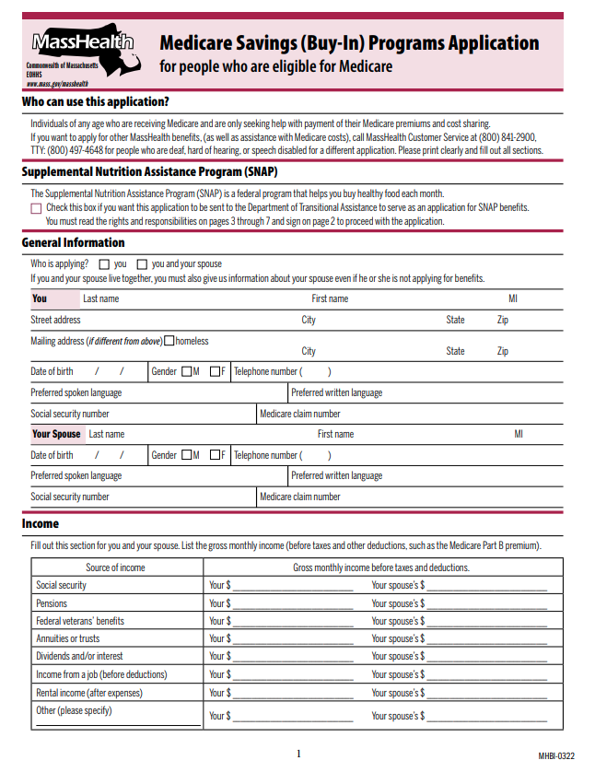
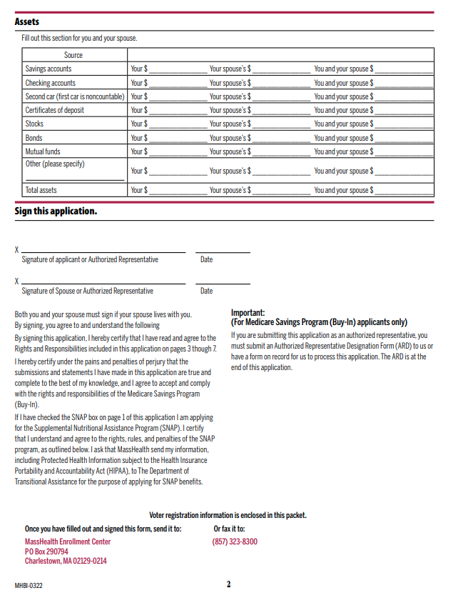
MHBI Application

Slide 11
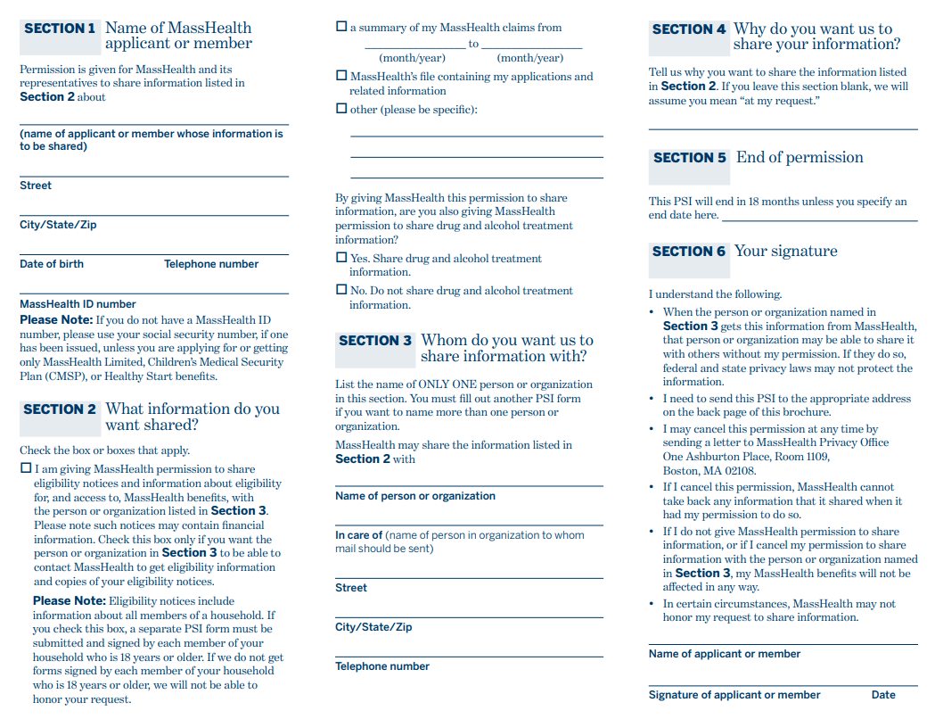
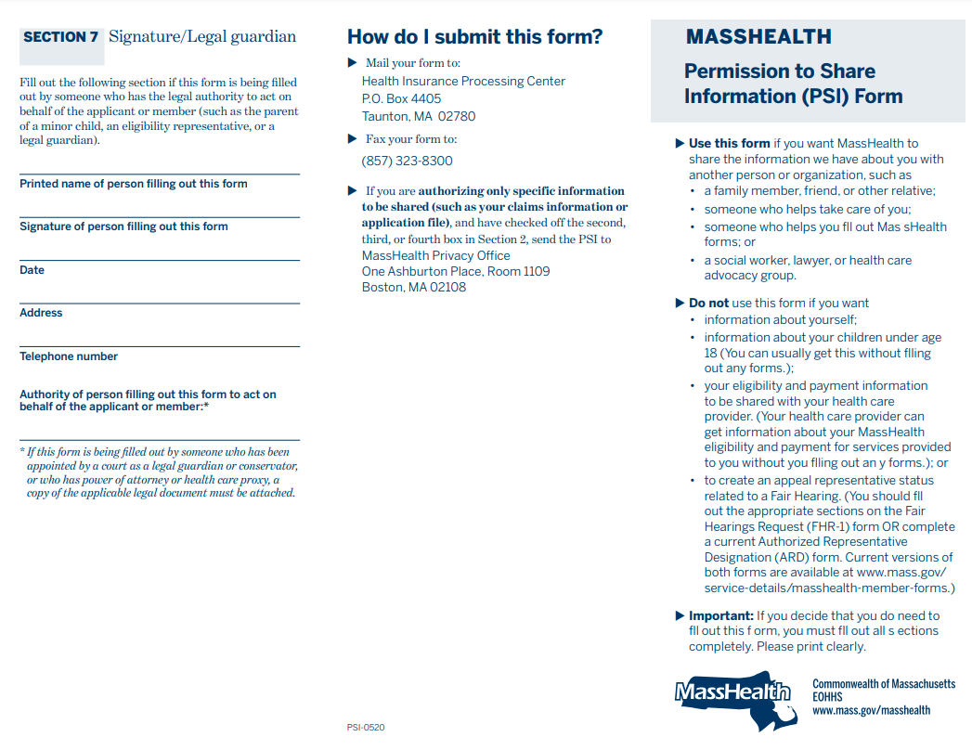
PSI Form

Slide 12
Now what?
Once your Chapter 115 recipient has been approved they will receive documentation from both MassHealth and Medicare stating when the MHBI is effective and when they can expect to receive a retroactive payment from Medicare.
Once the Medicare Part B premium is no longer being withheld from their Social Security, you need to amend their benefits to remove the reimbursement.
The client should apply for a waiver of the overpayment to DVS.

