Slide 1

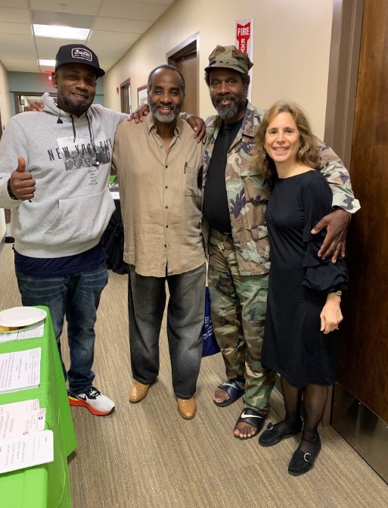
Lawyers Serving Warriors®
Know Your Rights
Combat-Related Special Compensation
Rochelle Bobroff, Director of Pro Bono
Erin Mee, Pro Bono Coordinating Attorney
David Sonenshine, Senior Staff Attorney
with Pro Bono Attorneys from DLA Piper

Slide 2
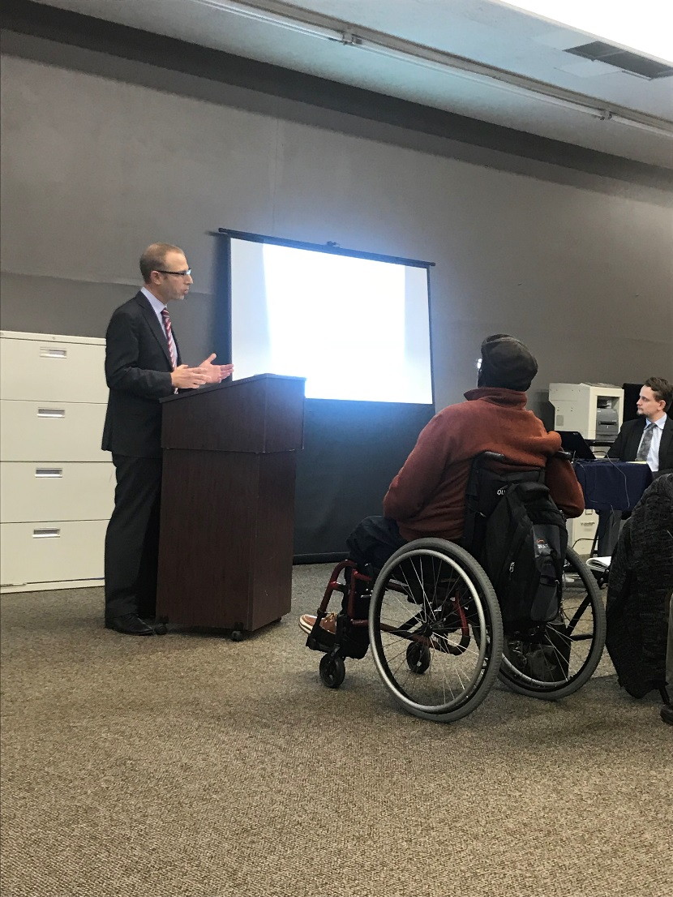
Presentation Overview
Introduction to NVLSP
Overview of CRSC
Categories of CRSC
CRSC Application with Tips for Applying
Questions/Conclusion

Slide 3
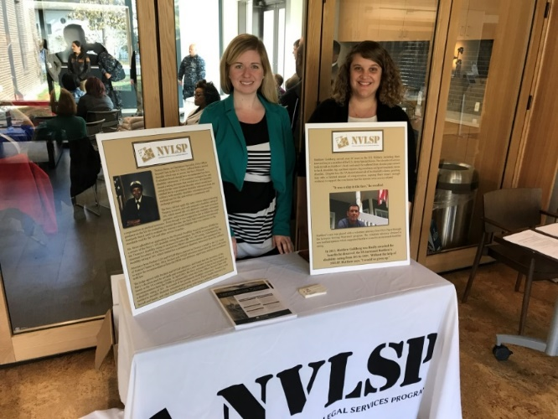
National Veterans Legal Services Program
  NVLSP is a nonprofit organization formed in 1981. We work to ensure that our nation’s disabled veterans, service members, and survivors receive the benefits to which they are entitled.
What We Do:
  Individual Attorney Representation and Class Action Lawsuits
  Training & Mentoring of Veterans Advocates
  Publication of Training Materials- Including the Veterans Benefits Manual
  Lawyers Serving Warriors®

Slide 4
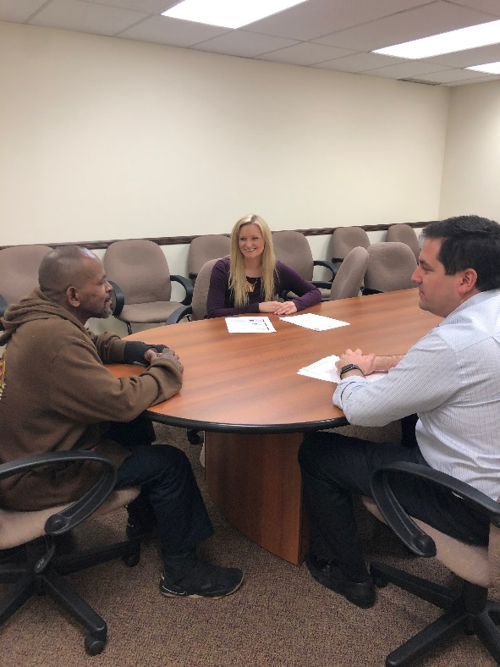
NVLSP: Lawyers Serving Warriors® (LSW)
  Lawyers Serving Warriors® is NVLSP’s pro bono project that provides free legal assistance through a network of volunteer attorneys to veterans on various issues.

Slide 5
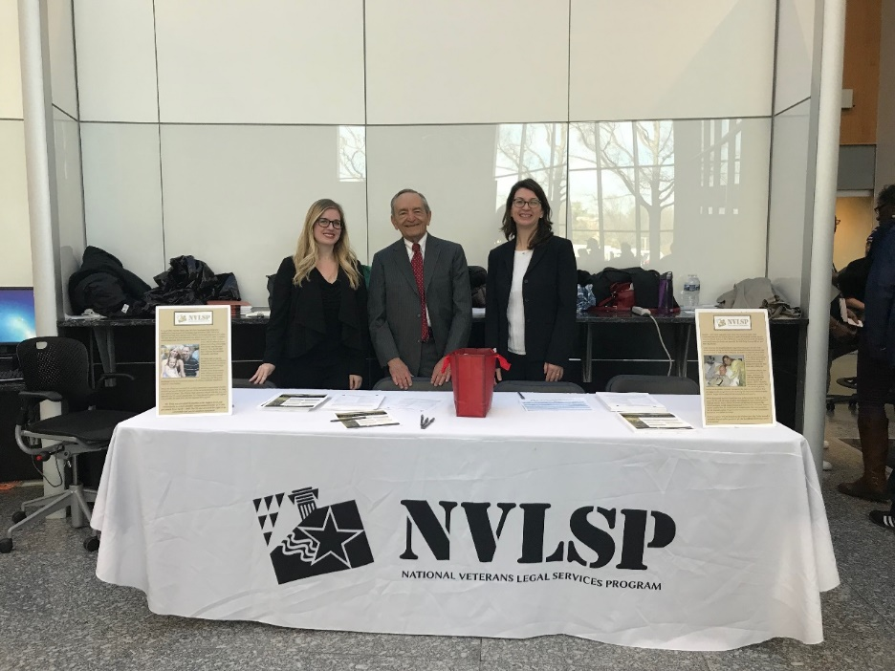
NVLSP: Lawyers Serving Warriors® (LSW) Process
  A veteran applies to LSW for free legal assistance with his or her claim.
  LSW then requests the veteran’s medical and military personnel records in order to evaluate the veteran’s case.
  LSW staff attorneys review the veteran’s application to determine whether it fits our criteria and place eligible cases with volunteer law firm/corporate counsel attorneys, mentoring the volunteers.

Slide 6
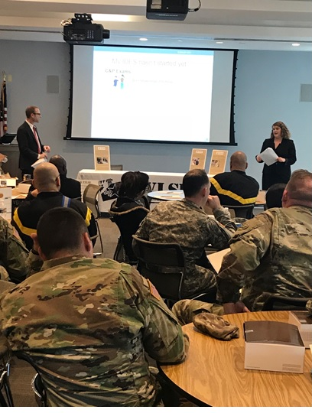
Our Contact Info for Free Legal Services
Website:
https://www.nvlsp.org/what-we-do/lawyers-serving-warriors/
Phone:
202.265.8305, ext. 152
E-mail:
info@nvlsp.org

Slide 7
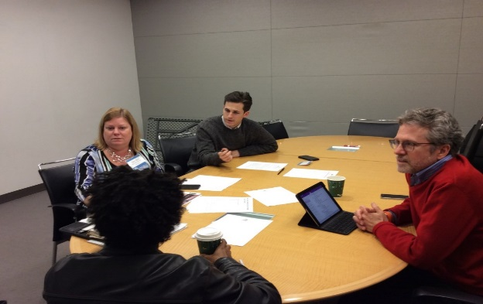
Lawyers Serving Warriors® (LSW):
Overview of CRSC

Slide 8
What is CRSC?
CRSC is a tax-free monthly payment provided by the Department of Defense, that is available to eligible veterans who have injuries that are combat-related, as defined by law.
CRSC is an extra payment that is in addition to any military disability retirement pay and/or VA disability compensation that the veteran may be receiving each month.

Slide 9
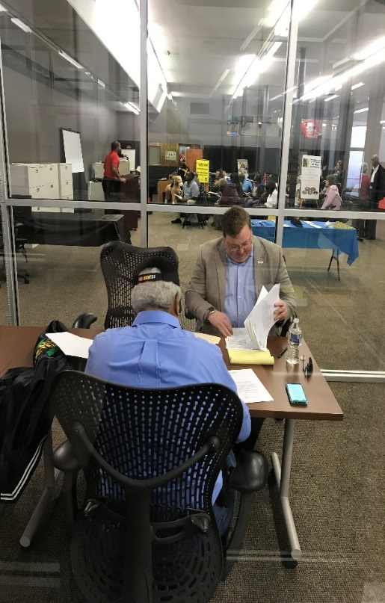
What Types of Injuries/Conditions are Eligible for CRSC?
Injuries/conditions that are service-connected by the VA with a disability rating of at least 10%.
If ratings increase, CRSC payments will increase.
Injuries/conditions that are service connected at 0% are eligible for payments if the rating is subsequently increased.

Slide 10
Example of Successful Award
An Army Staff Sergeant served in Iraq and Afghanistan as a Combat Engineer. He was injured by an Improvised Explosive Device and awarded a Purple Heart and Combat Badge. He was diagnosed with Post-Traumatic Stress Disorder and Tinnitus.
DLA Piper, mentored by NVLSP, submitted a detailed brief with extensive supporting evidence.
The veteran received CRSC for PTSD, initially rated at 50% and then increased to 70% as well as tinnitus rated at 10%. He was also found eligible for his hearing loss, rated at 0%, though he did not receive benefits for hearing loss due to this rating.

Slide 11
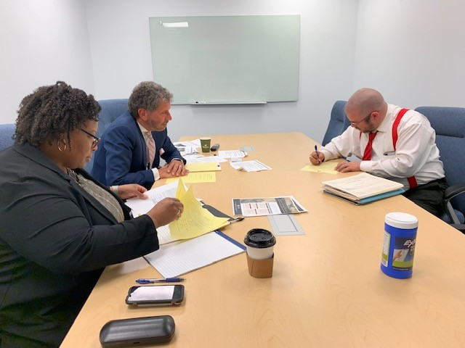
Retirement is a Prerequisite
The primary eligibility requirement for CRSC is that the individual must have been retired from the military either due to years of service or disability.

Slide 12
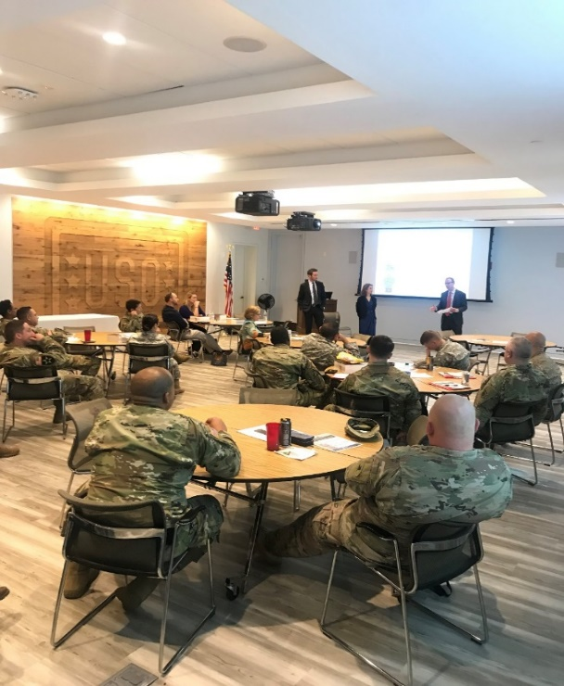
Military Medical Retirement
Medical or disability retirement requires a service-connected medical condition(s) severe enough to interfere with the proper performance of one’s military duties and that injury is rated at 30% or more.
In order to be retired, a service member must be found unfit for military duty by a Physical Evaluation Board (PEB) in the Integrated Disability Evaluation System process.
May be multiple impairments, physical and/or mental, with total rating at 30% or more.

Slide 13
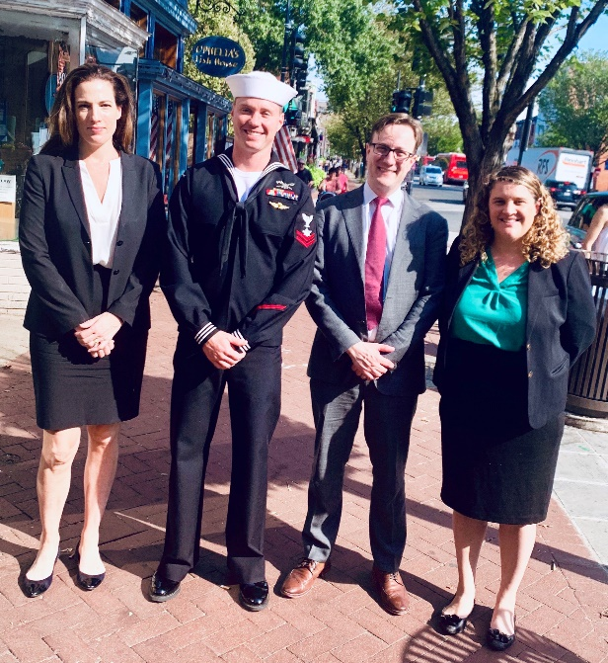
Military Medical Retirement
NVLSP’s Lawyers Serving Warriors® assists veterans seeking a military medical retirement post-discharge with applications to the Boards for Correction of Military/Naval Records and/or courts
To learn more or apply, go to https://www.nvlsp.org/what-we-do/lawyers-serving-warriors/

Slide 14
Years of Service Retirement
A service member can be retired from active service due to having served on active duty for at least 20 years or more.
A service member can be retired from Reserve/National Guard service due to having served at least 20 or more years in the Reserve/National Guard.
While a veteran may receive a “20-year letter” confirming 20 or more years of service in the Reserve/National Guard, the veteran will likely not be able to receive retirement benefits until he/she reaches the age of 60. As a result, a veteran with a years of service retirement from the Reserve/National Guard will not be eligible to apply for CRSC until their retirement benefits begin after turning 60, or possibly sooner depending on the number of years of active service.

Slide 15
Concurrent Retirement
Disability Pay (CRDP)
CRDP is only available to military veterans who have served at least 20 years of service, and have a VA disability rating of 50% or higher.
CRDP allows a veteran to receive the full amount of their VA disability compensation and military retired pay. CRDP is taxable in the same manner as military retirement pay.
A veteran cannot receive both CRSC and CRDP. A veteran who is entitled to both will be allowed to choose whether to receive CRSC or CRDP by the Defense Finance and Accounting Service.

Slide 16
Benefits for Military Retirees
Combat-Related Special Compensation (CRSC)
- Retirement based on years of service, or disability.
- Partial restoration of military retirement pay.
- CRSC is tax-free.
Concurrent Retirement Disability Pay (CRDP)
- Must have served at least 20 years, and have a combined VA disability rating of at least 50%.
- Full restoration of military retirement pay.
- CRDP is taxable.

Slide 17
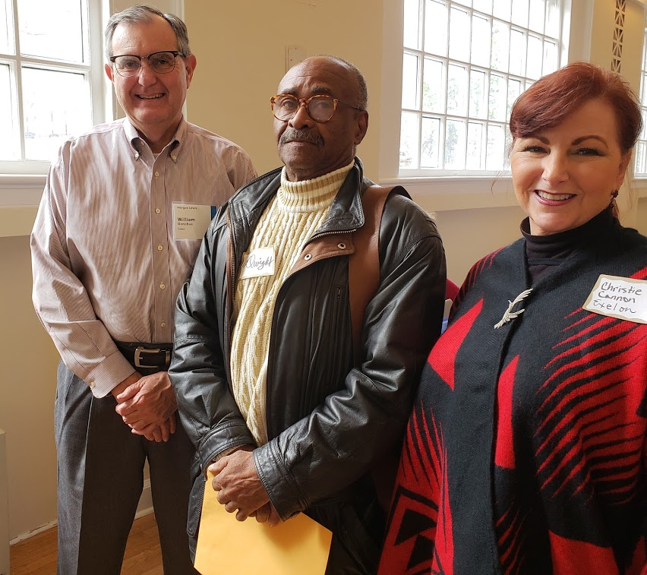
Lawyers Serving Warriors® (LSW):
Categories of CRSC

Slide 18
What Makes an Injury/Condition Combat-Related?
Under 10 U.S.C. 1413a, the following are the five primary categories of combat-related disabilities eligible for CRSC:
1. Injuries incurred as a direct result of armed conflict
2. Injuries incurred through an instrumentality of war
3. Injuries incurred in the performance of duty under conditions simulating war
4. Injuries incurred while engaged in hazardous service
5. Injuries for which the member was awarded the Purple Heart

Slide 19
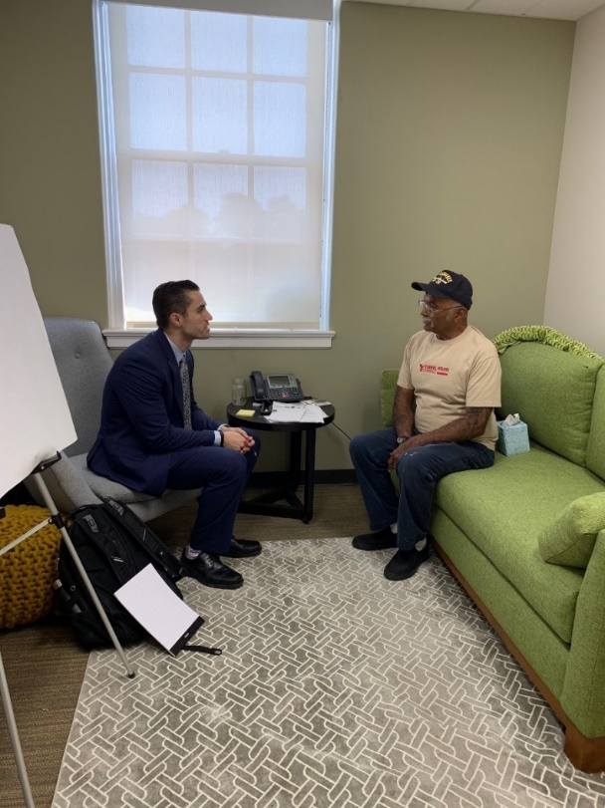
Direct Result of Armed Conflict
Any action in which service members are engaged with hostile or belligerent forces.
Must be a causal relationship between the armed conflict and the disability.

Slide 20
Combat-Related Mental Health Conditions
Post-traumatic Stress Disorder (PTSD) is a mental disorder caused by traumatic experiences (called a “stressor”).
PTSD is diagnosed by medical professionals based on the stressors experienced by the patient.
A diagnosis of PTSD is an affirmation by the medical professional that the patient experienced stressors that caused PTSD.
Combat stressors may lead to other mental health conditions, such as anxiety or depression.

Slide 21
Armed Conflict PTSD Success Story
An Army Staff Sergeant (SSG) deployed to Iraq three times as an Infantryman in heavy combat areas. He raided target houses and was repeatedly exposed to small arms fire, heavy artillery fire, and explosives. He suffered from nightmares of traumatic events, intrusive memories, and emotional numbing. He was diagnosed with PTSD.
DLA Piper, mentored by NVLSP, submitted a detailed brief with extensive supporting evidence.
The veteran received CRSC under the Armed Conflict category for PTSD.

Slide 22
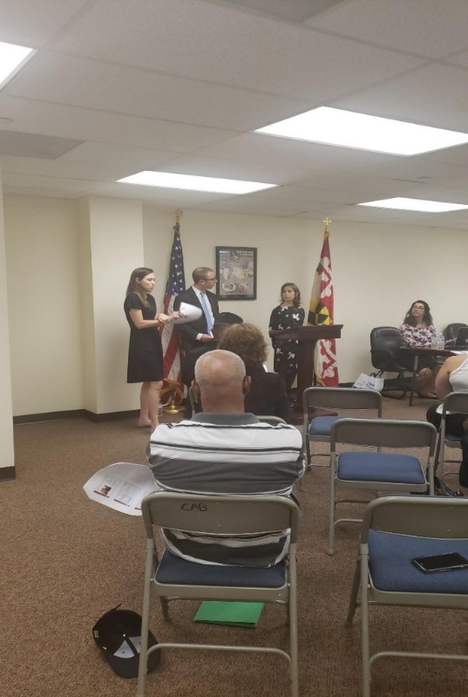
Instrumentality of War
An instrumentality of war includes a vehicle, vessel, or device designed primarily for military service and intended for use in such service at the time of the occurrence or injury.
This category includes wounds caused by a military weapons, accidents involving a military combat vehicle, injury or sickness caused by fumes, gases, or explosion of military ordnance, vehicles, or material.

Slide 23
Instrumentality of War
This category may also include instrumentalities not designed primarily for military service if the use of the instrumentality subjects the individual to a hazard peculiar to military service. Example: Assault with a shovel.
There must be a causal relationship between the instrumentality of war and the disability

Slide 24
Instrumentality of War Success Story
The service member served in the Army and Air Force as a Wheeled Vehicle Mechanic, deploying to Iraq and Afghanistan. While pushing a Humvee backward in training, it rolled over his leg, injuring his foot and ankle. Other soldiers had to push the Humvee off his leg.
DLA Piper, mentored by NVLSP, submitted a detailed brief with extensive supporting evidence.
The veteran received CRSC under the Instrumentality of War category for foot and ankle conditions.

Slide 25
Instrumentality of War Success Story 2
An Air Force Technical Sergeant (TSgt) was bitten on his left wrist by military German Shephard during canine training. Subsequently, when deployed to Korea, he re-injured the wrist during a two-man lift. He had surgery on the wrist.
DLA Piper, mentored by NVLSP, submitted a detailed brief with extensive supporting evidence.
The veteran received CRSC under the Instrumentality of War category for scars, paralysis and limited motion of the wrist.

Slide 26

Hazardous Service
Such service includes, but is not limited to, aerial flight, parachute duty, demolition duty, experimental stress duty, and diving duty.
The injury or disease must be the direct result of actions taken in the performance of such service.

Slide 27
Hazardous Service Success Story
An Airman worked in prisons performing detainee operations in Afghanistan. He encountered volatile situations during riots and entering locked areas with enemy combatants. He subsequently experienced anxiety with panic attacks and nightmares. He was diagnosed with Post-Traumatic Stress Disorder (PTSD).
DLA Piper, mentored by NVLSP, submitted a detailed brief with extensive supporting evidence.
The veteran received CRSC under the Hazardous Service category for PTSD.

Slide 28
Hazardous Service Success Story 2
An Army SSG injured his back in a parachute landing. His back injury was aggravated when his vehicle was hit by an Explosively Formed Projectile during a deployment to Iraq.
DLA Piper, mentored by NVLSP, submitted a detailed brief with extensive supporting evidence.
The veteran received CRSC under the Hazardous Service category for his spine injuries.

Slide 29
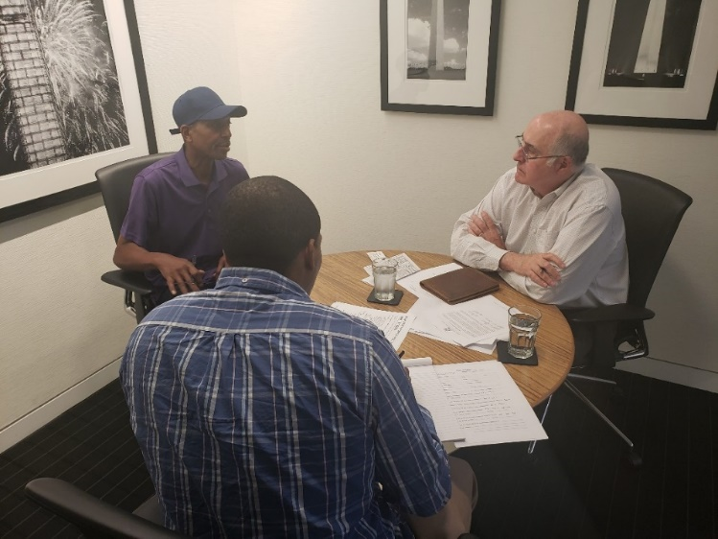
Conditions Simulating War
Disabilities resulting from military training, such as war games, airborne operations, grenade and live fire weapons practice, and hand-to-hand combat training.
Does not include physical training activities, such as calisthenics, jogging, or recreational sports activities.

Slide 30
Simulating War Success Story
In preparation for deployment to Iraq, an Army Captain participated in live fire vehicular training. The vehicle hit a ditch. He was pinned against the vehicle by another soldier, with the magazine of a firearm protruding into his back. He suffered a slipped disc which led to disc disease and radiculopathy.
An NVLSP pro bono partner, mentored by NVLSP, submitted a detailed brief with extensive supporting evidence.
The Officer received CRSC under Conditions Simulating War for his disc disease and radiculopathy.

Slide 31
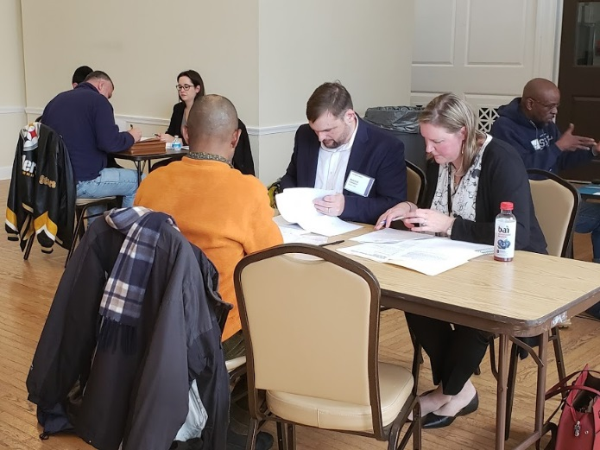
Purple Heart Disabilities
The Purple Heart is awarded to service members who are wounded or killed as a result of armed conflict
Need sufficient causal relationship between the disability and the injury for which a Purple Heart was awarded.

Slide 32
Combat-Related
Secondary Conditions
Secondary Condition: A condition that the VA has already service-connected based on a finding that it was caused by or aggravated by another VA service-connected disability (primary condition)
Example: Muscle damage of calf due to bullet wound (primary condition) results in knee instability (secondary condition).
For a secondary condition to qualify for CRSC, the primary condition must be combat-related under one of the six categories of disabilities eligible for CRSC (Armed Conflict, Through an Instrumentality of War, Hazardous Service, Under Conditions Simulating War, Purple Heart Disabilities, or Presumptive Conditions)
If primary condition is combat-related, the secondary condition is automatically combat-related.

Slide 33
Purple Heart and Secondary Conditions Success Story
An Army Corporal (CPL) was hit by an IED when driving a vehicle in Iraq. The IED blast caused the front right tire to blow out and punctured the fuel tank, starting a fire. The vehicle swerved off the road and rolled several times. Fellow soldiers attempted to assist CPL out of the cab, however a flame shot out from the fuel tank and the soldiers had to drop her back into the cab of the truck. The CPL received a Purple Heart for back injuries and other conditions resulting from this incident.
DLA Piper, mentored by NVLSP, submitted a detailed brief with extensive supporting evidence.
The veteran received CRSC for Purple Heart conditions, including a back disability, and for bilateral neuropathy secondary to the back injury.

Slide 34
Combat-Related
Presumptive Conditions
Conditions that automatically qualify as Combat-Related:
Presumptive Conditions
Agent Orange Exposure (Vietnam)
Chronic Disabilities from Persian Gulf War
Radiation/Mustard Gas/Lewsite Gas exposure
VA rating decision must indicate that the disability is based on one of these statutory presumptions.

Slide 35
Exposure to Burn Pits
On military bases in Iraq and Afghanistan, garbage disposal was done by dumping trash, medical waste, asbestos, and other chemicals into a burn pit. The trash was then lit on fire with jet fuel.
Service members who were deployed to the Middle East were exposed to smoke, fumes, and gases from burn pits.
Many of those service members have now developed respiratory illnesses and some rare forms of cancer that are now being tied to exposure to burn pits.

Slide 36
Burn Pits and CRSC
More veterans are applying to LSW for assistance with CRSC cases involving burn pits.
Air Force veteran who served as a fighter pilot stationed at Balad Air Base in Iraq. Smoke from the burn pits would enter the cockpit while the veteran was preparing for a mission.
Veteran has now been diagnosed with constructive bronchitis.
Developing arguments as to why CRSC should be awarded for veteran’s bronchitis as an instrumentality of war, armed conflict, or hazardous service.

Slide 37
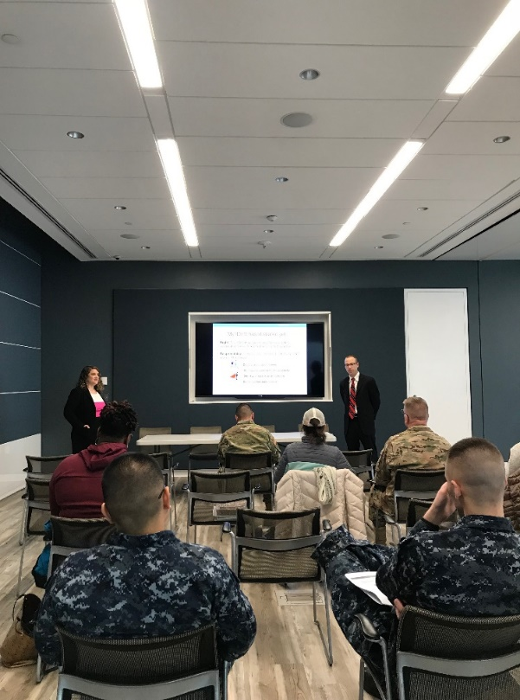
Lawyers Serving Warriors® (LSW):
CRSC Application

Slide 38
How to Apply for CRSC?
Complete a CRSC Application (DD Form 2860)
The CRSC Application must be filed with the service branch that retired the veteran.
In addition to the CRSC Application, the applicant should submit any medical records, award citations, lay statements, or any other evidence that supports that an injury was combat-related for CRSC purposes.

Slide 39
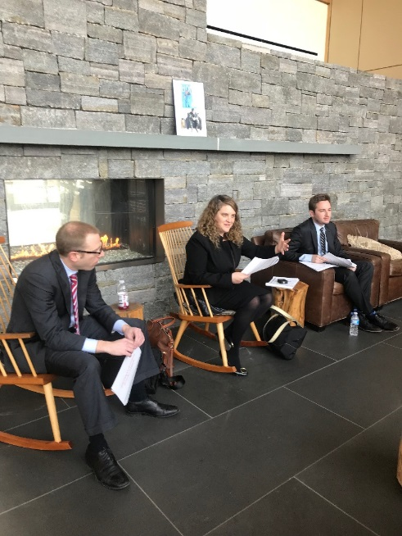
Tips for CRSC Advocacy
The key to a successful CRSC application is to include all relevant evidence that supports a combat-related determination for each combat-related disability.

Slide 40
Tips for CRSC Advocacy
Step 1: Identify potential CRSC disabilities by determining which disabilities are currently rated as service-connected by the VA.
Step 2: Review the VA claims file and military personnel file for information that supports a combat-related determination for any of the disabilities identified by Step 1.
Step 3: Complete a CRSC Application (DD Form 2860) and attach supporting documentation

Slide 41
Tips for Evidence Evaluation
Helpful Statements to Support a Claim: When reviewing VA and military records, look for phrases that tell “how” an injury/condition was incurred or aggravated.
  For example:
  " ….Doctor states injury is more likely then not caused by airborne duty, FTX, IED explosion, or specific instrument of war while training"
  " … hurt knee or shoulder during an airborne jump, with bad landing"
  " ….hearing loss caused by acoustic trauma"
  " … hatch cover hit head during training"
  " … shot in the leg by enemy in Iraq…“

Slide 42
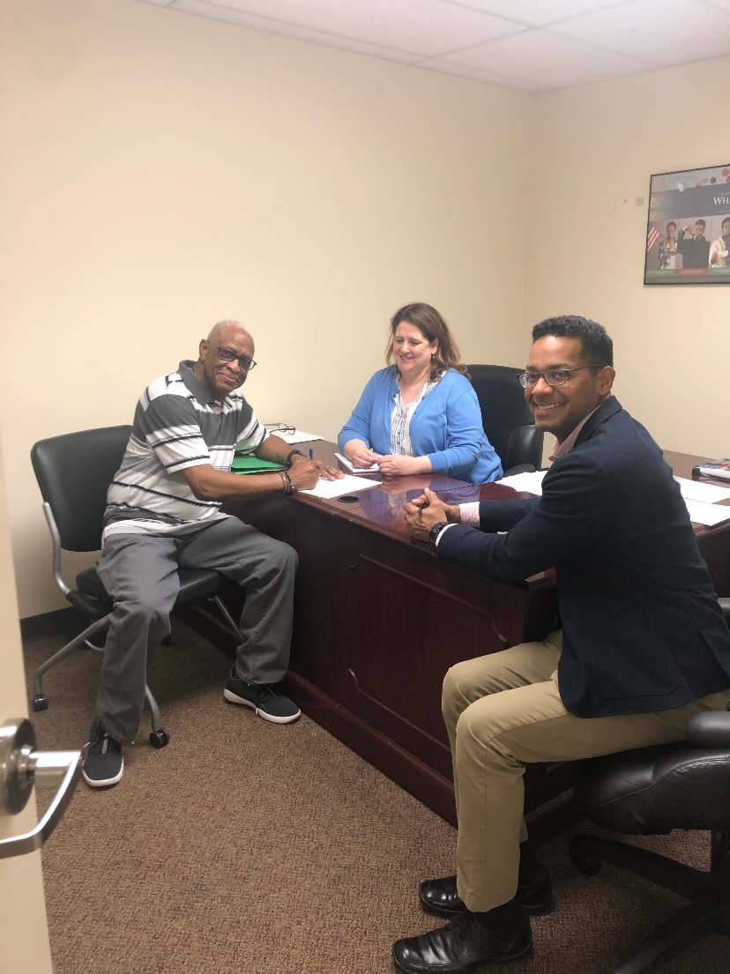
Tips for Evidence to Submit
Purple Heart Certificate/Orders
DD Form 214
VA Rating Decisions
Physical Evaluation Board (PEB) Findings
Medical Evaluation Board (MEB) Narrative Summary
Medical Records

Slide 43
CRSC Appeals Process
CRSC Reconsideration
Appeal to the Board for Correction of Military Records (Army, Air Force, Coast Guard) or Board for Correction of Naval Records (Navy, Marine Corp.)
Appeal to Court of Federal Claims if within 6 years of first denial
Appeal to US District Court if more than 6 years from initial denial and procedural error

Slide 44
CRSC Appeal Success Story
A Marine developed PTSD after being exposed to enemy mortar attacks while serving in Iraq at Al Asad Air Base. His CRSC application was denied by the Navy CRSC Board and the Board for Correction of Naval Records.
An NLVSP pro bono partner, mentored by NVLSP, filed an appeal in the U.S. District Court for the District of Columbia.
Following a remand from the Court, the Navy agreed that the Marine’s PTSD was caused by instrumentalities of war (mortars). The Marine will receive over ten years of retroactive CRSC pay and monthly payments for his combat-related injury.

Slide 45
Common Myths
None of the following automatically qualify for CRSC:
Condition began or aggravated while deployed to a combat zone.
Seeing dead bodies.
Buddy got CRSC for similar condition or event.
Doctor says condition is from combat.
PEB found that condition was combat-related (though presumption for Navy).
VA coded condition as related to combat.
Survived military sexual trauma or racial discrimination while deployed.

Slide 46
Our Contact Info for Free Legal Services
Website:
https://www.nvlsp.org/what-we-do/lawyers-serving-warriors/
Phone:
202.265.8305, ext. 152
E-mail:
info@nvlsp.org

Slide 47

Thank you for your service!

