Slide 1
2021 Eastern Region III Annual General Assembly
Date October 24, 2021

Slide 2
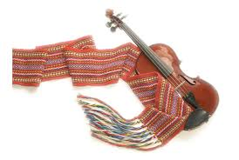
2021 ERIII
Annual General Assembly

Slide 3
Regional Council & Governance
NAME | LOCAL | POSITION HELD
Marg Friesen | ERIII | Regional Representative & Chairperson
Tracey Rogers | #103 Indian Head Sintaluta Wolseley | President
Dexter Mondor | # 182 Moose Mountain | President
Leebert Poitras | # 8 Lestock | President
Joe Pelletier | # 48 Lebret | Interim President
Tanya Hunter | # 135 Rocanville | President
Linda Legace | # 6 Fort Qu’Appelle | President
Trisha Nykiforuk-Racette | # 87 Weyburn | President
Linda Sopp | # 25 Estevan | President
Edmond McAuley |  | Youth Representative
2021 Regional
Representative
Report

Slide 4
Regional Council
ERIII regular meetings January 16, April 28, August 8
2 special meetings January 29, March 19
Due to COVID 19 we met virtually and 1 meeting in August was in person
Locals had an AGM virtually or via teleconference Local 6, Local 8, Local 25, Local 87, Local 182
Local 103, planned for Oct 25, Local 135 for Nov 7, Local 48 in November
All the locals within ERIII have met the necessary requirements of MN-S to remain as part of the legislative assembly and to have an active role in core governance

Slide 5
ERIII citizens participated in the MN-S provincial election May 29 2021
ERIII Regional Council participated in the Metis Nation Legislative Assembly held Feb 20 & 21, 2021 virtually

Slide 6
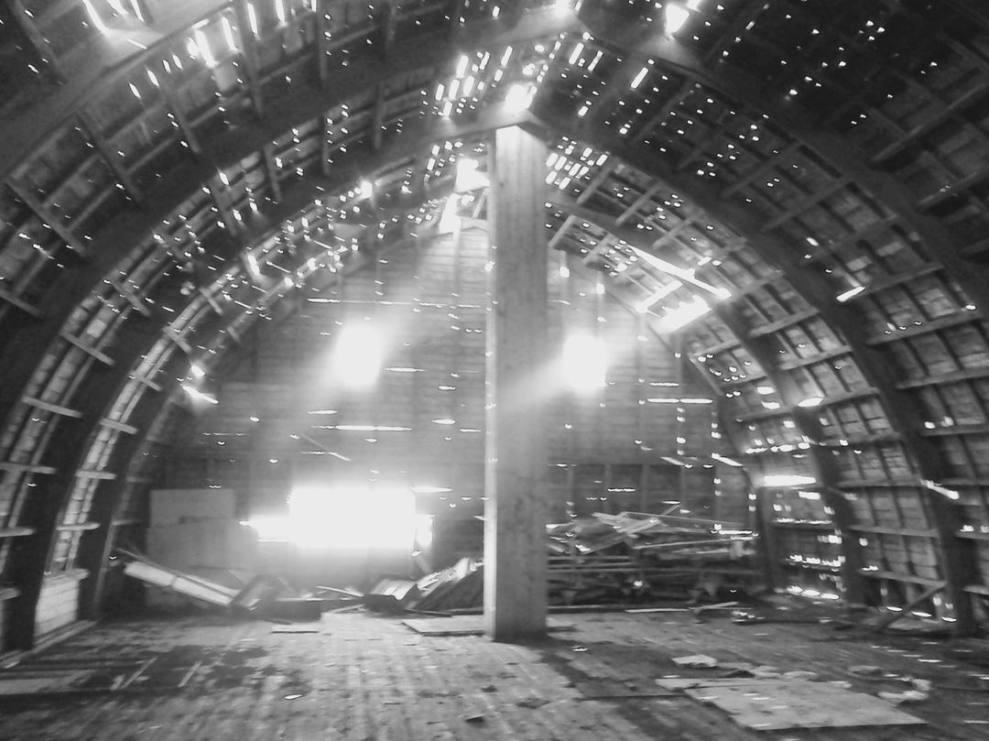
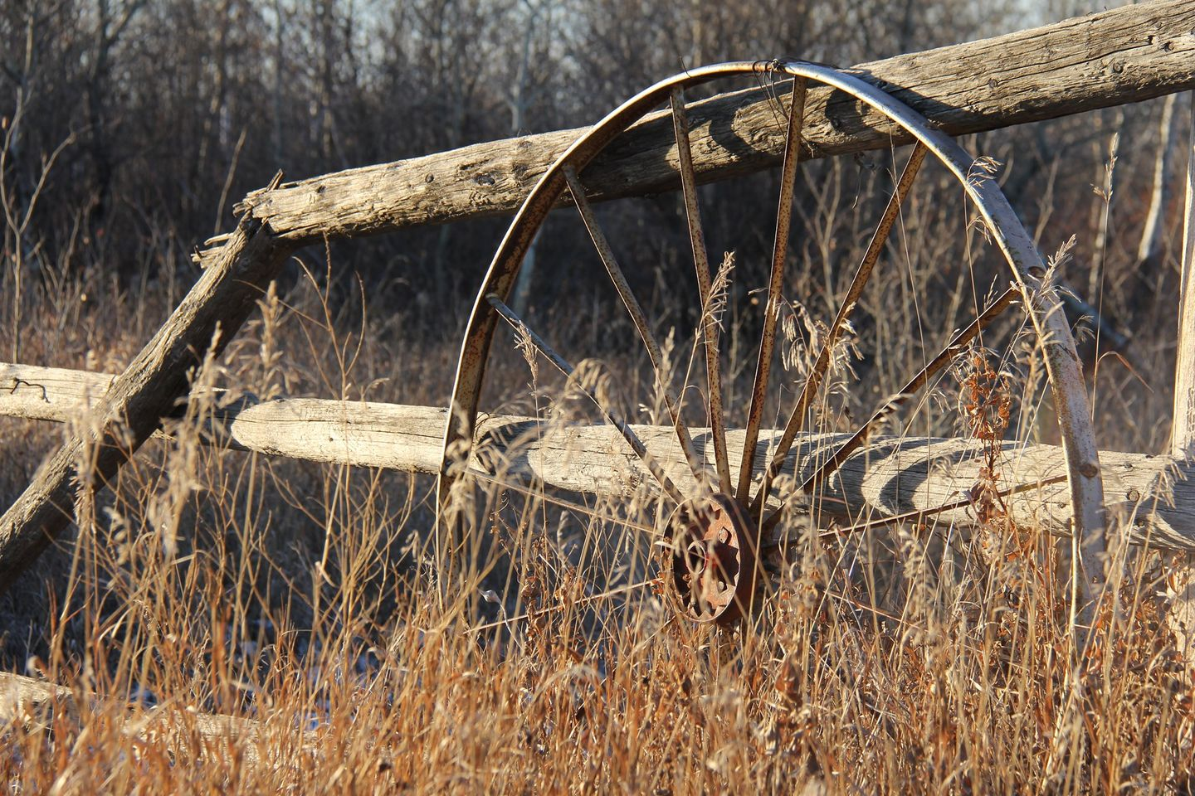
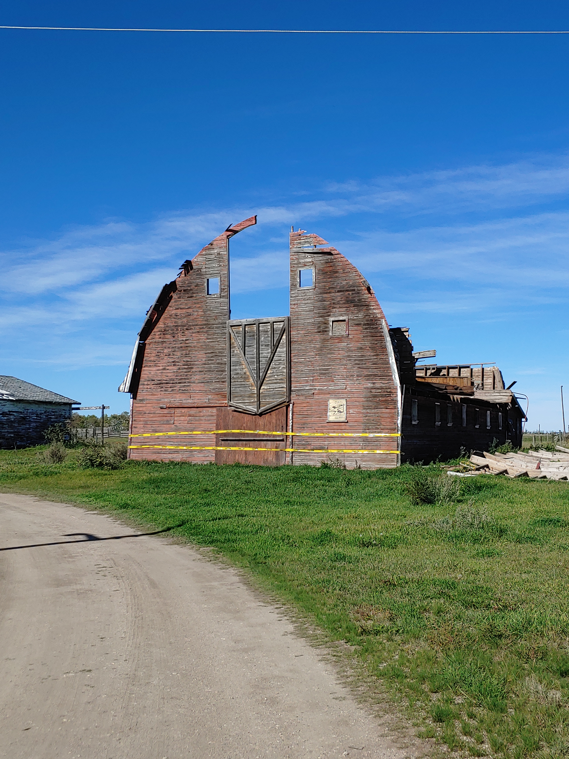
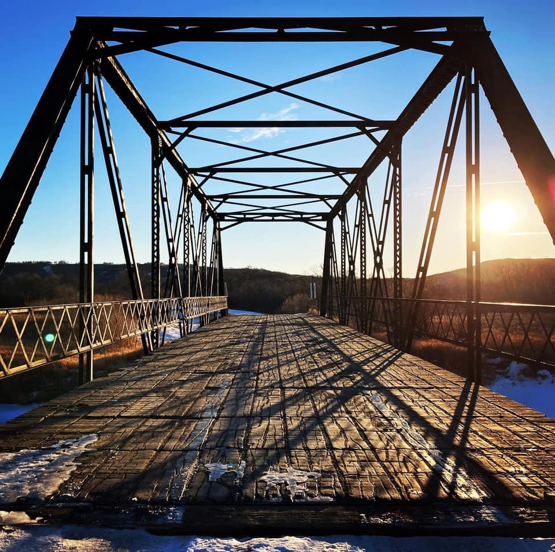
Regional Highlights
Traditional Land Use Study
The purpose of this study is to collect information from community members of how the land was an important part of family and community life growing up in the Qu’Appelle Valley, Souris Valley and surrounding areas.
Educating industry and other users will provide a mechanism for input into managing natural resources and encourage consultation with Métis traditional land users.
Virtual online storymaps, significant timelines for Metis people and mapping our Metis footprint and contributions
Parks Canada Motherwell National Historic Site
Notes:
The current generation of Elders is growing older, and it is very important to capture their traditional knowledge of the region while there is still time to do so.
Rapid expansion of resource development activities that are disturbing the land and possibly impacting traditional land use by Métis people is also a factor.
We are currently in the process of interviewing Métis Knowledge Holders and Elders 10n people so far about what their life was like growing up, gather their stories, hear about their traditions, and learn about the significance of the land, road allowances and settlements, etc. With these interviews, we can share their wealth of knowledge with our children, educators, and future generations through the development of online Story Maps, so that they will live on forever.
Phase 2 to start soon
Online newsletter subscribe and in print

Slide 7
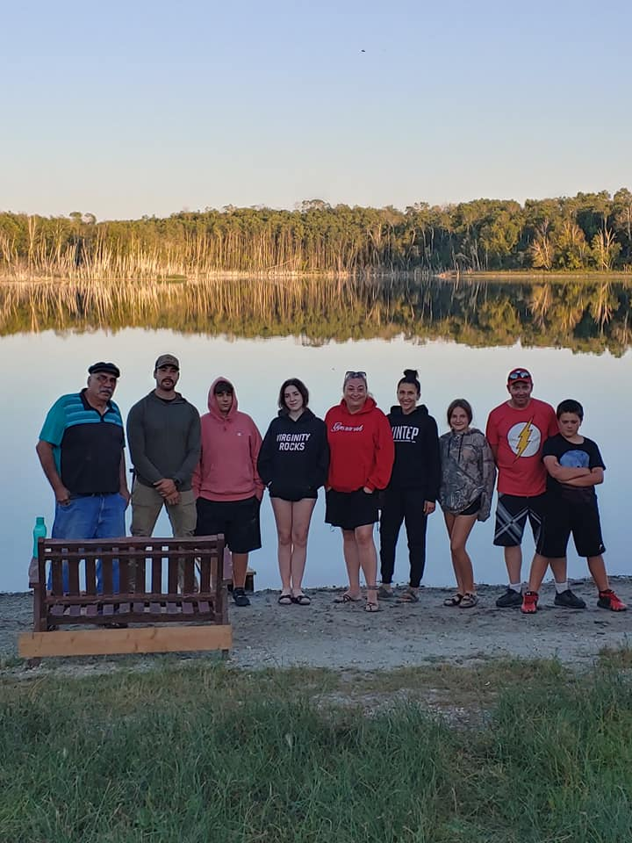
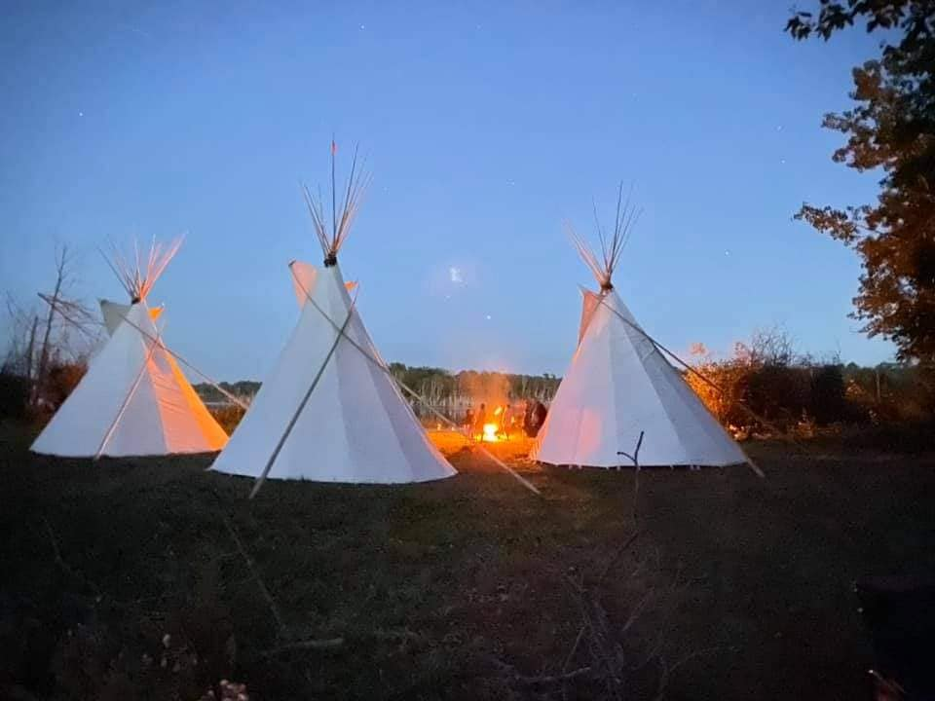
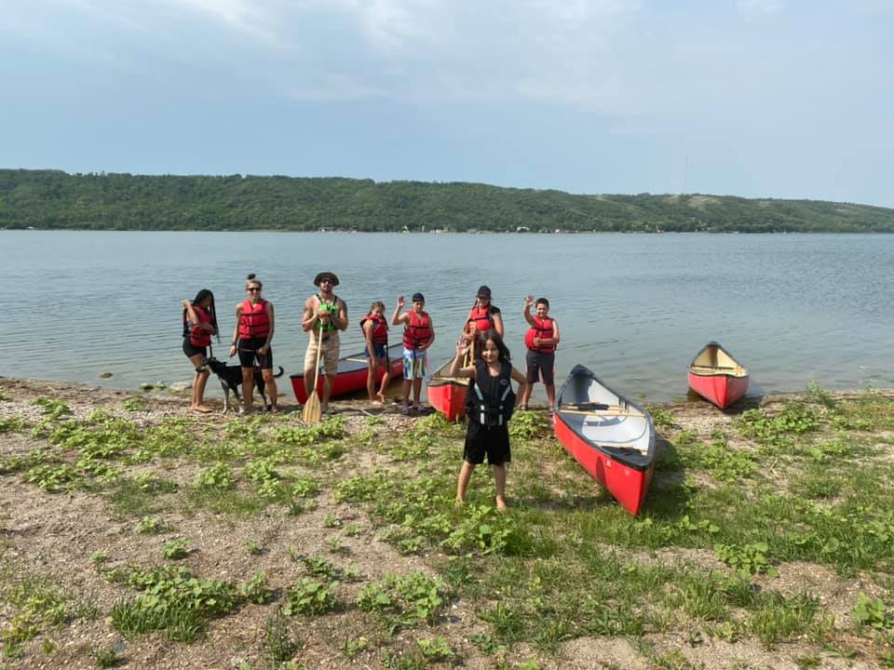
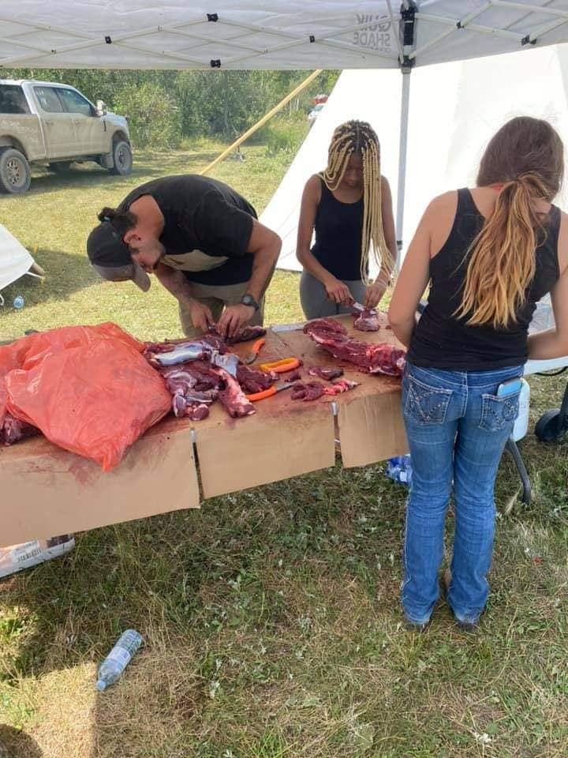
Highlights
Land Based Camps
All events were a part of the UPIP funding program
Revised project activities due to COVID 19 pandemic
Facilitated by land-based educator: Garrick Schmidt
Harvesting, processing, canoeing, water safety, plant & medicines, shelter build, conservation, traditional teachings of Metis way of life

Slide 8
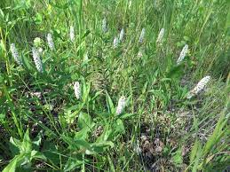
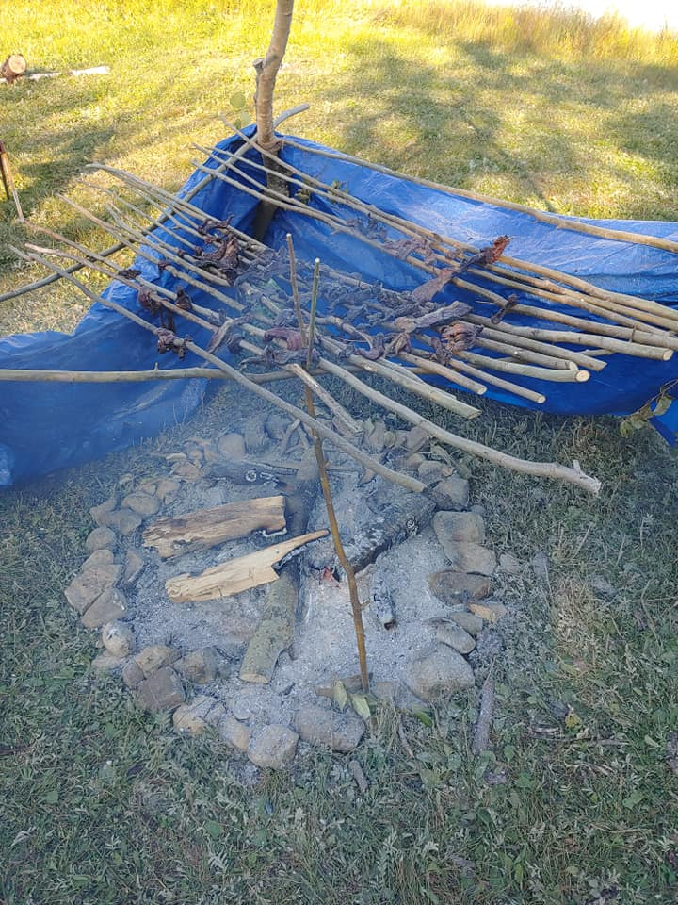
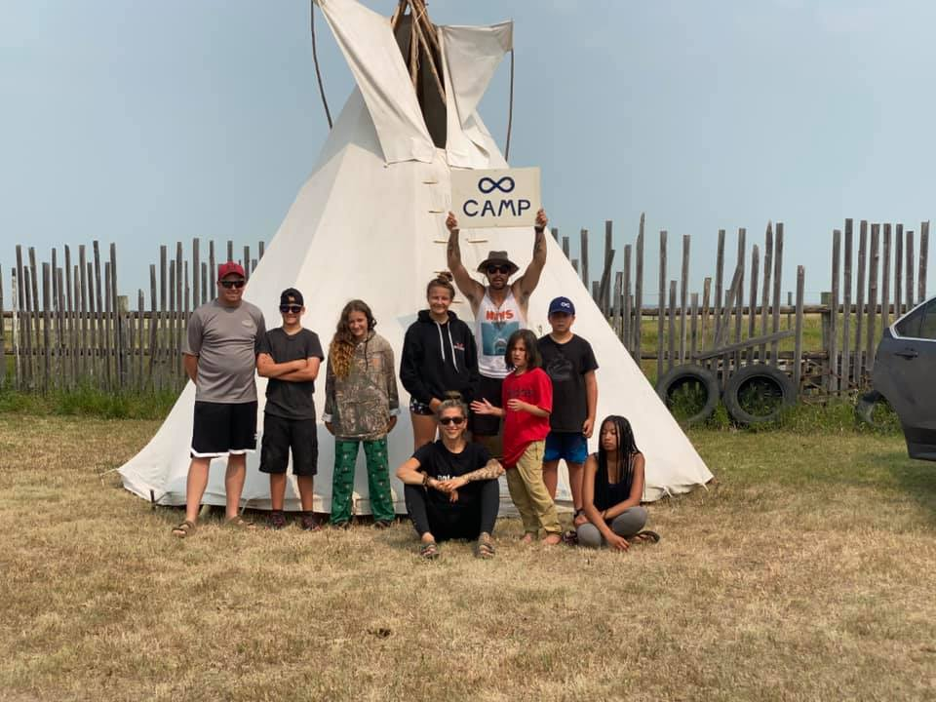
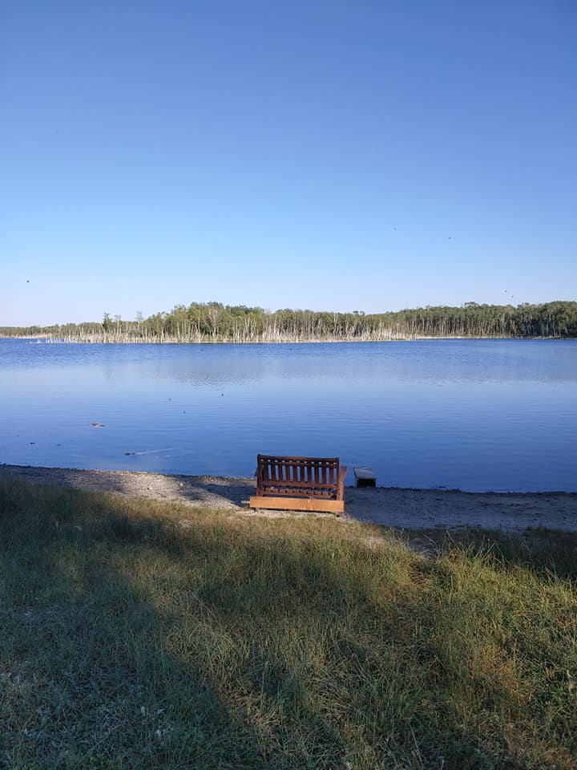
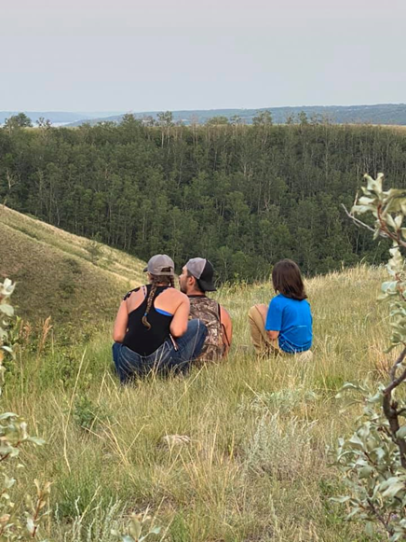
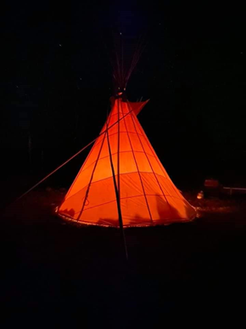
Land Based Camps

Slide 9
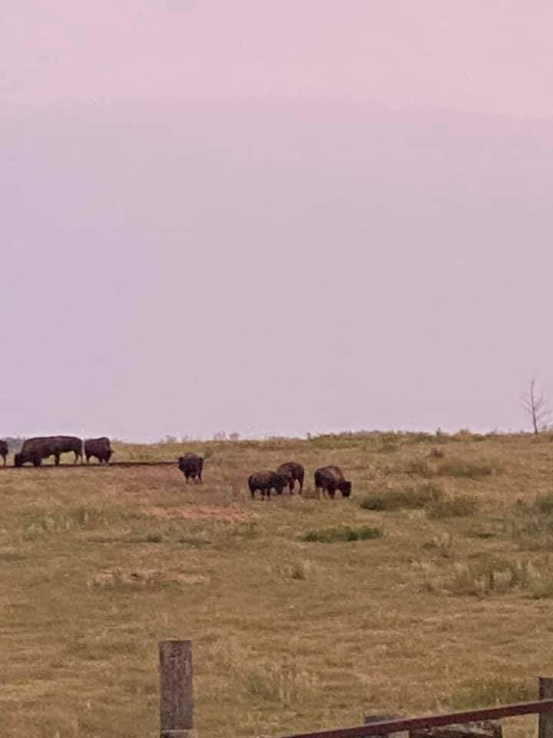
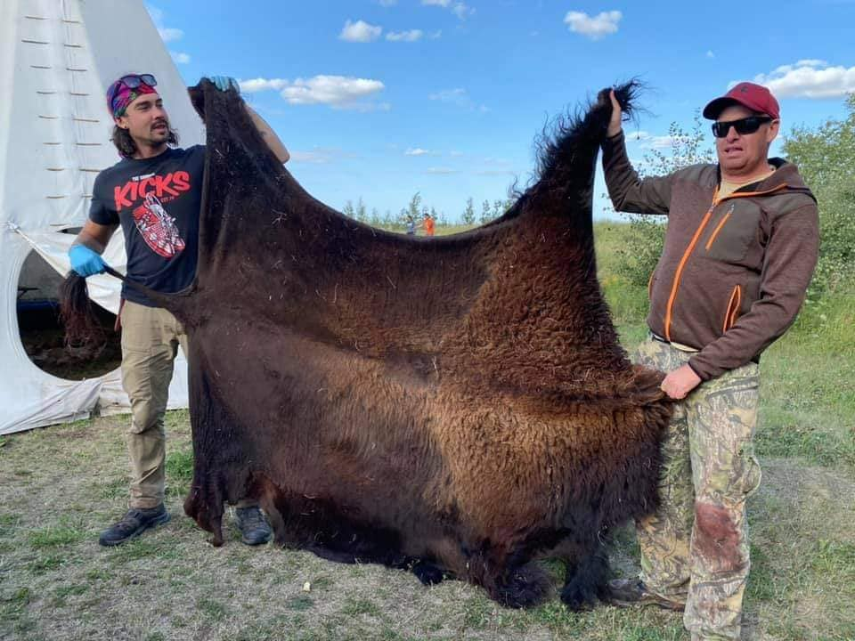
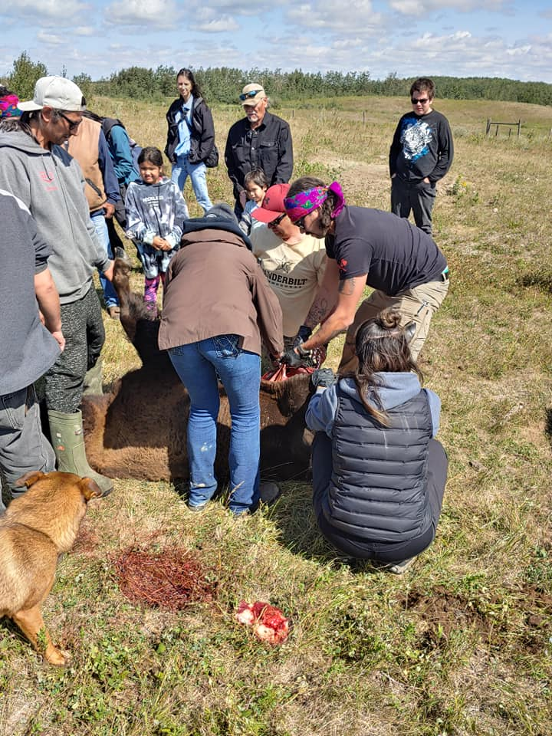
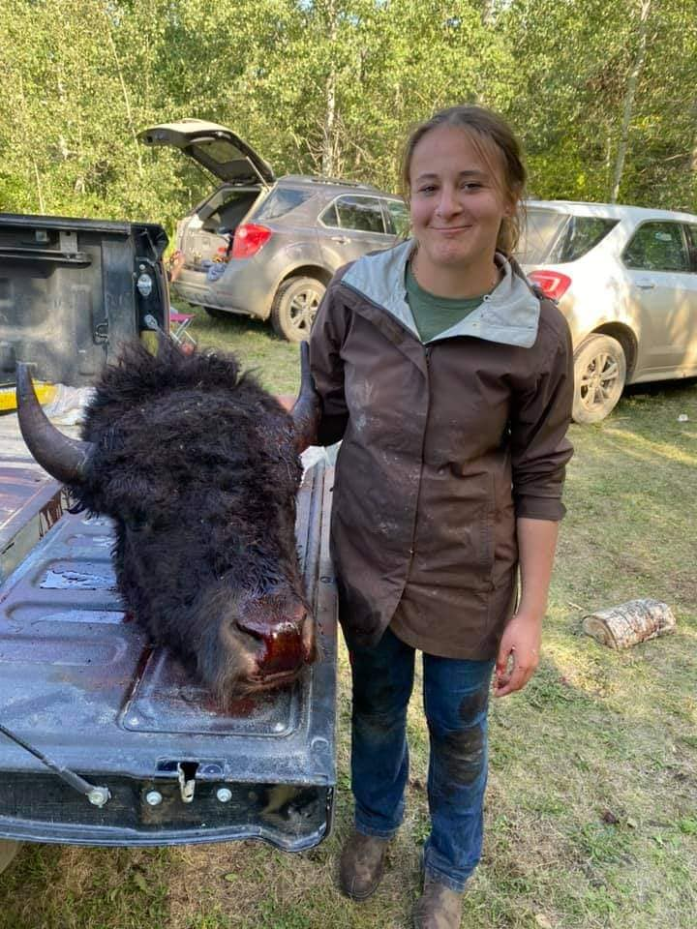
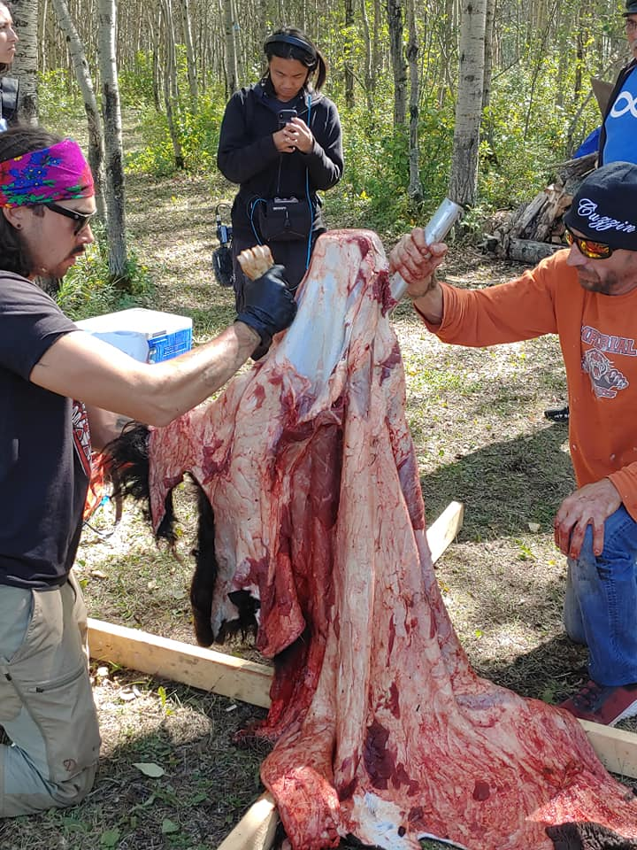
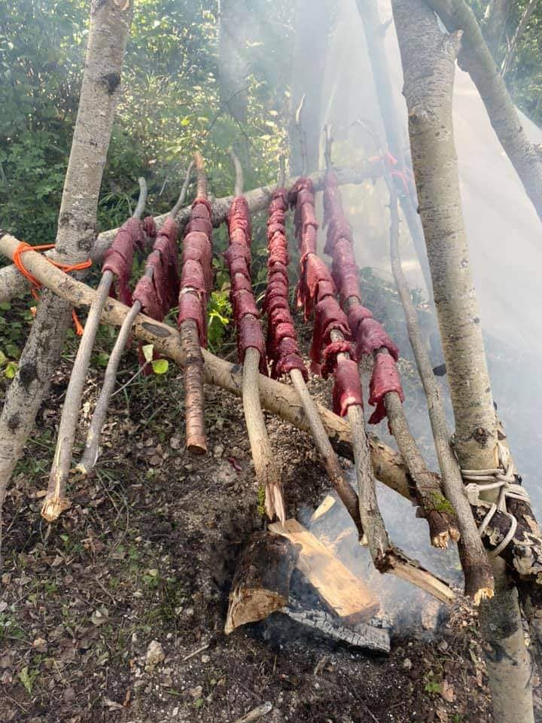
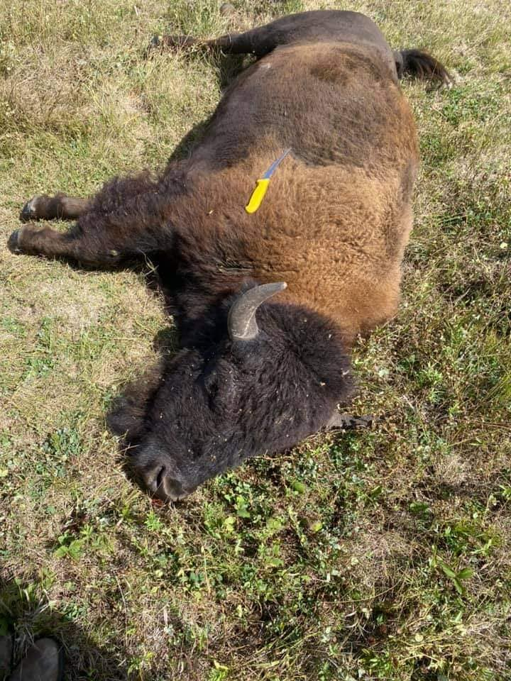
Buffalo Hunt Cultural Camp
Notes:
UPIP funding
About 30 participants children to seniors
Collaboration with Muskowagan FN
Canadian Geographic filmed to add to the Metis story
New York Times story coming up
Annual event for community building, reconnecting to the land, teaching moments, sustanence,

Slide 10
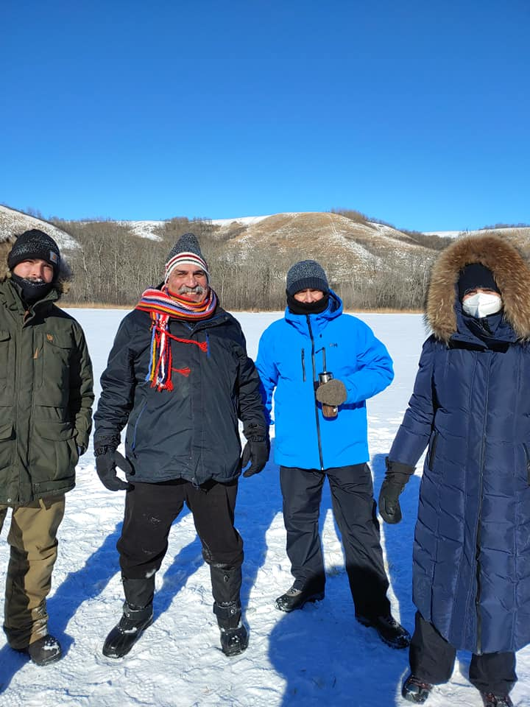
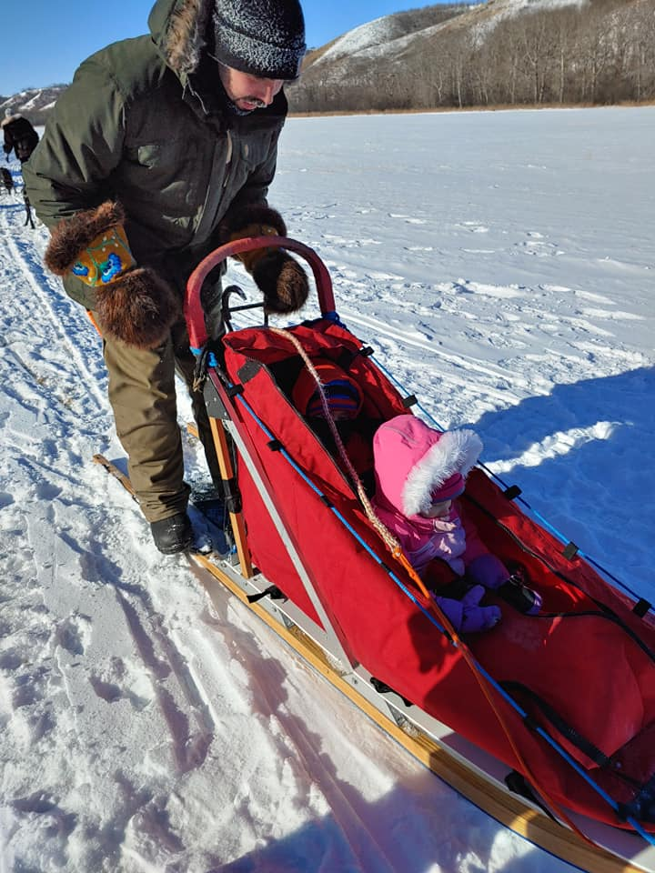
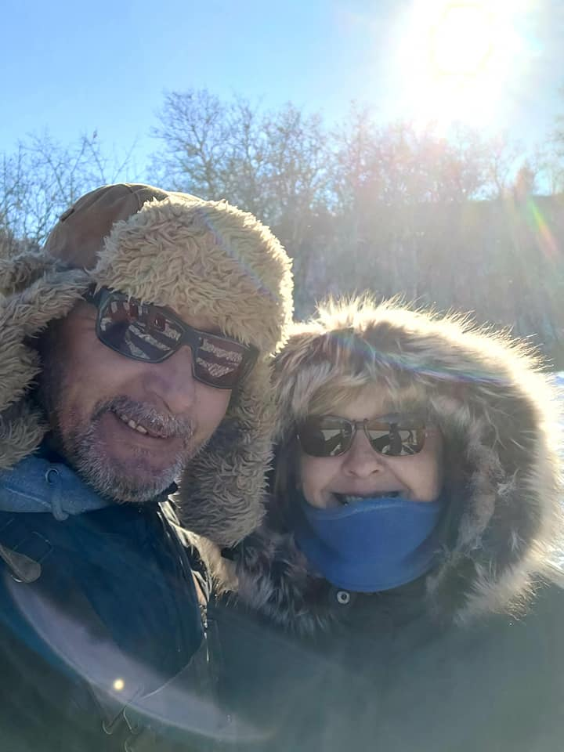
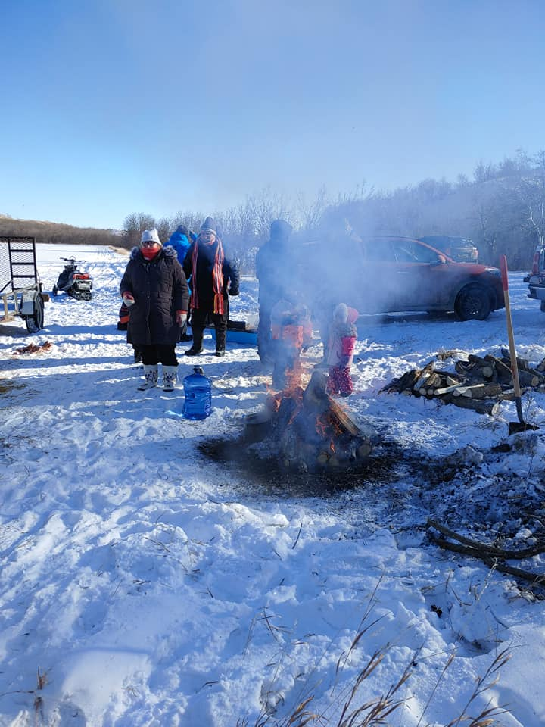
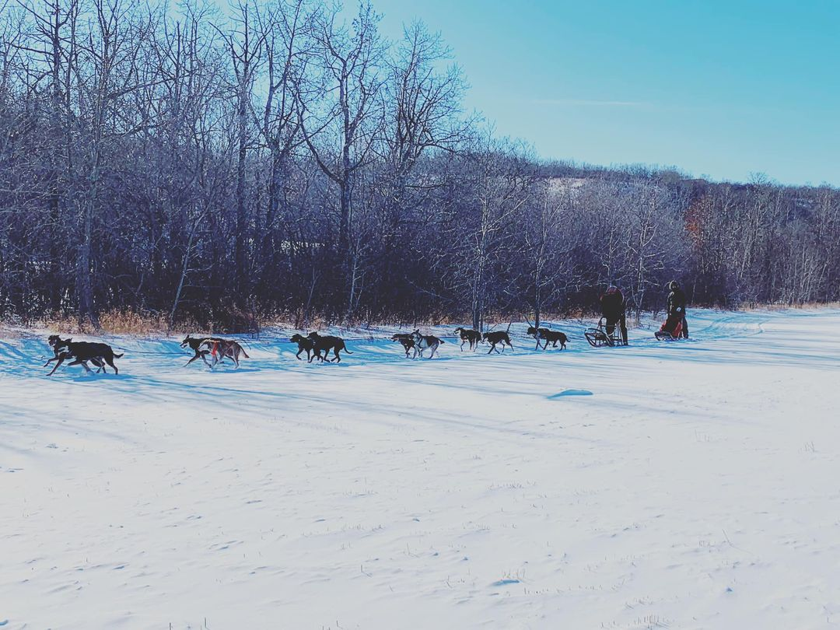
Dog Sled Tours
UPIP funding
Tours throughout the region
All ages
Winter months Jan, Feb
Eagle Ridge Dogsled Tours
Notes:
UPIP funding
Eagle Ridge Dog Sled Tours

Slide 11
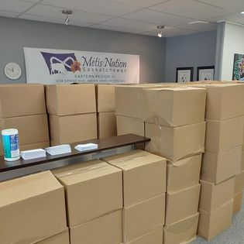
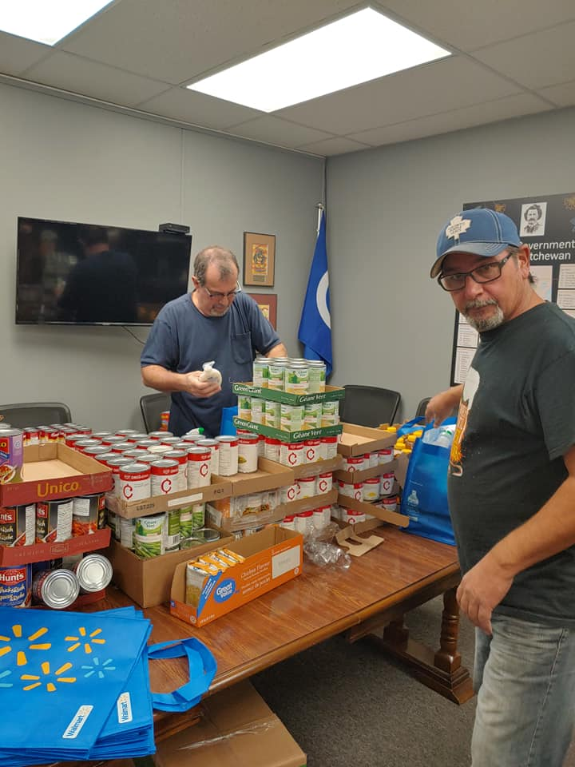
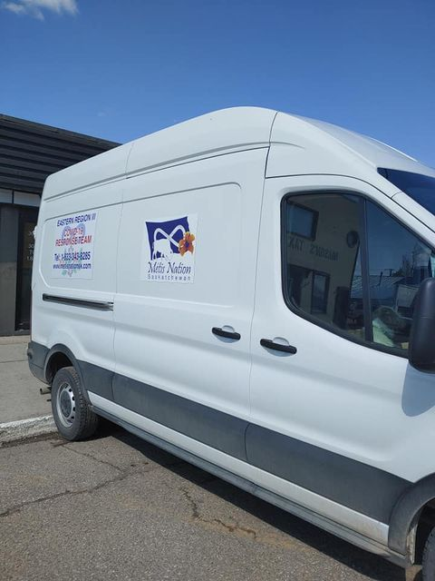
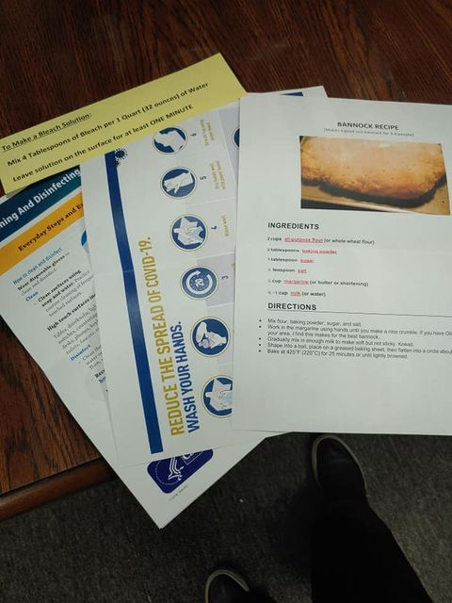
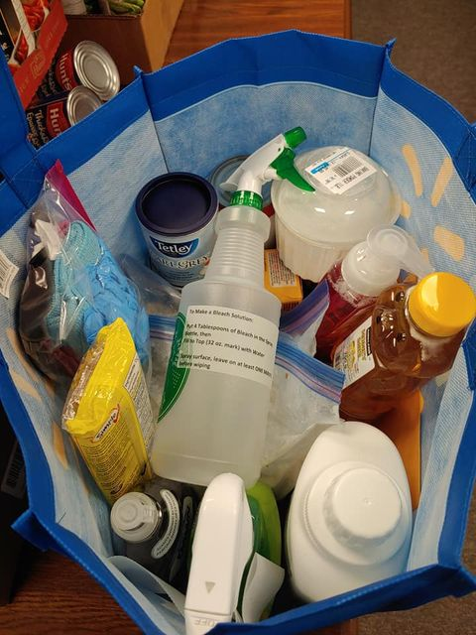
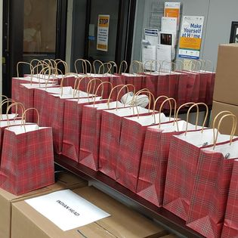
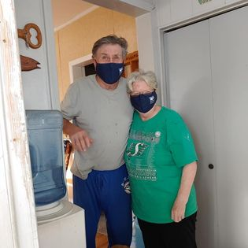
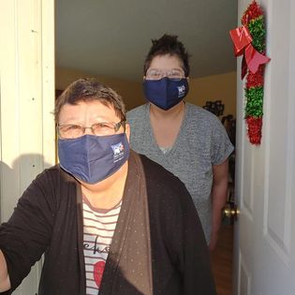
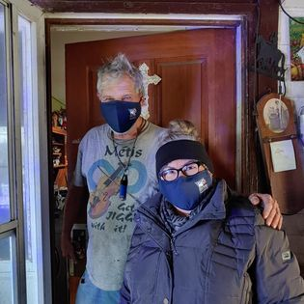
Eldercare Project
Notes:
COVID relief supports for Elders in ERIII
Citizesnhip in this region is over 50% Elders/seniors
About $70 of staples, a protein, seasonal fruit fresh or canned
PPE supplies, cleaning supplies and personal care items
Activity kits
Information on COVID, newsletters recipes etc.
Still going sustainable

Slide 12
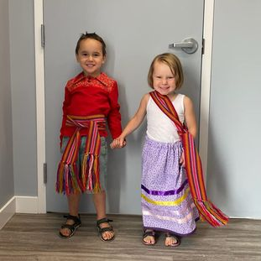
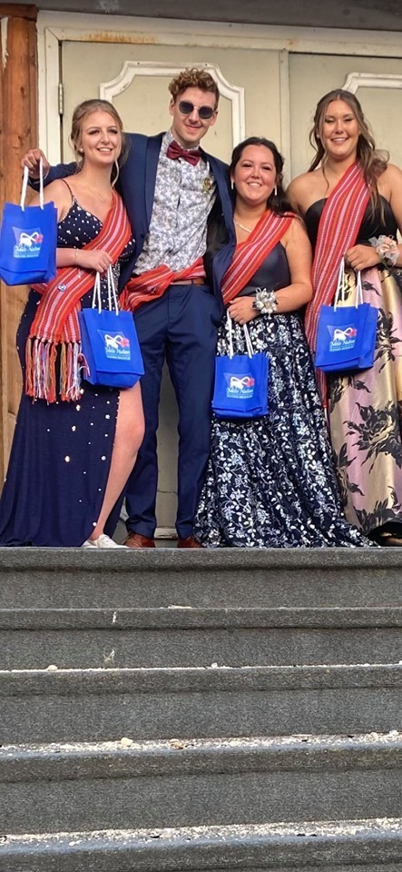
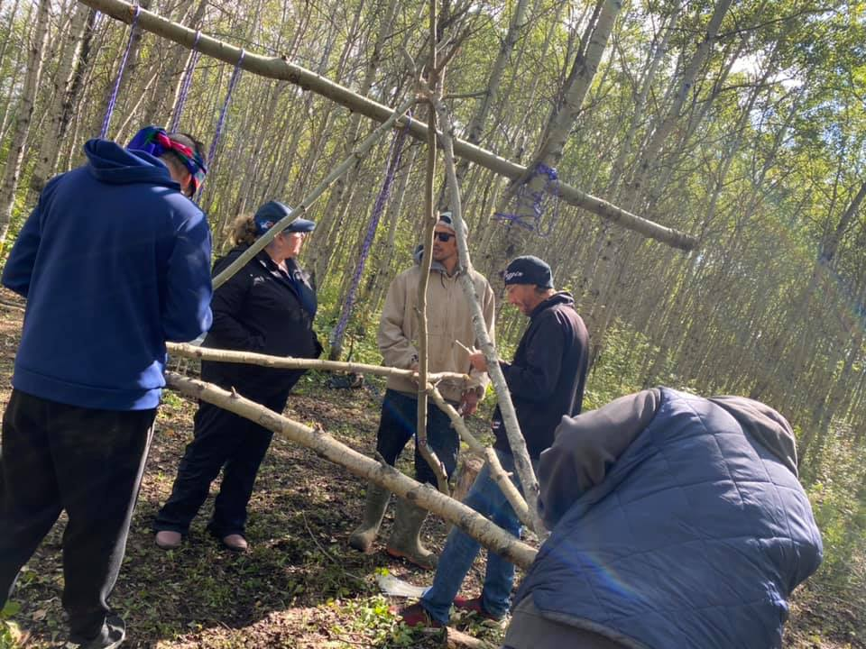
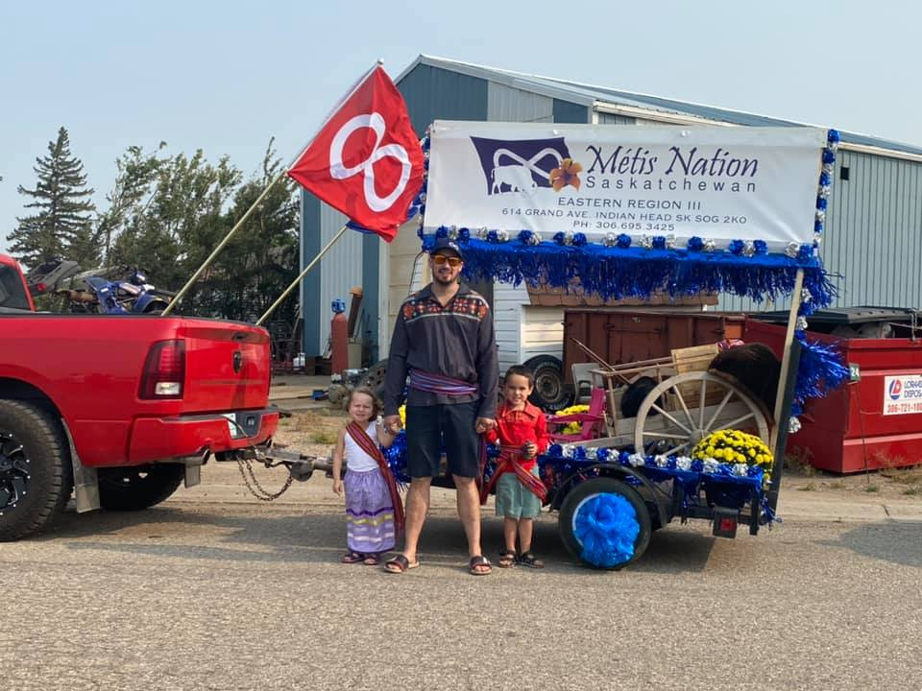
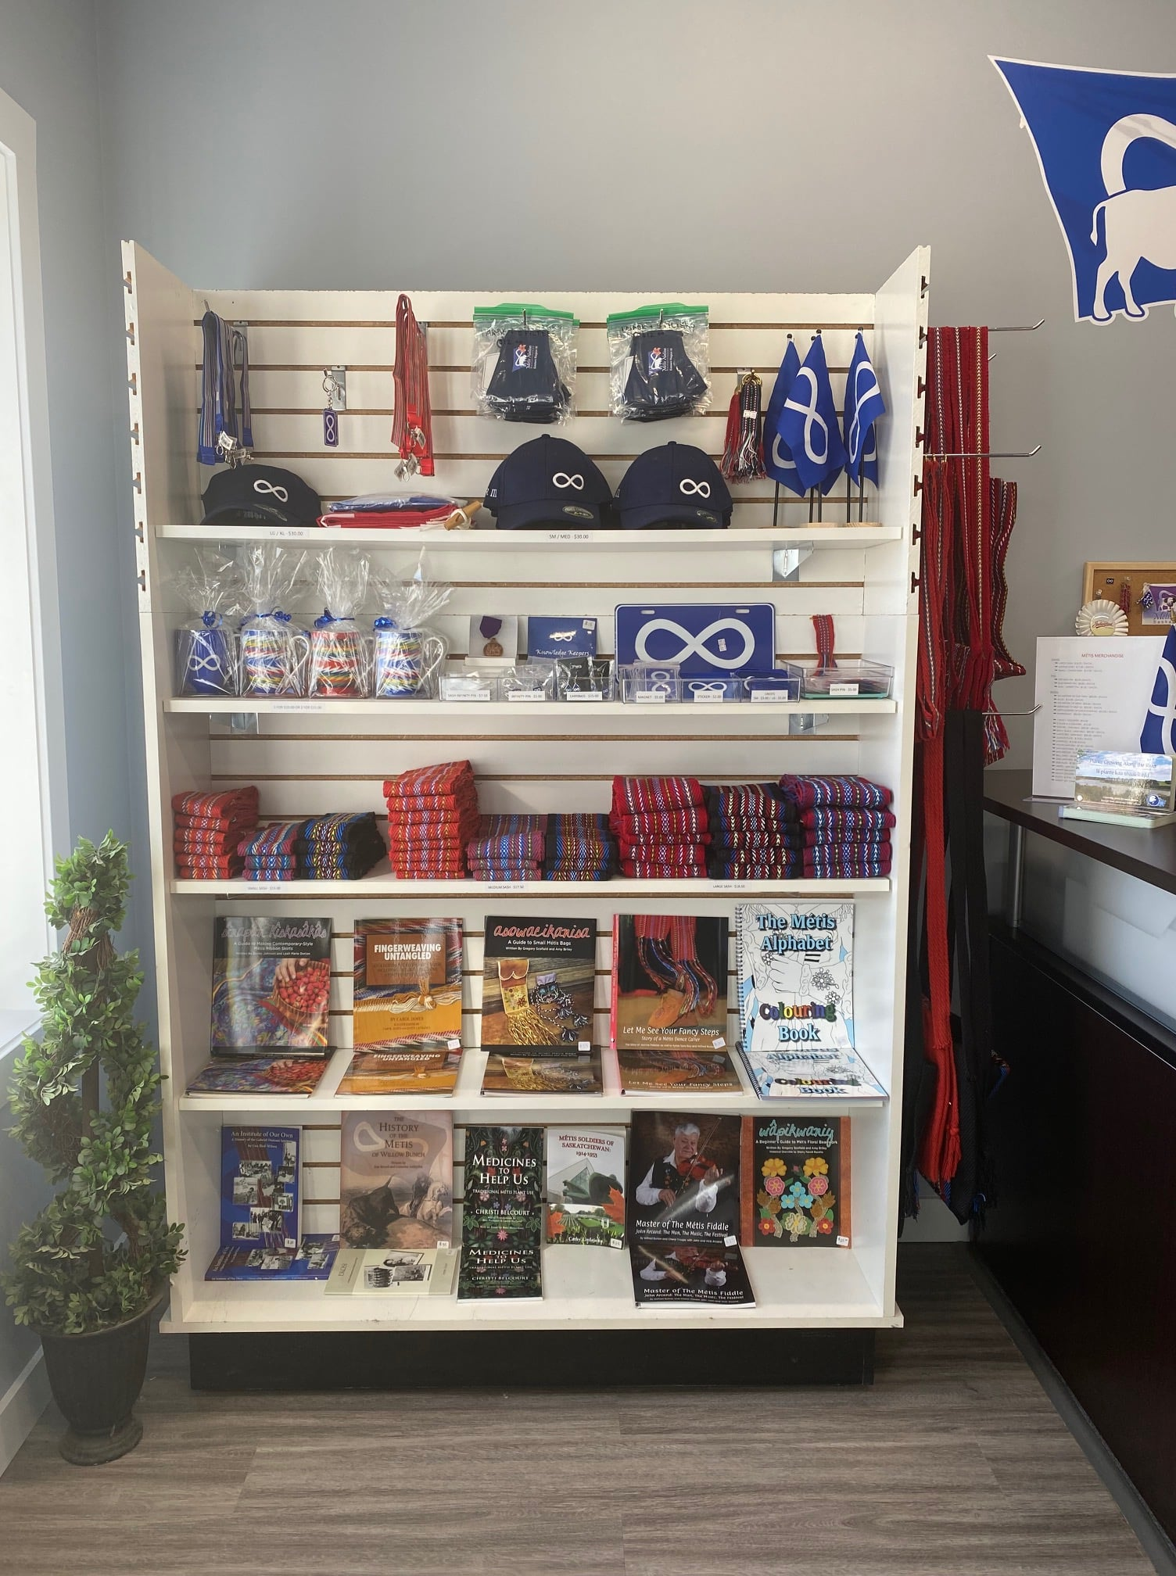
Other Events
Notes:
Indian Head Days

Slide 13
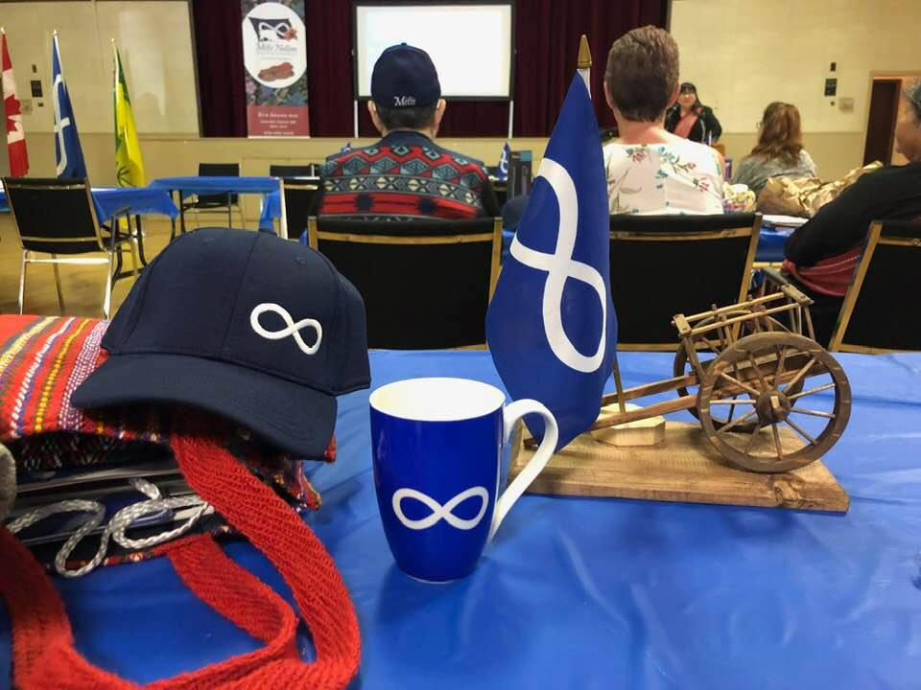

Slide 14
Annual Income Statement
Annual Expenses
Income & Expense Graph
Motion to approve
2021 Financial
Report

Slide 15
Maarsii Thank you!
EASTERN REGION III
BOX 1581
401-8 JOHNSTON AVE.
INDIAN HEAD SK S0G 0K0
TEL: 306.695.3425
wwwmnseasternregion3.com

Slide 16
EASTERN REGION III
401-8 JOHNSTON AVE
401-8

