Slide 1
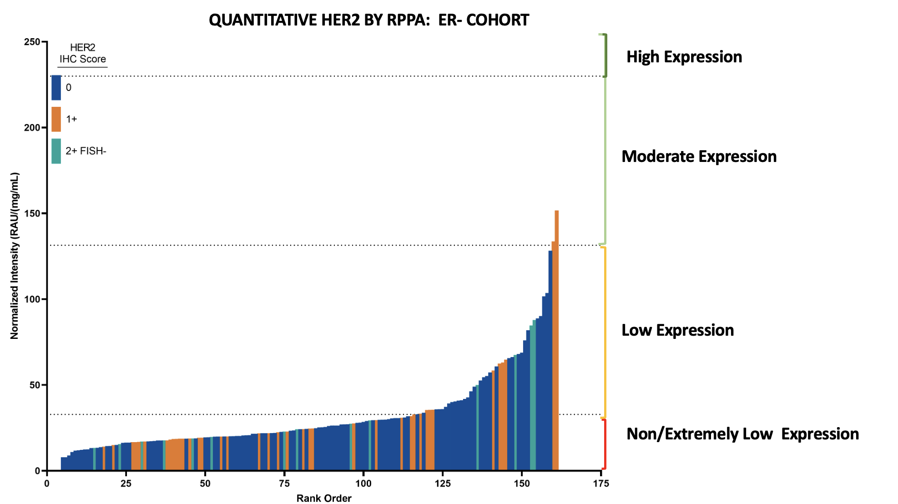
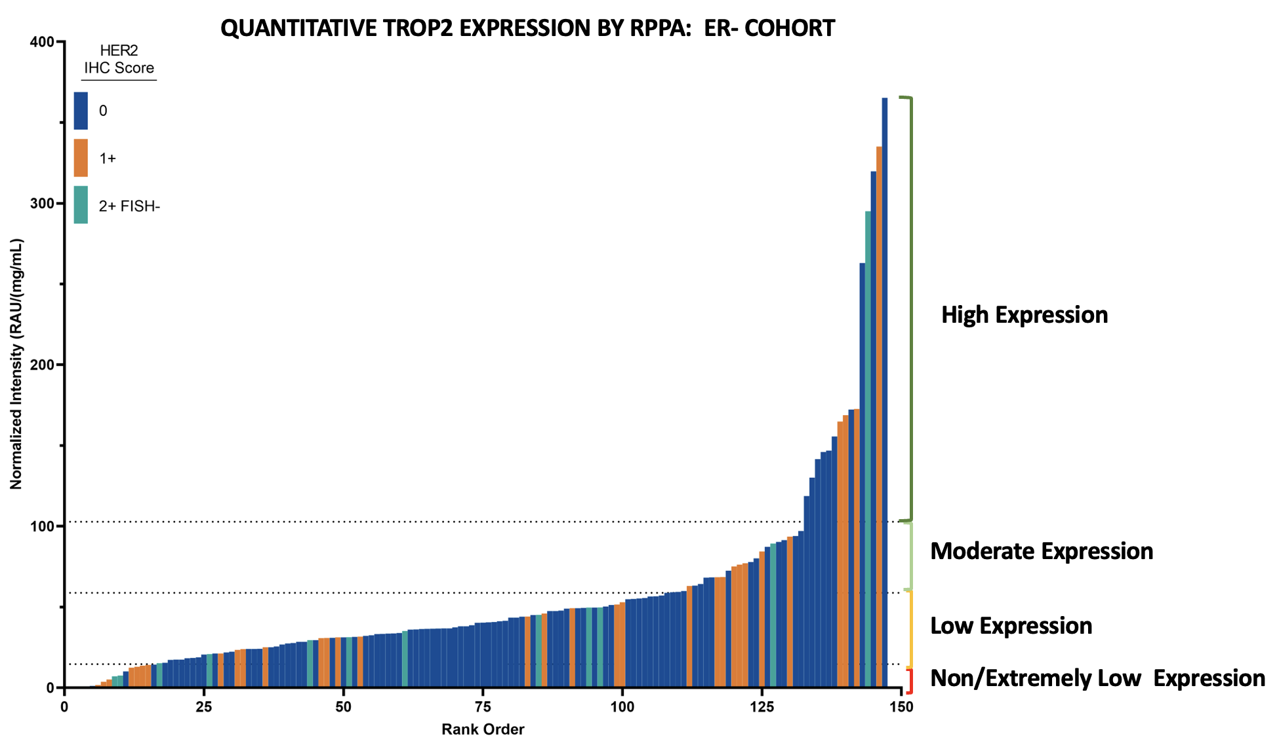
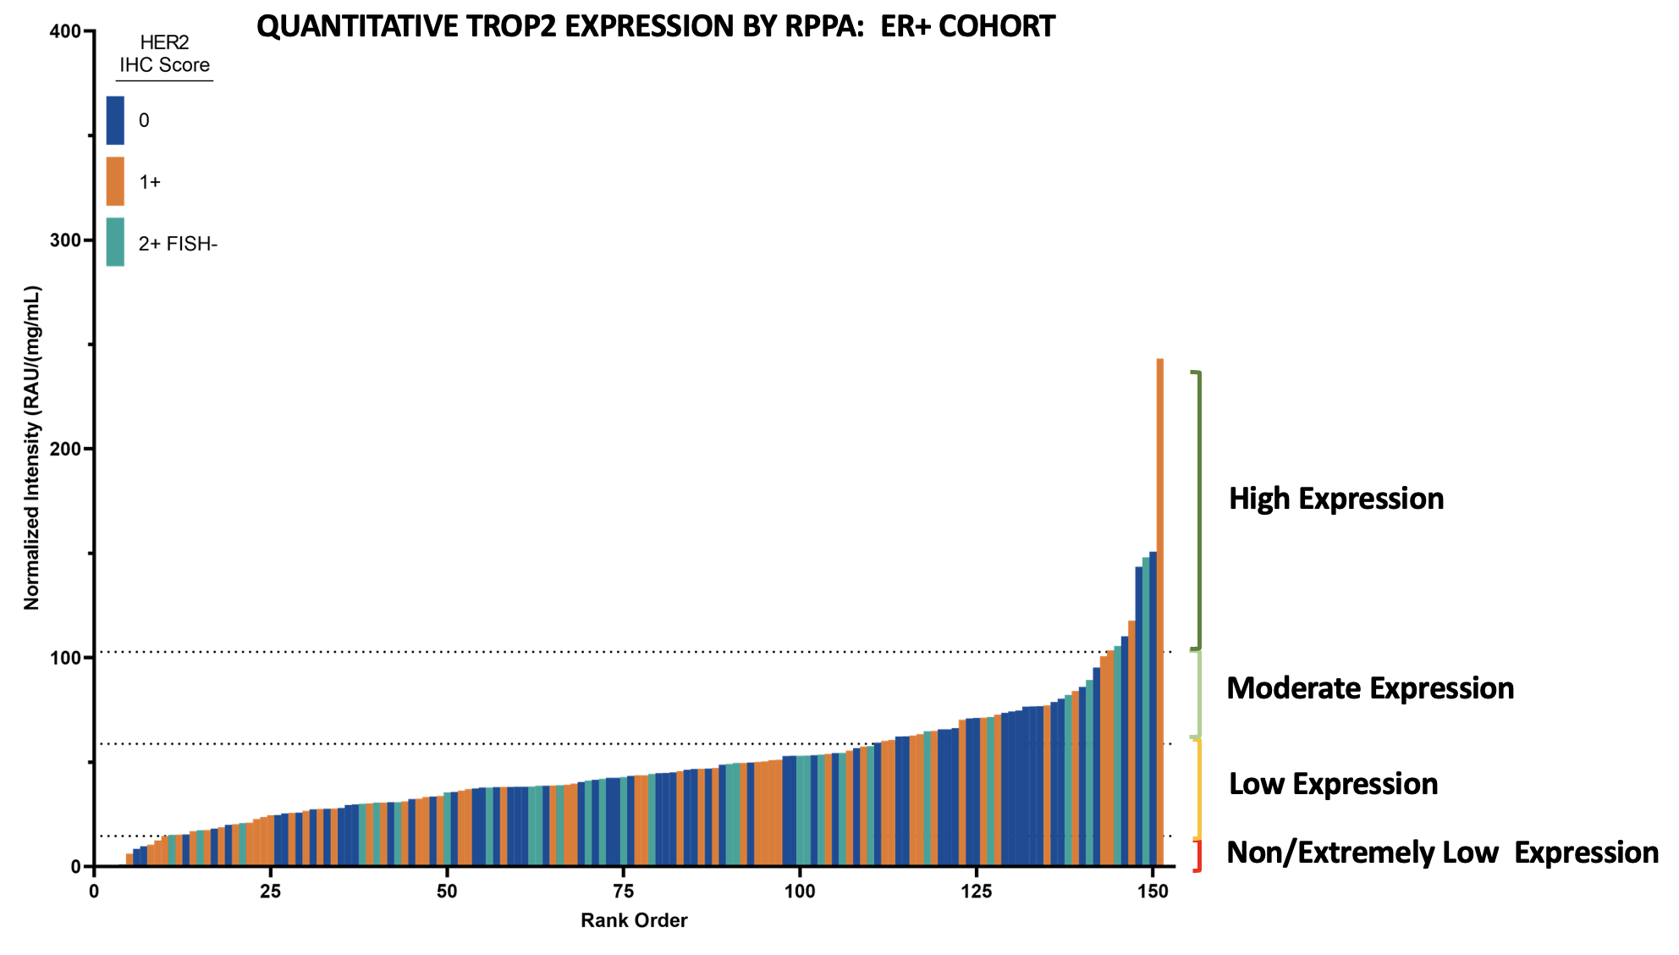
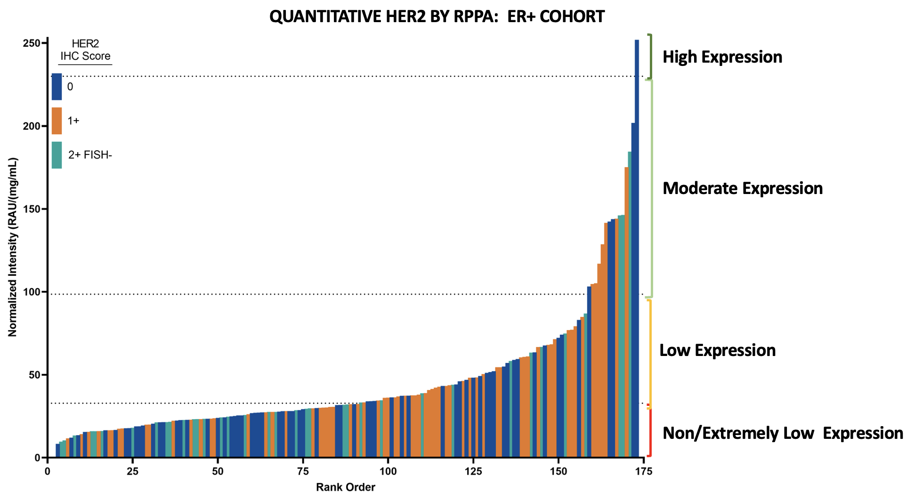
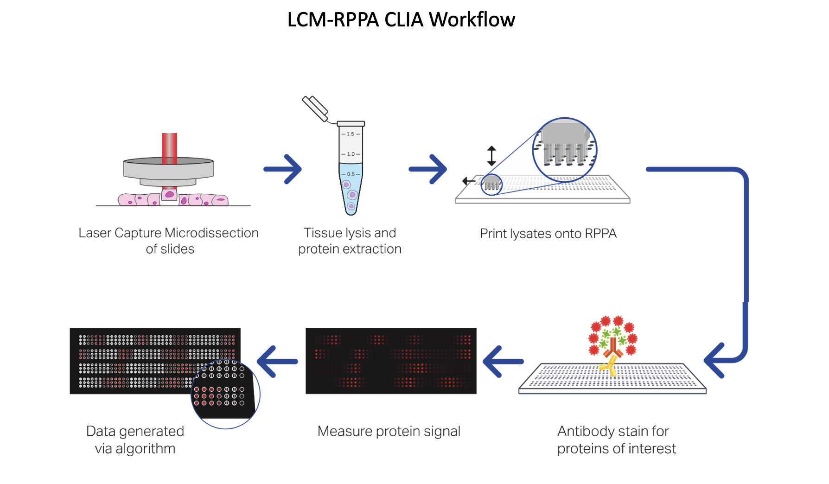
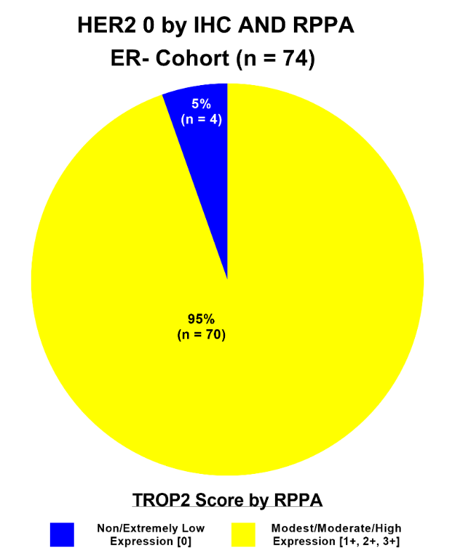
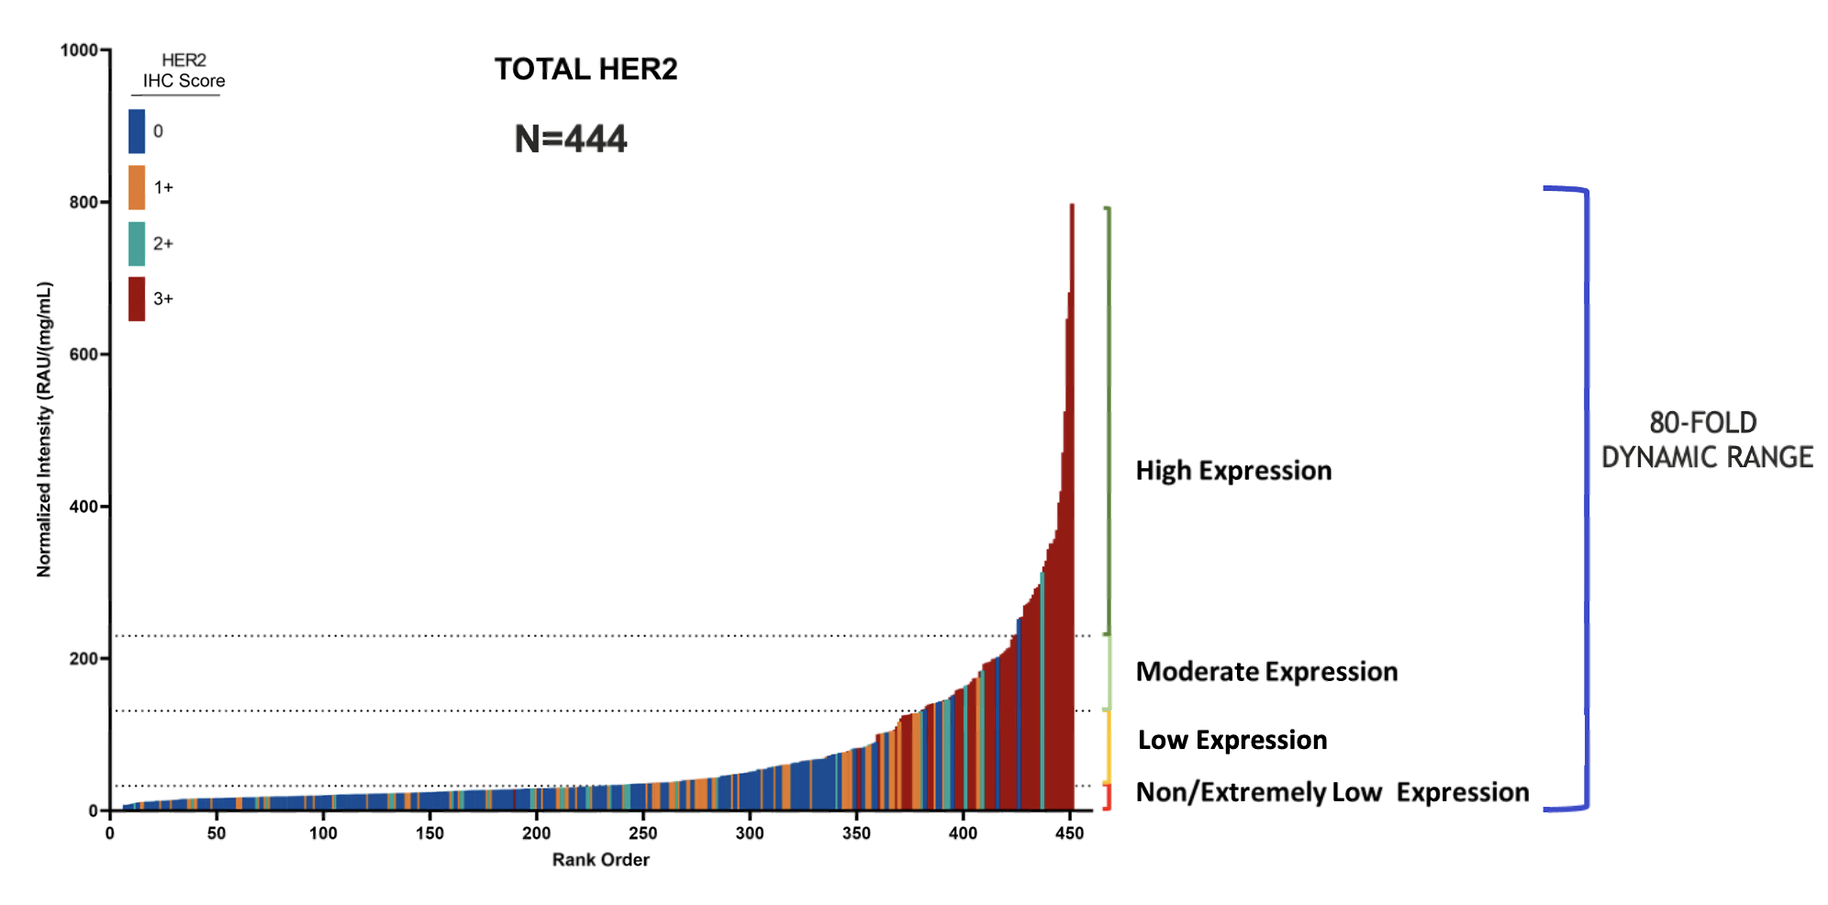
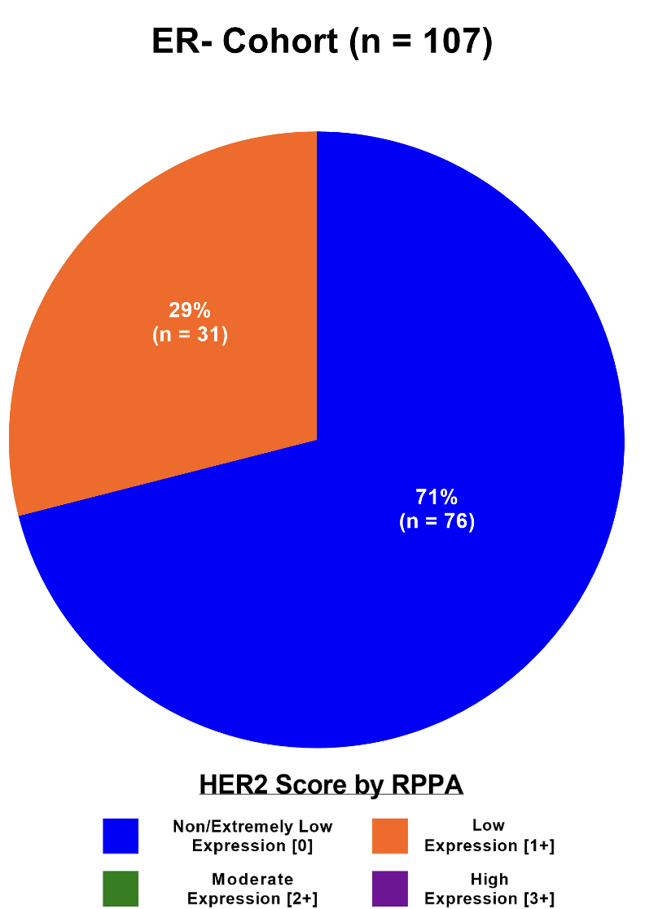
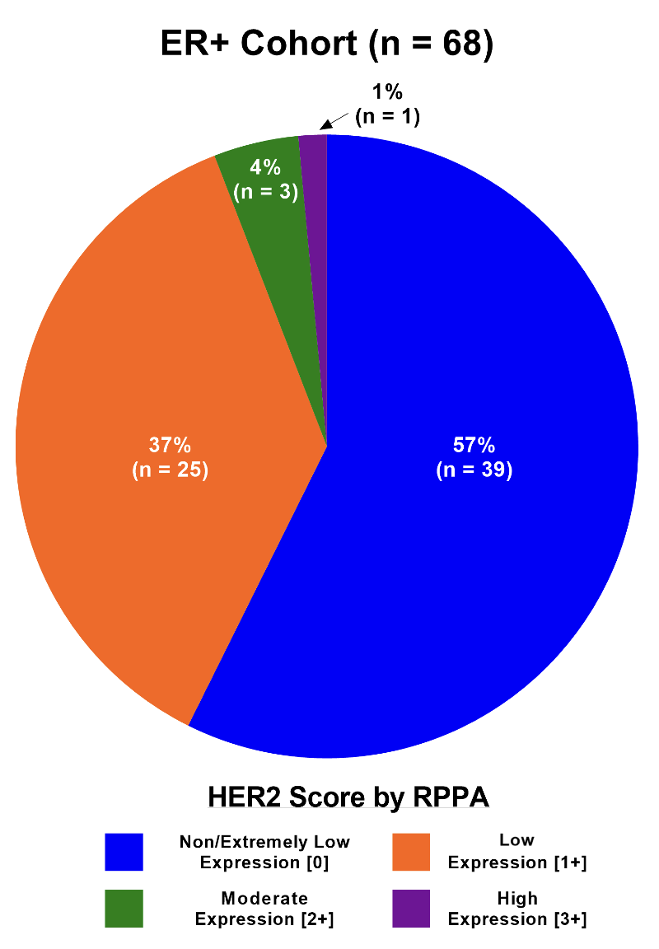
Novel Quantitative HER2 Assay for Determining Dynamic HER2 Expression in the HER2 IHC 0 “Ultra-Low” Setting:
Implications for Precision Therapy in HER2- Breast Cancer
Brian Corgiat¹, Joyce O’Shaughnessy,² Patricia LoRusso³, Kris Weinberg¹, Justin Davis¹, Chelsea Gawryletz³, Emanuel F Petricoin III⁴
¹Theralink Technologies, Inc.; ² Baylor University Medical Center, Texas Oncology, US Oncology, Dallas, TX, ³Yale Cancer Center, ⁴ UCHealth- Cancer Care and Hematology, ⁵ George Mason University
Poster ID: HER2 -17
Contact: Emanuel Petricoin
epetrico@gmu.edu
BACKGROUND
QUANTITATIVE HER2 EXPRESSION DYNAMICS IN THE
HER2 IHC LOW (IHC 0, 1+ AND 2+FISH-) SETTING
QUANTITATIVE TROP2 EXPRESSION DYNAMICS IN THE
HER2 IHC LOW (IHC 0, 1+ AND 2+FISH-) SETTING
Background: The HER2 antibody drug conjugate (ADC) fam-trastuzumab deruxtecan-nxki (T-DXd) significantly improves outcomes over standard chemotherapy in pts with HER2-LOW (IHC 1+ and IHC 2+ FISH-) metastatic breast cancer (MBC). Data from the DAISY (NCT04132960) trial in pts with HER2 IHC 0 or “ultra low” MBC revealed median progression-free survival (PFS) of 4.2 mos vs 6.7 mos in HER2-LOW and 11.1 mos in HER2 3+ pts (Diéras V, et al. Cancer Res. 2022;82(4_Suppl):PD8-02). There is an urgent need to develop methods to accurately discern HER2 LOW expression versus HER2 IHC 0/ultra-low expression so appropriate pts may receive T-DXd. We have developed a quantitative HER2 assay using reverse phase protein array (RPPA) technology with laser capture microdissection (LCM) enrichment of tumor epithelium that measures HER2 expression over a 65-fold dynamic range in HER2 IHC 0 to 3+ breast cancers. In I-SPY 1 and 2 trials we found that RPPA-assessed quantitative HER2 and activated/phosphorylated HER2 expression predicted for pathologic complete response in pts with HER2 IHC 0, HER2-LOW and HER2 3+ disease with various HER2 and other targeted agents. We then developed and validated the first CLIA/CAP-accredited quantitative HER2 protein expression and activation assay, and now explore quantitative HER2 expression in HER2 IHC 0/ultra low disease. Given the recent approval of sacituzumab govitecan-hziy in TNBC and the results of the TROPiCS-02 (NCT03901339), we also evaluated quantitative RPPA-based TROP-2 expression levels in HER2 IHC 0 breast cancer.
35-FOLD DYNAMIC RANGE
Methods
13-FOLD DYNAMIC RANGE
LCM-enriched tumor epithelium was obtained from freshly cut FFPE core needle and resected breast cancer samples from 451 pts with stage I-IV disease and central pathology determined HER2 IHC, ER IHC, and HER2 FISH status annotated to each case. Of these, 175 individual patient samples had central IHC HER2 IHC 0 status (N=68 ER+ and N=107 ER-). Quantitative HER2 output is generated as a relative intensity unit (RU) that is interpolated to an internal calibrator curve against the population referent comprised of known HER2+ (IHC 3+ and 2+/FISH+), HER2-LOW and HER2 IHC 0/ultra-low tumors to generate population-based cut-points as a referent. RPPA-based quantitative HER2 expression are reported as one of four levels of expression across the HER2 dynamic range observed: “non/extremely low”, “modest“, “moderate” , and “high”. Quantitative TROP2 protein expression levels were also measured for each case by the RPPA assay on the same lysate using the same adjectival determinants of relative expression as HER2.
13-FOLD DYNAMIC RANGE
STUDY SET CHARACTERISTICS
25-FOLD DYNAMIC RANGE
Results:
For the HER2 IHC 1+/2+FISH- (LOW) and IHC 0 (ULTRA-LOW) ER- cohort, we observed RPPA-based quantitative TROP-2 protein expression over a 35-fold dynamic range with HER2 IHC 0, 1+ and 2+FISH- tumor samples heterogeneously comingling in each of the RPPA expression categories.
For the HER2 IHC 1+/2+FISH- (LOW) and IHC 0 (ULTRA-LOW) ER+ cohort, we observed RPPA-based quantitative HER2 protein expression over a 13-fold dynamic range with HER2 IHC 0, 1+ and 2+FISH- tumor samples heterogeneously comingling in each of the RPPA expression categories.
RPPA-based quantitative TROP-2 protein expression was higher in the TNBC cohort compared to the HER2-/ER+ cohort in keeping with previous findings¹
Results:
For the HER2 IHC 1+/2+FISH- (LOW) and IHC 0 (ULTRA-LOW) ER- cohort, we observed RPPA-based quantitative HER2 protein expression over a 13-fold dynamic range with IHC 0, 1+ and 2+FISH- tumor samples heterogeneously comingling in each of the RPPA expression categories including the RPPA-assigned moderate expression ranges.
For the HER2 IHC 1+/2+FISH- (LOW) and IHC 0 (ULTRA-LOW) ER+ cohort, we observed RPPA-based quantitative HER2 protein expression over a 25-fold dynamic range with IHC 0, 1+ and 2+FISH- tumor samples heterogeneously comingling in each of the RPPA expression categories including the RPPA-assigned moderate and high expression ranges.
QUANTITATIVE TROP2 EXPRESSION FREQUENCIES IN THE HER2 ULTRA-LOW
AND HER2 NON/extremely low by quantitative rppa her2 assay
CONCORDANCE BETWEEN HER2 CENTRAL IHC/FISH AND RPPA QUANTITATIVE HER2 IN ROUTINELY COLLECTED FFPE SAMPLES
QUANTITATIVE HER2 EXPRESSION FREQUENCIES IN THE
HER2 ULTRA-LOW (IHC O) SETTING
Results:
TROP-2 protein expression was found to be at least modestly expressed in 95% (37/39) of ER+ and 95% (72/76) pf ER- HER2 IHC 0/ultra-low tumors, and which were also measured as HER2 non/extremely low by RPPA.
Conclusions
We have developed a CLIA RPPA based assay for quantitative assessment of HER2 expression that can utilize routinely collected and preserved FFPE tissue samples
IHC based determinations of HER2 0 expression were not analytically accurate. Nearly 40% of ER+ IHC 0/”ultra-low” and 30% of ER- IHC 0 “ultra-low” breast cancers actually expressed modest to moderate amounts of HER2, which approximates the response rate of 30% seen with T-DXd in HER2 IHC 0 pts in the DAISY trial (NCT04132960).
For the 60% and 70% IHC 0/ultra-low (ER+ and ER- respectively) that were verified to be truly HER2 non-expressing/very low by quantitative RPPA HER2 assay, TROP2 is at least modestly expressed in a large (~95%) majority regardless of ER status, making a TROP2-directed ADC an attractive therapeutic option for these pts.
If validated in larger studies, this quantitative HER2 expression assay could provide a better means of identifying which patients with HER2 IHC “ultra-low” disease would respond to T-DXd, may better define true ultra-low HER2 expression in HER2 IHC 0 tumor biopsies at baseline and refine the lower limit of the HER2-LOW designation
¹Vranic S, Gatalica Z. Trop-2 protein as a therapeutic target: A focused review on Trop-2-based antibody-drug conjugates and their predictive biomarkers. Bosn J Basic Med Sci. 2022 Feb 1;22(1):14-21.
RESULTS:
LCM-RPPA-based quantitative HER2 measurements have excellent concordance with central IHC with ~92% of IHC 3+ tumor samples found within the RPPA defined high expression and moderate expression categories.
LCM-RPPA-based quantitative HER2 measurements span an 80-fold dynamic range across the IHC 0-3+ expression categories
RESULTS:
For the HER2 IHC 0 ER- cohort 71% (N=76) had non/extremely low, and 31% (N=29%) low HER2 expression by the quantitative RPPA assay.
For the ER+ IHC 0/ULTRA LOW cohort 57% (N=39) had HER2 non/extremely low, 37% (N=25) low, and 4 (6%) moderate/high HER2 expression by the quantitative RPPA assay.

