Slide 1
ABOMINATION

Slide 2
About Definitions
All words in the Bible have a lexical definition
Meaning based on etymology and morphology
All words have a contextual meaning
Meaning based on context and usage
Many words have semantical variants
Words that look and are spelled the same but are different words
All words have semantical domains
Words that have similar meanings and may be interchangeable
To get an accurate definition of an ancient word one must study the lexical, contextual and semantical examples of the word

Slide 3
The Importance of Context
I have a heart beat.
The officer is on his beat.
Man, I am beat!
They beat him within an inch of his life.
LSU beat Alabama! No, wait, I was dreaming!

Slide 4
Abomination
Dictionary.com 1.anything abominable; anything greatly disliked or abhorred.
2.intense aversion or loathing; detestation: He regarded lying with abomination.
3.a vile, shameful, or detestable action, condition, habit, etc.: Spitting in public is an abomination.

Slide 5
The word “abomination” is not necessarily a religious word. It is a word used to describe something, or someone that is detestable or abhorrent.

Slide 6
When used in the Scriptures
“abomination” almost, but
not, always defines some
form of idolatry which in turn
draws the judgement of God

Slide 7
“The primary connotation is
anything that is abhorrent
to a holy God.”
Morris A. Weigelt, M. A. (1988). Abomination of Desolation. In Baker encyclopedia
of the Bible (Vol. 1, pp. 10–11). Grand Rapids, MI: Baker Book House.

Slide 8
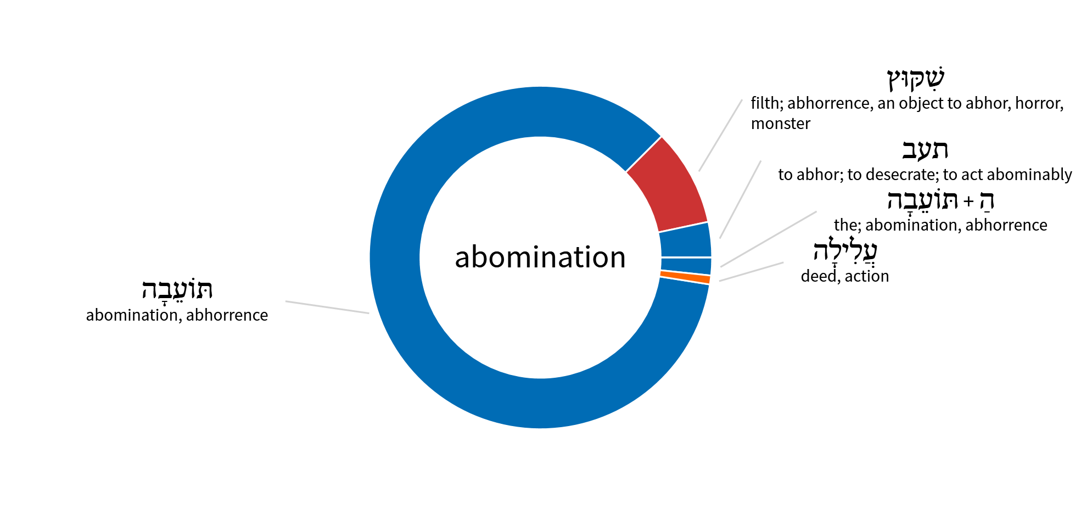
Abomination: O.T.

Slide 9
Old Testament Occurrences
To-e-ba-h
Exodus; 8:26 (2x), Leviticus 18:22, 27, 27, 29, 30, Deuteronomy 7:25, 12:31, 13:14, 22:5, 23:18, 24:4, 25:16, 27:15, 32:16, I Kings 14:24, II Kings 16:3, 21:2, 23:13, II Chronicles 28:3, 33:2, 34:33, 36:8, 36:14, 9:1, 9:11, Proverbs 3:32, 6:16, 8:7, 11:1, 20, 12:22, 13:19, 15:8, 9, 16, 16:5, 12, 17:15, 20:10, 23, 21:27, 24:9, 26:25, 28:9, 29:27, Isaiah 1:13, 41:24, 44:19, Jeremiah 2:7, 6:15, 7:10, 8:12, 16:18, 32:35, 44:22, Ezekiel 5:9, 11, 6:9, 11, 7:3, 4, 8, 9, 20, 8:6 (2x), 9, 13, 15, 17, 9:4, 11:18, 12:16, 14:6, 16:2, 22, 43, 47, 50, 51 (2x), 58, 18:12, 13, 24, 20:4, 22:2, 11, 23:36, 33:26, 29, 36:31, 43:8, 44:6, 7,

Slide 10
Old Testament Occurrences
Ta-ab
I Kings 21:26, Psalm 53:1, Exekiel 16:25, 52
Ha to-e-bah
Ezra 9:14, Jeremiah 44:4
Siq-quts
Deuteronomy 29:17, II Kings 23:13 (2x), 24, II Chronicles 15:8, Isaiah 66:3, Jeremiah 13:27, Exekiel 11:21, Daniel 9:27, 11:31, 12:11
Ali-lah
Psalm 14:1

Slide 11
Hebrew definitions
Ta-ab, Ha-to-e-bah, To-e-bah: by far the most common. NIV renders toʿebah as “detestable” in the vast majority of cases. Toʿebah expresses that which is repulsive, detestable, or offensive. Examples include sexual perversion (Lev. 18:22–26), pride (Prov. 16:5), hypocritical worship (Isa. 1:13), and especially idolatry (e.g., Deut. 7:25–26; 1 Kgs. 14:24; Ezek. 7:20).
Siq-quts: is the second most common Hebrew term for “abomination.” All instances of shiqquts in the OT are associated with idolatry, and usually the term describes the idols themselves. In the O.T., the word does not describe something vile in the eyes of Israelites or other people—but primarily of something vile and abominable in the eyes of God
Ali-lah: Deed or action. Mock, make sport of, deal ruthlessly, malevolent treatment. Exercise of power over another person, usually in a bad sense.

Slide 12
Adding Them All Together
Abomination in the O.T.: A detestable, repulsive and offensive action which is the product of perversion, pride and/or hypocritical worship. Such action leads a person to idolize a “thing” above almighty God. Such action makes sport of God. It is malevolent, self-exalting and it is mockery. Such action and idolatry angers and offends God thereby resulting in his judgement over both the activity and the idolatry.
An act, or thing that repulses God and brings His judgement!

Slide 13
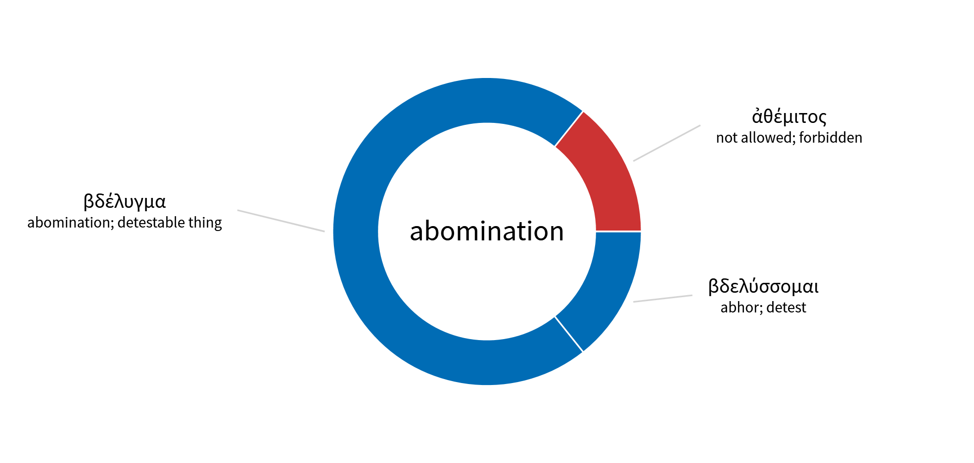
Abomination: N.T.

Slide 14
New Testament Occurrences
βδελυγμα: bdelugma
Matthew 24:15, Mark 13:14, Luke 16:15, Revelation 17:4, 5, 21:27
βδελυσσομαι: bdelussomai
Romans 2:22, Revelation 21:8
αθεμιτος : athemitos
Acts 10:28, I Peter 4:3

Slide 15
Greek Definitions
The idea of abomination is much less frequently approached in the N.T.
Bdelussomai: To strongly detest something on the basis that it is abominable. To abhor. In the secular world this word group denotes an improper attitude. In the N.T. and LXX, the emphasis is not the abhorrent nature of things, but the attitude and judgement of God in relation to things which He hates.
Athemitos: Not allowed, forbidden. Being bad, disgusting. Contrary to statute, illegal, criminal, always with the idea of a higher will.

Slide 16
Adding Them All Together
Abomination in the N.T.: To strongly detest something on the basis that it is abominable. To abhor. Contrary to statute, illegal, criminal from God’s perspective. Attitudes and activities that offend the senses of God and bring His judgement. For example, an idol is not abhorrent because of its appearance or construction. An idol is abhorrent because God hates it!
An act, or thing that repulses God and brings His judgement!

Slide 17
Observations Regarding “Abomination”
In the O.T. the word abomination is primarily associated with idol worship and activities surrounding idol worship
In the N.T. the word abomination is primarily associated with hypocritical godless behavior which God detests
In both the O.T. and the N.T the word abomination is associated with any behavior, activity or attitude that God hates.
What makes something abominable is God’s attitude toward it.

Slide 18
Abomination of Desolation

Slide 19
Abomination of Desolation in the Old Testament
The abomination of desolation is mentioned in Daniel 9:27; 11:31; 12:11.
The abomination of desolation is an idolatrous act, object, or person that makes the temple desolate of worshippers.
The “abomination” in Dan. 11:31. In 1 Maccabees it is recorded that the Syrian Antiochus Epiphanes invaded Palestine (167 bc) and erected a desolating sacrilege, probably a statue of Zeus, upon the altar of burnt offering in the temple (1 Mc 1:54). The humiliation of the Jews was climaxed by sacrificing swine on the altar, and by the death penalty for circumcision or for possessing the “Book of the Covenant.” (1 Macc. 1:47, 54, 59; 2 Macc. 6:4–5; Josephus Antiquities 12.5.4; cf. Dan. 8:13).
Daniel lived around 600 B.C. and Antiochus lived around 160 B.C. which was approximately 450 years after Daniel.
This act set the foundation for the Maccabean revolt

Slide 20
The Maccabean Revolt
In the narrative of I Maccabees, after Antiochus IV issued his decrees forbidding Jewish religious practice, a rural Jewish priest from Modiin, Mattathias the Hasmonean, sparked the revolt against the Seleucid Empire by refusing to worship the Greek gods.
Mattathias killed a Hellenistic Jew who stepped forward to offer a sacrifice to an idol in Mattathias' place. He and his five sons fled to the wilderness of Judah.
After Mattathias' death about one year later in 166 BC, his son Judah Maccabee led an army of Jewish dissidents to victory over the Seleucid dynasty in guerrilla warfare, which at first was directed against Hellenized Jews, of whom there were many.
The Maccabees destroyed pagan altars in the villages, circumcised boys and forced Hellenized Jews into outlawry. The term "Maccabees" used to describe the Jewish army is taken from the Hebrew word for "hammer".

Slide 21
Abomination of Desolation in the New Testament
“Abomination of desolation” appears twice in the NT (Matt. 24:15 and Mark 13:14).
In His Olivet Discourse, Jesus attributed the saying to the prophet Daniel and indicated that its fulfillment was yet future. Accepting Jesus’ testimony as authentic, all references to “the abomination of desolation” in Daniel were not fulfilled during the time of Antiochus IV.
Since Jesus spoke of the event in futuristic terms it is obvious that either the desecration of Antiochus was not the Abomination of Desolation, or there is a dual prophecy here.
Most scholars associate this NT “abomination of desolation” with (1) the destruction of the temple, (2) the eschatological antichrist, or (3) both.

Slide 22
Personal Opinion
Dual prophecy is not uncommon in the Bible, but tri-prophecy is unheard of
Therefore, it is highly unlikely that the Abomination of Desolation refers to Antiochus Epiphanes, the destruction of the Temple in 70 a.d. and the future anti-Christ.
To my knowledge there is very little debate regarding Antiochus Ephiphanes.
The question then remains, is the dual prophecy speaking of the destruction of the temple, or the future anti-Christ?
Let’s let the Scriptures decide.

Slide 23
Matthew 24:15-27
15 "Therefore when you see the ABOMINATION OF DESOLATION which was spoken of through Daniel the prophet, standing in the holy place (let the reader understand ), 16 then those who are in Judea must flee to the mountains… 21 "For then there will be a great tribulation, such as has not occurred since the beginning of the world until now, nor ever will. 22 "Unless those days had been cut short, no life would have been saved; but for the sake of the elect those days will be cut short… 24 "For false Christs and false prophets will arise and will show great signs and wonders, so as to mislead, if possible, even the elect. 25 "Behold, I have told you in advance. 26 "So if they say to you, 'Behold, He is in the wilderness,' do not go out, or, 'Behold, He is in the inner rooms,' do not believe them. 27 "For just as the lightning comes from the east and flashes even to the west, so will the coming of the Son of Man be.

Slide 24
Mark 13:24-27
24 "But in those days, after that tribulation, THE SUN WILL BE DARKENED AND THE MOON WILL NOT GIVE ITS LIGHT, 25 AND THE STARS WILL BE FALLING from heaven, and the powers that are in the heavens will be shaken. 26 "Then they will see THE SON OF MAN COMING IN CLOUDS with great power and glory. 27 "And then He will send forth the angels, and will gather together His elect from the four winds, from the farthest end of the earth to the farthest end of heaven… 30 "Truly I say to you, this generation will not pass away until all these things take place.

Slide 25
According to the Scriptures
After the Abomination of Desolation takes place several things will occur:
A great tribulation such as the world has never seen (Mt 24:21)
Shortened days (Mt 24:22)
False Christs performing great signs and wonders (Mt 24:24)
Sun and moon darkend and stars (probably meteors) falling (Mk 13:24)
The very heavens shaken (Mk 13:24)
The Son of Man coming in the clouds with power and glory (Mk 13:26)
The gathering of the elect (Mk 13:27)
Mk 13:30 "Truly I say to you, this generation will not pass away until all these things take place.

Slide 26
Did any of these things occur after the destruction of the Temple in 70 a.d.?

Slide 27
The answer is no!

Slide 28
So, the fulfillment of the Abomination of Desolation has not yet occured

