Slide 1
Silence and Solitude

Slide 2
What exactly is the discipline of solitude?
Silence: The voluntary and temporary abstention from speaking so certain spiritual goals may be sought.
Solitude: The voluntary and temporary withdrawal to privacy for spiritual purposes.
Whitney, Donald. Spiritual Disciplines for the Christian Life. (NavPress, 2014) 225.

Slide 3
An important note:
If you seek silence and solitude for any other reason then you are merely being alone and quiet.
For silence and solitude to be a discipline that brings spiritual growth and sensitivity there must be a spiritual purpose for it!

Slide 4
To be honest, many of us would have to conclude that we are addicted to noise.
We use noise to relax
We use noise to distract
We use noise to sleep!

Slide 5
Why are so many people afraid of being alone and quiet?
When we are alone and quiet we are left with our thoughts.
When we are alone and quiet we naturally start to contemplate over past experiences
When we are alone and quiet we start to think about the future before us.
When we are alone and quiet our minds start to play back past memories and we start to wonder “what if…”
When we are alone and quiet we are often forced to face the person in the mirror.
When we are alone and quiet we are often forced to face the God of the Scriptures.

Slide 6
Noise and distractions are wonderful. They can inoculate us from reality!

Slide 7
Thoughts on silence and solitude:
They serve as important components to fellowship with our God.
Like fasting, they are not commanded, but Jesus did them.
In our culture which uses noise and crowds for both distraction and comfort you may discover that silence and solitude are quite difficult to endure.
Whitney, Donald. Spiritual Disciplines for the Christian Life. (NavPress, 2014) 225.

Slide 8
Biblical Examples for Solitude
Matthew 4:1: “Then Jesus was led by the Spirit into the wilderness to be tempted by the devil.”
Matthew 14:23: “After he had dismissed the crowds, he went up on the mountain by himself to pray. When evening came, he was there alone.”
Mark 1:35: “Rising very early in the morning, while it was still dark, he departed and went out to a desolate place, and there he prayed.”
Luke 4:42: “When it was day, he departed and went into a desolate place. And the people sought him and came to him, and would have kept him from leaving them.
Whitney, Donald. Spiritual Disciplines for the Christian Life. (NavPress, 2014) 226-7.

Slide 9
To be more like Jesus we must discipline ourselves to find time for silence and solitude!
Whitney, Donald. Spiritual Disciplines for the Christian Life. (NavPress, 2014) 226-7.

Slide 10
Some reasons for silence and solitude
Minimize distractions for prayer and other Spiritual Disciplines.
For personal worship.
  “But the Lord is in His holy temple; let all the earth keep silence before Him.” Hab 2:20
  “Be silent before the Lord God.” Zeph 1:7
  “Be silent all flesh, before the Lord.” Zech 2:13
To find our strength in God.
  “For God alone my soul waits in silence; from him comes my salvation.” Psalm 62:5
  “Thus says the Lord God, the Holy One of Israel, ‘in returning and rest you shall be saved; in quietness and trust shall be your strength.’” Isaiah 30:15
For physical and spiritual restoration.
  “Come away by yourselves to a desolate place and rest a while.” Mark 6:31
Whitney, Donald. Spiritual Disciplines for the Christian Life. (NavPress, 2014) 227-38.

Slide 11
Some reasons for silence and solitude
To regain spiritual perspective.
  Sometimes we just need to get away where we can prayerfully seek God’s will without any distractions.
To seek God’s will.
  “In these days he went out to the mountain to pray, and all night he continued in prayer to God. And when day came, he called his disciples and chose from them twelve, whom he named apostles.” Luke 6:12-13
Whitney, Donald. Spiritual Disciplines for the Christian Life. (NavPress, 2014) 227-38.

Slide 12
Suggestions for silence and solitude
Minute retreats
A goal of scheduled daily silence and solitude
Schedule time away for solitude and silence.
Special places.
Whitney, Donald. Spiritual Disciplines for the Christian Life. (NavPress, 2014) 238-43.

Slide 13
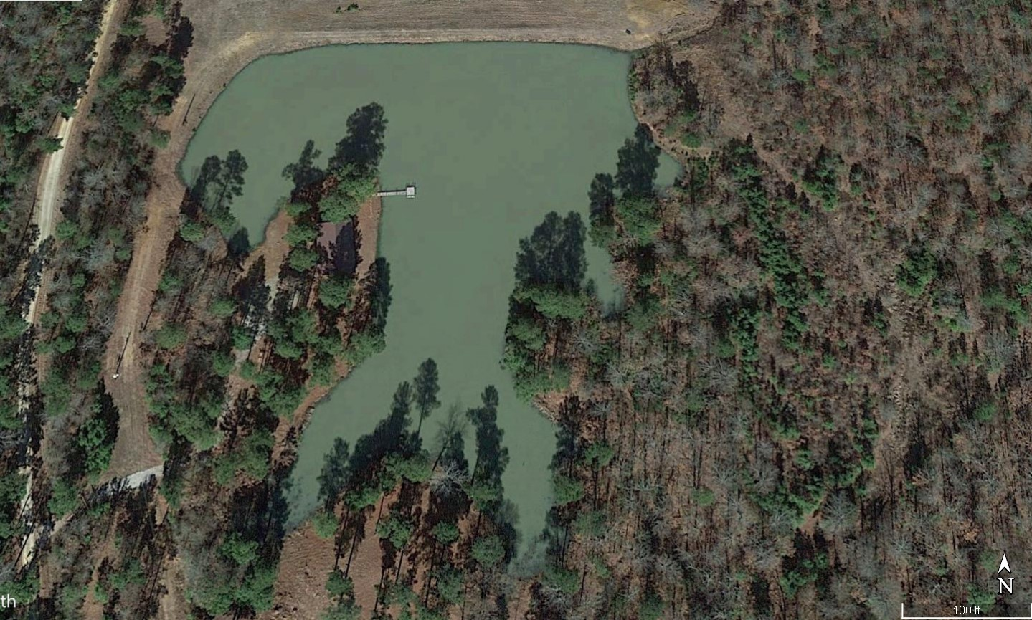
A special place

Slide 14
You will never find time for silence and solitude. You must make it!

