Slide 1
THE PEACE OF GOD

Slide 2
When you think of peace what image comes to your mind?

Slide 3
What is the world’s definition for peace?
1: A state of tranquility or quiet.
a: Freedom from civil disturbance.
b: A state of security or order within a community provided for by law.
2: Freedom from disquieting or oppressive thoughts or emotions.
3: Harmony in personal relations.
4: An agreement to end hostilities between those who have been at war.
5: Calm and quiet; freedom from worry or annoyance.

Slide 4
So, according to the world, peace is…

Slide 5
A state of tranquility or quiet. Freedom from oppressive thoughts or emotions. Harmony in personal relations. Calm and quiet. Freedom from worry or annoyance.

Slide 6
In other words. Peace is a life without any disturbances.

Slide 7
At times, this is exactly what the Bible is talking about when speaking of peace
The Hebrew word “shalom” means peace. Even today in the Jewish world “shalom” is used daily as a form of address. In America we say hello. In Israel they say shalom.
Jesus is called the Prince of Peace (Isaiah 9:6).
In Mark 5:34, Jesus tells a women He just healed to “go in peace.”
In Mark 9:50 Jesus tells his disciples, “Have salt among yourselves and keep peace with each other.”
In Romans 12:18 we are commanded, “If possible, so far as it depends on you, be at peace with all men.”
As Christians we are to be people of peace. However, this kind of peace is not the same thing as the spiritual fruit of peace.
We are commanded to be people of peace, however, we are also commanded to walk in the Spirit and by doing so, we are to embrace and live in the peace of God. This is a different kind of peace.

Slide 8
Peace as tranquility and the peace of God are not the same thing.

Slide 9
The peace of God
There is a peace that only comes from God.
“Peace I leave with you; My peace I give to you; not as the world gives do I give to you.” John 14:27
“These things I have spoken to you, so that in Me you have peace. In the world you have tribulation, but take courage; I have overcome the world.” John 16:33
“Let the peace of Christ rule in your hearts, to which indeed you were called in one body; and be thankful.” Colossians 3:15
“The peace of God, which surpasses all comprehension, will guard your hearts and your minds in Christ Jesus.” Philippians 4:7
So, we know the Bible tells us of a peace that comes from God. But, what is it and how do we acquire it?

Slide 10
Before looking into a working definition of the peace of God, an illustration involving two photographers can help to demonstrate how the peace of God operates in this life

Slide 11
Once upon a time two photographers were challenged to a competition. Their task was to provide a photograph that depicted their understanding of what peace looked like.

Slide 12
The first photographer provided a beautiful tranquil scene.
The setting was set early in the morning just as the sun had risen.
In the background was a majestic mountain powdered with snow facing the rising sun with strength and confidence.
Above was a beautiful blue sky with high soft clouds streaming overhead.
Just to the east and closer in was a solitary stand of straight and tall Spruce trees.
The mountain, sky and trees were set far in the background and a large clear lake loomed from the vantage point of the viewer all the way to the foot of the mountain.
The mountain, trees and sky reflected so perfectly on the water that one could turn the image upside down and not realize it.
The scene was absolutely still and quiet.
All who stopped to gazed at the image walked away with a feeling of calm, quiet serenity.

Slide 14
The second photographer offered a very different scene!
The photograph was of a torrential waterfall.
The cascading water crashed into the river below and sent plumes of mist in every direction.
The waterfall was engorged by a previous storm and the water was murky and silt-filled.
The stones that contained the river and fall were shear, dark, cold and grey.
The trees that surrounded the fall were leafless and battered.
The sky above was grey and ominous.
The scene was loud and violent.
All who stopped to view this image walked away feeling stress and anxiety
To all casual observers, it was the very opposite of peace.

Slide 16
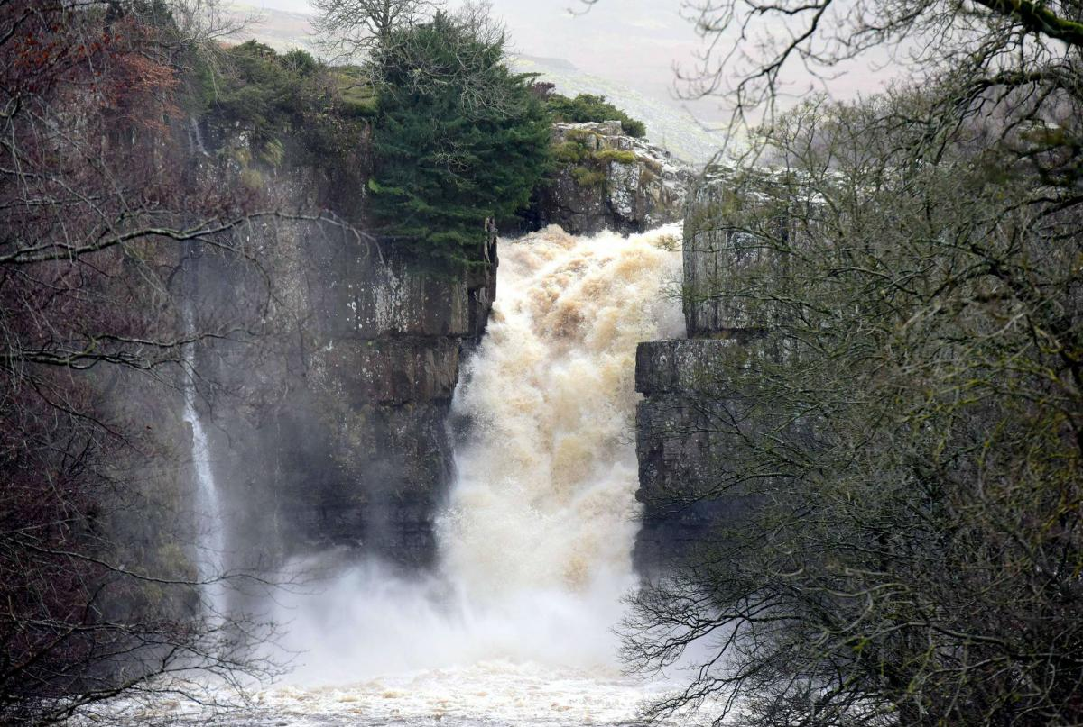
When put side by side, to the casual viewer, the winner was obvious!
However!!!
Calm serenity?
Once the images were examined more closely, people started changing their opinions.
Or violent cascade?

Slide 17
This first scene is peaceful. But there is no life! The landscape is tranquil, but it is also empty! This image betrays the reality that life is not serenity. The photograph is beautiful, but it offers a false hope!

Slide 18
This second scene is exhausting to look at but people can relate to it. Also, upon closer observation something very interesting is occurring in this image.

Slide 19
This second scene is torrential. However, in the
midst of all the turmoil there is a small bird in the top left corner of the image. Its head is raised and it is singing with joy as if to focus on life despite its surrounding difficulties. The bird cannot control its surroundings, but it can embrace life with all its hardships and still celebrate with jubilant song.

Slide 20
God’s Word never associates the peace of God with tranquility and personal safety. His Word insists that the life experiences that cause disruption and threaten personal safety are the very experiences through which the peace of God manifests itself

Slide 21
The peace of God is available to all His children regardless of circumstances
The peace of God is an inner serenity that God produces in you when you realize that He really is in control of all things.
It is an exuberance that swells within the depths of your heart as you realize that God is not only directing your life, but He is directing the lives of everyone–even your adversaries.
It is that steadfastness of spirit that emerges when you understand that God intends to use all the experiences in your life to reveal Himself, and strengthen you.
The peace of God is the ability to stare the torrents of life in the face and declare with faithful resolution that “I know whom I have believe in, and am persuaded that He is able, to keep that which I have committed unto Him until that day.”

Slide 22
A working definition of the peace of God
The basic feature of the peace of God is that the word does not describe our relationship between people, or our attitude.
It depicts a state of being.
Once again, we are not talking about peace with God. We are talking about the peace of God.
The peace of God is the inner serenity, the exuberance, the steadfastness of spirit, and the faithful resolution that comes from knowing that no matter what, our lives are in God’s hands and we can trust Him because He is trustworthy.
An inner serenity and steadfastness of spirit that comes from knowing we are in God’s hands and we can trust Him.

Slide 23
How can we acquire the peace of God?
First, remember that it comes from God.
You can conjure and fake the peace of God for a moment, but without the power of God, it will not last.
The peace of God is a fruit in which the Bible gives us a step by step process in order to acquire it.
The Bible tells us exactly what to do.
However, we must do exactly what the Bible says.
There are no shortcuts!
And, the process is laid out in a Bible passage that most believers can quote from heart!

Slide 24
Philippians 4:4-7
“Rejoice in the Lord always; again I will say, rejoice! 5 Let your gentle spirit be known to all men. The Lord is near. 6 Be anxious for nothing, but in everything by prayer and supplication with thanksgiving let your requests be made known to God. 7 And the peace of God, which surpasses all comprehension, will guard your hearts and your minds in Christ Jesus.”

Slide 25
A disclaimer on God’s peace
If you are stressed out, or if your heart is heavy and burdened, then you will not receive the peace of God unless you are willing to spend the time alone with God that is necessary.
You can’t bring your burdens before the Lord ten minutes before you go to bed ask Him to help, and then go to sleep.
You can’t wake up in the morning and offer God a fifteen-minute devotional and expect him to fill you with His peace.
It doesn’t work that way.
Before you can experience the peace of God you have to be desperate enough to make the pursuit of God a priority and a driving force in your life.
The amount of time you are willing to spend at the feet of Jesus will determine just how hungry you are for His peace!
Let’s be honest. We want and expect God to fix every situation in our lives according to our schedule and on our terms!

Slide 26
Seeking God’s peace
As a pastor, I am always on the clock. Even on days off my mind constantly delves into the issues of the church. Every night I go to bed thinking of issues that I will be addressing in the days to come. I am always burdened over the crises that face many of the members of the church. Many nights all of these issues coalesce in my mind and I cannot sleep. I lie in bed and just stare at the ceiling. When this happens I have a choice. I can either lie in bed, not sleep and stress over all the issues in my mind, or I can get up, not sleep, and spend the night on my knees with my savior until the stress and burdens lift. Either way I am not sleeping.
It is better get up and spend time with Jesus, than to stay put and spend time with my problems.
During these periods I will get before the Lord and I will not leave Him until His peace covers me. Sometimes it only takes minutes. Other times the sun will rise before I crawl back into bed.
I have learned that ten minutes of sleep and the peace of God is more energizing than eight hours of sleep and the stress of the world.

Slide 27
How hungry are you for God’s peace?

Slide 28
In Philippians 4:4-7, there are five steps we must take if we want God’s peace in our hearts

Slide 29
Philippians 4:4-7
“Rejoice in the Lord always; again I will say, rejoice! 5 Let your gentle spirit be known to all men. The Lord is near. 6 Be anxious for nothing, but in everything by prayer and supplication with thanksgiving let your requests be made known to God. 7 And the peace of God, which surpasses all comprehension, will guard your hearts and your minds in Christ Jesus.”

Slide 30
Step #1: We must rejoice!
“Rejoice in the Lord always; again I will say, rejoice!”
Whatever you are facing you must thank God for it. If it is in your life then either God is allowing it, or He is causing it. Either way, He wants to use it.
James tells us to consider it all joy when we encounter various trials.
Peter tells us that trials and hardships are more precious than silver.
There is a purpose to what your are encountering and God is not obligated to tell you what it is. Nevertheless, thank God. And, keep thanking Him until you know in your heart you are being honest and sincere.
If it takes half the night, then take half the night! Once you can honestly stand before God and thank Him, then you are ready to move to the next step.
If it takes more than one night, then it takes more than one night. If you are enduring a crisis that has been unfolding for a long time, then don’t expect God to resolve it over night.
If it took time to get where you are, then it will probably take time to get where God wants you!

Slide 31
Step #2: Embrace a gentle disposition
“Let your gentle spirit be known to all men.”
There is a certain attitude that God wants you to embrace.
Don’t go around and tell the world how bad life is! Don’t spend every waking hour obsessing over the negative.
Philippians 4:8-9 tells us where to focus our thoughts. If we do what this passage tells us, then the God of peace will be with us. That’s a promise.
You must make a deliberate attempt to think only about things that honor God. Do not dwell on the crisis. Make sure when people see you they see the love of Jesus and not the problems of the world.
When we replay a crisis over and over in our own minds it becomes all consuming. Then we project the crisis to everyone who we talk to. God says don’t do this. Instead, let people see a gentle spirit that focuses on things that are true, honorable, right, pure, lovely, and good.
If you train yourself to do this, you will discover that your attitude will start to improve.

Slide 32
Step #3: Acknowledge God’s presence
“The Lord is near.”
God is here. He is with you.
Psalm 23 “Even though I walk through the valley of the shadow of death, You are with me.”
No matter the crisis, God was there when it was unfolding and He allowed it. This reality leads some people to bitterness toward God. This is where it gets tough. We must humbly accept the reality that God allowed this hardship for His purposes and we have a choice. We can either become hardened and embittered, or we can humbly acknowledge that our lives are not about us!
God allows us to go through valleys so that we can emerge on the other side and be a blessing and a guide for those who are struggling with the same dilemma.
No matter what we are going through, God is with us. He is here, right now!
Remember, God allowed His son to die on a cross for sins He did not commit. The cross was the greatest injustice in world history, but for the sake of our salvation it was necessary.

Slide 33
Step #4: Be anxious for nothing!
“Be anxious for nothing.”
I am glad the Bible does not start here. It would be impossible.
We are asked to not be anxious only after we have thanked God and have spent time focusing on the things that honor and please God, and acknowledged His presence in our lives. With these three steps under our belts we will be in a position to lay our anxiety down.
Remember, to thank God is to acknowledging that the crisis is a tool God will use in your life. By showing gentleness you are demonstrating to the world that this crisis does not consume you. More important, you will start to realize for yourself that this crisis does not have to consume you. You will realize that you do not have to stress out. God really is in control!
Therefore, once we have developed the right attitude, we will have the means and ability to not be controlled by the stress and anxiety.

Slide 34
Step #5: Pray constantly
“But in everything by prayer and supplication with thanksgiving let your requests be made known to God.”
With an attitude of thanksgiving we are to pray for everything. Nothing is too small for God.
Tell God how your are feeling. He already knows, so you might as well be honest. What is your request? What do you want? Then ask Him?
“When all else fails, pray,” is really bad advice. Because if we don’t pray, then all else will fail. So, we start with prayer. We continue with prayer. And we end with prayer. Prayer must saturate our lives.
Every area of our lives must be a matter of prayer.

Slide 35
God’s peace come on His terms!
God’s terms require patience and humility, but they are achievable for every child of God.
Rejoice
Embrace a gentle disposition
Acknowledge God’s presence
Be anxious for nothing
Pray constantly

Slide 36
God’s peace can come despite our circumstances
Your life may not be a tranquil countryside with sloping mountains, majestic trees, a placid lake, and soft clouds. It may be a torrent. The waves of life may crash all around you and shake you to the core. The mist of hardships and the floods of adversity may seem overwhelming. But you can still sing for joy.
If you bring your burdens and crises to God with rejoicing; If you focus on the things that honor God, acknowledge His presence in your life, lay your burdens at His feet, and pray about everything; If you practice these steps until God brings resolution, then according to God’s Word, “the peace of God which surpasses all comprehension, will guard your minds in Christ Jesus.”
You can experience that inner serenity, the exuberance, the steadfastness of spirit and the faithful resolution that comes from knowing that no matter what, your life is in God’s hands and you can trust Him because He is trustworthy.

Slide 37
You can know the peace of God

