Slide 1
Goodness
“But the fruit of the Spirit is love, joy, peace, patience, kindness, goodness…” Galatians 5:22

Slide 2
Recurring themes of the fruits of the Spirit
They all come from the Holy Spirit.
None are products of human nature.
All start with an attitude which results in some form of action.
All require continued diligence with humility, self-denial and personal obedience.
To walk in the Spirit requires daily discipline.
Being a child of God does not guarantee you will bear any Spiritual fruit.
Not all trees bear fruit. The quality of fruit is directly linked to one’s environment.
They are readily available to all believers, but one must acquire them on God’s terms.

Slide 3
World’s Definition of Goodness
Something conforming to the moral order of the universe
Praiseworthy character
Advancement of prosperity or well-being
Something useful or beneficial
Of a kind that is pleasing or enjoyable, or of high quality
Morally right or admirable
Very satisfactory, enjoyable, pleasant, or interesting

Slide 4
The meaning of “Goodness” is completely determined by culture
Something conforming to the moral order of the universe
  Whose moral order?
Praiseworthy character
  What kind of character?
Advancement of prosperity or well-being
  What type of prosperity or whose well-being?
Something useful or beneficial
  Useful or beneficial in what way?
Of a kind that is pleasing or enjoyable, or of high quality
  By whose standard?
Very satisfactory, enjoyable, pleasant, or interesting
  By what standard?

Slide 5
The world’s “goodness” is driven by situational ethics
To the militant homosexual, a good person is someone who embraces and supports homosexuality.
  Everyone else is homophobic.
To the transgender crowd, a good person is someone who embraces and supports transgenderism.
  Everyone else is just transphobic.
To many, a good person is any other person who embraces the same moral, political, and religious convictions as they do.
  Everyone else is just ignorant.

Slide 6
The world’s definition of goodness is a moving target. It changes from generation to generation.

Slide 7
Biblical goodness as a fruit of the Spirit is a fixed concept. It does not change from generation to generation

Slide 8
“Goodness” in the Bible

Slide 9
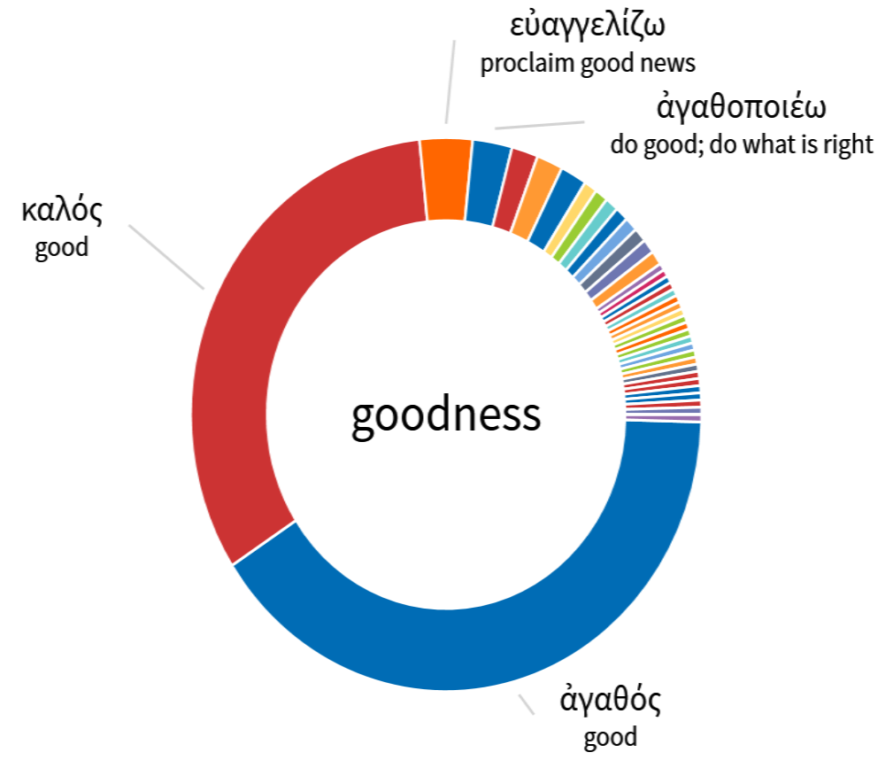
There are dozens of words and concepts related to goodness.

Slide 10
“Goodness” in the Bible
There are dozens of words and concepts related to goodness. However, the Bible primarily uses two Greek words for “goodness.” The word used in Galatians 5:22 is used over 100 times.
To be generous: “Or are you jealous because I am generous?” (Mt 20:15)
To perform the expected function in a fully satisfactory way: “Remember that you received good things during your life…” (Lk 16:25). “It fell into good soil…” (Lk 8:8) “Every good tree produces fine fruit…” (Mt 7:17)..
Positive moral qualities of the most general nature, good, goodness. “What good thing must I do to receive eternal life…” (Mt 19:16).
Biblical goodness is a gift from God (Lk 16:25). It comes to those who position themselves in the right environments (Lk 8:8). The fruit a person produces will reveal their level of goodness (Mt 7:17).
Biblical goodness is a quality that God produces in the lives of His children.

Slide 11
Why must we rely on the Holy Spirit for biblical goodness?
Because wickedness is in the nature of all unbelievers.
  “Woe to those who call evil good, and good evil; Who substitute darkness for light and light for darkness; Who substitute bitter for sweet and sweet for bitter!” Isaiah 5:20
  “He who justifies the wicked and he who condemns the righteous, both of them alike are an abomination to the Lord.” Proverbs 17:15
  “To show partiality to the wicked is not good, nor to thrust aside the righteous in judgement.” Proverbs 18:5
Because wickedness is in the heart of all believers.
  “In the heart dwells no good thing…” Romans 7:18
  “There is no one who is good but God…” Romans 3:10, Mark 18:10
  “The heart is deceitful, and above all things desperately wicked…” Jeremiah 17:9

Slide 12
Biblical goodness is a Fruit of the Spirit
“The fruit of the Spirit is love, joy, peace, patience, kindness, goodness…” Galatians 5:22
Biblical goodness is always a product of the Holy Spirit.
Within the human heart there is no natural goodness.
According to one source: Biblical goodness is a quality of moral that is not stagnant, but actively working itself out.
According to the Scriptures, biblical goodness is accompanied with righteousness and truth.
“For the fruit of the Light consists in all goodness and righteousness and truth…” Ephesians 5:9
According to Ephesians 5:9, goodness exists concurrently with righteousness and truth.
If one is not walking in righteousness and truth, then one is not walking in Spirit led, biblical goodness.

Slide 13
Ephesians 5:8-18
For you were formerly darkness, but now you are Light in the Lord; walk as children of Light 9 (for the fruit of the Light consists in all goodness and righteousness and truth ), 10 trying to learn what is pleasing to the Lord. 11 Do not participate in the unfruitful deeds of darkness, but instead even expose them; 12 for it is disgraceful even to speak of the things which are done by them in secret. 13 But all things become visible when they are exposed by the light, for everything that becomes visible is light. 14 For this reason it says, "Awake, sleeper, And arise from the dead, And Christ will shine on you." 15 Therefore be careful how you walk, not as unwise men but as wise, 16 making the most of your time, because the days are evil. 17 So then do not be foolish, but understand what the will of the Lord is. 18 And do not get drunk with wine, for that is dissipation, but be filled with the Spirit,

Slide 14
The Effect of Biblical Goodness
You are Light in the Lord; walk as children of Light
  To walk in light is to live in such a way that the world sees Jesus. (Matthew 5:16)
The fruit of the Light consists in all goodness and righteousness and truth.
  Goodness is accompanied by righteousness and truth.
Do not participate in the unfruitful deeds of darkness, but instead even expose them.
  By nature, light exposes darkness.
all things become visible when they are exposed by the light.
  When righteousness and light enter a place, all the wickedness and darkness are exposed.
for everything that becomes visible is light.
  Once wickedness and darkness are exposed, then those who are in darkness can be led into light.
Awake, sleeper, And arise from the dead, And Christ will shine on you.
  When we become a child of God, He will then use our lives to expose others.
When I have the spiritual fruit of goodness, that goodness will become not only a defining factor in my life, but it will also become a barometer in the lives of everyone around me.

Slide 15
Spiritual goodness is not a passive concept
Being good is not just being nice.
Being good is not just being someone who always helps others.
By definition, one cannot be neutral if he wants to be good.
A good person not only does what is right, but a good person exposes that which is evil.
17 Therefore, to one who knows to do good and does not do it, to him it is sin.” James 4:17
When a person walks in the spiritual fruit of goodness he/she will honor God, edify the church, and rub unbelievers and disobedient believers the wrong way!
One who walks with the spiritual fruit of goodness will not only walk in righteousness and truth, but they will affect everyone around them just as light affects darkness.

Slide 16
You will know you are walking in the spiritual fruit of goodness when godless people do not particularly like being around you.

Slide 17
It is not that you are mean, or that you are looking to expose people. It is just that a godly righteous life that focuses on God’s goodness will expose and amplify the fact that others around you are not focused on God’s goodness and the Bible says that men love darkness rather than light because their deeds are evil.

Slide 18
If you live with Spirit filled goodness the world will not like it. But God will love it!

