Slide 1
Instructional System Design

Slide 2
Instructional System Design Defined
The design of training programs should be systematic to ensure that they:
  Target the most important learning needs,
  Use the most appropriate methods, and
  Enhance on-the-job performance.
Instructional System Design (ISD) is a linear, step-by-step process for developing training programs.

Slide 3
Steps of the Training Design Process
Step 1 - Conduct a needs assessment
Conduct organizational, person, and task analyses
Step 2 - Ensure that employees are ready for training
Take an inventory of trainees’ basic skills, motivation, and attitudes
Step 3 - Create a learning environment that facilitates learning and transfer
Step 4 - Ensure learning is transferred to the work environment
Step 5 - Develop an evaluation plan
Measure various outcomes of training
Step 6 - Design and conduct the learning event
Choose multiple traditional and e-learning training methods
Step 7 - Monitor and evaluate the training
Determine the effectiveness and strategic value of training
Identify if training is needed
Identify what kind of training is most valuable
Ensure they have the qualifications to master the training content
Plan program administration
Encourage support from peers and managers
Teach self-management strategies
Prepare to calculate return on investment (ROI)
Identify changes that can be made to improve training
Deliver the training instruction
Consider the learning objectives and learning environment
Measure the costs and benefits of training
Shape learning culture
Use learning objectives, meaningful material, practice, feedback, and modeling

Slide 4
Step 1 - Conduct a needs assessment
Conduct organizational, person, and task analyses
Identify if training is needed
Identify what kind of training is most valuable

Slide 5
Step 2 - Ensure that employees are ready for training
Take an inventory of trainees’ basic skills, motivation, and attitudes
Ensure they have the qualifications to master the training content

Slide 6
Step 3 - Create a learning environment that facilitates learning and transfer
Plan program administration
Shape learning culture
Use learning objectives, meaningful material, practice, feedback, and modeling

Slide 7
Step 4 - Ensure learning is transferred to the work environment
Encourage support from peers and managers
Teach self-management strategies

Slide 8
Step 5 - Develop an evaluation plan
Measure various outcomes of training
Prepare to calculate return on investment (ROI)
Measure the costs and benefits of training

Slide 9
Step 6 - Design and conduct the learning event
Choose multiple traditional and e-learning training methods
Deliver the training instruction
Consider the learning objectives and learning environment

Slide 10
Step 7 - Monitor and evaluate the training
Determine the effectiveness and strategic value of training
Identify changes that can be made to improve training

Slide 11
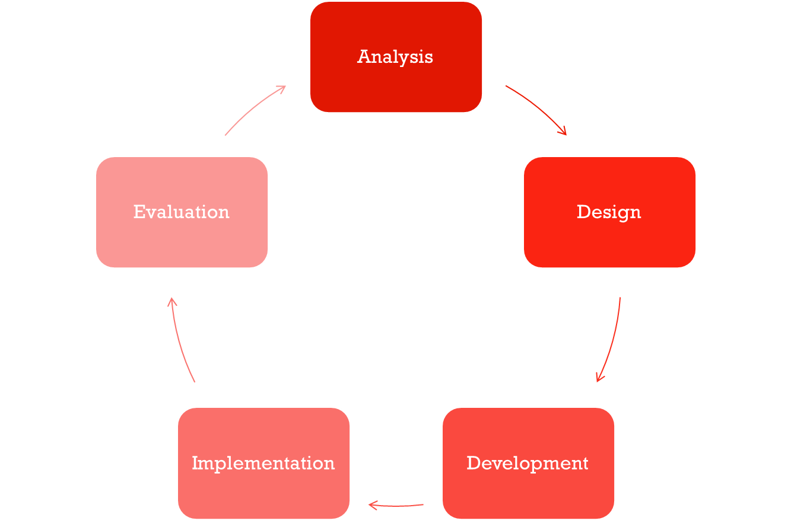
ADDIE Model

Slide 12
Weaknesses of the ISD Model
It does not reflect the reality of training design, which rarely follows a neat and orderly plan.
Its linear nature does not provide much flexibility in the design process.
It implies that training evaluation is the endpoint.
Its principles are sometimes applied incorrectly or insufficiently.

Slide 13
Applying the ISD Model
The training design process should be flexible enough to adapt to changing business needs.
Focus more on the components of each step and focus less on completing the steps in a purely linear fashion.
Depending on the circumstances, the steps may be completed simultaneously.

