Slide 1
Development Planning Process

Slide 2
Development Planning Systems
Development opportunities can help companies gain a competitive advantage.
A development planning system is designed to retain and motivate employees by attempting to meet their development needs.

Slide 3
Steps of the Development Planning Process
Self-Assessment
Reality Check
Goal Setting
Action Planning
Employees identify growth opportunities and areas of improvement.
Employees identify the most realistic needs to develop.
Employees identify specific goals and measures of goal progress.
Employees identify and prioritize the steps and timetable to reach their goals.
Employers provide assessments.
Employers provide performance feedback, explain where employees fit in long-term plans, and share relevant updates.
Employers ensure employees’ goals are SMART and commit to helping employees reach their goals.
Employers identify resources, such as additional assessments, courses, job experiences, and relationships.

Slide 4
Self-Assessment
Self-assessment is the self-directed process of determining one’s career interests, values, aptitudes, and behavioral tendencies.
It often involves psychological tests such as the NEO Personality Inventory (NEO-PI).
The results can be used (with caution) to identify development needs and opportunities.

Slide 5
Reality Check
Reality check refers to the feedback employees receive about how their KSAOs are evaluated and where they fit into the company’s future plans.
Employees can receive feedback from their manager through the formal appraisal process or through 360-degree feedback.

Slide 6
Goal Setting
Through goal setting, employees create short- and long-term goals to direct and motivate their development efforts.
These goals usually relate to securing a new position, moving to a new work setting, acquiring new skills, and applying skills to meet a business need.

Slide 7
Action Planning
An action plan is a written strategy that outlines how employees will reach a development goal.
The plan identifies and prioritizes the specific steps that employees will need to take to achieve the stated objective.
These plans can be used as both a learning tool and an evaluation tool.

Slide 8
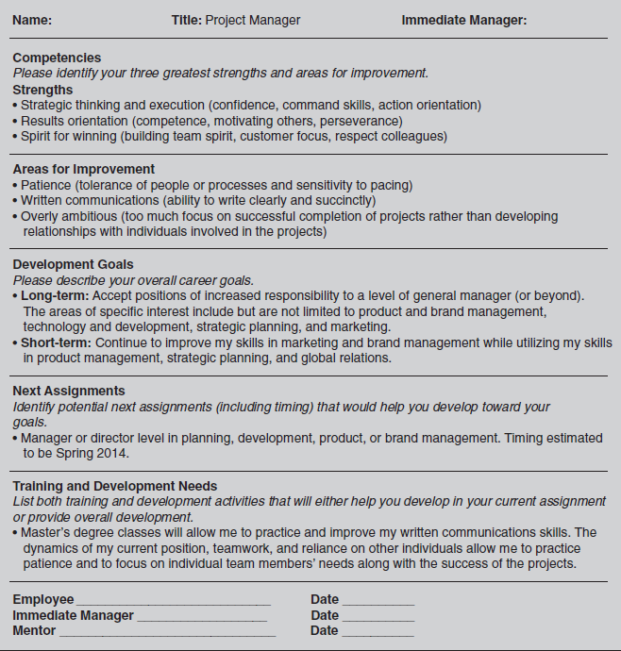
Example of a Development Plan

