Slide 1
Competency Models

Slide 2
Competency Model Defined
Competency models describe the competencies that are common for an occupation, organization, job family, or specific job.
The descriptions include:
  The name of each competency,
  Levels of demonstrated proficiency, and
  The KSAOs that represent proficiency.

Slide 3
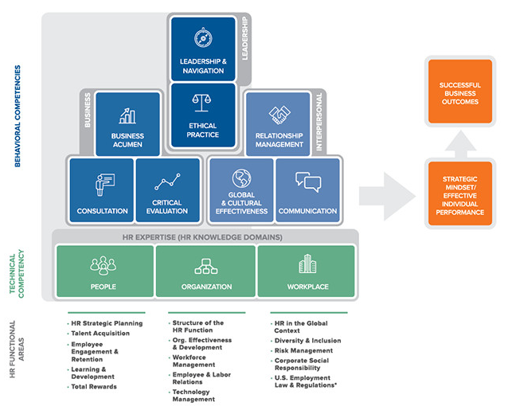
SHRM’s Body of Competency & KnowledgeTM

Slide 4
Benefits of Competency Models
Competency models can:
  Inform other HR activities.
  Define high performance.
  Establish evaluation criteria.
  Identify required KSAOs.
  Provide a framework for feedback.
  Create a road map for succession planning.

Slide 5
Competency Modeling Process
Competency modeling, the process of developing a competency model, follows these basic steps:
Identify business strategy and goals.
Identify jobs, positions, or job families.
Conduct interviews and focus groups with top performers.
Develop competencies and the competency model.
Validate and review the model.

