Slide 1
Technology-Based Training Tools

Slide 2

Internet of Things (IoT)
Internet of things (IoT) devices refers to smart devices, like phones and tablets, with sensors and access to the internet.
These devices connect learners to training content and SMEs.
Training can be continuous, on-demand, and personalized to meet learners’ needs.

Slide 3
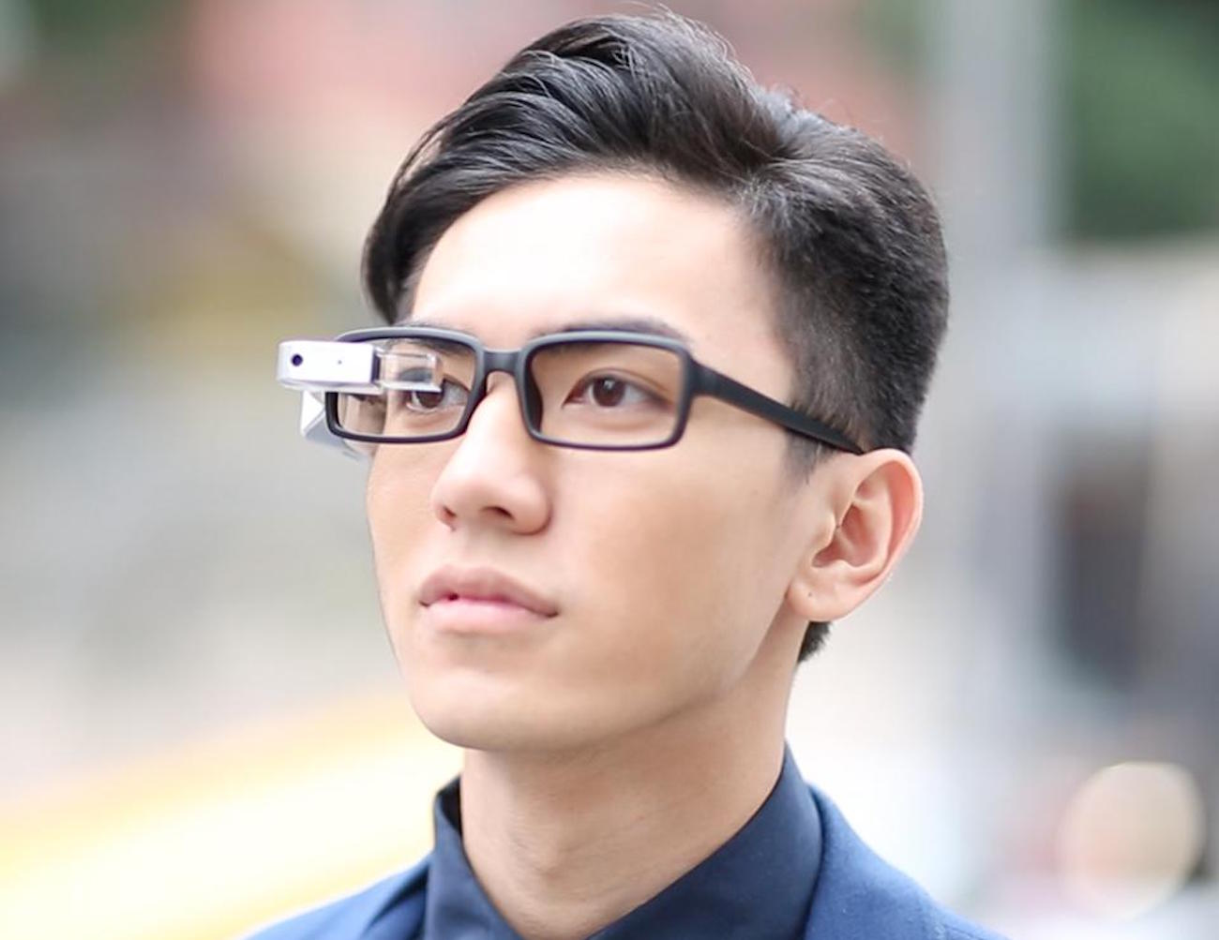
Wearables
Wearables refer to smart devices that worn on the body, such as watches, bands, and eyewear.
Smart eyewear provides:
  Hands-free, voice-activated access to training content, and
  Real-time notifications and alerts.

Slide 4
Gamification
Game-based training incorporates principles of gaming design to engage trainees and maximize learning.
  Content can be delivered through short interactive lessons.
  Trainees can interact with other trainees and receive feedback.
  The design can encourage collaboration or competition.
Games based on digital twins allow trainees to explore digital representations of concepts in a 3D environment.

Slide 5
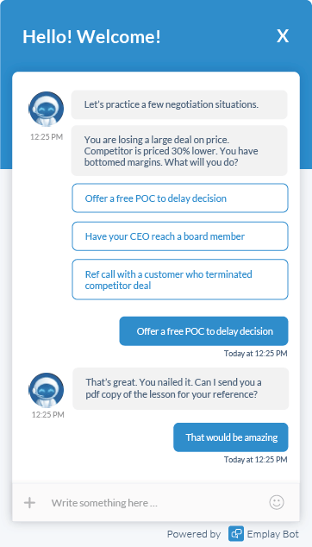
Artificial Intelligence
Artificial intelligence (AI) is technology that tries to mimic human intelligence.
AI can deliver customized training through learning bots, which can answer trainees’ questions and make recommendations.
AI can also identify training needs, provide feedback, and coach employees.

Slide 6
Tin Can API
Experience API (xAPI) or tin can API is a software specification that enables different learning tools to communicate with one another.
The learning records store (LRS) collects, organizes, and tracks employees’ formal and informal learning experiences.
Data can be used assess the relationship between learning and business outcomes.

Slide 7
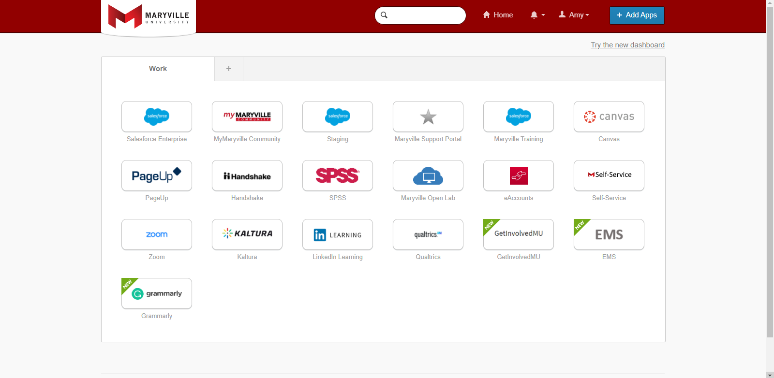
Tin Can API

