Slide 1
Learning and Transfer of Training Defined

Slide 2
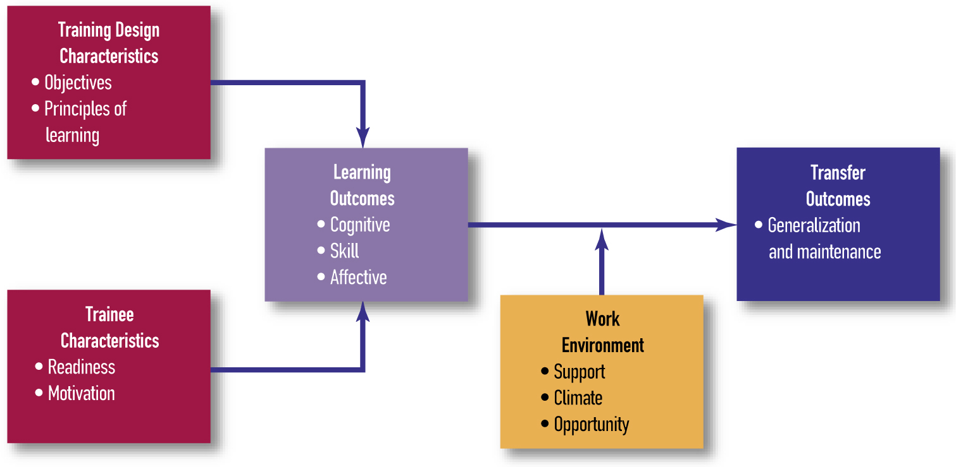
Overview

Slide 3
Processes of Learning
Learning is a relatively permanent change in KSAOs and behavior that is produced by experience and practice.
The learning strategy affects the coding of training content in memory.
  Using rehearsal, learning occurs through repetition.
  Organizing involves finding similarities and themes across training content.
  To elaborate means relating the material to other more familiar knowledge.

Slide 4
Transfer of Training Defined
Transfer of training is the application of what was learned in training to the job.
  Generalization is the application of what was learned to situations that are similar but not identical to those encountered during training.
  Maintenance is the continued use of what was learned over time.

Slide 5
Necessary Conditions
Internal conditions are processes within the learner that are necessary for learning and transfer to occur.
  Trainees have required prerequisites.
  Training content is meaningful.
  Trainees learn through experience.

Slide 6
Necessary Conditions
External conditions are processes in the environment that are necessary for learning and transfer to occur.
  Provide opportunities for practice and feedback.
  Ensure managers and peers are supportive of learning and transfer.

