Slide 1
Implications of Learning Theories
Part 2

Slide 2
Needs Theories
These theories attempt to explain how needs motivate behavior.
  A need is a deficiency we experience at a given point in time.
  They motivate us to behave in ways that satisfy the needs.
Trainers should try to understand trainees’ needs, explain how training will meet their needs, and provide choices.

Slide 3
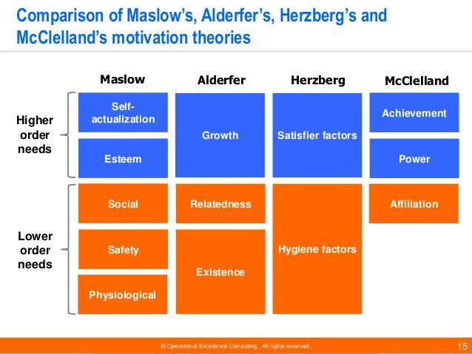
Needs Theories

Slide 4
Expectancy Theory
This theory suggests that behavior is influenced by trainees’ perceptions of expectancy, instrumentality, and valence.
To motivate learning, trainees need to:
  Be confident in their ability to perform (expectancy),
  Value the proposed rewards (valence), and
  Believe they will receive the rewards if they perform well (instrumentality).

Slide 5
Adult
Learning Theory
This theory suggests adults:
  Need to know “why,”
  Need to self-direct learning,
  Bring work-related experiences and a problem-centered approach to the learning situation, and
  Are both extrinsically and intrinsically motivated.

Slide 6
Adult
Learning Theory
Trainers should:
  Develop instruction based on learners’ interests and competencies.
  Ensure training is problem-centered.
  Use trainees’ experiences for examples and applications.
  Provide opportunities for immediate application.

Slide 7
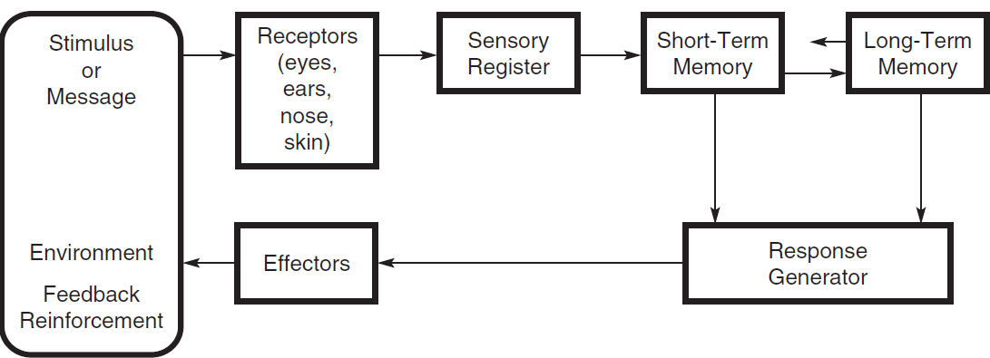
Information Processing Theory
This theory proposes that information taken in by the learner undergoes several transformations in the brain before a response is organized.

Slide 8
Information Processing Theory
Trainers can support information processing using the following strategies:
  To establish expectations, communicate the learning outcomes.
  To facilitate encoding:
    Include meaningful content.
    Use pictures, diagrams, and maps.
    Use demonstrations and verbal instructions.

