Slide 1

Brain Fit for Life
Simple Ideas for Creating Balance in Work, School, & Life
Jennifer Jelavich, Back2Basics4Life.com
(925) 997-4952 – phone/text
Jennifer@Back2Basics4Life.com

Slide 2

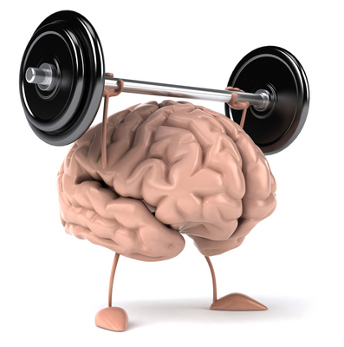
Brain Fit for Life
Simple Ideas for Creating Balance in Work, School, & Life
Blue Zones: Areas of the world where people live the longest lives, consistently reaching age 100.
Amen University: A healthy brain is the “hardware.” Amen Clinics provide strategies for a healthy and happy brain.

Slide 3




  20+ years longevity study
It all began with with Dan Buettner’s
20+ year longevity study to find the world’s healthiest people

Slide 4
20+ Year Longevity Study
3x
Ikaria
Greece
more likely
to live to 100
Sardinia
Italy
Okinawa
Japan
Living on average
good years than
we do in North America.
12 more
Nicoya
Costa Rica
Loma Linda
California

Slide 5
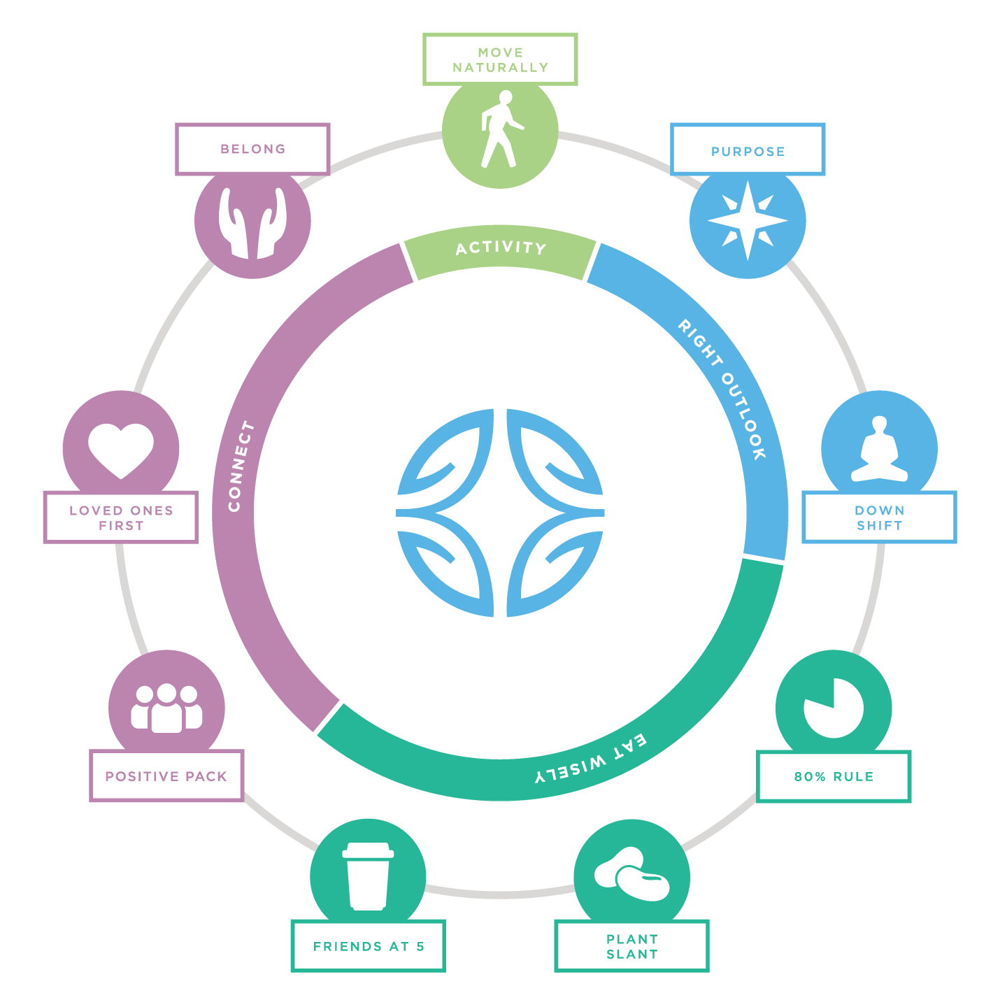
POWER 9®
Lessons for living longer, better

Slide 6

What determines our health?
20%
80%
genetics
lifestyle and environment

Slide 7
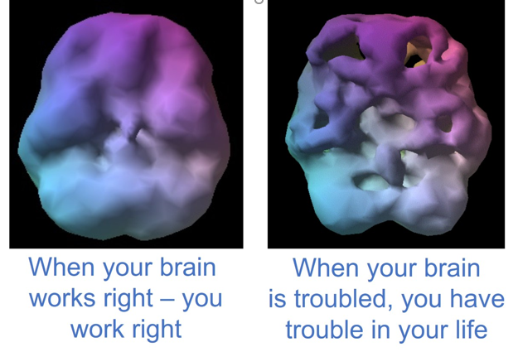
Brain Health…
Your brain is involved in EVERYTHING you do!
How you think, feel, act and interact.
Organ of intelligence, character and every decision you make!
Amen Clinic
Brain Scans

Slide 8

Brain Fun Facts…
Your brain is ridiculously complex
Most complicated organ in the universe
100 billion neurons, trillions of supporting cells
More connections in the brain than stars in the universe
2% of body’s weight & uses 20%-30% of kcals
20% of the oxygen and blood flow

Slide 9
Brain Fun Facts…
Your brain is ridiculously complex
Information travels up to 268mph
Brain tissue of a grain of sand has 100,000 neurons and a billion connections talking to one another
Storage capacity of 6 million years of Wall Street Journals
Males have 10% more neurons
Females have more connections

Slide 10
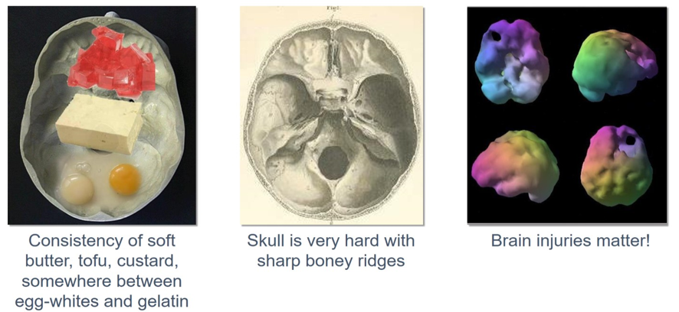
Brain Fun Facts…
Your brain is soft & housed in a hard skull

Slide 11
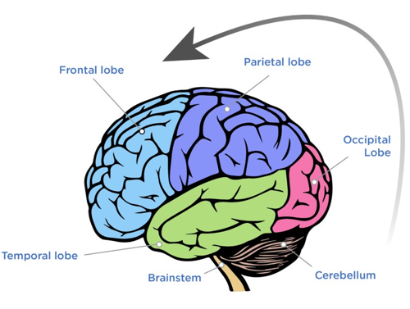
Brain Fun Facts…
PFC Last Part of Brain to Fully Develop
Completes around age 25 in females and 28 in males
Planning, judgment, forethought, impulse control, organization, time management, procrastination, goal planning, learning from mistakes

Slide 12

Welcome to Normal!
Most of us have issues
51% of the US population will have a mental health issue at some point in their life
If you struggle with attention, focus, sadness, anxiety, worry, flexibility, stubbornness, or impulsivity….
Welcome to Normal!
The good news is you can change your brain and change your life.

Slide 13
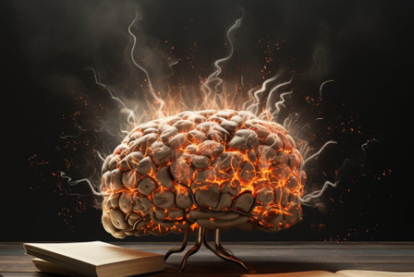
Brain Robbers
Excessive Caffeine
Excessive Computer Use
Excessive Cell Phone Use
Excessive Text Messaging
Excessive TV
Excessive Video Games
Fear of Failure
Alcohol Use
Drug Use
Environmental Toxins
Head Injury
High Stress
Irrational Fears
Negative Thinking
Not Challenging Yourself
Poor Diet
Poor Mental Exercise
Poor Sleep
Poor Water Intake
Smoking
Staying in a Routine

Slide 14
Brain Enhancers
Sleep 7-8 hours
Limited Screen Time
Intention
Gratitude
Appreciation
Protecting Your Brain
Positive Thinking
Challenging Yourself
Mozart and Strauss
Hydration
Meditation
Deep Relaxation Techniques
Exercise
Mental Exercise
Great Diet
Healthy Weight
Healthy Routines

Slide 15
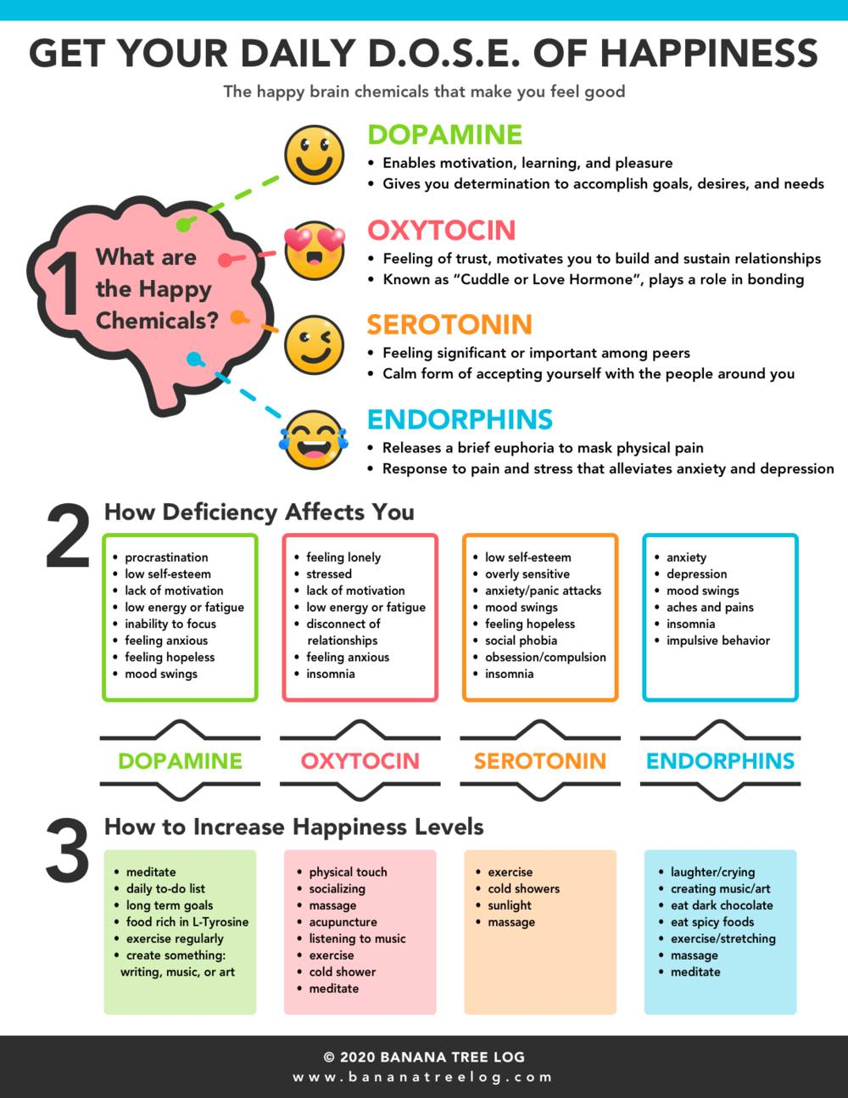

Slide 18
How much time do you have?
5 minutes
15 minutes
30 minutes
Try a breathing exercise.
Inhale for 5 counts, hold for 5, exhale for 5, hold for 5, repeat
Dance or sing to a favorite song.
Change position; stretch your arms, legs, and back.
Take a quick walk outside.
Water your plants or garden.
Organize a small space in your home.
Play with your kids. Do something simple like color or draw with them.
Take a power nap.
Call a friend or family member to catch up and check in.
Take a bath or shower.
Download a mindfulness app. There are many free apps available online.
Play a game, work on a puzzle, or try a new online game.
Join a parent support group.
Go for a jog, do tai chi, or any physical activity that makes you happy.

Slide 19

Idea #1: Practice Gratitude
20 Seconds Thinking of One Thing You are Grateful For Each Day
Science says if you can put your attention on one thing for 20 seconds continuously, it etches or imprints it in the pre-frontal cortex.
20 Minute Gratitude Letter Once Per Week
Sciences says if you write a gratitude letter for 20 minute to someone once a week (and you don’t even need to send it) - this awakens hormones and chemicals and starts impacting the neurological framework of your brain.

Slide 20
Idea #1: Practice Gratitude
Wake up each day saying…
“Today is going to be a great day.”
End the day asking yourself ….
“What went well today?”

Slide 21
Idea #1: Practice Gratitude
Things I am Grateful For….
People
Places
Things
The Gratitude Experiment - https://www.youtube.com/watch?v=U5lZBjWDR_c

Slide 22
Idea #2: Watch Your Thoughts
Thoughts are powerful!
Thoughts release chemicals that change your brain and body
Can immediately change how we feel
Changes your brain wave pattern, hand temperature, sweat gland activity, heart rate, breathing rate and muscle tension
Our natural tendency is to be negative

Slide 23
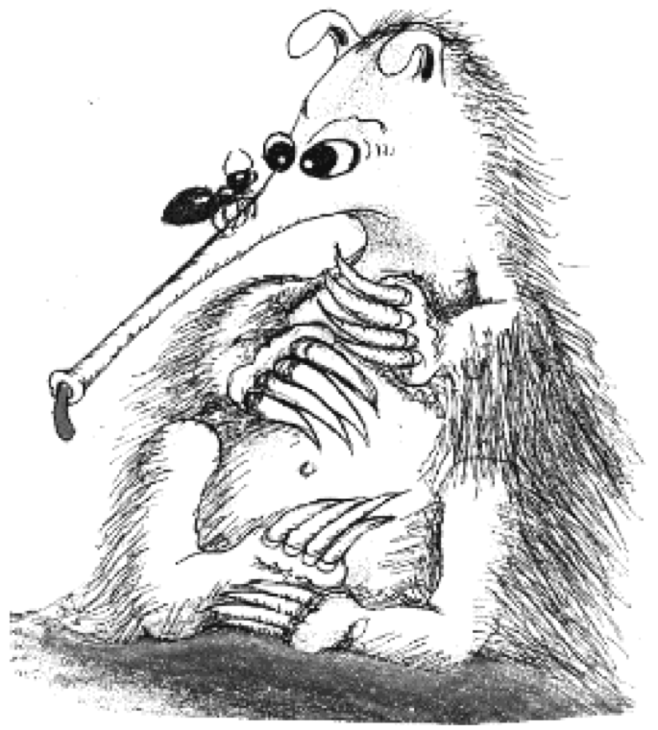
Idea #2: Watch Your Thoughts
KILL THE ANTS (Automatic Negative Thoughts)
    ANTs steal your happiness
    Thoughts lie -- a lot!
    Learning to kill the ANTs:
      - Decreases anxiety and depression
      - Improves self-esteeem
      - Improves relationships and schoolwork

Slide 24
Idea #2: Watch Your Thoughts
Eliminate the ANTS Tool
Whenever you feel sad, mad, or nervous write down your automatic negative thoughts (ANTs)
Talk back to them using 5 Questions:
    1. Is it true?
    2. Can I absolutely know it’s true?
    3. How do I feel when I have the thought?
    4. How would I feel without the thought?
    5. Turn it around to its opposite thought?

Slide 25
Idea #2:
Watch Your Thoughts
What do you want?
What are you doing to make it happen?
- Relationships
- School/work
- Money
- Physical
- Emotional
- Spiritual

Slide 26

Idea #3: Work Your Brain
It’s like a muscle. The more you use it, the stronger it becomes
New learning makes new connections
No learning causes disconnections
Spend at least 15 minutes/day learning something new
Never too late to start learning new things!

Slide 27
Idea #3: Work Your Brain
Visit new places
Join a reading group
Cross-train in jobs
Sign up for classes outside your interest
Learn to play a musical instrument
Surround yourself with people smarter than you
Word games
New language
New dance steps
Laughter
Shake up your routine

Slide 28

Idea #4: Destress Your Brain
Need to teach the brain to relax
Make it a daily practice
Keep it simple
Use your five senses
Relaxation counters the fight or flight response
Physical reactions: Warms hands, lowers sweat gland activity, slows the heart rate speed, flows and deepens breathing, lowers muscle tension

Slide 29
Idea #4:
Destress Your Brain
Simple Hand Warming
Technique

Slide 30


Slide 31


Slide 32


Slide 33


Slide 34


Slide 35


Slide 36
Idea #4: Destress Your Brain
Diaphragmatic Breathing Exercise
Whenever you feel stress, anxious or tense, take a deep breath.
Hold it for four or five seconds.
Slowly exhale, taking about six to eight seconds to exhale completely.
Repeat this series about ten times.
Chances are you will start to feel relaxed.

Slide 37

Idea #4: Destress Your Brain
Meditation
Many different forms
Very simple
Improves both physical and mental health

Slide 38

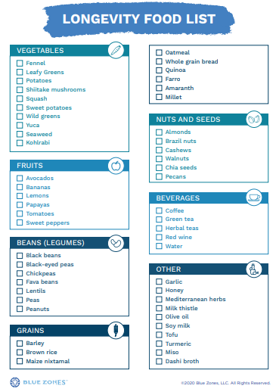

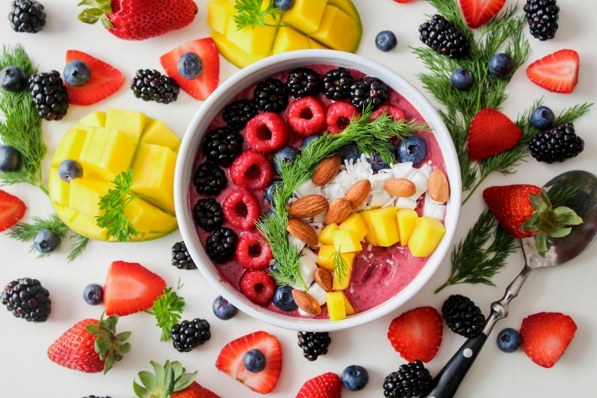

Idea #5: Nourish Your Brain
Starchy
Carbs
Protein
Fiber
https://www.facebook.com/watch/?v=634903261894361
Eat the rainbow!

Slide 39
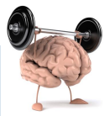
BRIGHT MINDS
11 Major Risk Factors & Brain Healthy Habits
B - Blood Flow: Walk like you are late for 45 min at least 4 times/week
R - Retirement/Aging: Engage in 15 minutes of new learning each day
I - Inflammation: Floss your teeth regularly to avoid periodontal disease
G - Genetics: Know your family history risk factors and start preventing them as soon as possible
H - Head Trauma: Protect your head (stop texting and driving)
T - Toxins: Detoxify your body by taking regular saunas
Change Your Brain Every Day by Dr. Daniel G. Amen

Slide 40
BRIGHT MINDS
11 Major Risk Factors & Brain Healthy Habits
M - Mental Health: Whenever you are sad, mad, nervous, or out of control, write down your negative thoughts and ask, “Is this true?”
I - Immunity/Infections: Know and optimize your vitamin D level
N - Neurohormone Issues: Test your hormones yearly and work with your doctor to optimize them
D - Diabesity: Eat a brain-healthy diet
S - Sleep Issues: Aim for seven hours of sleep a night
Change Your Brain Every Day by Dr. Daniel G. Amen

Slide 41
Brain Fit for Life
Simple Ideas for Creating
Balance in Work, School, & Life
Thank you!
Jennifer Jelavich, Back2Basics4Life.com
(925) 997-4952 – phone/text
Jennifer@Back2Basics4Life.com

