Slide 1
The Decline in Sexual Recidivism Rates: Implications for Assessment and Treatment
March 15, 2018
VSOTA Conference
Michael F. Caldwell, Psy.D.
mfcaldwell@wisc.edu

Slide 2
Base rates: why it is important
The base rate tells us where the problem is.
The base rate for recidivism determines:
  The opportunity cost of prevention vs. containment vs. incapacitation.
  The difficulty in identifying risk factors
  The performance characteristics of risk assessment methods.
  The utility of ROC Area Under the Curve values.
Notes:
Lightening strikes in one year = hard to predict. Any rain in one year = easy. Over 90% of arrested sex offenders are first time offenders.

Slide 3
NIBRS data for victims under 13
Age Distribution of Accused Sexual Offenders
350
Peaks at age 13/14 and drops by 1/2 by age 22
300
250
200
150
100
Age 16
50
0
7
8
9
10
11
12
13
14
15
16
17
18
19
20
21
22
23
24
25
Offender Age

Slide 4
NIBRS data for victims under 7
Sexual Assaults by Offender Age
200
Age 16
180
160
140
120
Offense Rate
100
80
60
40
20
0
7
9
11
13
15
17
19
21
23
25
27
29
31
33
35
37
39
41
43
45
47
49
Age of Offender

Slide 6
Perspective
Crime in general, and violent crime in particular has been dropping in recent decades.
Decline in juvenile crime has been as great or greater.
Lots of speculation as to why, no one thing explains it all, (but see Finkelhor & Jones, 2004, 2006, 2012).
FBI arrest rates show a decline.

Slide 7
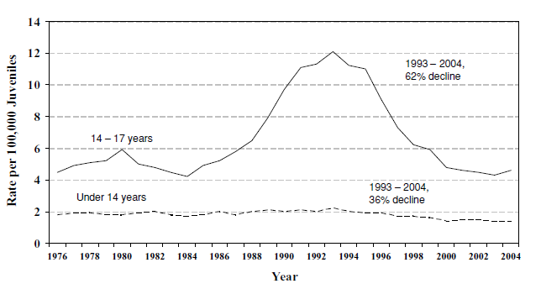
OJJDP juvenile homicide data
Notes:
Important: murder and violent crime rates in the South are 3 to 4 times that of the midwest and northeast. About a 10% jump in murder last year, but still 19% lower than 2006.

Slide 8
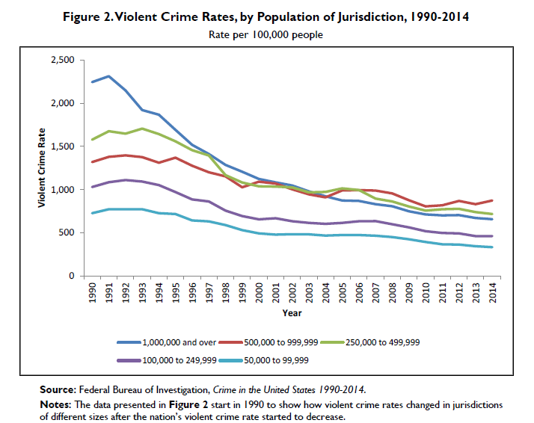
Notes:
Recent jump in homicides rates: not as large as they may appear because they start with very low rates. Also, seem to be very localized, even in cities that have had large percentage jumps (i.e. Milwaukee).

Slide 9
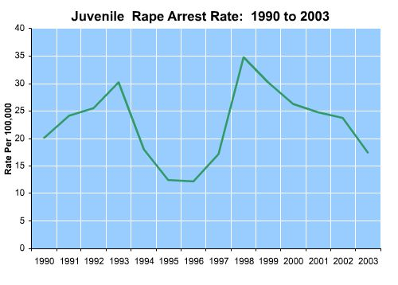

Slide 11
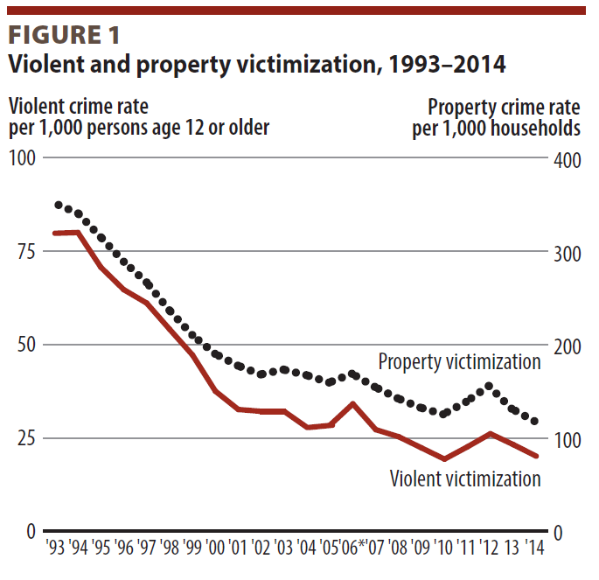
Truman, & Langton, Criminal Victimizations 2014, BJS
Notes:
Truman Langton, Criminal Victimizations 2014

Slide 12
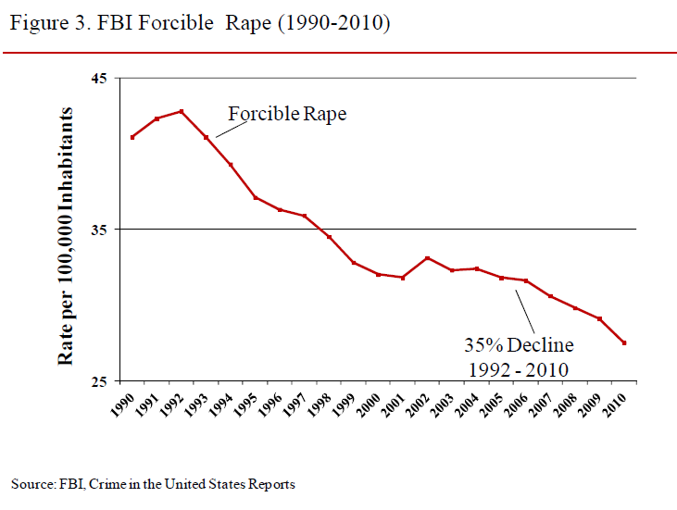

Slide 13
Reporting explanation
Are fewer assaults being referred to the police?
  Sources of referrals show similar declines.
Is the police clearance rate dropping?
  No, it has stayed about the same

Slide 14
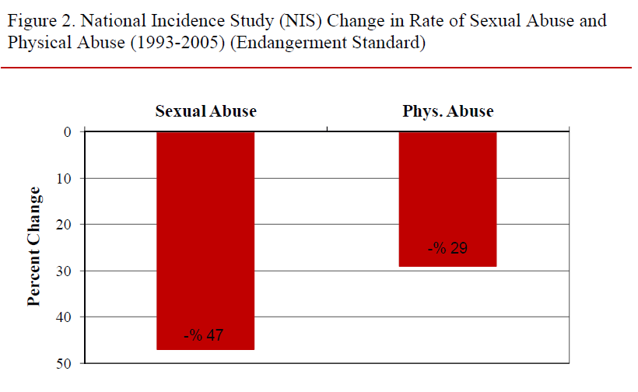
NIC study of cases known to professionals
Notes:
These are cases that come to the attention of mandated reporters.

Slide 15
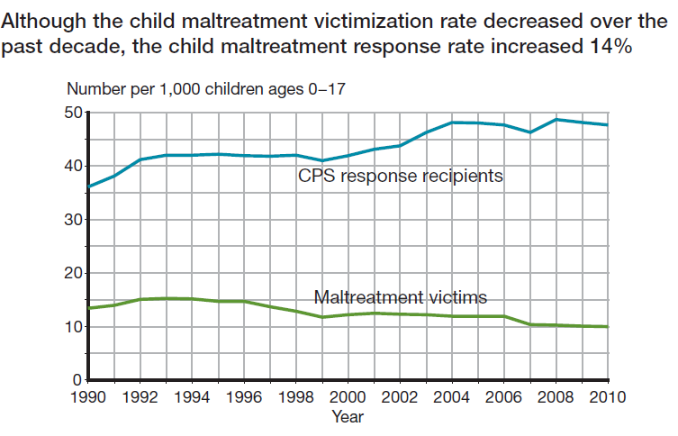

Slide 16
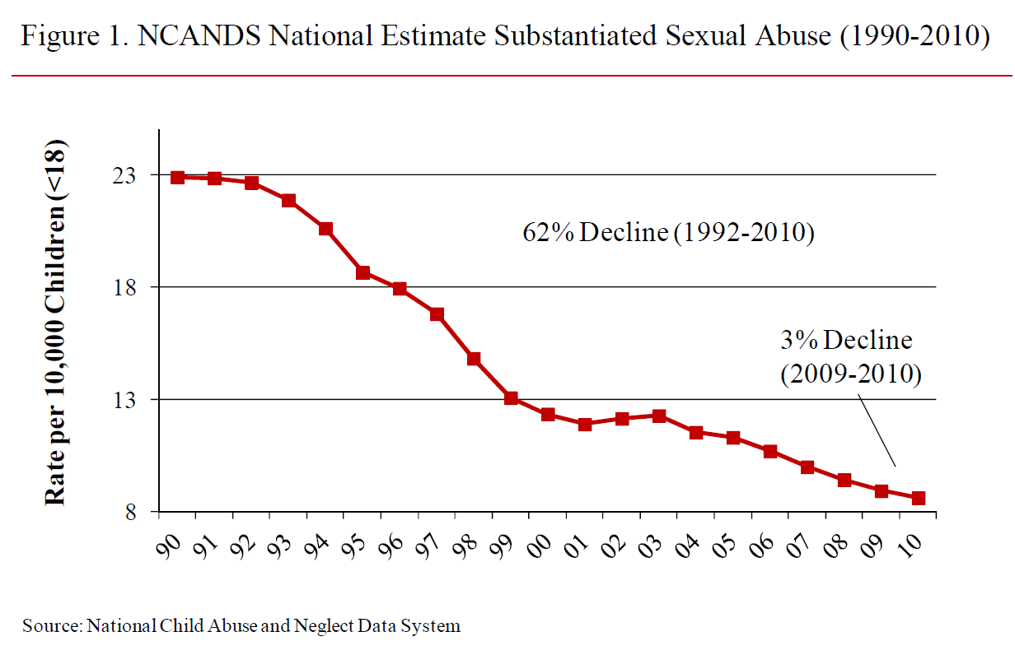

Slide 17
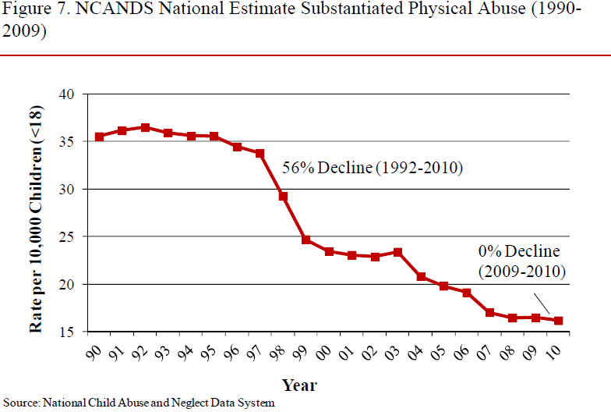
Child protection agency survey
Notes:
Why the abortion explanation does not work: if you had fewer unwanted children you should start to see a drop in CPA and infanticide in 1970’s. That decline also did not start until about 1997.

Slide 18
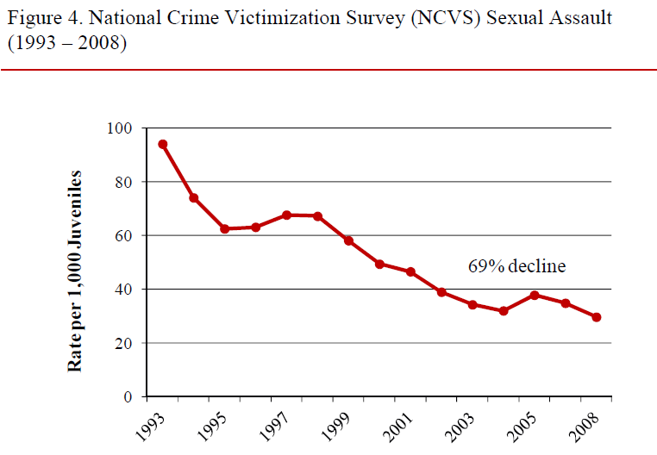
National Crime Victim Survey

Slide 19
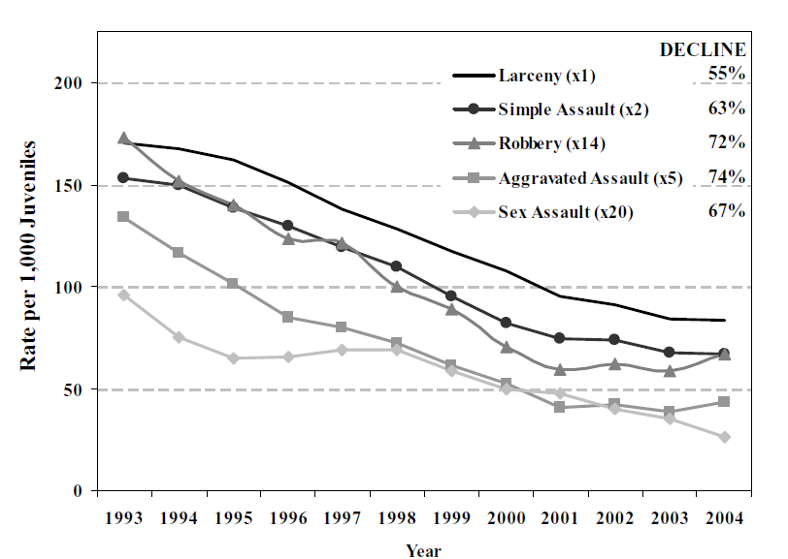
NCVS results

Slide 20
National Crime Victim Surveys
Maybe fewer cases are coming to the attention of CPS, police, and other officials. Abusers have gotten better at evading detection.
National Crime Victimization surveys show a similar decline.
Notes:
Victim data caution: Date rape 25% report, family – up to 40%; stranger up to 66%.

Slide 21
More Perspective
About 90+% of sexual assault arrests are first offenders (no prior sexual assault arrests).
The recent declines mostly reflect fewer first offenders.
Recidivism would tap those people who were not effected by whatever forces caused fewer first offenders.

Slide 22
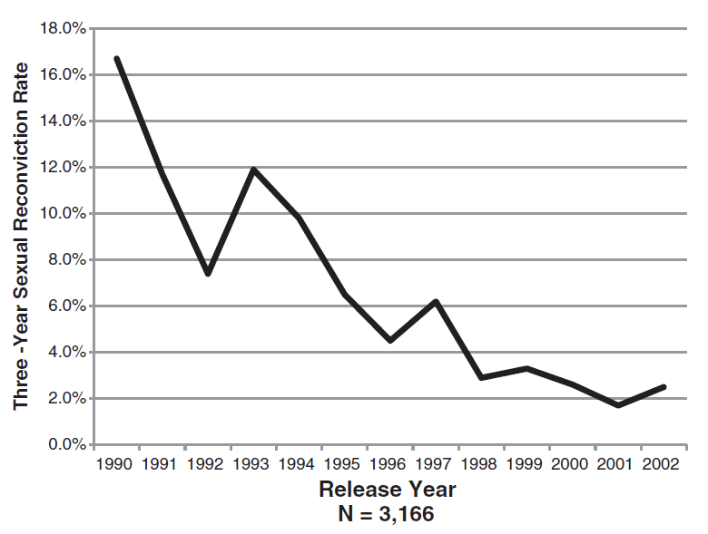
MnDOC (2007) 3-year reconviction rates
Notes:
85% decline.

Slide 23
MnDOC (2007)
Sexual recidivism declined 85%
Re-validation of the MnSOST-R failed.
Civil commitments exploded in 2004; after this 85% drop in recidivism.

Slide 24
Notes:
Number of recidivists is between 14 and 23 each year. Number of released increases from 293 to 1007. Joseph Tartar & Tony Streveler.

Slide 25
Tartar & Streveler caveats
About the same number of recidivists in each time frame.
Decline is due to much larger numbers of SO’s released.
Could be that higher adult incarceration rates has diluted this pool.

Slide 26
Justice Research & Statistical Assn. (2009)
USDOJ data
9 states including Illinois
3 year follow-up
Re-arrests, reconviction, re-incarceration as the outcome.
Groups released in 2001
N = 9,691

Slide 27
Justice Research and Statistics Association (2009)
State | AK | AZ | DE | IL | IA | NM | SC | UT
% Sex offense re-arrest | 3.4 | 2.3 | 3.8 | 2.4 | 3.9 | 1.8 | 4.0 | 9.0

Slide 28
Nature and limits of ROC analysis
ROC was initially developed to evaluate the relative predictive accuracy of radar systems.
In radar systems; as you adjust the sensitivity dial, you evaluate whether you get a ping and whether it is accurate.
Utility of a risk scale with a significant AUC depends on how it’s used, and it’s calibration.

Slide 29
Mossman (1994)
Ultimate Outcome Status | Prediction | Polly | Libby
Violent (n = 100)
 | Admit (high risk) | 93 | 50
 | Release (low risk) | 7 | 50
Non violent (n = 900)
 | Admit (high risk) | 450 | 60
 | Release (low risk) | 450 | 840
Fraction correct |  | .54 | .89
ROC AUC |  | .856 | .856
Notes:
The accuracy of a measure with a particular AUC depends on how the scale is used; what cut points are used AND what the base rate is.

Slide 30
ROC illustration
1000 imaginary people classified using an imaginary scale
The scale has 5 risk levels
The base rate is 10%

Slide 31
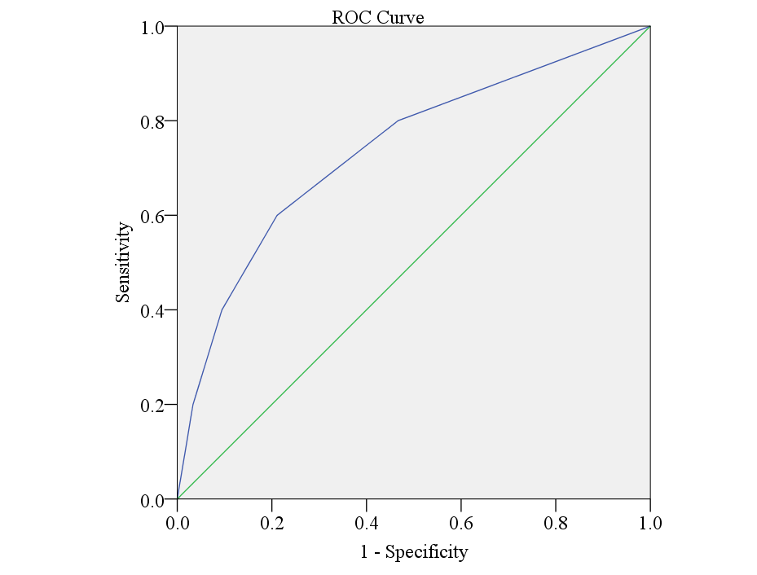
Receiver Operator Curve AUC = .74 (p < .0005, 95% C.I. = .68 - .79).

Slide 32
Model risk measure
Risk level | Total number | Recidivism rate
1- Low | 480 | 4.0%
2 – Mod Low | 210 | 8.0%
3 – Moderate | 105 | 16.0%
4 – High | 50 | 26.7%
5 – Very High | 30 | 40.0%
Number of recidivists
20
20
20
20
20
N = 1000; base rate = 10.0%; χ2 = 27.34, p < .0005

Slide 33
Decline in Juvenile Sexual Recidivism Study

Slide 34
Meta-analysis of CASH recidivism
Search of several databases, gov’t reports, unpublished data, dissertations, conference presentations and posters, etc.
Studies included if they had:
  N > 20, mostly male adolescent CASH.
  Not heavily screened (NGI, Tx successes, etc.)
  Reported sex recidivism from some official source
  Reported follow-up time
  Ideally also reported general recidivism, year of the study, location, source of the sample, other details.

Slide 35
Studies characteristics
Search yielded 106 data sets from 98 reports published between 1938 & 2015. Median year = 1997.
Total N = 33,783 ; Median = 171.
US = 79; Canada = 13; Australia = 8; Switzerland & Netherlands = 2; UK & Singapore = 1.
F/U Mean = 60.0 months, Range = 12 – 420 months.

Slide 36
Study characteristics
Retrospective studies of adult recidivism of JSO’s = 27
Prospective JSO’s including only JSO recidivism = 28
Retrospective using JSO and adult recidivism = 51
79 were peer reviewed
27 not peer reviewed reports or unpublished data sets
48 drawn from community placed JSO’s
23 drawn from residential community settings
29 drawn from secured corrections settings

Slide 37
Results
Weighted Mean sexual recidivism rate = 4.97%.
Mean general recidivism rate = 41.24% (SD = 1.9%).
Weighted Mean follow – up of 62.06 months.
49 studies reported sexual recidivism below 5%.
3 reported sexual recidivism at 15% or above.
5 studies reported sexual recidivism of 0%, 2 reported rates < 1%.
Middle 75 percentile range = 3.14% to 9.50%.

Slide 38
 | Number of data sets | Sexual recidivism (%) Mean / (SD) | Follow – up months / (SD) | Mean age / (SD)
Total sample (weighted) | 106 | 4.97 | 62.06 | 14.94
U.S. studies | 79 | 6.43ª / (4.61) | 52.60 (36.14) | 14.88 (0.80)
All other countries | 27 | 7.92ª / (3.62) | 64.19 (39.75) | 15.21 (0.65)
Unpublished | 27 | 3.74^{d} / (3.10) | 38.54ª (17.88) | 14.64ª (0.78)
Published | 79 | 8.17^{d} / (4.76) | 61.56ª (40.42) | 15.05ª (.076)
Juvenile only recidivism | 28 | 7.05 / (5.79) | 28.50^{cd} (11.99) | 14.78 / (0.75)
Adult only recidivism | 27 | 6.95 / (4.07) | 70.30^{d} / (43.63) | 15.24 / (1.02)
Both | 51 | 7.08 / (4.64) | 63.27^{c} / (35.83) | 14.92 / (0.60)
ª = p < .05; ^{c} = p < .005; ^{d} = p < .0005.

Slide 39
Results
No significant difference in sexual recidivism rates across settings (Community, residential, secured)
No significant difference in sexual recidivism rates across 3 recidivism sources (juvenile only, adult only, both)
BUT juvenile only studies had shorter f/u times.
US studies reported LOWER recidivism rates than other countries.

Slide 40
Results
Unpublished studies tended to be statewide studies of all adjudicated JSO’s (not pre – screened)
9 of the 10 statewide or national studies were unpublished.
Lowest sexual recidivism rate (Mean = 3.74, SD = 3.10, F = 10.49, p < .0005).
Also shortest f/u time 38.54 months (SD = 17.88, F = 2.34, p <.05). Also, slightly younger mean age.

Slide 41
Results: Follow – up times
How long is a long enough f/u time?
Divided f/u times into 12 one-year categories.
Series of logistic regressions comparing each one-year step in f/u to the longer f/u group.
Studies with f/u 36 months & more reported sexual recidivism similar to 36 months & less (F 1,56, = 2.76, R² = 0.05, p < n.s.).
8 studies exceeded 10 years, not significantly higher sexual recidivism rates (8.8%, SD = 2.9%,); 3 to 10 years = 7.3%, SD = 4.2%, n.s.)

Slide 42
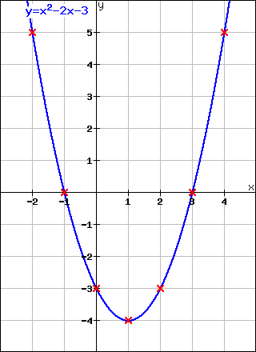
Start f/u
When does the curve become essentially flat?

Slide 43
Evaluating trends in recidivism rates
The studies conducted before 1980 often included “fornication”, “homosexuality”, “cohabitation” and “promiscuity” in their definitions of sexual offenses.
In very old studies (before 1940’s), the majority of JSO’s were female.
Studies conducted before 1980 were censored (n = 94).
We entered the f/u time and year of f/u in a linear regression model to predict sexual recidivism.

Slide 44
Significance of f/u year
Factors | R² change | Std. β | Sig. (p =) | Eta squared | 95% C.I.
Step 1: Months of follow-up | .12 | 0.346 | .001 | .119 | .021 / .252
Step2: Months of follow-up |  | 0.276 | .005
Year of follow – up | .13 | - 0.369 | .0002 | .149 | .036 / .286

Slide 45
How much of a decline?
Classed studies into “older” studies (1980 to 1995) and “newer” (2000 to 2014)
Older = 45 studies with 9,106 cases
Newer = 33 studies with 20,008 cases
No differences on location, age, f/u time, etc.

Slide 46
Decline in sexual recidivism
73% decline
Notes:
DOC (2015) was 72.4%.

Slide 47
Rates of general recidivism
Notes:
13% decline, includes all offenses including sex offenses.

Slide 48
What to do?
Mostly, JSO risk methods borrow from theory or adult risk factors (except the JSORRAT-II)
Most adult risk factors fail with juveniles
  Male child victim:
    Robust predictor with adult offenders
    18 studies in JSO’s, 16 found no relationship with sexual recidivism; 2 found a protective effect (lower sexual recidivism among JSO’s with a male victim).
  Prior sexual offense
    16 studies; 13 n.s.; 3 significant.

Slide 49
Why?

Slide 50
Other Explanations
More adolescents being arrested means more low risk offenders in the pool in recent years.
  BUT arrest rates for juvenile sexual offenses is dropping.
More juveniles being prosecuted as adults means fewer high risk offenders in the pool in recent years.
  BUT transfer rates are declining. Several states have made it more difficult to transfer youth, and the number of youth held in jails on adult charges is dropping.

Slide 51
Other Explanations
Sex offender registries, community notification and residency restriction came in about the time the decline started.
  BUT every study of the issue has found no general or specific deterrent effect for any of these policies.
  This wouldn’t explain the decline in juvenile arrest rates because most juvenile arrests are first offenses.
  More data that the unintended effects of these policies may increase risk.
More likely the decline is in spite of, not due to, these policies.

Slide 52
Other Explanations
More youth going to secured custody could mean more incapacitation OR
Less secured custody could mean less iatrogenic recidivism
  Same proportion of secured custody youth in early and recent studies
  No significant differences across settings
  Wouldn’t explain decline in victim survey data

Slide 53
More Explanations
Better treatment and community supervision services.
  There are far more treatment services available in the recent time frame.
  Evidence – based treatment is more common
  Standards for treatment programs have been generated by ATSA
  Few well constructed efficacy studies, but the early indications are that treatment can be effective.
  Does not explain all the victimization survey results, but no contradictory data to dismiss better Tx & Sup. as factors.

Slide 54
The Belgian Explanation
Violent video games may be keeping youth that are prone to violence in their Mom’s basement playing GTO or WOW instead of out raping and pillaging.
Would explain the drop in general violence, BUT
  Large meta-analysis (Anderson, et.al., 2010) pretty convincingly shows that violent video games cause more aggression.

Slide 55
More Explanations
Better prevention programs in school may be reducing the global propensity for violence and crime in society.
  Prevention studies are limited to college aged folks
  Prevention has improved in the recent time frame
  Studies show prevention programs can change attitudes
  With a few exceptions, little evidence that prevention reduces sexual violence (but there is some).

