Slide 1

PMO Model

Slide 2
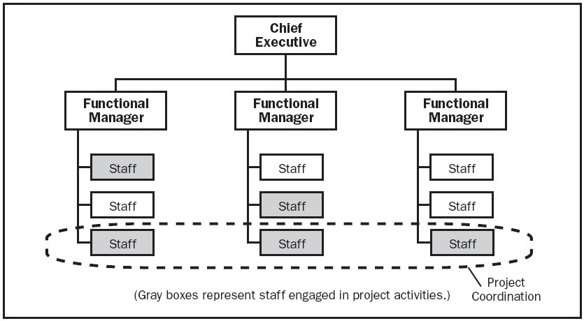
Weak Matrix
Project managers have no authority, little insight into resource availability, and do not control project budgets.

Slide 3
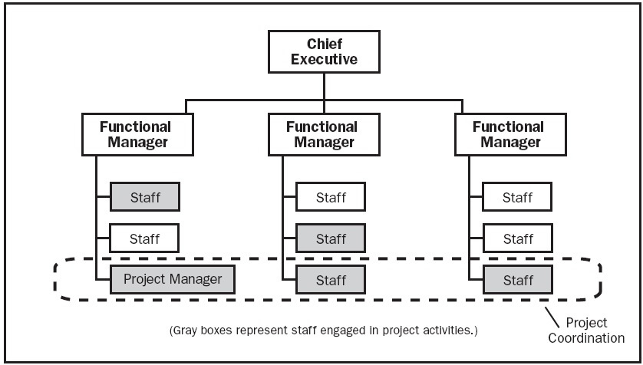
Balanced Matrix
Project managers have low to moderate authority, may have insight into resource availability in their function (but not other functions), and do not control project budgets (in the case of CHS).

Slide 4
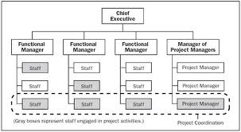
Strong Matrix
Project managers have moderate authority, moderate visibility into resource availability, and control/manage project budgets.

Slide 5
Decision
Which model will fit best here?

Slide 6
PMO Charter
Facilitate the creation and management of the strategic master plan. Provide the aerial view that allows the leadership team to balance risk and rewards in the portfolio. Ensure linkage of programs to the plan, drive implementation of the strategy (at the portfolio, program (product), and project level (custom))
Derive the right mix of strategic & tactical programs balancing growth and cost, product and market, customer touch and back office, long term and short term
Own portfolio management for the company including program (product) & project (custom) proposal, evaluation, prioritization, authorization, management, and control
Rationalize the work at the portfolio, program, and project level to deliver a small number of highly successful programs & projects in order to limit the diffusion of money, time, brainpower, and focus
Manage portfolio, program, project realignment in response to change
Monitor portfolio (programs, projects) health (program key performance indicators)
Provide a common language across programs & projects (templates & gate reviews)
Communicate clear, concise, and timely information (scorecards, reviews, SharePoint)
Individual project management of custom requests (to support SI work)
Program management of standard product/service offer development
Provide a forum to answer the questions . . .
Are we sure this investment is right for us?
How will it contribute to our strategic objectives?

Slide 7
Program Management Process
Program Identification
Program Priority Setting
Program Roles
Program Management
Program Reporting/Monitoring

Slide 8
Program Identification
New Program Proposal
  Program initiation process (New offers, custom projects, strategic initiatives)
  Standing leadership team meeting to review new proposals
  Needs/issues to be addressed (benefits)
  Strategic fit against company imperatives
  Performance against priority-setting criteria
  Estimated Costs & personnel time
  Gross margin fit
  Probability of success
Formal Program approval
  Standing agenda item for discussing & approving programs at Exec staff
  Executive sponsor approval
  Funding approval
Program Identification
Program Priority Setting
Program Roles
Program Management
Program Reporting/Monitoring

Slide 9
Program Priority Setting
Provide a forum and Decision Analysis tool for the leadership team to set program priorities on an ongoing basis
Prioritization criteria
  Revenue opportunity
  Establish/widen competitive advantage
  Reduce cost
  Investment requirements ($$ & HR)
  Development duration
Analyze resource capacity
Assess current program commitments
Evaluate project portfolio
Prioritize
Initiate, Kill, Delay
Program Identification
Program Priority Setting
Program Roles
Program Management
Program Reporting/Monitoring

Slide 10
Program Roles Identification
Executive program sponsor
Program steering committee
Program manager
Program Core Team (Engineering, Day 0, Day 1, Day 2 representation as applicable to the program)
PMO director will
  Develop & maintain methodology and standards across programs
  Provide training & mentoring
Program Identification
Program Priority Setting
Program Roles
Program Management
Program Reporting/Monitoring

Slide 11
Program Management
Solutions Development Process
  Concept Approval Gate (OK to Start)
  Requirements Gate(OK to Plan)
  Planning Gate (OK to Develop)
  Beta Entry Gate(OK to Beta)
  FCS/GA Ready Gate(OK to Launch)
  EOL Entry Gate
Ongoing risk analysis and contingency planning
  What if the project misses the schedule?
  What if the project overspends?
  Etc….
Program Identification
Program Priority Setting
Program Roles
Program Management
Program Reporting/Monitoring

Slide 12
Program Reporting/Monitoring
Reporting
  Projects
  Programs
  Portfolio
  Process
Elements of reporting
  Results
  Schedule and cost
  Issue-resolution
  Stakeholder satisfaction
Program Identification
Program Priority Setting
Program Roles
Program Management
Program Reporting/Monitoring

Slide 13
Prioritization/Decision Analysis Tool

Slide 14
Program Name:
<Name>
<Prgm Phase>
Program Manager:
<Name>
Update Date:
<Date>
Status |  | ●
Program Objective: <GM improvement, grow business, retain customers, etc.>
Status Summary: <1-2 sentence narrative on program status highlights>
Category | Issue/Risk/Critical Dependencies | Mitigation Plan | Status
<Resource, schedule, …> |  |  | <IP or Need Help, yellow or red>
Core Components | Status
Engineering
Day 0
Day 1
Day 2
Key Milestones | Date
Concept Gate | Skipped
Requirements “OK to Plan” Gate | Target 9/30
Services/Engineering Commit “OK to Develop” Gate | TBD
OK to Beta Gate | TBD
OK to Launch Gate | TBD
Global Availability | TBD
Schedule
Status | <On track or Delayed>
% Complete | <Percent complete>
Critical Path | <Critical path task>
Period | Budget | Actuals
Current QTR
Next QTR
Next Half

Slide 15
Services Solution Program Management Responsibilities
Role | Accountability*
Solution Program Manager | Delivery of the program requirements as per the SRD Overall program management covering every aspect of the SRD and including the master project plan, schedule, budget, risks register, communications, legal, financial Gate reviews, core team, reporting, issue escalations
Engineering Project Manager | Delivery of the Engineering requirements as per the SRD Engineering readiness and readiness reporting TRD
Day 0 Project Manager | Delivery of the Day 0 requirements as per the SRD Day 0 readiness and readiness reporting Consultant on Day 1 Handoff Process
Day 1 Project Manager | Day 0 Handoff process Delivery of the Day 1 requirements as per the SRD Day 1 readiness and readiness reporting Consultant on Day 2 Handoff process SDR
Day 2 Project Manager | Day 1 Handoff Process Delivery of the Day 2 requirements as per the SRD Day 2 readiness and readiness reporting SDR
* Defined as ultimately accountable for the correct and thorough completion of the deliverable or task, and the one to whom Responsible(s) is accountable

Slide 16
Program Management RACI
Role | Accountability*
Solution PM | Delivery of the program requirements as per the SRD Overall program management covering every aspect of the SRD and including the master project plan, schedule, budget, risks register, communications, legal, financial Gate reviews, core team, reporting, issue escalations
Day 0 PM | Delivery of the Day 0 requirements as per the SRD Documentation program management Training program management Day 0 readiness and readiness reporting
Day 1 PM | Delivery of the Day 1 requirements as per the SRD Day 1 readiness and readiness reporting
Day 2 PM | Delivery of the Day 2 requirements as per the SRD Day 2 readiness and readiness reporting
* Defined as ultimately accountable for the correct and thorough completion of the deliverable or task, and the one to whom Responsible(s) is accountable

Slide 17
Reporting Objectives
Make progress and performance visible to the management team
Focus on metrics that show if a project is achieving expected results
Show predicted-v-actual to highlight variance
Fact-based where possible
Reduce manually intensive reporting as much as possible
Primarily focus on results, secondarily on activities
Keep reports simple, short, and sweet
Align to a report template
Consistent availability from a reliable source identifying trends
Cover results, cost, schedule, issues
Answer the questions;
  Are we doing the right things? (CSAT, Financials, Performance Relative to Competition)
  Are we doing things right? (Project, program, portfolio management process effectiveness)

Slide 18
Solutions Development Process Phases
OK to Start Gate (Concept Approval)
OK to Launch Gate (FCS/GA Ready)
Solution Development Process
Requirements
Major Deliverables
MRD
Owners
Development
Beta & Pilot
Launch
Sustain & Enhance
Retire/EOL
SRD
Project Plan
& Detailed Requirements
High Level Design
Planning
Detailed tech specs, test plans, Beta plan
Detailed Launch plan Release Readiness
GA Solution
Field Input for features
EOL Request template
Product Management
Product Management
Eng, Day 0,1,2, Product Management
Eng, Day 0,1,2, Product Management
Prod Mgmt, Product Marketing
Product Mgmt, Program Mgmt
Product Mgmt, EOL team
Concept
OK to Plan Gate (Requirements)
OK to Develop Gate
(Plan)
OK to Beta Gate (Beta Entry)
EOL Entry Gate
Note: the Planning phase includes detailed requirements for engineering (TRD), Day 0, Day 1 (SDR), and Day 2 (SDR)

Slide 19
Gate Review Process
Leverages PDP gate review process
Purpose is to review readiness to pass through a gate from one phase to the next
Core team puts together the gate review slides and provides input on “readiness to pass”
A program dependent Governance Committee provides “phase exit approval”
Governance Committee members are responsible for resource allocation for the next phase

Slide 20
PMO Controls
Program
Reviews
& Phase
Gate
Approvals
Program
Status
Reporting
Central
Program
Scheduling
(Critical
Path/
Dependencies)
Risk
Management
Program
Team
Meetings
Google Repository & MS Project

