Slide 1
Cyber Recovery in the
Age of AI Enabled Ransomware
Daniel Heidt, VP of Hybrid Cloud, People Driven Technology
NOVEMBER 14, 2024

Slide 2
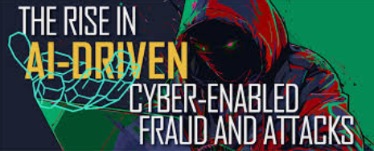
AI-Enabled Cyber Attacks
Closing the time between vulnerability detection and payload execution
Makes attacks more cost and time effective
Increase Bad Actors time-to-value
Better matching between vulnerability and exploitation tools
Better understanding of exfiltration targets

Slide 3
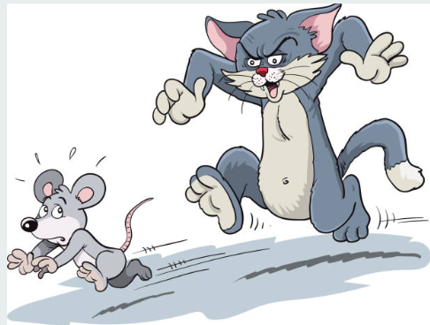
Exposing execution maturity gaps
Critical Patch Execution Windows
Time to Remediation
Zero-Day Procedures
Threat Intelligence

Slide 4
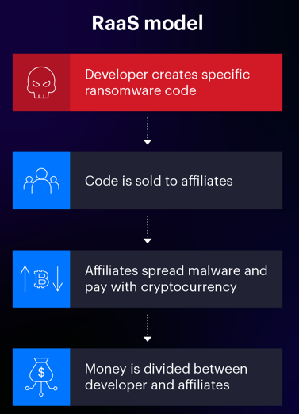
What is RaaS or Ransomware-as-a-Service?

Slide 5
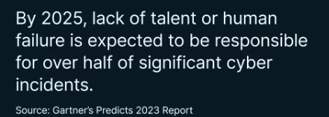
How is AI helping defend customers’ cyber security?
Recognizes patterns faster
Processes large data sets faster
Mostly improving reaction time
Higher accuracy

Slide 6
Hierarchal Driven Recovery & Data Recovery Methodologies

Slide 7
Hierarchal Driven Recovery Architecture
1st Layer – Production workloads protected by Layered Security and Resilience
2nd Layer – Instant Recovery – Immutable Snapshots
3rd Layer – Emergency Recovery – Indelible Snapshots
4th Layer – Disaster Recovery – Point-in-Time copies
5th Layer – The Vault– Public/Private Cloud Repository

Slide 8
Data Recovery Methods by Layer
Tier 1 – Production Workloads
Tier 2 – Instant Recovery – Immutable Snapshots
Tier 3 – Emergency Recovery – Indelible Snapshots
Tier 4 – Disaster Recovery – Backup Software
Tier 5 – The Vault – Public/Private Cloud Repository

Slide 9
Proactive Tips
Pick a Partner that can deliver consistent resources.
Project management makes the difference.
Focus on AVAILABILITY over up-time.

Slide 10
Better Together with PDT
Experience our “One Team” Approach to Success
Customers love Data-Driven outcomes. Together we can integrate modern technologies for a better future.

