Slide 1
An Interactive Introduction to Microsoft Power BI
Robert Homan
Drinking Water and Environmental Health Division
Data Application Support Unit
Homanr1@michigan.gov
(517) 599-8661

Slide 2
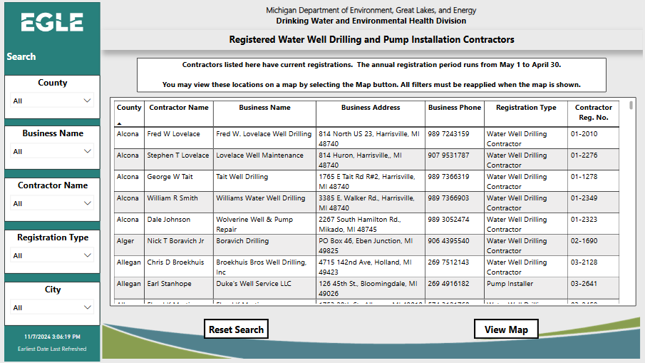
What is Microsoft Power BI?
Power BI is a Report Building Software Program
Creates Dynamic Visual Reports
Available in Software Center
Example

Slide 3
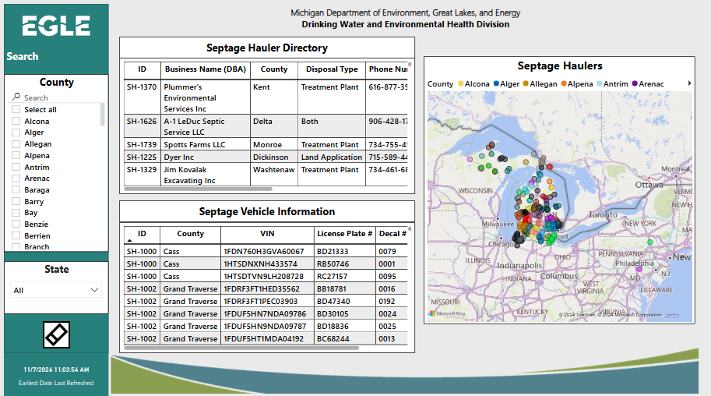
What We Will Use Power BI To Do
Turn an Excel file into an Interactive Report
Mask errors in the data
Create & Modify Visuals:
  Tables
  Graphs
  Slicers
Add Alternate Text
Publish reports

Slide 4

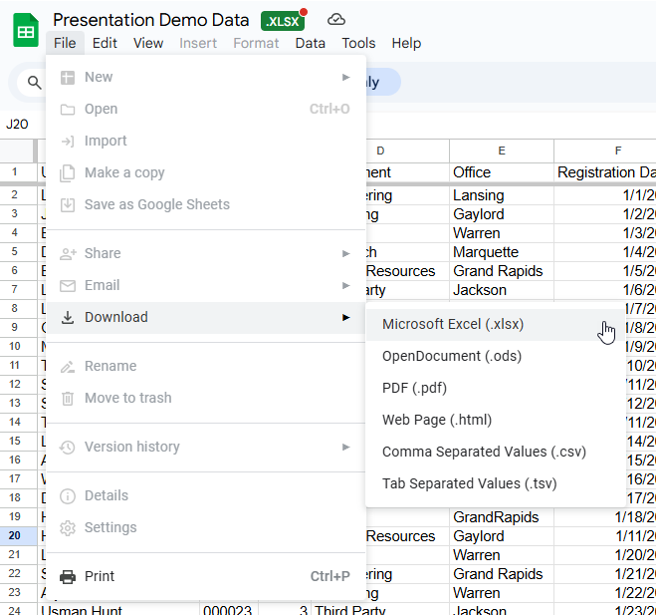
Use This Link or the QR Code to Access the Testing Data
Please Follow Along With the Demonstration!
Notes:
https://docs.google.com/spreadsheets/d/1DN9a7tSC3ms3qMDWnew59cFFLUJjN8Oc/edit?gid=1783115224#gid=1783115224

Slide 5
Works Cited
Trevithick Press Ltd. (2022, March 24). Name generator. Masterpiece Generator. Retrieved November 4, 2024, from https://www.name-generator.org.uk/

Slide 6
Closing slide

