Slide 1
PRESENT
WITH EASE

Slide 2
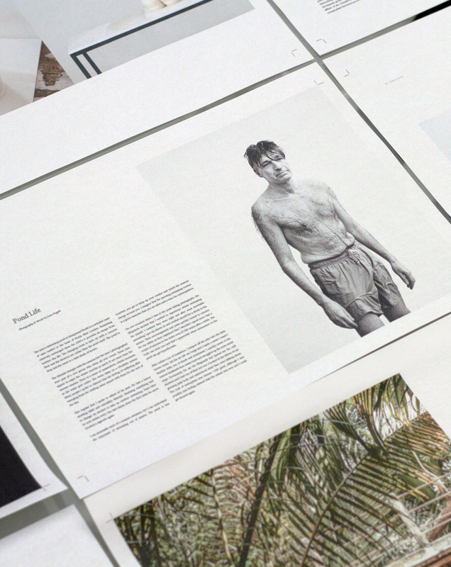
Choose from professionally-made templates
Over a thousand presentation templates
to choose from to fit any objective or topic.
It is mostly presented before an audience. It serves
a variety of purposes, making presentations powerful tools for convincing and teaching.

Slide 3
1
Presentations are communication tools that can be used as demonstrations, lectures, speeches, reports, and more. It is mostly presented before an audience.
Customize with text
and photos
2
Presentations are communication tools that can be used as demonstrations, lectures, speeches, reports, and more. It is mostly presented before an audience.
Add curved text and shadow
for style, and make images
move with photo effects.

Slide 4
Apply page animations and transitions
It's the easiest way to emphasize ideas and make them even more memorable.
Example
Example
Example
Elaborate on the concepts with helpful examples and illustrations. Duplicate this page as many times as needed to give you more space for discussion.
Elaborate on the concepts with helpful examples and illustrations. Duplicate this page as many times as needed to give you more space for discussion.
Elaborate on the concepts with helpful examples and illustrations. Duplicate this page as many times as needed to give you more space for discussion.

Slide 5
Visualize information with charts
Simplify rather complicated and dense information. Use charts and graphs to help people process and remember data quickly.
87%
Briefly elaborate on what you want to discuss.
Briefly elaborate on what you want to discuss.

Slide 6
Make it extra with magic shortcuts.
Find the fun in presenting!
Press
Press
Press
C
D
O
for confetti
for a drumroll
for bubbles
Presentations are communication tools that can be used as demonstrations, lectures, speeches, reports, and more.
Presentations are communication tools that can be used as demonstrations, lectures, speeches, reports, and more.
Presentations are communication tools that can be used as demonstrations, lectures, speeches, reports, and more.

Slide 7
Access your presentation on any device
Open your presentation on any
browser on any mobile device.
Design, edit, and present on the go.
You can export your Canva Presentation as PDF or video format, depending
on what’s convenient for you.

Slide 8
Collaborate in real-time
Feel like you’re in the same room as your teammates or
co-presenters. Share tasks
and work simultaneously to create a powerful presentation.

Slide 9
Pre-record
to present anytime, anywhere
Add audio or record yourself talking over a presentation, then share your video with everyone. It’s excellent for capturing audiences beyond a one-time event.
1
2
3
Presentations are communication tools that can be used as demonstrations, lectures, speeches, reports, and more.
Presentations are communication tools that can be used as demonstrations, lectures, speeches, reports, and more.
Presentations are communication tools that can be used as demonstrations, lectures, speeches, reports, and more.

Slide 10
Present like a pro
using presenter view
Feel calm and confident with a private screen
to read your script and notes, view a timer,
and know your
upcoming slides.
Point 1
Point 2
Point 3
Presentations are communication tools that can be used as demonstrations, lectures, speeches, reports, and more.
Presentations are communication tools that can be used as demonstrations, lectures, speeches, reports, and more.
Presentations are communication tools that can be used as demonstrations, lectures, speeches, reports, and more.

Slide 11
Engage with your audience using Live Q&A
Send surveys and questions your audience can answer on their devices.
It is mostly presented before an audience. It serves a variety of purposes, making presentations powerful tools for convincing and teaching.
It is mostly presented before an audience. It serves a variety of purposes, making presentations powerful tools for convincing and teaching.

Slide 12
Wow any
audience with
your presentation.
Presentations are communication tools that can be used as demonstrations, lectures, speeches, reports, and more.
1
Presentations are communication tools that can be used as demonstrations, lectures, speeches, reports, and more.
2
Presentations are communication tools that can be used as demonstrations, lectures, speeches, reports, and more.

Slide 13
PLAN,
Design,
Present
All in one place.

Slide 15
Free Resource Page
Use these elements in your Canva presentation.

