Slide 1

Unlocking the Power of Using Visual Tools:
Why Visual Schedules, First/Then, Timers, and Social Scripts are essential!
Charting the Cs Conference 2025:
To Literacy and Beyond
Cooperation
Communication
Collaboration
Presentation Date April 2025
Presenters Names:
Laura Kleffman, Occupational Therapist
Jen Jaros, Early Childhood Family Education Coordinator

Slide 2
Universal Design for Learning
Guidelines that offer a set of concrete suggestions that can be applied to any discipline or domain to ensure that all learners can access and participate in meaningful, challenging learning opportunities.
UDL aims to change the design of the environment rather than to situate the problem as a perceived deficit within the learner.
Implications for the Early Childhood Environment…

Slide 3
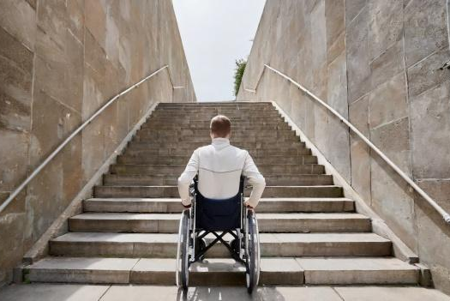
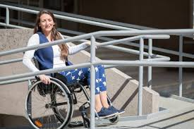
Universal Design:
Providing support for more people rather than fewer.
How many times have ramps prevented someone with independent mobility from physically accessing a desired location?
How many times have stairs prevented someone who relies on wheeled mobility from physically accessing a desired location?

Slide 4

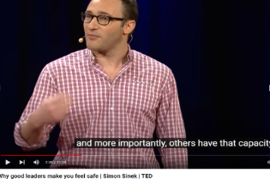
Universal Design:
Providing support for more individuals rather than fewer.
How many times have people without hearing loss used Closed Captioning to support the message of the spoken word?
How many times have people with hearing loss missed out on the message of the spoken word without Closed Captioning?

Slide 5
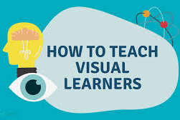
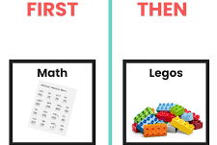
Consider how pictures can be a Universal Design tool to promote independence and increased understanding…
Point: the use of a visual picture tool provides access in a way that honors an individual’s strengths and comprehension
Be aware of the messaging, and how it’s being sent and received. How does the message sent find a useful spot to land?

Slide 6
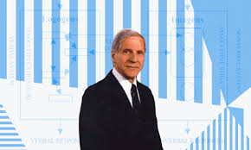
DUAL CODING THEORY By Allan Paivio
The theory, developed by psychologist Allan Paivio, is based on the understanding that our memory utilizes two separate channels to store information: visual and verbal. While these channels function independently, they can also work together to establish connections between words and images.

Slide 7
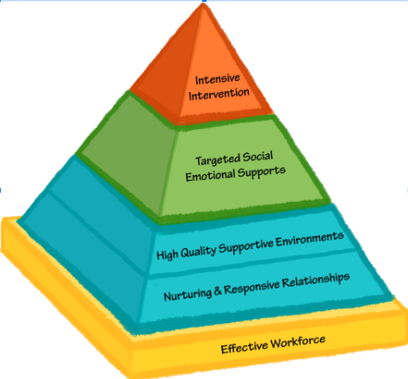
The Pyramid Model
The Pyramid Model (AKA Positive Behavioral Interventions and Supports) is a framework for early childhood education and care that uses visuals to promote social-emotional learning and behavior in children.
Visuals are used at all levels of the Pyramid Model to support these needs and aid in mutual understanding amongst the group or the individuals who need the targeted intervention.

Slide 8
Early Childhood Literature and the use of Pictures - WHY?
Zhihui Fang of Purdue University in 1996 concluded:
In summary, illustrations in picture books are meant to delight, to capture attention, to amplify or tell a story, to teach a concept, and to develop appreciation and awareness in children. Given the important role illustrations play in children's picture books and in children's language and literacy development, it is imperative that teachers, textbook writers and illustrators become more sensitive to the information conveyed through the delicate interplay of print, pictures, and the child reader.

Slide 9
Autism and Use of Visuals
Brain Processing: Research indicates that autistic individuals may process language through visual areas of the brain, leading to a preference for visual information.
Concrete Understanding: Pictures provide a concrete representation of concepts, which can be easier to grasp than abstract spoken language, especially when dealing with complex ideas or social cues
Reduced Cognitive Load: Interpreting spoken language often requires additional processing to understand nuances like tone and body language, which can be challenging for people with autism; visuals bypass this extra cognitive load

Slide 10
Autism and Use of Visuals, References
Kasari, C., Brady, N., Lord, C., & Tager-Flusberg, H. (2013). Assessing the minimally verbal school-aged child with autism spectrum disorder. Autism Research, 6(6), 479–493. doi: 10.1002/aur.1334.Review. Retrieved November 8, 2016, from https://www.ncbi.nlm.nih.gov/ pubmed/24353165.
Tager-Flusberg, H., & Kasari, C. (2013). Minimally verbal school-aged children with autism spectrum disorder: the neglected end of the spectrum. Autism Research, 6(6), 468–478. doi: 10.1002/aur.1329. Review. Retrieved November 8, 2016, from https://www.ncbi.nlm.nih. gov/pubmed/24124067.
https://www.verywellhealth.com/visual-thinking-and-autism-5119992

Slide 11
Additional Resources Used for this Presentation as it relates to the diagnosis of Autism:
From preschool aged children in a classroom, school age supports, to adults on the job site or visiting a doctor; the use of visual tools accelerated a person’s ability to engage in a common routine, understand expectations, social norms, and functional engagement in the activity.
Preschool Aged Resources: Head Start - Early Childhood Learning and Knowledge Center
Journal of Intellectual and Developmental Disability: The effectiveness of visual activity schedules for individuals with ID; A meta-analysis.
Visual Supports and Autism from Vanderbilt Kennedy Center

Slide 12
OK enough theory and resources….Time to Dive into Visual Tools!

Slide 13
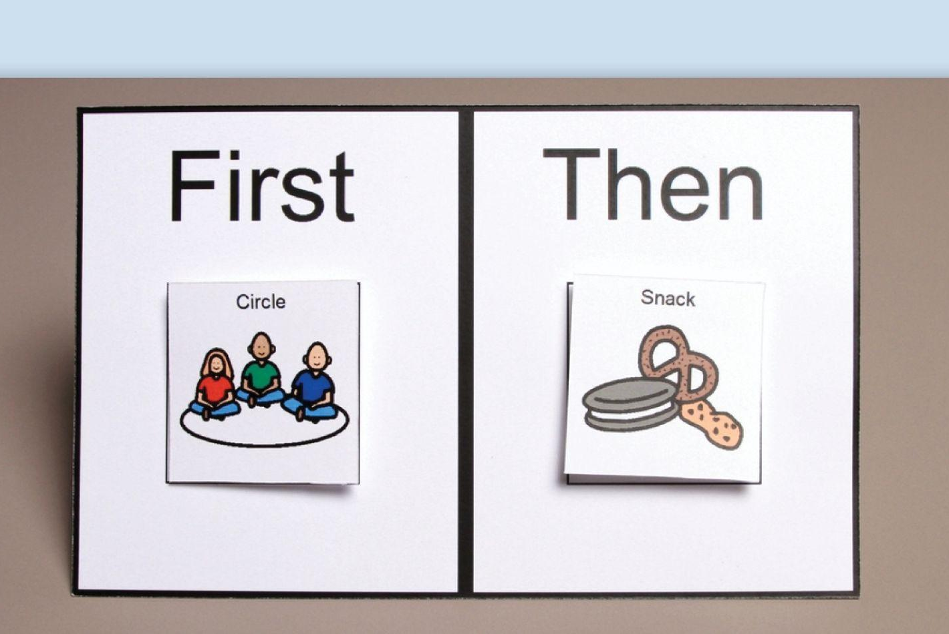
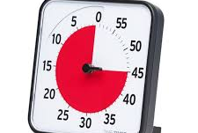
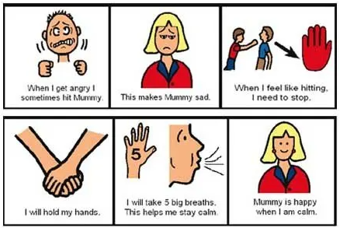
Common Visuals Considered and Utilized in Classrooms, Group Homes, Family Homes, Child Care Sites, Playgrounds Etc.
All of these tools rely on creating a visual image or picture.
When it’s visual, it doesn’t disappear like spoken words do!

Slide 14

Organizing ourselves for the rest of this presentation
WHO are we focused on?
WHAT are we doing... theoretically?
WHERE are these used?
WHEN do we provide visual tools?
WHY do we use these?
HOW do we get started?

Slide 15
WHO is helped by visual tools?
People…
Who are learning to read
Who might struggle with understanding spoken language
Who have a strength with understanding language spoken to them and struggle to express themselves regularly or reliably.
Who experience hearing loss
Who are neurodiverse
Who display uneven development
Who are typically developing, and are in the stages of mastery with receptive and expressive language processing
ALL people

Slide 16
WHAT are we doing?
1. Accommodating Processing Skills
2. Supporting Receptive Language
The way in which information goes in, gets stored and creates a response, may take longer for some.
Tapping into someone’s understanding of language and concepts through alternative means.

Slide 17
WHAT are we doing? (Continued)
3. Supporting Concrete Learners
4. Did you know that 80-85% of our sensory input is visual?
Helping the concept that is spoken and “stays in the air”and never really “lands” anywhere.

Slide 18

WHERE can we use visuals?
At home
In the car
At work
Dr/Dentist appointment
Restaurant
Grocery store
Trying a new activity/location
During a transition
Anywhere, they can be portable!

Slide 19
WHEN do we use visuals? Anytime we need to….
...increase structure and predictability (which means decreasing anxiety about the future)
....switch our focus on behaviors of resistance TO what we’re asking that is preventing forward progress or participation

Slide 20
WHEN do we use visuals? Anytime we need to….(Cont’d)
...measure the passage of time for those who don’t understand how to measure time on a clock or understand the concept of time being measured
…create a tool that explains complex and abstract concepts. Examples: social cues interactions or social cues/norms.

Slide 21
WHY use visual tools?
Display behavioral expectations
Develop predictable routines
Support a clear compromise
Expand play
Decrease the teaching and learning cycle for all involved
Reduce anxiety
Measure time
Tap into an individual's receptive language skills
Create a common understanding between two people regardless of skill level
Support positive reinforcement
A way to increase cooperation
Address social and emotional needs

Slide 22
How do visual schedules relate to English Language Arts?
Pre-reading Visual Skills
Developmentally, top to bottom visual scanning occurs first.
Then, left to right sequencing develops.
Some people don’t master the left to right sequencing and then we meet them where their skills are.

Slide 23
How do visual schedules relate to English Language Arts?
Traditional Academic Instruction
Support Visual Perceptual Skills
Visually recognizing similarities and differences
Derive meaning from visual information
Provides structure for a lesson, life skills, social cues
Promotes independence
Can pair text with picture cues
Introduces new vocabulary
Story sequencing

Slide 24
HOW to initiate and implement visual tools?
Decide with your team what is needed to focus on first?
Teach or reinforce social skills
Establish a routine or daily schedule
Give choices / reminders
Positive reinforcers
Measure time
Brainstorm ideas and give yourself grace! Try to predict how this will go well and how it might need revision.
On behalf of the people needing it and implementing it!
Both sides matter for successful interventions!

Slide 25
HOW to initiate and implement visual tools? (Cont’d)
Acquire Materials Needed!
Do you need a commercial product?
Can something be made?
What materials or technology is needed?
How much time is needed?
How will this work for the long term?
Is it durable?
And finally, what’s the easiest way to create and manipulate this visual tool?

Slide 26
High Tech Options…

Slide 27
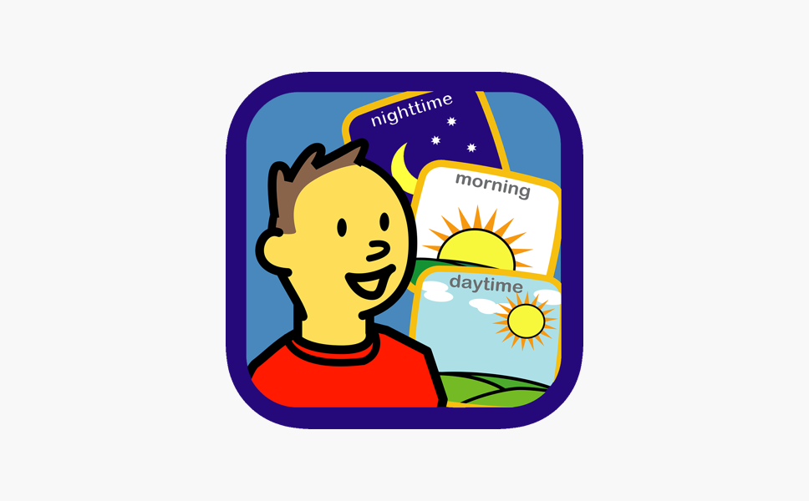



Apple/IPAD Apps To Consider
Choiceworks (top left image)
First Then Visual Schedule HD (top right)
Visual Schedule Planner (bottom left)
Time Timer (bottom right)
All schedule apps are available for purchase.
The Time Timer app is free.

Slide 28


CHROME STORE Apps
Visual Schedule Pro (Top image)
Pictogram Agenda (Bottom image)

Slide 29
Low Tech Options….

Slide 30
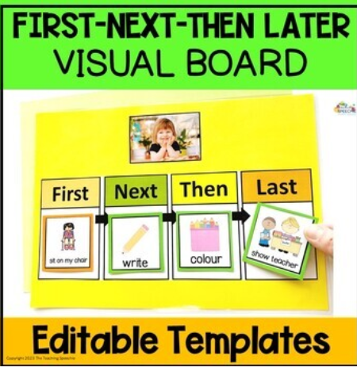
Templates can be purchased online
(Pinterest, Teachers Pay Teachers, etc)
Templates are available for purchase,
or can be made by reviewing others strategies and what is needed.
(The Teaching Speechie)

Slide 31
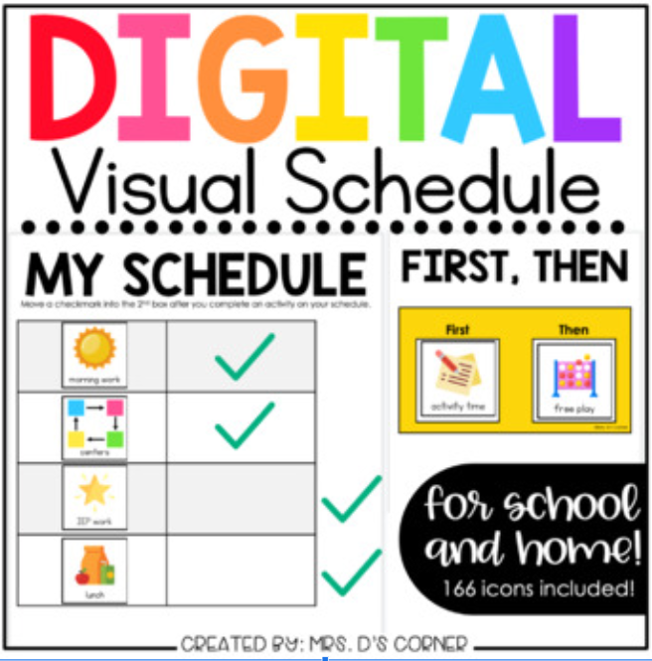
Template Examples
Digital Visual Schedule
(Mrs. D’s Corner)

Slide 32
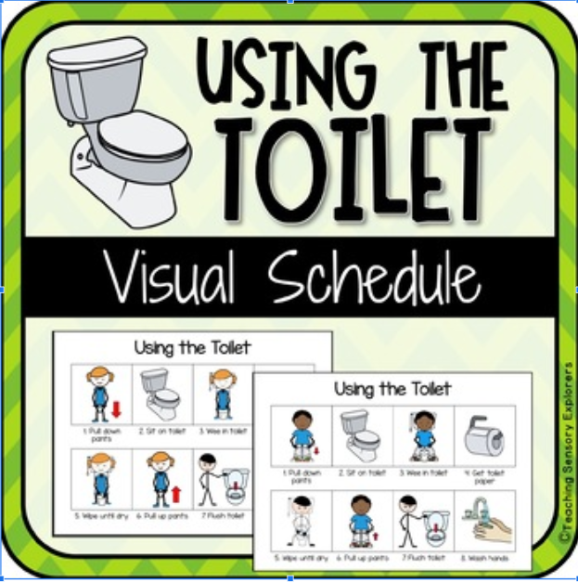
Templates for multiple steps in one task.
Instead of multiple tasks, sometimes we need multiple steps for one task - routines within routines.
(Teaching Sensory Explorers)

Slide 33
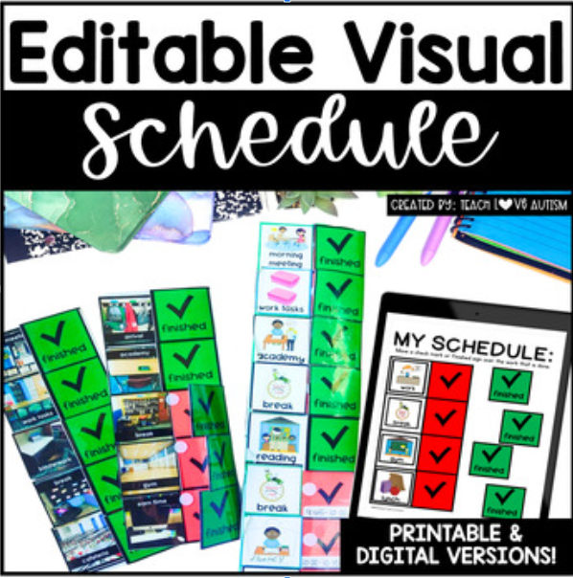
Templates with a fold over option.
(Teach, Love, Autism)

Slide 34
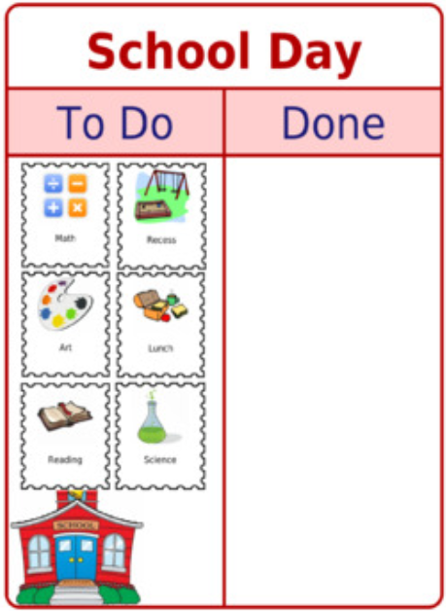
Additional Examples….
Sometimes people need to have the task that is finished moved from one side to the other.

Slide 35
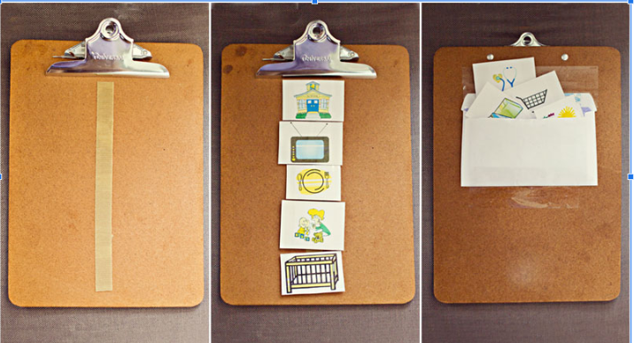
More Low Tech Examples….
Sometimes having something durable, portable, or “cleanable” helps the lifespan of the visual tool.
Sometimes pictures need to disappear for the individual to focus on the appropriate images.

Slide 36
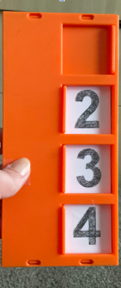
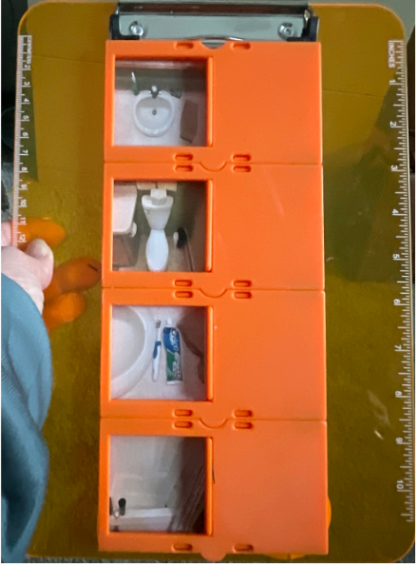
Early Examples of the EZ Slide Schedule
Seeing a picture, closing a door when something is completed. Doors can be closed in any order, see the bathroom images example.

Slide 37
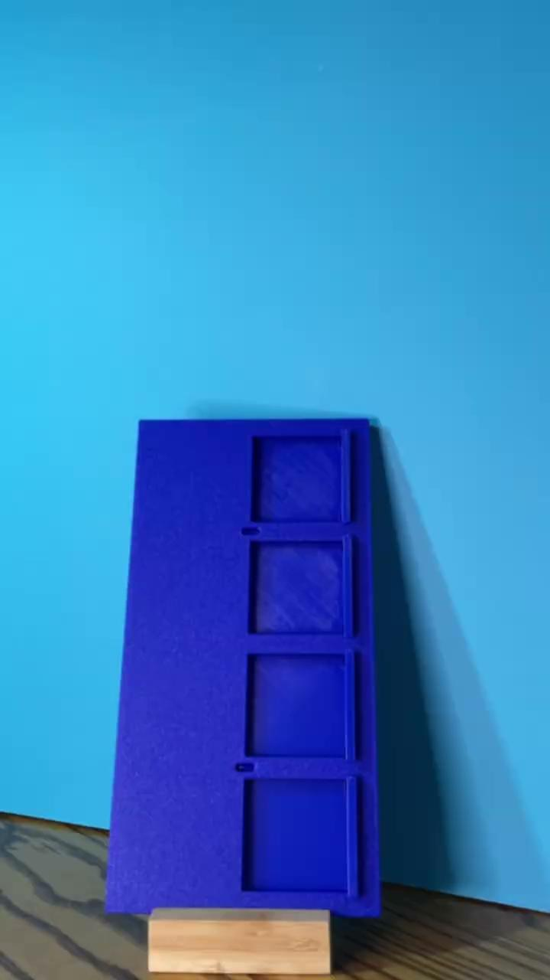
EZ Slide Schedule Assembly Video

Slide 38
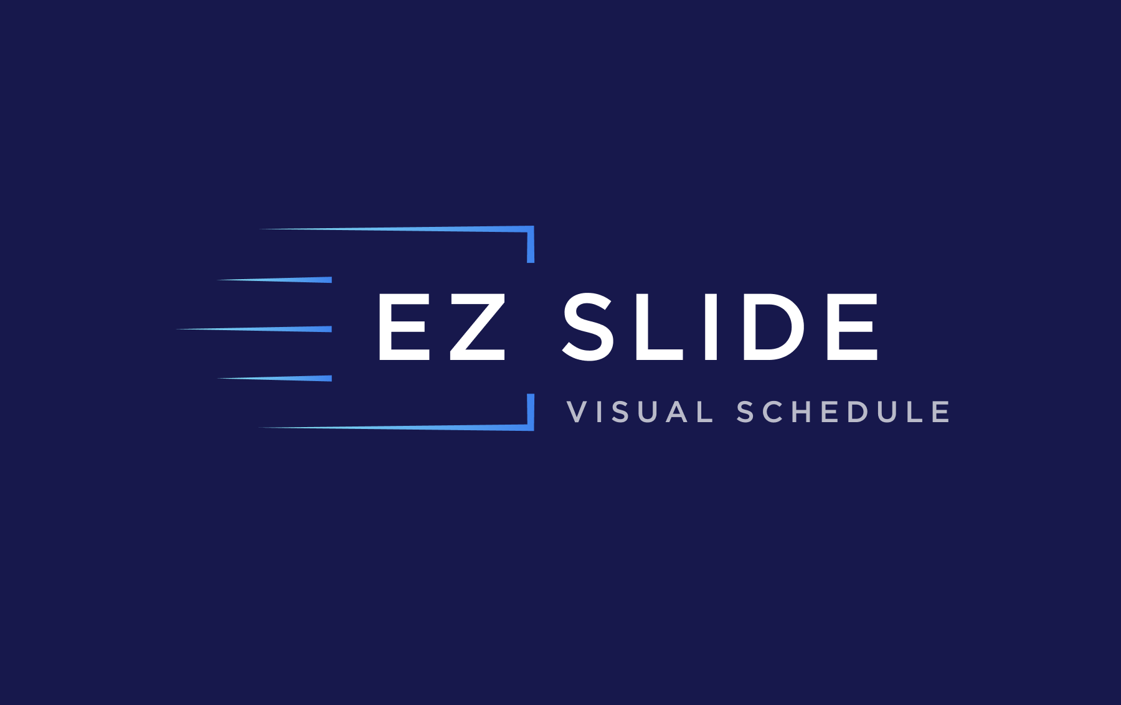
Let’s practice making an EZ Slide Schedule!
EZ Slide Schedule:
Materials - EZ Slide Schedule, pictures, laminator (optional), scissors or cutters
Cut pictures (rectangles)
Laminate pictures (optional) and cut again.
Insert pictures into the schedule
DONE - use it right away!

Slide 39

Thank you!
Laura Kleffman & Jen Jaros
info@ezslideschedule.com

Slide 40
Charting the Cs Conference 2025
Statewide Professional Development to Support the Workforce and Low Incidence Disability Areas in the State of Minnesota.
This presentation is partially funded with a grant from the Minnesota Department of Education using federal funding, CFDA 84.027A, Special Education – Grants to States. The contents of this website do not necessarily represent the policy of the federal Department of Education, or the state Department of Education and you should not assume endorsement by the federal or state government.

