Slide 1
#AlwaysRHSHoot
Red Hat Society, Inc. • P&G’s Always Discreet at Walmart Event

Slide 2
#AlwaysRHSHoot
A Look at the RSVPs
Total RSVPs: 2,170
United States: 2,005
International (Canada & Australia): 165
Red Hat Society, Inc. • P&G’s Always Discreet at Walmart Event

Slide 3
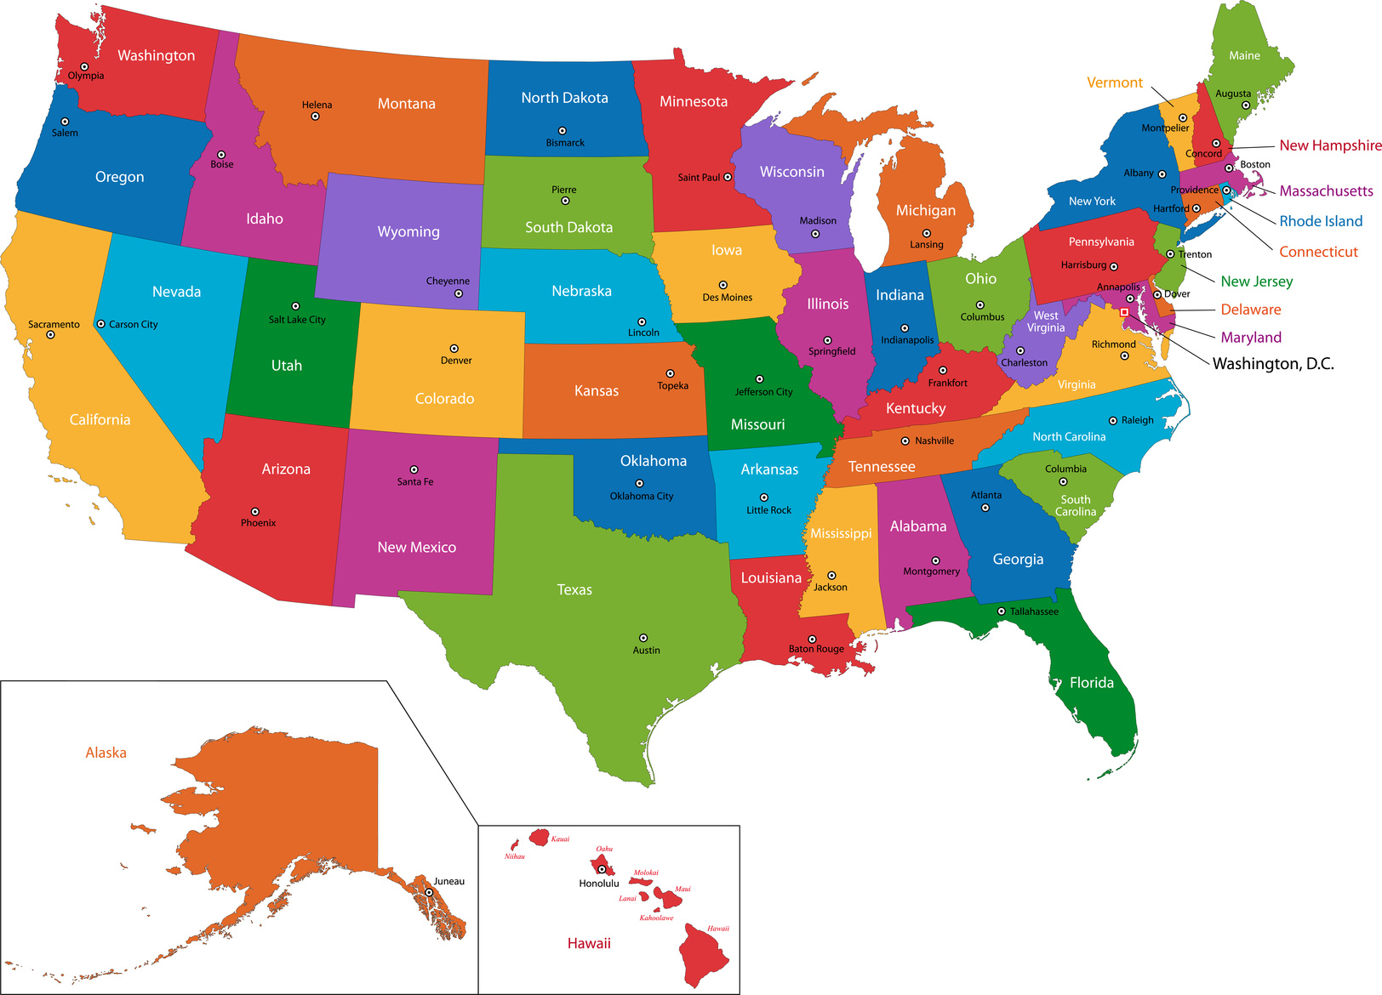
#AlwaysRHSHoot
A Look at the RSVPs
All 50 States of the United States were represented!
Red Hat Society, Inc. • P&G’s Always Discreet at Walmart Event

Slide 4
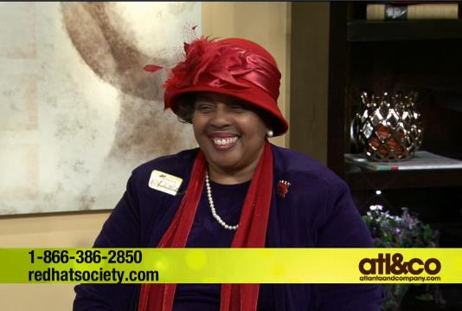
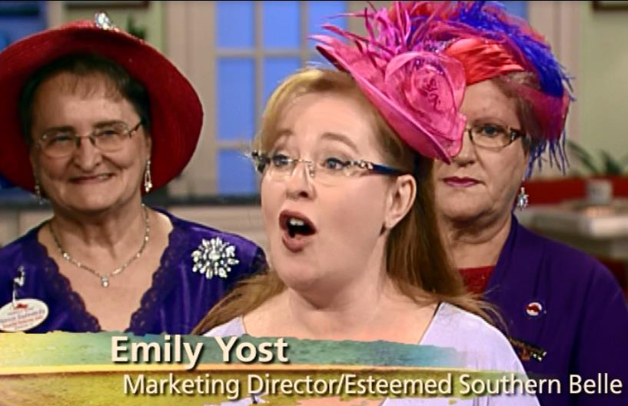
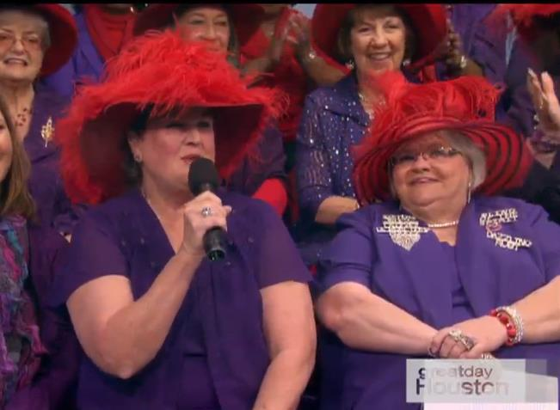
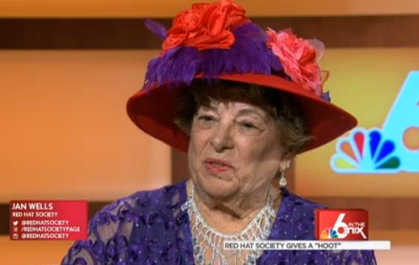
#AlwaysRHSHoot
Traditional Media-Broadcast
15 airings in five target markets
170 airings from syndicated placement
Total Reach= 280,605
Red Hat Society, Inc. • P&G’s Always Discreet at Walmart Event

Slide 5
#AlwaysRHSHoot
A Look at the Social Media Impact
229 Members used the #AlwaysRHSHoot when posting online
Nearly 300 Members posted photos with the product and/or scavenger hunt card
LIKES grew by 127 in one day
RHS’s Reach for the week of the Always RHS Hoot was more than 30,000
Red Hat Society, Inc. • P&G’s Always Discreet at Walmart Event

Slide 6
#AlwaysRHSHoot
A Look at the Impressions
Traditional Media Impressions: 139,164,506
Social Media Impressions: 119,713
Total = 139,284,219
Impressions to date
Red Hat Society, Inc. • P&G’s Always Discreet at Walmart Event

Slide 7
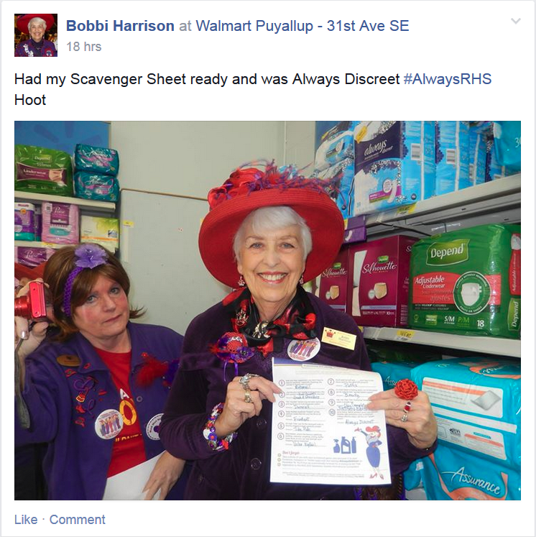
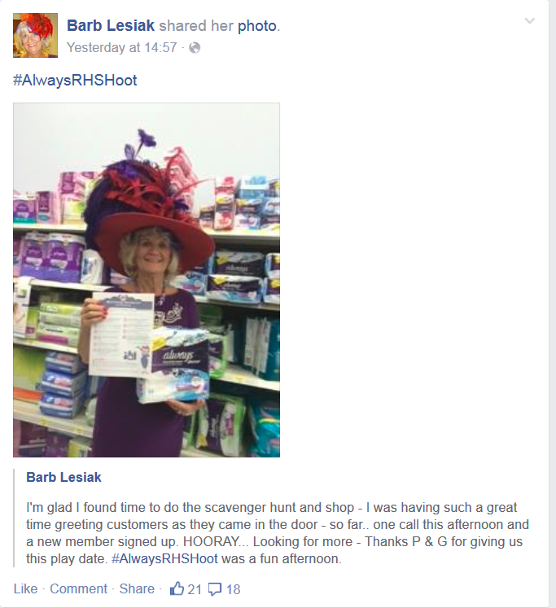
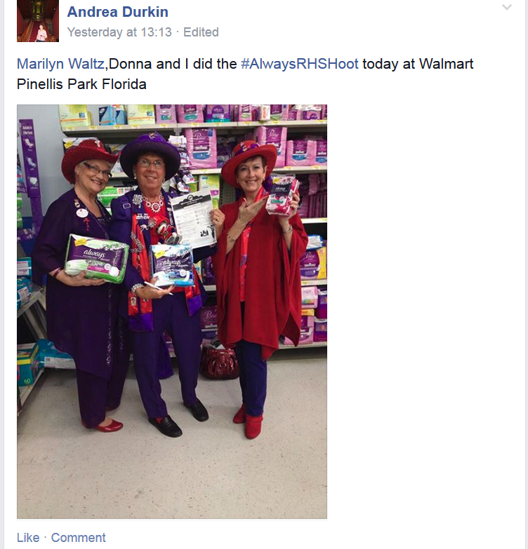
#AlwaysRHSHoot
A look at the day…
Red Hat Society, Inc. • P&G’s Always Discreet at Walmart Event

Slide 8
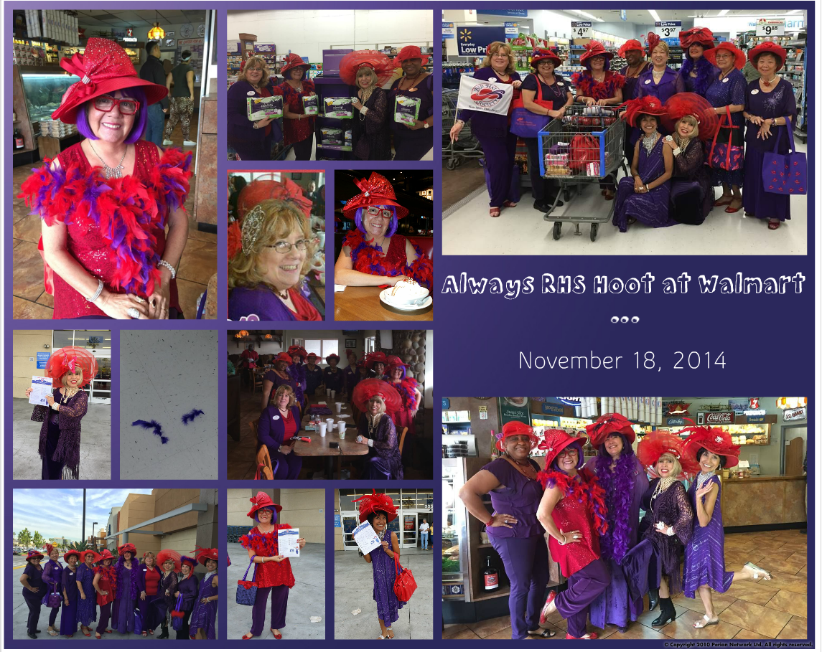
#AlwaysRHSHoot
A look at the day…
Red Hat Society, Inc. • P&G’s Always Discreet at Walmart Event

Slide 9
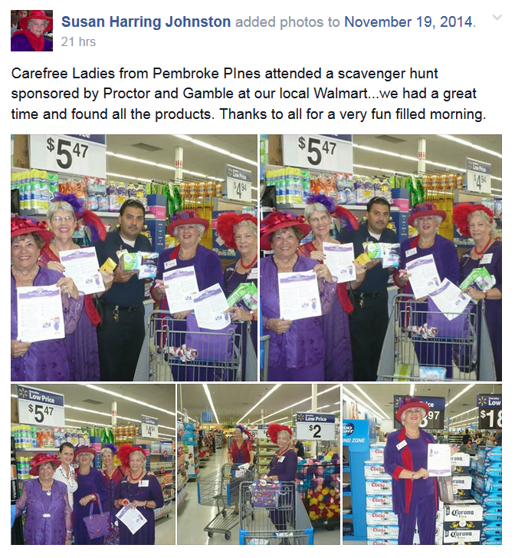
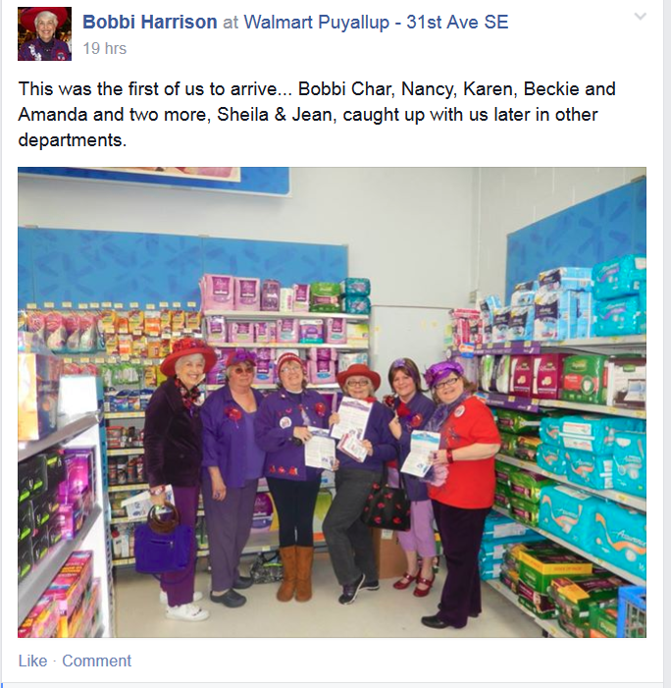
#AlwaysRHSHoot
Red Hat Society, Inc. • P&G’s Always Discreet at Walmart Event

Slide 10
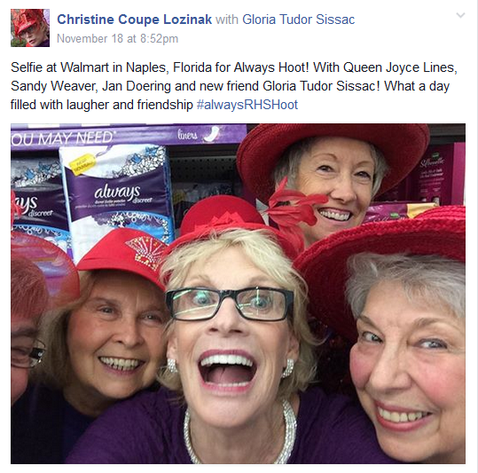
#AlwaysRHSHoot
So, what did we learn?...
Red Hat Society, Inc. • P&G’s Always Discreet at Walmart Event

Slide 11
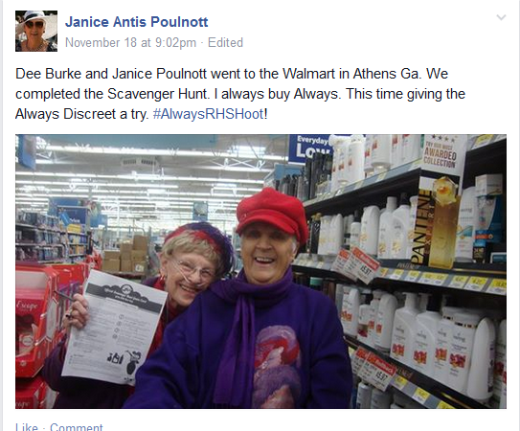
#AlwaysRHSHoot
We learned…
Always Discreet has RHS Members throughout the country trying the product because of the partnership!
And…laughing all the way to the checkout line!
Red Hat Society, Inc. • P&G’s Always Discreet at Walmart Event

Slide 12
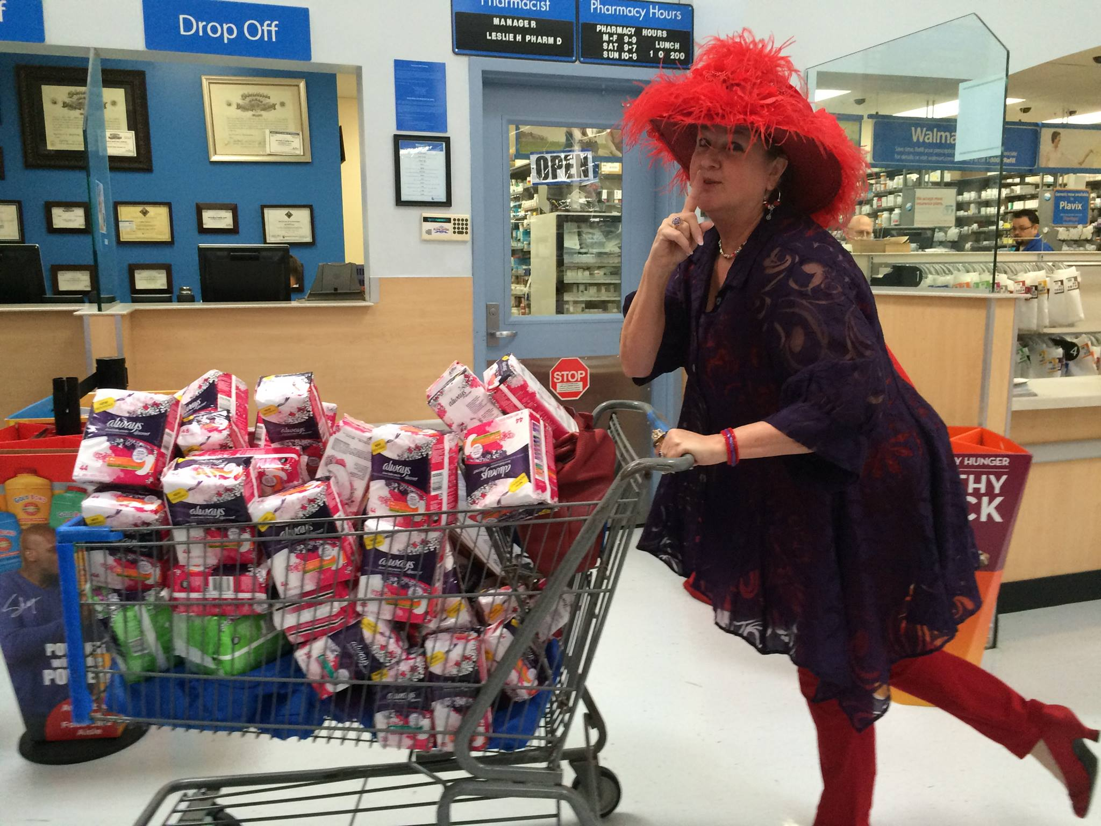
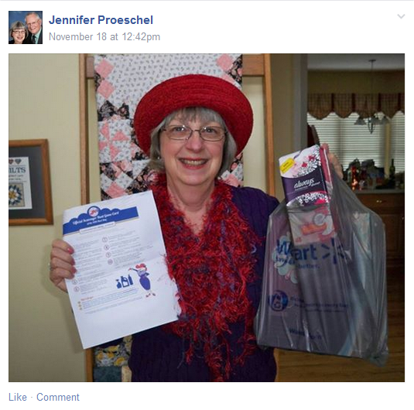
#AlwaysRHSHoot
We learned…
They bought the product!!! Many shared they were “stocking up for the winter!”
Red Hat Society, Inc. • P&G’s Always Discreet at Walmart Event

Slide 13
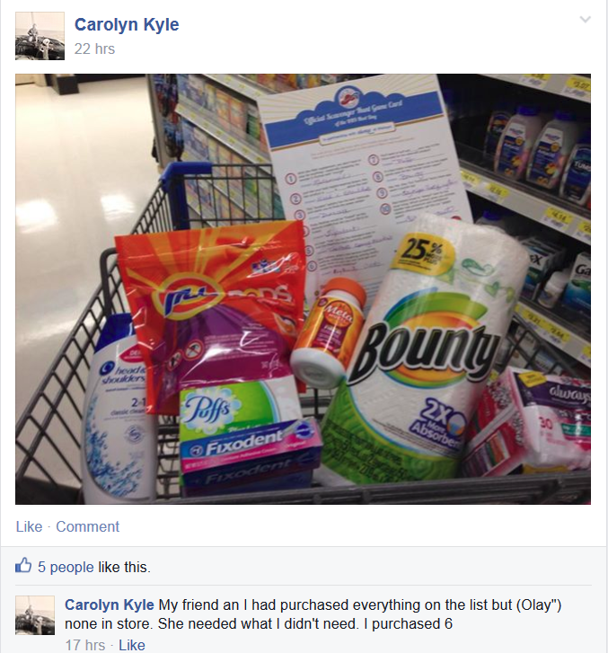
#AlwaysRHSHoot
We learned…
In addition to purchasing Always Discreet, the RHS Members bought other P&G items found on the scavenger hunt card!
Red Hat Society, Inc. • P&G’s Always Discreet at Walmart Event

Slide 14
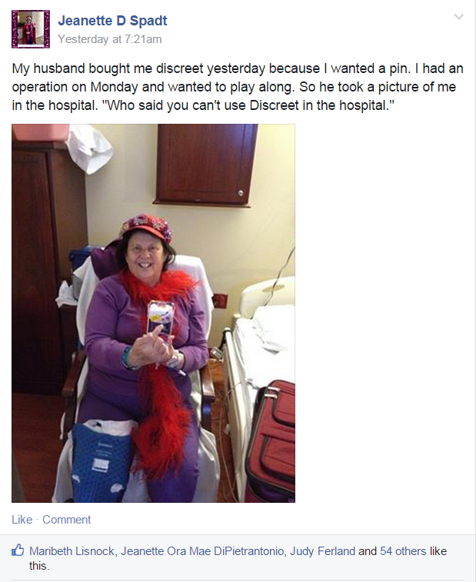
#AlwaysRHSHoot
We learned…
Even if they were hospitalized, they made sure they didn’t miss out on the fun!
Red Hat Society, Inc. • P&G’s Always Discreet at Walmart Event

Slide 15
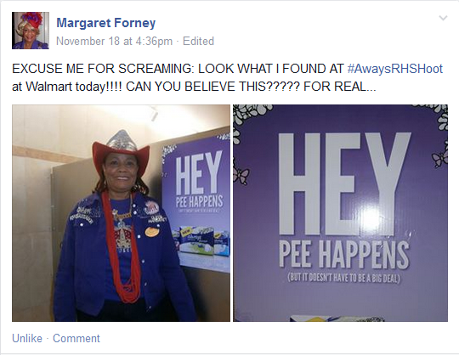
#AlwaysRHSHoot
We learned…
They will go to every location in a Walmart Store for a photo opp..even the bathroom. Look what they found!
Red Hat Society, Inc. • P&G’s Always Discreet at Walmart Event

Slide 16
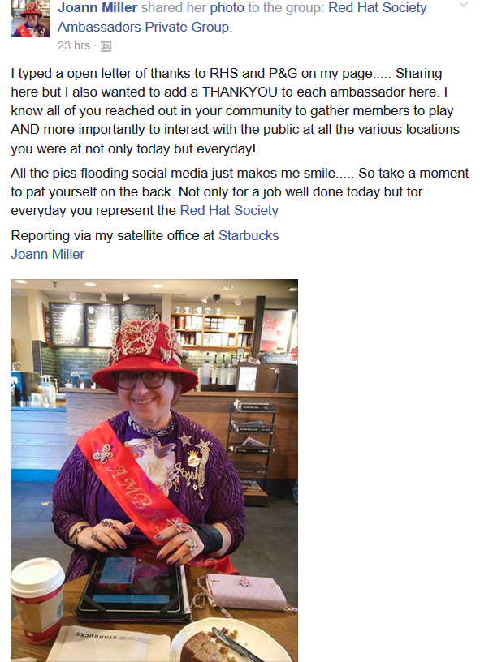
#AlwaysRHSHoot
We learned…
RHS Ambassadors & Social Butterflies became “satellite” reporters and took the time to keep the RHS Members informed of the fun happening in real time. They also took the time to thank the Members for supporting RHS and P&G!
Red Hat Society, Inc. • P&G’s Always Discreet at Walmart Event

Slide 17
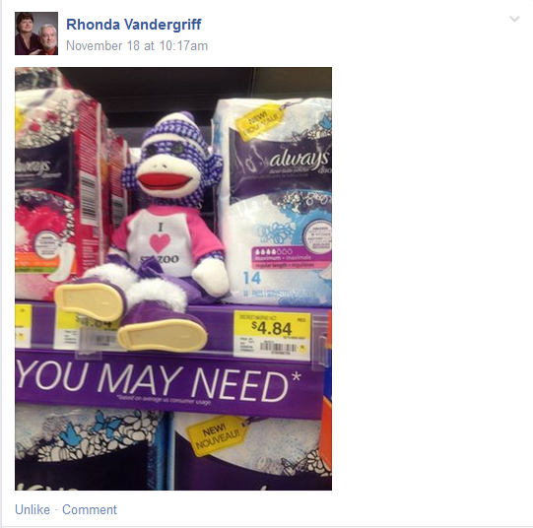
#AlwaysRHSHoot
We learned…
RHS Mascots are an integral part of promoting the Always Discreet brand!
Yes, it’s all about having fun!!!
Red Hat Society, Inc. • P&G’s Always Discreet at Walmart Event

Slide 18
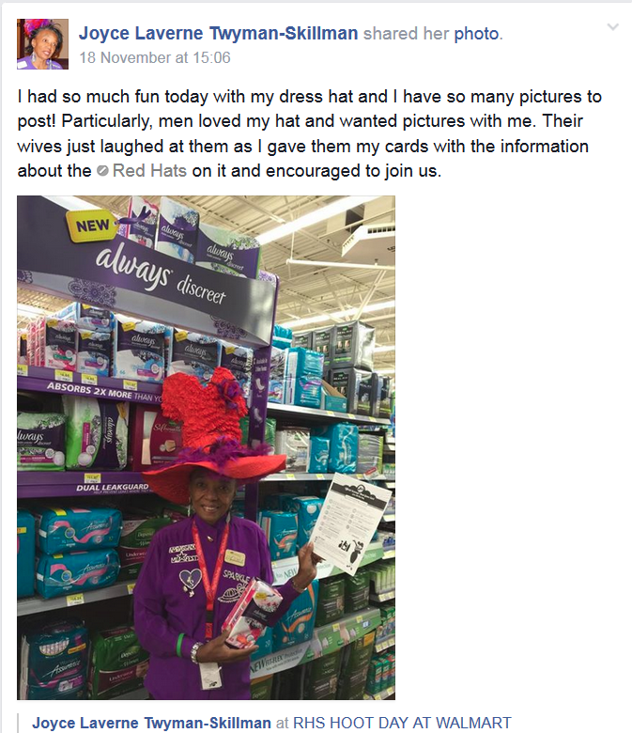
#AlwaysRHSHoot
We learned…
Given the opportunity, RHS Members shared the message of The Red Hat Society with all they came in contact with!
Red Hat Society, Inc. • P&G’s Always Discreet at Walmart Event

Slide 19
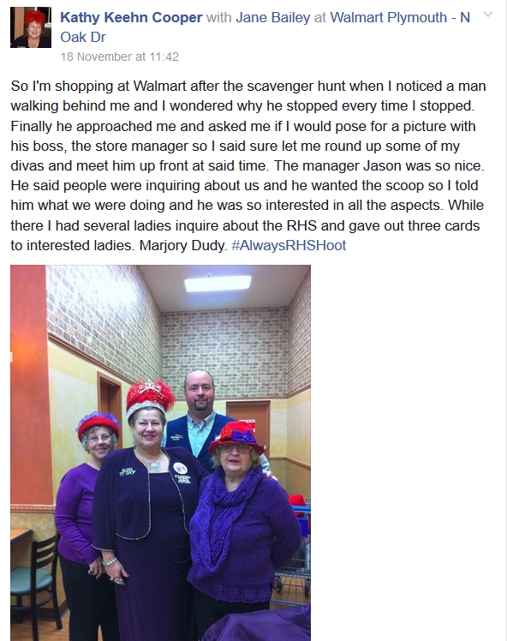
#AlwaysRHSHoot
We learned…
Walmart Stores were thrilled to have us!
Red Hat Society, Inc. • P&G’s Always Discreet at Walmart Event

Slide 20
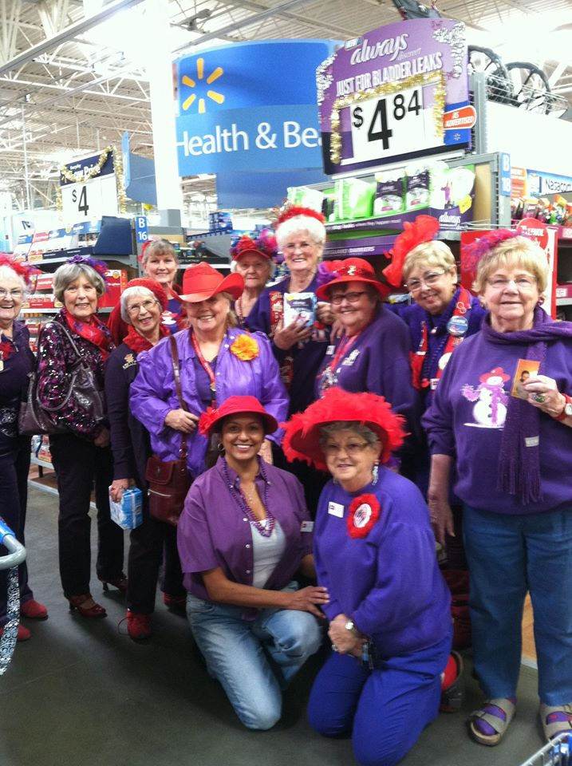
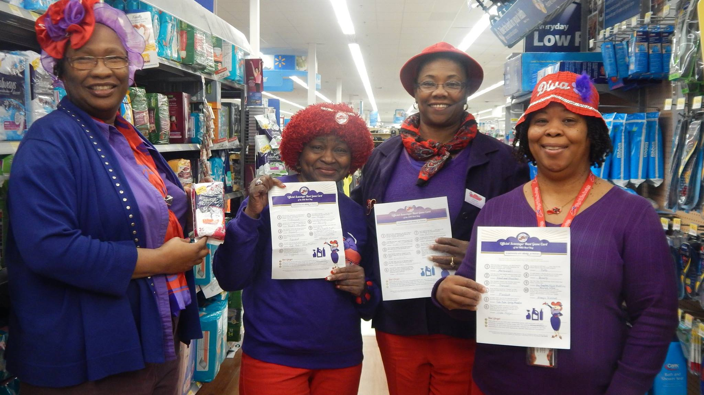
#AlwaysRHSHoot
We learned…
The incontinence aisle is a FUN place to hang out!!!
Red Hat Society, Inc. • P&G’s Always Discreet at Walmart Event

Slide 21
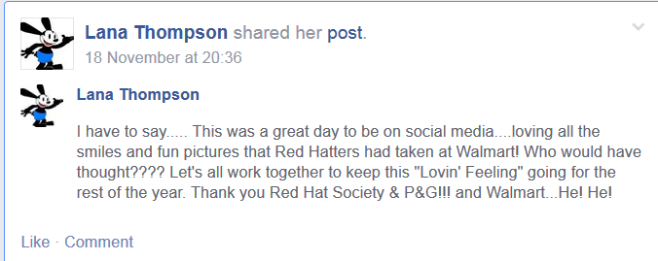
#AlwaysRHSHoot
We learned…
The fun was infectious and social media really can create a euphoric feeling similar to being at convention for RHS Members.
Red Hat Society, Inc. • P&G’s Always Discreet at Walmart Event

Slide 22
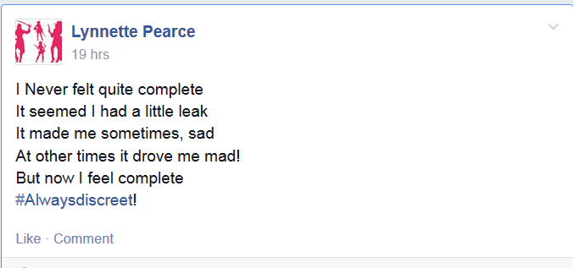
#AlwaysRHSHoot
We learned…
Always Discreet at Walmart is now the subject of poetry!
Red Hat Society, Inc. • P&G’s Always Discreet at Walmart Event

Slide 23
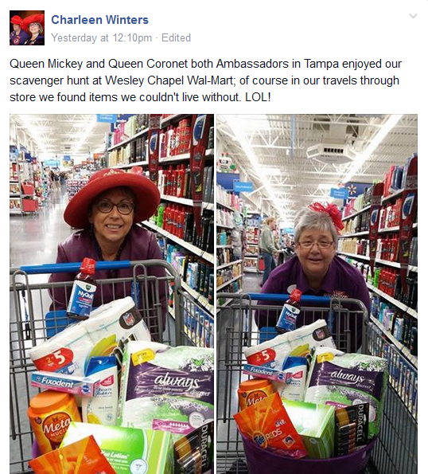
#AlwaysRHSHoot
We learned…
RHS Members could not live without these products!!!
Yes, P&G is the perfect partner for RHS!!!
Red Hat Society, Inc. • P&G’s Always Discreet at Walmart Event

Slide 24
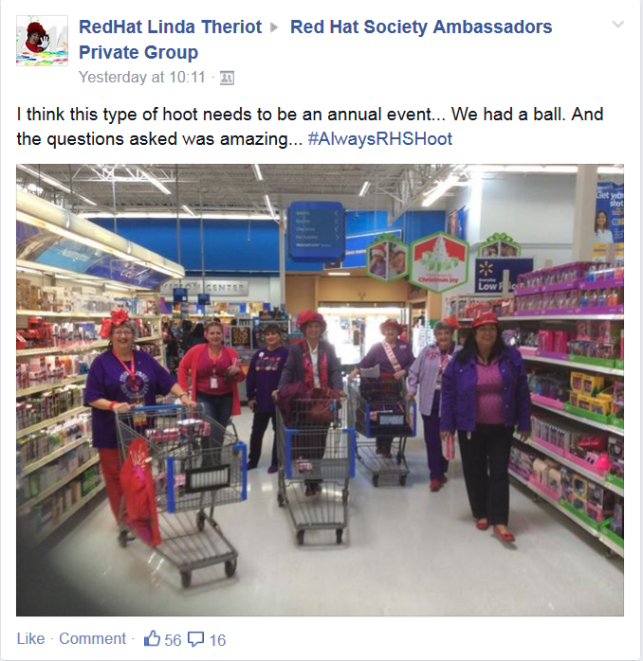
#AlwaysRHSHoot
But most importantly, we learned…
The RHS Members want to do this again!
Red Hat Society, Inc. • P&G’s Always Discreet at Walmart Event

Slide 25
#AlwaysRHSHoot
Thank you!!!
Red Hat Society, Inc. • P&G’s Always Discreet at Walmart Event

