Slide 1


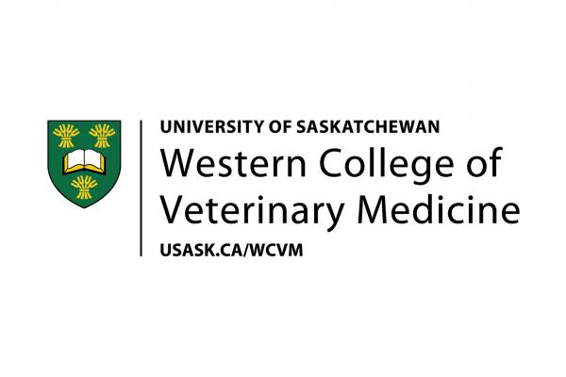





Saving Pets’ Lives:
Naloxone Training for
Dog Opioid Overdoses
March 2026
Dr. Jen Loewen, DVM, Western College Veterinary Medicine
Dr. Barbara Fornssler, PhD, School of Public Health
Maryellen Gibson, MPH, School of Public Health
Dr. Colleen Anne Dell, School of Public Health & Department of Sociology
Notes:
This powerpoint deck is available in an article format in The Conversation, titled “Dogs can overdose too: Naloxone training can save pets’ lives as well as humans”.
Photos source: Canva stock images

Slide 2


Opioid Risk for Pets
  Pets, especially dogs, are at risk of opioid overdose due to their exploratory behavior and use of their nose.
Naloxone Awareness Gap
  Many pet owners are unaware that naloxone can reverse opioid overdoses in dogs, leading to underutilization during emergencies.
Unique Veterinary Considerations
  Dogs require specific naloxone dosing due to unique metabolism and physiological differences compared to humans.
  Offering Care
  Administering naloxone or providing first aid to an animal in an emergency does not fall within the regulated practice of veterinary medicine; be sure to seek immediate veterinary care if possible.
OVERVIEW

Slide 3
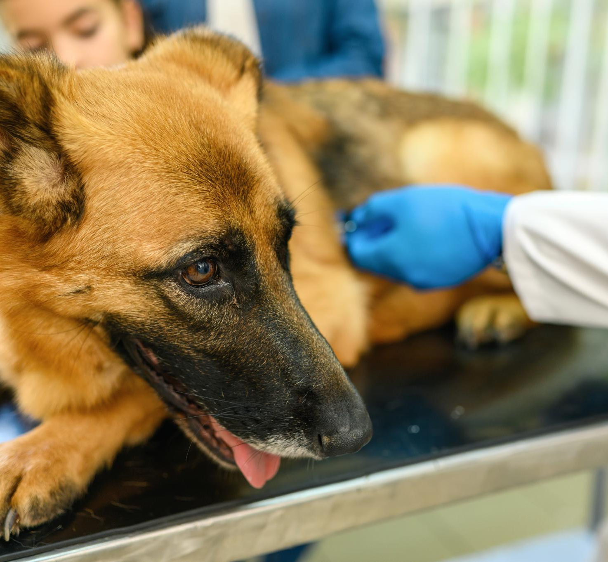
OFF-LABEL USE & EFFECTIVENESS
Off-Label Use in Animals
  Naloxone is used off-label in dogs, especially police dogs exposed to opioids, despite no formal approval.
Effectiveness Against Fentanyl
  Studies show naloxone effectively reverses fentanyl sedation in dogs via intramuscular or intranasal administration.
Safety and Monitoring
  Naloxone is generally safe for dogs, but monitoring for rare adverse reactions remains important during treatment.

Slide 4
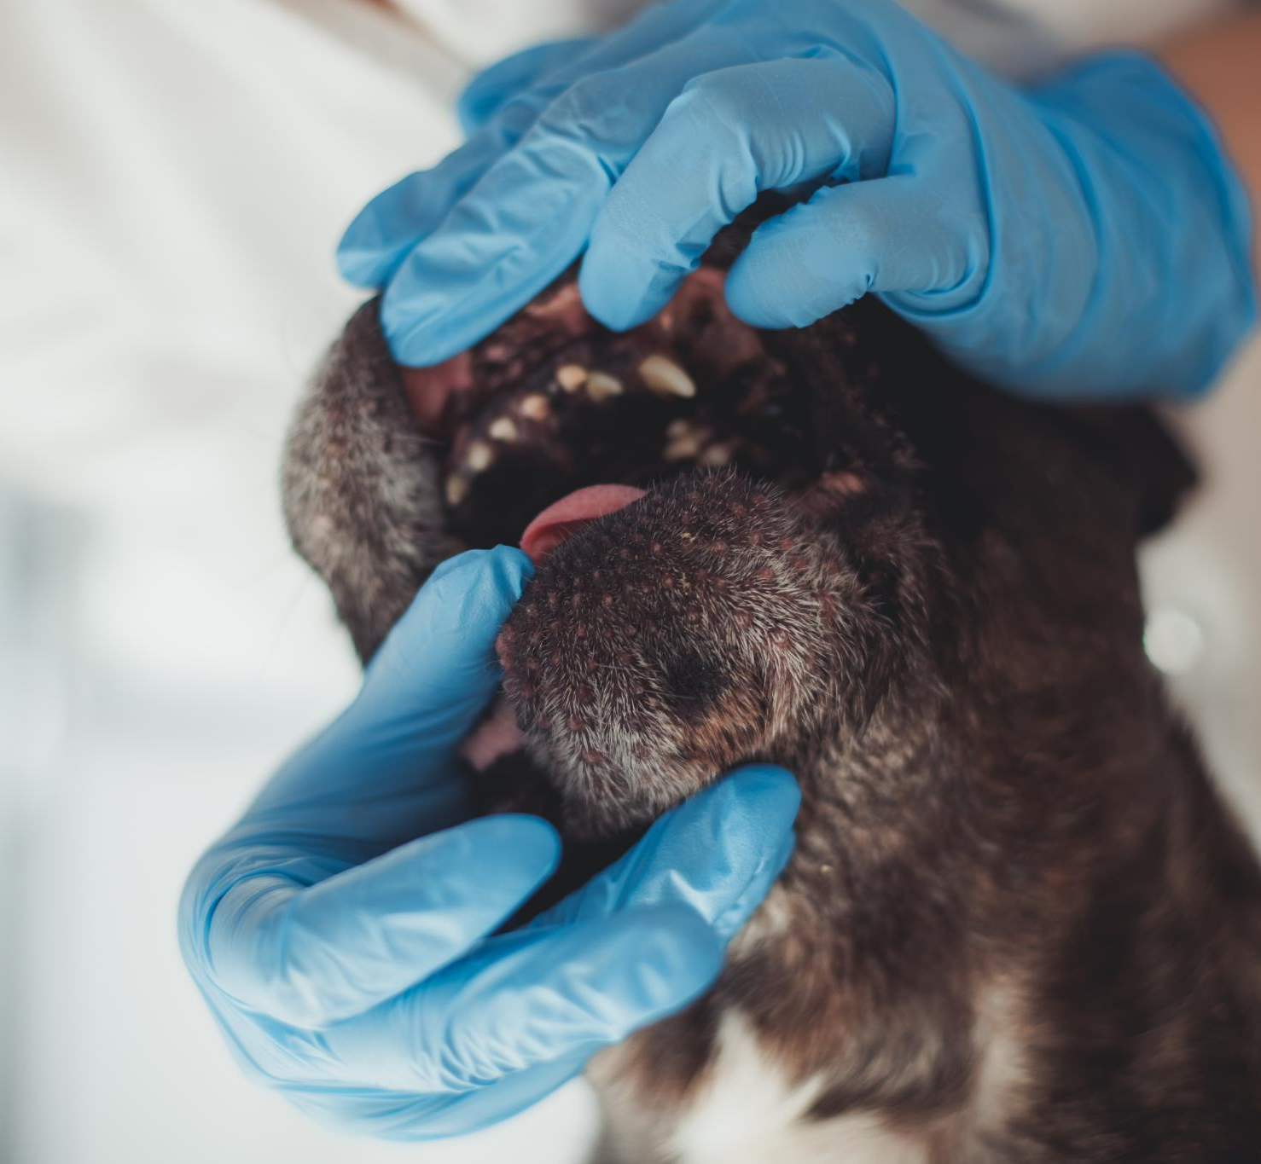
SIGNS OF OPIOID POISONING IN DOGS
Critical Respiratory Signs
  Slow or absent breathing is the most life-threatening symptom indicating severe respiratory depression.
Other Key Symptoms
  Signs include extreme lethargy, blank stare, unconsciousness, unresponsiveness, pale gums, pinpoint (very small) pupils, and vomiting.
Immediate Intervention
  Administer naloxone promptly and seek veterinary care; hesitation can cost a dog’s life.

Slide 5
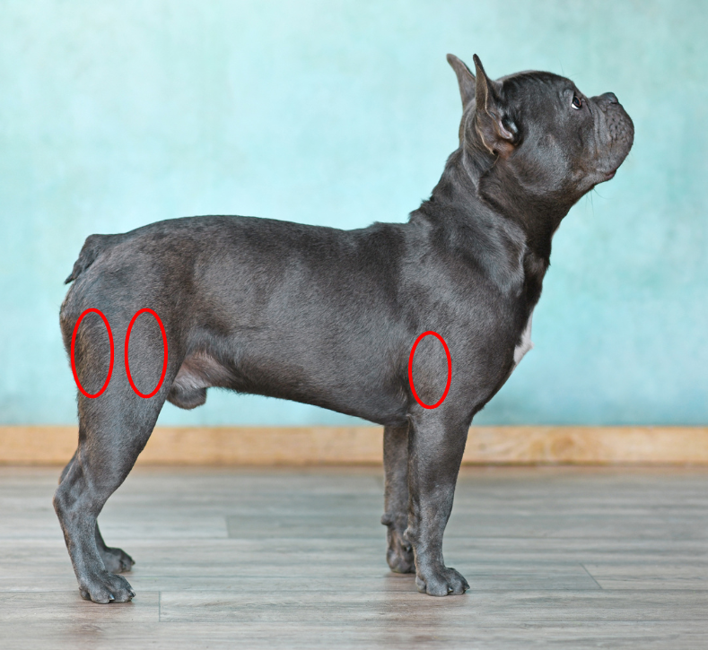
HOW TO ADMINISTER
NALOXONE TO DOGS
Intranasal Administration
  Hold dog’s snout closed, spray naloxone into one nostril, and cover nose with towel to prevent sneezing and spreading opioid residue.
Intramuscular Injection
Inject naloxone into large muscles, specifically the front portion of the upper thigh of the leg.
← See photo
Responder Safety Measures
  Wear gloves, wash hands thoroughly after administration, avoid touching face to prevent exposure, use a breathing barrier if rescue breaths are needed (particularly important because dogs likely inhaled the opioid).

Slide 6
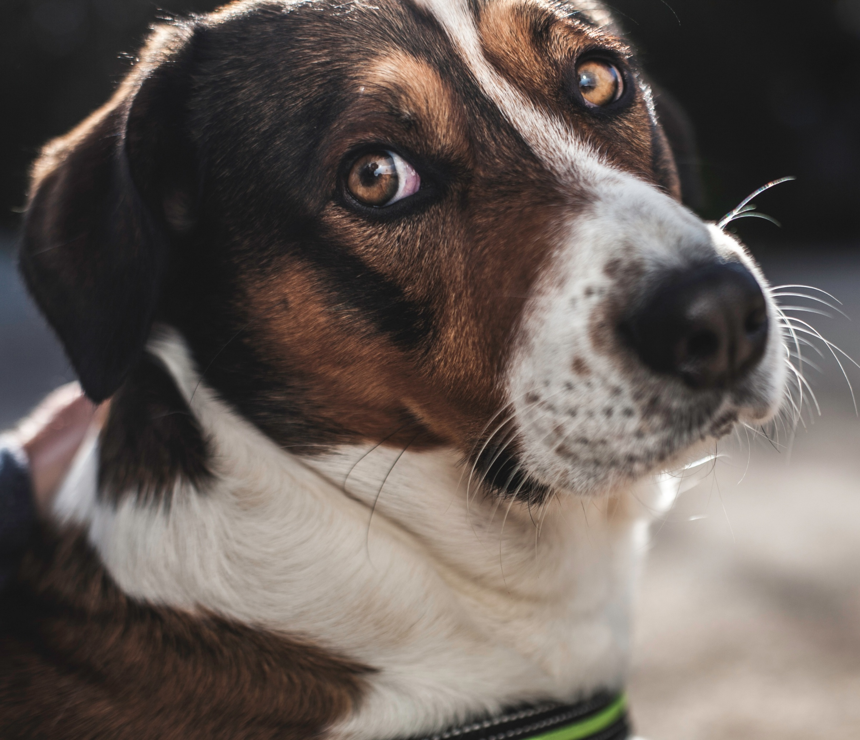
Standard naloxone dosage
Take-home naloxone kits have fixed doses safe for humans and dogs.
Repeat Dosing Guidelines
If no improvement after 2-3 minutes, a second dose is recommended; dosing may continue every 2-3 minutes until recovery.
Dose Adjustments for Large Dogs
Larger dogs or high opioid exposure cases may require multiple of higher doses for effective overdose reversal.
Naloxone Monitoring Duration
  Naloxone effects are short-lived; seek immediate veterinary care; dogs must be monitored closely for a minimum of 30-90 minutes after treatment for symptom return.
  Post-Treatment Hygiene
  Wash hands, face, launder clothing, and clean surfaces to reduce risk of secondary opioid exposure after treatment.
DOSAGE, ADMINISTER,
REPEAT & MONITOR

Slide 7
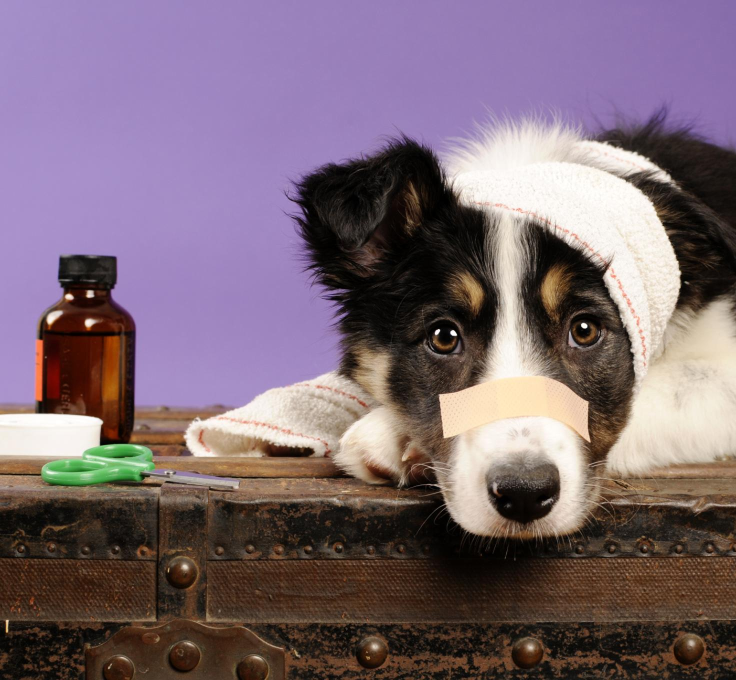
Secure Medication Storage
  Store all human and pet medications securely and out of pets’ reach.
Recognize Poisoning Signs
  Know the signs of opioid poisoning in pets and seek immediate veterinary care if exposure is suspected.
  Have 24/7 Resources available
  Access the Pet Poison Helpline (fee: $89 USD) or APSCA Poison control hotline (fee: $95 USD)
Use Naloxone Wisely
  Naloxone should be used only for opioid poisoning; it does not reverse other drug effects like veterinary sedatives.
Avoid Toxic Substances
  Prevent exposure to other toxic foods and substances such as chocolate, onions, grapes, and cannabis to keep pets safe.
  Toxic Substances
  Always give medications as prescribed and safely dispose of when unused or expired.
  See more information in The Conversation
  www.theconversation.com/ca
KEEPING PETS SAFE

