Slide 1
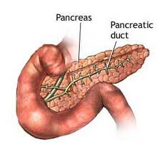
PANCREATITIS
RICHARD L. MONES MD
HARLEM HOSPITAL

Slide 2
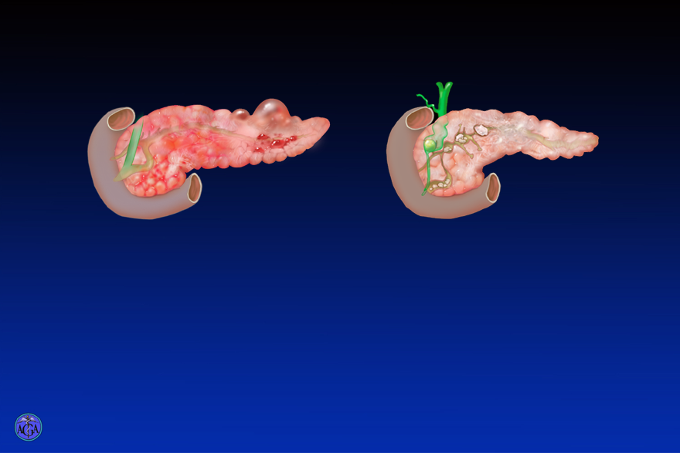
Classification of pancreatitis
Pancreatitis
Acute
  Acute inflammation
  Abdominal pain
  Elevated pancreatic enzymes in serum
  Self-limiting
Chronic
  Chronic inflammation
  Chronic abdominal pain
  Progressive loss of pancreatic endocrine and exocrine function
Notes:
Slide 126
Classification of pancreatitis
This image depicts the two clinical presentations of pancreatitis. Acute pancreatitis presents with acute and severe abdominal pain, nausea and vomiting. The pancreas is acutely inflamed (left image) and serum levels of pancreatic enzymes are elevated. Although the mortality from acute pancreatitis is several percent, full recovery is observed in the remainder of the patients. Gallstones that cause obstruction of the pancreatic duct or alcohol abuse most often cause acute pancreatitis. Chronic pancreatitis presents with chronic abdominal pain and progressive loss of endocrine and exocrine function. As a marker of the chronic damage, the pancreas is fibrotic and calcium stones form within the ducts (right image). Chronic pancreatitis is most often caused by alcohol abuse.

Slide 3
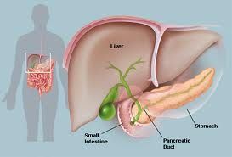
BASIC ANATOMY

Slide 4
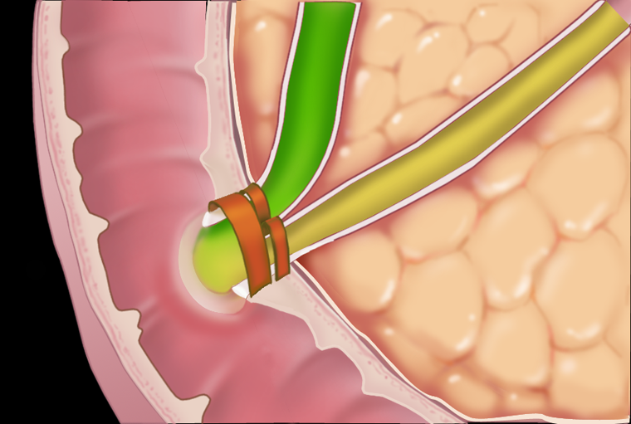
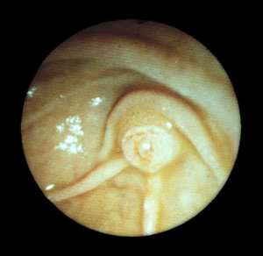
Ampullary Anatomy
Ampullary Anatomy
Papilla of Vater
Bile duct sphincter
Pancreatic duct sphincter
Sphincter of Oddi
Notes:
Slide 16
Ampullary Anatomy
In the majority of pancreatic and biliary secretions enter the duodenum through the ampulla of Vater. The image in the insert is an endoscopic photograph of the duodenum at this entry site. The entry site is called the papilla of Vater. Sphincters regulate entry of secretions into the duodenum. The sphincter at the ampulla of Vater is called the sphincter of Oddi. In addition, there are individual sphincters for both the common bile duct and the pancreatic duct just proximal to the sphincter of Oddi. All the sphincters are neurohumorally regulated. For example, there is relaxation during a meal mediated by the action of cholecystokinin on inhibitory neural pathways that cause the sphincter muscles to relax and allow pancreatic and biliary secretions to flow into the duodenum. It is believed that stenosis or spasm of these sphincters may occasionally result in obstruction of the bile and/or pancreatic ducts.

Slide 5
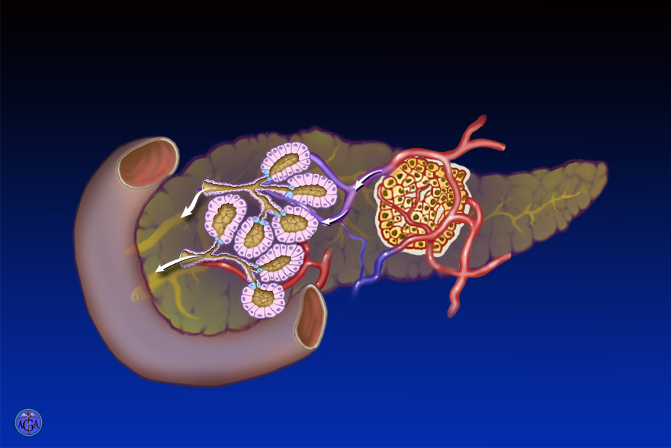

Slide 6
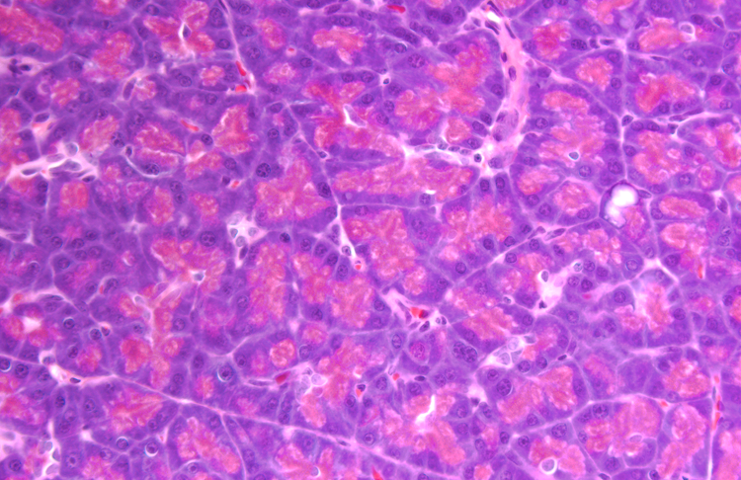

Slide 7
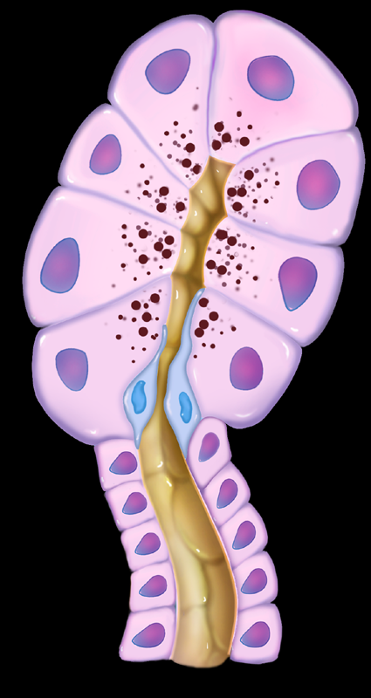
Major Functional Units
Secretory productsProenzymes
and enzymes
Secretory products
  Water and electrolytes
Acinus
Duct

Slide 8
Regulation of Exocrine Secretion
Regulation
Endocrine
Neurocrine
Ach
GRP
VIP
Substance P
CCK
Secretin
Secretin
Ach
Notes:
Slide 27
Regulation of Exocrine Secretion
Exocrine pancreatic secretions are regulated by both endocrine and neurocrine pathways. In addition, the endocrine and neurocrine mediators regulating secretion differ between the acinus and the duct. For the acinus, cholecystokinin (CCK), acetylcholine (Ach), gastrin releasing peptide (GRP), vasoactive intestinal polypeptide (VIP) and substance P regulate secretion. In humans, CCK receptors have not been found on acinar cells. However, CCK may stimulate acinar cell secretion indirectly by exciting neural pathways. For the duct, secretin and acetylcholine are the major regulators of secretion. Serotonin may act through 5-HT receptors to regulate acinar and duct cell secretion, but the importance and mechanism of this pathway in humans has not been defined.

Slide 9
Pancreas
Secretory Pattern
15
Meal
10
Trypsin
output
5
0
Fasting (interdigestive)
Fed
Midnight
6 am
Noon
E. DiMagno and P. Layer, 1993
Notes:
Slide 34
Secretory Pattern of Pancreatic Digestive Enzymes
This graphic shows the output of the digestive enzyme, trypsin, into the duodenum both during the fasting state and after a meal. During fasting there are small periodic increases in trypsin output. These increases correlate with activation of the motility of the intestine during the migrating motor complex (MMC). With a meal, there is a much larger increase in trypsin output due to the inputs of several meal stimuli that mediate secretion through both neural and humoral mechanisms.
Adapted from E. DiMagno and P. Layer, Human Exocrine Pancreatic Secretion in The Pancreas. Editors: V.L.W. Go, E. P. DiMagno, J.D. Gardner, E. Lebenthal, H.A.Reber, and G.A. Scheele. p275-301, 1993. Raven Press, New York.

Slide 10
Classes of Pancreatic Enzymes
Classes of Enzymes in Pancreatic Juice
Proteases
90%
Amylase - 7%
Lipases - 2%
Nucleases <1%
G. Scheele, et al., Gastroenterology 1981; 80:461
Notes:
Slide 51
Classes of Pancreatic Enzymes
The pie chart depicts the relative amounts (by weight) of the different classes of pancreatic digestive enzymes. Proteases are the most abundant class of enzymes.
Scheele G, Bartelt D, Bieger W. Gastroenterology 1981; 80:461-473.

Slide 11
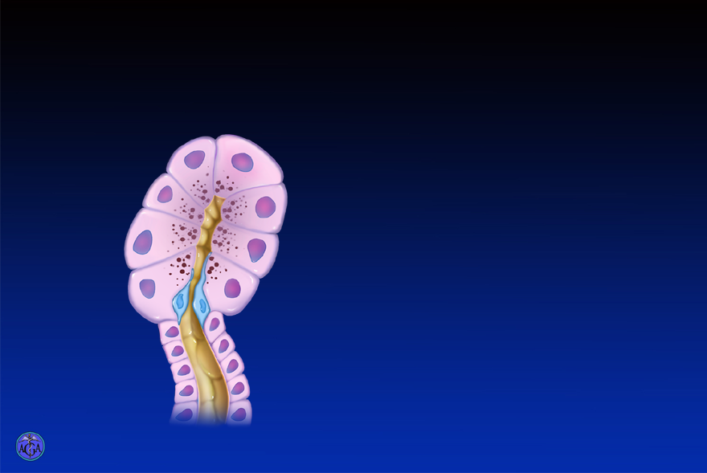
Pancreas
Coupled Water and Bicarbonate Secretion
Volume
of H₂O
HCO₃⁻
H₂O
HCO₃⁻ output
Notes:
Slide 66
Pancreatic Water and Bicarbonate Secretion
This image illustrates that the stimulation of the pancreas results in increasing volume output and bicarbonate concentration. The association of increased bicarbonate concentration with increased volume output results because the volume of acinar secretions that contain chloride is relatively small even with maximal stimulation. In contrast, with increasing stimulation, duct cells secrete large amounts of water with bicarbonate. Thus, with increasing stimulation of the exocrine pancreas, the volume increases results from ductal secretion and the concentration of ions approaches that of the ductal secretions that contain bicarbonate.

Slide 12

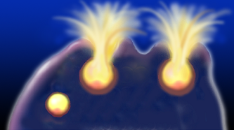
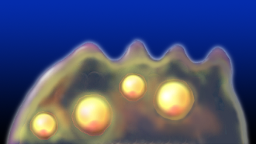
Enzyme Activation and Inhibited Secretion are Both Needed to Initiate Disease
GRP: activated enzymes secreted
Supraphysiologic CCK: activated enzymes not secreted
No Pancreatitis
Pancreatitis
T. Grady, Am.J.Phy. 1998; 275:G1010
Notes:
Slide 102
Activation of Digestive Enzyme Conversion and Inhibition of Secretion are Needed to Initiate Disease
Both bombesin (GRP) and CCK at high doses cause activation of digestive enzymes inside the pancreatic acinar cell. However, CCK but not GRP causes both blockade of secretion and pancreatitis. The findings suggest that a necessary step in the mechanism of pancreatitis is blockade of stimulated digestive enzyme secretion. Of note, the blockade of secretion with CCK is due to the effect of CCK on the subapical actin web.
O'Konski MS, Pandol SJ. J. Clin. Invest. 1990; 86:1649-1657.
Grady T, Mah'moud M, Otani T, Rhee S, Lerch M, Gorelick F. Am J. Physiol. 1998: 275:G1010-G1017.

Slide 13
Acinar Cell Zymogen Activation
Protective Mechanisms
Synthesis of enyzmes as inactive zymogens
Trypsin inhibitor packaged in zymogen granule
Segregation of enzymes in membrane-bound compartments
Enterokinase restricted to small intestine
Notes:
Slide 131
Protective mechanisms in the pancreas
The cartoon indicates zymogens that have been pathologically activated in an acinar cell. This lists the protective mechanisms present in the pancreas to prevent activation of zymogens in the pancreatic cell and thus prevent that damaging effects of zymogen activation.

Slide 14
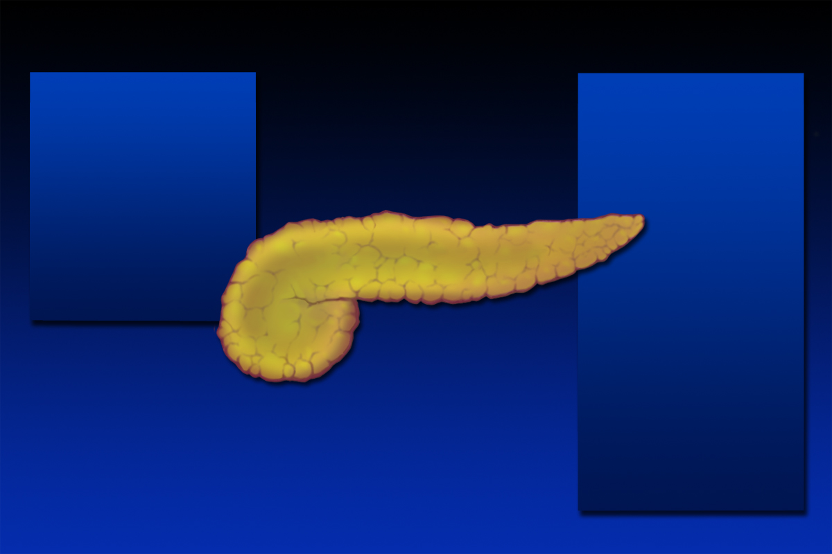
Pancreatic cytokine production
Pancreatic cytokine production
Cytokine Production
Anti-inflammatory
Pro-inflammatory
TNFα
IL-6
IL-1β
sIL-2R
IL-8
ICAM-1
iNOS
MCP-1
MIF
PAF
Sub P
PLA2
IL-10
IL-1ra
C5a
Notes:
Slide 136
Pancreatic cytokine production
The pancreas produces several cytokines during pancreatitis. As indicated in previous images, these cytokines are produced in the pancreatic parenchymal cells after the initial insults causing pancreatitis. However, the proinflammatory cytokines that are initially produced mediate the influx and activation of inflammatory cells that produce more cytokines. The result is a propagation and augmentation of the inflammatory response and pancreatitis. The image lists proinflammatory cytokines and other inflammatory molecules (i.e. iNOS and ICAM-1) that participate in the inflammatory response. Recent information suggests that polymorphisms in MCP-1 is a key determinant of severity for those who develop acute pancreatitis. Activation of pancreatitic phospholipase A2 leads to the production of arachidonic acid metabolites and lysophophatidylcholine which have both proinflammatory and cell damaging effects and are discussed elsewhere (see slides 201-204). The image also lists molecules that are anti-inflammatory that are produced during pancreatitis.
Adapted from Bhatia M, Brady M, Shokuhi S, Christmas S, Neoptolemos JP, Slavin J. J Pathol 2000;190:117-125.
Papachristou GI, Sass DA, Avula H, Lamb J, Lokshin A, Barmada MM, Slivka A, Whitcomb DC.
Clin Gastroenterol Hepatol. 2005 3(5):475-81.
Bhatia M. Scand J Surg. 2005 94(2):97-102.

Slide 15
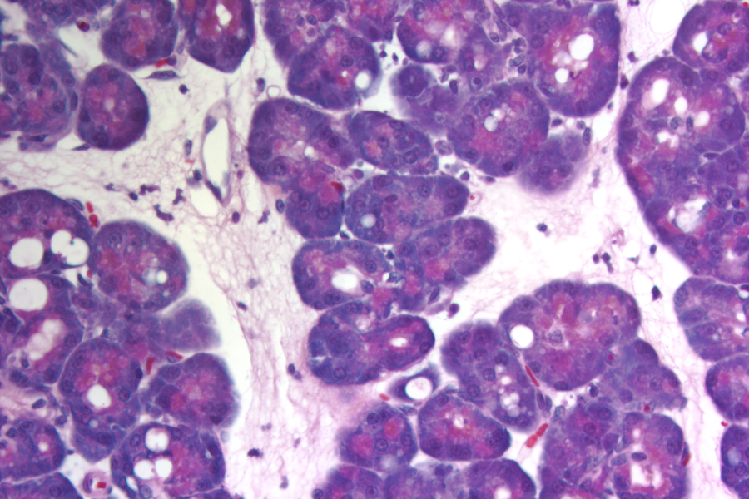
Histology mild disease
Notes:
Slide 159
Histology mild disease
Mild (edematous) pancreatitis is associated with edema, mild to moderate pancreatic inflammation, and acinar cell vacuolization with preservation of pancreatic architecture. At later times than shown in this micrograph there is mild necrosis, especially of fat (not shown).

Slide 16
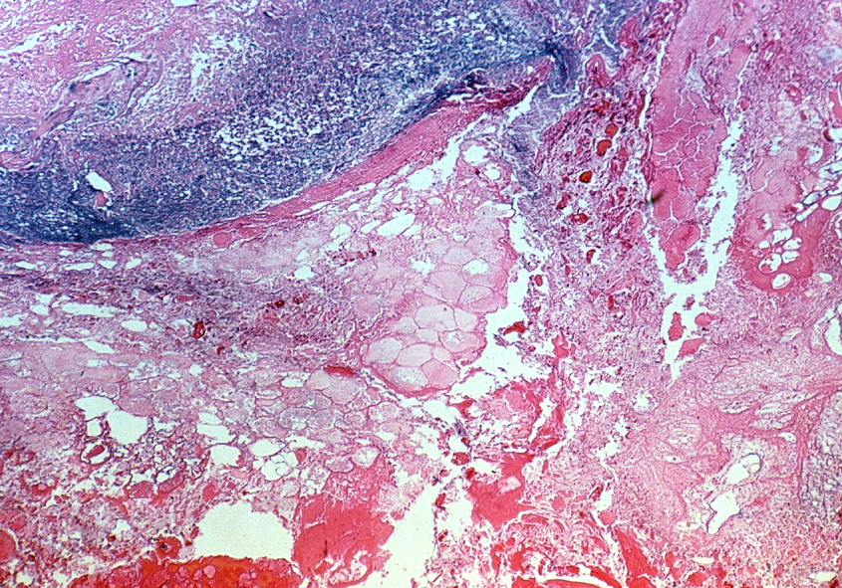
Histology severe disease
Notes:
Slide 161
Histology severe disease
Severe disease is associate loss of pancreatic architecture, severe inflammation, edema, necrosis of fat and parenchymal tissues, vascular injury and hemorrhage. (Courtesy of K. Barwick, Jacksonville, FL)

Slide 17
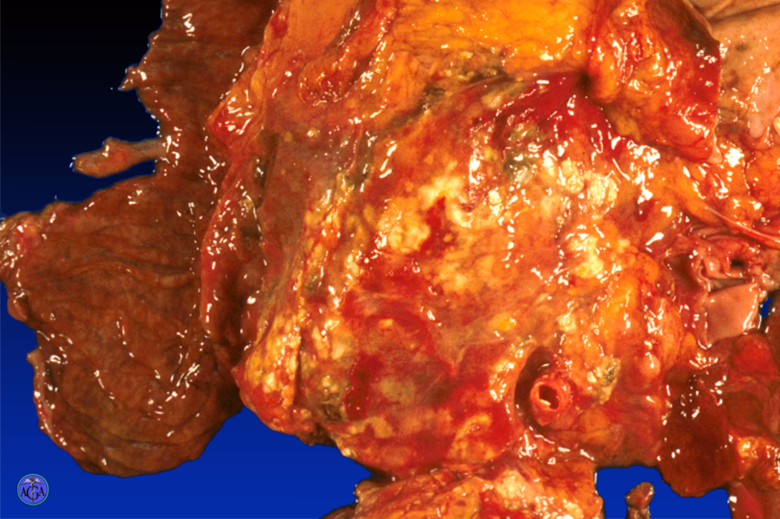
Gross specimen in severe pancreatitis
Necrosis
Duodenum
Hemorrhage
Notes:
Slide 164
Gross specimen in severe pancreatitis
This autopsy specimen comes from a patient who died from severe acute pancreatitis. It demonstrates hemorrhage and necrosis (Courtesy of Dr. Robert Homer, VAMC, West Haven, CT).

Slide 18
Etiologies of acute pancreatitis expanded
Etiologies
Acute Pancreatitis
Autoimmune
Drug-induced
Iatrogenic
IBD-related
Infectious
Inherited
Metabolic
Neoplastic
Structural
Toxic
Traumatic
Vascular
Alcoholic
Idiopathic
Other
Biliary
Notes:
Slide 166
Etiologies of acute pancreatitis expanded
Recognition of other causes of acute pancreatitis is important because they include reversible etiologies. For example, drugs and toxins can be avoided. Metabolic and structural causes can often be treated. In patients with recurrent episodes of acute pancreatitis, reversible etiologies must be carefully excluded.
Somogyi L, Martin SP, Venkatesan T, Ulrich CD. Gastroenterology 2001;120:708-17.

Slide 19
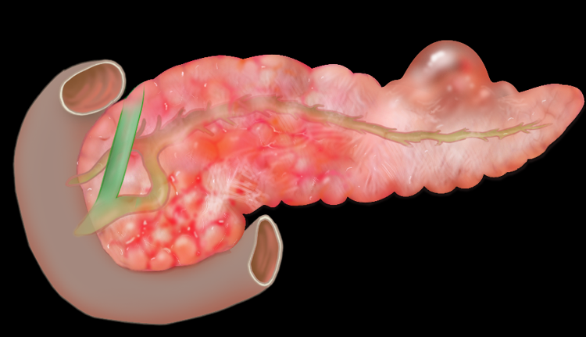
Etiologies of acute pancreatitis in childhood
Acute Pancreatitis
Etiologies in Childhood
Traumatic
Infectious
Structural
Drug-induced
Metabolic
Others
Notes:
Slide 167
Etiologies of acute pancreatitis in childhood
The causes of acute pancreatitis in childhood differ from those found in adults. Trauma and viral infections are probably common causes. Structural etiologies, including gallstones can cause disease and become more important in children with recurrent pancreatitis. Some drugs, such as isotretinoin and valproate, can cause pancreatitis and are used more frequently in children than adults.
Pietzak MM, Thomas DW. Pediatr Rev 2000; 21406-12.

Slide 20
Infections and pancreatitis
Acute Pancreatitis INFECTIONS
Class Example Mechanism
Viral Coxsackie Unclear
Parasitic Ascaris Obstructive
Fungal Candida Unclear
Bacterial Salmonella Toxin
Notes:
Slide 168
Infections and pancreatitis
All types of infectious agents can cause pancreatitis. One of the more common causes of pancreatitis in children is viral infection. These probably cause pancreatitis by direct pancreatic infection and inducing pancreatic inflammation. Parasites such as ascaris are a common cause of pancreatitis in some parts of the world. They may cause disease by obstructing the pancreatic duct. Fungal infections can cause pancreatitis most often in patients who are immuno-compromised. Some bacteria release toxins that can selectively affect the pancreatitis. Such pancreatitis is uncommon and mild.
Laszik ZG, Kallajoki M, Hyypia T, Rima B, Aho HJ, Nevalainen TJ. Scand.J.Gastroenterol. 1990;25:906-10.
Khuroo MS, Zargar SA, Yattoo GN, Koul P, Khan BA, Dar MY, Alai MS. Br.J.Surg. 1992;79:1335-8.
Lai ECS, Mok FPT, Tan ESY, Lo C-M, Fan S-T, You K-T, Wong J. N.Engl.J.Med. 1992;326:1582-6.
Sevastos, N.; Kolokotronis, K.; Papatheodoridis, G. V. Am. J. Gastroenterol. 2001; 96: 3450-3451.

Slide 21
Some specific classes of inherited causes of pancreatitis
Acute and Chronic Pancreatitis
Inherited Causes
Altered enzyme activity
  Trypsinogen mutations
Abnormal ion movement
  Cystic fibrosis transmembrane regulator (CFTR) mutations
Metabolic
  Familial hypertriglyceridemia
Notes:
Slide 171
Some specific classes of inherited causes of pancreatitis
The mutated proteins associated with pancreatitis fall into the general classes shown on this slide. Mutations in other genes, such cytokines, may modulate the susceptibility to and severity of disease (not shown).

Slide 22
Hereditary Pancreatitis
  Mutations in cationic trypsinogen
  Autosomal dominant
  Incomplete penetrance
  Early onset
  Frequent calcification
  Increased pancreatic cancer
affected
Notes:
Slide 119
Hereditary pancreatitis
This image lists the characteristics of hereditary pancreatitis. Hereditary pancreatitis is an autosomal disorder with incomplete penetrance as illustrated in the family tree on the right. It results from a genetic mutation in the trypsinogen gene. Patients develop this disorder in the first or second decade of life. Patients with this disorder have frequent attacks of pancreatitis leading to chronic pancreatitis with calcifications. They have a high incidence of pancreatic cancer.
Whitcomb DC, Gorry MC, Preston RA, Furey W, Sossenheimer MJ, Ulrich CD, Martin SP, Gates LK, Amann ST, Toskes PP, et al. Nat.Genet. 1996; 14:141-145.

Slide 23
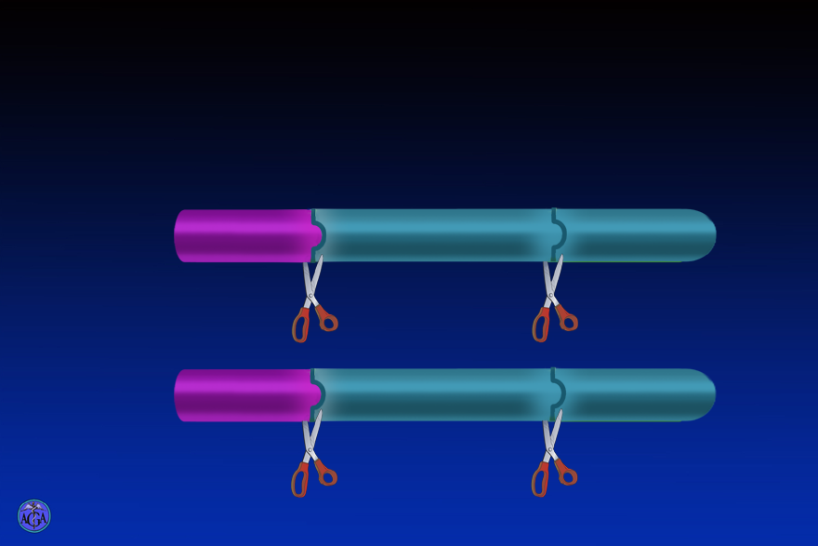
Hereditary Pancreatitis
Most Common Mutation - R122H
Normal
Trypsin
Activation
peptide
NH₂ -
- Lys - Ile -
- Arg¹²² -Val-
- COOH
Disease
Activation
Degradation
NH₂ -
- Lys - Ile -
- His¹²² -Val-
- COOH
Activation
Resistant to degradation
Notes:
Slide 121
Hereditary pancreatitis: most common mutation
The most common mutation for trypsinogen results in a substitution of arginine in position122 with histidine. This substitution may prevent degradation of trypsin after it is activated by cleavage of the activation peptide. That is, the catalytic removal in the activation peptide leads to active trypsin. This normal situation, the active trypsin is susceptible to degradation by several proteases. However, in the case of hereditary pancreatitis, the degradation may be prevented thereby resulting in excess activated trypsin. Because there is a continuous low-grade activation and degradation in the normal pancreatic gland, the mutation theoretically leads to large increases in active trypsin in the gland with a potential to cause pancreatitis.
Whitcomb DC, Gorry MC, Preston RA, Furey W, Sossenheimer MJ, Ulrich CD, Martin SP, Gates LK, Amann ST, Toskes PP, et al. Nat.Genet. 1996; 14:141-145.

Slide 24
Drug induced pancreatitis sorted by incidence
Acute Pancreatitis
Drug Induced Pancreatitis Sorted by Incidence
Common
Uncommon
Rare
asparaginase
ACE inhibitors
carbamazepine
azathioprine
acetaminophen
corticosteroids
6-mercaptopurine
5-amino ASA
estrogens
didanosine (DDI)
furosemide
minocycline
pentamidine
sulfasalazine
nitrofurantoin
valproate
thiazides
tetracycline
Notes:
Slide 172
Drug induced pancreatitis sorted by incidence
Although drug induced pancreatitis is not common, it needs to be considered in every patient, especially those with unexplained recurrent disease. While this slide lists some of drugs that have been reported to cause acute pancreatitis, the list is far from complete. The mechanisms of drug-induced pancreatitis are largely unknown. Notably, a number of drugs on the list contain sulfa-moieties. Estrogens and other drugs not listed here such as some HIV protease inhibitors andisotretinoinmay cause disease by increasing serum triglyceride levels.
Lankisch PG, Droge M, Gottesleben F. Gut 1995;37:565-7.
Trivedi CD, Pitchumoni CS. J ClinGastroenterol. 2005 39:709-16.

Slide 25
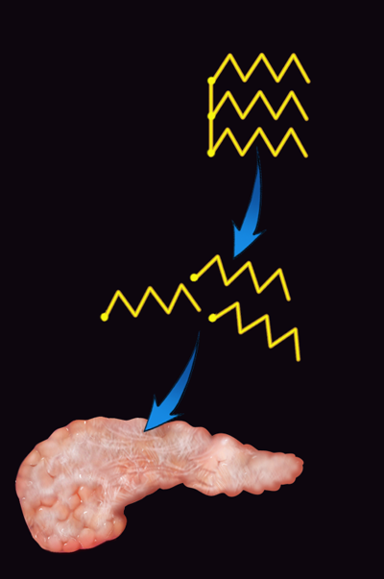
Hypertriglyceridemic Pancreatitis
Acute Pancreatitis
Hypertriglyceridemia
TG
Rare cause of acute pancreatitis
Serum triglycerides usually >1000 mg/dL
May cause chronic disease
Can be drug-induced:
  Alcohol, estrogens,
  isotretinoin, HIV-protease inhibitors
TG lipase
Free fatty acids
Cell damage
Notes:
Slide 218
Hypertriglyceridemic Pancreatitis
Although high serum triglycerides are an uncommon cause of acute pancreatitis, it is important to search for this etiology because it is reversible. The etiology includes familial hypertriglyceridemia, uncontrolled diabetes mellitus, pregnancy. Further, it can be caused by a number of drugs. In addition to causing acute pancreatitis, high serum triglycerides may also cause chronic pancreatitis. Although the mechanism of disease is uncertain, it probably occurs as shown on the right side of the slide. Thus, lipase is continuously released from the pancreas. In the pancreatic capillaries, the highest intravascular concentrations of intravascular lipase can interact with triglyceride. Hydrolysis of the triglyceride generates short-chain fatty acids that can be toxic to the pancreas. Appropriate diet and drug therapy is very effective in preventing relapse. Acutely plasmapheresis has been used to lower triglyceride levels in severe acute pancreatitis.
Furuya T, Komatsu M, Takahashi K, Hashimoto N, Hashizume T, Wajima N, Kubota M, Itoh S, Soeno T, Suzuki K, et al. TherApher 2002; 6:454-8.
Yadav D, Pitchumoni CS. J ClinGastroenterol 2003;36:54-62.
Athyros VG, Giouleme OI, Nikolaidis NL, Bouloukos VI, Kontopoulos AG, Eugenidis NP. J Clin Gastroenterology 2002;34:472-475.

Slide 26
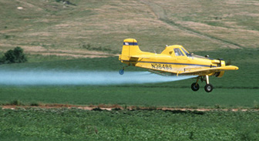
Environmental causes of pancreatitis
Pancreatitis
Environmental Toxic Causes
Definite
  Methanol
  Ethylene glycol
  Organophosphorus insecticides
  Scorpion toxins
Probable
  Pentachlorophenol
  Trichloroethylene
V Khurana and J Barkin, Pancreas 2001; 22:103
Notes:
Slide 173
Environmental causes of pancreatitis
Exposure to specific environmental insults has been associated with acute pancreatitis. Organophosphates are used as insecticides and inhibit acetylcholine-esterase. Some scorpion toxins, particularly the one produced by Tytiusserrulatus shown here, stimulate neurotransmitter release from nerve terminals. Both organophosphates and scorpion toxin may cause a hyperstimulation form of pancreatitis that is rarely severe. Pentachlorophenol and trichloroethylene are found in cleaning solutions and may cause pancreatitis.
Khurana V, Barkin JS. Pancreas 2001;22:102-5.

Slide 27
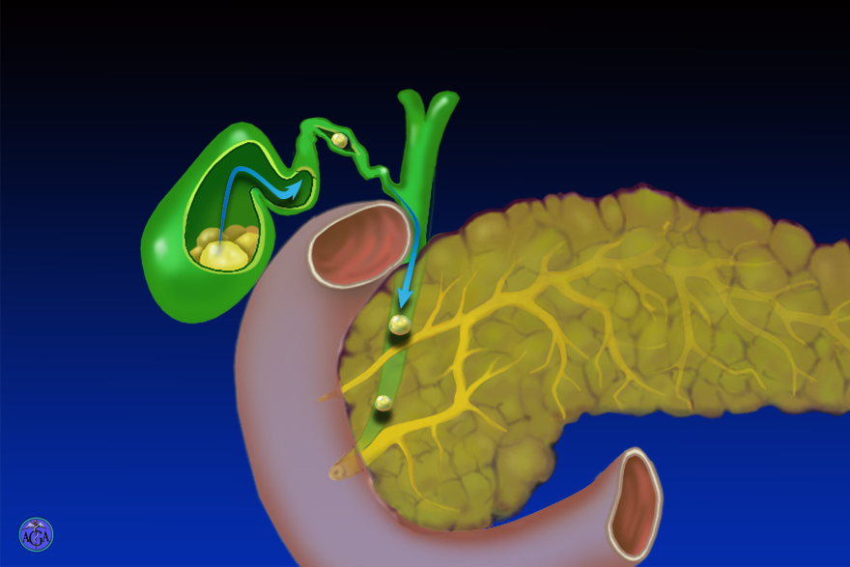
Gallstone migration
Gallstone Migration
Notes:
Slide 180
Gallstone migration
The cartoon shows small gallstones migrating out of the gallbladder, into the cystic duct, and then the common duct. When these stones obstruct the Ampulla of Vater they can cause pancreatitis and/or cholangitis.

Slide 28
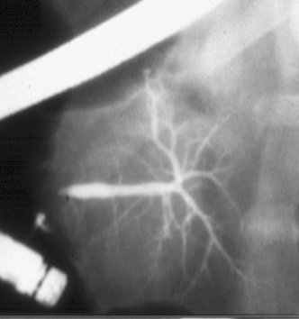
Pancreatitis
PANCREATIC DIVISUM
5-15% of population
Impaired duct drainage in minority
Benefit of endoscopic treatments limited to specific subgroups
Notes:
Slide 210
Pancreas divisum
Pancreas divisum is an anatomic variant present in 5% to 15% of the normal population. For an illustration of the embryologic origins of pancreas divisum, see slides 7 and 8. Most people with pancreas divisum do not have pancreatitis. It seems likely, however, that a subset of pancreas divisum patients have recurrent acute pancreatitis due to obstruction to flow through the minor papilla. These may be patients with a particularly diminutive minor papilla orifice. This theory has been substantiated by the results of secretin-stimulated ultrasound studies in patients with pancreatitis and divisum, the finding of a “Santorinicele” or dilated terminus of the pancreatic duct in some symptomatic divisum patients, numerous uncontrolled reports of endoscopic or surgical minor papilla therapy, and one controlled, randomized trial of endoscopic minor papilla stenting. About 70% of divisum patients with recurrent acute pancreatitis and a normal dorsal pancreatogram will do well following endoscopic minor papilla therapy. Those with chronic pancreatitis fare less well, and those with pain but no history of pancreatitis are unlikely to respond to minor papilla therapy.
The mechanism by which PD leads to recurrent pancreatitis in a subset of patients is unknown. There nay be a link between CFTR dysfunction and recurrent acute pancreatitis in patients with PD and may explain why a subset of patients with PD develops recurrent acute pancreatitis.
Heyries L, Barthet M, Delvasto C, Zamora C, Bernard JP, Sahel J. Gastrointest Endosc. 2002; 55:376-81.
Costamagna G, Ingrosso M, Tringali A, Mutignani M, Manfredi R. Gastrointest Endosc. 2000; 52:262-7.
Warshaw AL, Simeone J, Schapiro RH, Hedberg SE, Mueller PE, Ferrucci JT Jr. Am J Surg. 1985; 149:65-72.
Lans JI, Geenen JE, Johanson JF, Hogan WJ. Gastrointest Endosc. 1992; 38:430-4.
Lehman GA, Sherman S, Nisi R, Hawes RH. Gastrointest Endosc. 1993; 39:1-8.
Gelrud A, Sheth S, Banerjee S, Weed D, Shea J, Chuttani R, Howell DA, Telford JJ, Carr-Locke DL, Regan MM, Ellis L, Durie PR, Freedman SD. Am J Of Gastroenterology 2004;99:1557-1562.

Slide 29
Diagnostic Criteria
AUTOIMMUNE PANCREATITS
Diagnostic Criteria: I
Imaging
Diffuse pancreatic duct narrowing
Diffuse pancreatic enlargement
Immunity
Autoantibodies
Elevated gammaglobulins or IgG4
Histology
Periductular lymphoblastic infiltrate
Phlebitis
Fibrosis
Notes:
Slide 410
Autoimmune Pancreatitis: Diagnostic Criteria: I
Establishing the diagnosis of autoimmune pancreatitis (AIP) can be difficult, even when classic features are present, most often due to lack of specific symptoms the diagnosis is missed. The most frequent presentation is diffuse or focal pancreatic mass, it may present as acute pancreatitis, chronic pancreatitis, diabetes and steatorrhea. Radiological studies, serology and histology are helpful in making the diagnosis. Patients may present with minimal or no pain, cholestasis, and without prior pancreatitis. Frequently the initial presentation is an abnormal imaging study. Histological examination reveals periductular and perivenular lymphoplasmacytic infiltrate sparing small arteries. IgG4 immunostaining is positive. The Japan pancreas society has developed criteria for diagnosing AIP. These include the presence of a) Abnormal pancreas imaging with diffuse main pancreatic duct narrowing with irregular wall extending >33% of the duct with diffuse pancreatic enlargement along with either b) Autoantibodies, or elevated gammaglobulins or elevated IgG and or c) Histopathology showing a lymphoblastic infiltrate and pancreatic fibrosis.
Hamano H, Kawa S, Horiuchi Y, Unno H, Furuya N, Akamatsu T, Fukushima M, Nikaido T, Nakayama K, Usuda N, Kiyosawa K. N Engl J Med 2001;344:732-738.
Lara LP, Chari S. Current Gastroenterology Reports 2005;7:101-106.

Slide 30
Autoimmune Pancreatitis: Patient Characteristics
Autoimmune Pancreatitis
Patient Characteristics
Gender
  Male > female
Age
  Wide range (20-80 years), most > 50 years
Comorbidity
  Autoimmune diseases
Notes:
Slide 409
Autoimmune Pancreatitis: Patient Characteristics
Autoimmune pancreatitis is more common in males with a two to one predominance. There is a wide age range although it most commonly presents in the sixth decade. It may present with pancreatic involvement exclusively or in combination with several autoimmune diseases such as Sjogren’s syndrome, PBC, PSC, inflammatory bowel disease.
Okazaki K, Uchida K, Matsushita M, Takaoka M. Intern Med. 2005 44:1215-23.

Slide 31
Autoimmune Pancreatitis – IgG4
Autoimmune Pancreatitis
IgG4
1200
1000
80
IgG4 (mg/dl)
60
40
20
0
Pancreatic
cancer
CP
AIP
PBC
PSC
Sjögren’s
syndrome
Hamano H, N Engl J Med 2001;8;344:732
Notes:
Slide 415
Autoimmune Pancreatitis (AIP): IgG4
Hamano et al reported elevated serum IgG4 levels, which were sensitive and specific for the diagnosis of AIP. IgG4 concentrations in patients with AIP were compared to normal controls, patients with pancreatic cancer and patients with other autoimmune disorders. After four weeks of steroid therapy, these levels decreased but did not normalize in the majority of patients with AIP. These finding have not be reproduced by all investigators with some suggesting that elevated serum IgG4 levels are seen some patients with idiopathic or alcoholic chronic pancreatitis, although marked (>2 fold increase) has not been documented in non AIP patients.
Hamano H, Kawa S, Horiuchi Y, Unno H, Furuya N, Akamatsu T, Fukushima M, Nikaido T, Nakayama K, Usuda N, Kiyosawa K. N Engl J Med 2001;344:732-738.

Slide 32
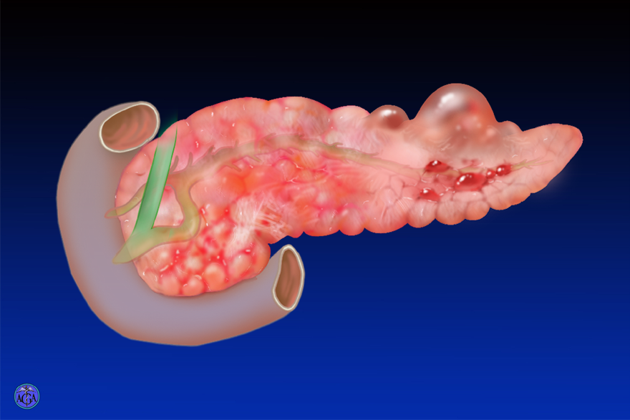
Clinical features of acute disease
Acute Pancreatitis
Abdominal Pain
Pancreatic Enzymes in Serum
Notes:
Slide 158
Clinical features of acute disease
The most common presenting features of acute pancreatitis are abdominal pain and increased serum levels of pancreatic enzymes. The pain is usually severe, begins in the epigastrum, and may radiate into the back or throughout the abdomen. Nausea and vomiting are often present. The increased serum levels of pancreatic amylase and lipase are used to diagnose the disease. After an isolated bout of acute pancreatitis, pancreatic function and histology return to normal. However, with severe disease, recovery may take up to a year.

Slide 33
Presenting features of acute pancreatitis
Acute Pancreatitis
Presenting Features
Abdominal pain
Nausea / vomiting
Tachycardia
Low grade fever
Abdominal guarding
Loss of bowel sounds
Jaundice
0
20
40
60
80
100
% patients
Notes:
Slide 219
Presenting features of acute pancreatitis
The cardinal symptom of acute pancreatitis is abdominal pain, which is present in 95% of patients. The pain is usually steady and severe, radiates from the upper abdomen to the back, and may improve with lying on the left side or leaning forward. Absence of pain may be associated with delayed diagnosis or severe disease, and is probably the reason why many cases of fatal pancreatitis are not diagnosed until postmortem exam. Nausea and/or vomiting are also extremely common in acute pancreatitis. Physical signs in acute pancreatitis include tachycardia, which may be due to intravascular hypovolemia and should prompt aggressive intravenous fluid and electrolyte replacement. Low grade fever is common, as are peritoneal signs such as guarding and rebound tenderness. The presence of guarding and/or ileus on exam has been identified as useful prognostic features in acute pancreatitis.
Lankisch PG, Schirren CA, Kunze E. Am.J.Gastroenterol. 1991; 86:322-26.
Rabeneck L, Feinstein AR, Horwitz RI, Wells CK. Am J Med. 1993; 95:61-70.

Slide 34
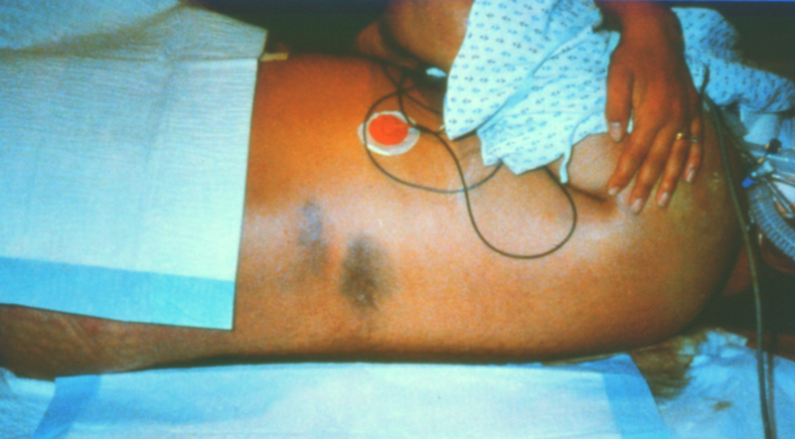
Grey Turner Sign in Acute Pancreatitis
Acute Pancreatitis
Gray Turner Sign
Notes:
Slide 238
Grey Turner Sign in Acute Pancreatitis
The finding of ecchymosis in one of either flanks (Grey Turner’s sign) or the periumbilical area (Cullen’s sign) represents extravasation of pancreatic hemorrhage into these areas. Such signs are associated with a poor prognosis.

Slide 35
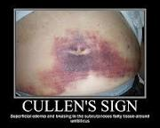

Slide 36
Acute Pancreatitis
Test Sensitivity Specificity Comment
Serum enzymes high moderate >3x normal
increases
specificity
Ultrasound moderate high best for
gallstones
CT moderate high detects edema, fluid collections
CT with IV moderate high detects
contrast necrosis
Notes:
Slide 221
Tests used to diagnosis acute pancreatitis
This slide compares tests commonly used for diagnosis of acute pancreatitis. The serum amylase is highly sensitive for diagnosis, although relatively nonspecific. Elevations greater than 3-fold normal are more specific (but less sensitive) for diagnosis. Imaging modalities, including ultrasound and CT, are less sensitive for diagnosis, missing some cases of mild disease, but have high specificity when typical imaging findings of pancreatitis are demonstrated. CT with intravenous contrast demonstrates pancreatic necrosis.
Agarwal N, Pitchumoni CS, Sivaprasad AV. Am J.Gastroenterol. 1990; 85:356-66.
Yadav D, Agarwal N, Pitchumoni CS. Am J Gastroenterol 2002; 97:1309-18.

Slide 37
Serum levels of pancreatic enzymes in acute pancreatitis
Acute Pancreatitis
Time Course of Enzyme Elevations
12
10
8
Fold increase over normal
Lipase
6
4
2
Amylase
0
0
6
12
24
48
72
96
Hours after onset
Notes:
Slide 222
Serum levels of pancreatic enzymes in acute pancreatitis
Some pancreatic enzymes normally enter the blood stream by unknown mechanisms. In acute pancreatitis the levels increase. This slide shows the time course of serum pancreatic enzyme levels in acute pancreatitis. Amylase levels typically fall more rapidly than lipase levels. Thus patients with a delayed presentation may have an elevated serum lipase with a normal serum amylase. An initial lipase determination is also useful since lipase is more specific than amylase for diagnosis, and hyperamylasemia may be absent in hyperlipidemic pancreatitis.

Slide 38
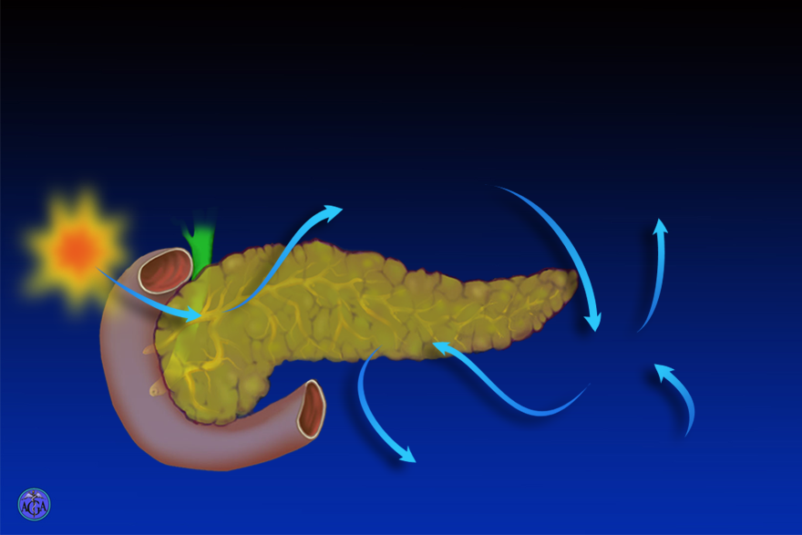
Mechanisms of acute pancreatitis - Pt. 1
Mechanisms
Acute Pancreatitis: Mechanisms
Zymogen activation
Generation of inflammatory mediators
Ischemia
Systemic inflammatory response
Multi-organ failure
Insult
Inflammation
Ischemia
Neurogenic stimulation
Necrosis
Apoptosis
Notes:
Slide 127
Mechanisms of acute pancreatitis
This image lists proposed mechanisms initiating pancreatitis and the multiorgan effects of pancreatitis. Of note, the most commonly accepted hypotheses indicate that insults to the pancreas cause activation of zymogens and production of cytokines and chemokines. The mechanisms involved in initiating these two types of events are not well understood yet although ischemia may promote both. The activation of zymogens leads to pancreatic parenchymal injury (i.e. necrosis and apoptosis). The production of cytokines, chemokines, and neurogenic factors (such as substance P) leads to an inflammatory response. Both the cytokines/chemokines and the inflammatory response also cause pancreatic parenchymal injury (i.e. necrosis, apoptosis and zymogen activation). The cytokines and chemokines generated from the pancreas can also cause a systemic inflammatory response and multiorgan injury as well as further ischemia to the pancreas and to other organs that may potentiate the responses.

Slide 39
Natural history of acute pancreatitis
Acute Pancreatitis - Natural History
Organ failure
Infection
Mild
Severe
Death
Notes:
Slide 231
Natural history of acute pancreatitis
This image shows the approximate disease course in patients with acute pancreatitis admitted to a hospital. The natural history of disease will vary with age and co-morbidity. An estimated 10%-20% of patients with AP develop severe disease. The incidence of pancreatic necrosis is between 6% and 20% and approximately 33% of these patients will develop infected pancreatic necrosis. Recurret acute pancreatitis may occur in a small proportion of patients and is usually secondary to alcohol and untreated gall stones.
Isenmann R, Berger HG. Best practice and research in Clin Gastroenterology 1999;13:291-301.

Slide 40
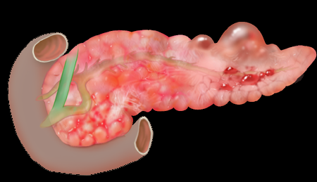
Causes of mortality
Acute Pancreatitis
DEATH
Early (< one week)
  Systemic inflammatory response syndrome (SIRS)
  Multiorgan failure
Late (> one week)
  Multiorgan failure
  Pancreatic infections/sepsis
Notes:
Slide 232
Causes of mortality
The major causes of death from acute pancreatitis change with time. In the first week, multi-organ failure is the most common cause of death. Later, infectious complications become important.
Mortality of AP is reported between 1.3% and 10%. When necrotizing pancreatitis is considered the mortality is between 14% and 30%. Mortality is influenced by age, etiology (more severe in idiopathic, post ERCP and gallstone), presence of organ failure on admission and pancreatic necrosis. Approximately half of the mortality is seen in the first 2 weeks and is due to organ failure.
De Beaux AC, Palmer KR, Carter DC. Gut 1995;37:120-126.

Slide 41
MORTALITY IN CHINREN-ACUTE PANCREATITIS
Cx BONE MARROW TPLANT
ALL
BOWEL PERFORATION/SEPSIS
CONG. HEART DISEASE
LUNG TPLANT
MULTIVISCERAL TPLANT
POLYARTERITS NODOSA

Slide 42
Treatment Modalities for Acute Pancreatitis
Acute Pancreatitis
Treatment
Supportive care
  Aggressive fluid and electrolyte replacement
  Monitoring
    Vital signs
    Urine output
    O₂ saturation
    Pain
  Analgesia, anti-emetics
Other treatments
  Acid suppression
  Antibiotics
  NG tube
  Nutritional support
  Urgent ERCP
Notes:
Slide 256
Treatment Modalities for Acute Pancreatitis
This slide lists the various monitoring and treatment modalities used for acute pancreatitis. The details of each are presented in other slides. Of note, there are no specific treatments for attenuating the underlying pathophysiologic mechanisms of acute pancreatitis.

Slide 43
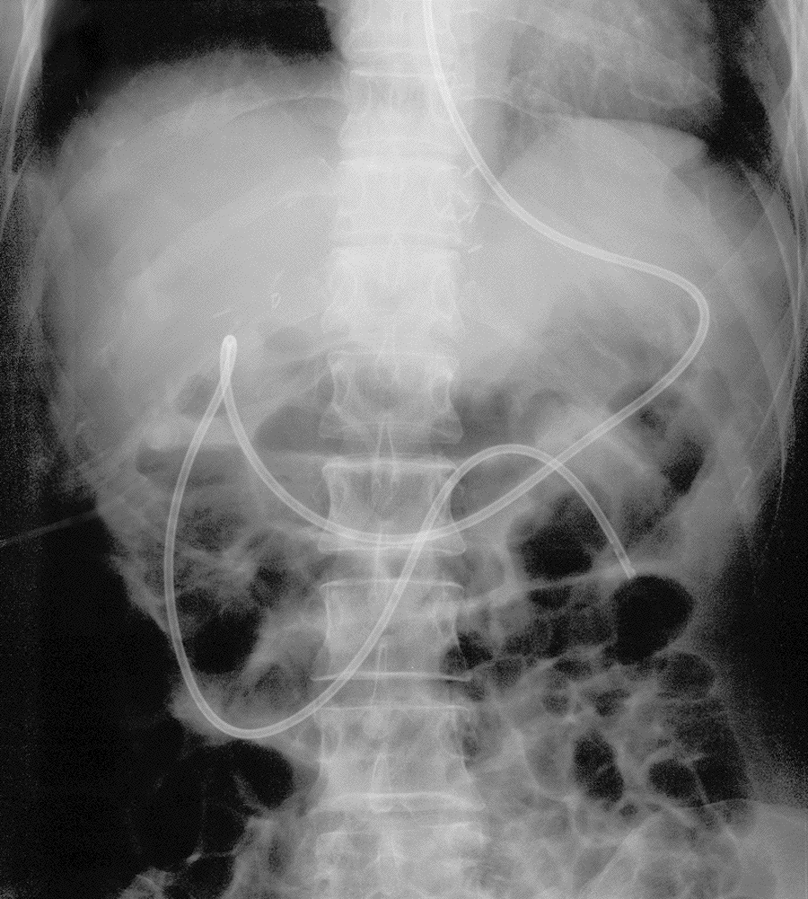
Nutrition Issues
Acute Pancreatitis
Nutrition Issues
Severe Acute Pancreatitis
Prevent nutritional depletion Negative nitrogen balance Shorten recovery Reduce inflammation
Mild to moderate pancreatitis
No benefit
Route
TPN v/s Enteral
Type of Nutrition
Complex v/s Elemental
Picture feeding tube
Notes:
Slide 261
Nutrition Issues
Acute pancreatitis is a hypermetabolic disease process that in severe pancreatitis leads to increased caloric requirements and loss of protein mass. Inadequate nutrition can result in nutritional depletion, negative nitrogen balance, higher mortality and prolonged recovery. Early nutritional support plays an important role in supportive care and may reduce complications in severe acute pancreatitis. Nutritional support is not as important in mild to moderate pancreatitis where early recovery is expected and morbidity and mortality is low. Nutritional support versus nil per oral does not haven any impact on the outcome in mild acute pancreatitis. In severe acute pancreatitis the routes for nutritional support include TPN, enteral feeding and a combination of the two. Studies to date have indicated that enteral feeding is safe in severe acute pancreatitis and may have a beneficial effect on systemic complications.
Studies in healthy humans have demonstrated that low fat elemental diet given into the mid to distal jejunum does not stimulate the pancreas. This may be important in the approach to enteral feeding in acute pancreatitis, although the clinical significance of pancreatic stimulation from feeding in acute pancreatitis is unclear.
Kaushik N, Pietraszewski M, Holst JJ, O’keefe SJ. Pancreas 2005;4:353-359.
Kalfarentzos F, Kehagias J, Mead N, Kokkinis K, Gogos CA. BJS.1997;84:1665-1669.
Winsor ACJ, Kanwar S, Li AGK, Barnes E, Guthrie J,A, Spark JI, Welse F, Guillou PJ, Reynold JV. Gut 1998;42:431-435.
Okeef SL, lee RB, Anderson FP. Am J Phy 2003,284:G27-36

Slide 44
Acute Pancreatitis: Nutrition
Route of Alimentation
Enteral
  Cost – moderate
  May stimulate pancreas
  Reduced infections
  Electrolytes undisturbed
  May retain gut integrity
TPN
  Cost – high
  No pancreas stimulation
  Increased infections
  Electrolyte disturbances
  Detrimental to gut integrity
Notes:
Slide 262
Route of Alimentation
The relative advantages and disadvantages of total parenteral nutrition (TPN) versus enteral alimentation (jejunal feeding) are compared on this slide. As shown, a number of factors favor the enteral route. Some of these advantages have been confirmed by clinical studies.
Heinrich S, Schafer M, Rousson V, Clavien PA. Ann Surg. 2006 ;243:154-68.
McClave SA, Chang WK, Dhaliwal R, Heyland DK. J Parenter Enteral Nutr. 2006;30:143-56.

Slide 45
Enteral Feeding: Clinical Issues
Severe Acute Pancreatitis
Enteral Feeding: Clinical Issues
Early feeding (48 to 72 hrs) may be important
Low-fat elemental diet may be preferable
Not necessary to achieve total caloric requirement immediately
Monitor for hyperglycemia
NG v/s NJ feeding
Notes:
Slide 266
Acute Pancreatitis: Enteral Feeding-Clinical Issues
Patients with severe acute pancreatitis are profoundly catabolic requiring nutritional support early in this disease. Clinical studies have demonstrated that enteral feeding is safe and may prevent infections complications compared to TPN.
Low fat - elemental diet causes significantly less pancreatic secretion in healthy adults compared to complex diets, especially if given into the mid to distal jejunum. This may be the preferred type of enteral diet in SAP. The importance of this is SAP is unclear as the pancreas may not respond to food stimulation in the usual fashion. Most clinical studies n AP have used a semi-elemental diet.
Enteral nutrition even in small amounts prevents intestinal mucosal atrophy and may have a beneficial effect on permeability and inflammation. Controlled studies indicate that enteral feeding within 48 hrs is feasible and tolerated. Early institution of feeding has many advantages including delivery of necessary calories and more importantly possibly maintaining gut integrity, thereby reducing bacterial translocation, bacteremia and reduction of infected pancreatic necrosis. Most clinical studies have also demonstrated that enterally fed patients only achieve 20-70% of the target caloric requirements early in the course of disease. This is due to ileus, pain, nausea, vomiting, tube dislodgment, and diarrhea. It is possible that some of these complications may be reduced by elemental feeding into the mid or distal jejunum. Even so patients benefit from enteral route of feeding indicating that it is as important to use the gut as it is to achieve caloric goals. Feeding is usually begun through an endoscopically placed jejunal feeding tube (beyond the ligamnet of Treitz), although recent evidence suggests that naso-gastric tube feeding may be as well tolerated as naso-jejunal feeding. A significant amount of patient’s will develop hyperglycemia, which should be monitored and aggressively treated with insulin.
Okeef SL, lee RB, Anderson FP. Am J Phy 2003,284:G27-36.
Kalfarentzos F, Kehagias J, Mead N, Kokkinis K, Gogos CA. BJS.1997;84:1665-1669.
Winsor ACJ, Kanwar S, Li AGK, Barnes E, Guthrie J,A, Spark JI, Welse F, Guillou PJ, Reynold JV. Gut 1998;42:431-435.
Eatock FC, Chong P, Menzes N, Murray L, McKay CJ, Carter CR. Imrie CW. Am J. Gastroenterology 2005;432-439.

Slide 46
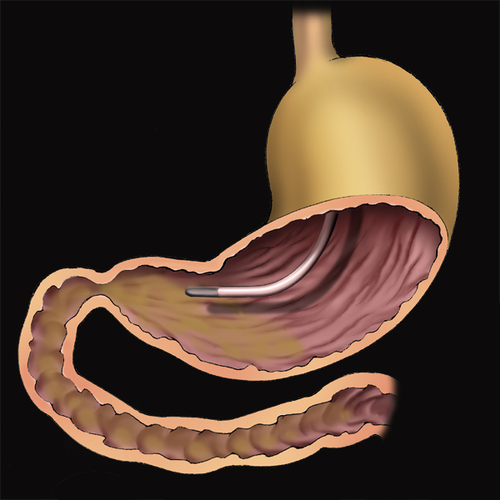
Naso-Gastric Tube Delivery
Acute Pancreatitis: Enteral nutrition
Naso-Gastric Tube Delivery
Issues
  Difficult to position/maintain NJ
  Lack of evidence that low-level pancreatic stimulation is harmful
Outcome
  Prospective trial NG vs NJ in 50 pts with APACHE II avg 11
  Semi-elemental diet low fat
  Similar mortality, APACHE change
Eatock Am J. Gastro 100: 432, 2005
Notes:
Slide 268
Acute Pancreatitis: Enteral nutrition - Nasogastric Tube Delivery
One study suggests that early nasojejunal (NJ) feeding may be safe in acute pancreatitis. A prospective randomized study of 50 patients compared nasogastric (NG) to NJ feeding. There were 27 patients in NG group v/s 22 NJ group, patients had SAP with APACHE >6, CRP>150. Feeding was started 24 hrs to 72 hrs from admission, with a full strength semi-elemental low fat diet. Total mortality was 24%, 5 in NG and 7 in NJ. There was no difference in pain, ileus, inflammatory mediators and hospital stay between AP patients fed by NG versus NJ tube. This study suggests that NG feeding may be equivalent and as safe as NJ feeding. However, this small study requires confirmation with larger prospective trials. One of the concerns raised by about this approach has the been whether the risk for aspiration might be increased.
Eatock FC, Chong P, Menzes N, Murray L, McKay CJ, Carter CR. Imrie CW. Am J. Gastroenterology 2005;432-439.

Slide 47
Major Complications of Acute Pancreatitis
Acute Pancreatitis
Major Complications
Local
  Fluid collections
  Necrosis
  Infection
  Ascites
  Erosion into adjacent structures
  GI obstruction
  Hemorrhage
Systemic
  Pulmonary
  Renal
  CNS
  Multiorgan failure
Metabolic
  Hypocalcemia
  Hyperglycemia
Notes:
Slide 270
Major Complications of Acute Pancreatitis
This slide lists the major complications of acute pancreatitis. Each of these is presented in more detail in other slides.

Slide 48
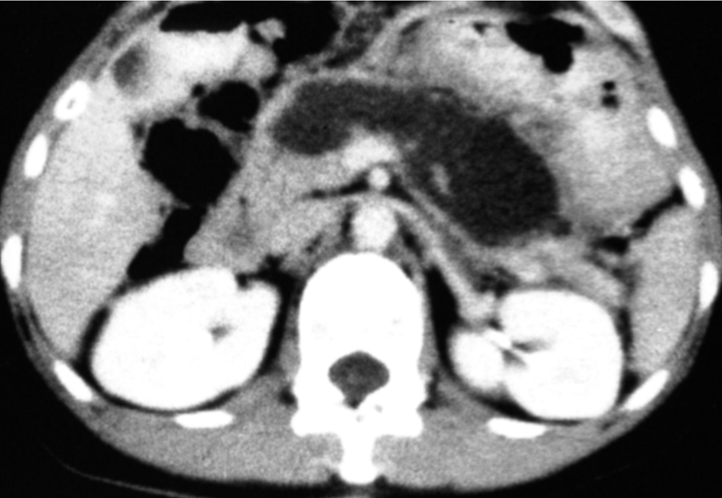
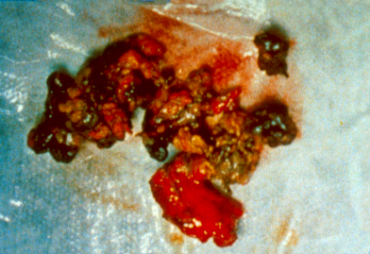
Appearance of severe pancreatic necrosis
Necrosis: Sterile
Notes:
Slide 280
Appearance of severe pancreatic necrosis
The CT image shows necrosis of the pancreatic body and tail in a patient with acute pancreatitis who underwent surgical debridement. Note the bright contrast opacification of the kidneys and total absence of contrast in the pancreas. The operative photo shows the necrotic material that was surgically removed from the pancreatic bed. Note the solid nature of the necrotic tissue and the absence of liquefaction or a capsule or fibrous wall (features thatmight be seen more than a month into the course of necrotizing pancreatitis).

Slide 49
Antibiotic use in acute pancreatitis
Acute Pancreatitis - Infections
Antibiotics
Prophylactic
  Prevent infection of necrosis
  Prevent infectious complications (e.g. urinary tract infection)
Therapeutic
  Cholangitis
  Pancreatic infection
Notes:
Slide 327
Antibiotic use in acute pancreatitis
In acute pancreatitis, antibiotics are used for two major indications. The prophylactic use of antibiotics may reduce the number of pancreatic and non-pancreatic infections, but are usually reserved for those with severe disease. Antibiotics are used therapeutically for the treatment of cholangitis or other infections.

Slide 50
Bacteria found in infected pancreatic necrosis before the regular use of prophylactic antibiotics
Bacteria in Infected Necrosis
Escherichia coli
Enterobacter sp.
Pseudomonas sp.
Streptococcus faecalis
Proteus sp.
Anaerobic sp.
Klebsiella sp.
Staphylococcus aureus
Beger, et al., Gastroenterology 1986; 91:433
Notes:
Slide 286
Bacteria found in infected pancreatic necrosis before the regular use of prophylactic antibiotics
These data were obtainedbefore antibiotics came into general use for the prophylactic treatment of patients with severe pancreatitis. Enteric organisms, including Gram-negative rods and anaerobic bacteria, most commonly cause infected necrosis. A significant minority of bacterial infections is due to Staphylococcus organisms. In severe acute pancreatitis, the prevalence of enteric organisms has been linked to increased intestinal mucosal permeability. Organisms translocate across the colonic mucosa into the portal venous system and seed necrotic pancreatic tissue early in disease, and may seed from other sources, including the small bowel later.
Beger HG, Bittner R, Block S, Buchler M. Gastroenterology 1986;91:433-438.

Slide 51
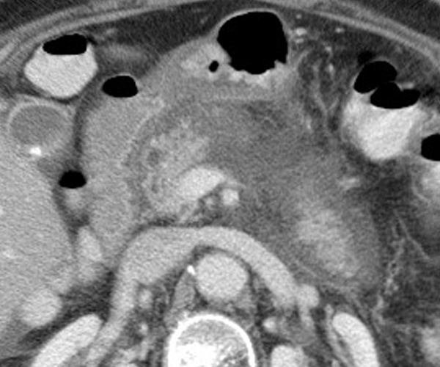
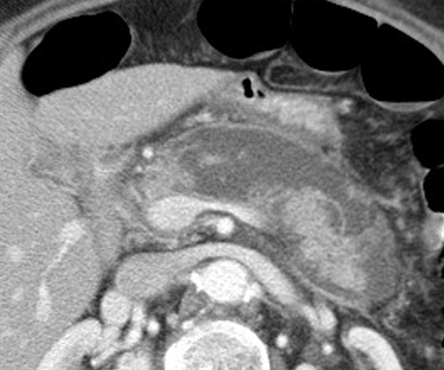
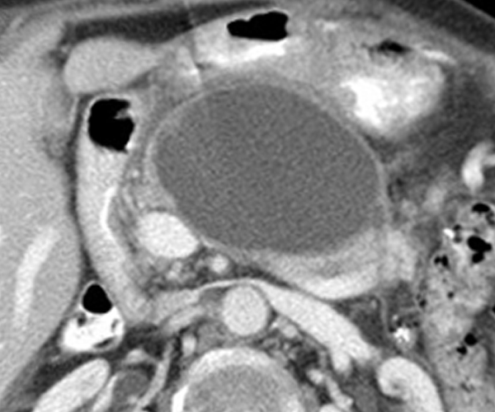
Evolution of Pancreatic Necrosis into a Pseudocyst
Pseudocyst
Organized Pancreatic Necrosis
Day 1
Day 7
Day 28
Notes:
Slide 288
Evolution of Pancreatic Necrosis into a Pseudocyst
Pseudocysts often develop in areas of previous pancreatic necrosis. These pseudocysts may be thought of as areas of organized pancreatic necrosis. Note the formation of a discrete wall around this pseudocyst and its enlargement over time. Although this collection appears homogeneous and has fluid density on CT scan, it is likely to contain partially liquefied necrotic debris. The complexity of organized pancreatic necrosis is underestimated by CT, and is an important consideration when drainage is necessary, since the thick material within the collection will not drain through a small diameter catheter or stent and is likely to become infected once instrumented. Necrosis may be associated with pancreatic ductal disruption. When this scenario occurs in the pancreatic body, pancreatic juice secreted by the viable pancreatic tail leaks from the disruption into an enlarging pseudocyst. This form of pancreatic pseudocyst is unlikely to resolve until a permanent tract is created for internal drainage of the pancreatic tail, or until the pancreatic tail atrophies or is resected.

Slide 52
Possible Strategies for Altering Severity
Relieve ductal obstruction
Protease inhibition
Modulate secretion
Inhibit inflammation
Reduce chemokines / cytokines
Modulate cell death
Notes:
Slide 319
Strategies for altering the severity of acute pancreatitis
Several strategies for reducing the severity of acute pancreatitis have been examined, but unequivocally positive data supports few of these interventions. In patients with severe gallstone pancreatitis, using ERCP to treat acute common bile duct obstruction appears beneficial. In contrast, in a large clinical trial in acute pancreatitis, the platelet activating factor (PAF) inhibitor, lexiplafant, failed to show a benefit.
Johnson CD, Kingsnorth AN, Imrie CW, McMahon MJ, Neoptolemos JP, McKay C, Toh SK, Skaife P, Leeder PC, Wilson P, et al. Gut 2001; 48: 62-69.

Slide 53
RETROSPECTIVE SRUDY OF 271 CHILDREN
YALE- 1995-2006
INCREASED INCIDENCE OF PANCREATITIS BY 53 %
15 % recurrence rate
Mean age 13 years
No stat. difference of BMI

Slide 54
CAUSES
BILIARY – 32%
  STONES
  MICROLITHIASIS/SLUDGE
  CHOLEDOCAL/PANCREATIC CYSTS
  ANNULAR PANCREAS
  TUMOR COMPRESSION

Slide 55
CAUSES
DRUGS- 25%
  VALPROIC ACID
  PREDNISONE
  AZATHIAPRINE

Slide 56
CAUSES
TRAUMA
SYSTEMIC ILLNESS/PICU
VIRAL INFECTION-7.95%
METABOLIC-DKA (5), HYPERTIGLYCERIDEMIA (3)
IDIOPATHIC 23%

Slide 57
SUMMARY
INDEX OF SUSPICION
DO ULTASOUND
NO CT AT PRESENTATION !!
NUTRITION IF ANTICIPATE > 7 DAYS
DON’T TREAT LAB DATA
MORPHINE FOR PAIN
NO NG SUCTION
ACID SUPPRESSION
SUPPORTIVE CARE

Slide 58
READING
CHANGING REFERRAL TRENDS OF ACUTE PANCREATITS IN CHILDREN: A 12 YEAR SINGLE-CENTER ANALYSIS: JPGN 2009 SEPT.49(3): 316-322
PANCRESATITIS IN CHILDREN JPGN 37; (5)NOV.591-595
AGA MEDICAL POSITION ON ACUTE PANCREATITS: GASTRO, MAY 2007 201902021

Slide 59
THE END
QUESTIONS?????

