Slide 1


Our Journey God’s Plan
Living & Caring as a Vincentian
2026

Slide 2
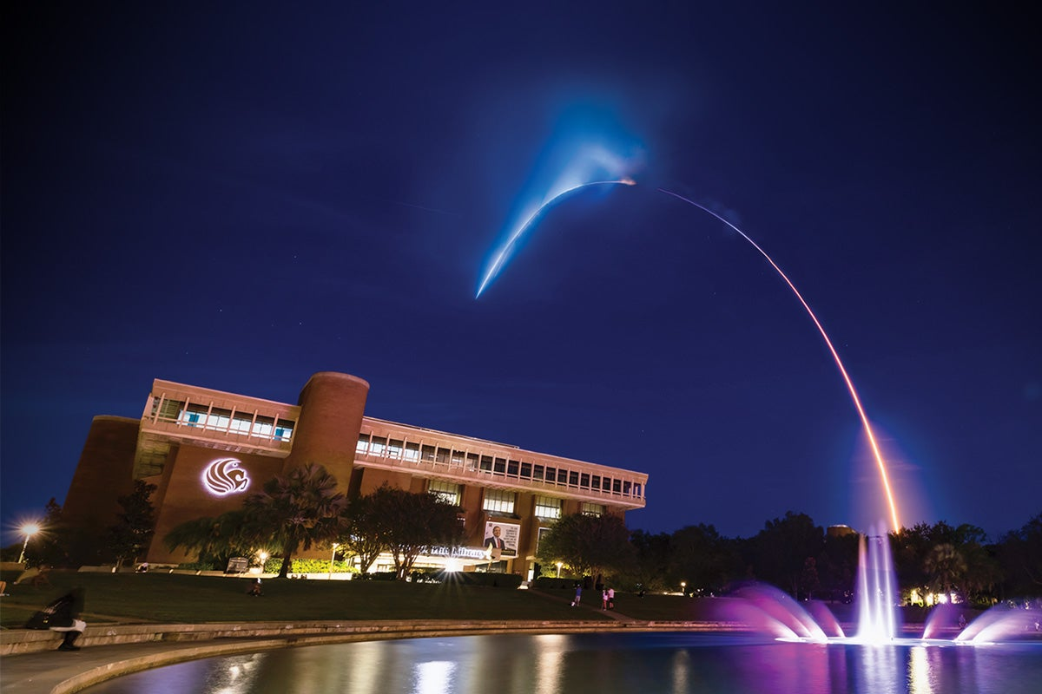
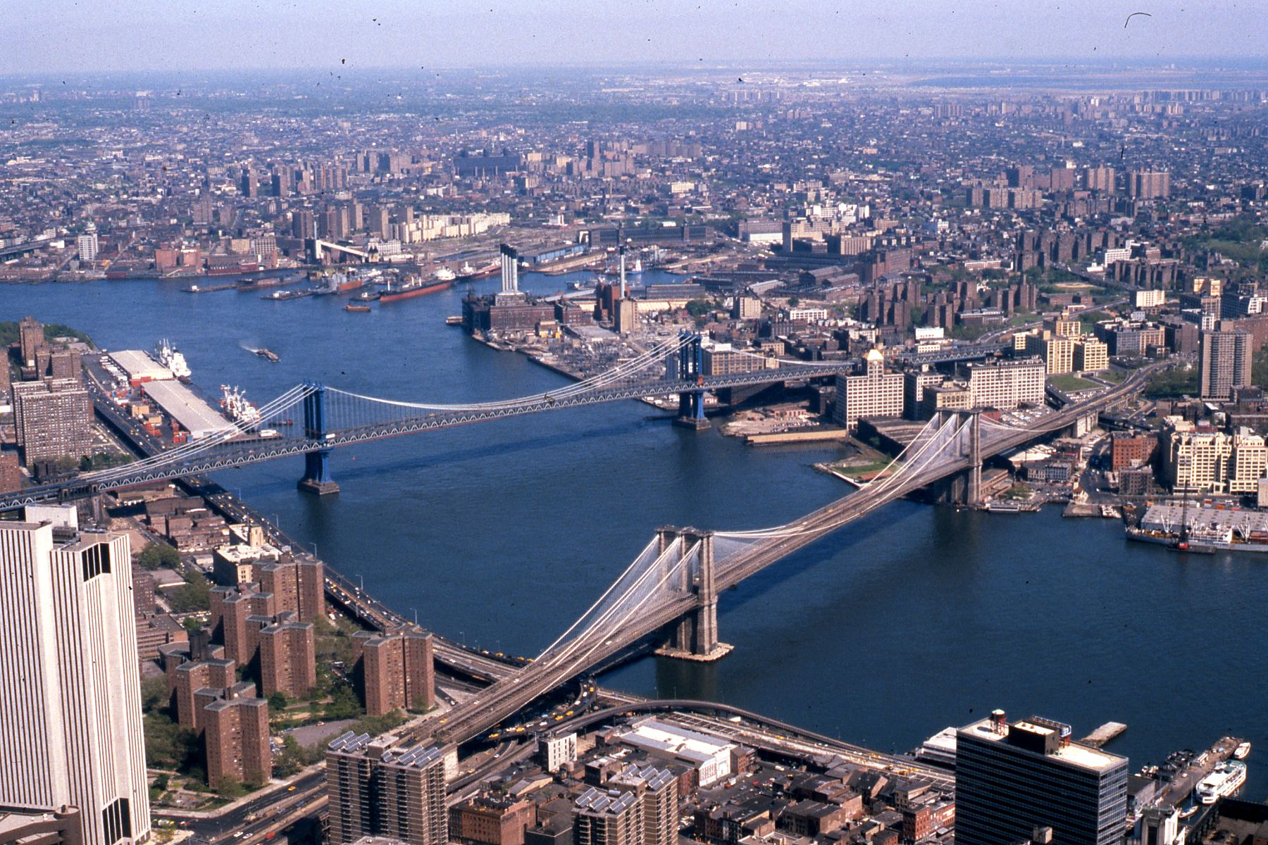
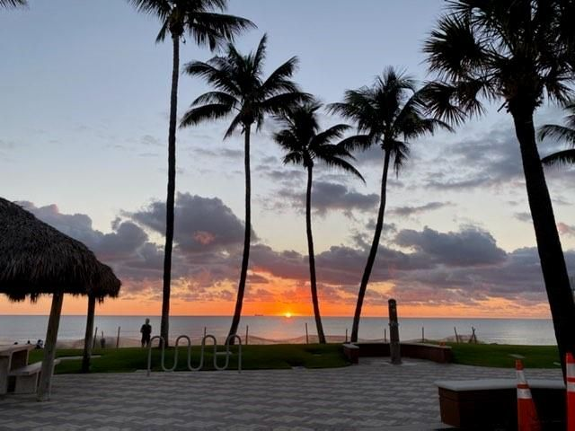
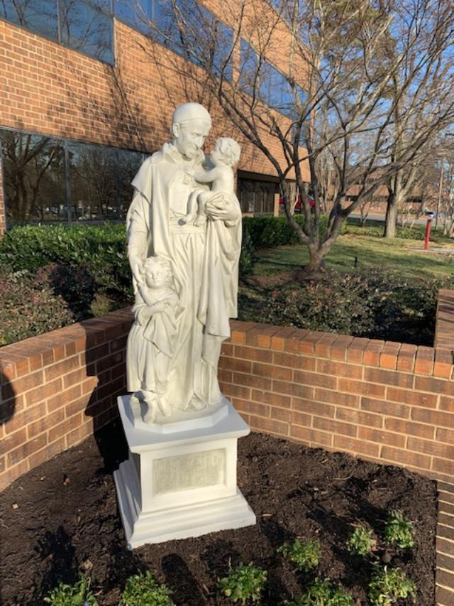
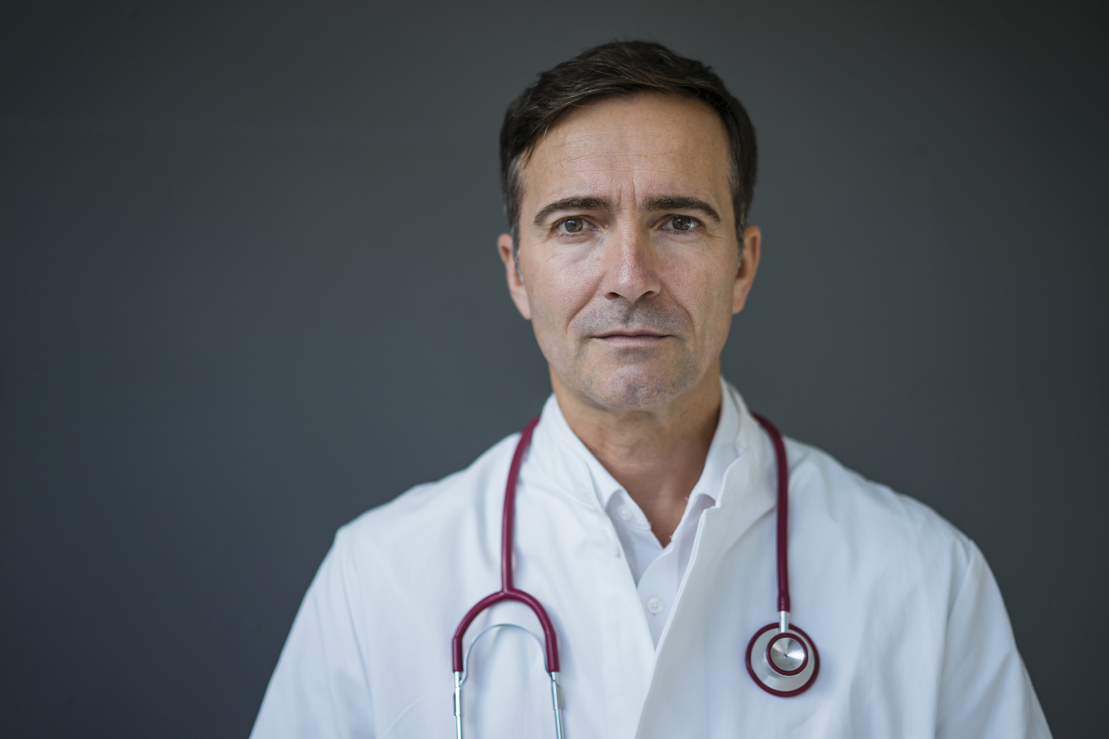


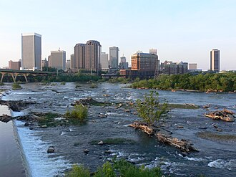
MY JOURNEY

Slide 3
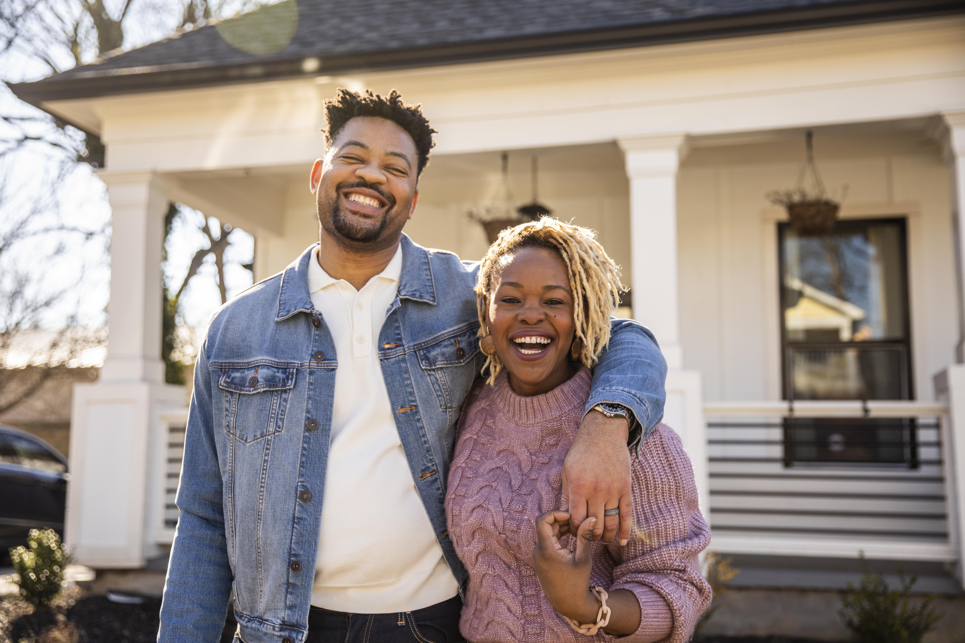



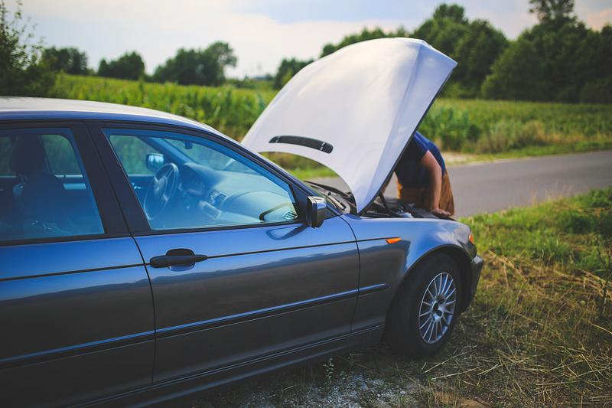

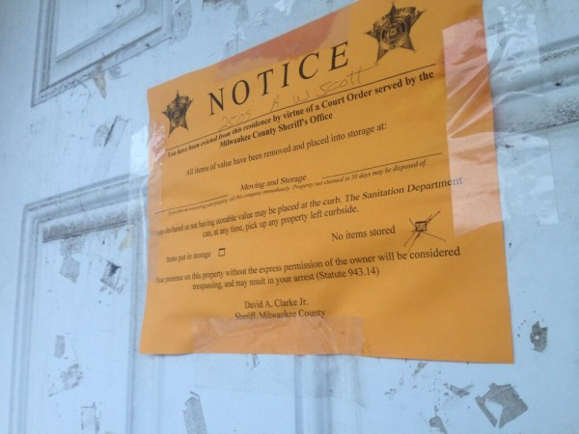
A NEIGHBOR IN NEED’S JOURNEY
This Photo by Unknown Author is licensed under CC BY-ND

Slide 4
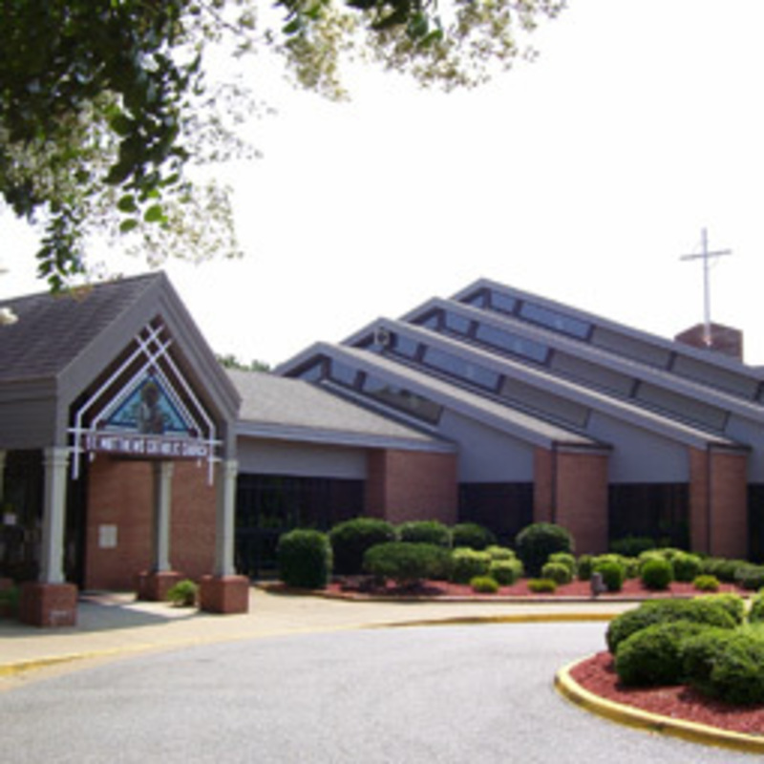
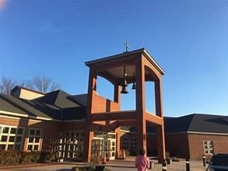

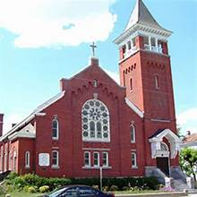
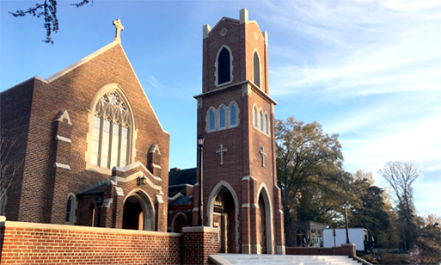
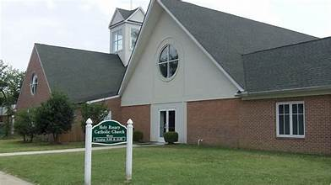
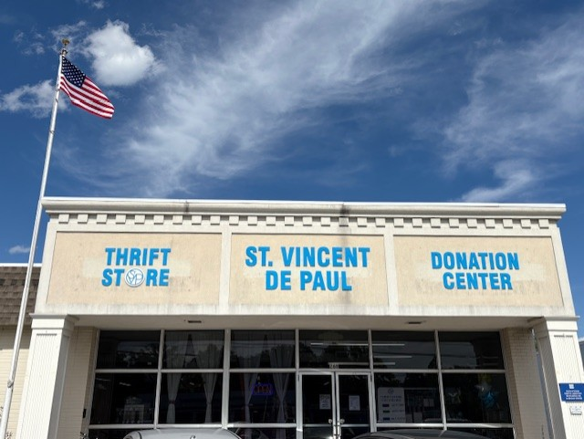
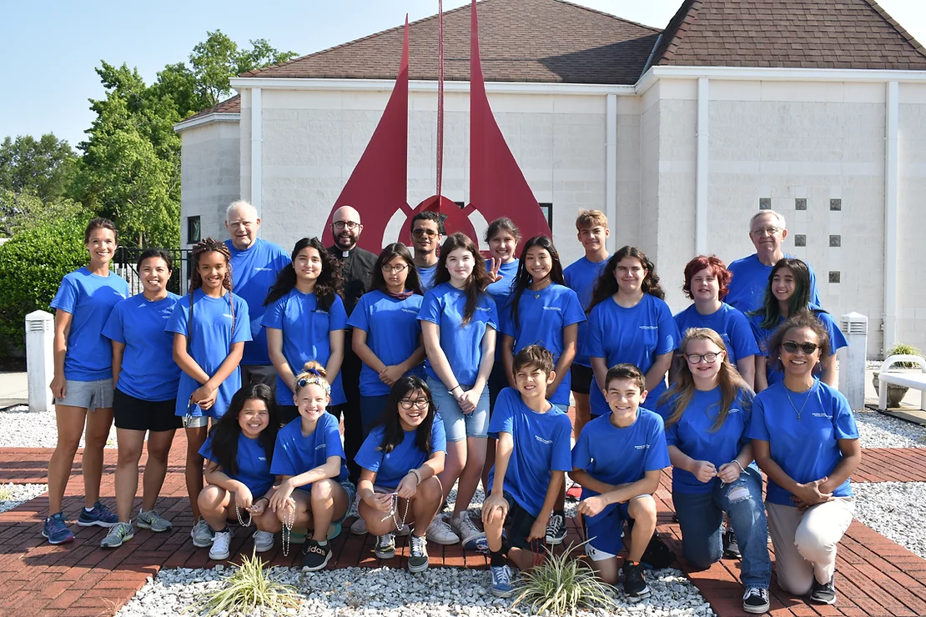
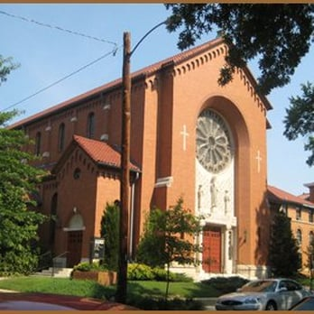
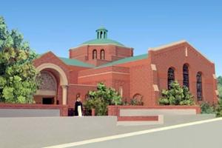
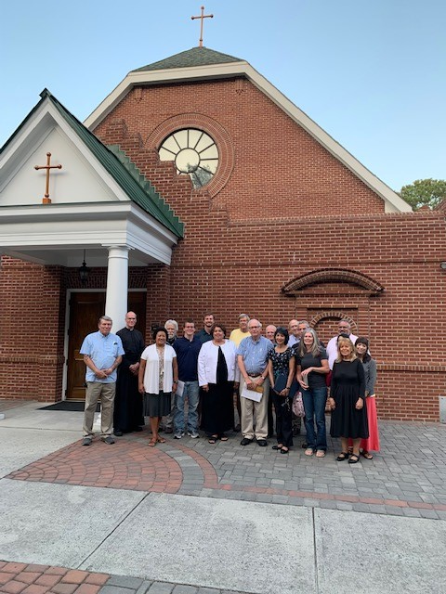
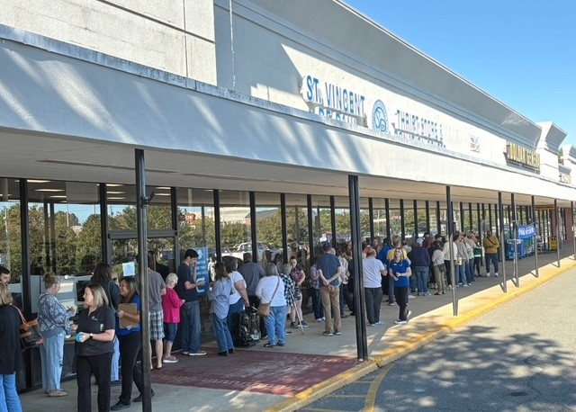
SVDP RICHMOND JOURNEY
2013
2016
2016
2019
2019
2023-2025
2019
2020
2021
2026

Slide 5
GOD HAS A PLAN

Slide 6
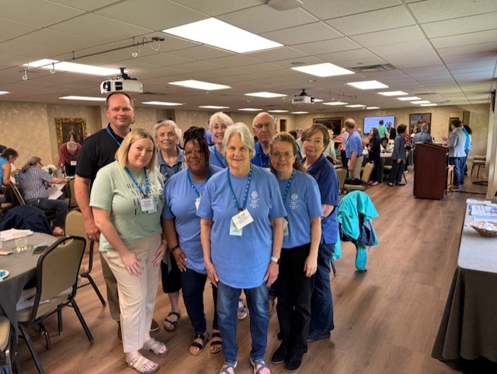
HOW SVDP HELPED EACH OF US
For me-strengthened my faith
Gave me passion to want to grow our mission
For neighbors in need-brought hope and dignity to over 12,000 people we helped in 2025

Slide 7
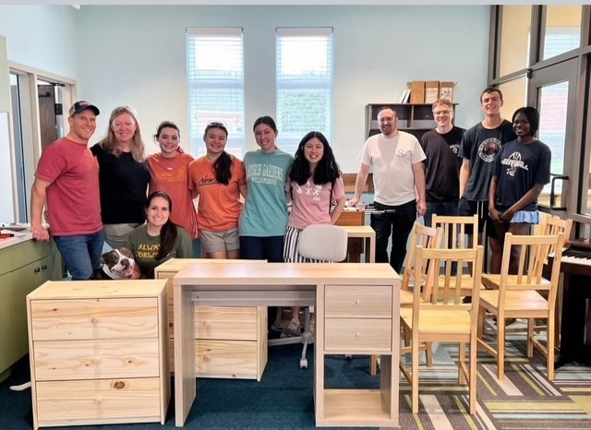
WHAT IS OUR DESTINATION
Prevent homelessness
Every neighbor in need should be able to have a Vincentian encounter
Never forgetting to be the face of Christ to those we serve and to see the face of Christ in those we serve

Slide 8
PREVENT HOMELESSNESS
RVA VB
Point in Time Count Summer 2025 680 327
Point in Time Count Winter 2025 660 311
Shelter Space (not inc seasonal) 398 173
Cost to Shelter
$30,000-$35,000 per year
Emergency Financial Assistance
$3,000
More economical, more dignified to help someone before they reach homelessness

Slide 9
VINCENTIAN SERVICES PREVENT HOMELESSNESS
Financial
Literacy
Workforce
Develop
Transportation
Housing
Health & Wellness
Youth &
Education
Programs
+
Advocacy

Slide 10
SVDP PREVENT HOMELESSNESS 2026-2028
Housing
Stability
Home Visit
Emergency Assist
New
Mattress Program
Motel
2
Home
Advocacy
Affordable
Housing

Slide 11
SVDP PREVENT HOMELESSNESS 2026-2028
Health & Wellness
Food Awareness & Access
Health
Care Costs
Benefits
Advocate

Slide 12
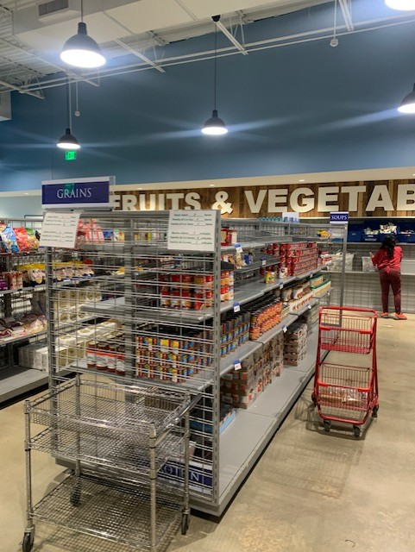
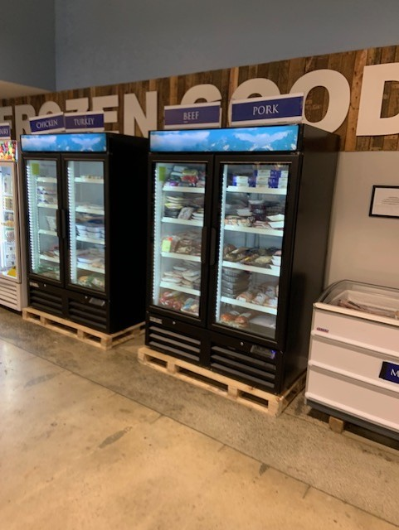
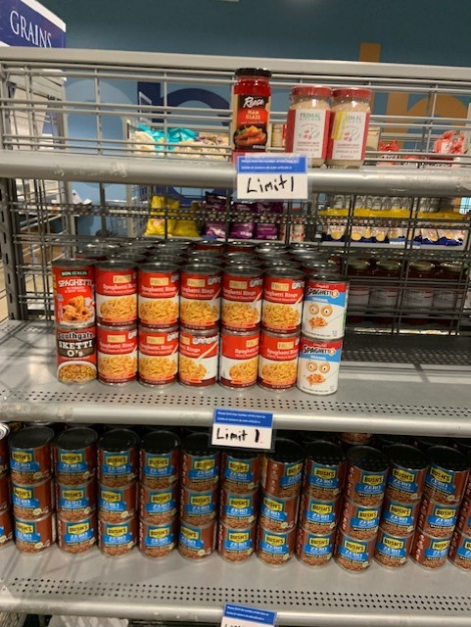
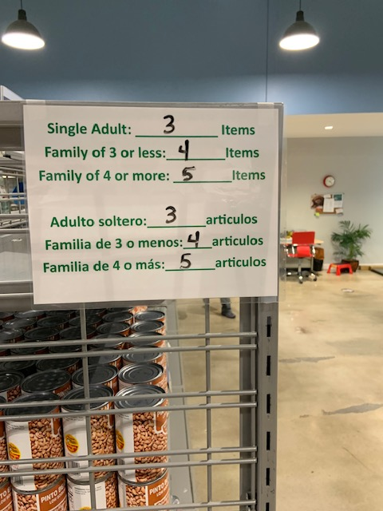
HEALTH & WELLNESS NEIGHBOR’S CHOICE PANTRY

Slide 13
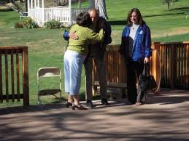
EVERY NEIGHBOR IN NEED HAS ACCESS TO A VINCENTIAN ENCOUNTER
9 Conferences / 15 parishes
350 Vincentians (240,000 Catholics in Diocese)
Helped 12,000 neighbors in need in 2025
We need your help to grow our reach
THERE IS NOTHING COMPARABLE TO A VINCENTIAN ENCOUNTER-

Slide 14
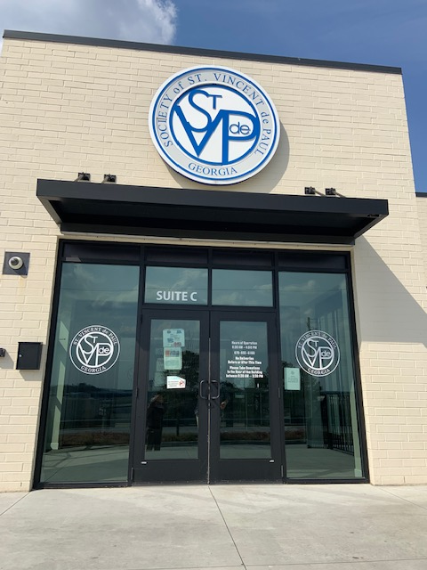
WHAT’S NEXT ON OUR SVDP JOURNEY
Expand our programs to prevent homelessness
Expand access to Vincentian encounters and services:
Adding more parishes
Adding more Vincentians
Vincentian Center

Slide 15

JOIN ME ON THIS JOURNEY OF FAITH
Let SVDP strengthen your faith on your journey
Help SVDP serve more of our neighbors in need and bring the face of Christ to them on their journey

Slide 16
ON THIS JOURNEY
GOD HAS A PLAN
TRUST IT

