Slide 1


Slide 2
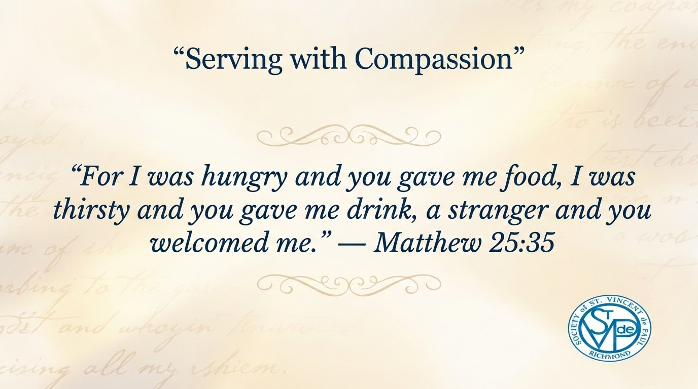

Slide 3
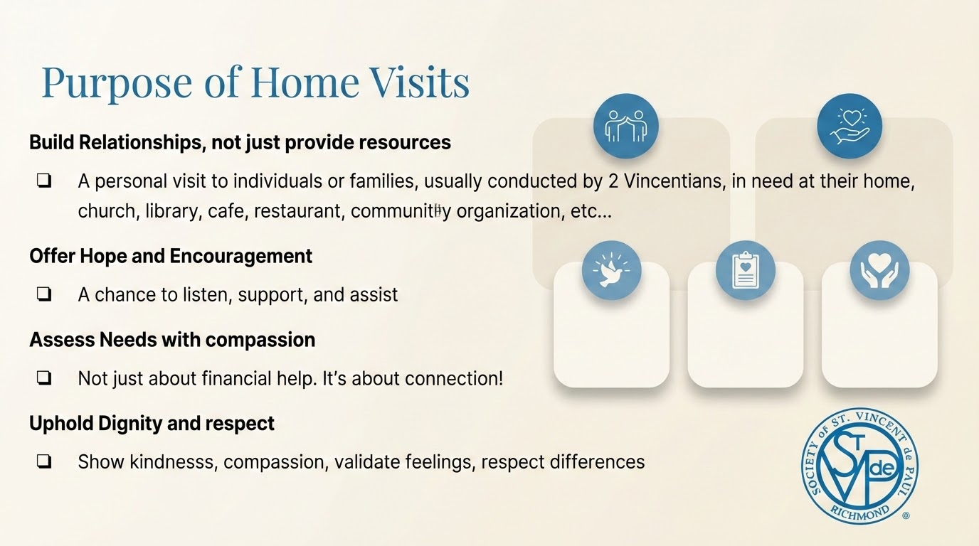

Slide 4

Boundaries & Safety
Always go in pairs
Be aware of surroundings
Respect personal space
Know when to refer to other resources

Slide 5
Things to be mindful of…
Don’t judge or criticize
Don’t make promises you can’t keep
Don’t rush the visit
Don’t Share personal opinions excessively

Slide 6
Addressing Needs…
Financial assistance (rent, utilities)
Food and basic needs
Referrals to community resources
Emotional and spiritual support

Slide 7
A home visit is not the end…. it’s the beginning
True impact happens in what follows…
Reduces isolation - Meaningful connections provides hope
Restores dignity - We are called to walk alongside, not just show up once
Builds trust - Follow-up communication (calls, texts, check-ins)
Support - Conference discussion and decision-making
Empowerment - Coordinating next steps for support
Strengthen Faith - Continued prayer and reflection
Personal transformation - for both the Vincentician’s and Neighbor’s

Slide 8
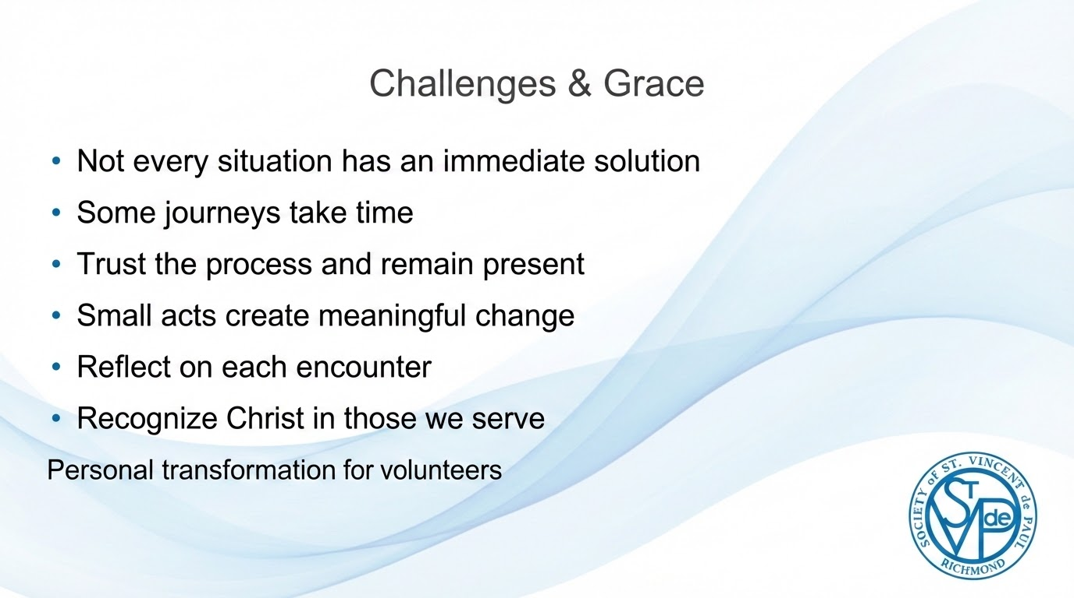

Slide 9
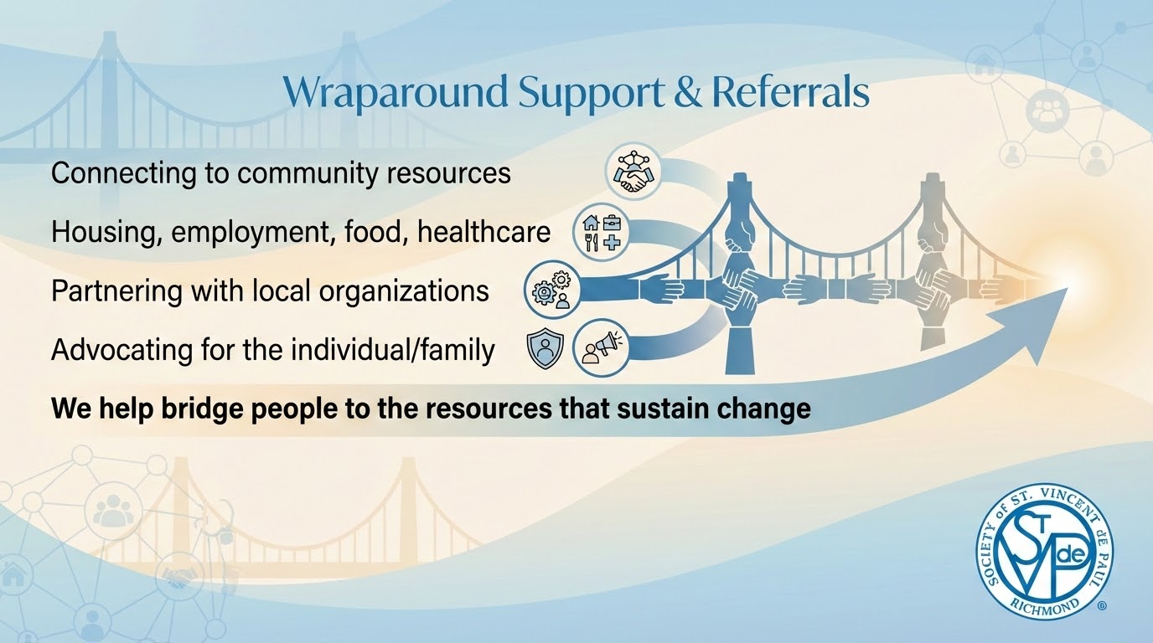

Slide 10


