Slide 1
Living & caring as a vincentian

Slide 2
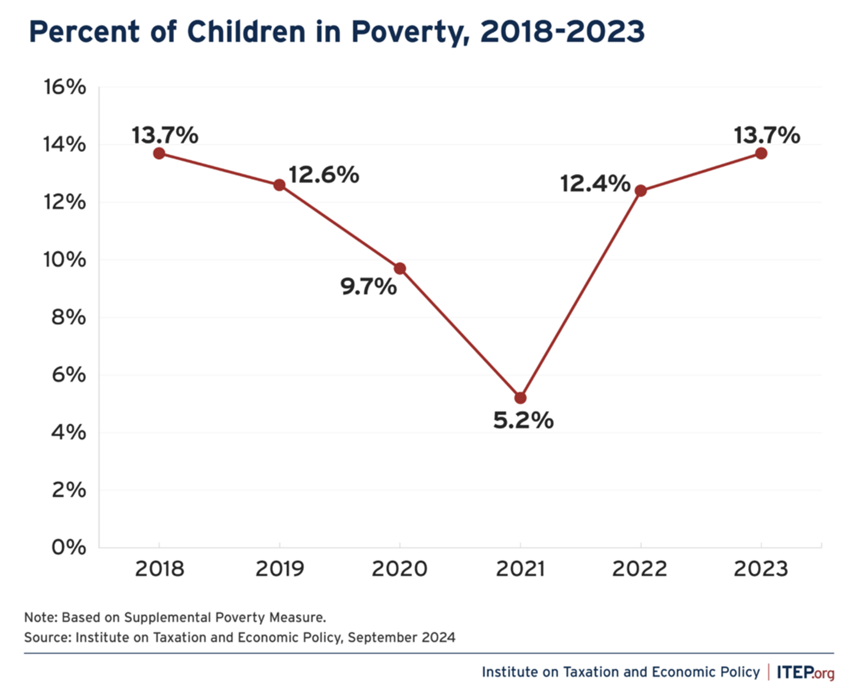

Slide 3
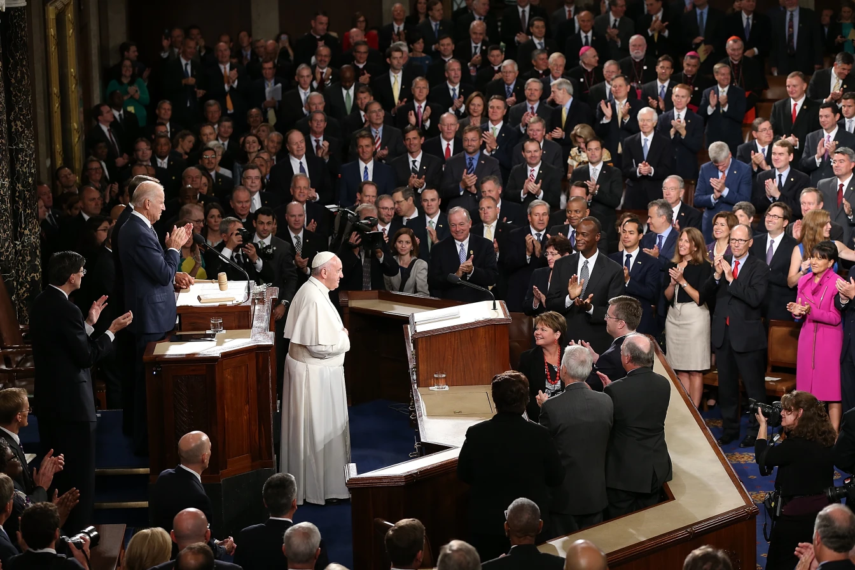
Catholic social Teaching on Advocacy

Slide 4
Pope Leo XIII, Rerum Novarum (no. 32)
“The foremost duty, therefore, of the rulers of the State should be to make sure that the laws and institutions, the general character and administration of the commonwealth, shall be such as of themselves to realize public well-being and private prosperity.”

Slide 5
Pope benedict XVI, Deus Caritas Est
“…charitable activity on behalf of the poor and suffering was naturally an essential part of the Church of Rome from the very beginning, based on the principles of Christian life given in the Acts of the Apostles.” (No. 23)
“…charity must animate the entire lives of the lay faithful and therefore also their political activity, lived as ‘social charity.’” (No. 29)

Slide 6
Pope francis, Evangelii Gaudium (no. 183)
“An authentic faith – which is never comfortable or completely personal – always involves a deep desire to change the world, to transmit values, to leave this earth somehow better that we found it. We love this magnificent planet on which God has put us, and we love the human family which dwells here, with all its tragedies and struggles, its hopes and aspirations, its strengths and weaknesses. The earth is our common home and all of us are brothers and sisters. If indeed ‘the just ordering of society and of the state is a central responsibility of politics’, the Church ‘cannot and must not remain on the sidelines in the fight for justice’.”

Slide 7

U.S. Bishops
Politically disenfranchised (FCFC, no. 16)
Not one issue voters (FCFC, no. 42)
Guided by moral conviction and not attachment to a party. If necessary, our participation should transform the party to which we belong (FCFC, no. 14)

Slide 8
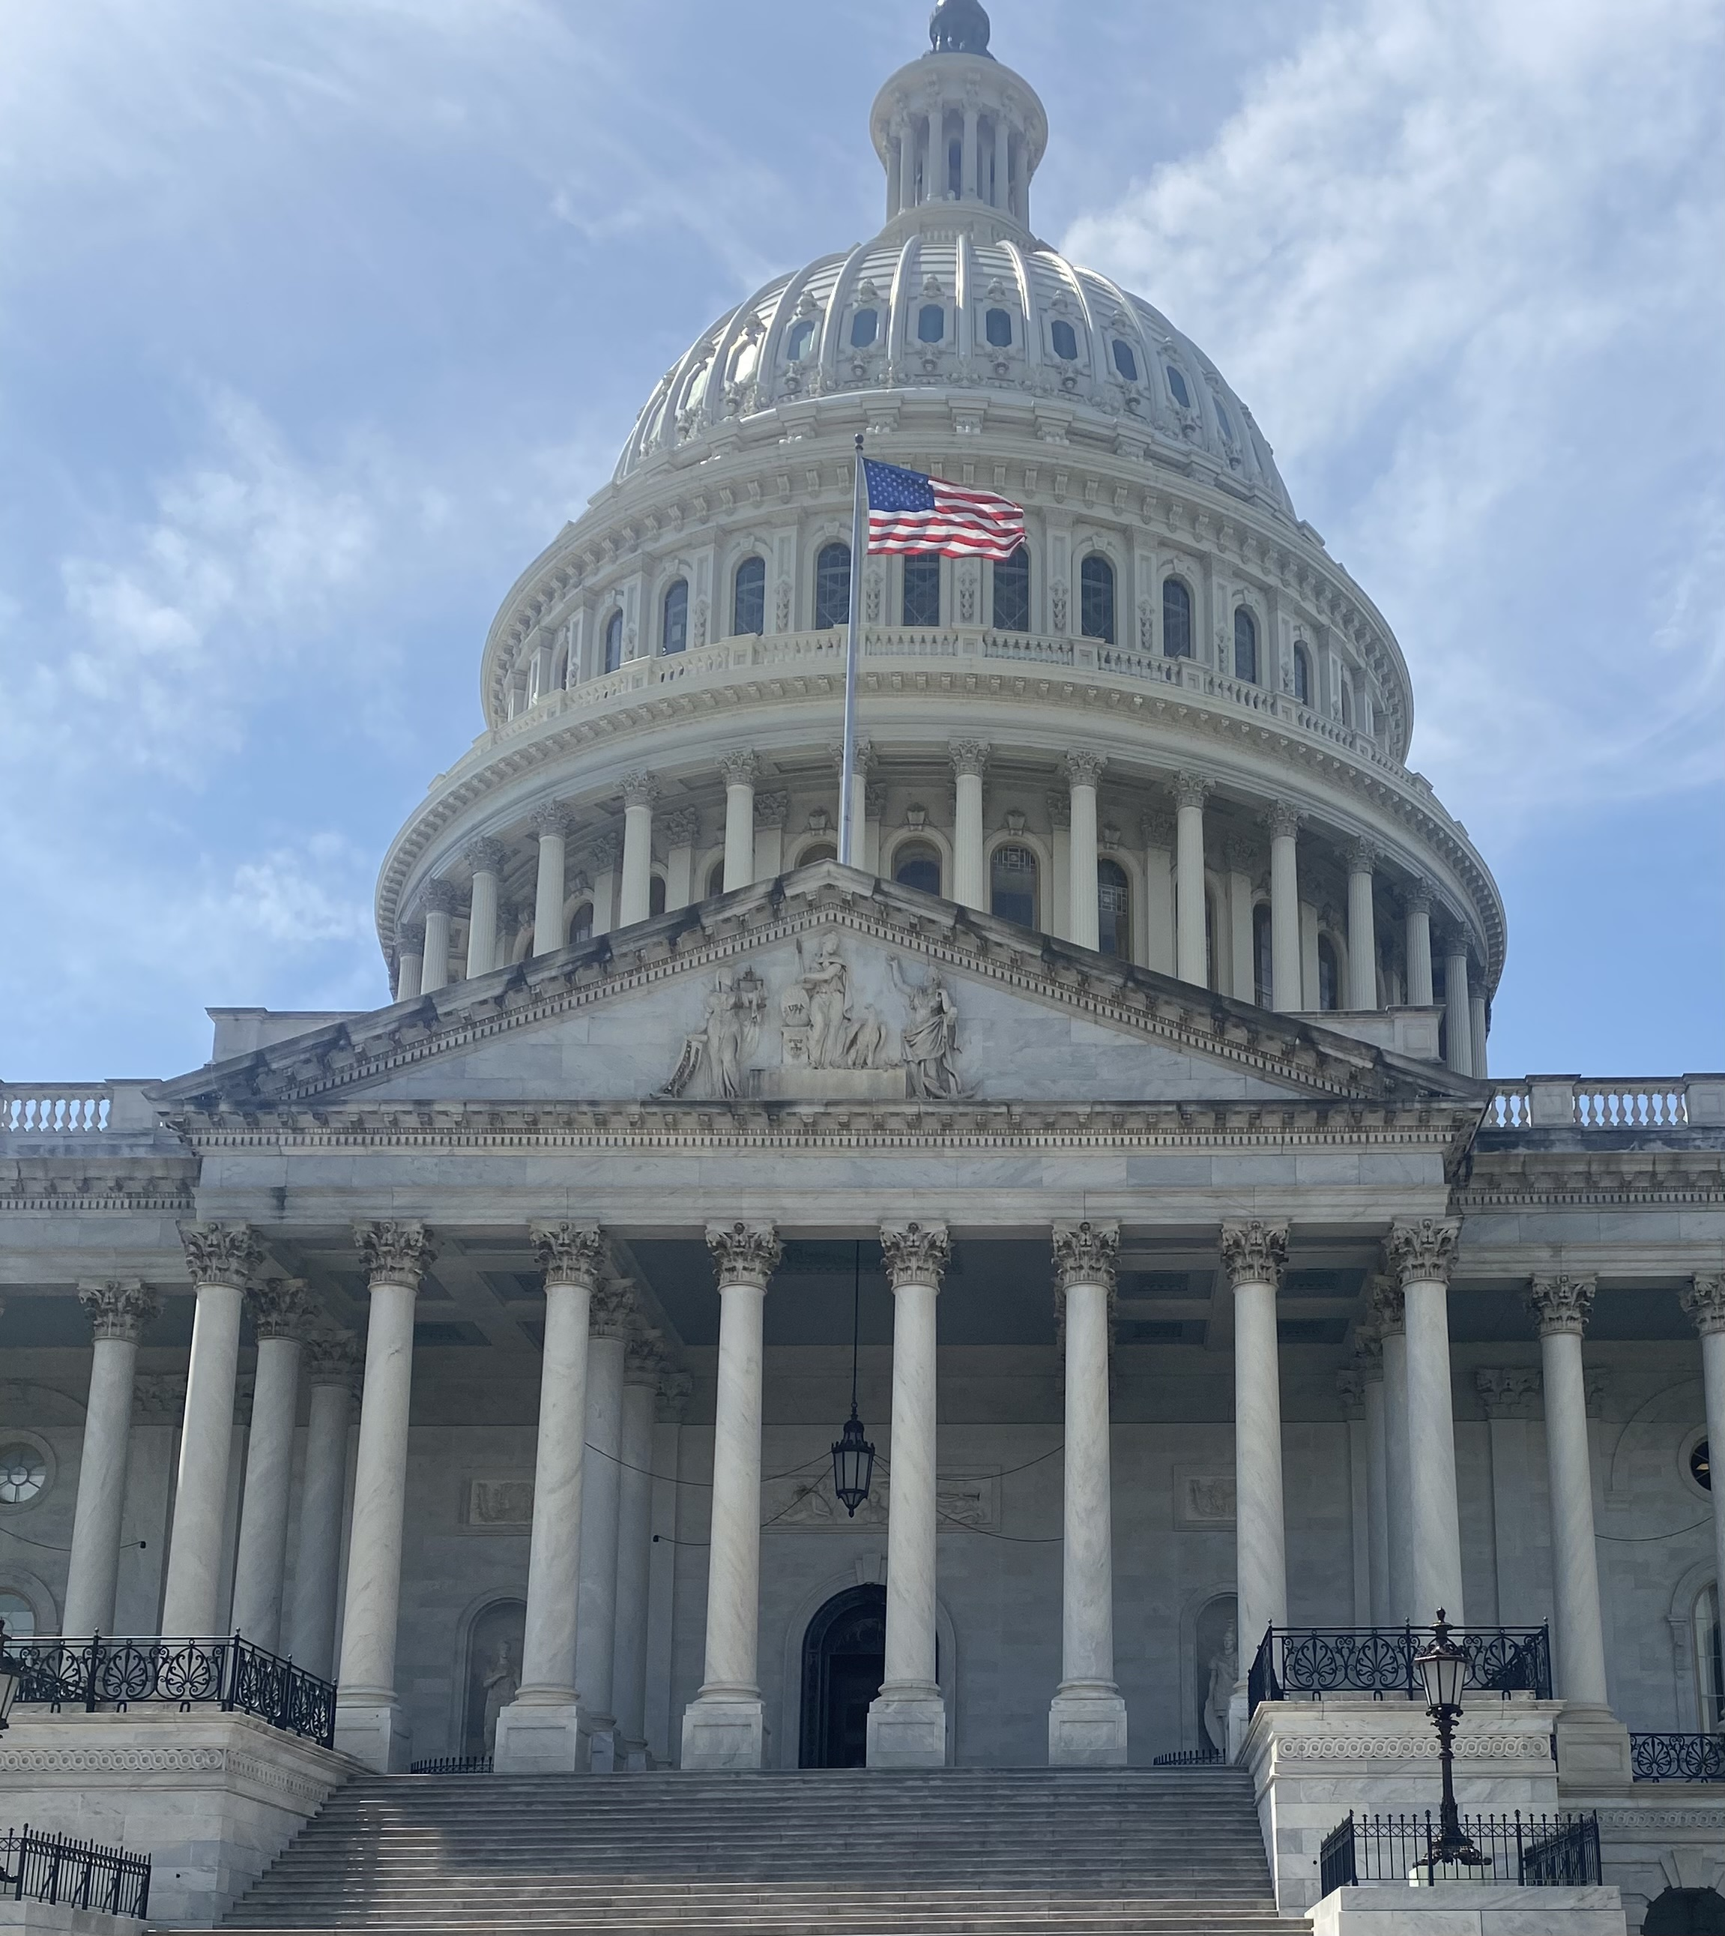
Current legislative landscape
Narrow majorities
Reconciliation
Appropriations
Government Shutdowns
Midterm Elections

Slide 9
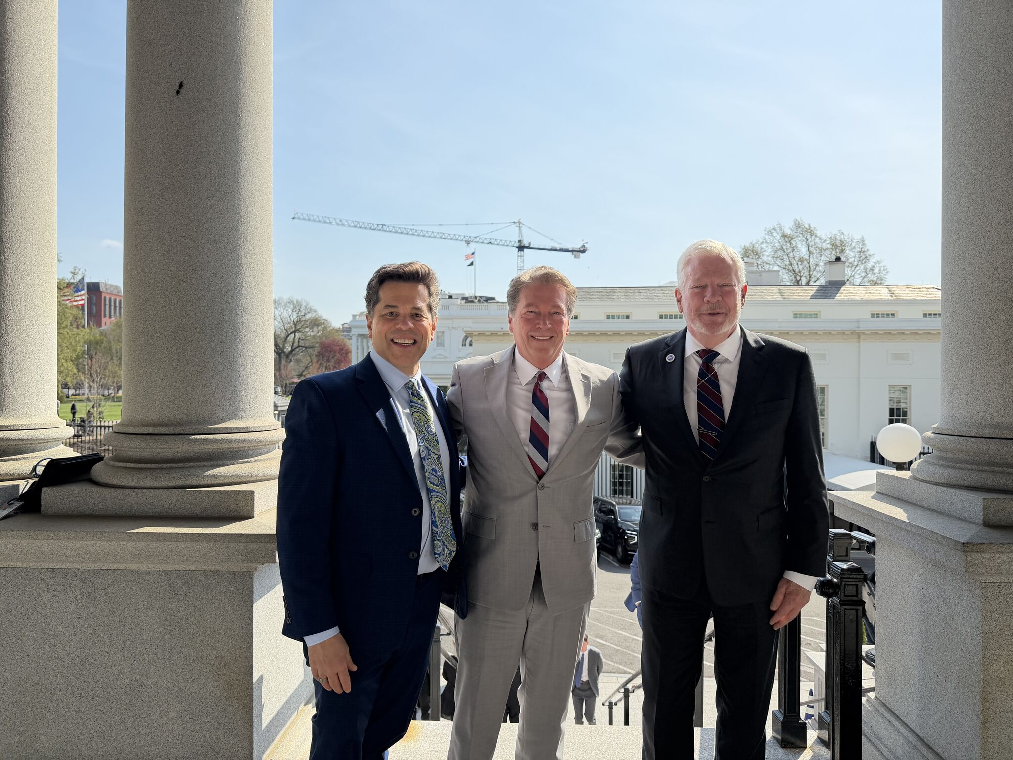
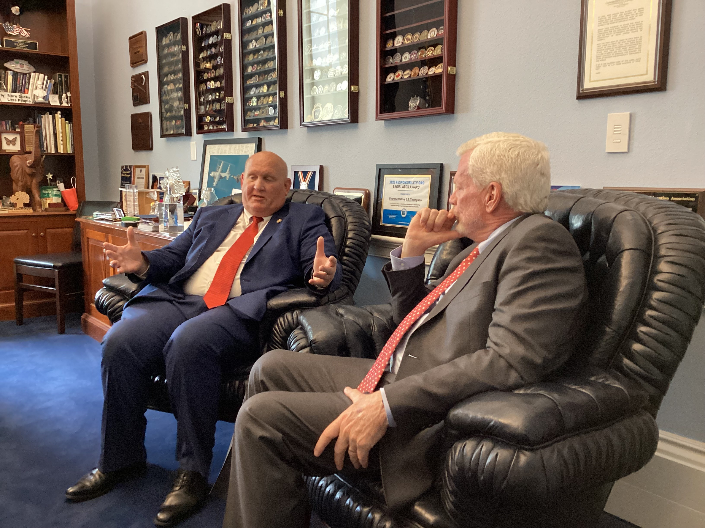
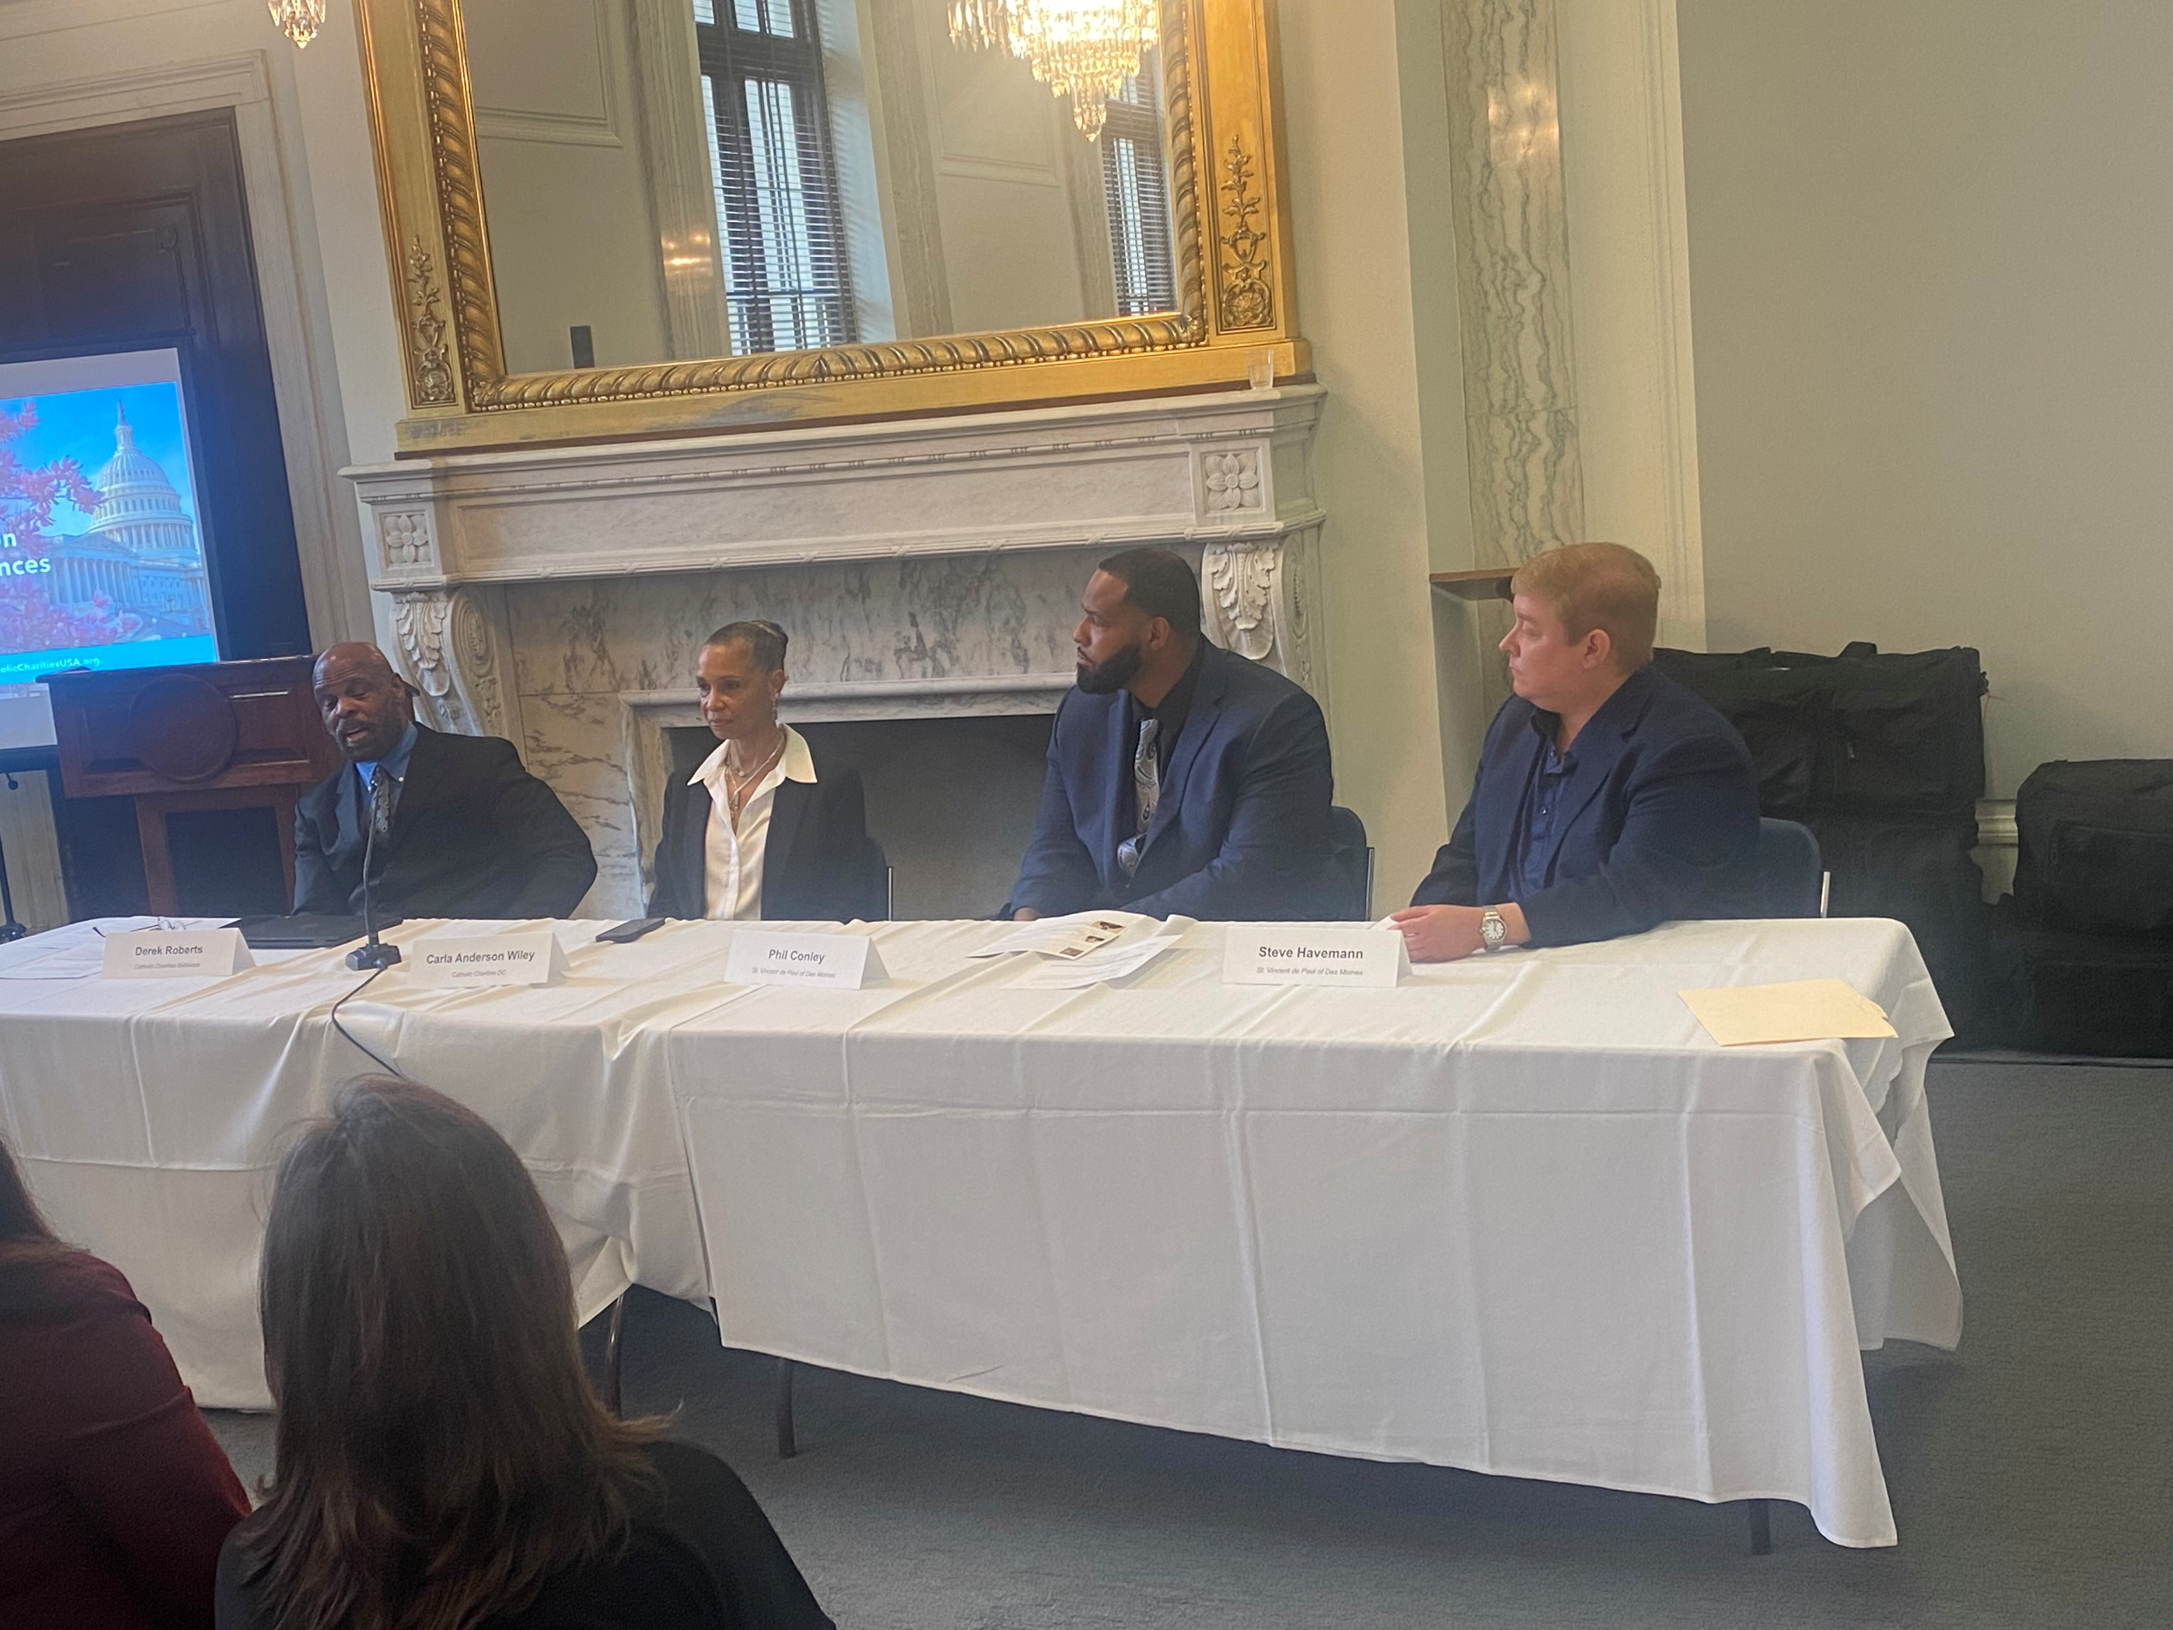
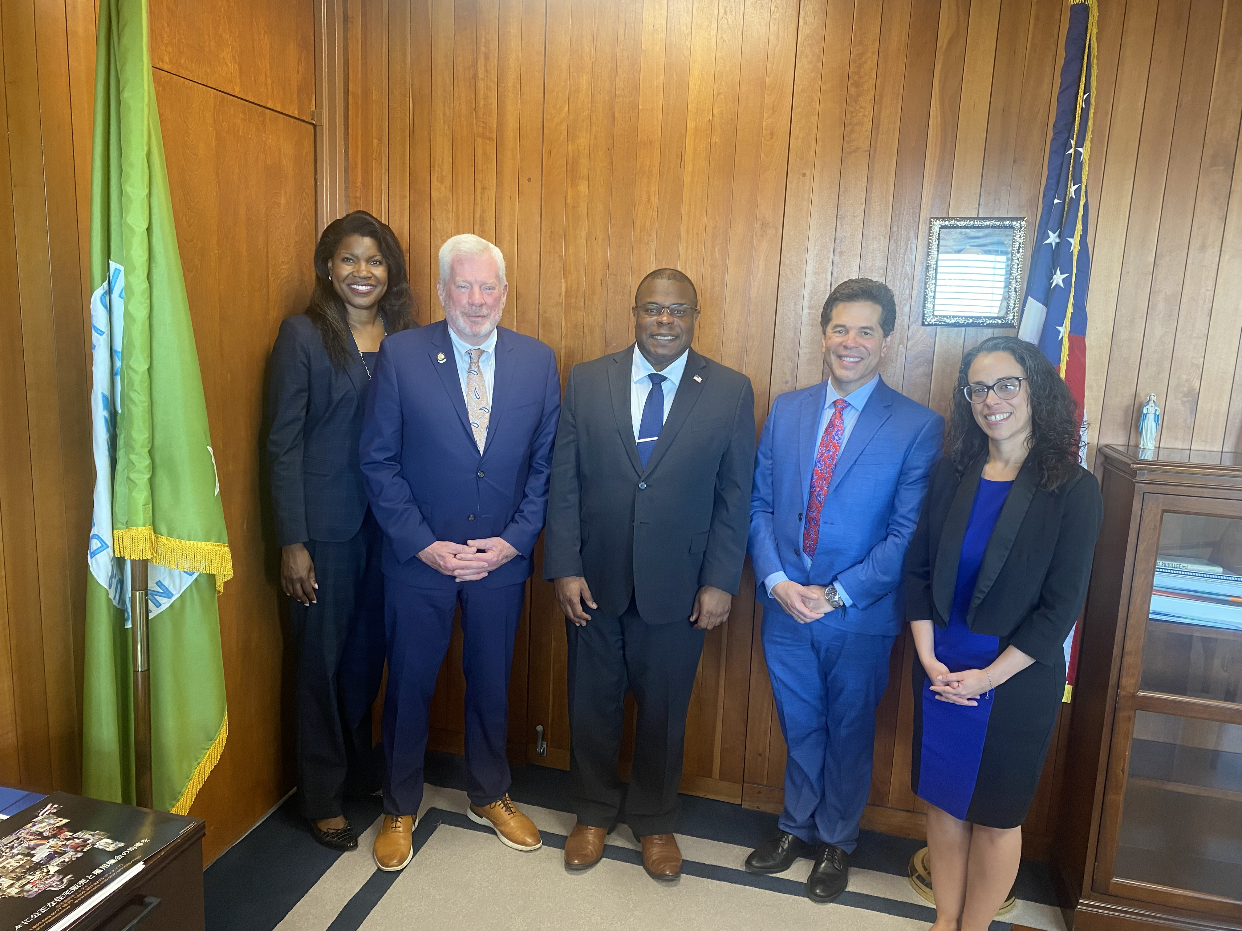
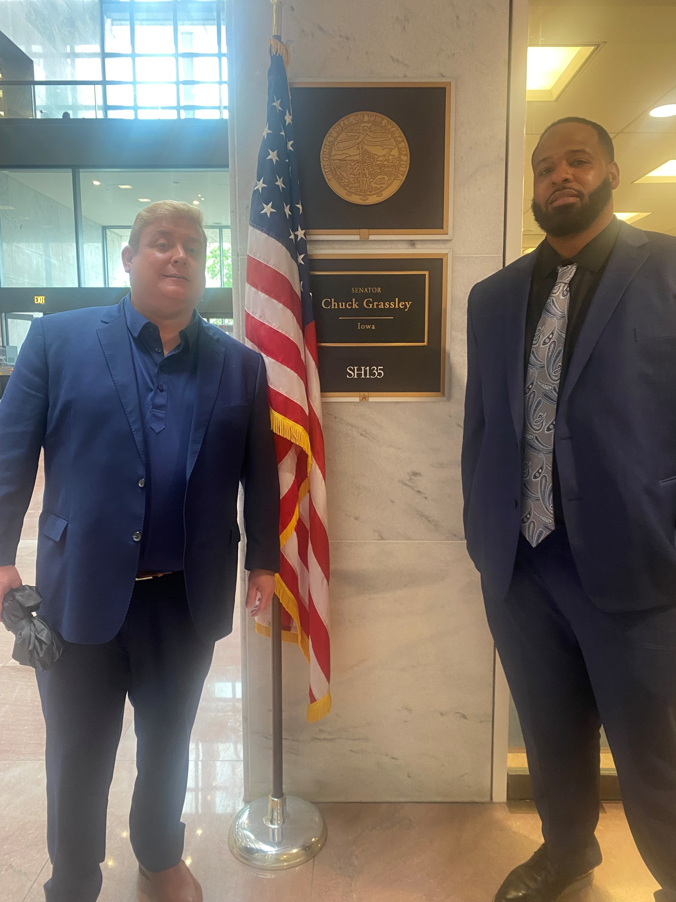
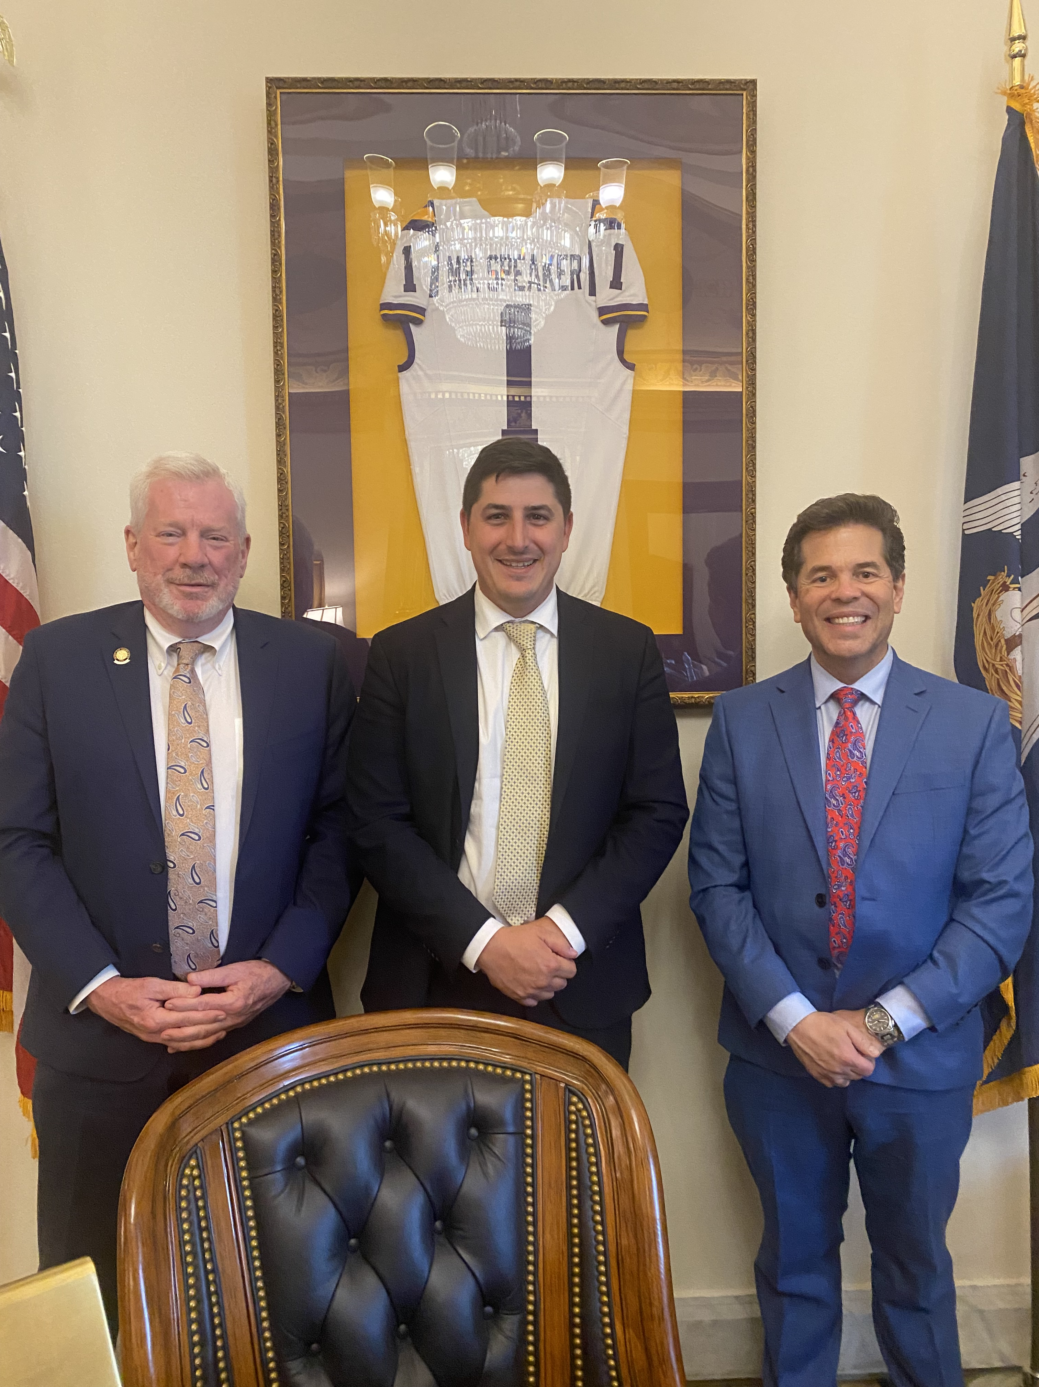
How is our DC Office engaging?
Bill/EO analysis
Building partnerships
Letters to Congress
Statements
Meetings
Hill briefing
Bill endorsements
Action alerts/Voter Voice
Strengthening advocacy infrastructure

Slide 10
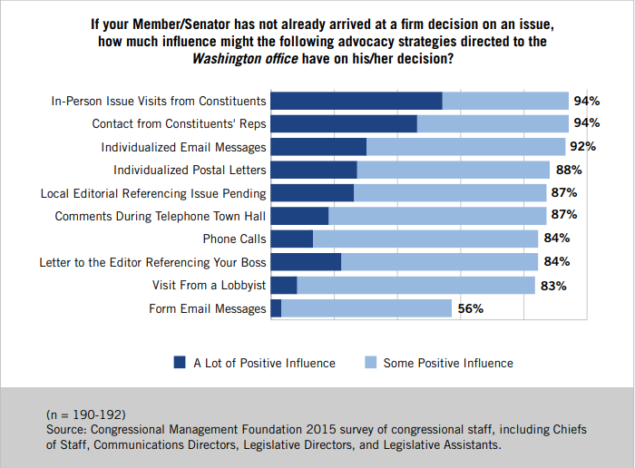
The importance of constituent advocacy

Slide 11
How can you engage in our advocacy efforts?
Sign up for electronic advocacy alerts: https://svdpusa.org/take-action
Find your members of Congress: www.Congress.gov
Monitor state legislation
Tell your stories: to me, to elected officials, to the public
Annual reports!
Stay in touch: idelgado@svdpusa.org

