Slide 1
Connection to Homeless Services 101: A collaborative and targeted response to homelessness in Greater Richmond
Homeward, www.homewardva.org
Greater Richmond continuum of Care, www.endhomelessnessrva.org

Slide 2
Overview of webinar
Overview of Homeward and the Greater Richmond Continuum of Care (GRCoC)
"How do people access the homeless crisis response system?"
Why call the Homeless Connection Line (HCL)?
What happens when you call?
What happens after the call? How are people connected to shelter?
Questions and how to learn more

Slide 3
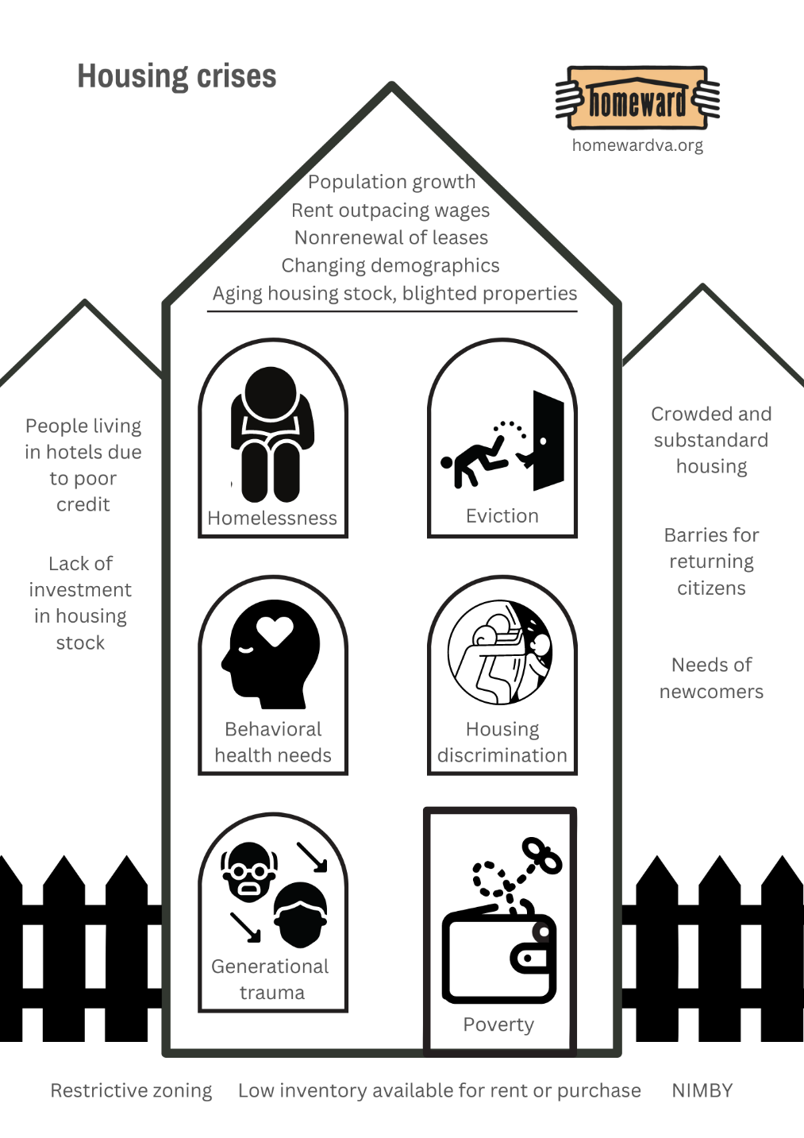
What is the affordable housing crisis?
Population growth and demographic changes
Subpopulations with specific needs:
People experiencing homelessness
Households with poor credit/ “unattractive” to landlords
Households being displaced by gentrification
Households in public housing slated for redevelopment
Newcomers
People returning to the community after incarceration (with felony convictions)
Zoning and land use policy
Increase in rents outpacing wages
Anti-development sentiment
Underinvestment in housing stock
Impact of development on those who are housed
Racial discrimination in housing and land use
Growing? Behavioral health needs?

Slide 5
What is the Continuum of Care?
The local or regional system of housing programs and supportive services working together to solve homelessness in a community or region. There are over 360 CoC’s in the country including 16 in Virginia.
A federal funding source that represents the largest single source of funding to address homelessness within a local system. This funding does not cover all program types and does not meet all the housing and service needs in the community.
A governance structure required by federal statute and defined in regulations administered by HUD that local communities must implement to receive federal homeless assistance funding.
www.endhomelessnessrva.org

Slide 6
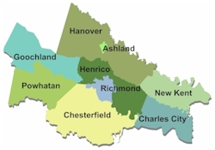
Community Coalition: Greater Richmond Continuum of Care (GRCoC)
Established in 1997 by community stakeholders to fight homelessness in the region. Homeward was created to support this effort.
400 Continuums of Care around the country; 16 in Virginia
Numerous statutes and regulations guide and govern CoC’s. The Homeless Emergency Assistance and Rapid Transition to Housing (HEARTH) Act of 2009 is the guiding legislation:
https://www.federalregister.gov/documents/2012/07/31/2012-17546/homeless-emergency-assistance-and-rapid-transition-to-housing-continuum-of-care-program
The GRCoC develops policies and procedures locally to maximize services for each household and resources.
Learn more: www.endhomelessnessrva.org
Map retrieved from http://www.richmondregional.org/

Slide 7
Access to homeless assistance programs
There are not enough resources to serve everyone who is eligible.
There is not a right to shelter or housing assistance.
Some people can be successfully connected or reconnected to their natural support system to solve their homelessness.
Access to programs with any public funding is coordinated.
Referrals to shelter and housing programs are centralized and prioritized.
Say no a lot in order to strategically say yes.
Individual choice.
People can turn down services—even housing.

Slide 8
Parts of Coordinated Entry as defined by HUD
Access
Assessment
Prioritization
Referral
Engagement
Understanding individual and community needs
Connections to services
Which programs have openings? How does the household get connected to the program?
How do we ensure the use of non-discrimination policies?
How do people find homeless assistance programs and get more information?
What are the household’s needs? Are they eligible for homeless assistance?
With insufficient resources, which households are most vulnerable/ most likely to die without assistance? Who should be the next household to be referred to available resources?

Slide 9
Before the Homeless Connection Line (HCL) and Coordinated Entry: What problem were we trying to solve?
For people with no safe place to go
How do I find a program with an open bed? Would other resources help me to solve my crisis?
For providers
How do we fill our beds?
How do we ensure that we are meeting funder guidelines about outcomes or occupancy rates?
What do we say to the person in front of us who is clearly in crisis?
How do we serve the people who need our help the most?
For the system as a whole
How do we reduce the frustration of people having to call every shelter looking for assistance?
How do we meet funder guidelines on outcomes or other metrics?
How do we help get people off the streets?
How do we support shelters to reduce unnecessary calls?
How do we support shelters in saying no to some people so that we can say yes to those who need the assistance the most?
How do we target resources and make better connections to other systems of care?

Slide 10
Requirement for Coordination
HUD introduced the concept of Coordinated Entry (or coordinated assessment) in 2012 regulations and defined as:
unified approach (policies and processes) that governs how people experiencing homelessness access the services available to them.
coordination and management of a crisis response system’s resources that allows users to make consistent decisions…[and] to efficiently and effectively connect people to interventions that will rapidly end their homelessness.
Communities are required to have a Coordinated Entry System (CES) to receive federal and state funding targeted to address homelessness. (Provisions in the 2012 CoC Program interim rule at 24 CFR 578.7(a)(8) require CoCs to establish a CES - hudexchange.info/news/hud-publishes-coordinated-entry-requirements-and-checklist-of-essential-elements/)
GRCoC developed CES in the early 2000’s and revised according to new HUD guidelines and requirements published in 2017 (following the introduction of the concept in 2012.)
The GRCoC Board designated the Homeless Connection Line (HCL) as the primary Access Point for the CES in 2018 as well Coordinated Street Outreach and the Empowernet Hotline.
*Other Access Points across Virginia - dhcd.virginia.gov/sites/default/files/Docx/vhsp/crisis-assistance-directory.pdf

Slide 11
Connecting with homeless assistance (shelters and housing programs): "Access Points"
Homeless Connection Line = Primary
Coordinated Outreach = Those who are unsheltered or lack access to a phone
EmpowerNet Hotline = Those fleeing or attempting to flee sexual or domestic violence, human trafficking, or stalking
All Access Points:
are collaborative projects with multiple partners.
receive at least some public funding that triggers data, reporting, policy, and service coordination requirements.
collect personal data. (HCL and Outreach use our CoC’s shared database, HCIS.)
make referrals to other community services.
EmpowerNet operates 24/7 (per state law) and is prohibited from using HCIS by federal law.

Slide 12
Collaborating to serve survivors of sexual and domestic violence
A COLLABORATIVE OF · GOOCHLANDCARES · HANOVER SAFE PLACE · JAMES HOUSE · SAFE HARBOR · THRIVE VIRGINIA · YWCA RICHMOND
Notes:
Collaborating to serve survivors of sexual and domestic violence.

Slide 13
Access for people sleeping outside: Coordinated Outreach (frontline response; boots on the ground)
http://bit.ly/RVAOutreach
Partners
Commonwealth Catholic Charities
Daily Planet Health Services
Health Care for Homeless Veterans
Richmond DSS
RBHA
Virginia Home for Boys and Girls

Slide 14
Access for most people experiencing homelessness: Homeless Connection Line
Partners:
ACTS
HomeAgain
Homeward
Housing Families First
SPAN Center
Monday – Friday, 8am to 12 pm; 1pm to 9pm
Saturday and Sunday, 1pm to 9pm

Slide 15
Brief history of the HCL
2015: CoC identifies need for diversion (exploring options for those seeking shelter)
2016 Diversion task force develops Shelter Diversion Line
2017 Piloted Shelter Diversion Line at YWCA
2022: Adjusted schedule to answer more calls live
2018 Expansion of HCL; Becomes multiagency partnership; designated as Primary Access Point; Separate navigation staff coordinated referrals to shelter and housing
2020: Expanded hours for evenings and weekends; Senior Connections joins
2021: Changed name to Homeless Connection Line

Slide 17
What happens when you call the HCL?
Automated greeting provides community information for callers
Callers experiencing homelessness select the option to speak to a Diversion Specialist (DS.)
If all DS are busy, the caller leaves a message which is returned within 24 hours, usually the same business day.
DS engages in a problem-solving conversation to understand the needs of the caller.
DS enters required data elements into the shared CoC database.
DS sends community resources by email or text if needed.
The need for emergency shelter or other programs for callers who cannot be diverted is captured in the database.

Slide 18
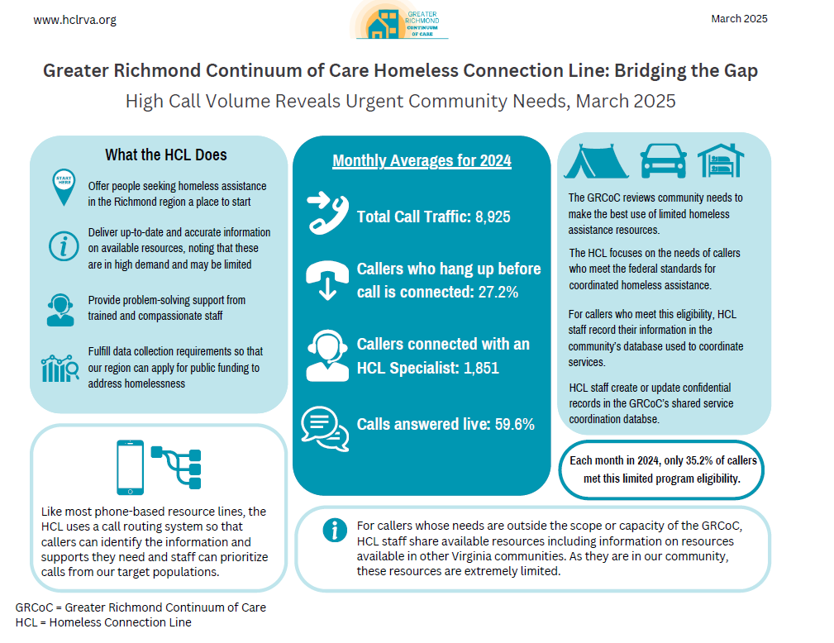

Slide 19
“Diversion” or Compassionate Problem-Solving Conversations: Focus of HCL
Diversion
A person-centered approach to assist callers.
Begun in the GRCoC in 2015/2016 as a way to make the best use of limited shelter beds while still meeting the needs of households who needed assistance but not necessarily a shelter stay.
Helps mediate conflicts with family or friends connected to housing
Assists in identifying resources and natural supports to retain or access housing
Strategy that empowers people facing imminent homelessness to identify safe and appropriate housing options, thereby assisting them to avoid emergency shelter.
Diversion is not a barrier to other resources, rather, a first step in assistance that may make other interventions unnecessary.
To learn more, visit usich.gov/resources/uploads/asset_library/Prevention-Diversion-Rapid-Exit-July-2019.pdf

Slide 20
What is Housing Problem Solving?
Housing problem solving is a person-centered, housing-focused approach to explore creative, safe, and cost-effective solutions to quickly resolve a housing crisis (HUD, 2021)
The goal of housing problem-solving is to support households in identifying their strengths, resources, and natural supports while empowering families and individuals to help resolve their housing crisis.

Slide 21
Where Does Housing Problem Happen?
1) The skills and practices of Housing Problem Solving can be deployed in homeless services of all types, housing assistance programs, eviction prevention programs, supportive service programs, and community-based organizations and ministries.
2) Housing Problem Solving is an approach. It is not a program and is not a service to “refer” people to. Many of you in this room are already doing housing problem solving.
3) Housing Problem Solving is not a magic resource and will not resolve all housing issues. Housing Problem Solving does not add more deeply affordable housing and does not address low wages or the lack of supportive services that are accessible to people in our community.

Slide 22
Problem Solving Partnerships
The housing problem-solver is entering a “problem solving partnership” with the family or individual, creating space to support the household in exploring safe, creative options to resolve their housing crisis and assist with linkages to other resources when appropriate.
The main work of the housing problem-solver is done through a “exploratory conversation” an empowering and person-centered discussion held with the household focused on identifying safe, alternative solutions aimed at resolving their housing crisis.
Key Components of an exploratory conversation:
Ask open ended-questions
Identify strengths and resources
Create an individualized plan of action
Provide follow-up support as needed

Slide 23
HCL Call Volume
HCL receives thousands of calls every month.
Our coordinated system serves
1,000 people
each & every day.
Types of calls HCL receives:
People within three days of losing housing
People who are not currently experiencing homelessness, but needing resources and support related to housing
People experiencing unsheltered homelessness
People who live outside of our region
Concerned citizens and community partners

Slide 25
Maximizing limited emergency shelter capacity to serve the most vulnerable households
Households are prioritized for shelter based on their high medical acuity, length of homelessness, and other factors as determined by GRCoC .
The Referral Coordinators coordinate shelter referrals and housing interventions.
Receives confirmation of available shelter beds by 8:30am each weekday
Pulls information from HMIS database. Households that have been prioritized are identified on the report and placed on a “match list” for referrals which is emailed to CES providers and partners.
Contacts households to inform and offer shelter placement.
Referrals are coordinated based on what best fits client’s needs and available shelter beds
Accommodations/Adjustments
Physical space limitations
Safety Regulations
Background
Referral Coordinators may reach out to additional households throughout the day to fill emergency shelter beds.
Shelter programs prepare for arrival and completion of intake and (minimal) necessary documentation.
Housing-focused planning begins.

Slide 26
Shelter and Housing Partners: Referrals
Shelters:
CARITAS (Men)
CARITAS (Women)
HomeAgain (Families)
Housing Families First (Families)
Salvation Army (Families)
Salvation Army (Men)
Housing Interventions:
HomeAgain
Housing Families First
Richmond Behavioral Health Authority
St. Joseph's Villa
SupportWorks Housing
Virginia Home for Boys and Girls (VHBG)

Slide 27
Advocacy Resources
Virginia Housing Alliance: vahousingalliance.org
National Alliance to End Homelessness: endhomelessness.org
National Low Income Housing Coalition: nlihc.org
Volunteer and Giving Information: cfengage.org
Homeward's Newsletter: homewardva.org/connect-with-us

Slide 28
Find out more at www.endhomelessnessrva.org
Terri Lawson
Access Programs Director
tlawson@homewardva.org
www.homewardva.org
www.endhomelessnessrva.org

