Slide 1
Yes, Why and the Society of St Vincent de Paul
Living & Caring as a Vincentian 2025

Slide 2
My Yes to St Vincent de Paul
Felt a call to want to directly help people in need
Not knowing what SVDP would do
Not knowing how SVDP would do it
But I loved SVDP’s why

Slide 3
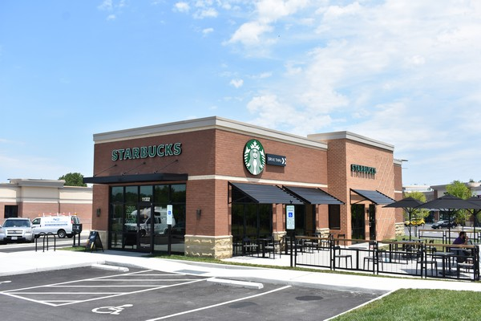
My Initial Concerns
Wait-we do home visits?
Do I have enough time?
Poverty is such a huge issue
Are there people in need really here and will they find us?
I just moved here and I don’t know many people or resources

Slide 4
Where We Were in 2017
HOW
Had over 700 encounters with neighbors in need
WHAT
Provided more than $90,000 towards preventing homelessness for 2,000 people

Slide 5
Where We Were in 2017
WHAT
3 active Conferences
0 Council
0 Thrift Stores
0 Young Vincentian Groups
60 Vincentians
First Friend of the Poor Walk

Slide 6
Fast Forward to 2024
HOW
Had over 5,000 encounters with neighbors in need
WHAT
Provided more than $980,000 towards preventing homelessness for 12,000 people

Slide 7
Fast Forward to 2024
WHAT
8 active Conferences with 9th in formation
1 Council
1 Thrift Stores (for now)
3 Young Vincentian Groups
319 Vincentians

Slide 8
Benefits to Saying Yes
Spirituality
Friendship
Service
Notes:
-- Essential Elements of the Society as shown above
-- Explain each one.
Suggested text:
The Essential Elements of the Society are those components that must be present at every level of the Society. These three Essential Elements are the very foundation of the Society, from its beginning in 1833.
Spirituality:
Our primary goal is spiritual growth. We pray together and we pray with those in need.
We see Christ’s face in the needy and show God‘s love to them.
Friendship:
Working together on home visits and on special projects.
Collaboration with other Conferences.
Praying together at Retreats and Festival Meetings.
(Festival Meeting is a Liturgical celebration by Conference as a whole)
Service:
We help those in need with person-to-person service, taking the time always to listen to them and hear their stories. We provide material assistance (food, clothing, furniture), financial assistance (rent, utilities, travel) and we run Special Works (stores, pantries, housing). But always our first priority is to show God’s love to those in need.

Slide 9
Starts With Why
Be the face of Christ
Personal encounter
Prevent homelessness
“Starts With Why”-Simon Sinek

Slide 10
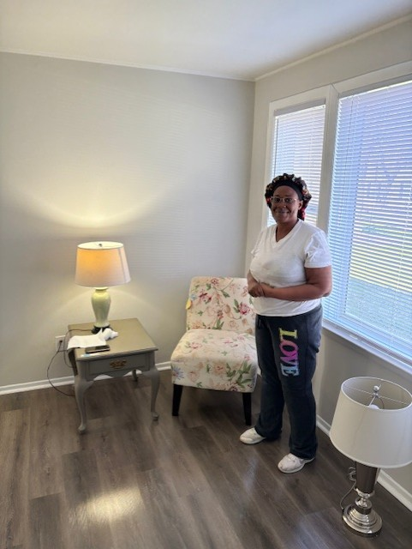
What Does 2025 Look Like
Motel 2 Home
Car Repair
Rest Easy Mattress Program
Voice for the Poor Advocacy
Young Vincentians

Slide 11
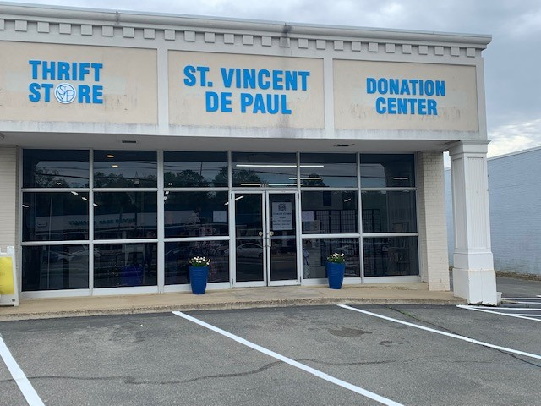
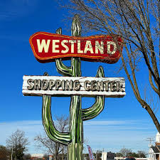
What Does 2025 Look Like
2 thrift stores in Richmond area with our newest opening in Fall 2025

Slide 12
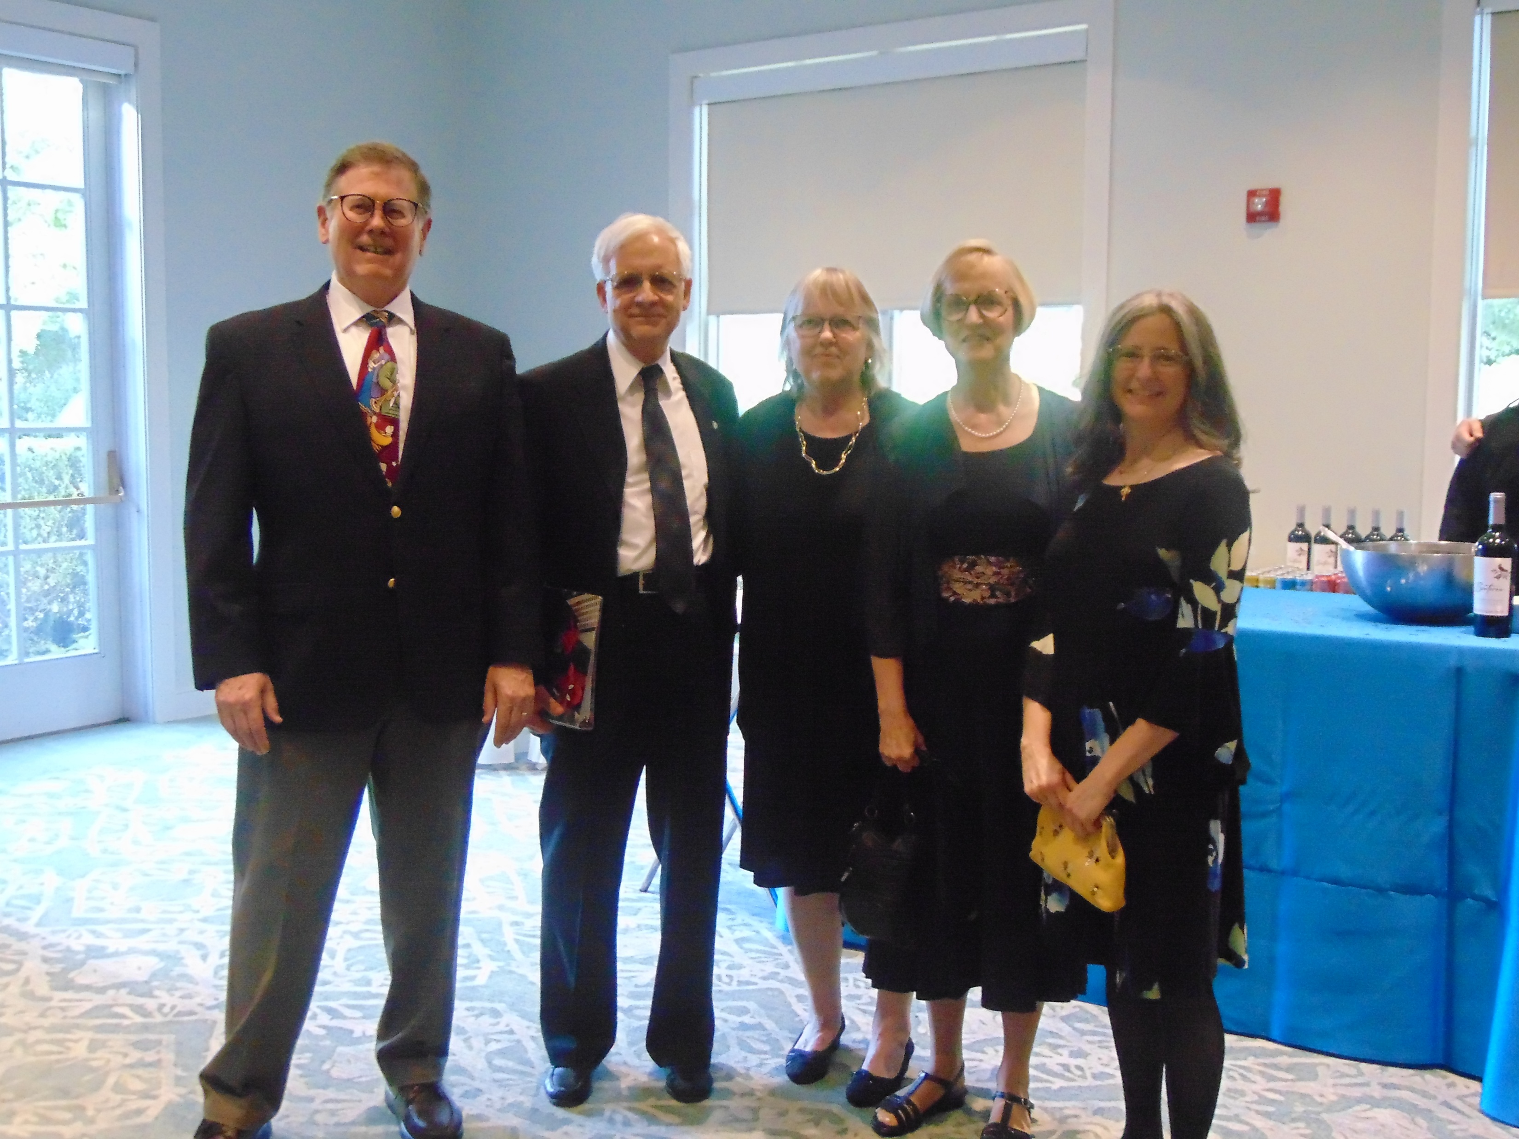
What Does 2025 Look Like
Night of Hope at The Jefferson-May 30, 2025
www.svdp-rvacouncil.org

Slide 13
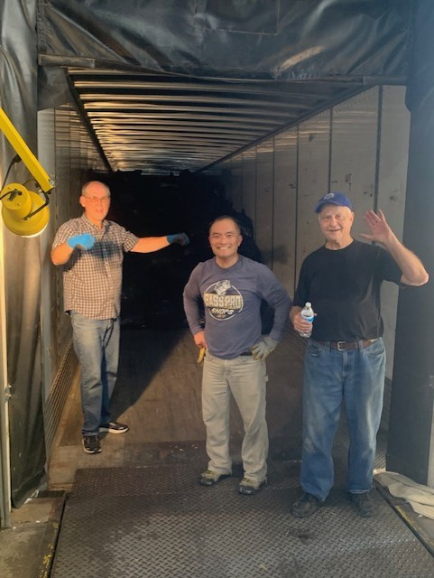
Hopes for the Future
New Conferences
More Vincentians
More volunteer opportunities
New programs
Food
Intake
School support programs

Slide 14
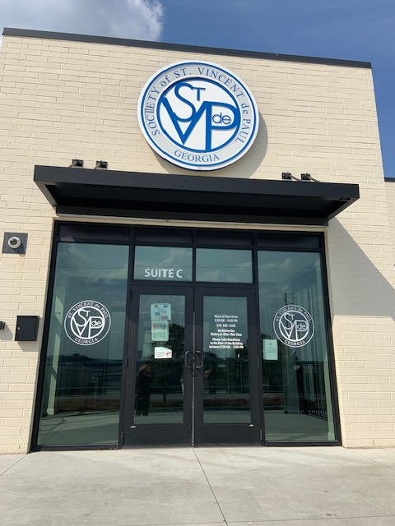
Hopes for the Future
Vincentian Center where we can serve more neighbors in need

