Slide 1

Raising Funds, Awareness and Thrift Stores
How to raise money for svdp

Slide 2
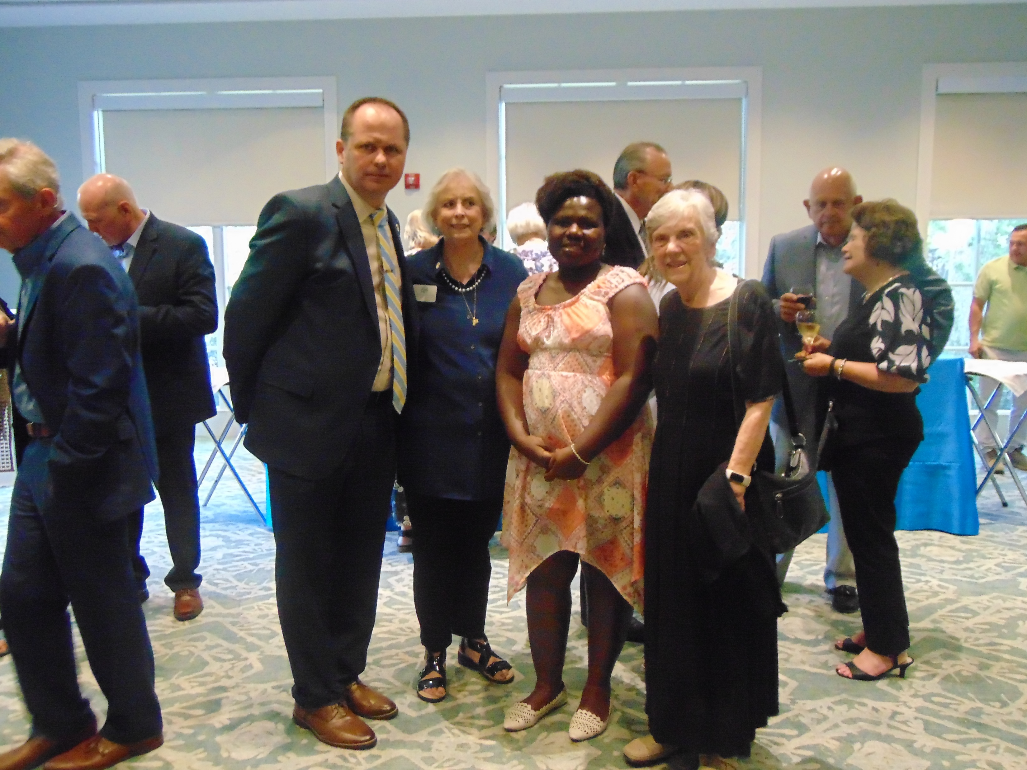
Agenda
Telling our story
Fundraising as a Vincentian
The role of a thrift store
Q&A

Slide 3

How Do You Tell Our Vincentian Story
Be the face of Christ
Personal encounter
Prevent homelessness
“Starts With Why”-Simon Sinek

Slide 4
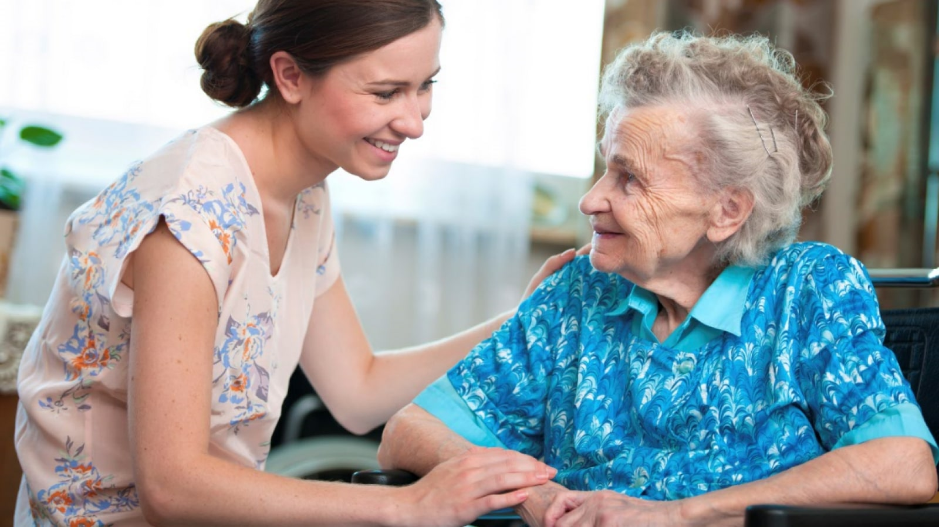

Heart, Brain or Both
Stories
Data
Know your audience
Be passionate

Slide 5
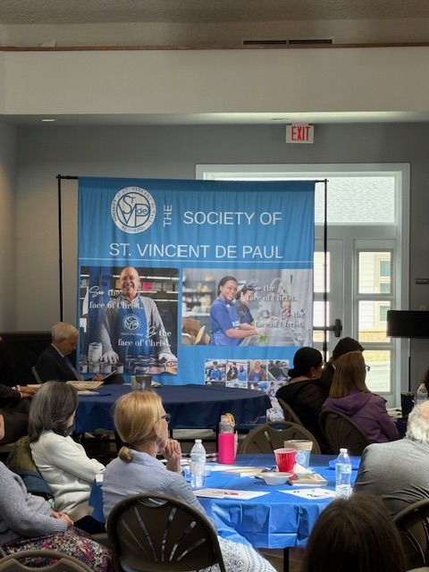
How Do You Share Our Work
Physical Presence
Banners, signage
You
Digital Presence
Website / email blasts
Social media
Print Presence
Bulletin, Newspaper

Slide 6
Agenda
Telling our story
Fundraising as a Vincentian
The role of a thrift store
Q&A

Slide 7
Fundraising and SVDP
“I am now completely convinced that when one does a deed of charity one need not worry about where the money will come from: it will always come.”
-Blessed Frederic Ozanam

Slide 8
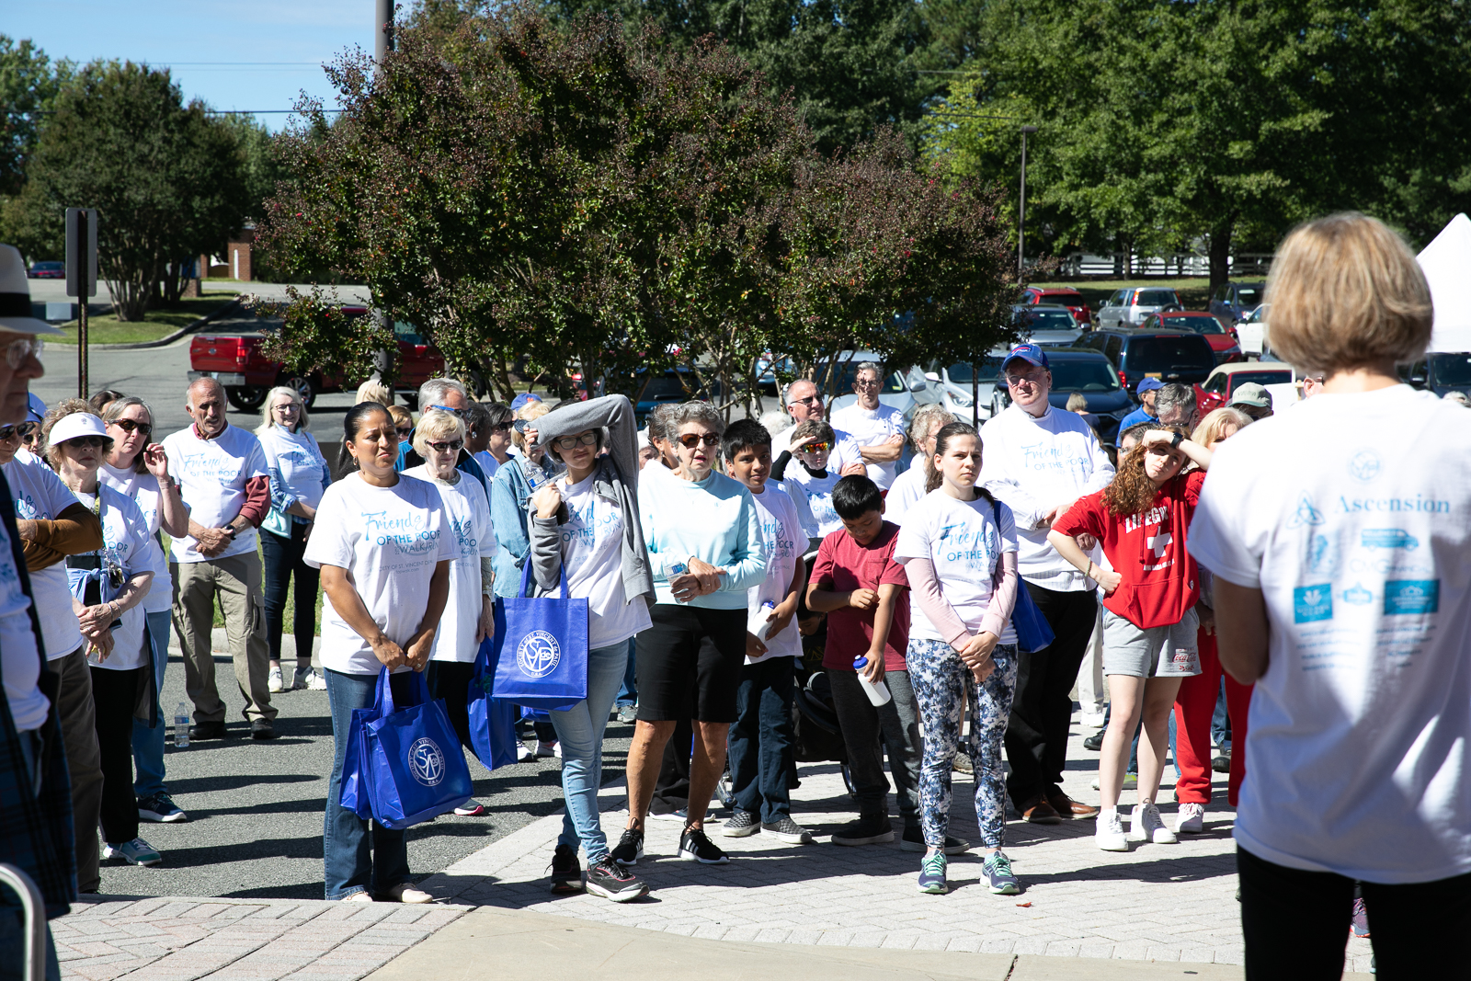
Why People Don’t Give
Don’t know what you do
Did not engage me
You did not ask or too hard to give
Did not thank me

Slide 9
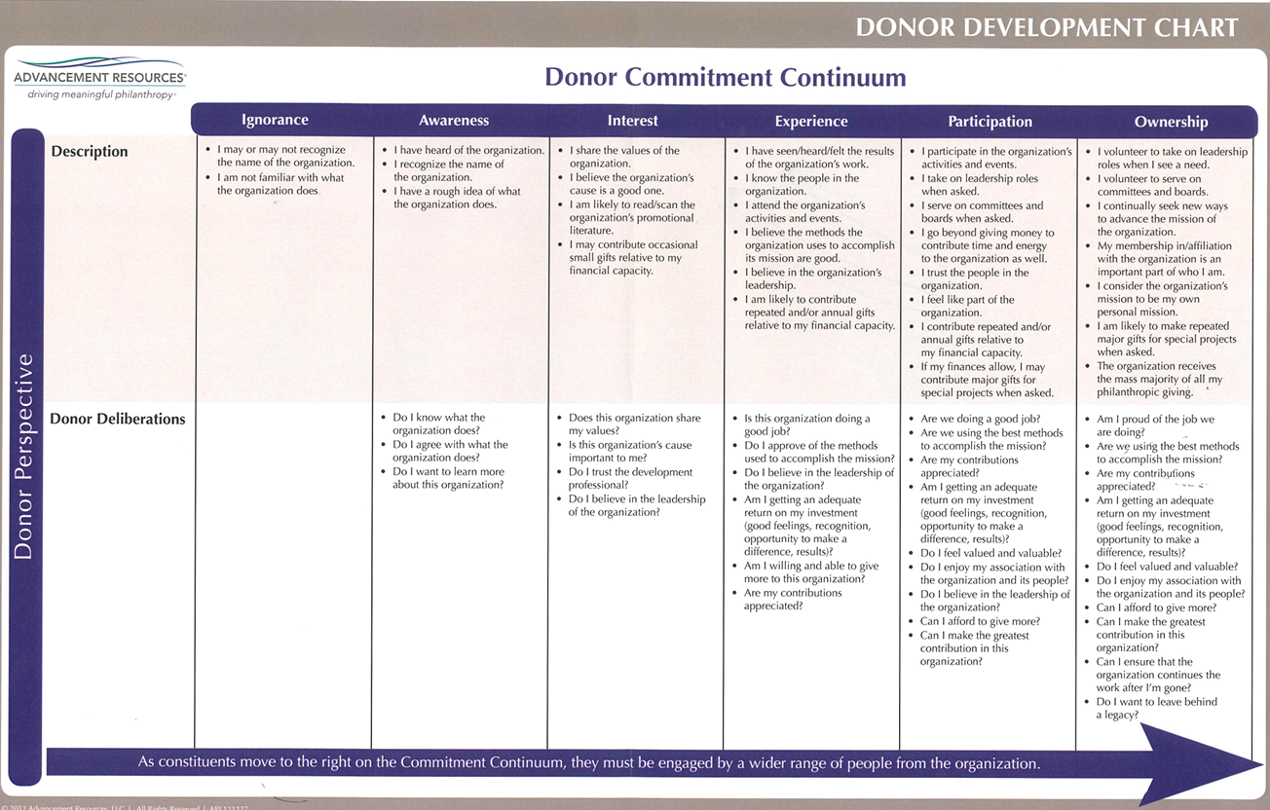

Slide 10
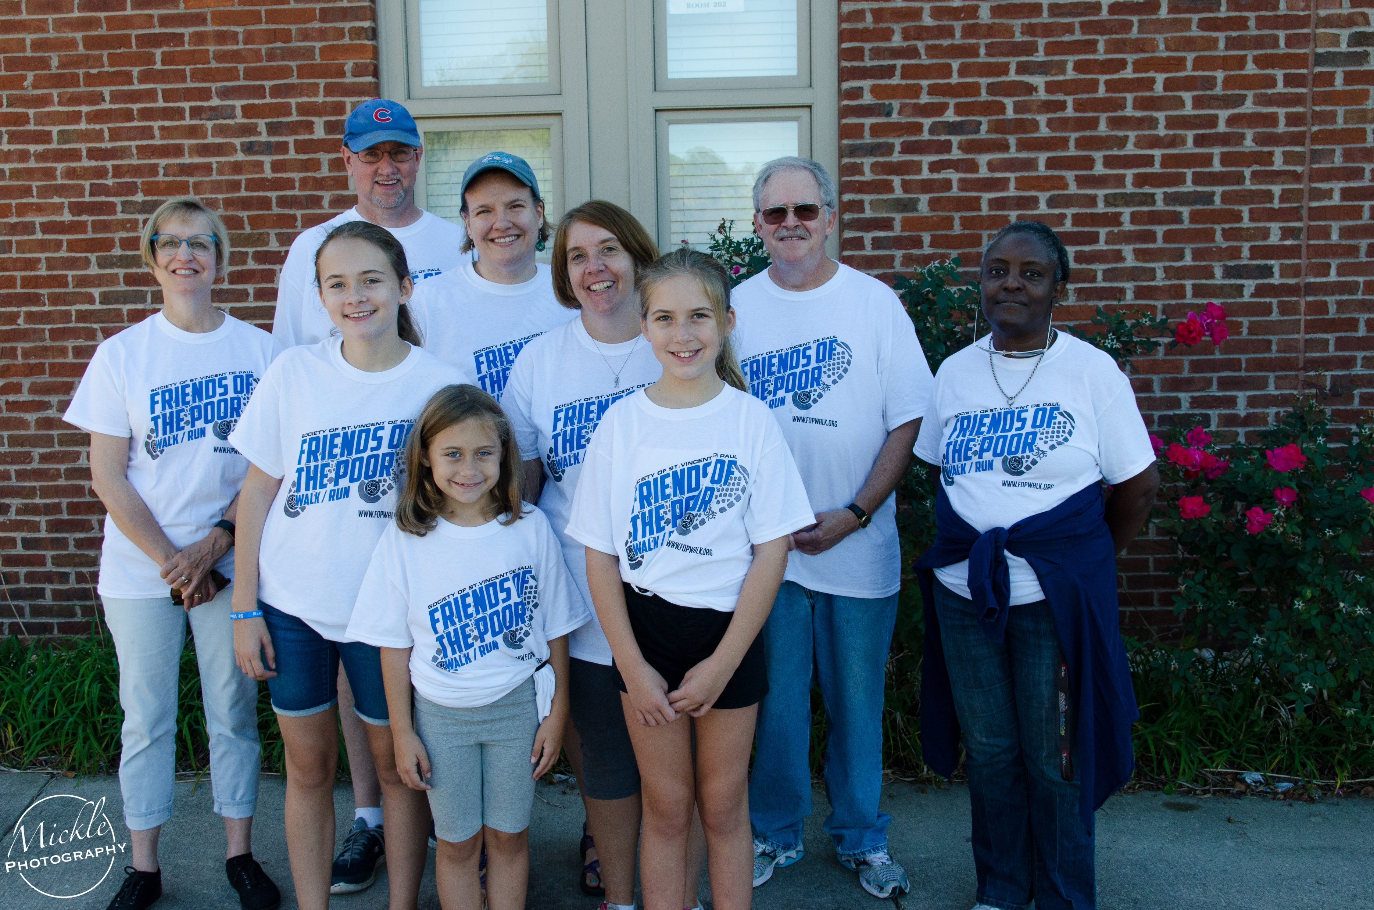
Fundraising Strategy for SVDP
Have a fundraising strategy
Diversify revenue sources
Individuals
Events
Grants
Parish support
Everyone needs to help-share connections and ask

Slide 11
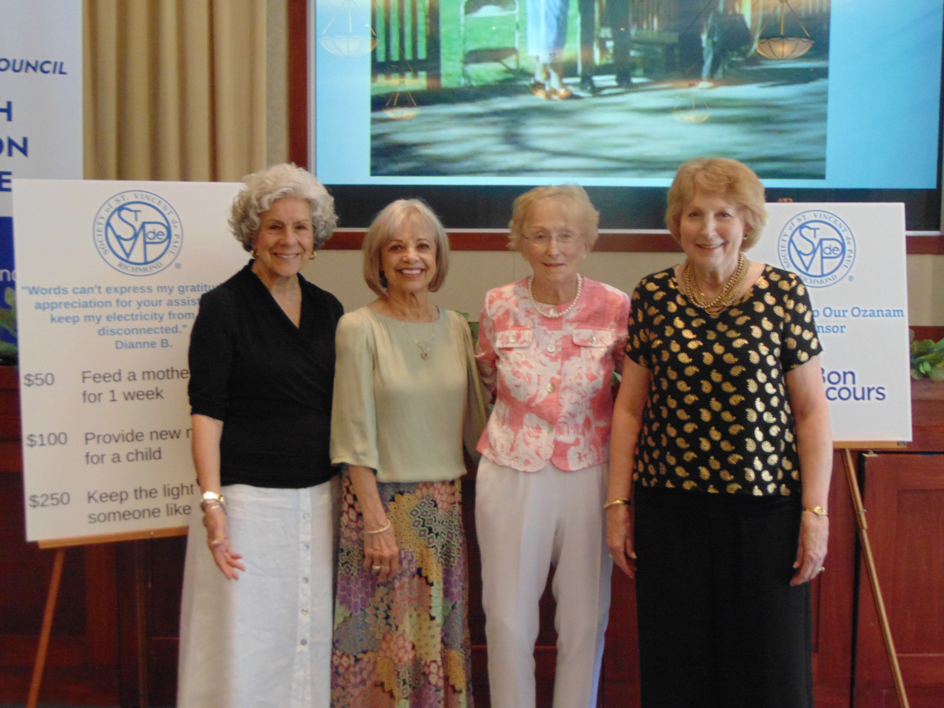
Individuals
Are your reaching out to them?
Is it easy to give to you?
Mailers
Online
Stock
Planned gift
Thank you process
Donor database or CRM

Slide 12

Ideas for Individual Giving
Year end appeal
“Christmas Lights appeal”
Lent
Mite boxes
Specific need
Pantry / program
Recurring donors

Slide 13
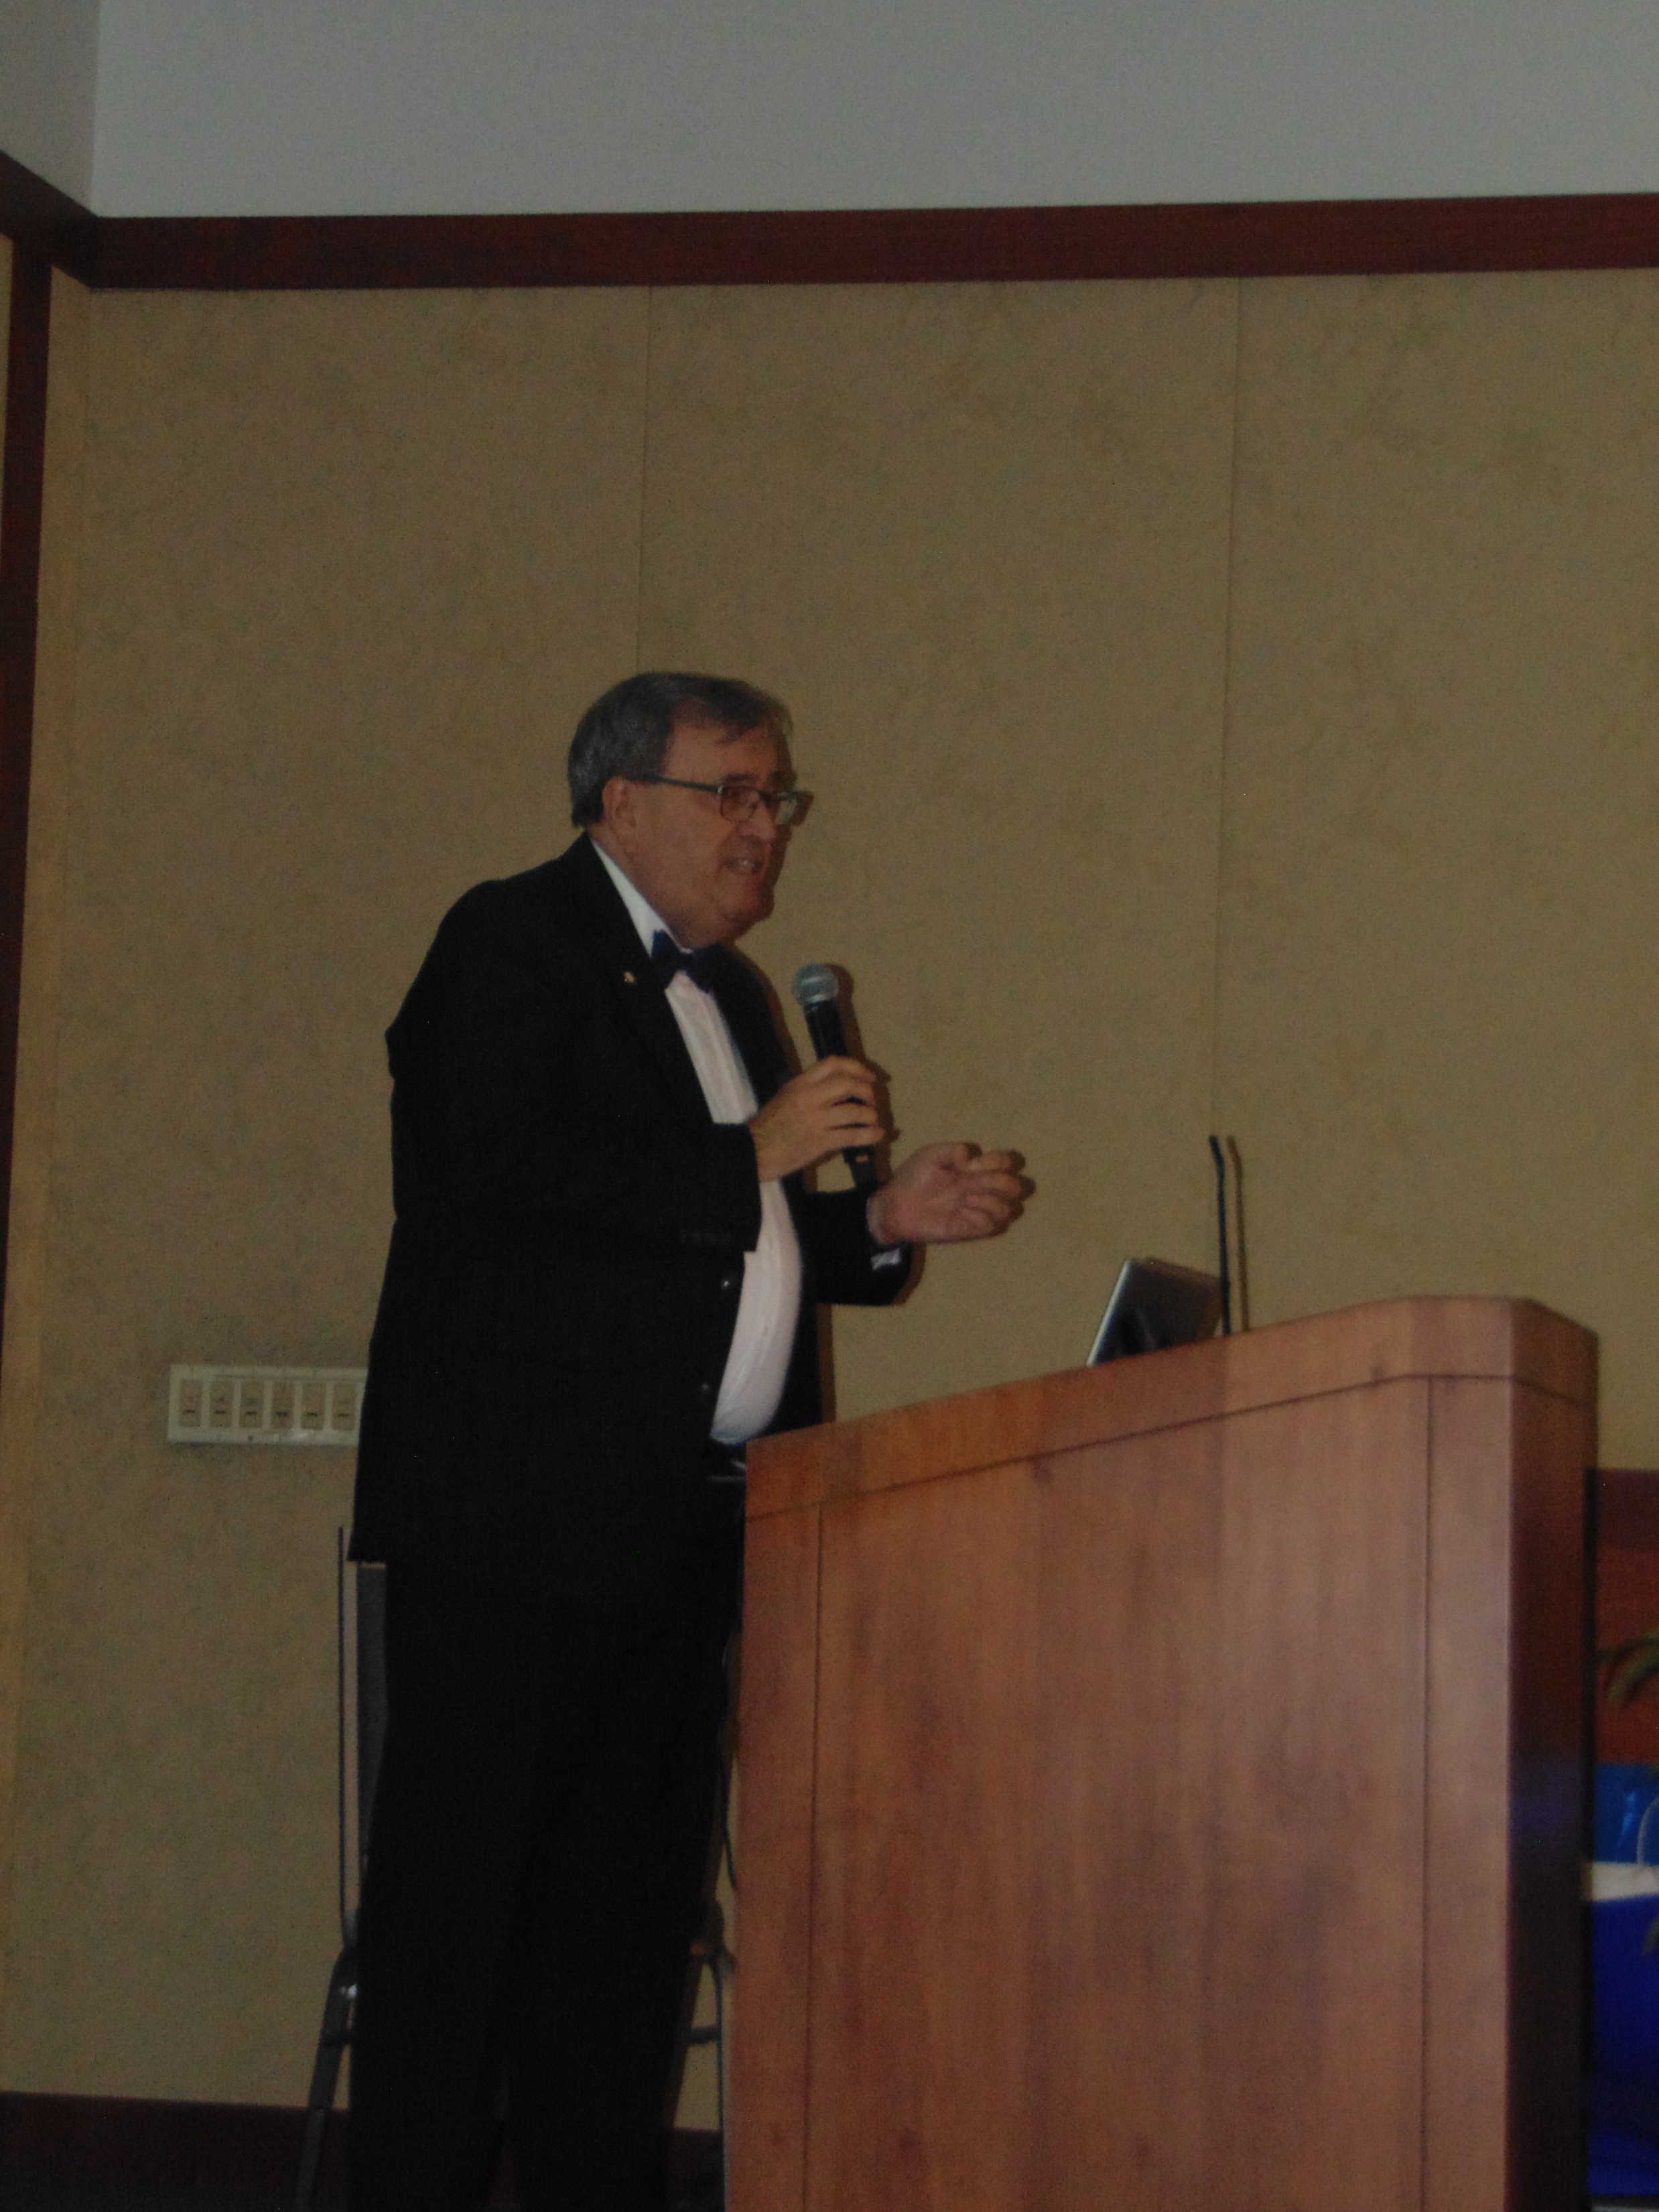
Events
Do you raise enough to make it worth your effort?
Why are you doing the event?
Don’t nickel and dime donors
Coordinate event calendars
Sponsors are key
“Heart ask” / testimonials

Slide 14
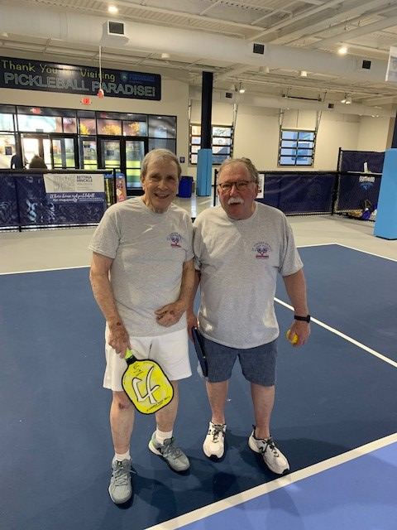
Event Ideas That Have Worked
Gala / dinner (formal)
BBQ / Beach Night in Winter (casual)
Athletic / activity
Friends of the Poor Walk
Golf
Pickleball

Slide 15
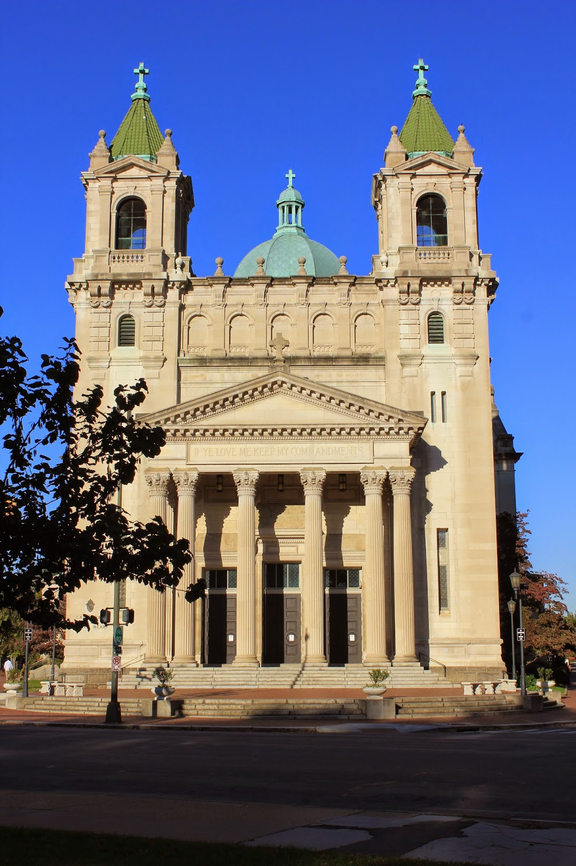
Grants
Research funders
Family foundations
Corporate foundations
Government
Grant requirements
Is it worth the effort?

Slide 16
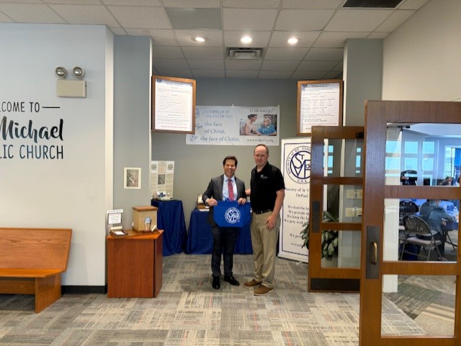
Parish Support
Do parishioners know SVDP & what you do?
Physical presence in building
Speak to congregation
“Get to Know SVDP” events
Pastor relationship
Regular meeting / updates-COMMUNICATE!

Slide 17
Agenda
Telling our story
Fundraising as a Vincentian
The role of a thrift store
Q&A

Slide 18
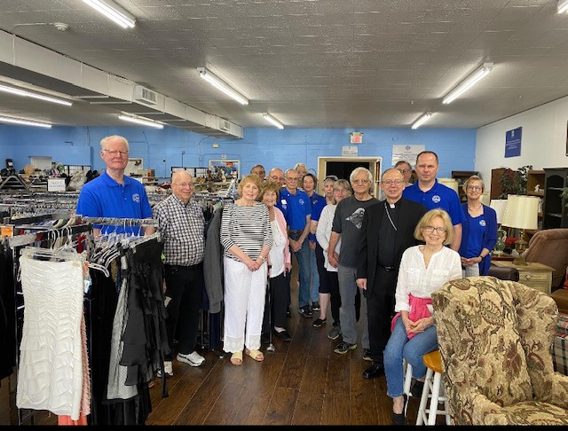
Thrift Stores and Fundraising
Purpose of the store
Raise funds to support our mission
Provide furniture and bedding to our neighbors in need
Outreach to community

Slide 19

Take Aways From All This
Know our why and share it-be passionate about our work
Have a fundraising strategy
-Diversify revenue sources
-Know your donors-use technology
3. Don’t be shy-ask and try

Slide 20
Resources
Catholic Funding Guide
www.catholicfunidngguide.com
SVDP USA Branding Materials
https://members.ssvpusa.org/communications-branding/
SVDP Richmond Council
www.svdp-rvacouncil.org

Slide 21

QUESTIONS?
Dan Kearns, Exec. Director
SVDP-Richmond
dkearns@svdp-rvacouncil.org
954-809-8115

