Slide 1
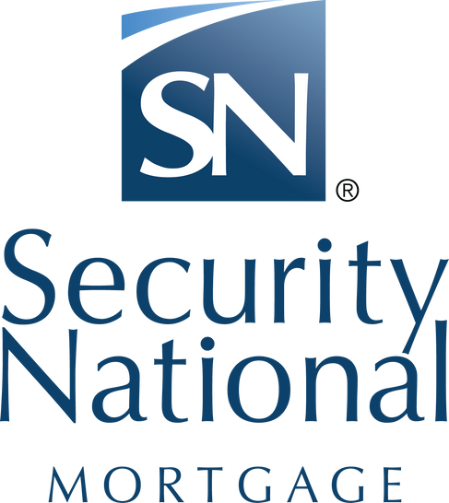
Creating more opportunity for the self-employed borrowers
SecurityNational Mortgage Company NMLS #3116|Equal Housing Lender

Slide 2
Loan Officer Name
Loan Officer Pic
LO INFO:
  Expert in NON-QM & QM lending (fancy term for all residential loan types)
  Mortgage LO for 13 years
  Licensed in Utah, Idaho, Montana, Nevada and Arizona
  Self-Employed Experienced for 24 years
  Expert in Structuring Traditional and Non-Traditional loans
  Author of “Mortgage for Mavericks: The Business Owners and Self-Employed Guide to Funding Your Dream Home and Investment Properties.
  28 years in the Service industry
2

Slide 3
NON-QM LOANS
WHAT ARE THEY?

Slide 4
QM loans
  QM loan - Mortgage jargon for traditional lending. Any loan type that follows traditional guidelines
    FHA
    VA
    CONVENTIONAL
    USDA
4

Slide 5
NON-QM LOANS
  NON-QM LOAN or a NON-QUALIFIED MORTGAGE, is a type of mortgage loan that allows you to qualify based on alternative methods, instead of the traditional income verification required for most loans.
5

Slide 6
NON-QM LOAN PROGRAMS
AltDoc programs AKA Bank Statement for primary residence
Self-Employed- Real Estate Agent, Tattoo Artists, Hair Stylists, Nail Techs, DJ, Wedding Planners, Landscapers
- 2 years history of SELF-EMPLOYED REQUIRED
W2 employee with side business – this allows to use mixed income from Buyer and Co-Buyer
1 or 2 year 1099
01
02
03
04
6

Slide 7





NON-QM cont.
DSCR- INVESTOR PROGRAM – No Income to qualify
NO DTI/ NO INCOME- No Income / No Employment
Asset Allowance – heavy asset- light on income
Asset Only - heavy asset
P&L Only- Generated by a CPA
7

Slide 8
  Bank Statements – no Tax Returns needed (Business and Personal) 12 or 24 months
  Lease agreements in lieu of Schedule E – no Tax Returns
  Asset Xpress – asset heavy – light on income Asset Assist - use assets for additional income to qualify
  1 or 2 years 1099 with borrower prepared P & L
  K1 using gross income, verified via 4506
  Cash flow in business less than 1 year
Multiple Ways to Qualify
8

Slide 9
  Life Events – One day out of Bankruptcy or Foreclosure
  Non-Warrantable Condos OK
  Co-Borrower score is not used to qualify
  Foreign National Program, ITIN, Non-Perm Resident Alien
  Non-TRID Investor Programs-DSCR to .5
  Full Doc/Alt Doc down to a 540 FICO Score
Continued…
9

Slide 10
Questions
10

Slide 11








Minimum FICO score 600 up
Minimum 10% down payment
6 months reserves
Bank Statement Qualifications
Loan amounts 100k to 3M
60 days source and season cash to close
Can have 1X30 late on mortgage history can have up to 4 1x 30 rolling
1 day out of BK
Not concerned about lates on credit card or auto loans
11

Slide 12
Questions/Scenarios
on the Bank Statement Loans
12

Slide 13
DSCR Investor Program
No Income Required
Minimum FICO 640
20% minimum down payment
Rent to cover 75% of Mortgage
6 months reserves for subject property ONLY 60 day seasoning
10 day cash to close seasoning
Can be purchased as an Individual or LLC
1- 26 units
13

Slide 14
Questions/Scenarios
on DSCR

Slide 15







Community Mortgage Qualifications
NO Income / NO Employment
Minimum FICO 640
20% down
Piggyback option
100% gift funds allowed
No Bankruptcy seasoning
12 to 18months reserves – credit score dictates
15

Slide 16
Questions/Scenarios
on the NO DTI/NO- INCOME
16

Slide 17
NON-QM Advantages
Open doors for you, your home buyers and your investors to reach their dreams. Easier and faster than before.
SecurityNational Mortgage Company NMLS #3116|Equal Housing Lender
17

