Slide 1
Financial Plan
Prepared for:
Happy Home Buyer
10/03/2024
Mortgage Company NMLS #1234|Equal Housing Lender

Slide 2
The Munford Team Difference
  We will ALWAYS communicate pro-actively by giving you, your agent, and the seller’s agent a written update via email.
  We will ALWAYS ask the necessary questions to learn and understand YOUR financial goals.
  We will explain EVERY piece of the loan process.
  Your closing costs will ALWAYS be equal to or LESS than our Loan Disclosure.
  We will ALWAYS honor our approval letters/commitments and close your loan.
  We will NEVER cause your closing to be delayed.
  Just like a professional financial advisor will manage assets, we will manage your mortgage after closing, so you are ALWAYS in the best loan.
Mortgage Company NMLS #1234|Equal Housing Lender

Slide 3
Our Role
• Our Primary Role is to help you select the perfect loan strategy for you and your family and to help you integrate that strategy into your overall financial plan. That allows you to maximize your savings, cash flow and net worth.
• Simply stated, I am here to help you save money and to make this process both easy and enjoyable. I will take care of your loan so you can get back to your life.
Mortgage Company NMLS #1234|Equal Housing Lender

Slide 4
My Questions For You
  Why have you decided now is the time for you to buy a new home?
  Which parts of the buying process are you most familiar and least familiar with?
  How much do you know about our local real estate market, current inventory levels, and how quickly homes are going under contract?
  What, if anything, would hold you back from buying a home once we get started?
(Agent)

Slide 5
My Questions For You
  Have you considered how this home purchase could eventually play into your retirement plans?
  Outside the purchase of this home is there anything else in your financial life that you are concerned about?
  On a scale of 1 to 10, how confident are you in your ability to be a successful homeowner and maximize the value of your home?
(Agent)

Slide 6
My Questions For You
•What is most important about this home loan to you?
•What are your concerns?
• What happens to the Housing Market at 5% rates?
(LO)
Mortgage Company NMLS #1234|Equal Housing Lender

Slide 7
What Happens To The Housing Market At 5% Rates?
"Skate to where the puck is going,
not where it has been.”
- Wayne Gretzky
Mortgage Company NMLS #1234|Equal Housing Lender

Slide 8
The Solution? BECOME AN ELITE BUYER
1. Comprehensive Market Analysis
  Understand why the housing market has been so resilient and continues to appreciate
  Understanding how rates can work for you
2. Successful Homeownership Before, During, and After Your New Home Purchase
3. Underwritten Approval & Competitive Offer Strategies
  Compete with all cash offers
  No loan contingencies
Mortgage Company NMLS #1234|Equal Housing Lender

Slide 9
Historically, when headline inflation is above 5% and unemployment is below 5%,
THERE IS A 100% CHANCE OF A RECESSION.
This happened in Q4 of 2021.
Source: Department of Labor and Statistics
Mortgage Company NMLS #1234|Equal Housing Lender

Slide 10


Mortgage rates plummet in recessions.
30-year fixed mortgage rate
Recessions
18% to 13%
+20mm qualified
16% to 11.75%
+21.25mm qualified
11% to 8.75%
+11.25mm qualified
7.375% to 6.75%
+3.25mm qualified
6% to 4.875%
10% to 9%
+5.6mm qualified
+5mm qualified
3.75% to 2.75%
+5mm qualified
Source: Freddie Mac
Mortgage Company NMLS #1234|Equal Housing Lender

Slide 11
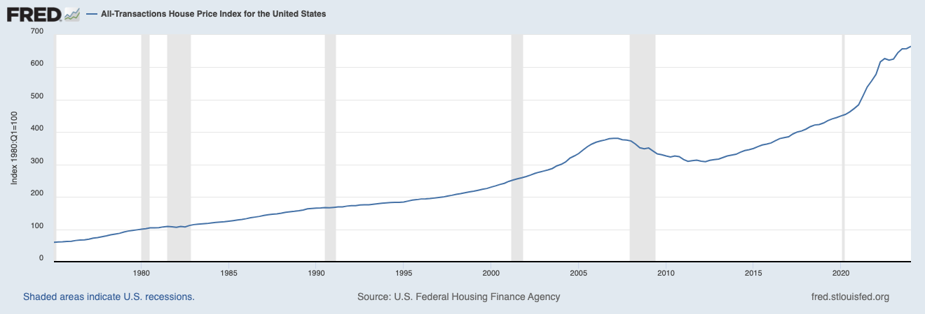

Housing prices have gone up in 5 of the last 6 recessions.
Source: Federal Housing Finance Agency
Mortgage Company NMLS #1234|Equal Housing Lender

Slide 12
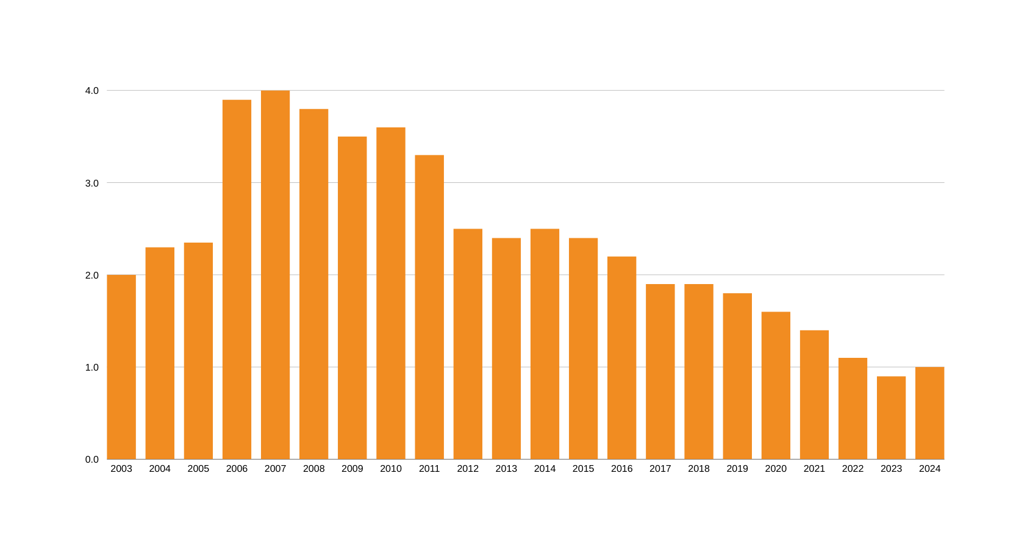

75% fewer homes on the market today than when the market crashed.
Crash
+4,000,000
4m
3m
2m
Today
1,002,695
1m
Inventory of homes on the market
Source: NAR, Redfin
Mortgage Company NMLS #1234|Equal Housing Lender

Slide 13
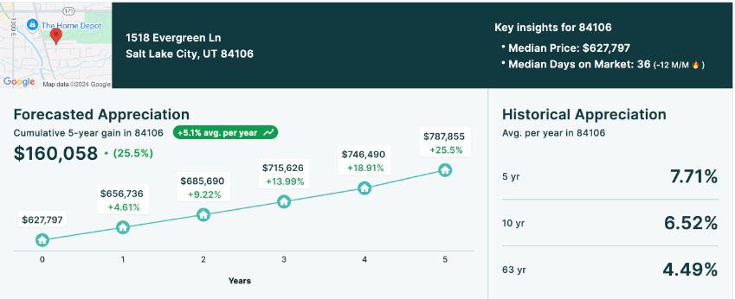
Low Inventory Pushing Prices Higher
Mortgage Company NMLS #1234|Equal Housing Lender

Slide 14
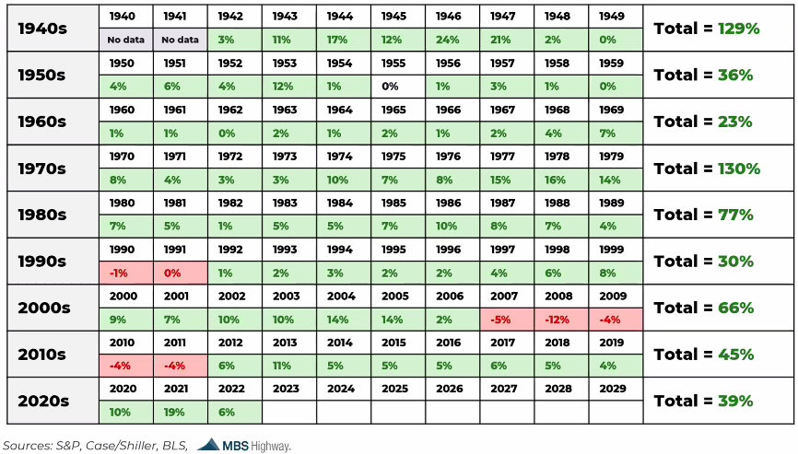
Real Estate Has a 90% Win Rate
73/7/1
Since 1942
Mortgage Company NMLS #1234|Equal Housing Lender

Slide 15
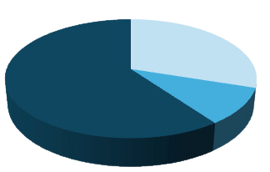
Our Value to You and Your Family
Before, During, & After
Our goal is to help you become a more educated, confident and successful homeowner.
BEFORE | Preparing and Planning (30% of our value)
Creating a more intentional process before buying or selling to ensure this strategy fits into your short and long-term goals.
DURING | Your Contract Period (10% of our value)
Allowing you to the experience the joy of the homebuying process instead of the anxiety of a typical real estate transaction.
AFTER | Building Generational Wealth (60% of our value)
Helping you accomplish your real estate and financial goals through our advice and network of professionals.

Slide 16
ELITE Home Buyer Process
3. Define your home-buying goals and home search criteria
  Discuss various property types and locations
  Work within the confines of pre-approval range
  Search MLS and other sources for properties
5. Prepare, submit, and negotiate offer
  Draft all offer documents and related addenda
  Review offer, disclosures, any legal issues
  Submit offer to seller or listing agent
7. Long-term commitment
  Evaluation of financial needs outside the home
  Maintenance service providers to maximize your home’s value
  Mortgage under constant management
  Annual financial review & goal setting
  Monthly real estate wealth digest
1. Initial Consultation
  Discuss your dreams & goals
  Provide home-buyer book
  Discuss market conditions & bulletproof buyer strategy
1
2
3
4
5
6
7
2. Discuss Mortgage & Pre-approval Strategy
  Helps determine buyer ability
  Refines search price range
  Assists in making your offer more competitive
  Must present lender letter with any offer
  If paying cash, must present proof of funds
4. View properties and select a home
  Schedule showings (some sellers require 24-hour notice)
  Attend showings with you
  Narrow down prospects
  Create dynamic market analysis, analyze comparable sales
  Discuss offer strategy
6. Contract acceptance and closing
  Negotiate on your behalf to get contract accepted
  Review your dates and deadlines, any action steps
  Communicate with all related parties
  Attend final walk-through with you
  Facilitate and attend closing

Slide 17
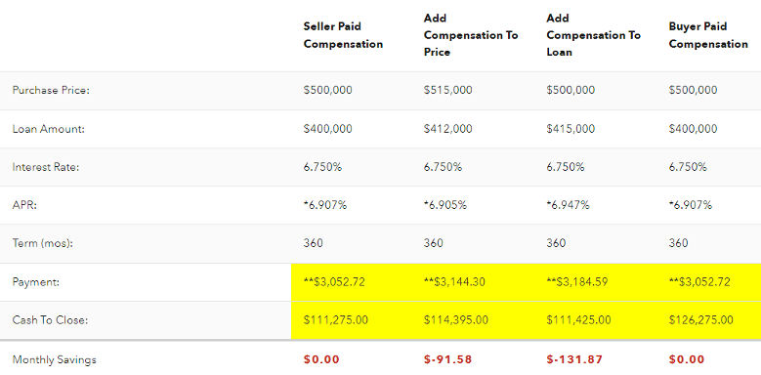
Representation Strategies
Mortgage Company NMLS #1234|Equal Housing Lender

Slide 18

How confident are you with your knowledge of Mortgage Interest Rates and how they work?

Slide 19





Understanding Rates and How Rates Can Work for YOU
1938-2009
2009-Present
Conforming
Rates were the same for
Everyone who qualified
Sub-Prime
“Non-conforming”
Rates varied greatly, based
on anything & everything
Conventional
Based on Loan Level Pricing
Adjustments (LLPA)
30 Things can affect rate.
Mortgage Company NMLS #1234|Equal Housing Lender

Slide 20
30 Things That Can Affect Rates
Loan Amount (<$180K, >$417K)
Loan Term (30, 15, 7/1)
Purpose (Purchase, Refinance)
LTV
Property/State
Occupancy (Owner/Investment)
Credit History
Asset Verification
Relocation
Concessions
Employment Status
Co-Borrower (Occ/Un-Occ)
Lock Period (15, 30, 45, 60)
UW System (DU, LP, AUS)
Property Type (SFR, Condo)
Loan Type (CONV, FHA, VA, USDA)
Amortization (Fixed, ARM)
Cash Out/Amount
Debt Tolerance Ratio
CLTV
Property County
# of Units (1-4)
Credit Score
Reserves
Gift Funds
Income Verification
Employment Documentation
Citizenship
Mortgage Insurance (MO, LPMI)
Escrow (Included, Yes or No)
Mortgage Company NMLS #1234|Equal Housing Lender

Slide 21
Why and When do rates change?
A mortgage backed security (MBS) is a type of asset-backed security that is
secured by a mortgage. The mortgages are usually sold to a government agency (Fannie Mae or Freddie Mac), who “securitizes” or “packages” the loans into a security that can be sold to investors.
THE PRICE OF MORTGAGE BACKED SECURITIES IS THE ONLY THING THAT MOVES MORTGAGE RATES!
Has anyone ever explained this to you?
Mortgage Company NMLS #1234|Equal Housing Lender

Slide 22
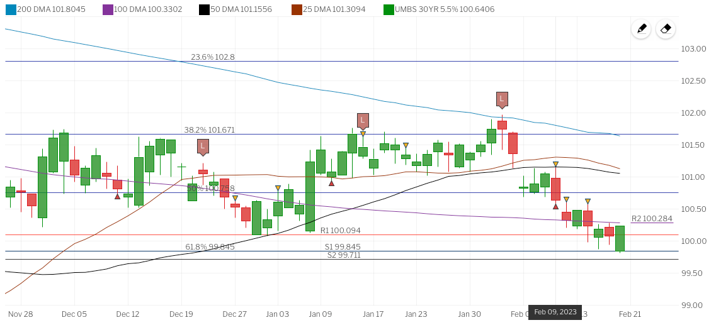
Why and When do rates change?
Do you want the lowest rate today or when you close?
How long do you think it will be before you close?
LEND
WITH
LOVE
Would I recommend locking in the rate?
Mortgage Company NMLS #1234|Equal Housing Lender

Slide 23
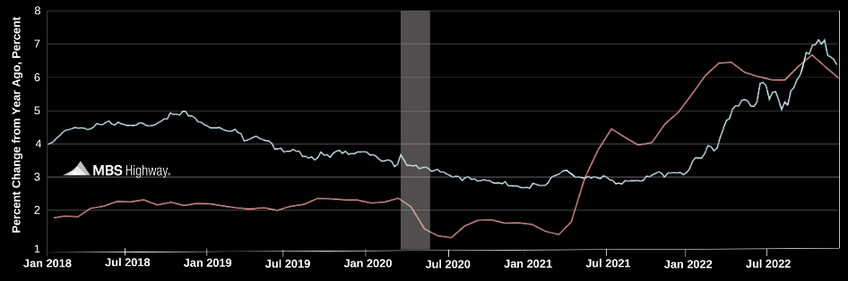
How can we save you money?
Inflation Drives Mortgage Rates.
Real-time market data with
lock recommendations
Daily Rate Advice:
Higher Stock prices coupled with an uptick in core consumer inflation are pushing Mortgage Bonds lower this morning, following yesterday's steep losses.
The two-day Fed meeting kicks off on Capitol Hill this morning. There will be no headlines out of today’s meeting. The monetary policy statement will be released at 2:00 p.m. ET tomorrow with a press conference by Fed Chair Yellen at 2:30.
With the recent big drop in Mortgage Bond prices and technical damage done, carefully floating is recommended. If anything changes, I will get back to you.
30-year fixed mortgage rate
Core Consumer Price Index (CPI)
LEND
WITH
LOVE
Mortgage Company NMLS #1234|Equal Housing Lender

Slide 24
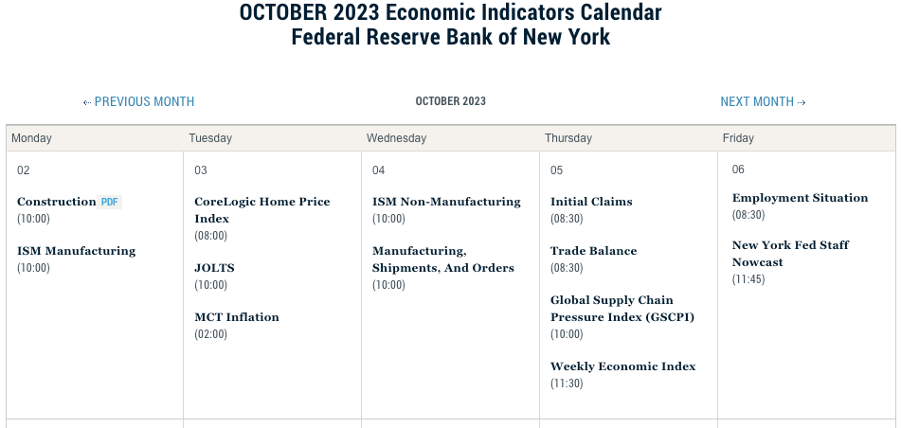
How can we save you money?
Weekly forecast and economic calendar monitoring.
Mortgage Company NMLS #1234|Equal Housing Lender

Slide 25


How familiar are you with the term points?
Rate
Points
If you lowered your rate by 0.25%, how much do you think it would lower you monthly payment?
$__________ / month.
7.125
0.00
6.99
.500
6.875
1.00
2.00
6.49
Projected Loan Amount
1% =
Payment @ 7.125%
$3,800.30
$486,400.00
$4,864.00
Payment @ 6.875%
$3,718.63
Mortgage Company NMLS #1234|Equal Housing Lender

Slide 26
How familiar are you with the term points?
  Would you pay $4,864.00
today to save $81.67 a month?
  How long do you plan on living in this home?
  How many homes have you owned?
  How long did you live in your last home?
  Have you ever refinanced? If so, how many times?
  When did you buy your first home?
The average loan is only in place 5 years.
It would take almost
5 years (59.5 months)
to make your
money back
Mortgage Company NMLS #1234|Equal Housing Lender

Slide 27

Fully Underwritten Loan Approval
36% of homes nationally sold all cash in 2022
How can financed buyers COMPETE in this market?
  Complete pre-underwriting
  Get fully approved outside of the property/title/appraisal
  Cash Purchase Program
Requirements:
  Actively making offers in the next 60 days?
  Ready to provide all documentation for full underwriting approval?
  Are we the right lending team for you?
Mortgage Company NMLS #1234|Equal Housing Lender

Slide 28
Strategic Mortgage Plan
  Make sure we are the right lender for you
  Provide all documentation for full underwriting approval
  Complete pre-underwriting
  Get fully approved outside of the property/title/appraisal
  Daily rate advice (lock once under contract)
  Waive the appraisal (if possible) and financing contingencies
  Actively making offers
  Close on your new home in 15 days
Mortgage Company NMLS #1234|Equal Housing Lender

Slide 29
THANK YOU!
“OUR GOAL IS TO HELP YOU ACCRUE GENERATIONAL WEALTH THROUGH THE ACQUISITION OF REAL ESTATE AND OUR MANAGEMENT OF THAT DEBT.”
John Smith
Certified Mortgage Advisor
NMLS #123456
Jane Doe
Pipeline Manager
NMLS# 123456
.com
Mortgage Company NMLS #1234|Equal Housing Lender

