Slide 1

Mortgage Company
SNMC Advantage
Employee Benefit Program
Copyright © | SecurityNational Mortgage Company| NMLS 3116 | NMLS #139374 | All Rights Reserved.

Slide 2

Who we are
A mortgage company with a rock-solid reputation.
You can feel confident that you’re getting the guidance and professional treatment you deserve. With over 50 years of experience, SecurityNational has the consistent track record and dependable financial backing of Security National Financial, our publicly traded parent company (NASDAQ: SNFCA). We’ve steadfastly weathered all the ups and downs of the economy and gained a reputation for outstanding leadership in the home loan market.
We’ve got professional mortgage branches from coast-to-coast, and hundreds of experienced loan professionals ready to take you through the loan process with top-notch service. Not to brag, but we’re consistently ranked a Top 50 mortgage company by Scotsman Guide in the United States.

Slide 3

EMPOWER YOUR EMPLOYEES
As a dedicated business owner, you understand the importance of empowering your employees. We're excited to introduce an exclusive employee benefit program in partnership with SecurityNational Mortgage. This initiative is designed to guide your team on their path to homeownership, offering education and special discounts on mortgage services.

Slide 4
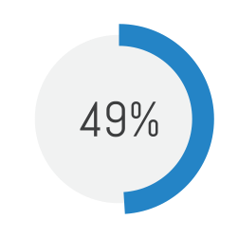


of employees are concerned, anxious or fearful about their current financial wellbeing.
When work and life are in discord, happiness, and productivity in employees’ lives are affected.

Slide 5
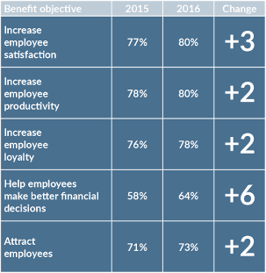
Increased Recognition of the Value of Benefits to Employees
Year after year, employers are paying more attention to incorporating benefits that add value to both employees and company.

Slide 6
Why Homeownership Matters:
Investing in Your Employees' Future
  Stability and Security: Homeownership provides a sense of stability and security, crucial for employee well-being and productivity.
  Financial Growth: It's an investment in their financial future, building generational wealth and credit.
  Community Engagement: Owning a home fosters a deeper connection with the community, enhancing overall job satisfaction.

Slide 7

Real Impact on Real Lives
  Exclusive Discounts
  Lunch and Learns
  Seminars to help with better financial decisions
  One on One Consultations
  It’s Better Here Guarantee
  Annual Borrower Reviews
  Streamlined Process

Slide 8

This Coupon entitles ________ to
$500 OFF
home purchase or refinance closing costs
Equal Housing
Lender

Slide 9

Educational Lunch and Learn Seminars
Many businesses are not offering financial education. workshops that would help their employees. Employers have an opportunity to close the knowledge gap.
Our team offers a range of topics to educate employees on the home buying experience so they can feel prepared when thew time is right to buy a home.
  The Home Buying Process A to Z
  Reverse Mortgage
  Financial Literacy
  Rent VS Own
  Financing Options

Slide 10
Financial Plan
Personalized Consultations: One-on-one meetings with SecurityNational Mortgage experts to educate, assess individual needs and readiness.
Prepared for:
New Home Buyer
02/02/2024

Slide 11

Our “It’s Better Here Guarantee” gives borrowers the flexible options to obtain the property they want today, and opt-in for a no lender fee refinance in the future, should their needs change.
IT’S BETTER HERE
GUARANTEE

Slide 12

The Annual Financial Review shows the customer how invested we are in helping them set goals for homeownership, growing generational wealth and achieving financial freedom. Our team gathers information about the borrowers family, current financial situation and their short and long term goals with real estate and finance. We follow up post-closing and reach out at 3, 6, 12 months and beyond to strengthen relationships which builds client loyalty.

Slide 13

Streamlined Process: We deliver a superior client experience with real-time updates, end-to-end loan processing, and handy tools like a mortgage calculator. SNapp Home prioritizes the journey of your employees, fostering satisfaction and loyalty.

Slide 14


Mortgage Company
CONTACT INFO
S
L
ALT
AKE
REGION
Copyright © | SecurityNational Mortgage Company| NMLS 3116 | NMLS #139374 | All Rights Reserved.

