Slide 1


SNMC ADVANTAGE BUYER
How to Massively Increase Your
Odds of a Successful Home Purchase
SecurityNational Mortgage Company NMLS #3116|Equal Housing Lender
Notes:
THIS IS BY FAR THE MOST CHALLENGING REAL ESTATE MARKET I’VE NAVIGATED IN THE 23 YEARS I’VE BEEN HELPING FAMILIES BUY AND FINANCE HOMES.
1

Slide 2

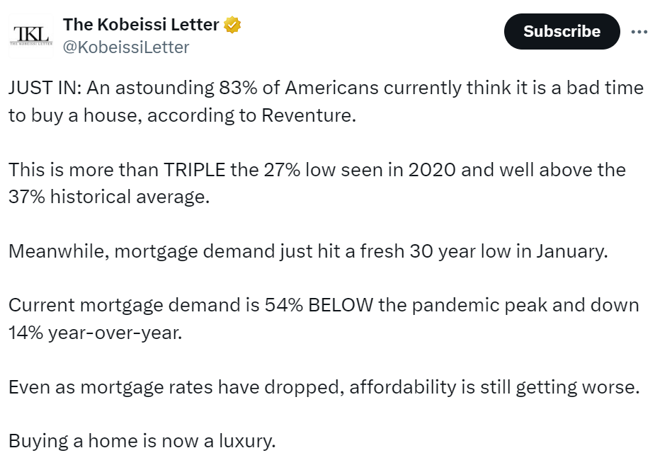
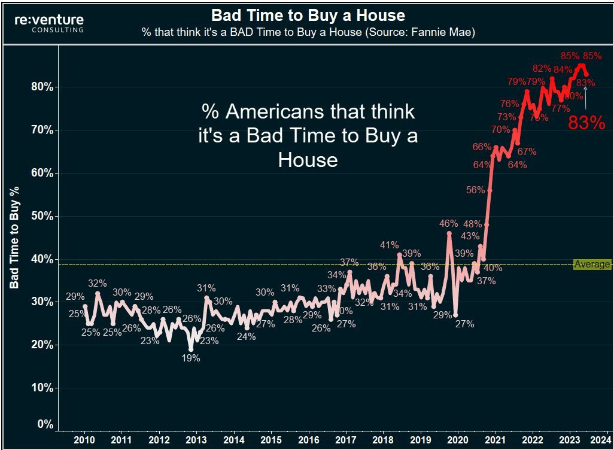

SecurityNational Mortgage Company NMLS #3116|Equal Housing Lender
Notes:
There is a LOT wrong with this post from X by the Kobeissi Letter but it’s worth hitting this nail on the head with clients so we can challenge the narrative of the Mainstream Media.
YES the FNMA homebuyer sentiment report showed 83% of those polled thought it was not a good time to buy a home. But if you ZOOM out you realize people always say they wish they had bought sooner before prices went up. Help buyers think in terms of decades not one or two years.
Mortgage demand hit a 30 year low because mortgage rates hit a 30 year high in the 4th quarter of 2023 and have since come down.
It’s NOT true that even though mortgage rates have dropped affordability is still getting worse. The fact is, rates are down about 1% from their peak and incomes are still growing faster than the historical average. Yes home prices continue to appreciate, but affordability is increasing with lower rates and higher wages.
YES this is a challenging buyer market, that’s why we created the Bulletproof Buyer Program.
2

Slide 3

The Solution? BECOME A ADVANTAGE BUYER
1. Comprehensive Upfront Market Analysis
    Understand why the housing market has been so resilient and continues to appreciate.
2. 40 Steps To A Flawless Home Purchase
3. Fully Underwritten Approval
    No loan contingencies
    Compete with all cash offers
4. Make An All-Cash Offer - Buy Before You Sell –
    Move Into Your New Home Now & Sell Your Old Home Later.
    Turn A Mortgage Financed Offer Into A Cash Offer
    Close on the new home in as little as 10 days
    Maximize profits on your departing home sale
Mortgage Company NMLS #3116|Equal Housing Lender
Notes:
AS I SEE IT YOU HAVE THREE OPTIONS:
SIT IDLY BY WHILE THE MARKET GOES HIGHER
DO THE BEAR MINIMUM TO GET PREPARED AND HOPE YOU ARE THE ONLY OFFER ON THE HOME YOU FALL IN LOVE WITH
OR BECOME A BULLETPROOF BUYER, WHO IS MORE PREPARED THAN ANYONE ELSE IN THE MARKET
IN MY EXPERIENCE, A BULLETPROOF BUYER IS AT LEAST 3 X AS LIKELY TO GET THEIR OFFER ACCEPTED AND CLOSE ON THEIR NEW HOME.
3

Slide 4
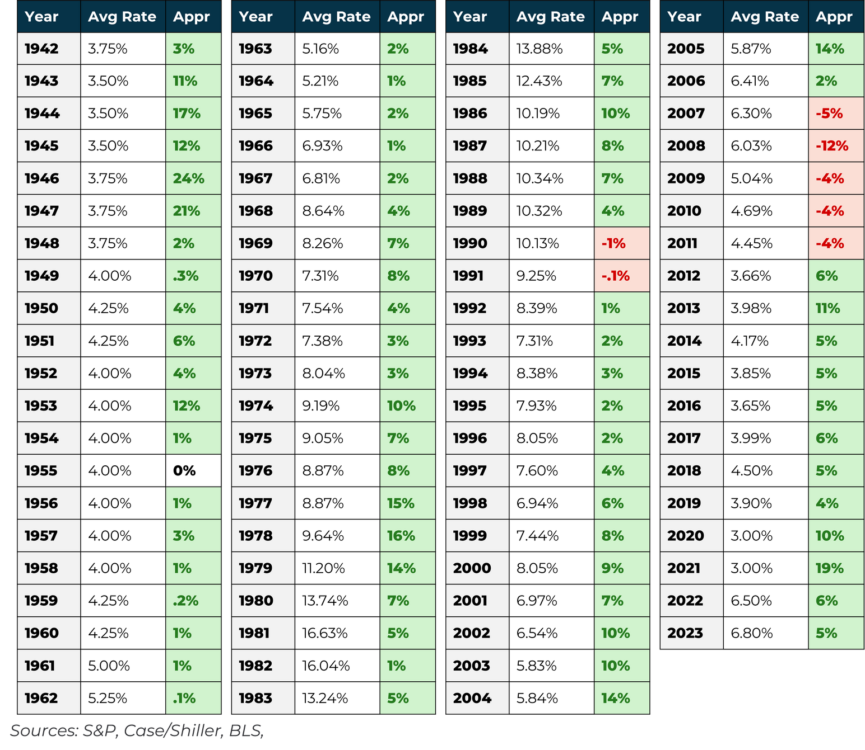

Home Prices Go Up 90% Of The Time
74 / 7 / 1
since 1942
Notes:
Going back to 1942 home prices have moved higher 74 years, have been down only 7 years (4 of which were in the Great Recession), and flat in one ear (1955).
That means residential real estate has a 90%-win rate as an asset class.
Regardless of interest rates and throughout elevated rate periods like the 70’s and 80’s, homes still continued to appreciate.
Think in terms of decades rather than months and a year or two.
4

Slide 5
This Cycle Is NOTHING Like The Last
Key Variables | Last Housing Cycle | Current Housing Cycle
Job Cuts (net of gains and losses) | Unemployment rate 10% | Unemployment rate 3.7%
Total Jobs (Household survey) | 138 million | 161 million
Subprime Loans | Prevalent | Virtually none
5-year cumulative new home construction | 7.65 million | 4.6 million (40% less)
Inventory on Market | 4 million | 795k (80% less)
Mortgage Delinquency | 10.1% | 2.1%
Homes in Foreclosure | 4.6% | 1.05%
Notes:
2024 IS NOTHING LIKE 2006/2008 AND ELEVATED PRICES ALONE ARE NOT REASON FOR A CRASH.
SOURCES:
Employment:
https://data.bls.gov/timeseries/LNS12000000&from_year=1994&output_type=column
https://data.bls.gov/timeseries/LNS12000000&from_year=1994&output_type=column
New Home Construction (Housing Starts:
https://www.census.gov/construction/nrc/data/series.html
Inventory on Market (Actual Inventory = Active Listings – Pending Sales)
https://www.redfin.com/news/data-center/
Mortgage Delinquency
https://fred.stlouisfed.org/series/DRSFRMACBS
Foreclosures:
https://www.corelogic.com/intelligence/loan-performance-insights-july-2023/
5

Slide 6
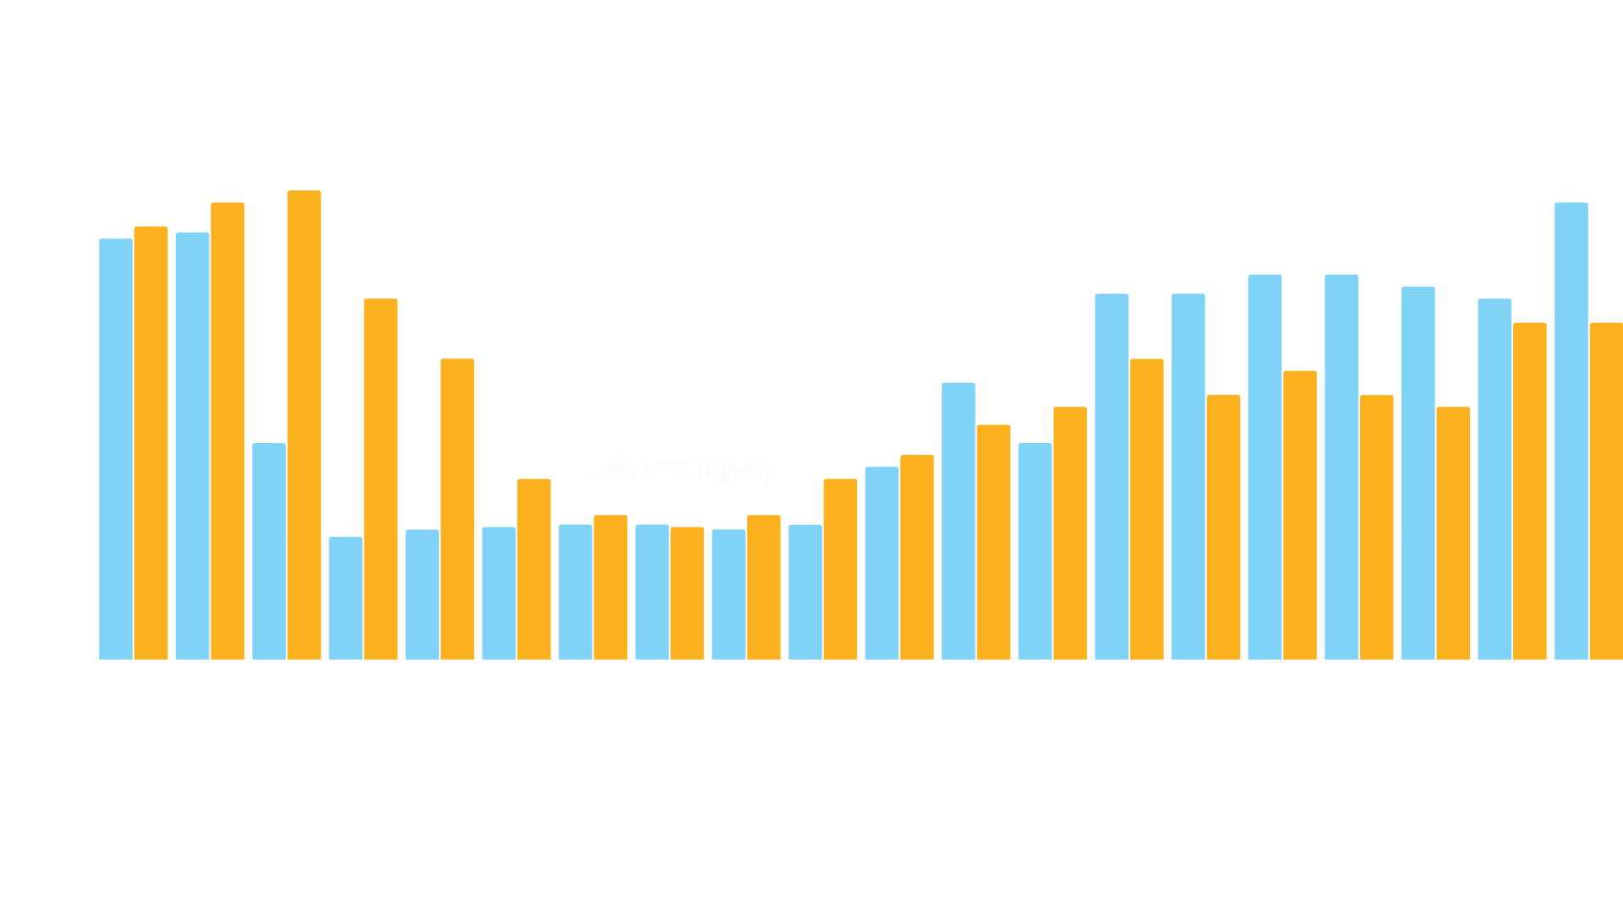
Demographics Driving The Housing Market
Prior to 2010, there were far more new homes constructed than there were new households formed. Since 2010, there have been far more new households created than new homes.
Huge drop in formations
Formations
Completions
Most completions in history
Notes:
Housing Shortages.
Row V. Wade 1973 – Birth Control – Contraceptives
Prior to 2008, there were far more new homes constructed than there were new households formed (when kids move out, graduate from college, get married, etc.). Since 2008, however, the reverse has taken place, as there have been far more new households created than new homes coming online.
6

Slide 7
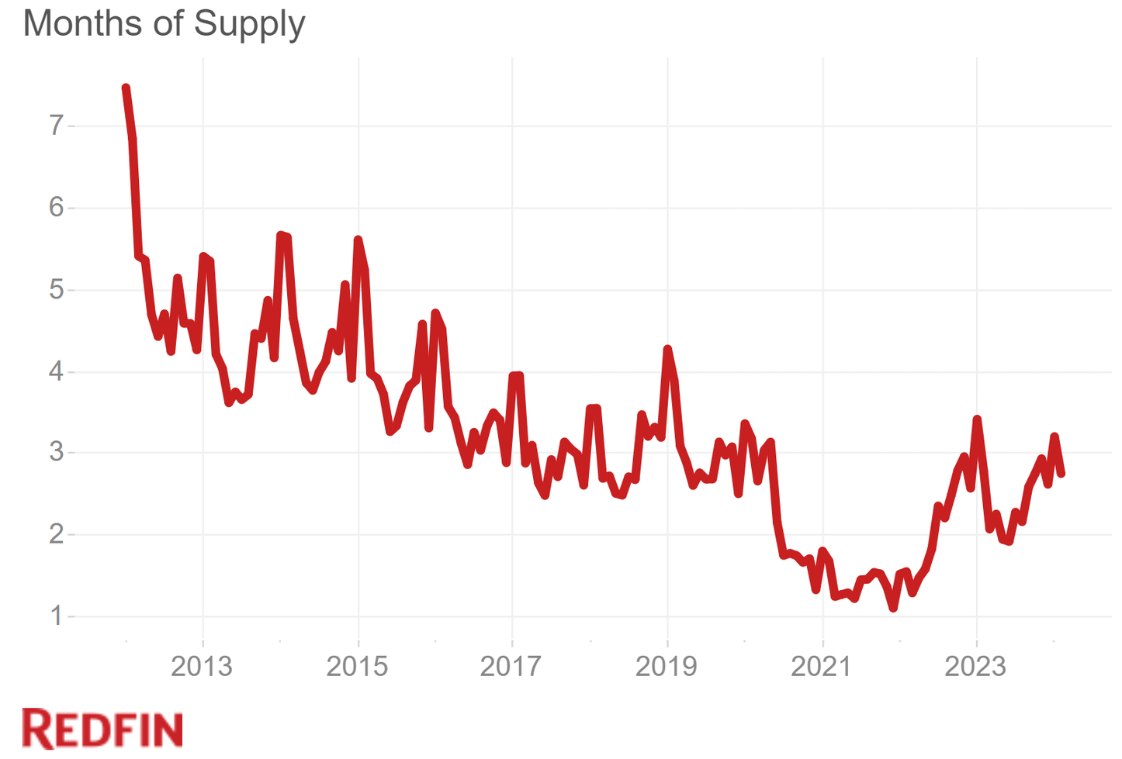
Housing Inventory Is Extremely Tight
Notes:
LOW INVENTORY MEANS MULTIPLE OFFER SITUATIONS FOR THE BEST HOMES IN THE BEST NEIGHBORHOODS
7

Slide 8
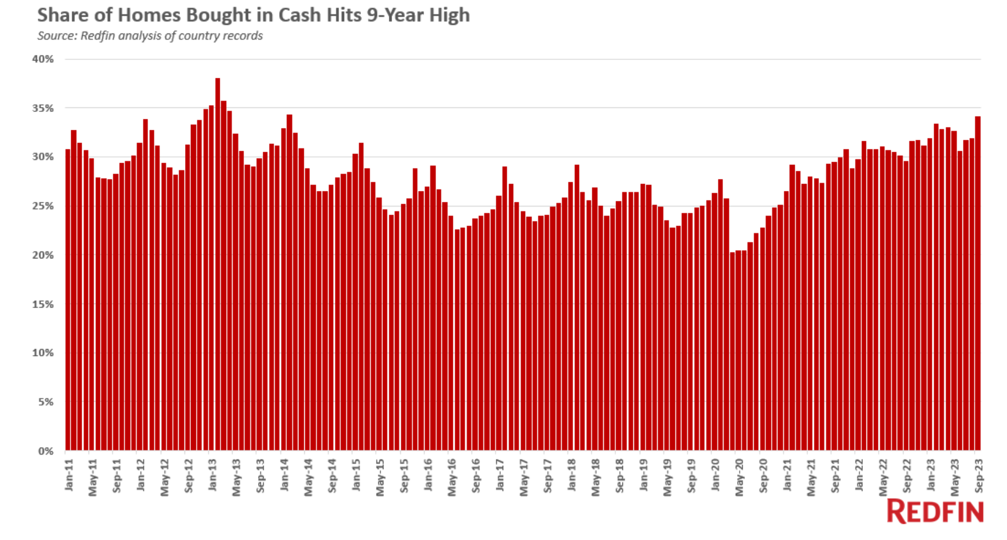
34% Of All Sales Are Sold To Cash Buyer
Notes:
ONE IN THREE HOMES ARE SELLING TO CASH OFFERS – WE NEED TO BE ABLE TO COMPETE AND WIN AGAINST MULTIPLE OFFER SITUATIONS AND BUYERS PAYING CASH.
8

Slide 9
40 Steps To A Flawless Home Purchase
  Meet Buyers and Discuss Their Goals
  Help Buyers Find a Mortgage Lender
  Overview Current Market Conditions
  Explain Home Inspection Process
  Educate Buyers About Local Neighborhoods
  Explain School Districts Effect on Home Values
  Schedule & Organize All Showings
  Look For Repair Issues While Showing
  Share Knowledge & Insight About Homes
  Discuss Homeowner’s Associations
  Explain Property Appraisal Process
  Discuss Multiple Offer Situations
  Determine Property Inclusions & Exclusions
  Review Comps to Determine Value
  Verify Listing Data is Correct
  Educate on Sales Contract Options
  Prepare & Write Sales Contract
  Negotiate Buyers Offer With Listing Agent
  Explain Home Warranty Options
  Discuss Loan Objection Deadlines
21. Choose a Mutually Agreeable Closing Date
22. Verify Listing Data is Correct
23. Once Under Contract, Send to Title Company
24. Obtain Copy of Sellers Disclosure for Buyers
25. Deliver Copies of Contract/Addendum to Buyers
26. Obtain a Copy of HOA Bylaws
27. Meet Appraiser at Property With Prepared Comps
28. Coordinate Inspections
29. Meet Inspector at the Property
30. Review Home Inspection With Buyers
31. Negotiate Inspection Objections
32. Get All Agreed Upon Repair Items in Writing
33. Negotiate any Unsatisfactory Appraisal
34. Coordinate Closing Times & Location
35. Aid in Transfer of Utilities & Internet
36. Receive and Review Closing Documents
37. Verify any Repairs Have Been Made by Sellers
38. Perform Final Walk-Through With Buyers
39. Attend Closing & Advise What to Look out for
40. Give Keys and Accessories to Buyers
Notes:
There is a LOT wrong with this post from X by the Kobeissi Letter but it’s worth hitting this nail on the head with clients so we can challenge the narrative of the Mainstream Media.
YES the FNMA homebuyer sentiment report showed 83% of those polled thought it was not a good time to buy a home. But if you ZOOM out you realize people always say they wish they had bought sooner before prices went up. Help buyers think in terms of decades not one or two years.
Mortgage demand hit a 30 year low because mortgage rates hit a 30 year high in the 4th quarter of 2023 and have since come down.
It’s NOT true that even though mortgage rates have dropped affordability is still getting worse. The fact is, rates are down about 1% from their peak and incomes are still growing faster than the historical average. Yes home prices continue to appreciate, but affordability is increasing with lower rates and higher wages.
YES this is a challenging buyer market, that’s why we created the Bulletproof Buyer Program.
9

Slide 10
Perfect Home-Buying Process
Initial consultation
    Discuss your needs/goals
    Provide home-buyer book
    Discuss market conditions
Discuss mortgage & pre-approval strategy
    Helps determine buyer power
    Refines search price range
    Assists in making your offer more competitive
    Must present lender letter with any offer
    If paying cash, must present proof of funds
Define your home-buying goals and home search criteria
    Discuss various property types and locations
    Work within the confines of pre-approval range
    Search MLS and other sources for properties
Notes:
ONE IN THREE HOMES ARE SELLING TO CASH OFFERS – WE NEED TO BE ABLE TO COMPETE AND WIN AGAINST MULTIPLE OFFER SITUATIONS AND BUYERS PAYING CASH.
10

Slide 11
Perfect Home-Buying Process
View properties and select home
    Schedule showings (some sellers require 24-hour notice)
    Attend showings with you
    Narrow down prospects
    Create market analysis, analyze comparables
    Discuss offer strategy
Prepare, review and submit offer
    Draft all offer documents and related addenda
    Review offer, disclosures, any legal issues with you
    Submit offer to seller or listing agent
Contract acceptance and closing
    Negotiate on your behalf to get contract accepted
    Review your dates and deadlines, any action steps
    Communicate with all related parties
    Attend final walk-through with you
    Facilitate and attend closing, subject to covid rules
Notes:
ONE IN THREE HOMES ARE SELLING TO CASH OFFERS – WE NEED TO BE ABLE TO COMPETE AND WIN AGAINST MULTIPLE OFFER SITUATIONS AND BUYERS PAYING CASH.
11

Slide 12
Appraisal Gap Strategy
Why might appraisals start coming in low?
    Appraisers use previous sale data to determine value
    Appreciation will happen too fast to rely on historical data
The Solution?
    Appraisal Gap Strategy to remove appraisal contingency up front
Notes:
Appraisals come in low from time to time in low inventory environments. Low inventory leads to less transactions. Low transaction frequency and fast appreciation are factors commonly associated with low appraisals.
12

Slide 13
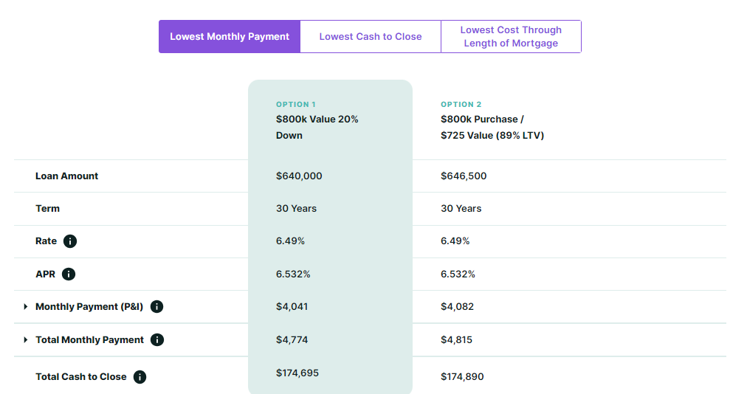
Appraisal Gap Strategy = Negligible Cash Difference
Notes:
20% down to 89% LTV and buyout mortgage insurance premium. I bet you are like me and you don’t want to overpay for your home.
13

Slide 14
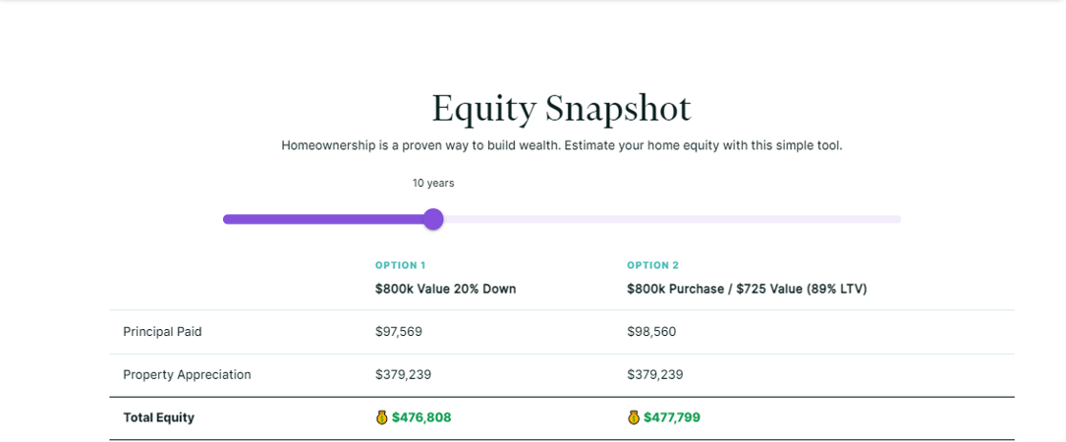
Appraisal Gap Strategy = Negligible Cash Difference
Notes:
I BET YOU ARE LIKE ME, IN THAT YOU HATE TO OVERPAY. BUT IN THIS INSTANCE, MY MORTGAGE PARTNER AND I WERE ABLE TO WALK THE FAMILY THROUGH THEIR FUTURE APPRECIATION GAIN AND SHOW THEM IF THEY REALLY LOVED THE HOME, THE NUMBERS WOULD STILL WORK VERY POSITIVELY OVER TIME.
14

Slide 15
Fully Underwritten Loan Approval
34% of homes nationally sold all cash in 2023.
How can financed buyers COMPETE in this market?
    Complete pre-underwriting
    Get fully approved outside of the property/title/appraisal
Requirements:
    Actively making offers in the next 60 days
    Ready to provide all documentation for full underwriting approval
    Signed buyer representation agreement
Notes:
THINKING FROM A SELLER’S PERSPECTIVE, ONE IN THE HAND IS BETTER THAN TWO IN THE BUSHES.
AT THIS TIME, ARE YOU FEELING CONFIDENT IN MY TEAM AND I, OR ARE YOU STILL OUT SHOPPING FOR A MORTGAGE PARTNER?
15

Slide 16
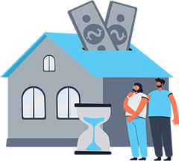


Submit an All-Cash Offer…WITHOUT THE CASH!
CASH PURCHASE PROGRAM provides home sellers and buyers the ability to make cash offers in today’s highly competitive real estate market.
Quick closing cash offers are more likely to be accepted than conventional financing offers and will help you negotiate the best price and terms possible.
BUY WITH CASH
PURCHASE WITH
CONFIDENCE
MOVE ONLY ONCE
You become a cash buyer with no contingencies. Cash offers are 3x more likely to win.
Secure your dream home in half the time of a typical financed offer.
You avoid the hassle of moving twice. You can move directly into your new home before selling your old one.
Notes:
16

Slide 17

OUR GOAL IS TO HELP YOU ACCRUE WEALTH THROUGH THE ACQUISITION OF REAL ESTATE AND OUR MANAGEMENT OF THAT DEBT.
Name
NMLS #123456
Name
NMLS# 123456
WWW..COM
SecurityNational Mortgage Company NMLS #3116|Equal Housing Lender

