Slide 1


Where Is The Puck Headed?
Clever Real Estate conducted a survey of Americans who bought a home in the past two years or plan to buy a home in the next two years.
  42% of recent buyers reported that their agent was “less helpful than expected.”
  54% said that the agent “cared more about making a deal than their best interests.”
  61% of sellers support a commission structure in which buyers are responsible for paying their own agent.
Source:

Slide 2
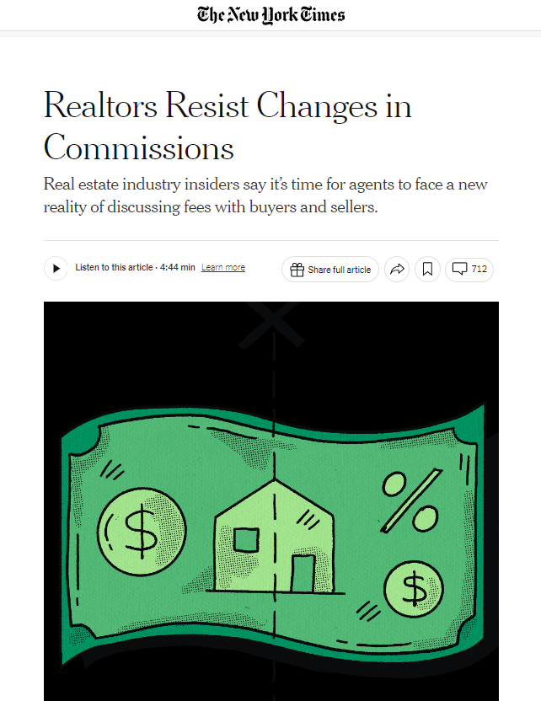
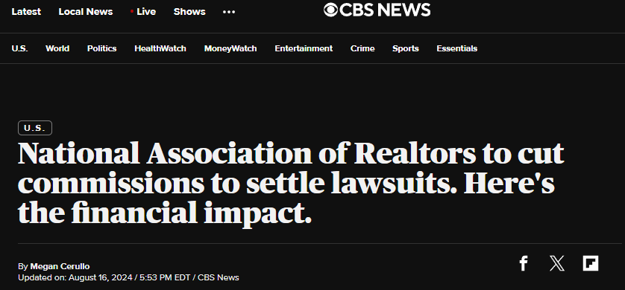
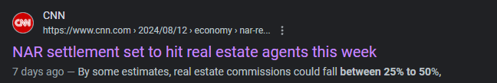
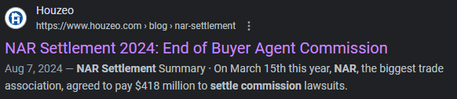

How do your buyer agents respond to this?
Notes:
2

Slide 3

Become So Valuable…
Agents Will Never Give Three Cards Again
1.
Most REALTORS are significantly underprepared
2.
Buyers and sellers WILL negotiate compensation and/or go directly to the listing agent
(estimated to drop 25 to 50%)
3.
Real estate insiders estimate 20% to 40% attrition in the industry
Notes:
This is the Kodak/Blockbuster moment for the RE industry & why we have created Empowering Buyer Agents Through Chaos Bootcamp.
3

Slide 4


SNMC ADVANTAGE BUYER CONSULTATION
Dreams & Goals Call Notes:
  Relocating family from CA to TX
  Bought a home in 2006 and concerned about buying into a real estate bubble
  Bought a home in 2018 and had a terrible time with the loan and homebuying process
  Aware real estate commission may now fall on the buyer and not necessarily paid by the seller
Notes:
4

Slide 5
SNMC ADVANTAGE BUYER CONSULTATION
1. Comprehensive Market Analysis
    Understand why the housing market has been so resilient and continues to appreciate
2. Successful Homeownership Before, During, and After
Your New Home Purchase
3. Underwritten Approval & Competitive Offer Strategies
    Compete with all cash offers
    No loan contingencies
    Appraisal gap strategies
Notes:
“AS I SEE IT YOU HAVE THREE OPTIONS:
SIT IDLY BY WHILE THE MARKET GOES HIGHER
DO THE BEAR MINIMUM TO GET PREPARED AND HOPE YOU ARE THE ONLY OFFER ON THE HOME YOU FALL IN LOVE WITH
OR BECOME A BULLETPROOF BUYER, WHO IS MORE PREPARED THAN ANYONE ELSE IN THE MARKET
IN MY EXPERIENCE, A BULLETPROOF BUYER IS AT LEAST 3 X AS LIKELY TO GET THEIR OFFER ACCEPTED AND CLOSE ON THEIR NEW HOME.”
5

Slide 6
What do you believe will happen to
home prices if rates move to
5%?
Notes:
6

Slide 7
Historically, when headline inflation is above 5% and unemployment is below 5%,
THERE IS A 100% CHANCE OF A RECESSION.
This happened in Q4 of 2021.
Source: Department of Labor and Statistics
Notes:
7

Slide 8


Mortgage rates plummet in recessions.
30-year fixed mortgage rate
Recessions
18% to 13%
+20mm qualified
16% to 11.75%
+21.25mm qualified
11% to 8.75%
+11.25mm qualified
7.375% to 6.75%
+3.25mm qualified
6% to 4.875%
10% to 9%
+5.6mm qualified
+5mm qualified
3.75% to 2.75%
+5mm qualified
Source: Freddie Mac
Notes:
8

Slide 9
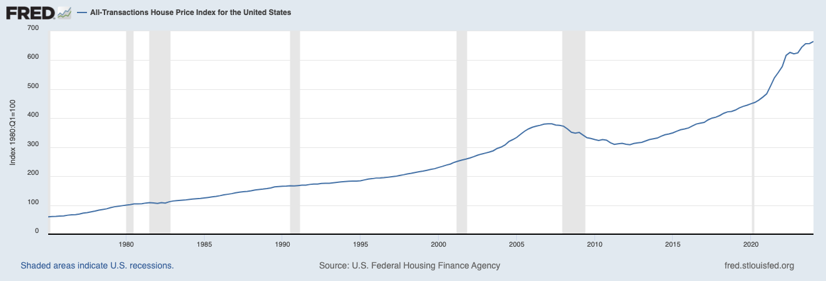

Housing prices have gone up in
5 of the last 6 recessions.
Source: Federal Housing Finance Agency
Notes:
9

Slide 10
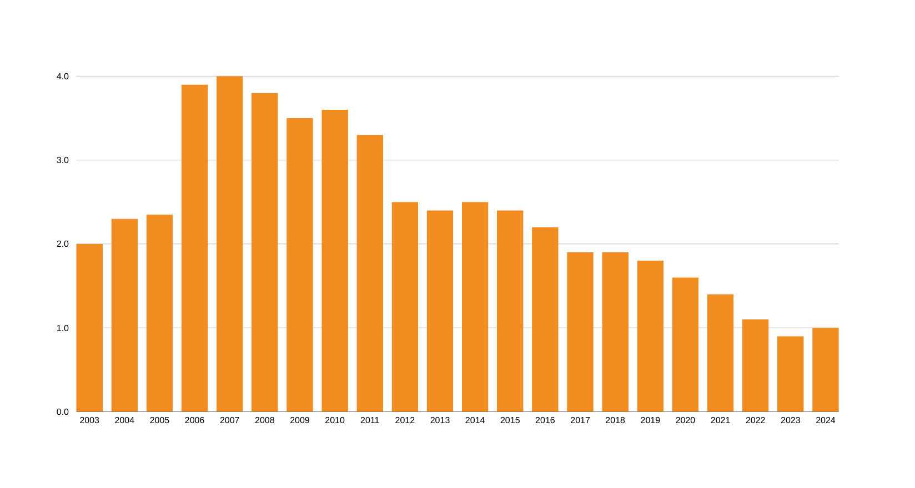
75% fewer homes on the market today
than when the market crashed.
Crash
+4,000,000
4m
3m
2m
Today
1,002,695
1m
Inventory of homes on the market
Source: NAR, Redfin
Notes:
LOW INVENTORY MEANS MULTIPLE OFFER SITUATIONS FOR THE BEST HOMES IN THE BEST NEIGHBORHOODS
10

Slide 11

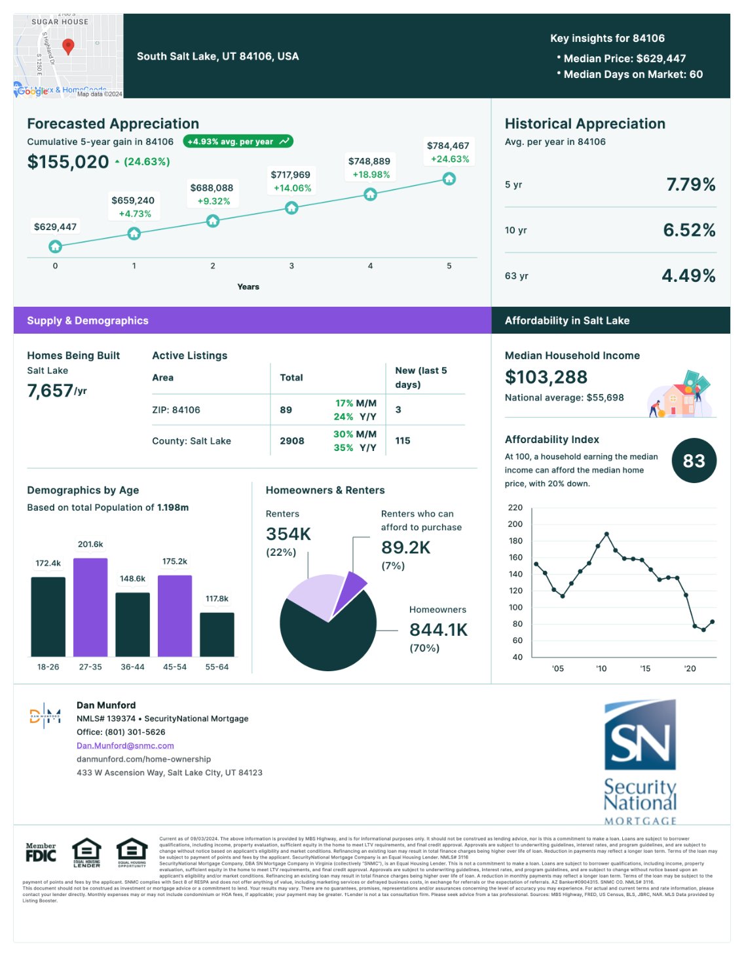
Notes:
Local market statistics provided by REALTOR or MBS Highway Report Card
11

Slide 12
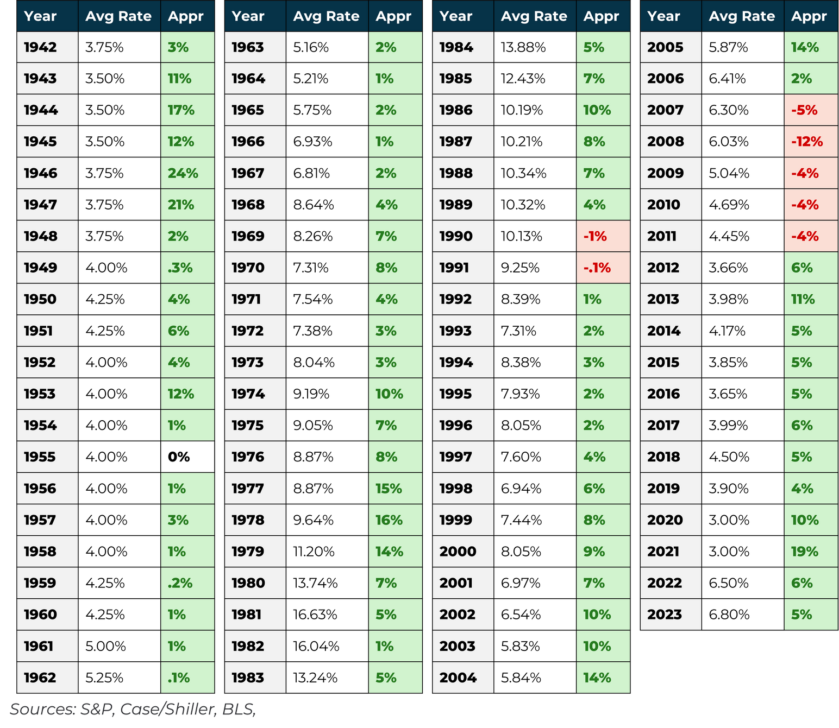
Home Prices Go Up 90% Of The Time
74 / 7 / 1
since 1942
Notes:
Going back to 1942 home prices have moved higher 74 years, have been down only 7 years (4 of which were in the Great Recession), and flat in one ear (1955).
That means residential real estate has a 90%-win rate as an asset class.
Regardless of interest rates and throughout elevated rate periods like the 70’s and 80’s, homes still continued to appreciate.
Think in terms of decades rather than months and a year or two.
12

Slide 13
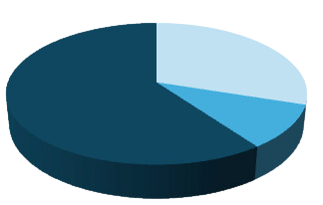
Our Value to You and Your Family
Before, During, & After
Our goal is to help you become a more educated, confident and successful homeowner.
BEFORE | Preparing and Planning (30% of our value)
Creating a more intentional process before buying or selling to ensure this strategy fits into your short and long-term goals.
DURING | Your Contract Period (10% of our value)
Allowing you to the experience the joy of the homebuying process instead of the anxiety of a typical real estate transaction.
AFTER | Building Generational Wealth (60% of our value)
Helping you accomplish your real estate and financial goals through our advice and network of professionals.
Notes:
13

Slide 14
ADVANTAGE Home Buyer Process
3. Define your home-buying goals and home search criteria
  Discuss various property types and locations
  Work within the confines of pre-approval range
  Search MLS and other sources for properties
5. Prepare, submit, and negotiate offer
  Draft all offer documents and related addenda
  Review offer, disclosures, any legal issues
  Submit offer to seller or listing agent
7. Long-term commitment
  Evaluation of financial needs outside the home
  Maintenance service providers to maximize your home’s value
  Mortgage under constant management
  Annual financial review & goal setting
  Monthly real estate wealth digest
1. Initial Consultation
  Discuss your dreams & goals
  Provide home-buyer book
  Discuss market conditions & bulletproof buyer strategy
1
2
3
4
5
6
7
2. Discuss Mortgage & Pre-approval Strategy
  Helps determine buyer ability
  Refines search price range
  Assists in making your offer more competitive
  Must present lender letter with any offer
  If paying cash, must present proof of funds
4. View properties and select a home
  Schedule showings (some sellers require 24-hour notice)
  Attend showings with you
  Narrow down prospects
  Create dynamic market analysis, analyze comparable sales
  Discuss offer strategy
6. Contract acceptance and closing
  Negotiate on your behalf to get contract accepted
  Review your dates and deadlines, any action steps
  Communicate with all related parties
  Attend final walk-through with you
  Facilitate and attend closing
Notes:
14

Slide 15

How Are Realtors
Compensated NOW?
1. Percentage of the purchase price of the home
2. Hourly rate
3. Flat fee
4. A la carte menu
5. Monthly retainer
Notes:
What do you know about how real estate professionals like me get paid in the post NAR settlement?
15

Slide 16
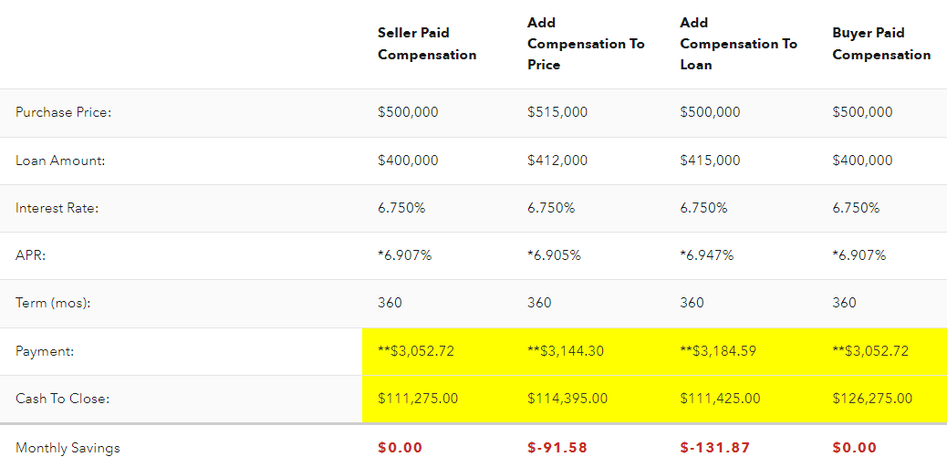
Representation Strategies
Notes:
16

Slide 17

Fully Underwritten Loan Approval
Over 34% of homes nationally are selling for all cash in 2024.
How can financed buyers COMPETE in this market?
    Complete pre-underwriting
    Get fully approved outside of the property/title/appraisal
    Appraisal gap strategy
    Cash purchase program
Requirements:
    Actively making offers in the next 60 days
    Ready to provide all documentation for full underwriting approval
Notes:
Typical offer acceptance rate is about 20%, our process increases your offer acceptance rate to North of 50%.
https://www.google.com/search?q=on+average%2C+how+many+offers+are+there+on+homes&rlz=1C1GCEA_enUS1034US1034&oq=on+average%2C+how+many+offers+are+there+on+homes&gs_lcrp=EgZjaHJvbWUyBggAEEUYOTIHCAEQIRigATIHCAIQIRigATIHCAMQIRigATIHCAQQIRigATIHCAUQIRirAtIBCDkyOTRqMGo3qAIAsAIA&sourceid=chrome&ie=UTF-8
17

Slide 18
Next Steps:
SNMC ADVANTAGE Buyer Consultation
1.
Signing the Buyer Agency Agreement outlining the details of our partnership.
2.
Fully underwritten loan approval by Mark and his team to ensure you are bulletproof.
3.
Consult with Mark and determine if Appraisal Gap Strategy & Cash Purchase Program are appropriate based on the time horizon for your move to TX.
4.
Schedule time to begin looking at homes.
Notes:
18

Slide 19

OUR GOAL IS TO HELP YOU ACCRUE WEALTH THROUGH THE ACQUISITION OF REAL ESTATE AND OUR MANAGEMENT OF THAT DEBT.
Name
NMLS #123456
Name
NMLS# 123456
WWW..COM
Notes:
TheLoanAtlas.com/bulletproof-mbs
19

