Slide 1

Mortgage Company
Financial Plan
Prepared for:
Team Logo
Borrower
Borrower
DATE
Date
SecurityNational Mortgage Company NMLS #3116|Equal Housing Lender

Slide 2
THE SNMC DIFFERENCE
• My Primary Role is to help you select the perfect loan strategy for you and your family and to help you integrate that strategy into your overall financial plan. That allows you to maximize your savings, cash flow and net worth.
• Simply stated, I am here to help you save money and to make this process both easy and enjoyable. I will take care of your loan so you can get back to your life.

Slide 3
My Questions for You:
•What is most important about this home loan to you?
•What are your concerns?
•Please describe what EXCELLENT customer service means to you?

Slide 4
My Commitments for You:
•Your closing costs will ALWAYS be equal to or LESS than our Loan Disclosure.
•We will ALWAYS honor our approval letters/commitments and close your loan.
•We will NEVER cause your closing to be delayed.
•We will ALWAYS ask the necessary questions to learn and understand YOUR financial goals and will explain EVERY piece of the loan process.
•We will study and review ALL of the possible scenarios to ensure you get the best options for your needs.
•We will communicate with your agent, CPA, Advisors, and/or attorneys to ensure your overall financial plans are integrated.
•Just like a professional financial advisor will manage assets, we will manage your mortgage after closing, so you are ALWAYS in the best loan.
•We will ALWAYS communicate pro-actively by giving you, your agent, and the seller’s agent a written update via email.
•We will ALWAYS ask you to explain your vision of excellent customer service so we can serve you better.
•We will ALWAYS do everything that we can to deliver your vision PLUS.

Slide 5




How can you get me the lowers rate?
1938-2009
2009-Present
Conventional
Based on Loan Level Pricing
Adjustments (LLPA)
Conforming
Rates were the same for
Everyone who qualified
Sub-Prime
“Non-conforming”
Rates varied greatly, based
on anything & everything

Slide 6
30 Things That Can Affect Rates
Loan Amount (<$180K, >$417K)
Loan Term (30, 15, 7/1)
Purpose (Purchase, Refinance)
LTV
Property/State
Occupancy (Owner/Investment)
Credit History
Asset Verification
Relocation
Concessions
Employment Status
Co-Borrower (Occ/Un-Occ)
Lock Period (15, 30, 45, 60)
UW System (DU, LP, AUS)
Property Type (SFR, Condo)
Loan Type (CONV, FHA, VA, USDA)
Amortization (Fixed, ARM)
Cash Out/Amount
Debt Tolerance Ratio
CLTV
Property County
# of Units (1-4)
Credit Score
Reserves
Gift Funds
Income Verification
Employment Documentation
Citizenship
Mortgage Insurance (MO, LPMI)
Escrow (Included, Yes or No)

Slide 7
Why and When do rates change?
A mortgage backed security (MBS) is a type of asset-backed security that is
secured by a mortgage. The mortgages are usually sold to a government agency (Fannie Mae or Freddie Mac), who “securitizes” or “packages” the loans into a security that can be sold to investors.
THE PRICE OF MORTGAGE BACKED SECURITIES IS THE ONLY THING THAT MOVES MORTGAGE RATES!
Has anyone ever explained this to you?

Slide 8
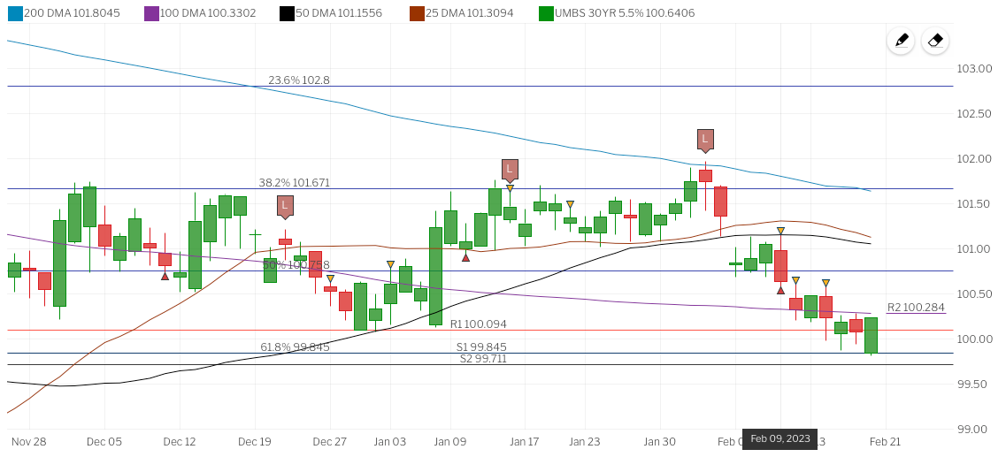
Why and When do rates change?
Do you want the lowest rate today or when you close?
How long do you think it will be before you close?
LEND
WITH
LOVE
Would I recommend locking in the rate?

Slide 9
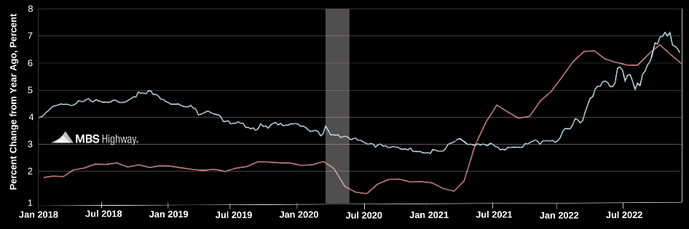
How can I save you money?
Inflation Drives Mortgage Rates.
Real-time market data with
lock recommendations
Daily Rate Advice:
Higher Stock prices coupled with an uptick in core
consumer inflation are pushing Mortgage Bonds lower
this morning, following yesterday's steep losses.
The two-day Fed meeting kicks off on Capitol Hill this morning. There will be no headlines out of today’s meeting. The monetary policy statement will be released at 2:00 p.m. ET tomorrow with a press conference by Fed Chair Yellen at 2:30.
With the recent big drop in Mortgage Bond prices and technical damage done, carefully floating is recommended. If anything changes, I will get back to you.
30-year fixed mortgage rate
Core Consumer Price Index (CPI)
LEND
WITH
LOVE

Slide 10
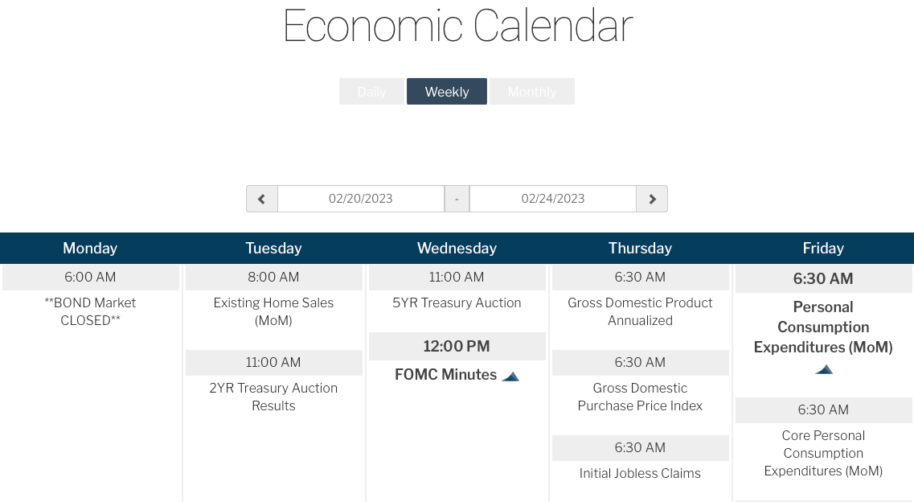
How can I save you money?
Weekly forecast and economic calendar monitoring
LEND
WITH
LOVE

Slide 11


How familiar are you with the term points?
Rate
Points
If you lowered your rate by 0.25%, how much do you think it would lower you monthly payment?
$__________ / month.
8.125%
1.00
Projected Loan Amount
1% =
Payment @ 8.125%
$1,811.69
$244,000
$2,440.00

Slide 12
How familiar are you with the term points?
  Would you pay $6,900
today to save $156.4 a month?
  How long do you plan on living in this home?
  How many homes have you owned?
  How long did you live in your last home?
  Have you ever refinanced? If so, how many times?
  When did you buy your first home?
The average loan is only in place 5 years.
It would take almost
3.6 years (44 months)
to make your
money back

Slide 13
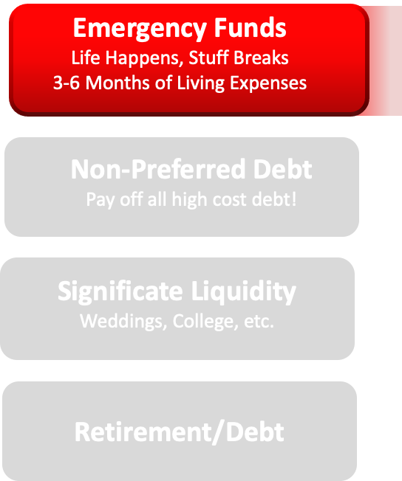

Down Payment Analysis and Document Review
Checking
Savings
LEND
WITH
LOVE
Money Market

Slide 14
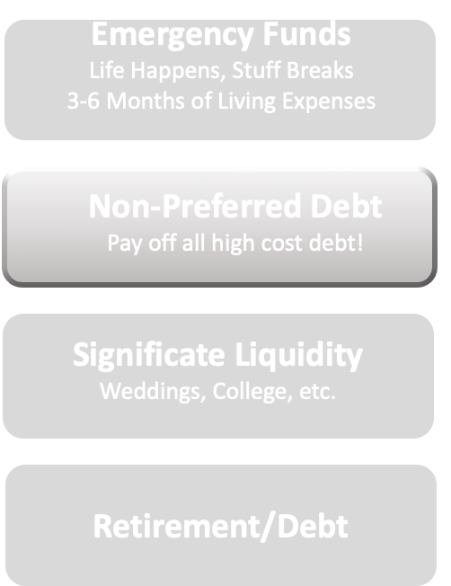

Down Payment Analysis and Document Review
Credit Card
Consumer
LEND
WITH
LOVE
Other

Slide 15
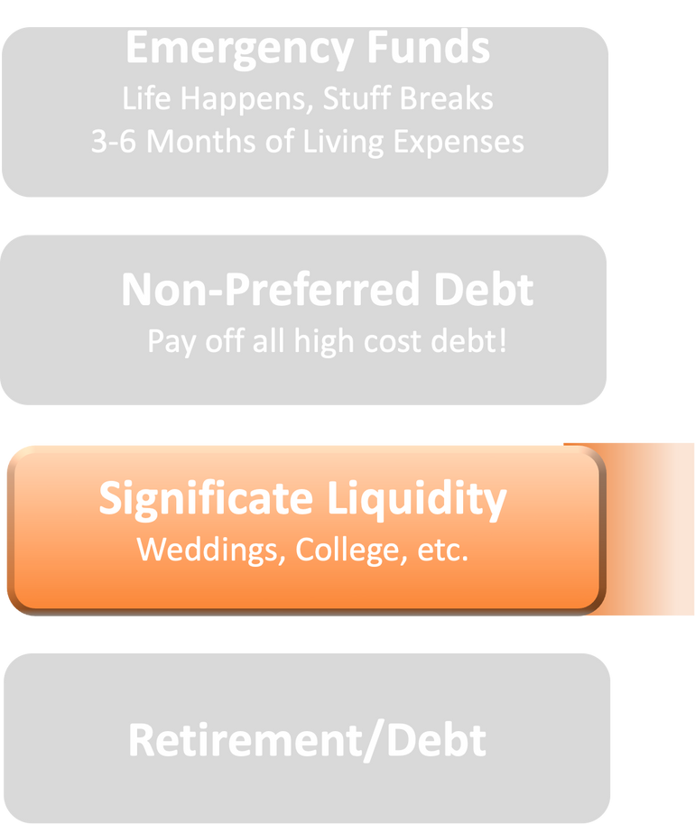
Down Payment Analysis and Document Review
401K, IRA
Stocks
Life Insurance (CV)

Slide 16
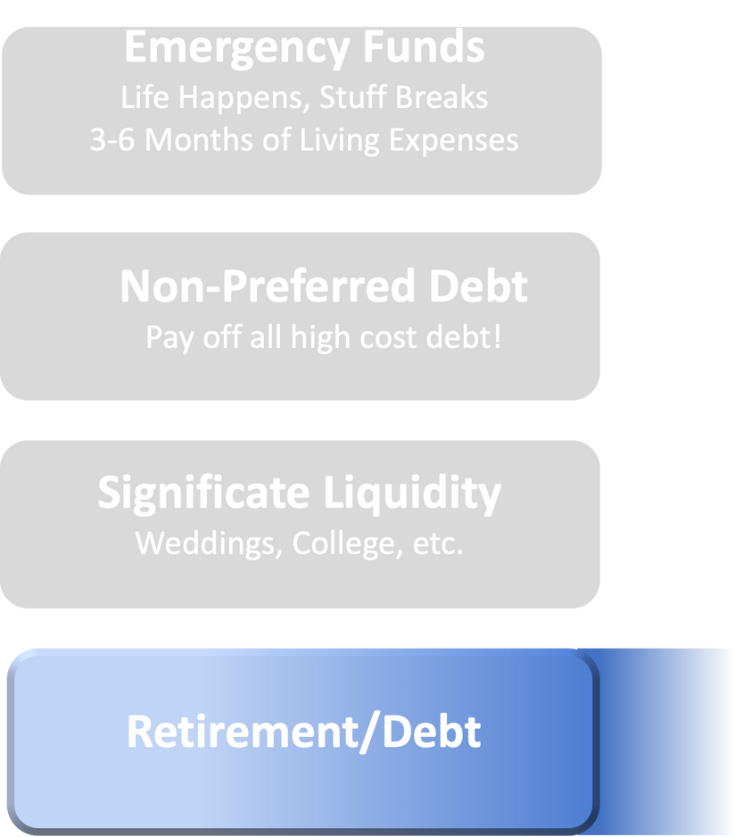
Down Payment Analysis and Document Review
Retirement Age
Location
Life Style

Slide 17
Strategic Mortgage Plan
Market Analysis Weekly Updates Short Term: Lock or Float? Long Term: Annual Reviews | Expected Closing Date: Approximately 45 Days With interest rates expected to climb, the current bias is always toward locking, but….
Down Payment Analysis I recommend _20_% down payment because | We believe the biggest mistake buyers make is putting too much down on their home. Whether it be paying down a higher cost debt or increasing liquidity, most money is better utilized in other ways.
Product Selection Years in house?___ Years with loan?___ | With rates at all time lows, fixed rate mortgages became more popular than ever. With rates increasing it became more important to work with a professional who can explain the details of all of your options.
Debt Retirement Plan | The first priority for a stable financial future is to secure your emergency funds and to pay off all high cost debt. From there, it is to invest and balance wisely.
Financial Plan | Once you have a solid emergency fund and have paid off all high cost debt, your focus turns to investing and paying off lower cost auto loans and have mortgages. If you are going to error, then do so on the side that gives you control…

Slide 18

Your Mortgage Loan Estimate
Fixed Costs
Variable Costs
Administration
$1,695.00
Pre-Paids
$1,253.00
Appraisal
$625.00
Title and Closing
$1.937.00
Escrow Reserves
$591.49

Slide 19
Things that can affect your approval (please contact me prior to any of these things taking place.):
  Any new debt or inquiries on your credit.
  Any use of part or all assets.
  A collection notification.
  A 30 day late payment.
  Job change of any kind.
  Do not co-sign for anyone.
  Call me before any large deposits are made to any account.
Also please make sure that all of your funds to close are seasoned for 2 months or we can document source. If you would like to discuss other options please call.

Slide 20
How Do You Feel?
  Have we answered all of your initial questions and concerns professionally?
  Have we met your expectations thus far?
  If not, what do we need to do?
  Do you feel less stressed than before?
  Did we show you how we can save you money?
  Do you feel like we delivered on our commitments thus far?

Slide 21

TEAM
MOTTO
TEAM
LOGO
Loan Officer
NMLS #123456
Team Member
NMLS# 123456
SNMC.com
Turning houses into Homes

