Slide 1



Planning for Lending through Accounting & Bookkeeping
Ebony Francis, BA, MBA, Accountant
E: ebony.francis@avesitcorp.com
T: (678) 671-4499
Book your free consultation today!
Bookings (avesticorp.com)
Services we offer:
Services (avesticorp.com)

Slide 2
Overview
1. Importance of Accounting and Bookkeeping
  Tracks income/expenses, aids budgeting, and decision-making.
  Ensures tax compliance and smooth audits.
2. Accounts Receivables vs. Accounts Payables
  AR: Money owed to the company, increases cash flow.
  AP: Money the company owes, decreases cash flow.
3. Transactions and Categorizations
  Ensures accurate financial reporting and compliance.
4. Bank Reconciliation
  Ensures accuracy, detects fraud, and manages cash flow.
5. Income & Profit & Loss Statement, Balance Sheet, Cash Flow, Retained Earnings
  Summarizes financial performance and aids decision-making.
  Snapshot of financial position, assesses liquidity and solvency.
  Supports growth, provides financing (accounts, credit, loans).
8. Asset and Inventory Management
  Ensures optimal asset use, balances inventory supply/demand.

Slide 3
Importance of Accounting and Bookkeeping
Notes:
Key Points:
Importance for Business Owners:
Enables informed decision-making
Reduces financial risks and errors
Enhances overall business efficiency
Takeaways
Accounting and bookkeeping are foundational to the success and sustainability of any business.
They provide critical insights that help in managing finances effectively and ensuring long-term growth.

Slide 4
Business Financial Services
Notes:
Key Points:
Importance of Business Financial Services:
Supports business growth and operations.
Provides necessary financing for various business needs
Conclusion:
Understanding and utilizing the right financial services is crucial for the success and sustainability of a business.
Businesses should assess their needs and choose the appropriate financial products.

Slide 5
Accounts Receivables vs Accounts Payables
Notes:
Key Points:
Accounts Receivables:
Reflects sales made on credit.
Critical for assessing the liquidity of the company.
Accounts Payables:
Reflects the company's obligations to pay off short-term debts.
Important for maintaining good supplier relationships.
Takeaways
Both AR and AP are crucial for maintaining healthy financial operations.
Effective management of AR and AP ensures good cash flow and financial stability.

Slide 6
Transactions and Categorizations
Notes:
Key Points:
Categorization of Transactions:
Ensures accurate financial reporting.
Helps in financial analysis and decision-making.
Impact on Financial Statements:
Accurate categorization affects the balance sheet, income statement, and cash flow statement.
Essential for compliance and financial transparency.
Takeaways
Proper categorization of transactions is vital for maintaining accurate financial records.
It aids in effective financial management and planning.

Slide 7
Bank Reconciliation
1. Obtain Bank Statement
  Collect the monthly bank statement. Includes credit card and loan statements.
2. Compare Bank Statement with Company Records
  Match the deposits and withdrawals in the bank statement with the company's cash book.
3. Identify Discrepancies
  Look for differences such as outstanding checks, deposits in transit, bank fees, and errors.
4. Adjust the Cash Book
  Make necessary adjustments to the company's records.
5. Prepare the Reconciliation Statement
  Document the adjustments and ensure the adjusted balances match.

Slide 8
Bank Reconciliation cont’d
Discrepancy | Description | Example
Outstanding Checks | Checks issued but not yet cleared by the bank | A check written but not cashed
Deposits in Transit | Deposits made but not yet recorded by the bank | A deposit made late in the day
Bank Fees | Service charges or fees deducted by the bank | Monthly maintenance fee
Errors | Mistakes in either the bank's or company's records | Incorrectly recorded transaction
Notes:
Key Points:
Importance of Bank Reconciliation:
Ensures accuracy of financial records.
Detects fraud and errors.
Helps in managing cash flow effectively.
Takeaways:
Regular bank reconciliation is essential for maintaining accurate financial records.
It helps in identifying discrepancies and ensuring the financial integrity of the company.

Slide 9
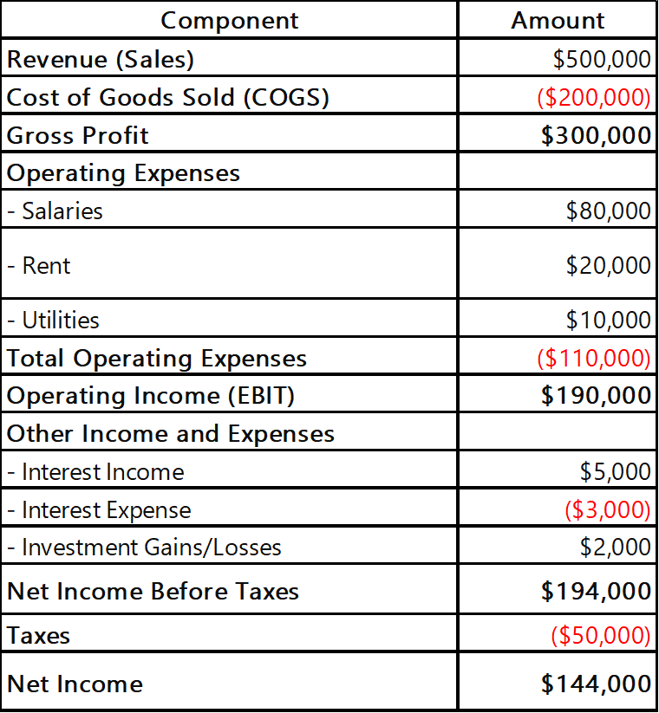
Income & Profit & Loss Statement
Components of an Income & Profit & Loss
1. Revenue - Total income from sales of goods or services
2. Cost of Goods Sold (COGS) - Direct costs attributable to the production of goods sold by a company
3. Gross Profit - Revenue minus COGS
4. Operating Expenses - Expenses required for the day-to-day functioning of the business (e.g., salaries, rent)
5. Operating Income - Gross Profit minus Operating Expenses
6. Other Income and Expenses - Includes non-operating items such as interest, taxes, and one-time gains or losses
7. Net Income - The final profit after all expenses, taxes, and other incomes have been deducted from total revenue
Notes:
Key Points:
Importance of Income Statement and Profit & Loss Statement
Provides a summary of the company’s financial performance over a specific period.
Helps in assessing the profitability of the business.
Essential for making informed business decisions.
Takeaways:
The income statement is a crucial financial document that helps stakeholders understand the company’s financial health.
Regular analysis of the income statement aids in strategic planning and performance improvement.

Slide 10
Balance Sheet
Components of a Balance Sheet:
1. Assets
  Current Assets
  Cash, accounts receivable, inventory
  Non-Current Assets
  Property, plant, equipment, intangible assets
2. Liabilities
  Current Liabilities
  Accounts payable, short-term loans, accrued expenses
  Non-Current Liabilities
  Long-term debt, deferred tax liabilities
3. Equity
  Owner's Equity
  Capital contributed by owners, retained earnings
  Shareholder's Equity
  Equity for publicly traded companies, includes stock and additional paid-in capital
Notes:
Key Points:
Importance of Balance Sheet:
Provides a snapshot of the company’s financial position at a specific point in time.
Helps in assessing the company’s liquidity, solvency, and overall financial health.
Takeaways:
The balance sheet is a vital financial statement that reflects the company’s assets, liabilities, and equity.
Regular review of the balance sheet assists in strategic planning and maintaining financial stability.

Slide 11
Cash Flow Statement
Components of a Cash Flow Statement:
1. Operating Activities - Cash generated from core business operations
  Examples: cash receipts from sales, cash payments to suppliers & employees
2. Investing Activities - Cash used for investing in the business
  Examples: purchase of equipment, sale of investments
3. Financing Activities - Cash flows related to financing the business
  Examples: issuing shares, repaying loans, paying dividends
Notes:
Key Points:
Importance of Cash Flow Statement:
Provides insights into the cash inflows and outflows over a period.
Essential for assessing the liquidity and financial health of the business.
Helps in identifying the cash generated or used by operating, investing, and financing activities.
Takeaways:
The cash flow statement is crucial for understanding the cash position of the company.
It assists in managing cash effectively, ensuring the company can meet its short-term and long-term obligations.

Slide 12
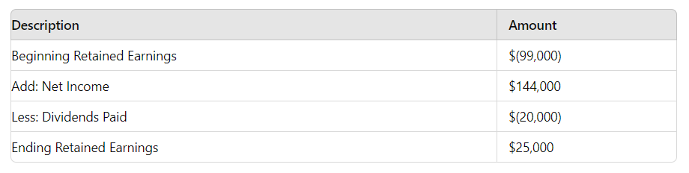
Retained Earnings
Notes:
Retained Earnings Statement
Beginning Retained Earnings:
Given the balance sheet, there is no explicit mention of the beginning retained earnings. However, the retained earnings at the end of the period can be derived using the information available.
Net Income:
From the profit and loss statement, the net income for the period is $144,000\$144,000$144,000.
Dividends Paid:
From the cash flow statement, the dividends paid during the period are $20,000\$20,000$20,000.
Calculation:
Ending Retained Earnings=Beginning Retained Earnings+Net Income−Dividends Paid\text{Ending Retained Earnings} = \text{Beginning Retained Earnings} + \text{Net Income} - \text{Dividends Paid}Ending Retained Earnings=Beginning Retained Earnings+Net Income−Dividends Paid
Given that the ending retained earnings from the balance sheet is $25,000\$25,000$25,000, we can calculate the beginning retained earnings:
Beginning Retained Earnings+$144,000−$20,000=$25,000\text{Beginning Retained Earnings} + \$144,000 - \$20,000 = \$25,000Beginning Retained Earnings+$144,000−$20,000=$25,000
Beginning Retained Earnings=$25,000−$144,000+$20,000\text{Beginning Retained Earnings} = \$25,000 - \$144,000 + \$20,000Beginning Retained Earnings=$25,000−$144,000+$20,000
Beginning Retained Earnings=$25,000−$124,000\text{Beginning Retained Earnings} = \$25,000 - \$124,000Beginning Retained Earnings=$25,000−$124,000
Beginning Retained Earnings=−$99,000\text{Beginning Retained Earnings} = -\$99,000Beginning Retained Earnings=−$99,000
Retained Earnings Statement:
DescriptionAmountBeginning Retained Earnings$(99,000)Add: Net Income$144,000Less: Dividends Paid$(20,000)Ending Retained Earnings$25,000Summary:
The beginning retained earnings were −$99,000-\$99,000−$99,000.
The net income for the period was $144,000\$144,000$144,000.
Dividends paid during the period were $20,000\$20,000$20,000.
The ending retained earnings, as per the balance sheet, are $25,000\$25,000$25,000.
This retained earnings statement shows the changes in the retained earnings over the period, starting from a deficit, adding the net income, and subtracting the dividends paid to arrive at the ending retained earnings.

Slide 13
W-2 Payroll vs. 1099 Contractors
Notes:
Key Points:
When to Use W-2 Employees:
Long-term roles.
Roles requiring significant oversight and control.
When to Use 1099 Contractors:
Short-term projects.
Specialized skills not needed on a permanent basis.
Conclusion:
Understanding the differences between W-2 payroll employees and 1099 contractors is essential for compliance and strategic workforce planning.
Proper classification ensures adherence to labor laws and avoids potential legal issues.

Slide 14
Asset and Inventory Management
Components of Inventory Management:
1. Inventory Control Systems - Software and tools for managing inventory levels
2. Stock Levels - Maintaining optimal stock to meet demand
3. Ordering Systems - Processes for replenishing inventory
4. Warehousing - Storing inventory
efficiently and securely
5. Inventory Turnover - Measuring how
often inventory is sold and replaced
Notes:
Key Points:
Importance of Asset Management:
Ensures optimal utilization and maintenance of company assets
Reduces costs and improves efficiency
Importance of Inventory Management:
Balances supply and demand
Minimizes holding costs and stockouts
Best Practices:
For Asset Management:
Regular audits
Implementing asset management software.
For Inventory Management:
Just-in-time inventory
Regular stock reviews
Conclusion:
Effective asset and inventory management are crucial for operational efficiency and financial health.
Proper management ensures resources are utilized optimally and costs are controlled.

Slide 15
Notes:
Here are some top software options for accounting, bookkeeping, asset management & inventory management.

