Slide 1
Alaska Adventures 2016
Holy Cross Travel Club

Slide 7
The Knock Off Denali Princess Hotel

Slide 11
Alaskan Sheep don’t even say “Bahh”…

Slide 14
What did Delaware?
Idaho, ALASKA!!!
HAAAAAAAAAAAAA!!!!

Slide 16
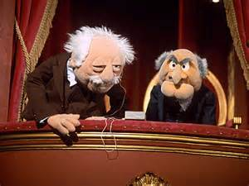

Slide 17
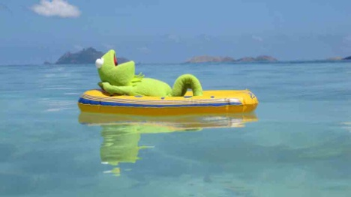

Slide 20
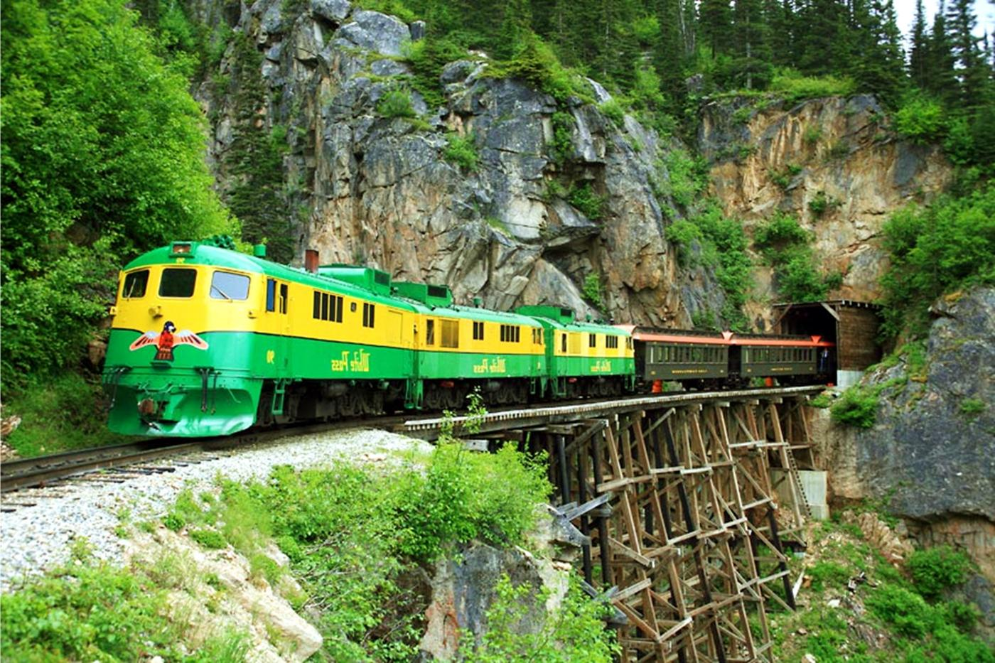

Slide 21
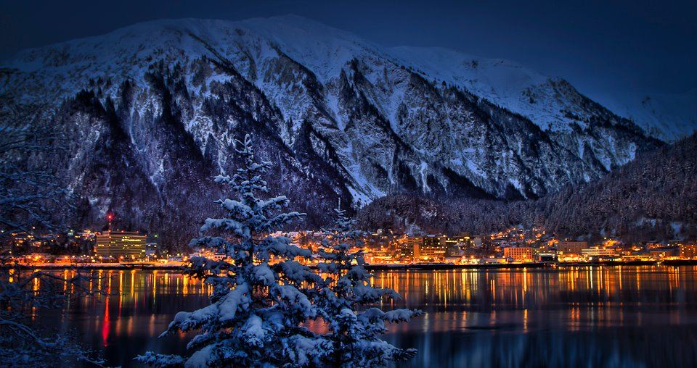

Slide 23
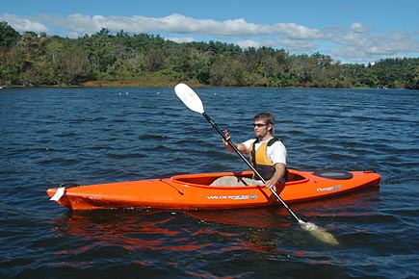
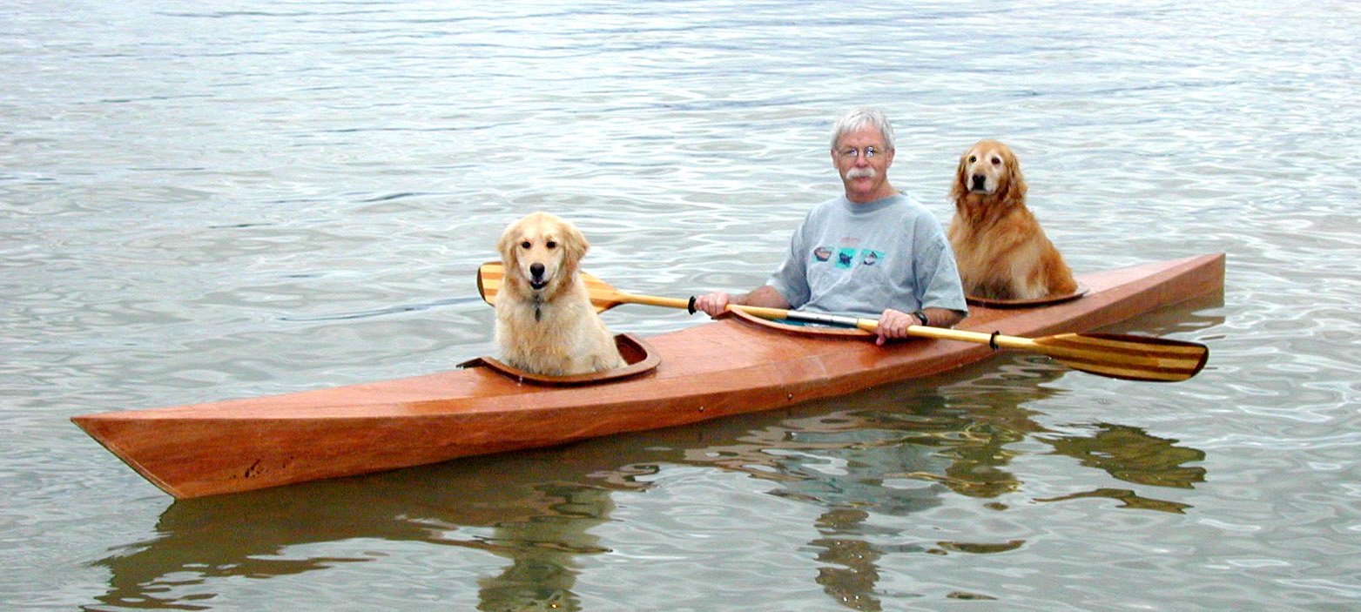

Slide 26
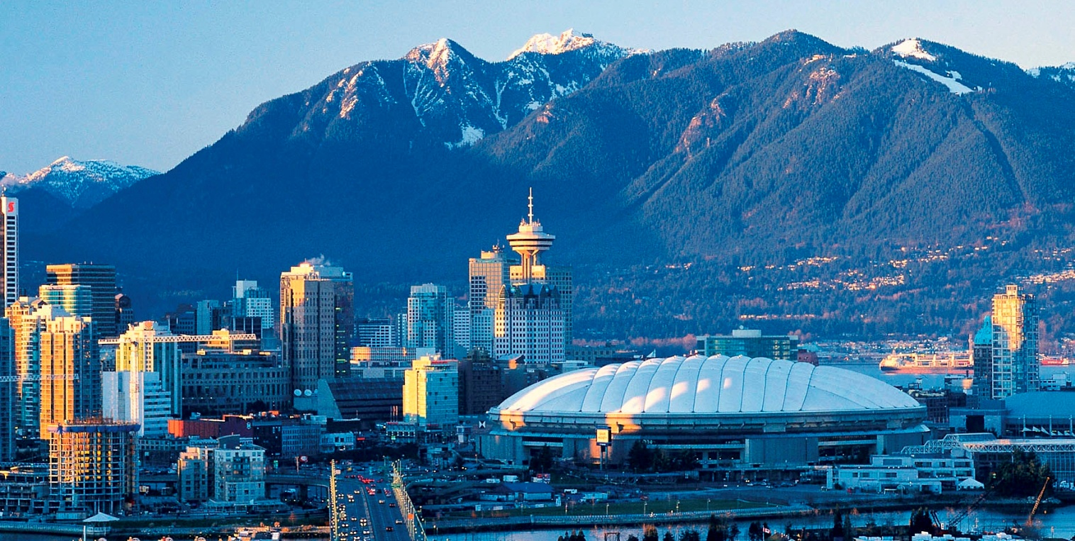

Slide 28
