Slide 1
Gull lake sewer + water authority
Asset Management + sustainability presentation
March 2018

Slide 2
Gull Lake sewer + Water Authority
Historical recap
Created in 1980 by the Townships of Ross, Richland, Barry and Prairieville, the Authority collects wastewater from over 2400 customers in northeastern Kalamazoo County and into Barry County, Michigan, using a network of over 50 miles of collector sewers, 36 pumping stations / forcemains and associated trunk sewers.
Wastewater is pumped to the City of Kalamazoo for treatment and final disposal.
The Authority provides complete system management, maintenance, repair and upgrades. The current service district consists of the Townships of Ross, Richland, Cooper, Village of Richland, and a portion of Charleston Township, plus the southerly portion of Barry and Prairieville Townships in Barry County.

Slide 3
Gull Lake sewer + Water Authority
Historical recap – cont’d
Relatively speaking, a “Simple Sewer System” -- Relatively new: post 1982: Gravity Although currently the authority does not own a water system, it is qualified and prepared to initiate, operate and administer a water system throughout any of its service districts or neighboring areas.
Initial System $9,550,000 of which 50% was grant funded – 1982 construction
Over 30 years, additional $13,000,000 of additional infrastructure constructed
Initially 24 pump stations with 1,000 connections , now 36 pump stations with 2400 connections

Slide 4
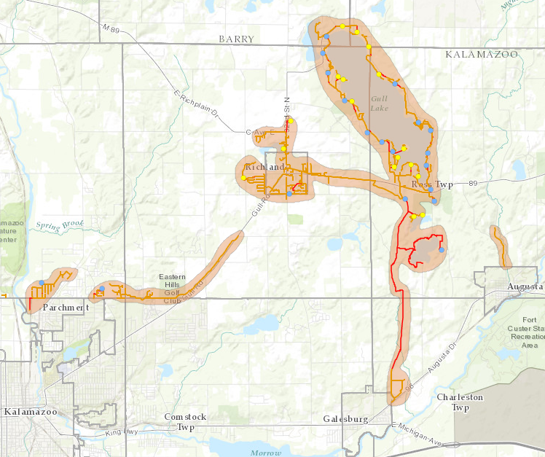
GLSWA – sewer Service district 2018

Slide 5
Gull lake Sewer + Water Authority
Mission Statement - 4 part
Part 1:
GLSWA is committed to preserving the environment, protecting the public health and safety while sustaining our wastewater utility system and its assets through the process of Asset Management and Community minded Level of Service goals.

Slide 6
Part 2:
We will collectively and proactively determine the importance / criticality of each functionally and financially significant (FFSA) asset, decide when to repair, replace or rehabilitate these FFSA assets and ultimately, evolve these improvements into a continuous Capital Improvement Plan (CIP)

Slide 7
Part 3:
– a CIP that is adequately funded through rates set by the Muncipalities and Authority Board --allowing the Authority to achieve sustainability and to maintain a continual Level of Service (LOS) that protects the groundwater, public and adjacent communities from potential negative impacts of the wastewater collection system, while effectively managing the long-term cost of operating those assets.

Slide 8
Part 4:
We will strive to maintain the highest-quality customer service at agreed to levels of service at the lowest life cycle cost possible.
------------------------------------------------
(What this means, in the long-term, is that we may not be the cheapest utility, but we will strive to be the best.)

Slide 9
Gull Lake Sewer and Water Authority
Commitment to Excellence
We are in business for our customers’
convenience and security, not our own.
We strive to tailor our services to our customers’
needs and continuously improve what we do.
We follow the golden rule and treat our
customers as we would like to be treated.
We aim for 100% satisfaction. If there is
anything you’re not satisfied with, we will do
everything in our power to make it right.

Slide 10
Glswa – asset management
2014-2017: MDEQ Asset Management Grant
reviewed each functionally and fiscally significant asset
Determined its condition, its likelihood of failure and its criticality
Determined when to repair, rehabilitate or replace it
Over 3000 assets
50-year view
submitted to rate consultant (required)
Goal of setting rates to achieve sustainability

Slide 11
Glswa – rate consultant results
20-year capital improvement plan
2.25% inflationary increases projected, plus
1.25% rehabilitation, replacement + capital sustainability
3.5% annual rate increase recommended

Slide 12
Glswa – rate review + recommendation
Historical
From 2014-current (4 yr): $26.00 per month per home (unit) ($78 per qtr).
From 2013-2014 (1 yr): $24.67 per month per home (unit) ($74 per qtr).
from 2012-2013 (1 yr): $23.33 per month per home (unit) ($70 per qtr).
From 2008-2012 (4 yrs): $21.67 per month per home (unit) ($65 per qtr).
From 2005-2008 (3 yrs): $20.00 per month per home (unit) ($60 per qtr).
From 1985-2005 (20 yrs): $18.33 per month per home (unit) ($55 per qtr).

Slide 13
Glswa – rate review + recommendation authority board recommendation
Establish a 4-year rate increase, then re-evaluate with rate consultant based on continual review of the asset management, rehab, replacement schedule
Increase $1 per month each of the next 4 years (3.6% average rate increase)
$27 per month - $81.00 per qtr per REU for all bills rendered after 3/31/2018.
$28 per month - $84.00 per qtr per REU for all bills rendered after 3/31/2019.
$29 per month - $87.00 per qtr per REU for all bills rendered after 3/31/2020.
$30 per month - $90.00 per qtr per reu for all bills rendered after 3/31/2021.

Slide 14
Gull lake sewer + water authority
Asset Management + sustainability presentation
March 2018
REVIEW OF RATE RESOLUTION
QUESTIONS ??

