Slide 1
Executive Summary
Turbomachinery Engineering is striving to serve the energy industry by cultivating technical knowledge, high-quality equipment suppliers, system integration, finance, expert consulting, and effective leadership.
The leading officers of the company are Dr. Yousef Jarrah, Chairman and CTO & Mr. Wassim Ismail, CEO.
To eliminate carbon footprint the company is forging ahead, pending funding, with the development of electricity producing system with Oxygen gas, obtained by separating air into Oxygen (O2) and Nitrogen (N2), being the fuel; thus significantly altering the energy landscape in favor of clean environment.

Slide 2
New Energy System
Continuously consumes outside air, separates air into O2 and N2 (step 1), burns high temperature-and-pressure O2 fuel (step 2), and produces clean electricity via turbo-generators (step 3). The 3 sequentially performed steps may utilize parallel arrangement of associated components
Can be deployed anywhere onsite or onboard

Slide 3
New Energy System
Harvests air to produce electricity by integrating 3 engineered products:
Air Separation Unit (ASU) to separate air and produce pressurized Oxygen.
Oxygen Processing Unit (OPU) to control Oxygen release rate-and-frequency into the burning chamber such as to achieve precise pressure and temperature.
Turbo-Generator Unit (TGU) to accept high pressure-and-temperature Oxygen which, in turn, cause high-speed rotation, thus converting input energy into electricity. Relatively cooler and low pressure output Oxygen is delivered back into the outside environment.

Slide 4
System Basic Architecture
O2
Oxygen Processing
Unit (OPU)
AIR
ASU
Ignitor
N2
Burning
Chamber
Electricity
Exhaust
O2
Turbo-Generator Unit (TGU)

Slide 5
Large Power System Architecture
AIR
AIR
AIR
ASU1 ASU2 ASU3 …
N2
O2
O2
Parallel Structure
When Need Be
OPU
TGU1 TGU2 TGU3….
Electricity 1, 2, 3, …

Slide 6
System Architecture Attributes
Uniquely integrates 3 continuously communicating products: ASU, OPU & TGU.
Utilizes single or parallel ASU & TGU configurations depending on application.
Proprietary frequency-based (pulsating) OPU for controlling quantity and release frequency of Oxygen, rate of burning, and delivery temperature and pressure.
Proprietary TGU design with parallel structure when need be.
Initial Phase 1 concept verification with existing production ASU and TGU.

Slide 7
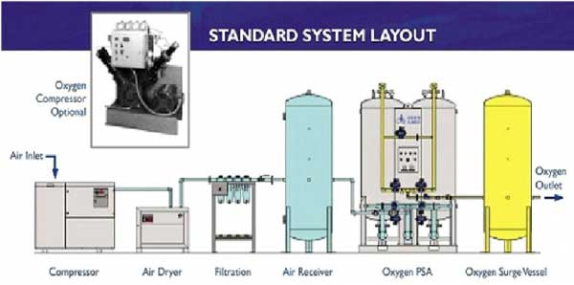
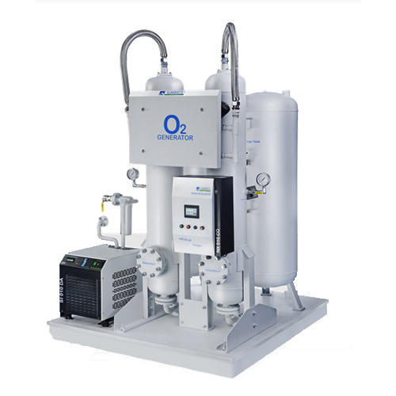
Existing ASU Process/Hardware Sample
PSA (Pressure Swing Adsorption) Oxygen Generator

Slide 8
Commonalities & Differences to Current Architectures
Like our system, nearly all current electricity generation is from power plants which utilize TGU’s to harvest heat and pressure energy.
Unlike our system, all current systems utilize different fuels and, therefore, maximize carbon footprint.
Examples of current systems include Micro-Turbines, Steam Turbines, and Aircraft Engines.

Slide 9
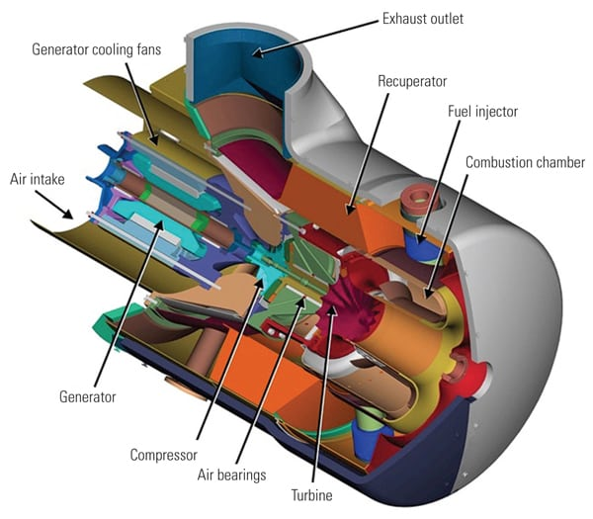
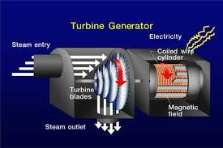
Examples of Existing Hardware
Steam Turbine-Generator
(steam is source of heat and pressure)
Microturbine
(hydrocarbon fuels, not Oxygen)

Slide 10
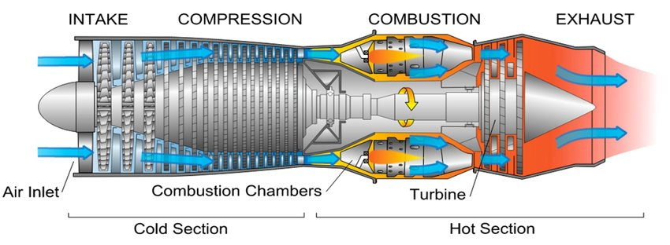
Existing Compress-Burn-Expand Hardware
Aircraft Engine: Sequential compression-combustion-expansion processes (to create thrust in this case, fuel is not Oxygen)

Slide 11
ASU - Sampling

Slide 12
TGU - Sampling

Slide 13
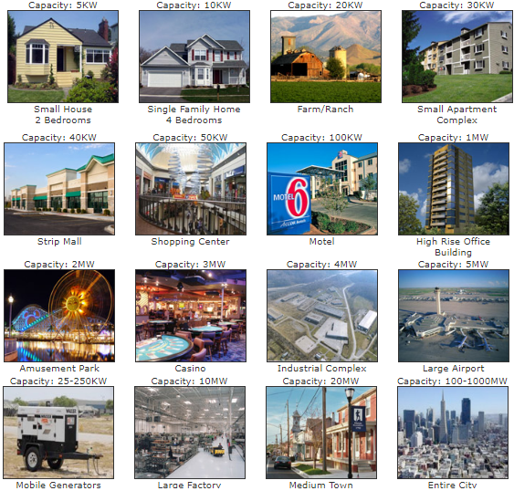
Standard Power Requirements

Slide 14
TME - Project Phases
Phase 1: Proof of Concept
- Accomplished by TME Team
- Expense absorbed by TME Team
- 6 Months Duration
- Outcome: Viable POC ( See attached POC)
Phase 2: R&D including Prototyping
- OPU Development
- ASU & TGU integration to invented OPU
- Patents in USA/Canada/Japan/Germany/Australia/Jordan/Turkey
- Awaiting funding (See attached budget)
- Patent/royalties/etc… partnerships schemes for the right financer
- 1 Year Duration (See attached time-line)
- Outcome: Operational prototype, final designs and schematics
Phase 3: Production
- Manufacturing Agreement with large energy companies including
royalties per unit.

Slide 15
OPU Differentiating Characteristics
Functionally communicating with ASU & TGU in order to electronically control:
Oxygen release, quantity and frequency, via valves. Excess Oxygen, if any, shall be released back into the environment, recirculated, or stored.
Oxygen burning rate to produce flowrate, pressure, and temperature which:
Are compatible with TGU operational parameters and output power.
Are within material, bearings, and structural limits.
Guarantee operational safety.

Slide 16
Manufacturing Processes
ASU: Individual units to be out-sourced, integration in-house.
OPU: Development, procurement, and testing in-house.
TGU: Work with current turbo-generator supplier to procure existing
TGU’s (Phase 1) and to produce new design architectures (Phase 2).
System Integration & Testing: In-house.

Slide 17
Verification, Development & Production Phases
Phase 1: Verification (A) and Development (B):
A1- Utilize market available ASU and TGU.
A2- Change the fuel into Oxygen.
A3- Experiment with OPU to determine optimum operational conditions.
B1- Verify OPU operation for parallel ASU’S and TGU’s.
B2- Establish optimum operational relationships among ASU, OPU & TGU.
Phase 2: Production: New-and-improved designs, system architectures,
and supplier partnerships.

Slide 18
System Novelties
New & Unique:
Carbon footprint eliminator.
Overall architecture and thermal interplay of components.
Design and functional communications of components.
Integration method when parallel ASU and TGU
configurations are required for high-power applications.
Patents to be submitted during phase 1.

Slide 19
Business Novelties
A true carbon footprint eliminator.
Produces low-cost electricity covering wide power spectrum.
Applicable to stationary and mobile applications.
Replaces existing carbon emission products such as microturbines, diesel engines, and coal power plants.
Applicable to other industries such as large trucks, ship propulsion, and aircraft engines.

Slide 20
Project Cost & Timeline
Phase | Cost (Million) | Timeline (Months)
1 | 10 | 12
2 | 5 | 6
3 | 5 | 6
Total | 20 | 24
From Project initiation date

Slide 21
Turbomachinery Engineering– Contact Details
Headquarter:
To be determine by sponsor
Tel:
Mr. Wassim Ismail +1-714-343-1773 - USA
Dr. Yousef Jarrah: +1-520-360-0446 – USA
Email:
Wassim.ismail@turbomachineryengineering.com
Yousef.jarrah@turbomachineryengineering.com

