Slide 1
Executive Summary
Turbomachinery Engineering is striving to serve the energy transition market by cultivating technical knowledge, high-quality equipment suppliers, system integration, finance, expert consulting, and effective leadership.
To eliminate carbon footprint the company is forging ahead, pending funding, with the development of electricity producing system with Oxygen as process fluid, Oxygen is obtained via Air Separation Unit(s) which separate air into Oxygen (O2) and Nitrogen (N2). O2 is utilized as fuel assisted by small amount of hydrocarbon for continuous burning, while N2 is released into the atmosphere.
When expanded via Microturbine(s), high temperature-and-pressure Oxygen creates significant quantity of power, more than any other element.

Slide 2

New Energy System
ASU’s consumes outside air, separates air into O2 and N2, While Microturbine(s) burns high temperature-and-pressure O2 fuel assisted by igniting hydrocarbon to produce electricity.
Can be deployed anywhere, onsite or onboard ships etc.

Slide 3
System Basic Architecture
AIR
ASU(s)
N2
O2
Ignitor
(little Hydrocarbon)
Burning
Chamber
Exhaust
Cold O2
Microturbine (s)
Electricity

Slide 4
New Energy System
Harvests air to produce electricity by integrating 2 engineered products:
Air Separation Unit (ASU) to separate air and produce Oxygen.
Microturbine (MT) to accept high pressure-and-temperature Oxygen which, in turn, cause high-speed rotation, thus converting input energy into electricity.
Relative to other elements, O2 creates huge amount of power when expanded.
Series or parallel arrangements, of ASU’s and/or Microturbines (MT’s), are possible depending on power requirements.

Slide 5
Large Power System Architecture
Parallel Structure
When Need Be
AIR
AIR
AIR
ASU1 ASU2 ASU3 …
N2
O2
O2
MT1 MT2 MT3….
Cold O2
Electricity 1, 2, 3, …

Slide 6
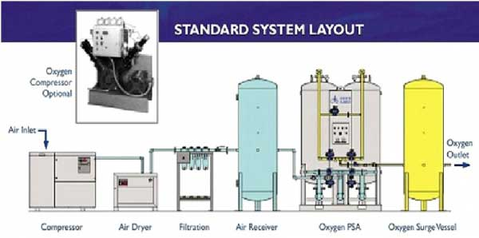
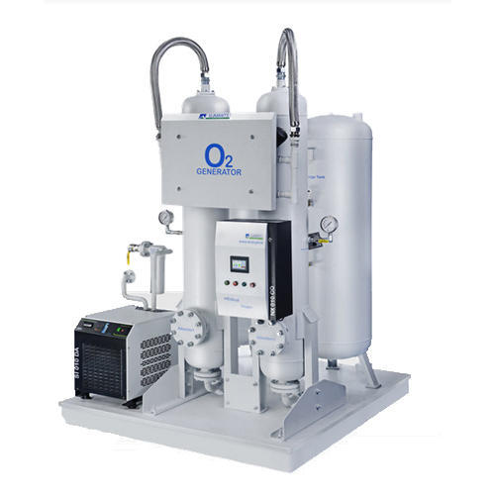
Existing ASU Process & Hardware
PSA (Pressure Swing Adsorption) Oxygen Generator

Slide 7
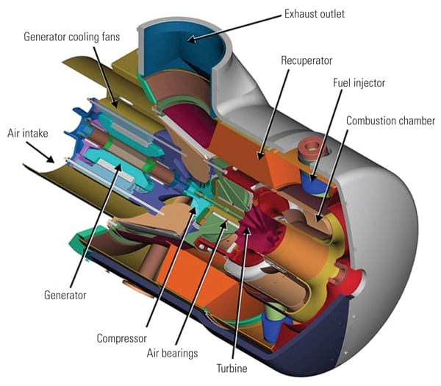
Example of Existing Microturbine
Oxygen will be the process fluid

Slide 8
System Novelties
New & Unique:
Carbon footprint eliminator.
Overall architecture and thermal interplay of components.
Design and functional communications of components.
Integration method when parallel ASU’s and MT’s
configurations are required for high-power applications.
Patents to be submitted during phase 1 (development, 2 year duration).
Production phase 2 (1 year after phase 1).

Slide 9
Business Novelties
A true carbon footprint eliminator.
Produces low-cost electricity covering wide power spectrum.
Applicable to stationary and mobile applications.
Replaces existing carbon emission products such as coal power plants.

