Slide 1
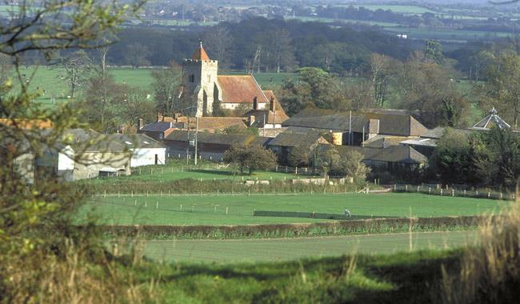
FIRLE PARISH COUNCIL
Annual Parish Meeting 13th May 2025
Chair’s report

Slide 2
Budget
01 April 2024 to 31 March 2025
Income
Precept
£11,500
  The precept is a tax that the Parish Council charge their local electors to meet their budget requirements
Expenditure
£10,620 – excludes spend from reserves which was £2432.

Slide 3
Allocated Reserves 01 April 2023 to 31 March 2024
Firle Parish Council maintains a reserve fund of which £9.7k was allocated to current and future projects and £2432 was spent:
Repairs to assets inc. bus shelters, playing fields
Community Celebrations (i.e. contribution to fireworks)
Parish Council election costs
Potential improvement projects
Reserves are also maintained unallocated to projects but as general reserves .

Slide 4
Grants/S237 Awarded
01 April 2024 to 31 March 2025
Firle Primary School
£276
Firle Village Hall Playing Fields Fencing Contribution £200
Poppy Wreath donation
£50
Christmas Hamper £100

Slide 5
Village Hall Donations
£318 for defibrillator battery and pads
£1200 additional contribution towards the fencing at the playing fields

Slide 6
Key Achievements of Firle Parish Council
2024 to 2025
Assets of Community Value have been nominated to LDC with the following successful: Firle Village Hall; The Ram Inn; Firle Cricket Pitch, Tennis Court and Playground.
Potholes and drain problems have been continuously reported and now many have been fixed by East Sussex Highways including the telescopic bollards at the bottom of Lane Wall.
The Street was swept of leaves which was arranged and co-ordinated by Firle Parish Council.
FPC responded to the Lewes District Local Plan Consultation.
FPC responded to the SDNPA Renewable Energy Consultation
FPC responded to the East Sussex Rights of Way Action Plan
The Bus Shelter was repaired and waterproofed.
FPC participated in the Millennium Woods tidy and funded the hire of a brush cutter.

Slide 7
Reminded ESH that Wick Street should be gritted in icy condition which they have agreed.
Workshops and consultation meetings attended:
  The future of the planning system
  SDNPA Parish Meeting
  Lewes District Local Plan consultation events
The FPC website has moved to a .gov website inline with best practice
FPC co-ordinated the cutting back of overhanging vegetation along The Street and The Dock
Anti-social behaviour of motorcyclists along the Old Coach Road was reported to the Rural Crime Team

Slide 8
Budget
01 April 2025 to
31 March 2026
Income
Precept £12,075
VAT return £180
Interest £100
Total £12,355
Expenditure
£12,132
  Key Areas of Spend
  Clerk and Cllr costs (salary and training)
  Administration costs (insurance, website, audit)
  Rent and hire costs (village hall, playing fields)
  Maintenance (notice boards, litter bins)
  Grants and donations
  Memberships and subscriptions

Slide 9
Projects with Allocated Reserves
01 April 2025 to
31 March 2026
Asset Repairs
Provision for a new bus shelter
Firework provision
Electricity to the park

