Slide 1
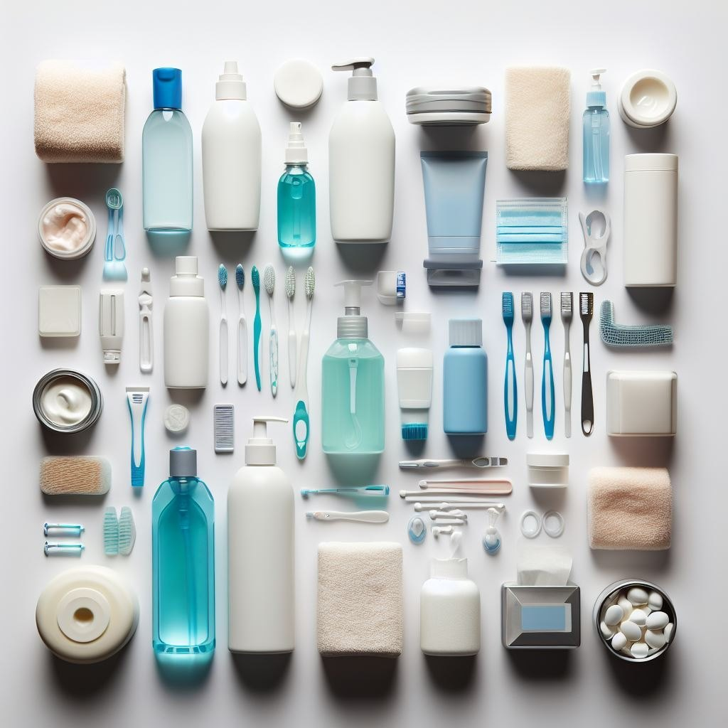
HYGIENE PRODUCTS
Sunday, August 17
Cal Heights United Methodist Church
3759 Orange Avenue | Long Beach, CA
562.595.1996 | office@calheightsumc.org

Slide 2

BACK-TO-SCHOOL
Sunday, August 24
Cal Heights United Methodist Church
3759 Orange Avenue | Long Beach, CA
562.595.1996 | office@calheightsumc.org

Slide 3

CHURCH OFFICES CLOSED
Monday, Sept. 1
Cal Heights United Methodist Church
3759 Orange Avenue | Long Beach, CA
562.595.1996 | office@calheightsumc.org

Slide 4
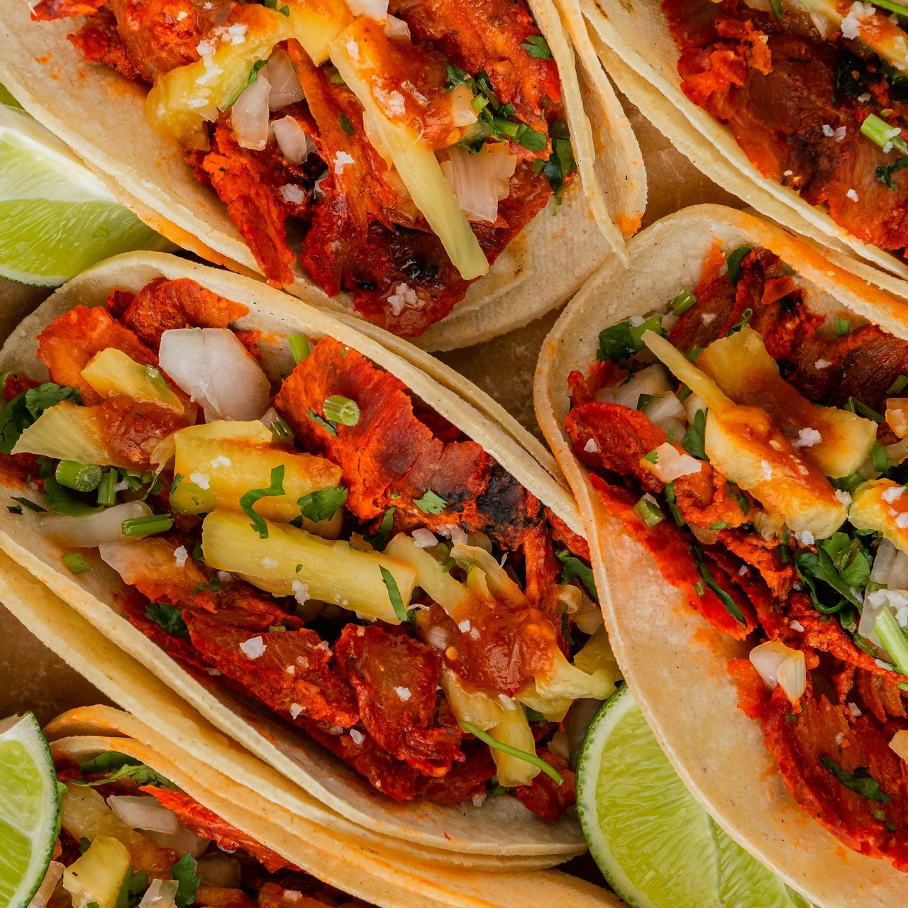
TACO TRUCK TUESDAY
September 9
5:00 – 7:30 PM
Cal Heights United Methodist Church
3759 Orange Avenue | Long Beach, CA
562.595.1996 | office@calheightsumc.org

Slide 5
L: Sing to the Lord a song of strength.
P: Our strength is in the Lord of hosts!

Slide 6
L: Sing to the Lord a song
of joy and love!
P: Our song is a song
of peace and hope! AMEN.

Slide 7

*OPENING HYMN
How Firm a Foundation
UMH #529 (v. 1-3, & 5)
California Heights UMC
ALL ARE WELCOME!

Slide 8
1. How firm a foundation,
ye saints of the Lord,
is laid for your faith
in his excellent word!

Slide 9
What more can he say
than to you he hath said,
to you who for refuge
to Jesus have fled?

Slide 10
2. “Fear not, I am with thee,
O be not dismayed,
for I am thy God
and will still give thee aid;

Slide 11
I’ll strengthen
and help thee,
and cause thee to stand
upheld by my righteous,
omnipotent hand.

Slide 12
3. “When through
the deep waters
I call thee to go,
the rivers of woe
shall not
thee overflow;

Slide 13
for I will be with thee,
thy troubles to bless,
and sanctify to thee
thy deepest distress.

Slide 14
5. “The soul that on Jesus
still leans for repose,
I will not, I will not
desert to its foes;

Slide 15
that soul, though all hell
should endeavor to shake,
I’ll never, no, never,
no, never forsake.”

Slide 16
CHILDREN’S MESSAGE
California Heights UMC
ALL ARE WELCOME!

Slide 17
Jesus loves the little children
All the children of the world
Every color, every race,
all are covered by His grace.
Jesus loves the little children
of the world.

Slide 18
*MORNING PRAYER
(in unison)
California Heights UMC
ALL ARE WELCOME!

Slide 19
L: Please join me as we pray together …
All: Gracious God, we ask for your presence and guidance. In your holy wisdom, tend the vines of our hearts. Teach us your righteousness,

Slide 20
that our lives may flower with justice. Show us the way, through Jesus your Son, to discern your will, hear your word, and grow in your ways, as we deepen the roots of our faith. We ask this in Jesus’ name as we pray now and in our time of silent prayer ...

Slide 21
THE LORD’S PRAYER
California Heights UMC
ALL ARE WELCOME!

Slide 22
Our Father, who art in heaven,
hallowed be Thy name.
Thy kingdom come Thy will be done
on earth as it is in heaven.
Give us this day our daily bread.

Slide 23
And forgive us our trespasses,
as we forgive those
who trespass against us.
And lead us not into temptation
but deliver us from evil;

Slide 24
for Thine is the kingdom,
and the power, and the glory,
forever. Amen.

Slide 25
CENTERING HYMN
Lord, Be Glorified
TFWS # 2150 (1-4)
California Heights UMC
ALL ARE WELCOME!

Slide 26
1. In our lives, Lord,
be glorified,
be glorified.
In our lives, Lord,
be glorified today.

Slide 27
2. In our homes, Lord,
be glorified,
be glorified.
In our homes, Lord,
be glorified today.

Slide 28
3. In your church, Lord,
be glorified,
be glorified.
In your church, Lord,
be glorified today.

Slide 29
4. In your world, Lord,
be glorified,
be glorified.
In your world, Lord,
be glorified today.

Slide 30
SCRIPTURE READING
Luke 12:49-56
New Revised Standard Version
California Heights UMC
ALL ARE WELCOME!

Slide 31
“I came to cast fire upon the earth. How I wish that it was already ablaze! I have a baptism I must experience. How I am distressed until it’s completed! Do you think that I have come to bring peace to the earth? No, I tell you, I have come

Slide 32
instead to bring division. From now on, a household of five will be divided - three against two and two against three. Father will square off against son and son against father; mother against daughter and daughter against mother; and

Slide 33
mother-in-law against daughter-in-law and daughter-in-law against mother-in-law.”
Jesus also said to the crowds, “When you see a cloud forming in the west, you immediately say, ‘It’s going to

Slide 34
rain.’ And indeed it does. And when a south wind blows, you say, ‘A heat wave is coming.’ And it does. Hypocrites! You know how to interpret conditions on earth and in the sky. How is it that you don’t know how to interpret the present time?”

Slide 35
This is the word of God
for us the people of God.
Thanks be to God.

Slide 36
*DOXOLOGY
Praise God, From Whom
All Blessings Flow
UMH # 94
California Heights UMC
ALL ARE WELCOME!

Slide 37
Praise God, from whom
all blessings flow;
Praise God, all creatures
here below:
Alleluia! Alleluia!

Slide 38
Praise God, the source
of all our gifts!
Praise Jesus Christ,
whose power uplifts!

Slide 39
Praise the Spirit,
Holy Spirit!
Alleluia! Alleluia! Alleluia!

Slide 40
*CLOSING HYMN
Love Divine, All Loves Excelling
UMH # 384 (1-4)
California Heights UMC
ALL ARE WELCOME!

Slide 41
1. Love divine,
all loves excelling,
joy of heaven,
to earth come down;

Slide 42
fix in us thy
humble dwelling;
all thy faithful
mercies crown!

Slide 43
Jesus, thou art
all compassion,
pure, unbounded
love thou art;

Slide 44
visit us with
thy salvation;
enter every
trembling heart.

Slide 45
2. Breathe, O breathe
thy loving Spirit
into every
troubled breast!

Slide 46
Let us all
in thee inherit;
let us find that
second rest.

Slide 47
Take away
our bent to sinning;
Alpha and
Omega be;

Slide 48
end of faith,
as its beginning,
set our hearts
at liberty.

Slide 49
3. Come, Almighty
to deliver,
let us all
thy life receive;

Slide 50
suddenly return
and never,
nevermore thy
temples leave.

Slide 51
Thee we would be
always blessing,
serve thee as
thy hosts above,

Slide 52
pray and praise thee
without ceasing,
glory in thy
perfect love.

Slide 53
4. Finish, then,
thy new creation;
pure and spotless
let us be.

Slide 54
Let us see thy
great salvation
perfectly restored
in thee;

Slide 55
changed from glory
into glory,
till in heaven
we take our place,

Slide 56
till we cast our
crowns before thee,
lost in wonder,
love, and praise.

