Slide 1





PLAY AS PRAXIS
UNIONIZING THE COLLEGIATE WRITING CLASSROOM THROUGH COLLABORATIVE GAMES
LET’S START
-
LET’S START
-
LET’S START
-
LET’S START
Notes:
When publications began to publish works about the integration of digital and analog games in collegiate first-year writing classrooms in 2002, popular and familiar video game titles were at the center of research detailing the integration of contemporary popular culture and developing technology in their classrooms, instead of what goals and skills were gamified and transformed through play (Jones 1). Scholars passionately argued that the use of popular role-playing simulators such as Bioshock and World of Warcraft allows students to rethink their approach to writing and collaboration through an extended exercise in the rhetorical situation (Holmes 136; Moberly 284). However, there is rarely any mention of students transferring their experiences to the page to write developed, well-rounded creative non-fiction narratives. Through this approach, students transform themselves into players engaging in the course and its assignments as missions for their hypothetical hero’s journey. This approach to play and gamification works with the creative in mind, but the understanding of writing for different audiences and genres varies with participation and what skills students and professors prioritize. Yet it is the opportunity to immerse oneself in these expansive narratives that makes the medium so compelling for educators working to diversify their classrooms and course materials. As Limarys Caraballo explains, “Educators, researchers, and policymakers historically have had both direct and indirect battles over the goals and objectives of education (Kliebard, 2004), but
the role of curriculum and pedagogy in reproducing dominant epistemic, raced,
classed, abled, and gendered norms in society has often remained uninterrogated” (Caraballo 84). As university-mandated technology, such as learning management systems, cloud storage hubs from Microsoft and Google that are enhanced with artificial intelligence, and test proctoring software, becomes increasingly invasive and mirrors previously hostile physical and digital pedagogical practices rooted in maintaining a strict hierarchy that requires professors to “remove degrees of creative agency from student writers’”, professors leading the contemporary composition classroom are tasked with the challenge of revitalizing a field in flux since the 1700s through innovative and rehabilitative tactics supported by the developing technology housed in their classrooms and their personal living spaces (Applebee 8).
This paper aims to explore how professors embracing an inclusive game-based pedagogy begin to create a First Year Writing course that seamlessly incorporates developing educational computational devices and software as supplemental tools into their coursework and physical classrooms. The implementation of digital games and game elements in a physical non-game setting transforms the act of play and gamification into a liberatory effort focused on developing a democratized environment that encourages students and professors to view each other as collaborators, even conspirators, of change through active engagement with the assignments during the drafting and peer reviewing stages of the student’s writing journey.

Slide 2




ROUND 1
BUILDING A GAME-BASED PEDAGOGY WITH TRANSFORMATIVE TECHNOLOGY
LET’S GO
LET’S GO
LET’S GO
LET’S GO
LET’S GO
LET’S GO
LET’S GO
LET’S GO

Slide 3




GAME-BASED PEDAGOGY
  REFORMULATE ASSIGNMENTS THROUGH GAME THEORY AND PLAY WITH MEDIUM
    DIGITAL (ONLINE)
    ANALOG (PHYSICAL)
  DEVELOP GAMES THAT PUSH LEARNING OBJECTIVES IN CONJUNCTION WITH SOCIOPOLITICAL CONSCIOUSNESS
  PRIORITIZE STUDENT AUTONOMY
    BUT PROCEED WITH CAUTION
Notes:
To successfully form a game-based pedagogy, professors must reformulate their assignments and in-class activities to match the qualifications of gamification and game theory and establish an environment that promotes autonomous discovery and creativity for students concurrently. A game-based pedagogy is a form of critical pedagogy because “these promises are made on the basis of a multitude of paradigms of ‘criticality’ – all of which assume somewhat different relationships between theoretical criticism, the production of critical knowledge, acts of liberation, practices of freedom and experiences of radical transformation in both individual subjectivity and social relationships – and one of which tends to prevail” (Amsler 46). Within video games, and analog games like board games, players are instructed to “interact with [rules] and embody [the game’s model]” to achieve the goal connected to the mission or quest (Shulz Colby 56). For an effective application of gamification, instructors need to change a non-game activity into a game whose mechanics “explore a political or culteral problem in a new way” and utilizes a student’s “gaming literacy—i.e., one’s ability to play video games and his or her proficiency navigating and using video game-related information” (Holmes 136; Arduini 90). Instructors must also consider “the material and social infrastructures necessary for meaningful engagement with digital composing” (Tham 1). Developing a timed group activity with a randomized order of students that asks the participants to answer questions about the themes of a narrative essay in a designated module hosted on the university’s learning management system is an example of a game-based method. Using technology purchased by institutions prevents students from having to pay for extra materials while maintaining a digital learning environment that is monitored by instructors for harmful speech and rhetoric. Just as students embody the role of the autonomous player, the professor remains the guide for moral and academic standards. In “Embracing discord? The rhetorical consequences of gaming platforms as classrooms, Emily Johnson and Anastasia Salter detail their experiences of designing an academic Discord community during the Covid-19 pandemic. They noticed that the more students frequented the platform outside of the classroom, the more inflammatory the messages became. They explain, “[F]or instance, in our use of the platform, a student posted a meme depicting a common symbol of white supremacy. The student’s comment itself was not inappropriate—it was a reply to a reminder the instructor posted—but the text was accompanied by an image of Pepe the Frog holding an umbrella” (Johnson and Salter 2). As displayed in Johnson and Salter’s research, student autonomy is a component of game-based pedagogy that still requires professorial assistance and occasional intervention to maintain the balance of the environment. With this in mind, instructors like myself have been carefully developing and monitoring the impact on their first-year students.

Slide 4
ROUND 2
THE JOYS OF COLLABORATION
LET’S GO
LET’S GO
LET’S GO
LET’S GO
LET’S GO
LET’S GO
LET’S GO
LET’S GO

Slide 5





HOW IT WORKS
HOW
  Treat the classroom like a canvas
    Utilize the resources found (e.g. white boards, projectors, desks)
  If possible, have students move around
  Re-orient the desks
Notes:
Just as the design of games is a fundamental part of the gamified composition classroom, collaborative-forward physical design in conjunction with the aforementioned mandated technology allows all students to feel fully welcomed into the immersive environment the professor has built. Physical gaming infrastructure consists of flexible physical components of the classroom that can be adjusted to match the structure of the class session (Rivard et al. 1). Successful applications of collaborative design initiate embodied immersion among students, which influences their participation in the course. Sarah Dwyer writes:
“Effective gamification is “gameful”: playeroriented and designed to “create platforms and experiences that empower players to have the spirit of the gamer [someone who is optimistic, curious, motivated, and always up for a tough challenge] in real life” (McGonigal, 2011). In gameful design, “organizational goals of the game are achieved by empowering the players to get more of what they really want” (McGonigal, 2011), and what a number of students at our institution wanted were tools to help them navigate their new university” (Dwyer 2).
Dwyer’s study allows students to immerse themselves in a gamified environment that respects who they are while tracking their evolution in the course in the form of “battles and quests” (Dwyer 4). Case studies like these continue to be developed and published, expanding the field of game-based learning.

Slide 6
WHY IT WORKS
  Breaks up the monotony of sedentary lectures
  Encourages students to work together with new people
  Helps with content retention (if you choose to give tests/quizzes in your course)
Notes:
By the second class session during my first year of teaching First Year Writing, I was confronted with incorrect MLA 9 style citations and grammatical errors as I reviewed the timed diagnostic essay they had composed earlier that day. When asked about their experiences in previous English courses, many admitted they had not received formal instruction in MLA or APA, which left them confused and fearful when creating citations for their diagnostic essays. With this in mind, I used the first two weeks of classes in my Core English I courses to facilitate an MLA workshop that included two collaborative games and written exercises. The digital and analog games I developed were made with a single caveat: the winning group will not receive individual physical prizes - food, toys, or recreational objects - or any related to their final grade. Restructuring the activities to be skill-focused team efforts transformed their goal from winning a prize to understanding the material in the unit. However, it was difficult to measure the long-term effects of the activities once I received their final papers because they occurred sporadically at the start of the semester.

Slide 7
ROUND 3
GAME EXAMPLE
LET’S GO
LET’S GO
LET’S GO
LET’S GO
LET’S GO
LET’S GO
LET’S GO
LET’S GO

Slide 8


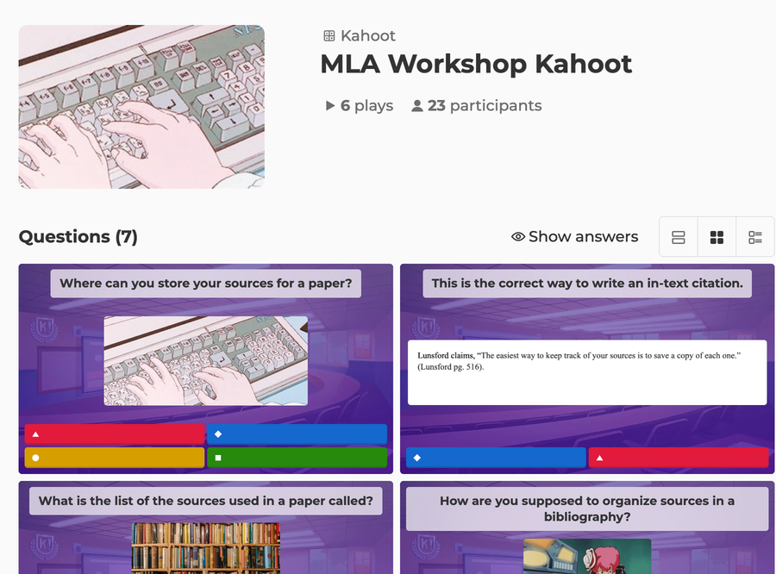
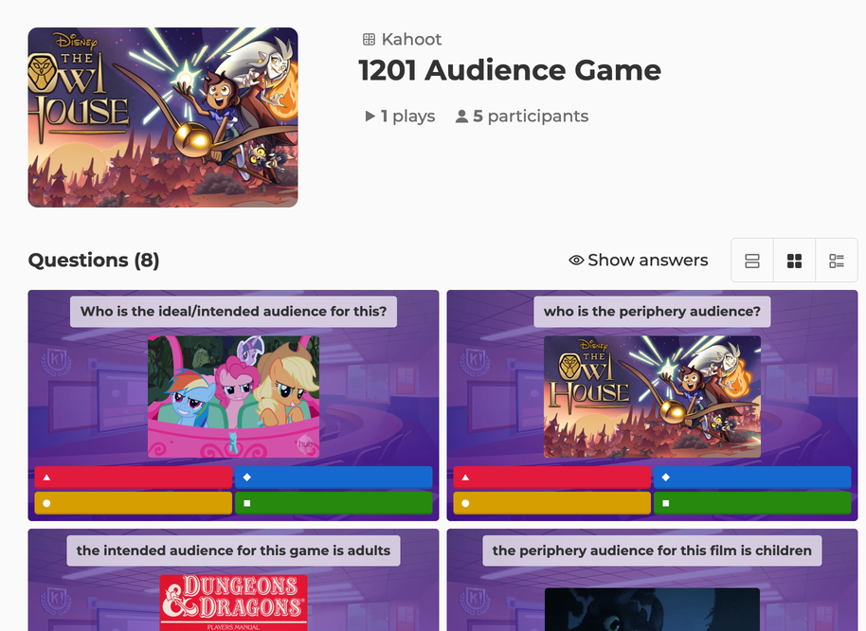


KAHOOT

Slide 9


THANK YOU
Notes:
As mentioned previously, composition studies is a field in flux due to changing administrative and federal policies alongside transformative sociopolitical shifts. As a result, departments and their faculty are pushed to adjust their pedagogical strategies to match these overwhelming phenomena. Even with these adjustments, the overexertion of professors, especially adjunct faculty, creates a hostile and apathetic learning environment for students. The apathy students experience ultimately affects their academic and social performance in the course, causing them to reduce their participation in class activities and submit subpar written assignments. However, these concerns are beginning to change as scholars and instructors are reinvigorating students and their peers by developing a game-based pedagogy that centers autonomous and inclusive collaborative learning. While issues pertaining to skill acquisition and long-term comprehension persist, proactive instructors are rebuilding the field’s foundations on virtual brick at a time.

