Slide 1

The Memoirs of a Chatbot:
Reflecting on AI use across several undergraduate writing classes
Matthew Frye-Castillo
Lecturer of Professional Writing
Lehman College, CUNY

Slide 2
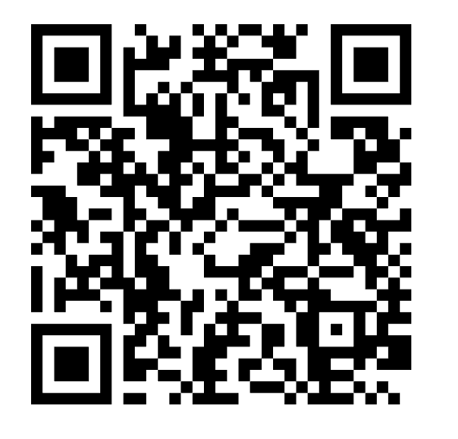
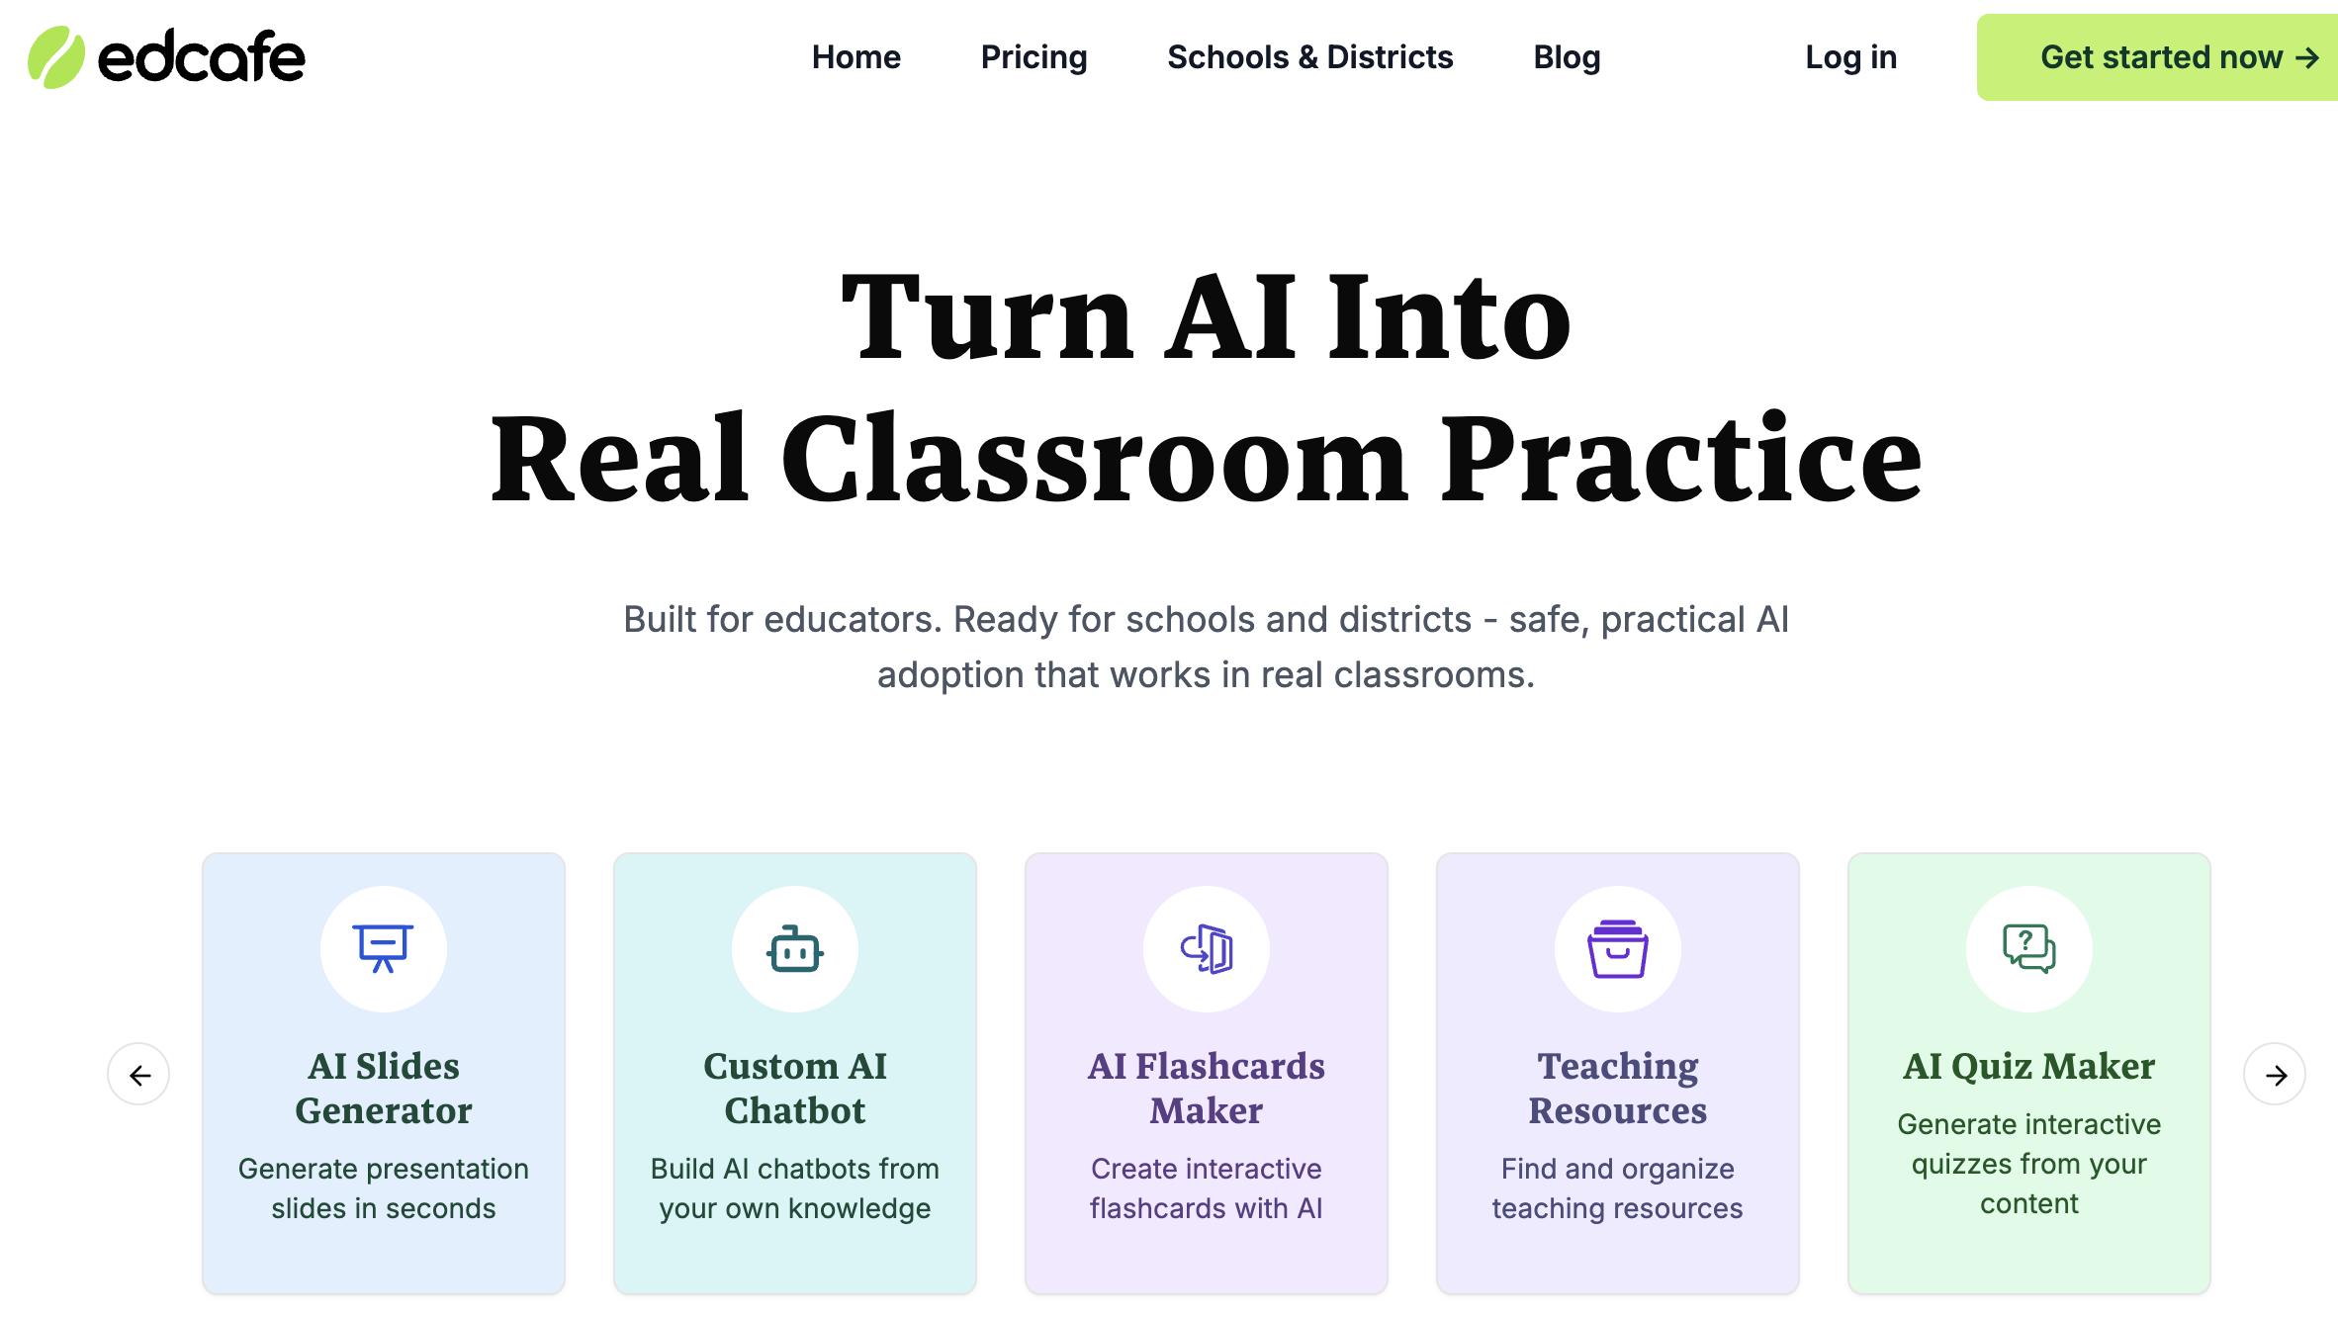
What I’m sharing today
Why chatbots
Experience with Edcafe
Recommendations
Use this QR code to add a comment or question

Slide 3
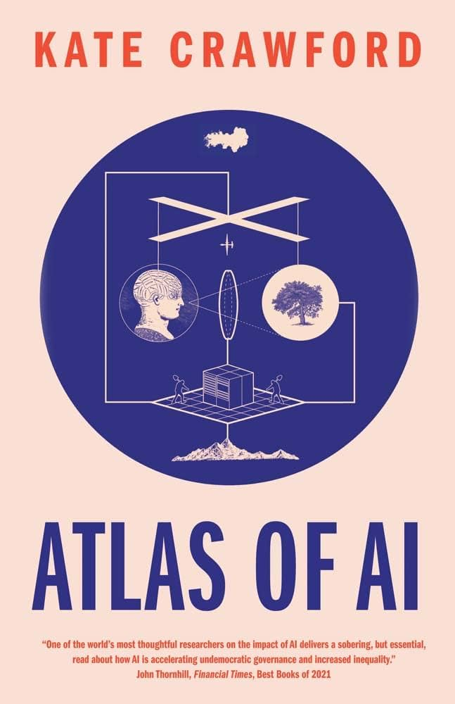
“Artificial intelligence is a registry of power”
— Atlas of AI: Power, Politics, and the Planetary Costs of Artificial Intelligence
Notes:
https://publicpurpose.com.au/artificial-intelligence-a-registry-of-power/
https://katecrawford.net/

Slide 4
Part I
Why chatbots?

Slide 5
Part 1: Why chatbots?
How Can I Best Serve Students?
Lehman College, CUNY
  12K undergraduate; 2k graduate; 60% first gen; 94% BIPOC; 50% family income of >40K; 21% of traditional students (18-21) vs. 60% average
Limits to empathy
  1:1 limitations, as first-gen Latino; generational differences
Becoming Hispanic-Serving Institutions (2019) by Gina Ann Garcia
  Time constraints; mental exhaustion; frequent interruptions; cultural gaps, e.g., meetings
Writing Across the Curriculum (WAC) & Amherst Writers & Artists Method (AWA)
  Ungrading, avoiding red pen, in-class time to write or read; focus on generative material, protecting voice, non-hierarchical arrangements
Executive training and continuing education
  Can a similar model of “work smart, not hard” be applied here to a 75-minute session?
Notes:
https://www.press.jhu.edu/books/title/12027/becoming-hispanic-serving-institutions?srsltid=AfmBOorJy90HmM4MspREfqVavH7AebKfdKYqb3US6Kg5L2qVrpGSa92a
https://www.lehman.edu/academics/education/institute-for-literacy-studies/Programs/Writing-Across-the-Curriculum/
https://amherstwriters.org/what-to-expect/philosophy-practices/
https://www.univstats.com/colleges/cuny-lehman-college/student-population/
https://www.collegefactual.com/colleges/cuny-lehman-college/student-life/diversity/

Slide 6
Part 1: Why chatbots?
What Tools Will Help Me Present & Assess in a 75-Minute session?
In addition to lecturer, discussions, writing activities, guest speakers, videos, what tools can help me present and assess 75-minute classes with no homework?
Kahoot mini lectures; collective quizzes after an in-class reading
AI? If so — I’d need the following:
  Individualized support with writing and reading comprehension
  Multilingual options
  Text-to-speech options
  Help build AI fluency
  Can handle voice memos and/or handwritten notes

Slide 7

Part 1: Why chatbots?
Why Edcafe.ai Stood Out
FERPA compliant, unlike ChatGPT and Claude
Co-founded and designed by researcher and edtech entrepreneur, John Yan, who also founded ClassPoint
Visibility to how students are using AI
Polished, clear interface suitable to college students compared to Magic School
Notes:
https://www.linkedin.com/in/johnyan001/
https://www.crunchbase.com/person/john-yan-2
https://www.classpoint.io/
https://www.magicschool.ai/
https://www.edcafe.ai/

Slide 8
Part 2
Edcafe Experience (so far!)

Slide 9
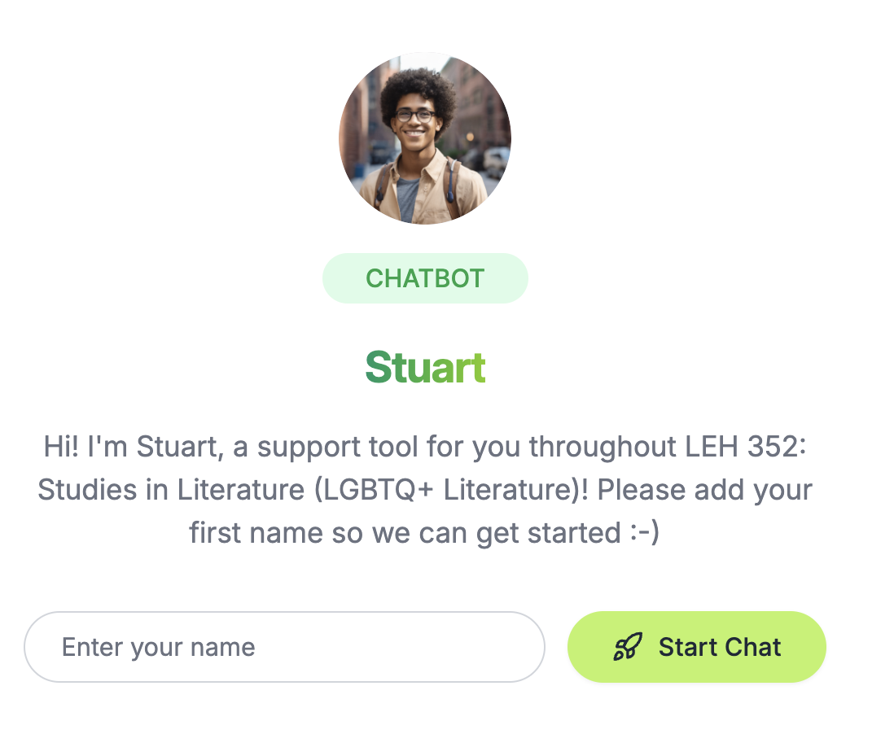
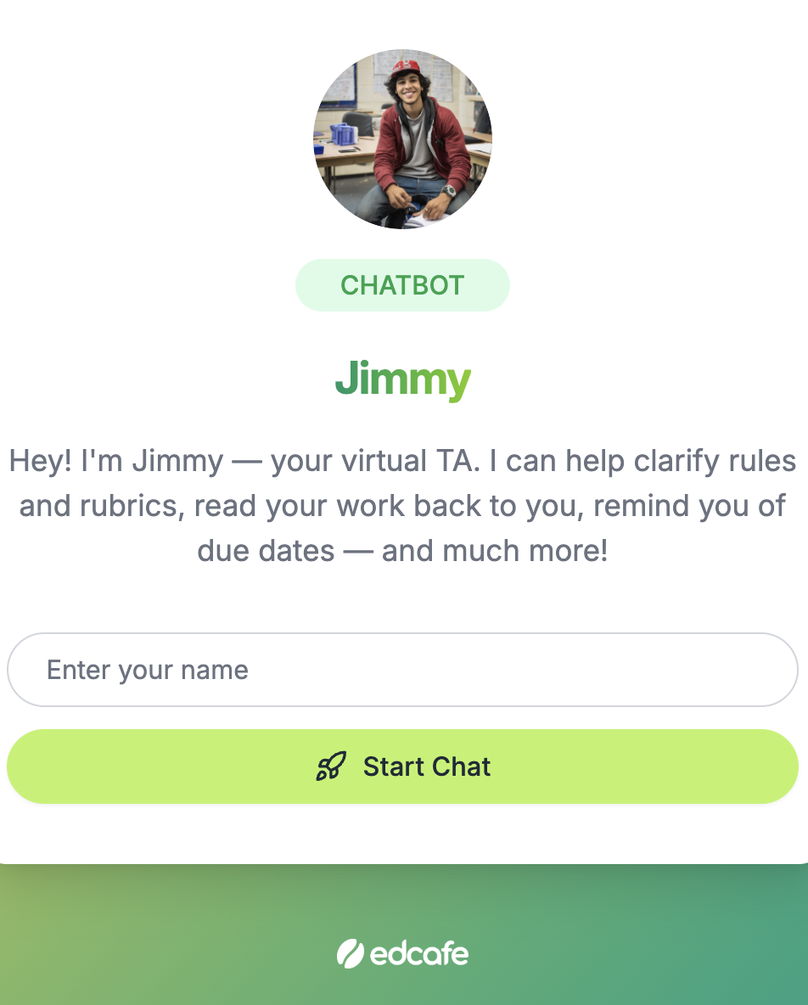
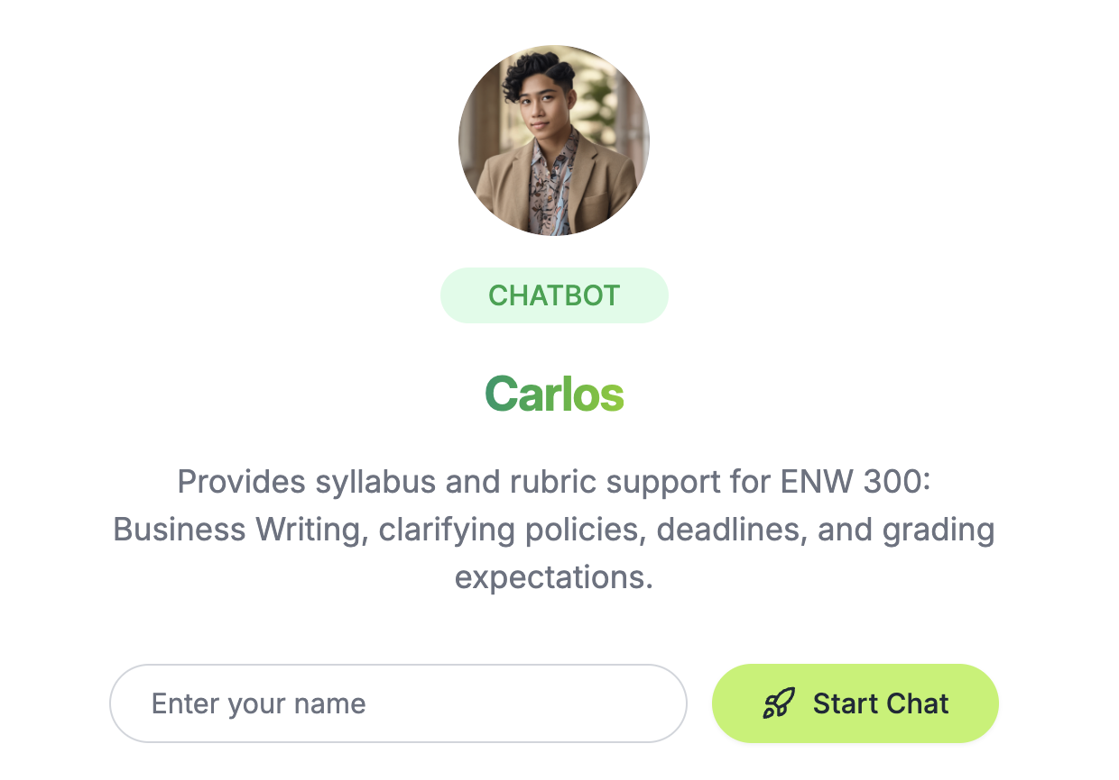
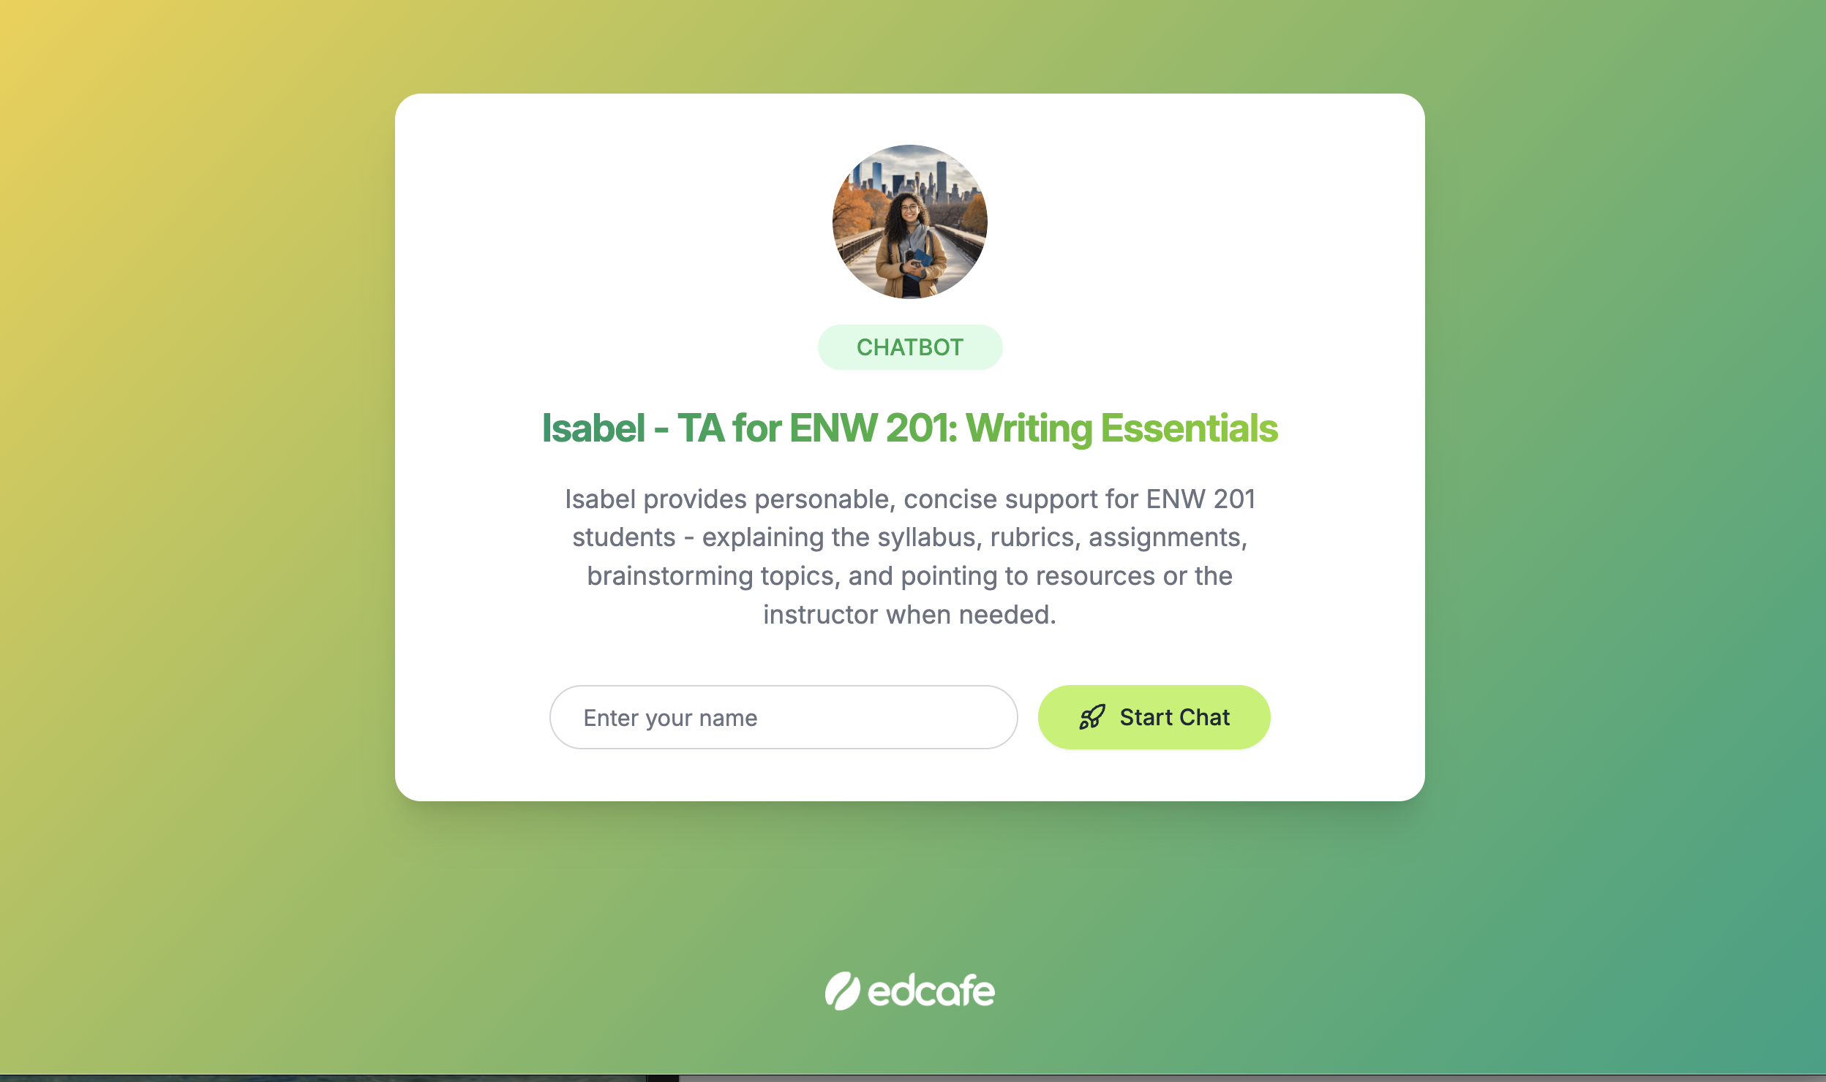
Intended for Syllabus/Rubric/Extra Credit support — Turned into much more
Applied in four classes Spring 2026
Business Writing
Writing Essentials (Intermediate Composition)
Creative Nonfiction
LGBTQ+ Literature (Gen-ed LEH 352)
Part 2: Edcafe Experience

Slide 10
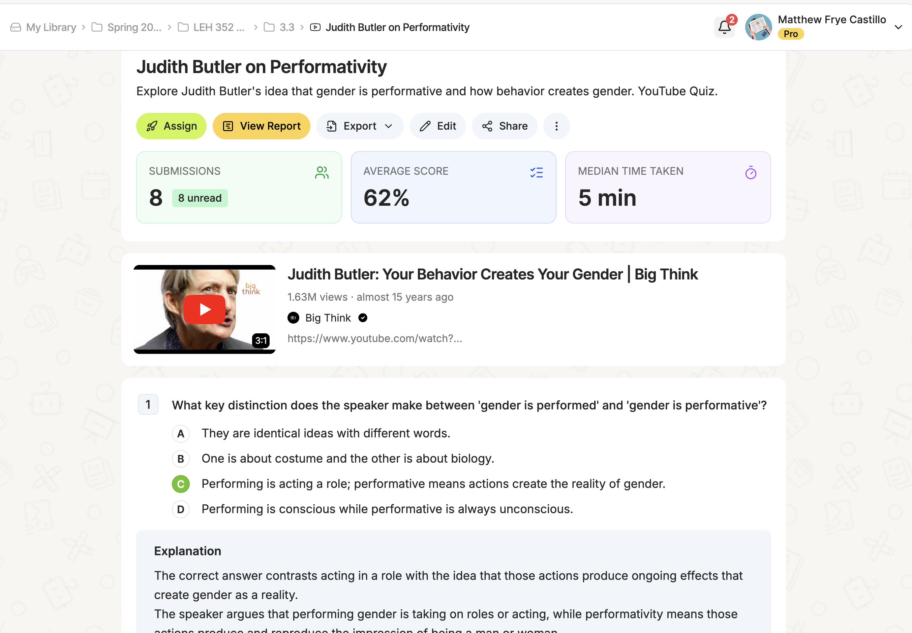
Youtube check-in quizzes
Example from LGBTQ+ Literature
Benefits
Easy quiz creation
Instant feedback to students
Real-time feedback to faculty on adjusting lesson
Part 2: Edcafe Experience

Slide 11
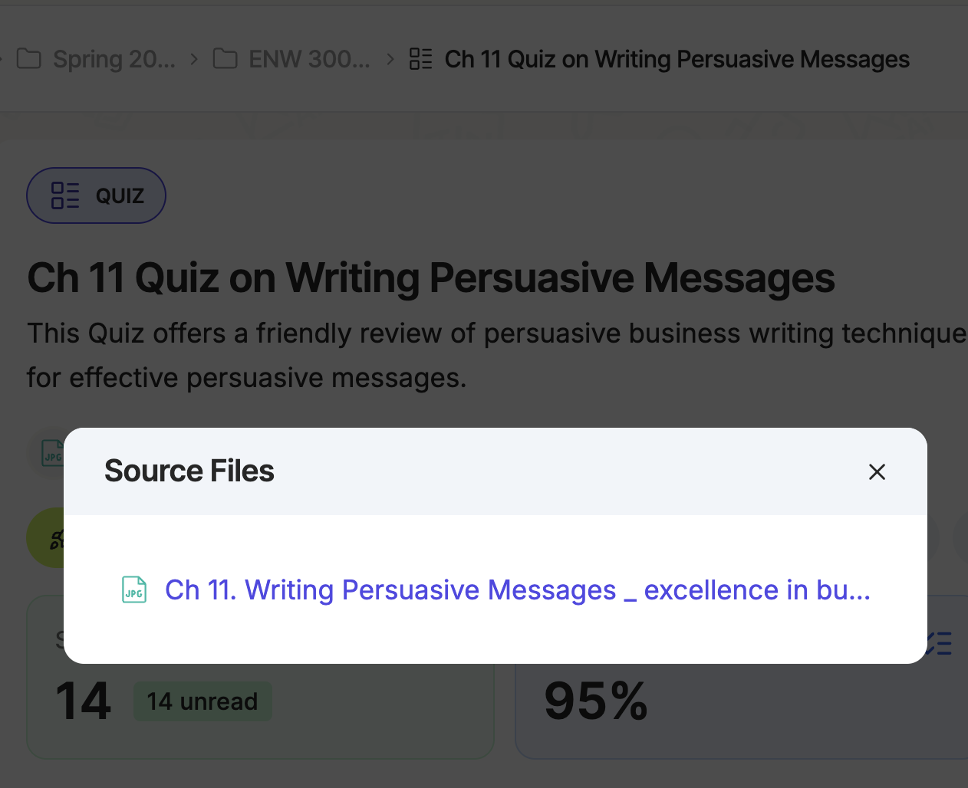
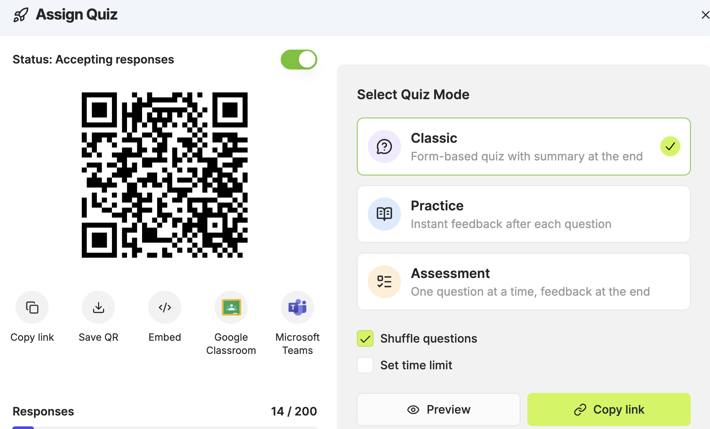
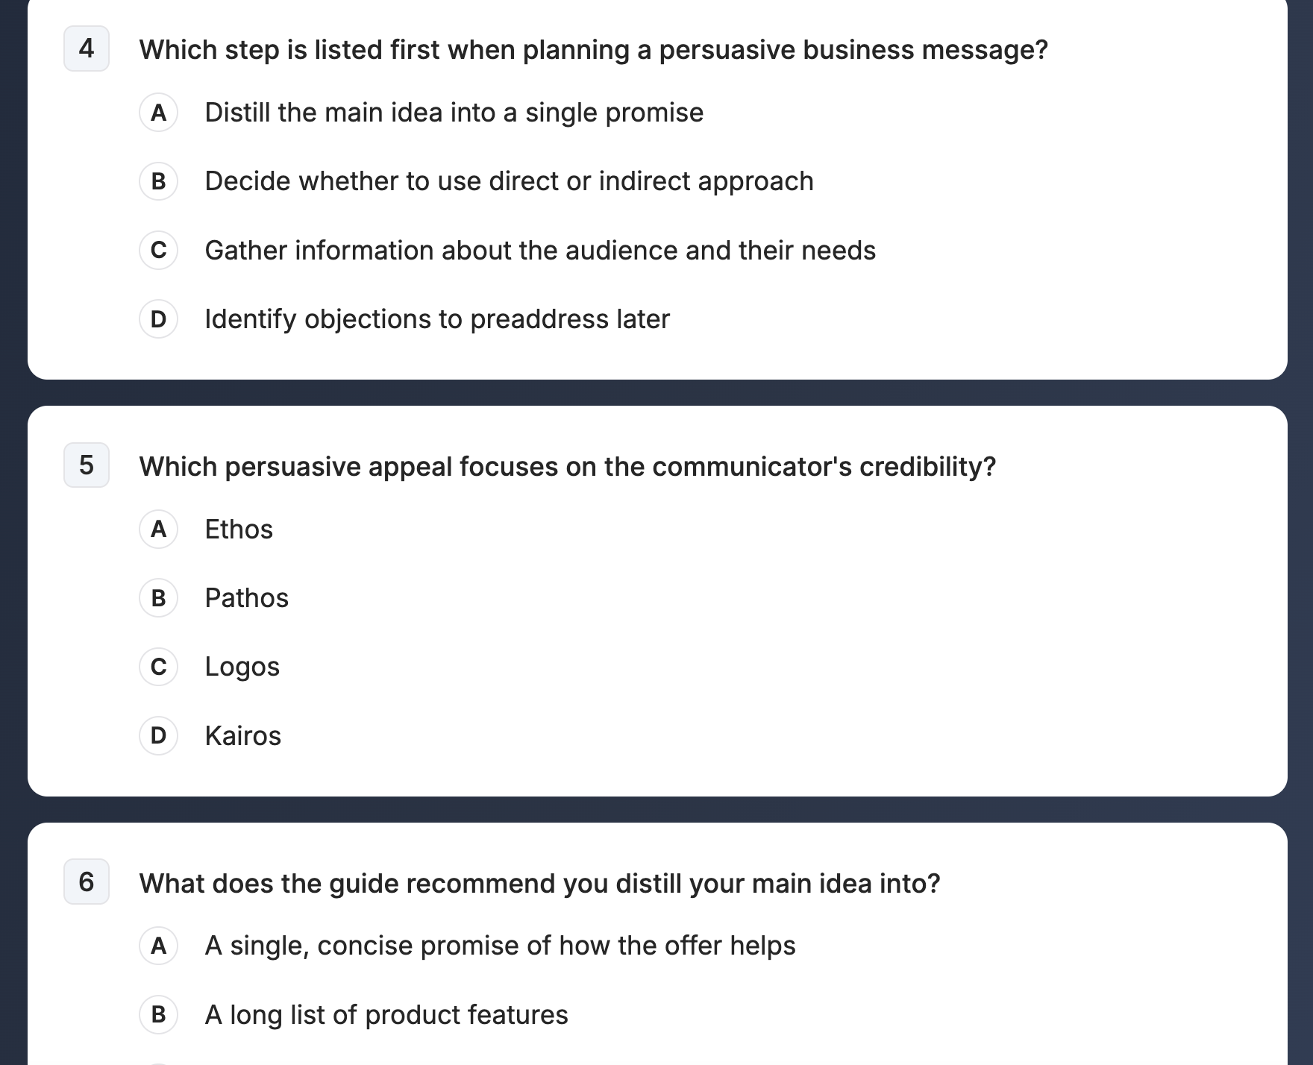
Quiz Generator using jpegs or pdFs
Example from Business Writing
Benefits
Expedites quiz generation
Bypasses log-in issues
Instant feedback to students
Part 2: Edcafe Experience

Slide 12
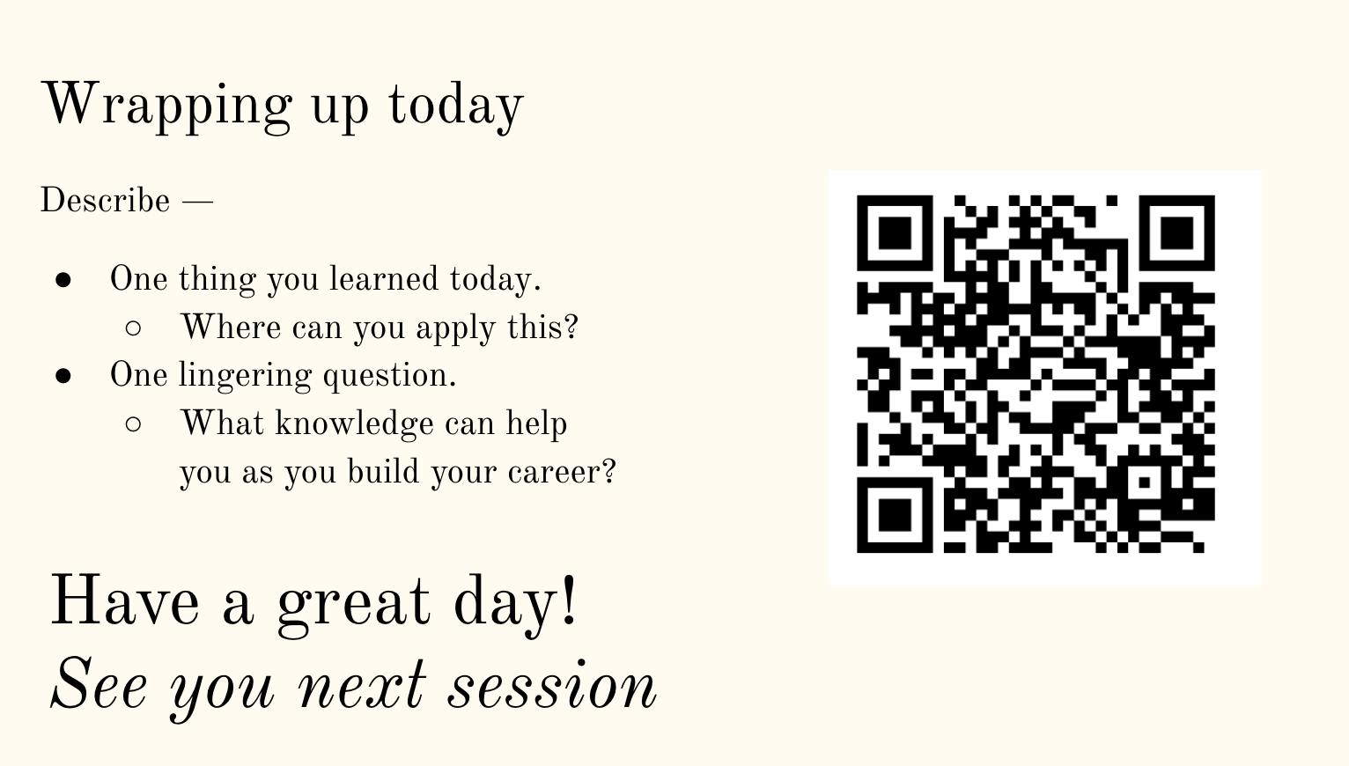
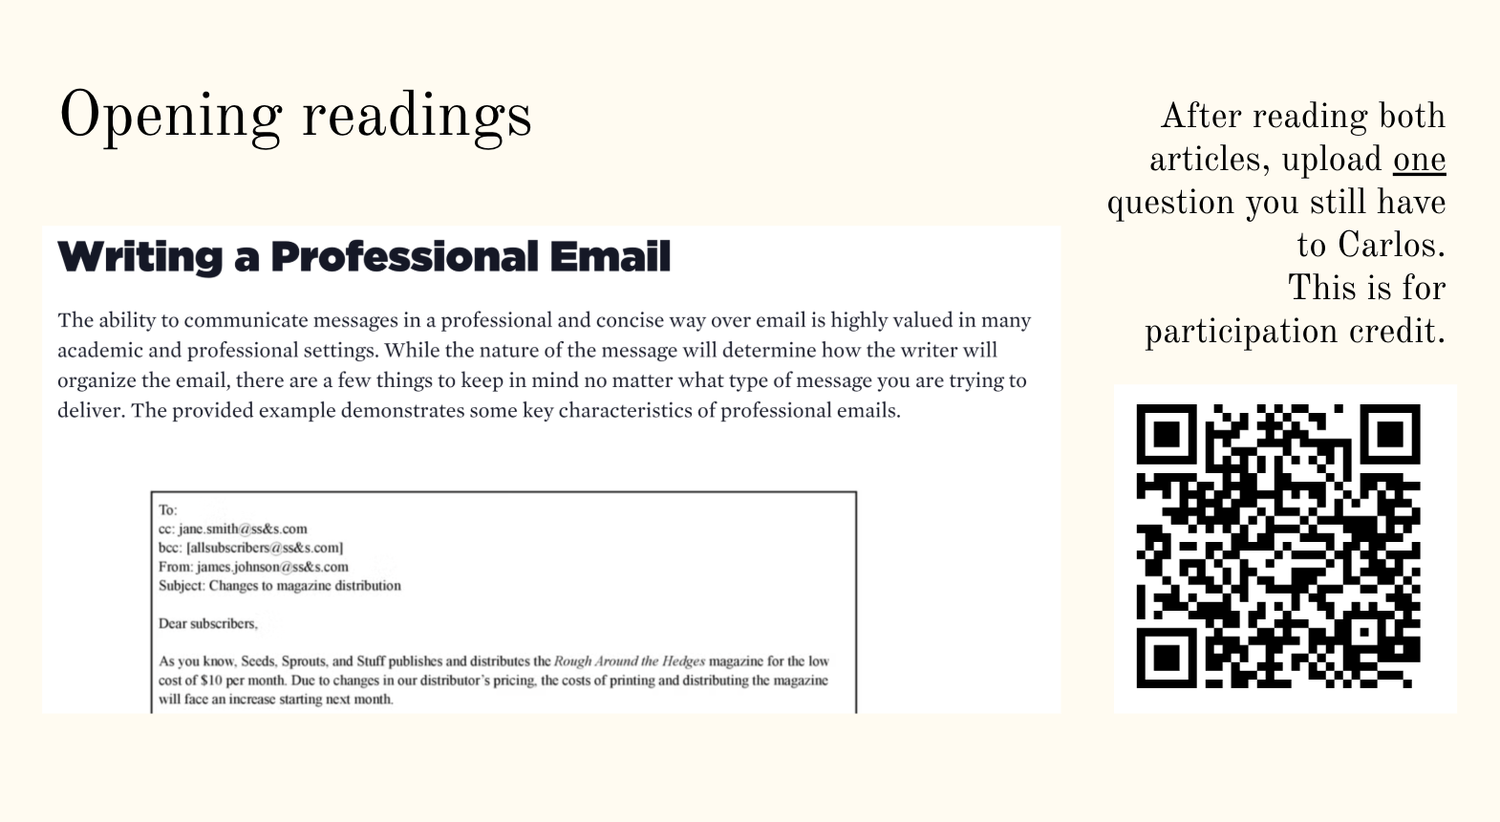
QR codes for participation
Example from Business Writing
Benefits
Instant feedback to students
Accelerate roll call
Easier to manage than paper slips or Brightspace
Part 2: Edcafe Experience

Slide 13
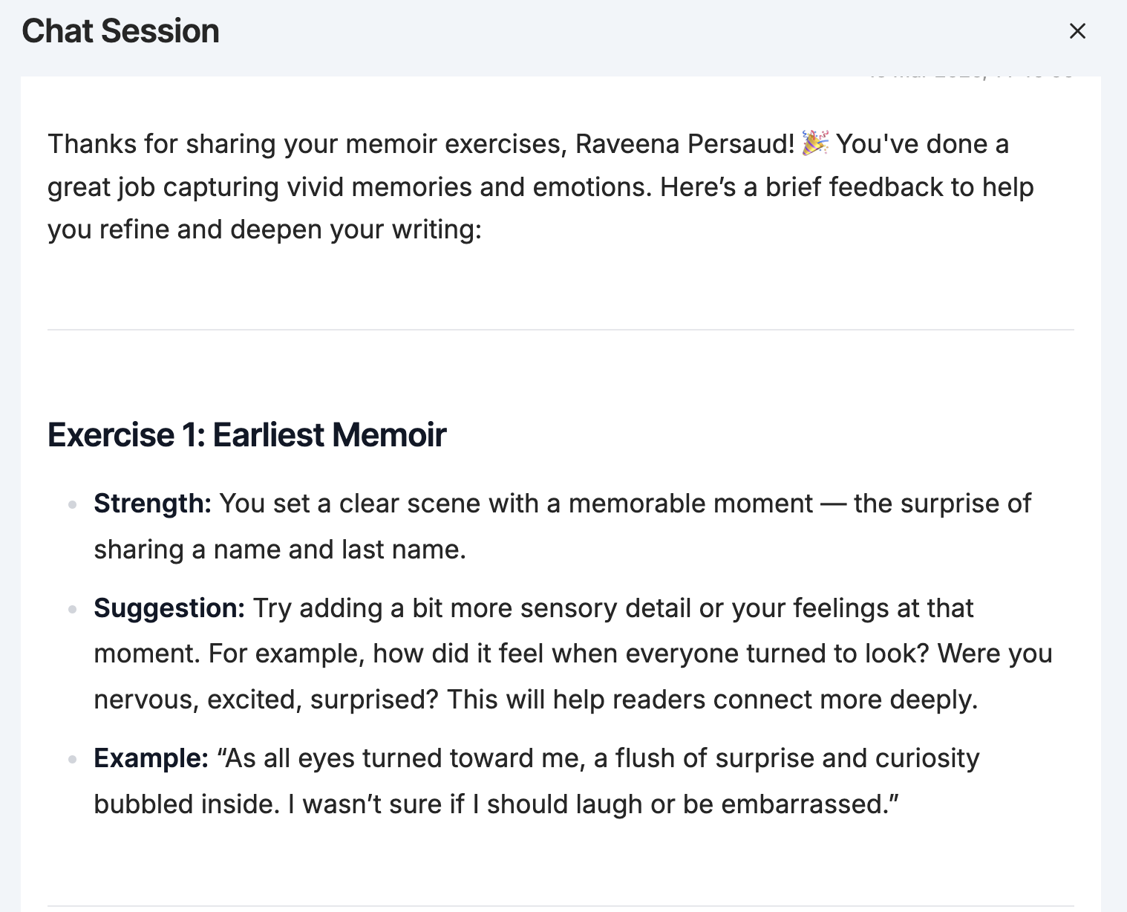
Fast, tailored feedback on low-stakes writing
Reflects what students are doing
Asks questions
Demonstrates other possibilities
Part 2: Edcafe Experience

Slide 14
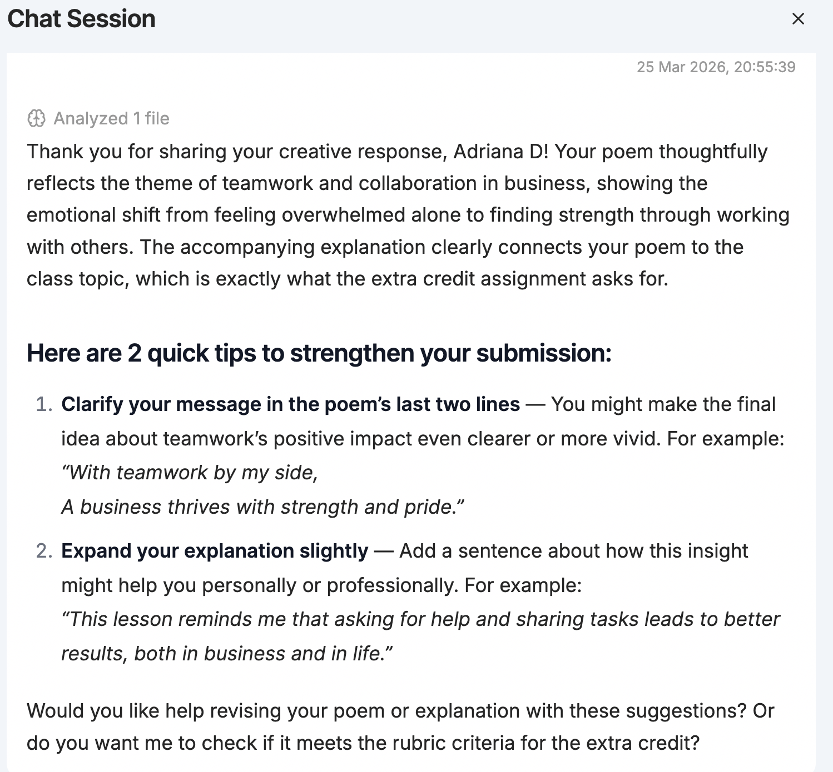
Fast, tailored feedback on low-stakes writing
Reflects what students are doing
Asks questions
Demonstrates other possibilities
Part 2: Edcafe Experience

Slide 15
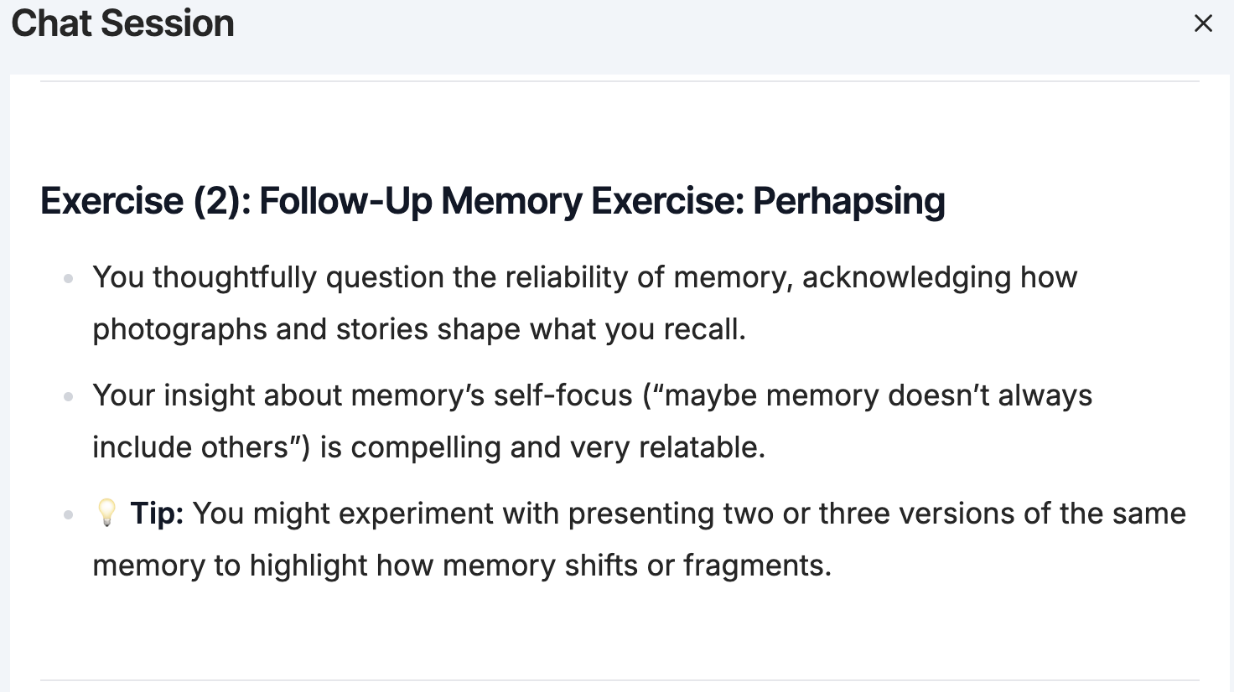
Fast, tailored feedback on low-stakes writing
Reflects what students are doing
Asks questions
Demonstrates other possibilities
Part 2: Edcafe Experience

Slide 16
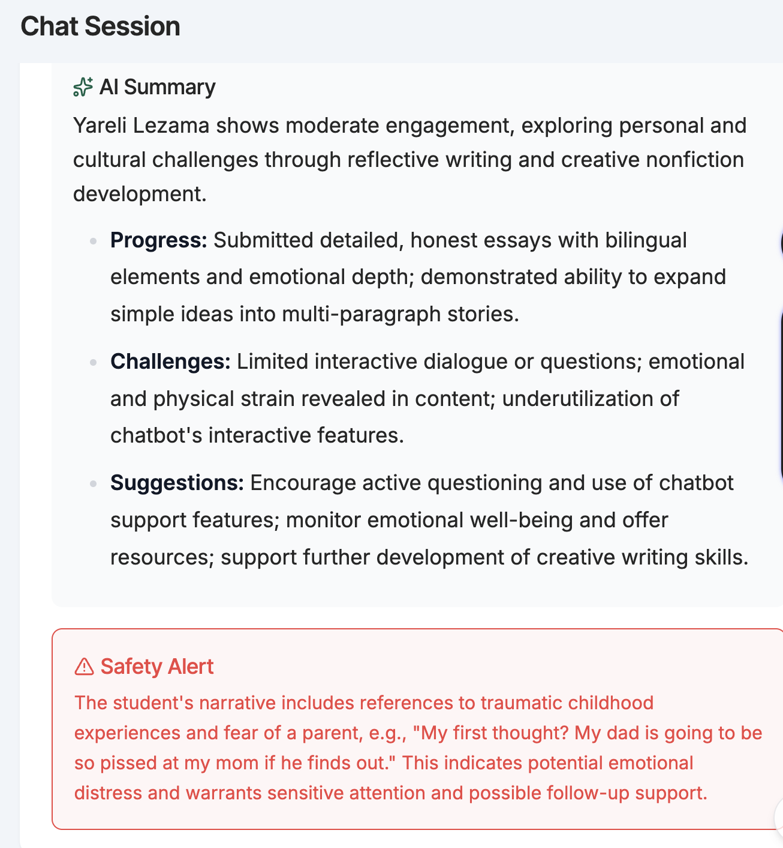
Safety checks
Part 2: Edcafe Experience

Slide 17
Use this QR code to add a comment or question

Slide 18
Part 3
Recommendations

Slide 19
Overall — one of many useful tools
Classroom culture
Edcafe eases classroom management as an attendance and participation tracker, a quiz generator, and a low-stakes writing TA. Faculty have more time and tools to assess learning.
Students are noticeably less stressed and present during class time. As their AI fluency increases, they are further positioned to succeed in their lives and careers.
Edcafe in practice
Copilot and Claude are better tools for research projects. Edcafe cannot link to external sites or generate images.
Edcafe text-to-speech options are limited.
In Spring 2026, students struggled with critical AI literacy and the dialectic nature of Edcafe.

Slide 20
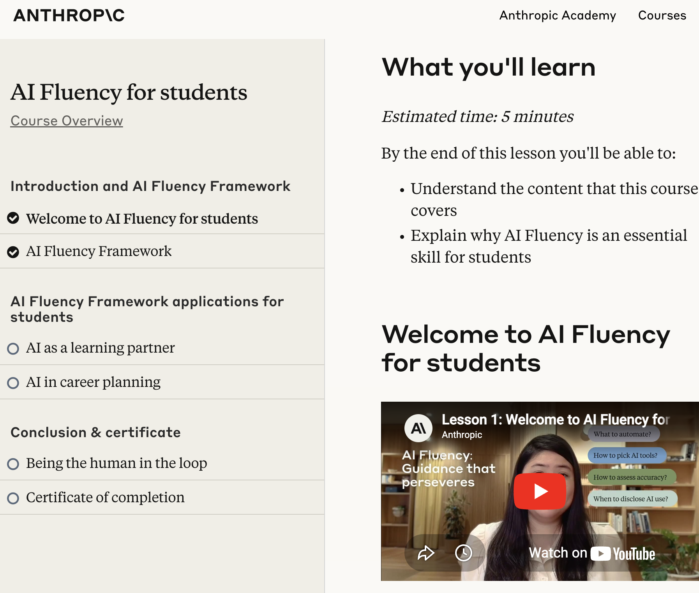
Pathways to Critical AI Literacy
Part 3: Recommendations

Slide 21
assignments where Edcafe excels
Refine a thesis
  Require five interactions
Create more titles for a piece
  Use Edcafe to generate 10 titles and defend your selection
Write a metacognition essay on Edcafe use
  Distinguish between chatbot as thinking aid and chatbot as source
Apply editing principles to various sentences
  Ellen Lupton 5 principles of writing (passive voice)
Grammar workshop
  Students ask a follow-up question for each re-write
Part 3: Recommendations

Slide 22
Thank you for listening! matthew.fryecastillo@lehman.cuny.edu
Closing Thought: First-gen students at a commuter school deserve tools that meet them where they are.
This is one of them.

