Slide 1
GhostWriter Help
Here’s How
I Can Help You
Make More Money
Dick Kuiper - www.GhostwriterHelp.com

Slide 2
GhostWriter Help
What Is a
Ghostwriter?
Lack of Time or Expertise
Need Professional Quality Writing
Want to Have a Best-Seller
Need to Become a Published Author

Slide 3
GhostWriter Help
What Makes
Quality Writing?
Interesting Reading
Compelling Storyline
Highly Informative

Slide 4
GhostWriter Help
Overview of Services
Non-Fiction Books
Website Content
Professional Bio
PowerPoint Presentations
Blog Posts
Articles
Marketing Collateral
Customer Success Stories
Fliers
Brochures
Scripts
Elevator Pitches
Video Scripts
Sales Pitches
Sales Objection Rebuttals

Slide 5
GhostWriter Help
What Makes Me Different?
100% Satisfaction Guarantee
Fixed Price Agreements
No price per word
40+ Years of Business and Writing Experience
Copyright-free Graphics Included

Slide 6
GhostWriter Help
First: Some Definitions
Proofreading
Spelling, Punctuation & Grammar
Editing or Copy-Editing - Refinement
Proofreading + Minor Content Changes
Ghostwriting – New Construction
Major Content Changes & Creation
Research & Fact Checking

Slide 7
GhostWriter Help
Books
Due to
Confidentiality Agreements
Most Book Titles
Cannot be Divulged
You Provide:
Original Ideas
Concepts
Notes
Rough Storyline
I Add:
Professional Quality
Research
Additional Commentary
Graphics
Formatting
Prep for Publication
Jan 2018 Release

Slide 8
GhostWriter Help
Books
Extra Bonuses
Publishing –
Free of Charge
Marketing Assistance –
Nominal Charge - $300
Print-Ready Formatting
Arrange for Printing
Arrange for Distribution
Setup with Amazon.com
Setup for Bookstores
Assistance with Kindle
Book Marketing Website Development – 4 Page Site *
Arrange Site Hosting **
Publish Website
* Content from book is included, extra content at a discounted rate
** Hosting Fees Due to GoDaddy, ** Approx. $100/year first 3 years

Slide 9
GhostWriter Help
Books
How the Process Works
Step 1
You provide concept and overview
Step 2
We agree on a preliminary chapter
Step 3
I write 10-20 pages of the preliminary chapter
Step 4
You review the chapter and makes notes

Slide 10
GhostWriter Help
Books
How the Process Works
Step 5
We review the chapter and notes – discuss next steps
Step 6
We negotiate the book size and my writing fee
Step 7
You decide whether or not you wish to proceed
If NO, we part as friends and you owe nothing
If Yes, we agree on a 3-part payment process based on milestones

Slide 11
GhostWriter Help
Books
How the Process Works
Step 8
I begin the writing process. I send you chapters/sections as progress checks and make necessary adjustments.
Step 9
I finish preliminary draft and you review it. We agree on any final changes needed.
Step 10
I make final changes and resubmit to you. We read aloud the semi-final draft. I make changes needed.

Slide 12
GhostWriter Help
Books
How the Process Works
Step 11
I make final changes and submit to you for approval.
Step 12
I upload final draft to the printer (CreateSpace) and order two proof copies, one for each of us.
Step 13
I make any last changes needed and resubmit to the printer. Your book will be ready for sale usually within two weeks.

Slide 13
GhostWriter Help
Blog Posts
Informative
Insightful
Humorous
Compelling
Thought
Leadership
Thought Provoking

Slide 14
GhostWriter Help
Articles
Eye-Catching
Insightful
Informative
Thought Provoking
Compelling

Slide 15
GhostWriter Help
Website Content
SEO-Powered

Slide 16
GhostWriter Help
Tri-Fold Brochures
Professional
Informative

Slide 17
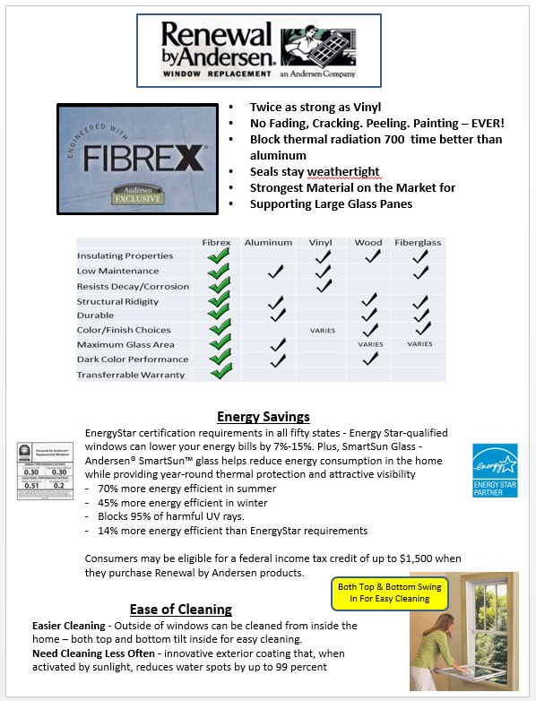
GhostWriter Help
Fliers

Slide 18
GhostWriter Help
Industry & Functional Specialties
Functional
General
Specific Industries
Web Content
Web Blogs
Sales
Marketing
Consulting
Management
Motivation
Coaching
Sales Forecasting
Recruiting
Human Resources
Writing
Public Speaking
Seminar Instruction
R&D
Manufacturing
Supply Chain
Entertainment
Distribution
Software
High Tech
Electronics
Automotive
Complex Machinery
Building Products
Pulp & Paper
Office Supplies
Windows & Doors
Timber Production
Consumer Products
Iron & Steel
Apparel
Construction
Health & Wellness
Real Estate
Food & Beverage
Home Security
Satellite TV
Aerospace
Financial Services
Professional Services
Textiles
Furniture
Cabinetry
Plastics
Dick Kuiper - www.GhostWriterHelp.com
(360) 670-2914

