Slide 1


Warrior Angel Riders Newsletter
October 2020
Contents:
2. Words From Lilyann
3. New Members of W.A.R.
4. Upcoming Events
5. W.A.R. Sponsored Events
6. Featured Member/Rider
7-8. Last Months Rides/Events
9-11. About W.A.R.
12-13. Service Tech Tips
14-15. Motorcycle Humor
16-18. Riding tips (Safety Officer)
19. Helpful Links

Slide 2

Words From Lilyann
Hello Ladies
W.A.R. is about having fun, enjoying life and RIDING. As we have witnessed by listening to the news, or worse, personally with a family or friend, life is unpredictable. Cherish every day, every moment.
Master Shifu (Kung Fu Panda) said, “Yesterday is History, Tomorrow is a Mystery. Today is a gift. That is why it’s called the Present.” Never stop doing little things for others. Sometimes those little things occupy the biggest part of their hearts.
If you had not heard, one of our own, Hollie “Thumper”, was involved in a horrific accident in Montana. She had surgery and is recovering at home. She still needs additional surgery, however, that must wait till her pelvic has healed. The doctors are telling her it will be at least a year of therapy. Hollie and Alex can use our assistance. She has a Meal Train site where we may place a donation to help her with meals. Also, her sister set up a go fund me.
Our Secretary, Rachael “Taz”, will be moving to Las Vegas in November. It saddens me to think she will not be (physically) with us at our meetings events and rides. Hopefully, we may one day see a chapter in Vegas! With her departure, we will hold our first election with the membership to fill a Board position, Secretary in October. Plan to attend our Meet and Greet to vote!
This year’s Challenge Ride was a huge success! We had 32 participants, of which 28 submitted a photo entry. We have 9 riders who completed all 16 locations, and 1 rider who missed 1 photo op. Behind are 4 others who needed only 2-3 submissions! In fact, some riders went with others and got a second submission. In all the entries there was one common denominator...SMILES! Now to see who takes 1st , 2nd and 3rd place!
Coming up November 14th , is our first “holiday party”! We plan to make it as much fun as possible so mark your calendars! We will see you at American Legion in Kent!.
“A strong woman thinks for herself, speaks for herself and does for herself. She knows
the most dependable person in the world is herself.”
Lilyann “Pixel”
Director, W.A.R.

Slide 3
Welcome newest ladies of W.A.R.!
We Are the B.E.S.T:
Beauty
Empowerment
Strength
Trust
No New Ladies this month!!

Slide 4
Upcoming Events:
ATTENTION: Due to COVID-19 virus situation please check that any event you plan to attend is still occurring. Thank you.
Oct 3 - 11AM - Challenge Ride Luncheon @ American Legion in Kent
Oct 6 – 6:30PM October Meet N Greet @ Elmers Tacoma
Oct 10 – 9:30AM 5th Annual Wigged out ride (wear pink!)
Nov 7 - 8-12pm – Puyallup - W.A.R. on the Range (Marksman Gun Range)
Nov 14 - 2PM-4PM - W.A.R. Holiday Luncheon @ TBD
Dec 10 - 7-9pm – TBD .- Sizzle Sparkle #50
Jan 1, 2021 – Co’Ed New Years day ride
Mar 5 to Mar 7 – 2nd Annual Meet at the Beach @ Pacific Beach – Ocean SHORES
May 1, 2021 – 9AM International Female Ride Day

Slide 5
WAR Sponsored Upcoming Events:
None upcoming!!

Slide 6
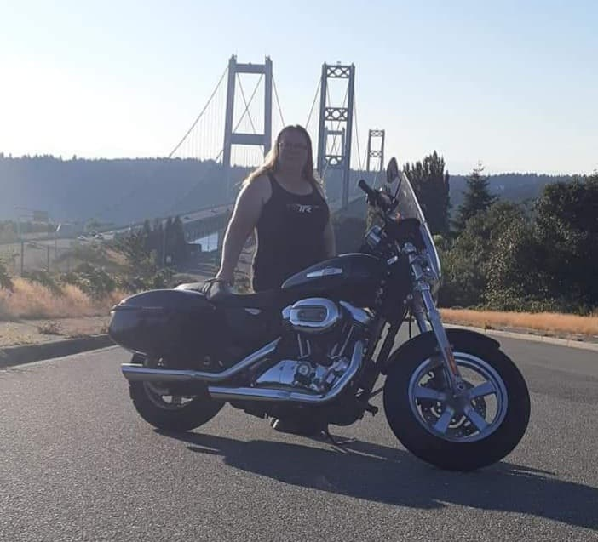
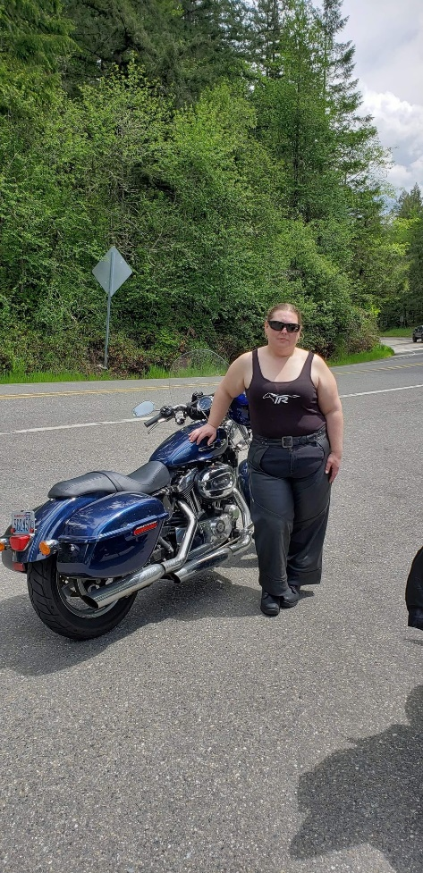
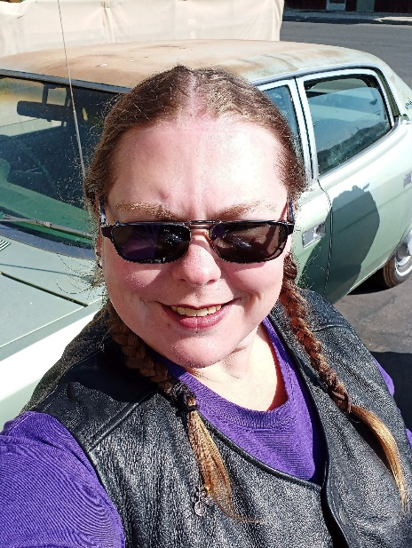
Featured Member/Rider
Stacy “Keys” Allen
I was truly introduced to motorcycles by my stepfather who would take me for rides on the back of his. He convinced me to take the safety course to find out if it's something that I would like to do on my own. I was immediately hooked! That was in 2009. I went out and bought my first bike which was a brand-new Harley Sportster 883 low. 27 hours later I wrecked the bike. After having the entire right side rebuilt and healing from my road rash and stress fracture, I was eager to get back on! 4 years later I was forced to sell my bike and I went 7 years without owning one. May 2nd, I got back into writing when I bought my Linda which is a 2013 Sportster 1200 custom. Now I also have Brandy which is my Dyna Switchback. After losing my dad in 2018 I hit rock bottom and really lost myself. Getting back into riding help me find my way again and breathe life back into my body and my soul. And now I have met you amazing women and I’m so grateful to be a part of this Sisterhood!

Slide 7
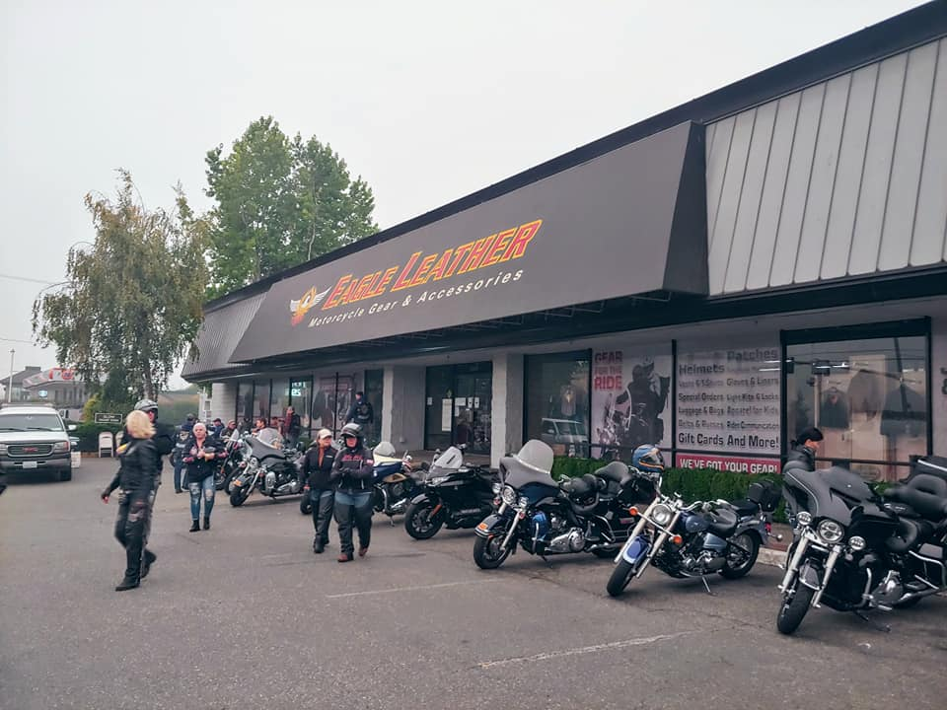
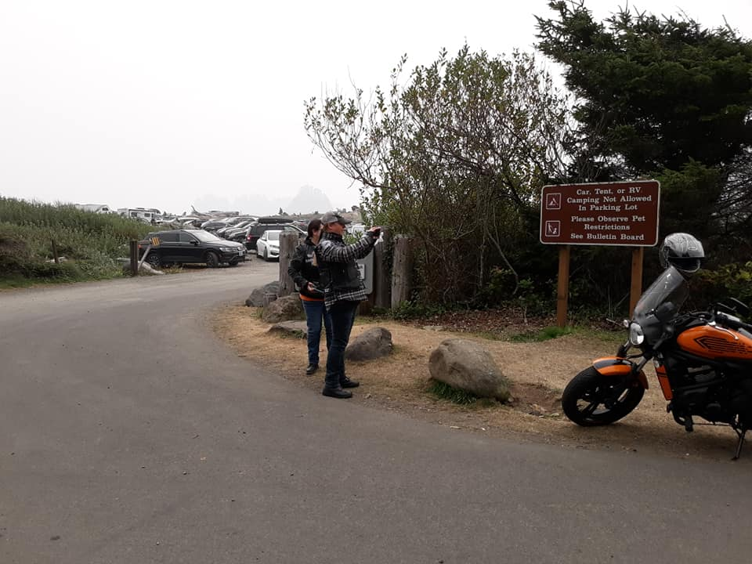
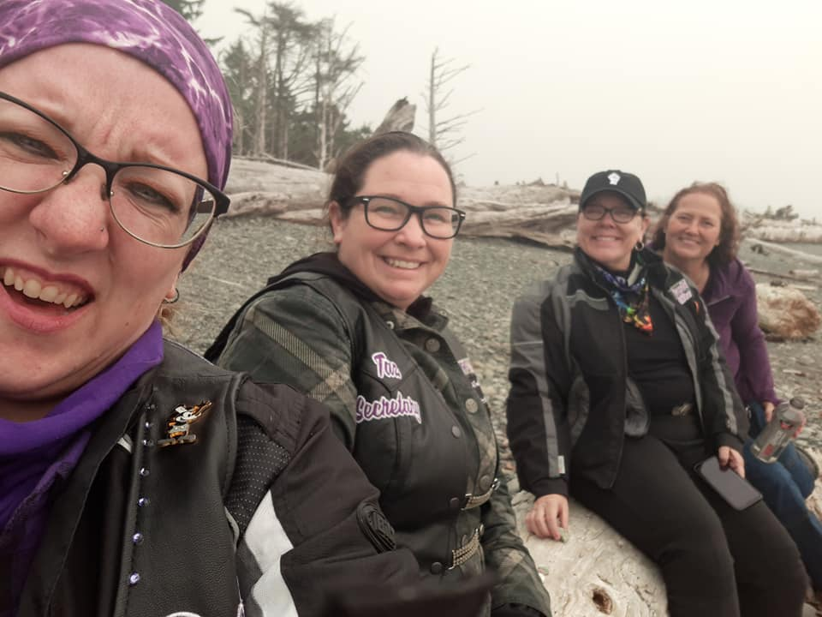
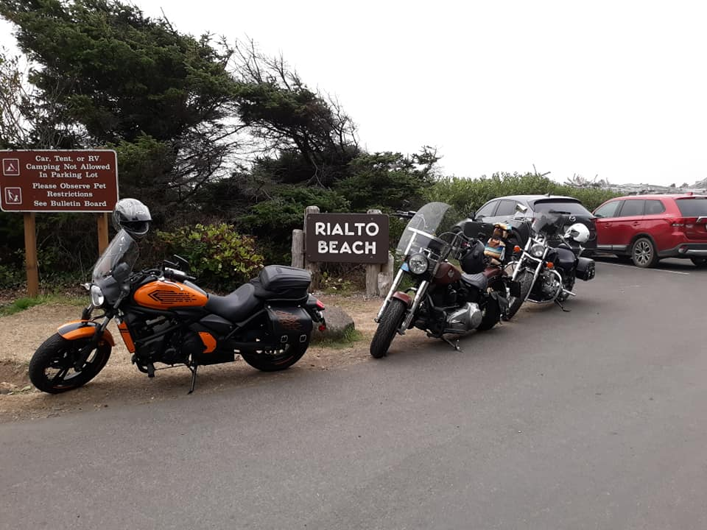
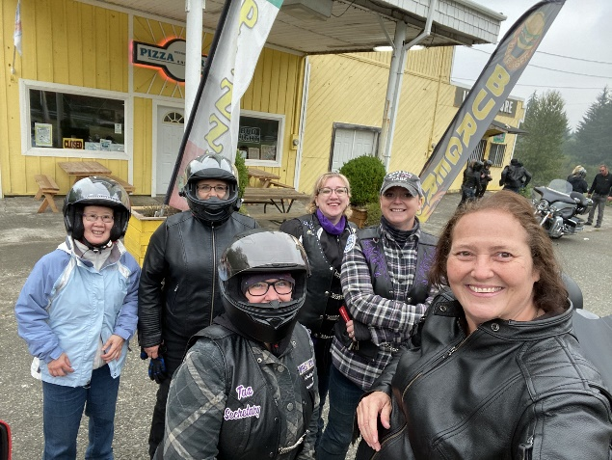
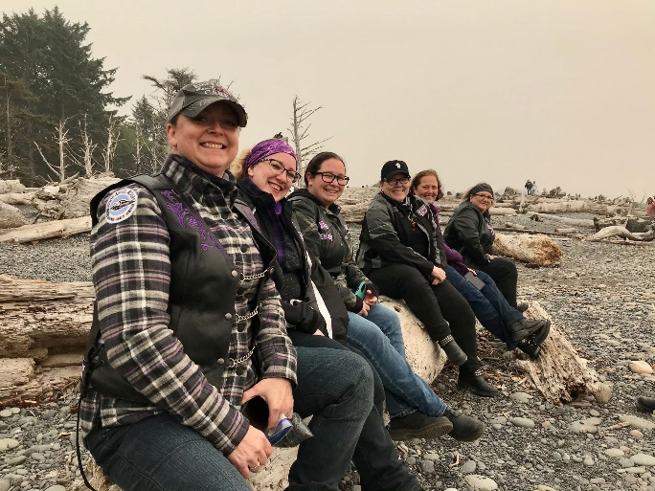
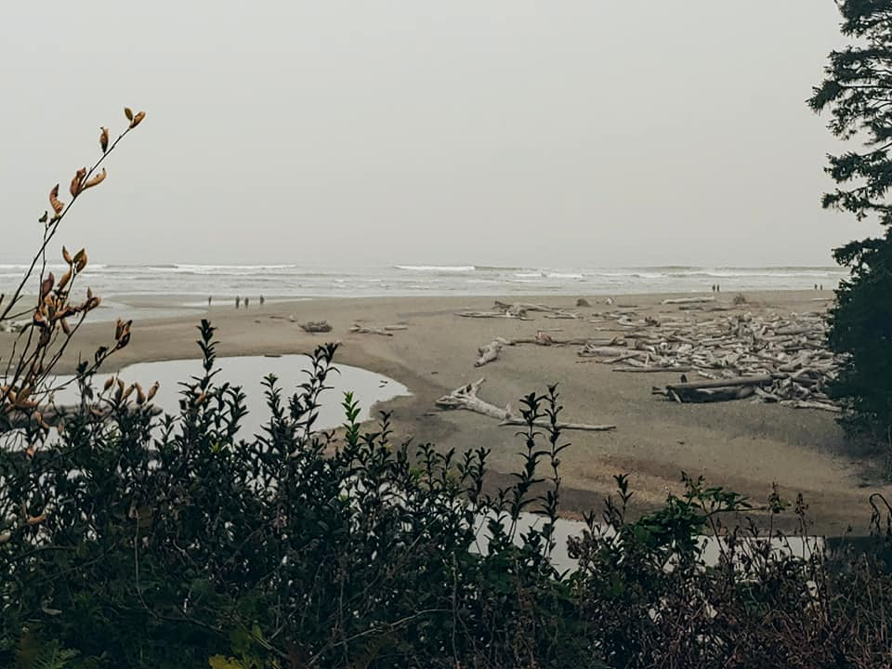
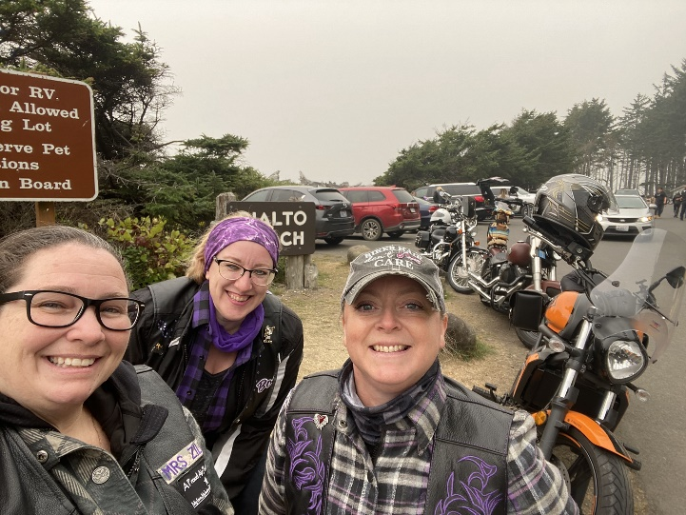
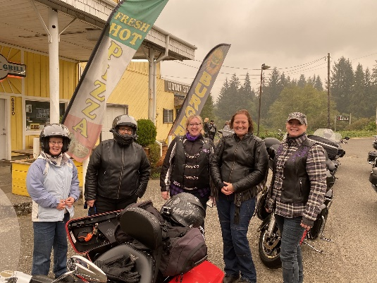
Last Months Rides/Events
Forks Ride 9-12

Slide 8
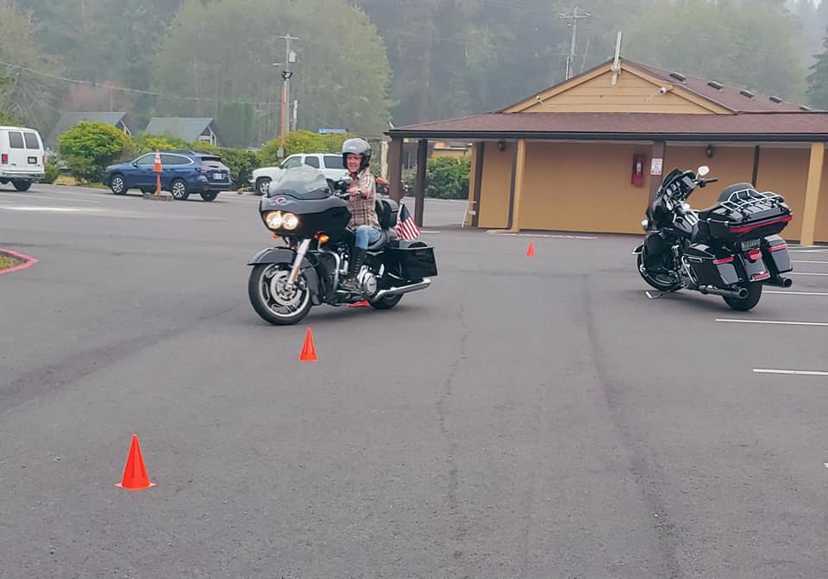
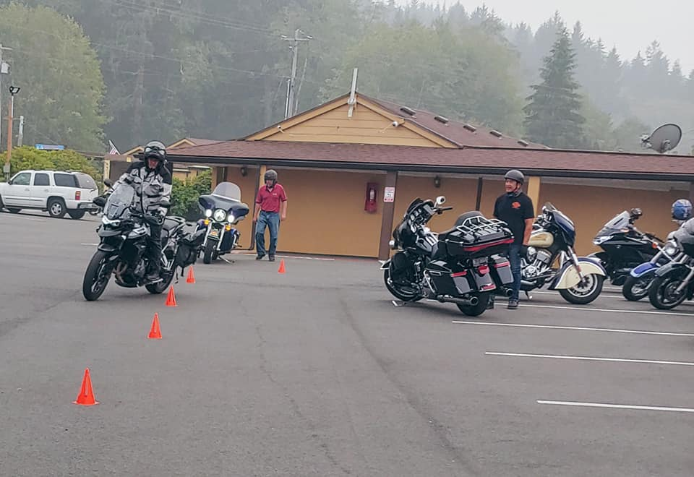
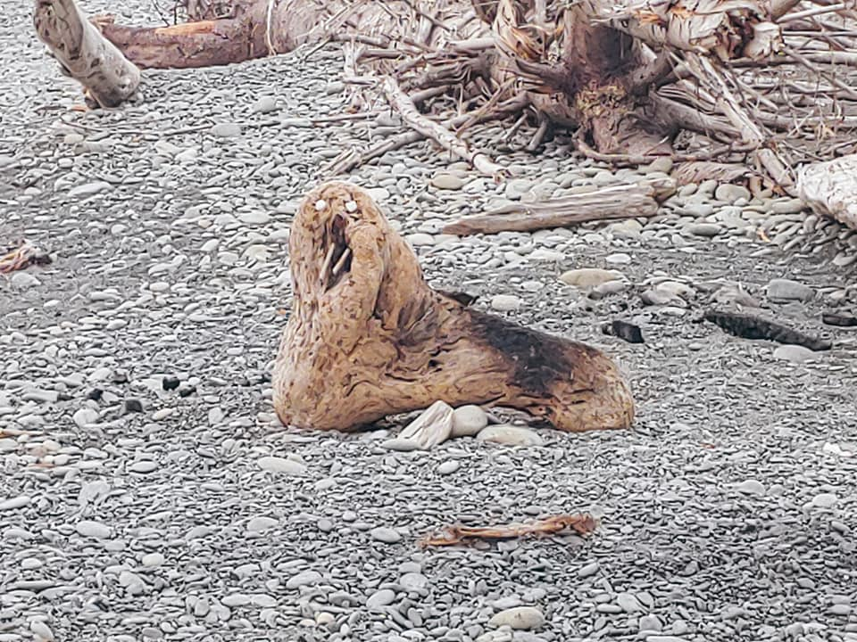
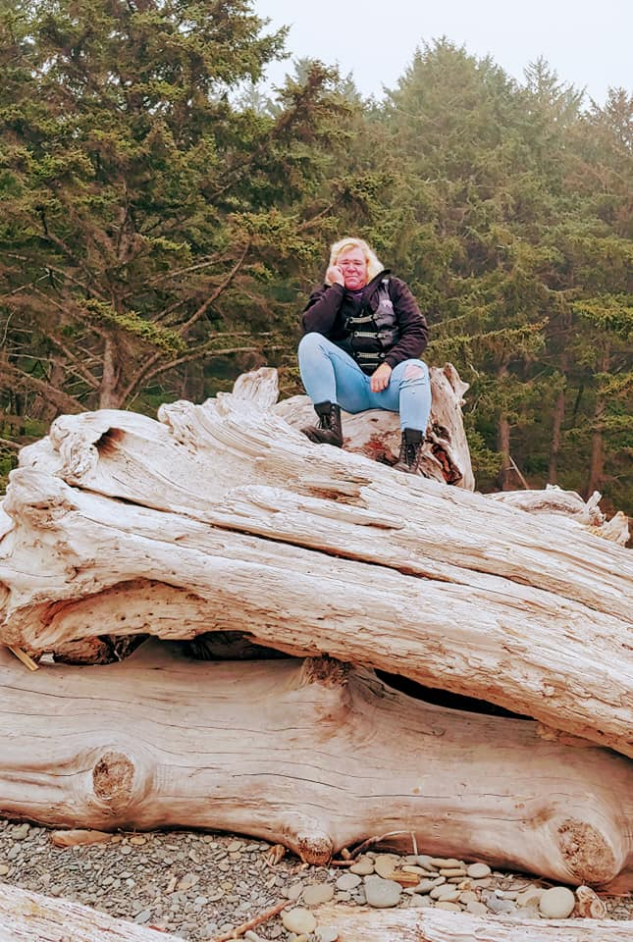
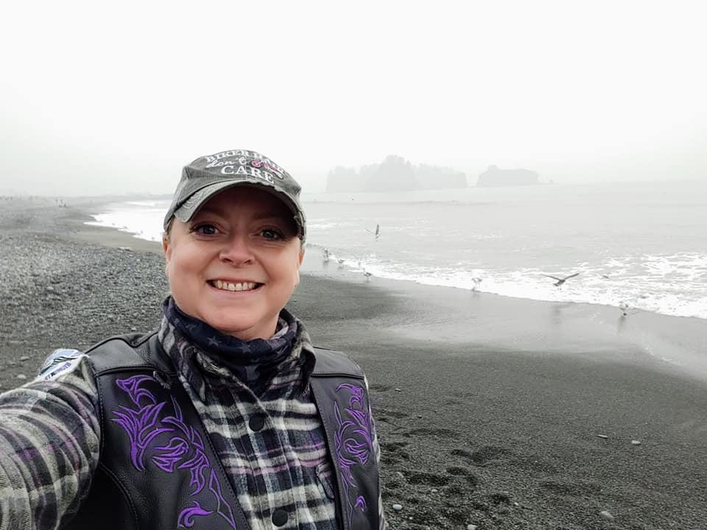
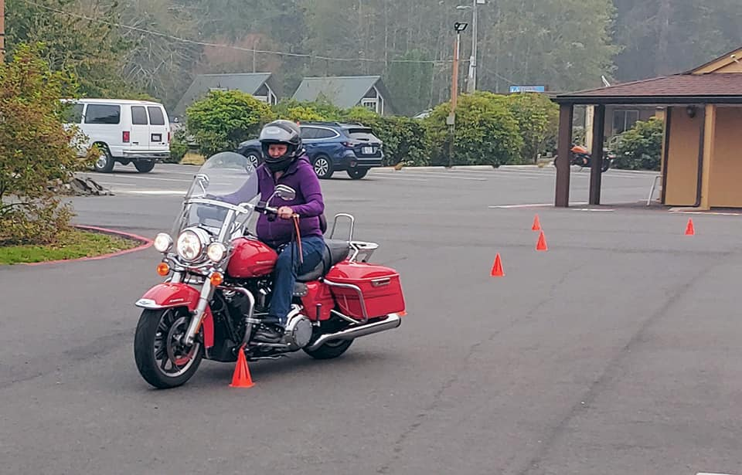
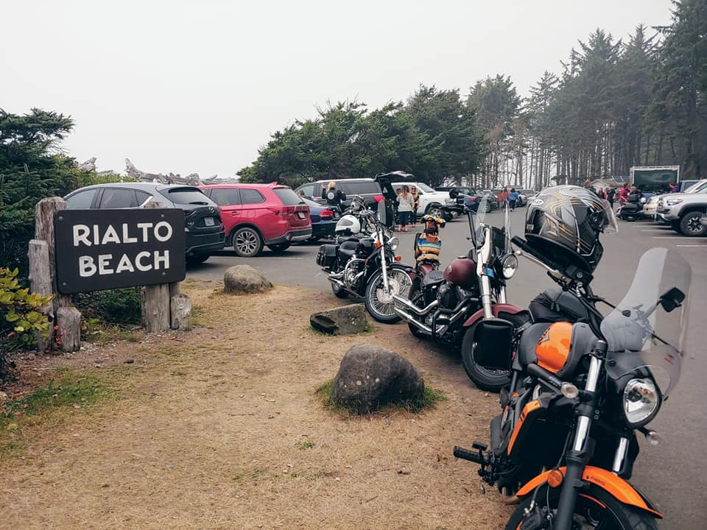
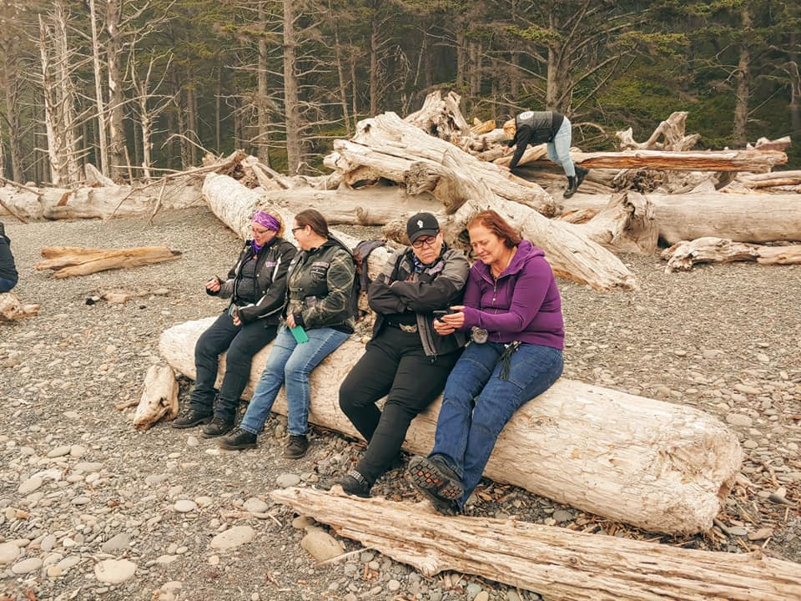
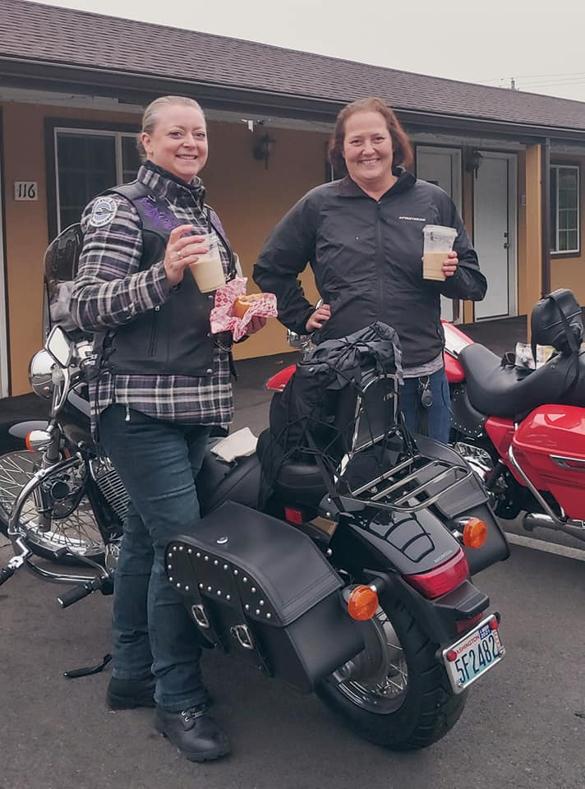
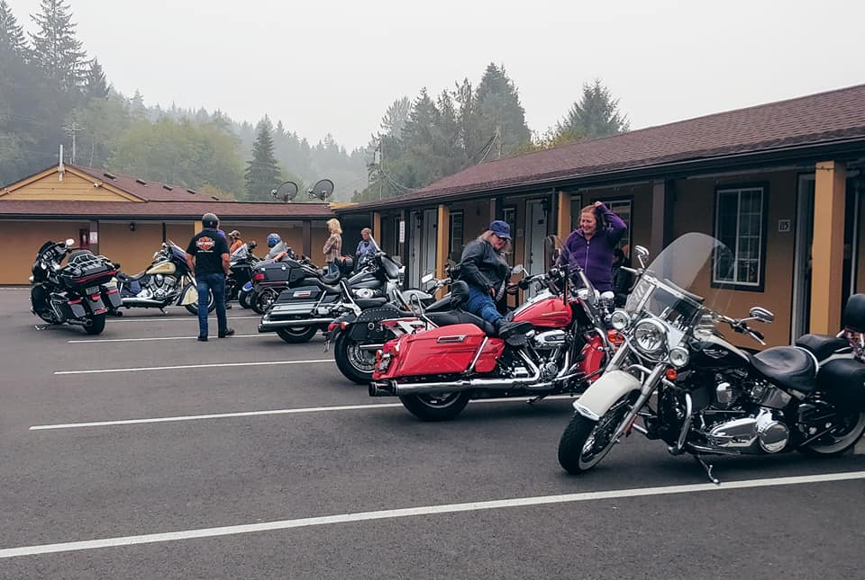
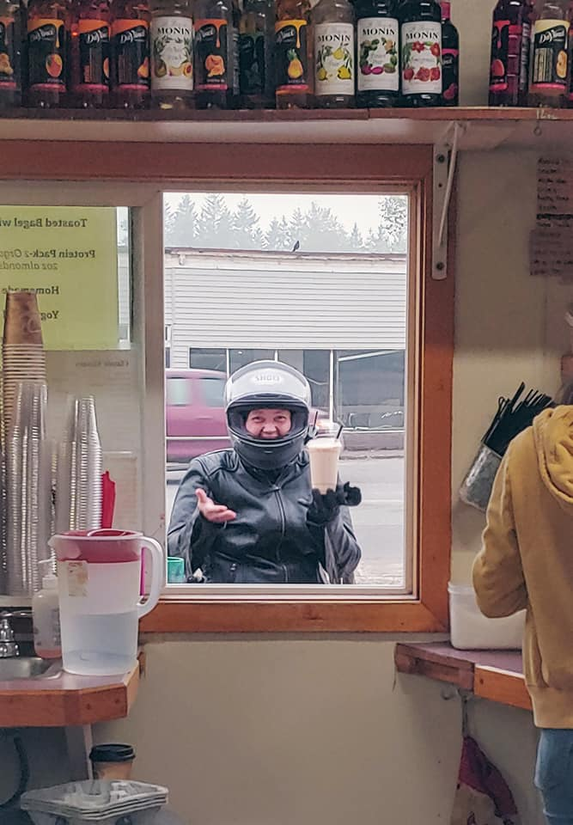
Last Months Rides/Events
Forks ride 9-12

Slide 9

About W.A.R. :
W.A.R. Meaning
Warrior – is a woman whose strength has endured. Several of our gals are breast cancer survivors. Sadly, a few had to lay to rest their child, a spouse or a loved one. Something no one should ever have to experience alone. As women, we ALL fight our battles, support each other, struggle to survive and find the courage to live.
Angel – is a woman who looks after family, friends, co-workers, strangers. She is a loving and caring person who will make your day brighter just being there. She shows compassion; protecting and guiding, who is selfless.
Riders – as women riders, there is nothing more empowering than climbing onto your own bike and taking to the open road.
Our color choice to represent us: Purple and White.
Purple is associated with royalty. It symbolizes power, nobility, luxury, and ambition. It conveys wealth and extravagance. Purple is associated with wisdom, dignity, independence, creativity, mystery, and magic.
White, an inherently positive color, is associated with purity, virginity, innocence, light, goodness, safety, brilliance, illumination, understanding, cleanliness, faith, beginnings,
sterility, spirituality, possibility, humility, sincerity, protection, softness,
and perfection.
We believe in pursuing to be the BEST as women, through every aspect of life.
*Beauty* *Empowerment* *Strength* *Trust*

Slide 10

More About W.A.R. :
How To Join
If you have any questions about Ladies of W.A.R. or want to know when we have our meetings and events, please feel free to call Lilyann @253-325-2405 or email at
warriorangelriders@gmail.com.
W.A.R. Meetings
Director
Lilyann Lear
Meetings held monthly.
Socialization @ Elmer’s in Tacoma begins at 6:00 p.m. followed by the meeting at 7:00 p.m. You can simply attend the meeting or choose to eat and enjoy a beverage. The members of WAR run their own meetings and sponsor activities that ladies can participate in.
Assistant Director
Charlie Houmes
History:
In 2017, we were on a group ride with some experienced riders; the ride started at a respectful pace until we hit the backroads. The guys love the twisty roads and took off! Understandably. And yes, there are gals who enjoy the spirited ride too. However, several gals were not at the same riding level and felt uncomfortable being pushed to ride faster than their guardian angel can fly.
Later several of us ladies got together for lunch, talked about the ride and asked ourselves, “what can we do to make sure we are riding within our group’s level, leaving no rider behind”. We discussed offering to be a mentor, helping to develop our riding skills, offering tips from our own riding experiences.
“Warrior Angel Riders (WAR)” was born!
Assistant Director
Gloria Padgett
2020 W.A.R. Meeting Schedule
September 08
WAR is a group
of dedicated and talented women
who love to get together,
have fun, and ride. We are a
very diverse group of women
coming from different
backgrounds who pull together
to make our events
successful and fun. This is
where lasting friendships and
memories are made.
HOME BASE
Tacoma

Slide 11
W.A.R. Contacts:
W.A.R. Officers
Director- Lilyann “Pixel” Lear- warriorangelriders@gmail.com
Assistant Director- Charlie “Angel” Houmes- charlie.houmes@gmail.com
Assistant Director- Gloria “Fireball” Padgett- organizer.gloria.war@gmail.com
Treasurer- Rachel “Girl Scout” Stepner- treasurer.rachel.war@gmail.com
Secretary- Rachael Rollins- secretary.rachael.war@gmail.com
Membership Officer- Michèle “Stitch” Courvoisier - membership.michele.war@gmail.com
Activities Officer-
Editor- Cammie “Boots” Wood – editor.cammie.war@gmail.com
Photographer-
Safety Officer- Shawna “Thunder” Chisholm- safetyofficer.Shawna.war@gmail.com
Road Captains
Road Captain- Tracy “Switchback” Cutler - roadcaptain.tracy.war@gmail.com
Road Captain- Sandy “Badass” Knab-

Slide 12
Service Tech Tips:
Regular Rider Maintenance For Your Motorcycle
If you value safety, there are some things you should check yourself on a regular basis. Routine maintenance is important but pre-ride inspections and regular safety checks should be done between service intervals. If you don’t have an owner’s manual with specs on your motorcycle, try to get one. If you can’t find your owners manual or if it is lacking specifications, you may want to consider purchasing a service manual for reference. Factory manuals can be very expensive, but there are generic manuals available at most motorcycle shops and bookstores that will have the information you need for your bike.
You should always have the manufacturer’s recommended regular services performed, but the following are things the operator should do between services.
Things you should check before every ride:
Tires and Tire pressure – Make sure both the tires are in good condition. Look for uneven tread wear or damage. You should have a good tire gauge and check that the tires are inflated to specifications. (Note: Because your tires may not be the same brand as the ones that were originally on the motorcycle check the max pressure inscribed on the sidewall of the tire, NOT the numbers listed in the Owner’s Manual or the sticker on the frame.) Remember that the tire pressure should be checked and adjusted when the tires are “cold” aka ambient air temperature. Tire pressures will rise 10% or more when they reach operating temperature. Don’t trust gas station pump air gauges they are often inaccurate; use a good hand-held air gauge. And check the tire pressure regularly. Tires will loose air over time; as much as 5 psi per week.

Slide 13
Service Tech Tips Cont:
Regular Rider Maintenance For Your Motorcycle cont.
Oil level – Check the oil as per manual with the bike on a level ground.
Brakes – Make sure the brakes are functioning properly.
Lights – All lights should be checked; high and low beam, turn signals, running lights and brake light (check both front and rear brake lever activation).
Chain or Belt – Check the tension of the belt or chain. Look for damage on belts and make sure chains are well lubricated.
Things to check periodically on your motorcycle
Battery – Make sure battery connections are tight and free of corrosion. Also check the electrolyte level on conventional batteries.
Brakes – Look for fluid leaks and inspect brake pads or shoes for wear.
Controls – Levers and switches should operate smoothly. Check cables for signs of wear or breakage.
These suggestions are for the operator to perform between regular service intervals. Be sure to keep up with the regular scheduled maintenance as these procedures are designed to avoid catastrophic failures and prolong the dependability and ride ability of your motorcycle.

Slide 14
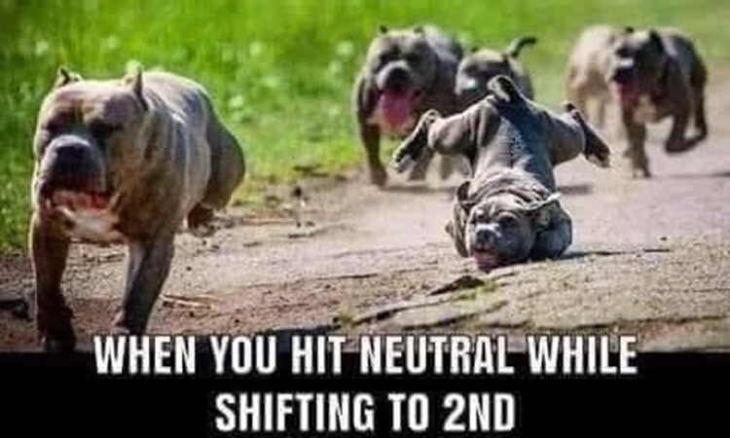
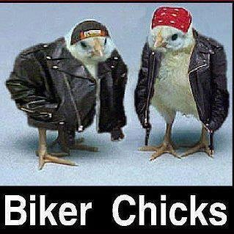
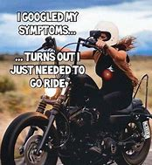
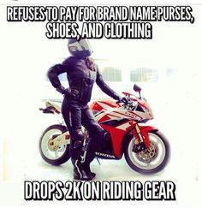
Motorcycle Humor!

Slide 15
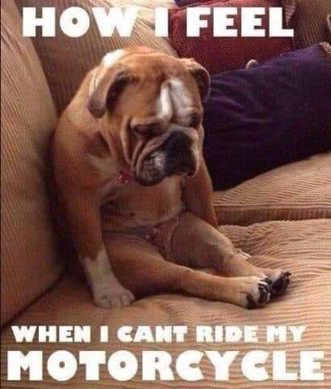
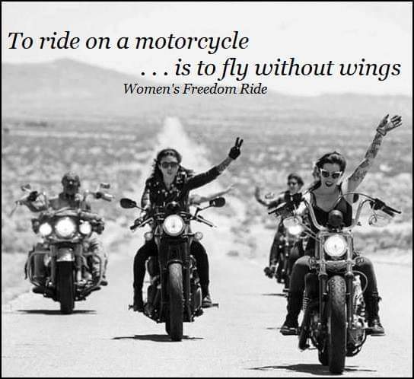
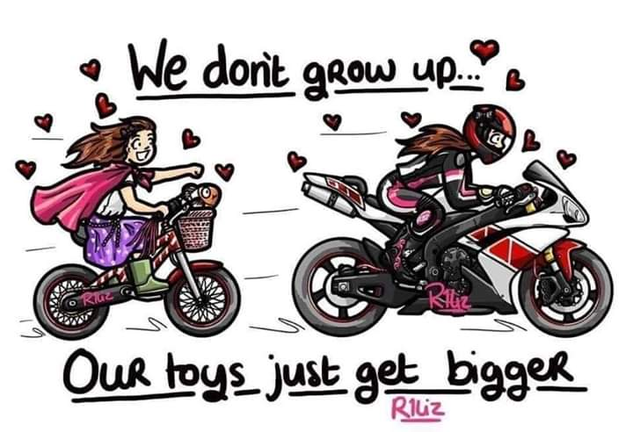
More Motorcycle Humor!
https://www.pinterest.co.uk/pin/407223991282829436/

Slide 16
Riding Tips with Shawnna
A word or two from your Safety Officer…
Motorcycle Braking Techniques
Braking, as with any other riding technique, is a learned ability. It is not a natural skill, but something that is studied and put into practice. Before you can be certain that you will do the right things in a crisis, you must learn the proper braking techniques first, enough to make them an instinctual response.
Based on broad research, about 33% of all riders do literally nothing in an adverse circumstance. They don’t even apply the brakes! This is as a result of panic that overwhelms the rider’s calm and calculated response to the crisis. If, however, your emergency braking techniques are so well learnt that they are intuitive, you will do it right, regardless of what the circumstances are.
Then again, this obliges you to do a ton of emergency braking practice, as hopefully, you will not be called upon to carry out emergency braking in every typical riding situation. In this article, we will discuss some very important types of motorcycle braking techniques that you should become expert with. As an experienced motorcycle instructor I am continually surprised at how many motorcyclists, some who are riding very powerful machines, do not have the knowledge and skills to make good decisions at the time when emergency braking is required.

Slide 17
Riding Tips Cont.
4 steps to corner a motorcycle like a pro CONT.
Hard Braking on the Front Wheel - The front brake is proven to be the best and most effective of the two brakes, giving up to 80%-90% of the motorcycle’s stopping power in emergency stops, contingent on surface conditions. For this reason a large percentage of weight of the motorcycle and rider needs to transfer forward onto the front wheel and suspension when the brakes are applied.
The weight transfer that happens under braking on a motorcycle compresses the front forks and then pushes down on the front tire, enlarging the contact patch and thereby increasing the grip.
Training Options:
Training to perform correct braking procedure is important. Remember that you in an emergency and it doesn’t matter what kind of emergency you fall back on your training. This training needs to instill the correct procedure into muscle memory because in an emergency there is no opportunity to consider options and then apply the correct procedure. It is recommended to consider learning advanced skills at a training organization. Even motorcycle racers learn and hone their skills by using a coach. Very few motorcyclists are really in a position to say, ”I know it all.”
Hard Braking on the Rear Wheel
With most of the weight transferring to the front wheel under braking, the back wheel has a tendency to become light under braking. Because of this the rear wheel can lock up quite readily if over-applied. If the rear wheel does lock it will cause the motorcycle to skid. If this happens it is vital for the rider to maintain “eyes-up” and keep the feet on the footpegs..

Slide 18
Riding Tips Cont
4 steps to corner a motorcycle like a pro CONT.
4. Roll:
The final step is to roll on the throttle. By rolling on the throttle though out the corner you will allow the motorcycle to settle into the turn and remain balanced as you smoothly complete the turn. Applying the brakes or rolling off the throttle will make the corner choppy, out of balance and will require a lot of input from you to get through the corner. If your entry speed is correct you should be able to roll on or maintain throttle through out the entire corner. At the end of the corner rolling on the throttle a little more will help stand the bike up and help you exit the corner looking like a pro.
The steps in proper cornering are subtle, remember my favorite saying for motorcycle control is this: technique + smooth = control. In this article I talked about technique. Technique are things you learn from reading, watching or instruction. If you take technique and apply it properly you will get smooth, getting smooth with a technique can only happen with practice. If you take technique (knowledge) and add that to smooth (practice) you get control. Once you get control your ride not only becomes safer it becomes more enjoyable.
https://www.mcrider.com/4-steps-corner-motorcycle-like-pro/

Slide 19
Helpful Links
Warrior Angel Riders- www.warriorangelriders.org
Jet City Harley Davidson- www.jetcityharley.com
Eagle Leather- https://eagleleather.com

