Slide 1


1
Warrior Angel Riders Newsletter
Contents:
Words From The Board
Who we are
Featured Member of the Month
New Member’s of W.A.R.
Upcoming Events
Last Months Rides/Events
Safety Tips with Shawna
Motorcycle Humor
W.A.R. Contact Info
November 2020

Slide 2
2
Words from the Board
Hello Ladies
November always reminds me to take a moment, reflect, and give thanks.
Life isn’t always roses and butterflies. Not “real life” as most of us know it to be. Covid has devastated
so many families and business, small and large. There was no way for us to prepare let alone anticipate
for this pandemic. The way our lives have changed…social distancing, wearing a mask, etc. will never be
forgotten.
Some of us may have experienced this year joy celebrating new life, goals and accomplishments met,
new adventures taking us to unknown places. Then there is sadness. The loss of property, accidents are
never planned. Break-up of relationships, sorrow of losing someone whom we loved, admired and
cherished.
I am blessed and thankful for you, my sisters, the Warrior Angel Riders. You give so selfishly, caring and
supportive. We may be small in membership (at this time) but we are Mighty. Makes me think of Mighty
Mouse! We are not about “quantity” but the “quality” of the ladies who join us.
I saw this saying and thought of you:
“I am so thankful for the amazing people God has placed in my life. I might not get along with everyone
all the time but I do know there are lessons to learn every step of the way. I pray God opens my eyes
and lets me see these moments as a time of growth and a time to become a stronger person, more full
of love. May God Bless you and keep you safe, healthy and happy today and always.”
Happy Thanksgiving!
Love to all of my sisters.
Lilyann “Pixel”
Director, W.A.R.

Slide 3
3
Warrior – is a woman whose strength has endured. Several of our gals are breast cancer survivors. Sadly, a few had to lay to rest their child, a spouse or a loved one. Something no one should ever have to experience alone. As women, we ALL fight our battles, support each other, struggle to survive and find the courage to live.
Angel – is a woman who looks after family, friends, co-workers, strangers. She is a loving and caring person who will make your day brighter just being there. She shows compassion; protecting and guiding, who is selfless.
Riders – as women riders, there is nothing more empowering than climbing onto your own bike and taking to the open road.
OUR COLOR CHOICE TO REPRESENT US: Purple and White.
Purple is associated with royalty. It symbolizes power, nobility, luxury, and ambition. It conveys wealth and extravagance. Purple is associated with wisdom, dignity, independence, creativity, mystery, and magic.
White, an inherently positive color, is associated with purity, virginity, innocence, light, goodness, safety, brilliance, illumination, understanding, cleanliness, faith, beginnings, sterility, spirituality, possibility, humility, sincerity, protection, softness, and perfection.
We believe in pursuing to be the BEST as women, through every aspect of life.
*Beauty* *Empowerment* *Strength* *Trust*
Who we are:

Slide 4

Who we are cont.
4
History
In 2017, we were on a group ride with some experienced riders; the ride started at a respectful pace until we hit the backroads. The guys love the twisty roads and took off!
Understandably. And yes, there are gals who enjoy the spirited ride too. However, several gals were not at the same riding level and felt uncomfortable being pushed to ride faster than their guardian angel can fly.
Later several of us ladies got together for lunch, talked about the ride and asked ourselves, “what can we do to make sure we are riding within our group’s level, leaving no rider behind”. We discussed offering to be a mentor, helping to develop our riding skills, offering tips from our own riding experiences.
“Warrior Angel Riders (W.A.R.)” was born!
5
W.A.R. Meetings
Meetings held monthly.
Socialization @ Elmer’s in Tacoma begins at 6:30 p.m. followed by the meeting at 7:00 p.m. You can simply attend the meeting or choose to eat and enjoy a beverage. The members of WAR run their own meetings and sponsor activities that ladies can participate in.
WAR is a group of dedicated and talented women who love to get together, have fun, and ride. We are a very diverse group of women coming from different backgrounds who pull together to make our events successful and fun. This is where lasting friendships and memories are made.
W.A.R. Upcoming Meeting Schedule
If you have any questions about Ladies of W.A.R. or want to know when we have our meetings and events, please feel free to call Lilyann @253-325-2405 or email at
warriorangelriders@gmail.com.
December 8

Slide 5
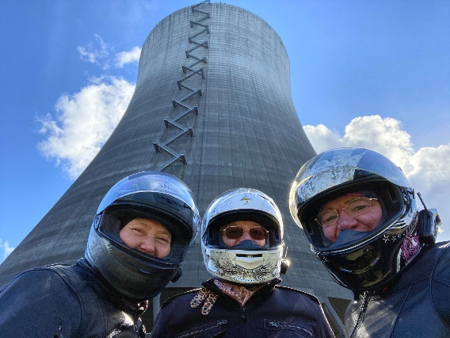
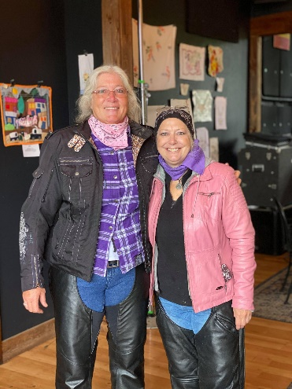
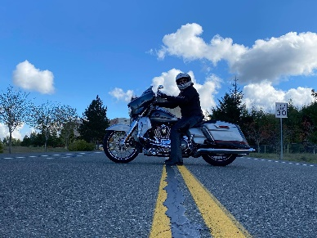
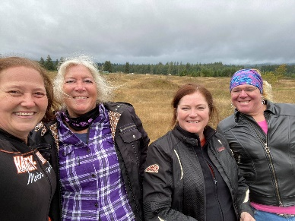
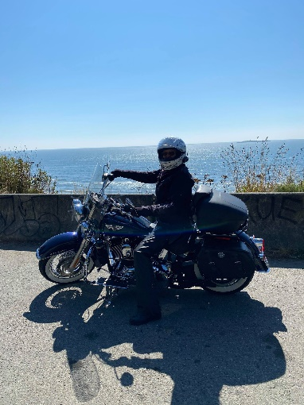
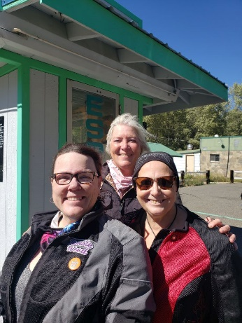
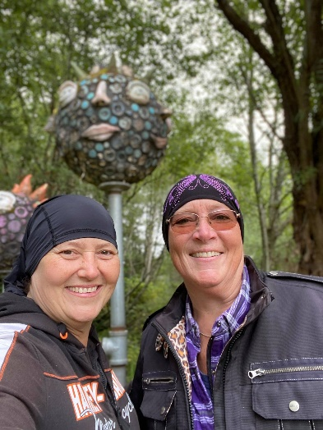
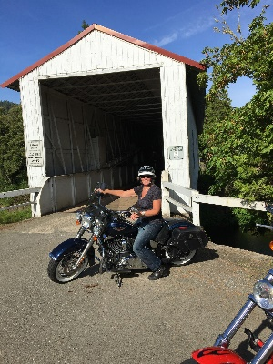
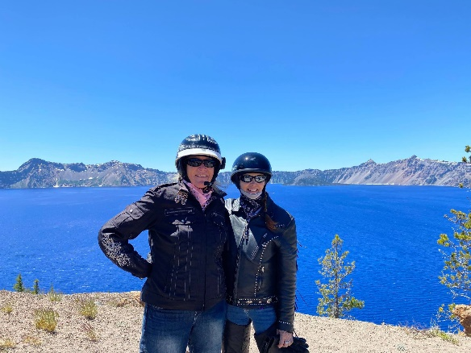
5
Featured Rider
I’ve been riding motorcycles since I was about 12, Gloria’s sister introduced me to their Honda Trail 90 and I was hooked! I didn’t have the money for a car at 16 so I bought a bike and used it as my transportation. I mostly rode enduro/dirt bikes until I had kids and then my riding went on the back burner. I kept up my endorsement all that time and 8 years ago my husband bought a Harley, the seat on the back was about 4x6 inches and there was no way I’d be riding bitch on that, about 3 weeks later I was the proud owner of my Softail Deluxe (Bitch’n Blue Betty), oh the love of a good exhaust rumble setting off car alarms and the wind in my face to make me smile, I never looked back! I recently bought a CVO Street Glide (Silver Lady) and have had a new challenge learning a new bike, so much fun and wow does it have all the bells and whistles! I’m so glad Gloria introduced me to WAR about 3 years ago, it was just forming and was just what I needed, a group of great women who shared the same motorcycle enthusiasm, everyone was so welcoming and always looked out for each other. Since then, I’ve made some incredible lifetime memories and friends!
Cheryl Ramsay

Slide 6

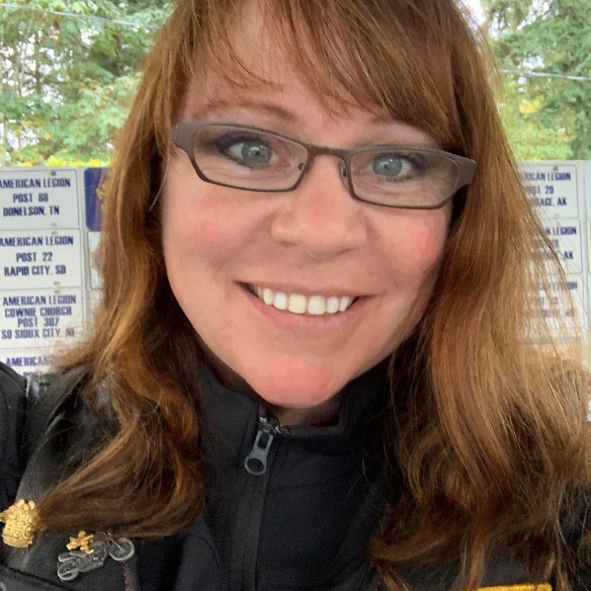
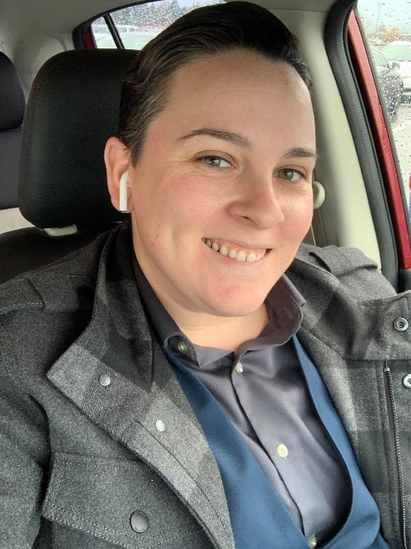
6
Cheryl Ramsay
Debi Lovelace
Drake
Lindy Nagle – No Pic available
Welcome newest ladies of W.A.R.

Slide 7
7
11/7 - 8-12pm – Puyallup - W.A.R. on the Range (Marksman Gun Range)
11/14 - 2PM-4PM - W.A.R. Holiday Luncheon @ American Legion in Kent
12/6 – 10AM-2PM – Garage Day W/Jessie @ Cheryl Ramsay’s Home
12/10 - 7-9pm – TBD - Sizzle Sparkle #50
1/1/2021 – Co-Ed New Years day ride
3/5-3/7/2021 – 2nd Annual Meet at the Beach @ Pacific Beach/Ocean Shores
3-20/2021-9/22/2021 – 2nd Annual N’usual to Pekuliar Ride
5/1/2021 – 9AM International Female Ride Day
7/4/2021 – 4th of July Parade in Stilacoom
7/8/2021-7/11/2021 – Hell’s Canyon Ride – Baker City, OR
Upcoming Events:
ATTENTION: Due to COVID-19 virus situation please check that any event you plan to attend is still occurring. Thank you.

Slide 8
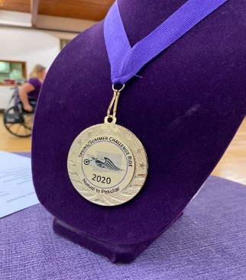
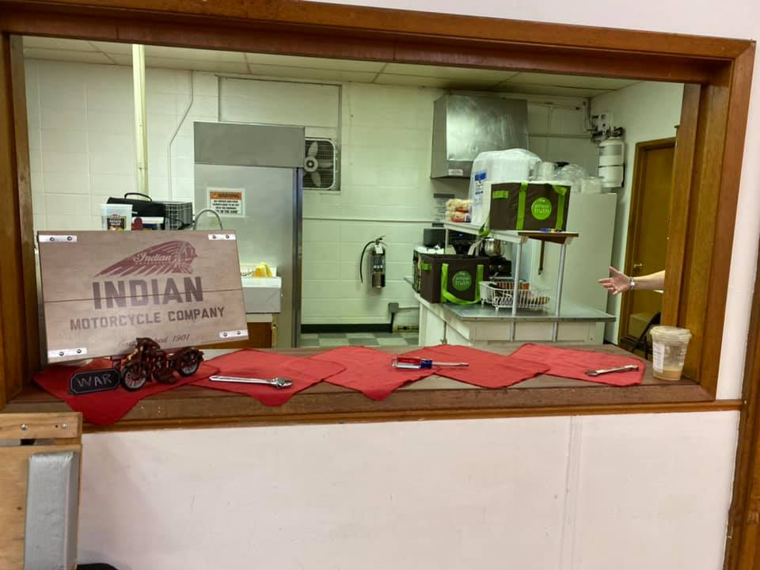
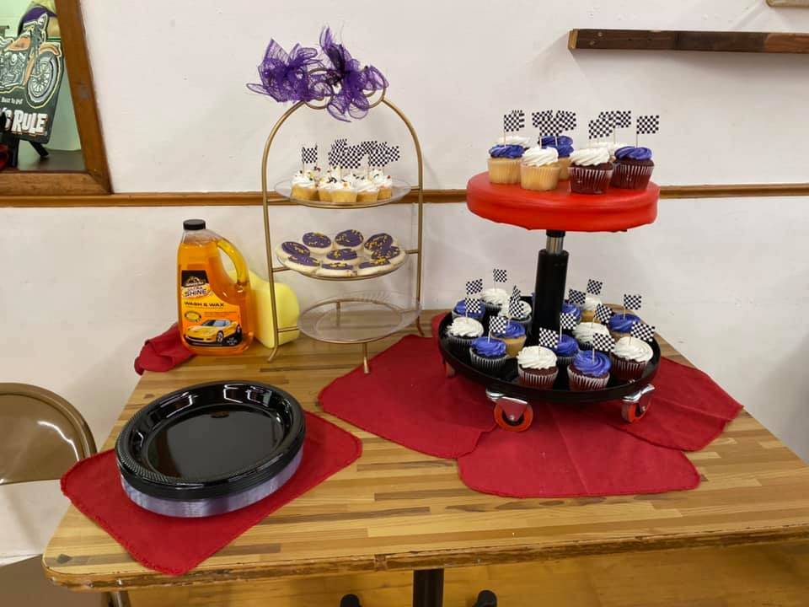
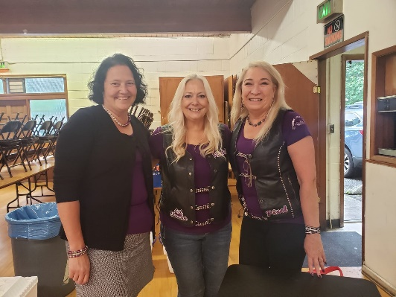
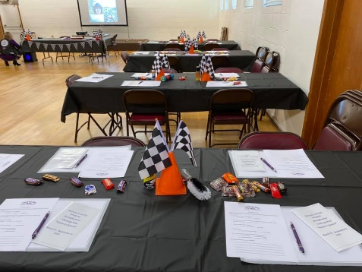
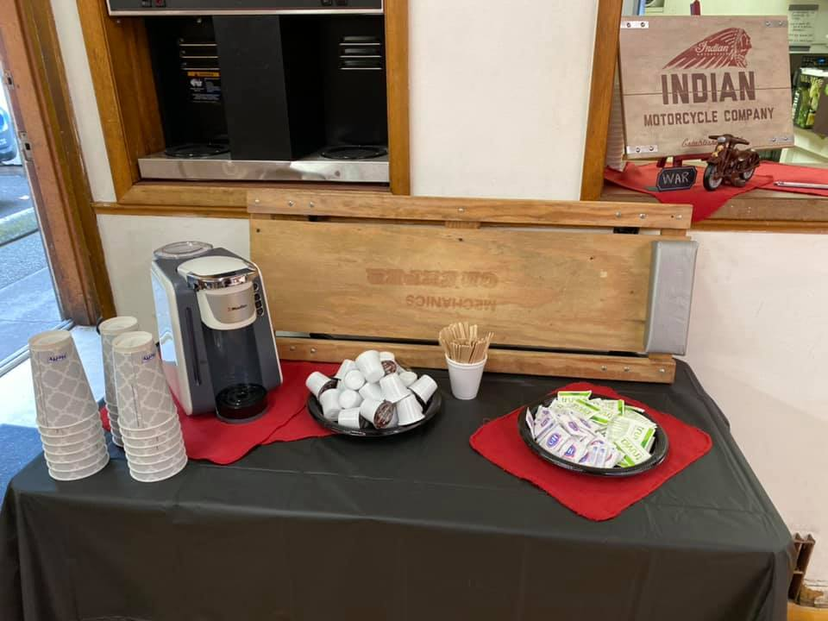
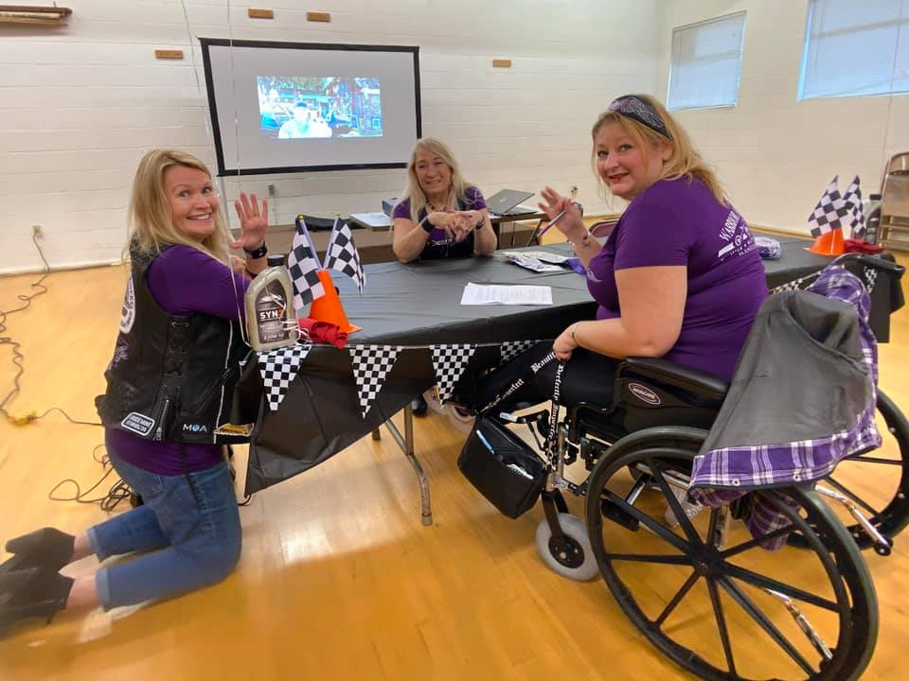
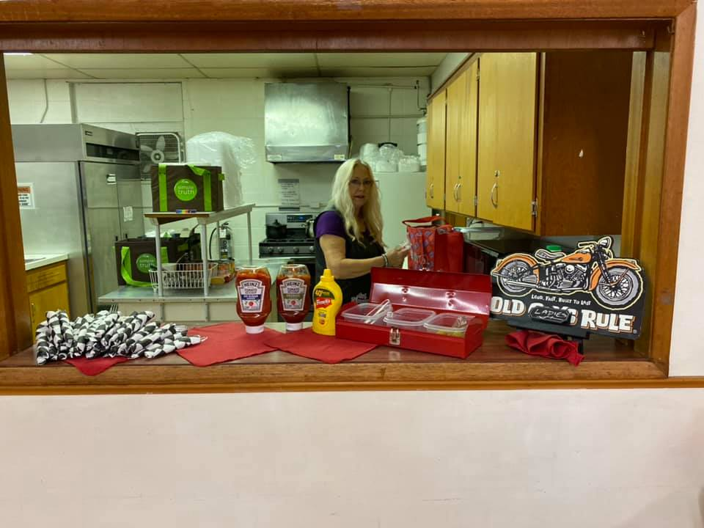
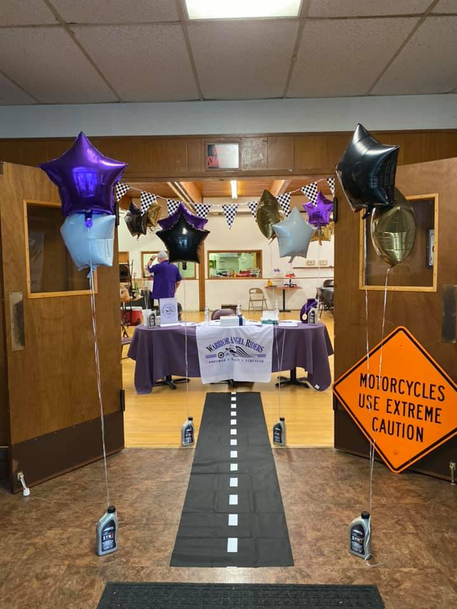
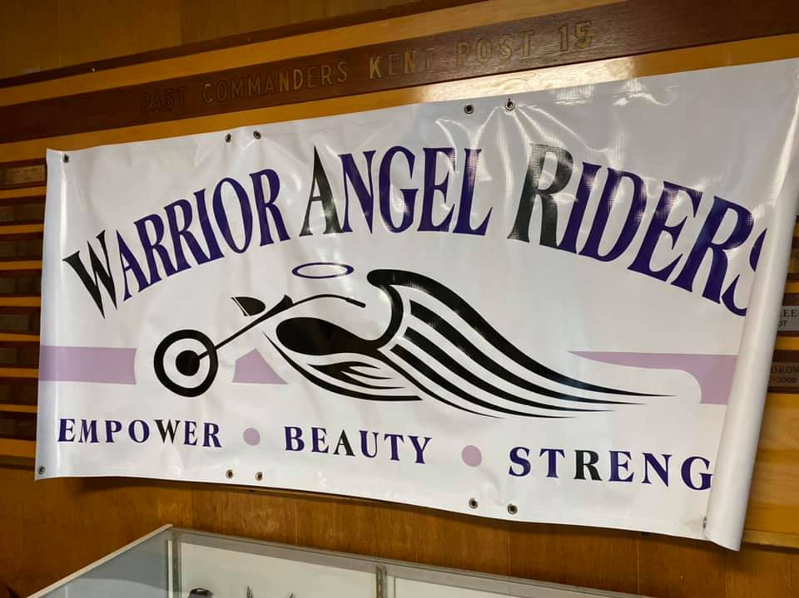
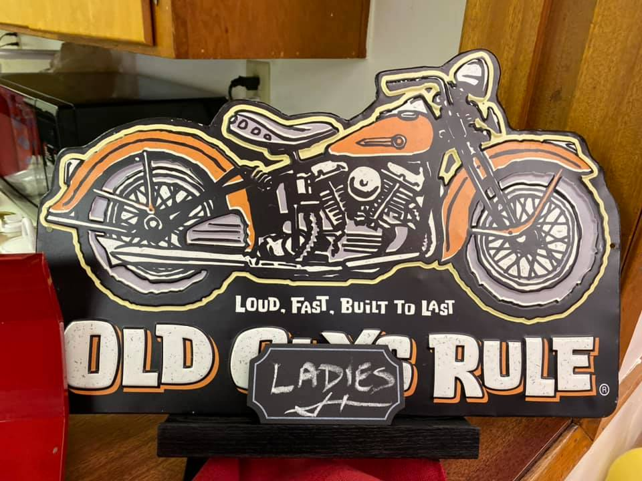
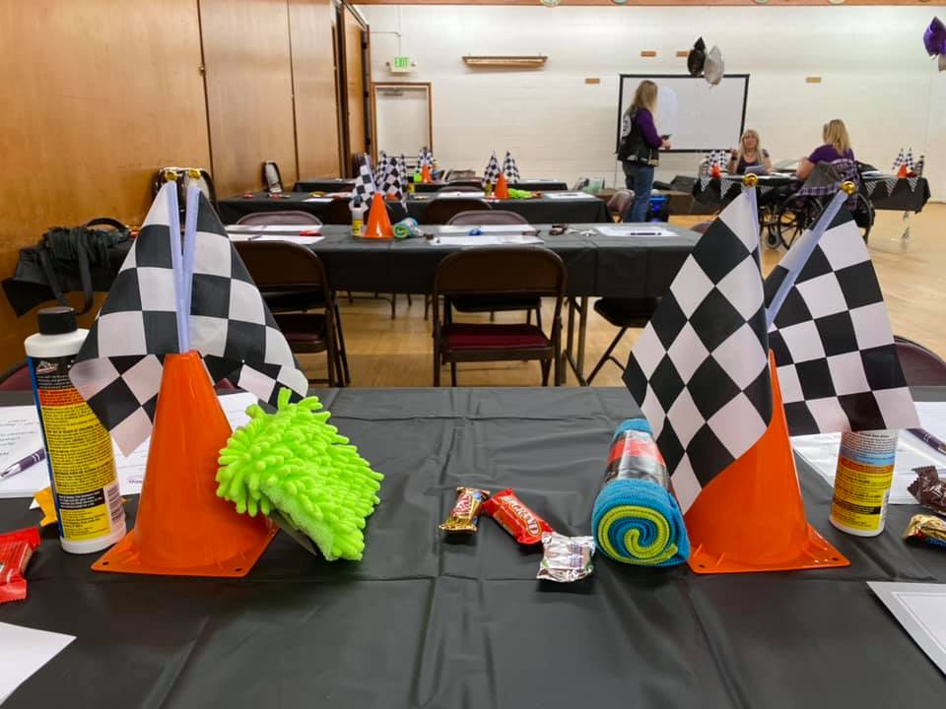
8
Last Months Rides/Events
Challenge Luncheon 10-3

Slide 9
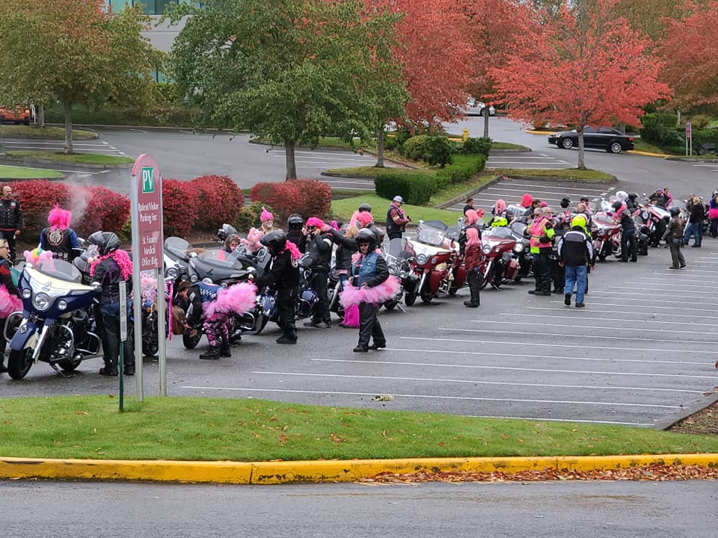
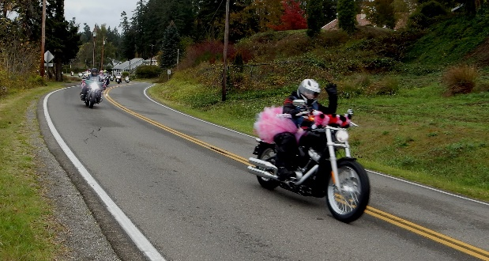
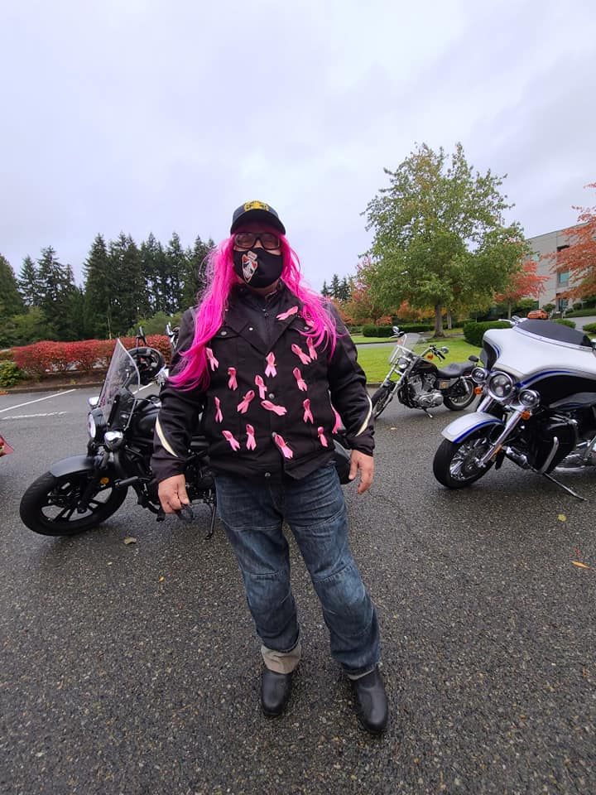
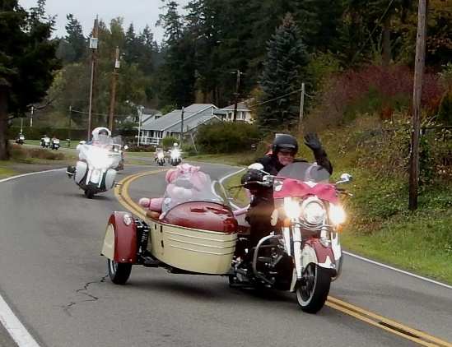
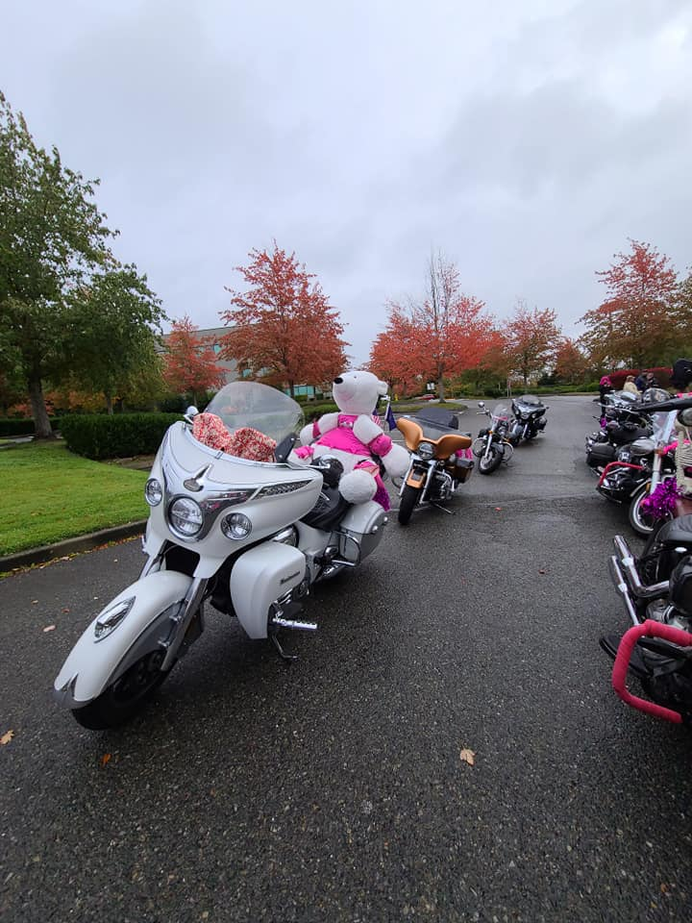
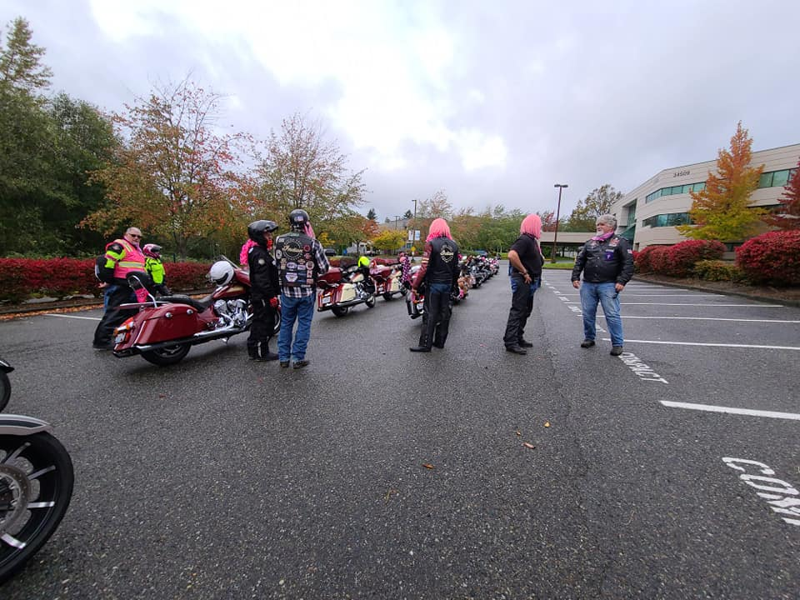
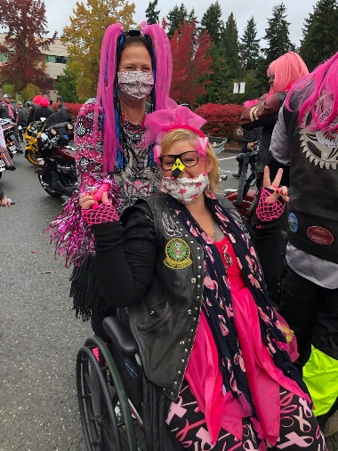
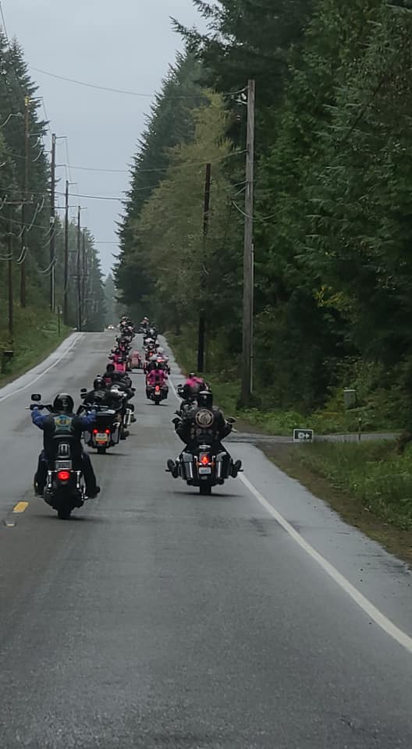
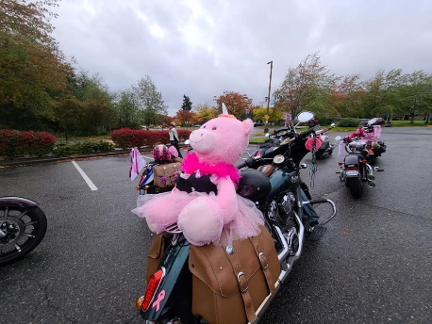
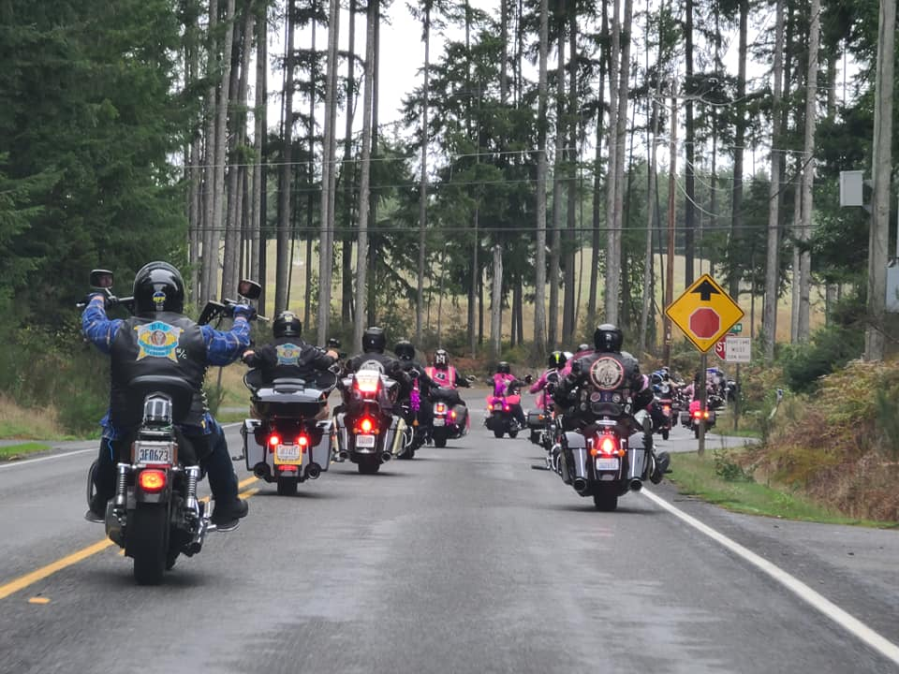
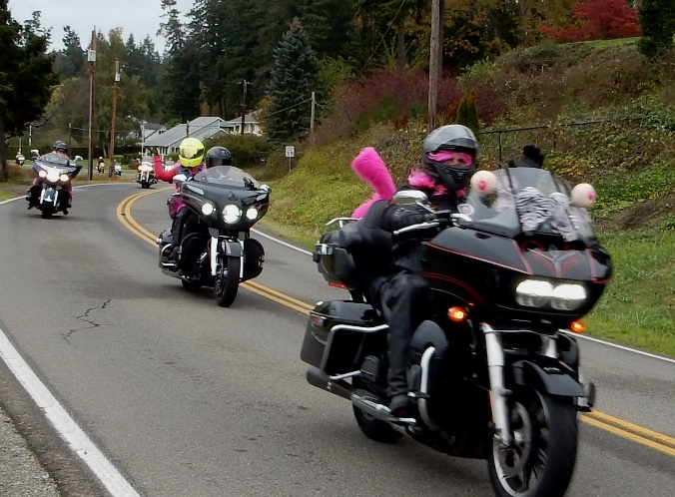
Wigged out Ride 10/17
9

Slide 10
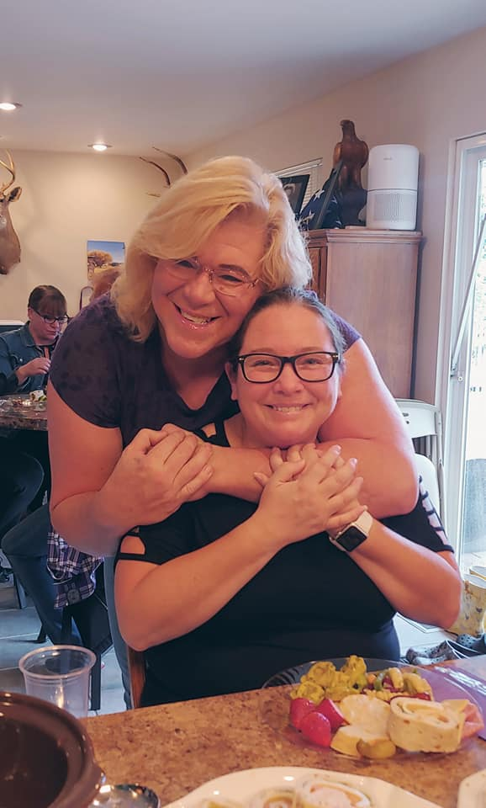
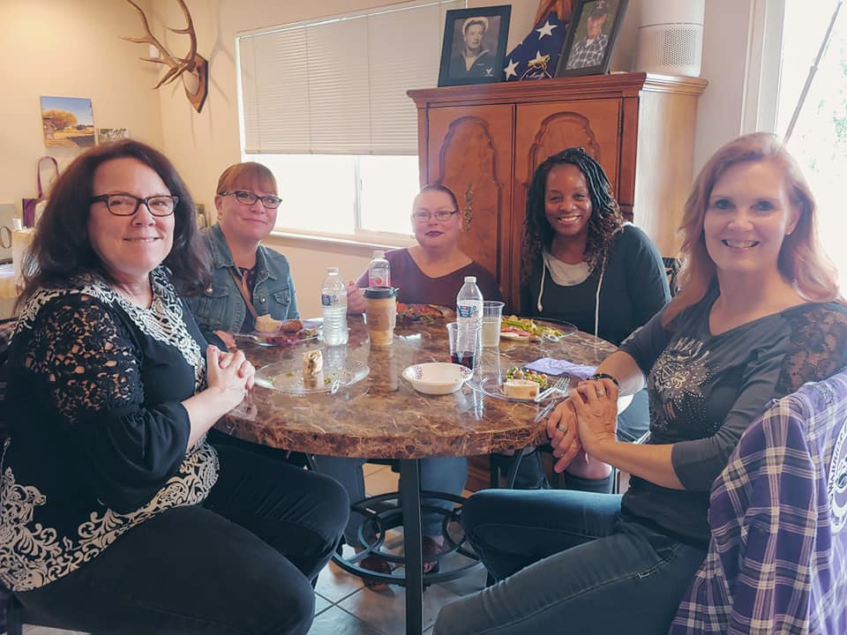
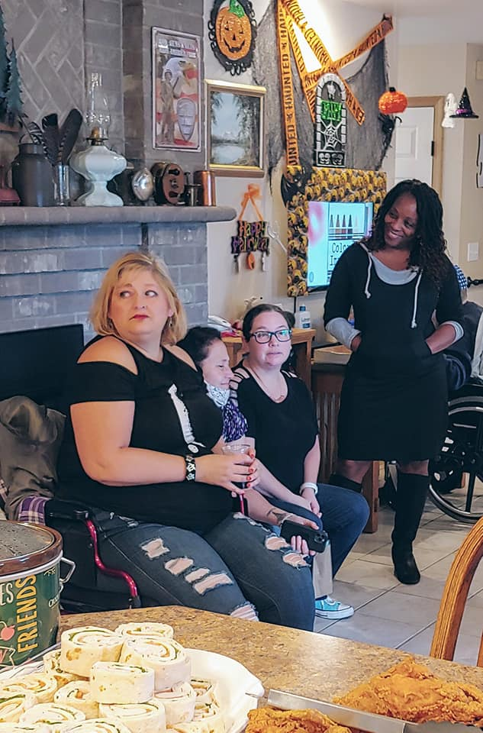
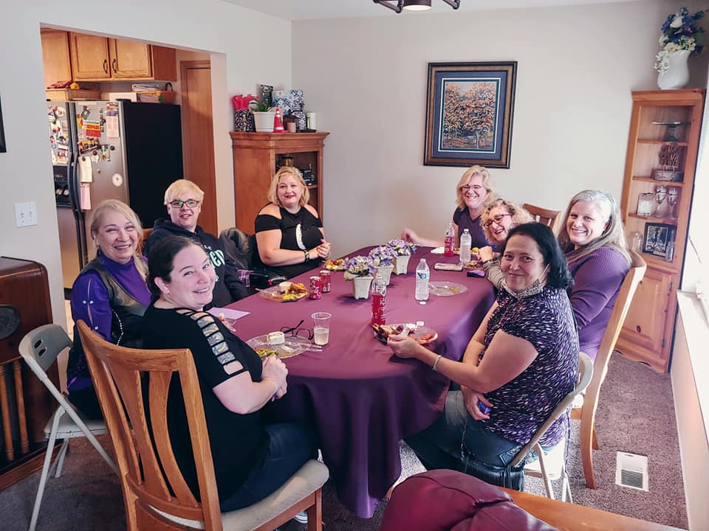
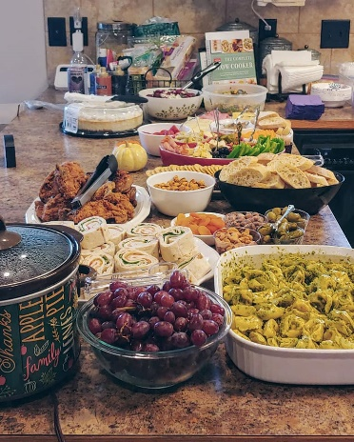
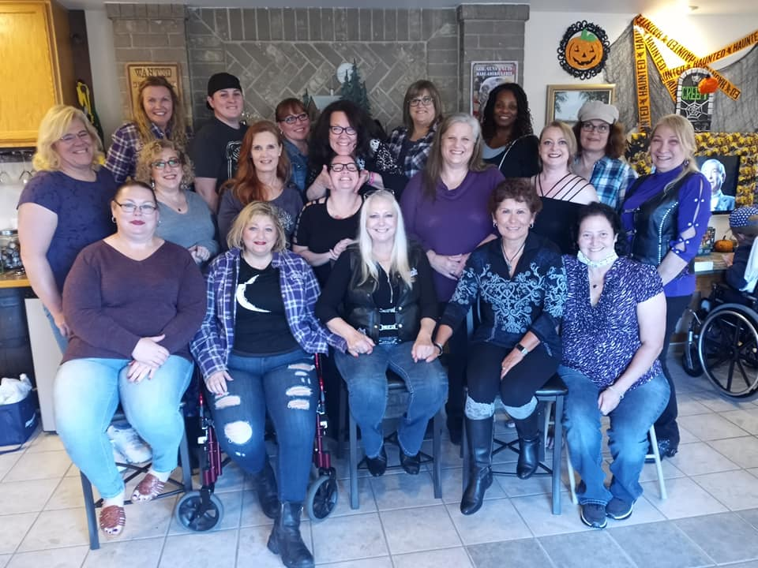
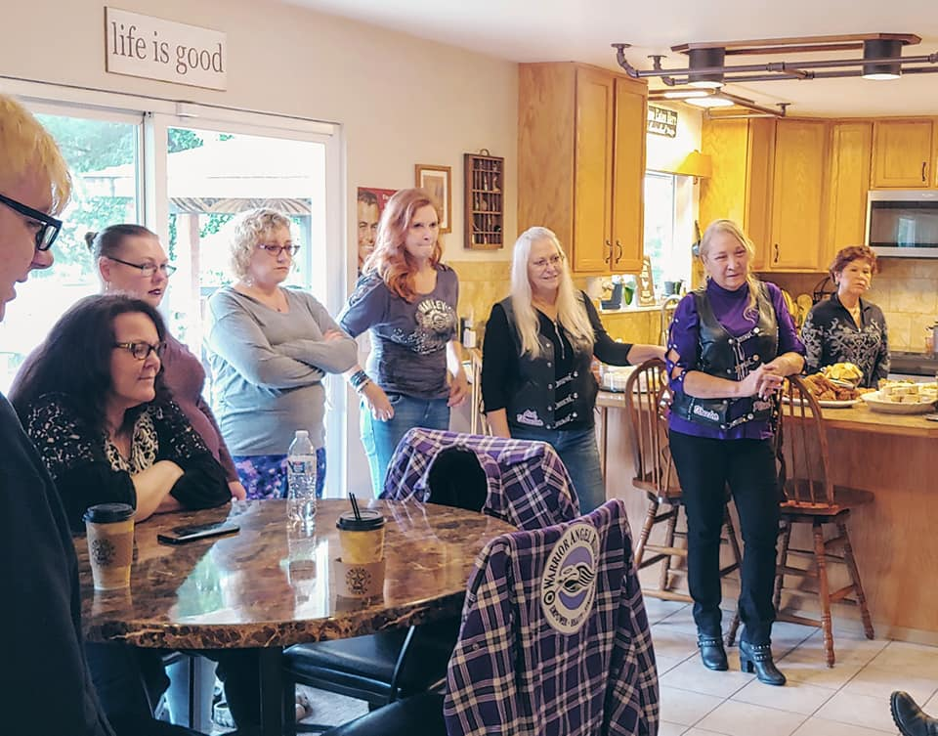
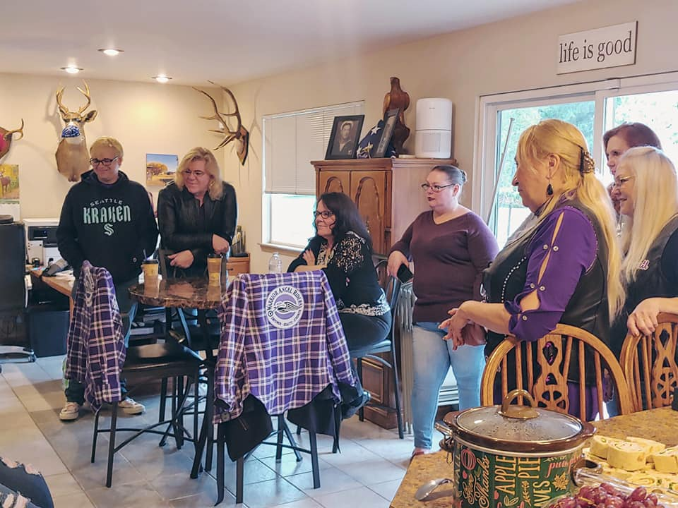
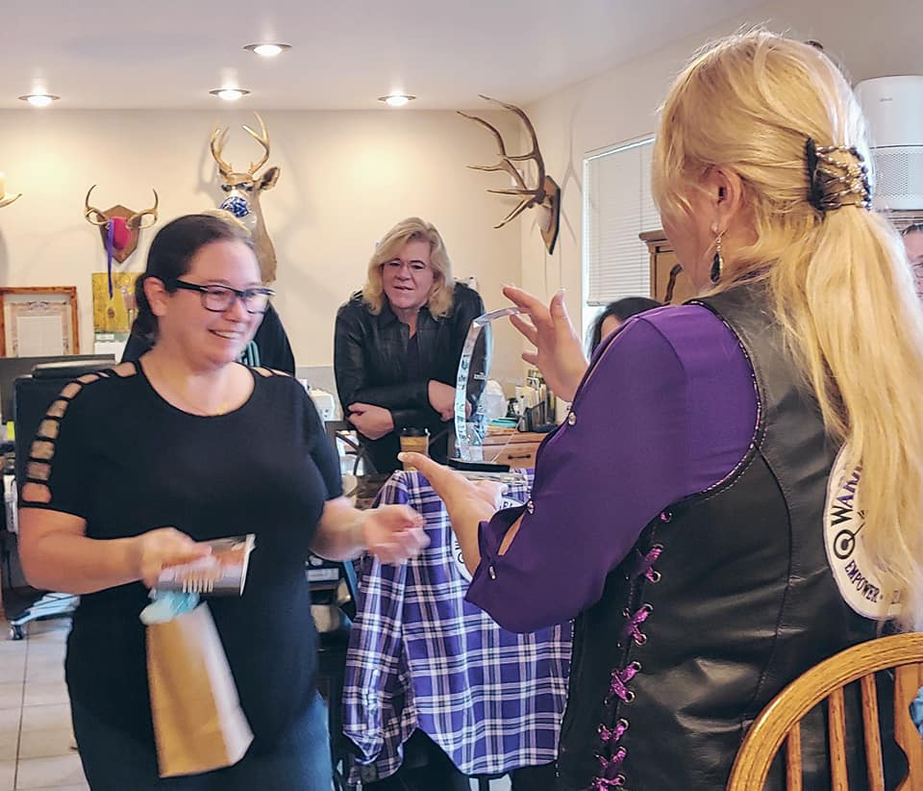
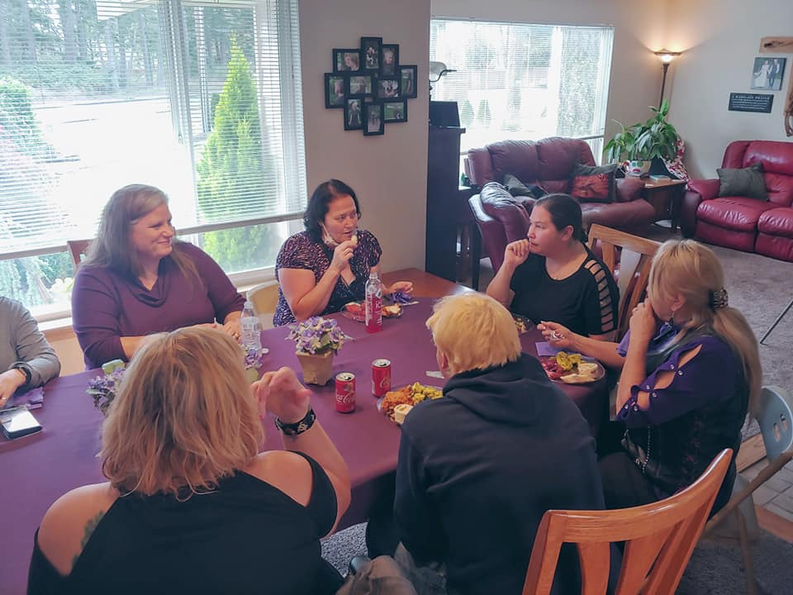
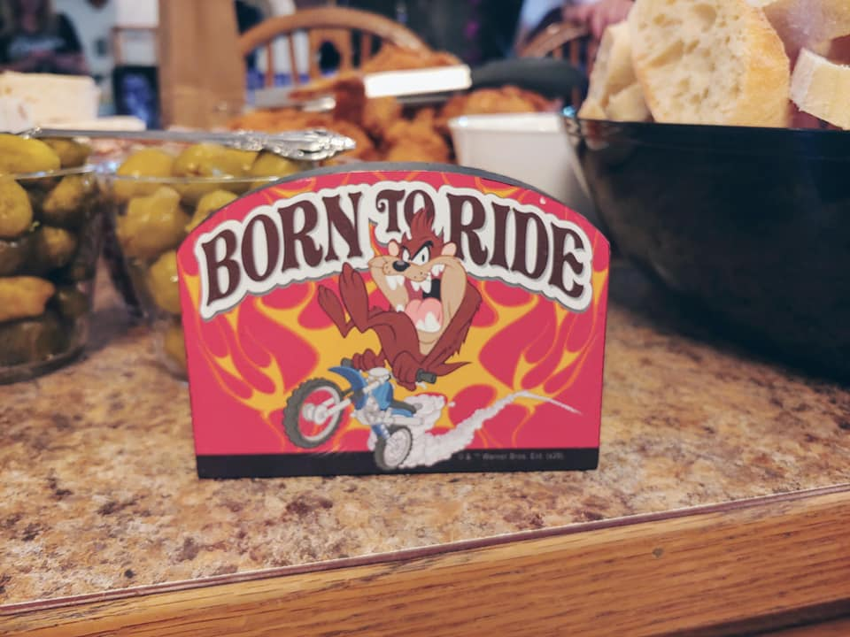
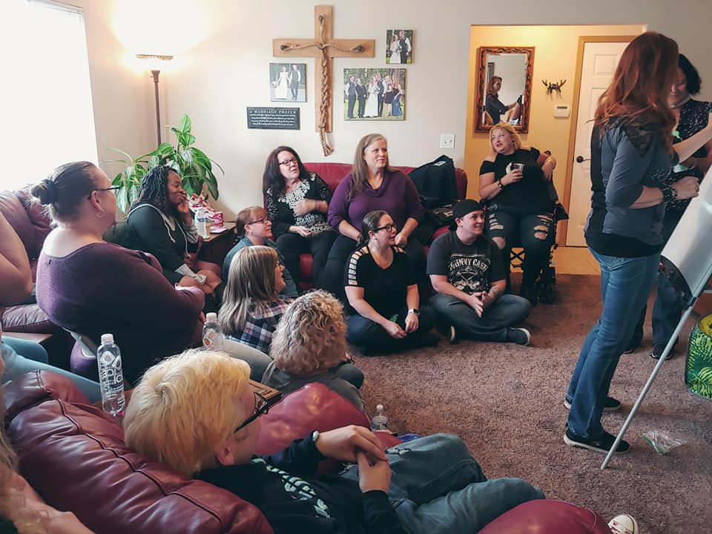
10
Rachael Goodbye Luncheon 10/18

Slide 11
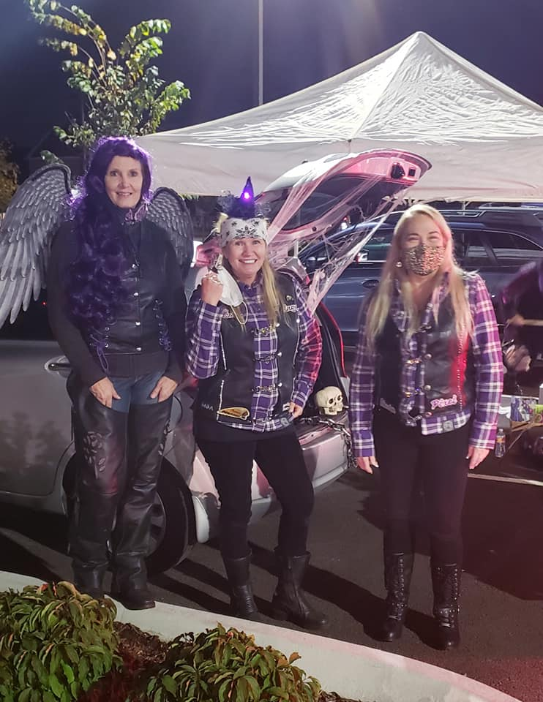
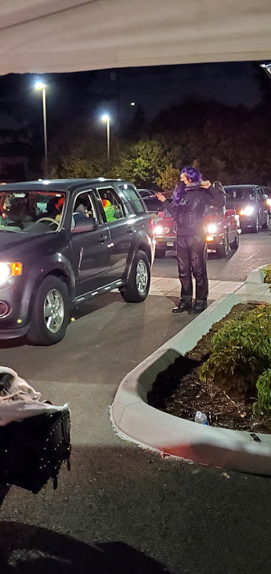
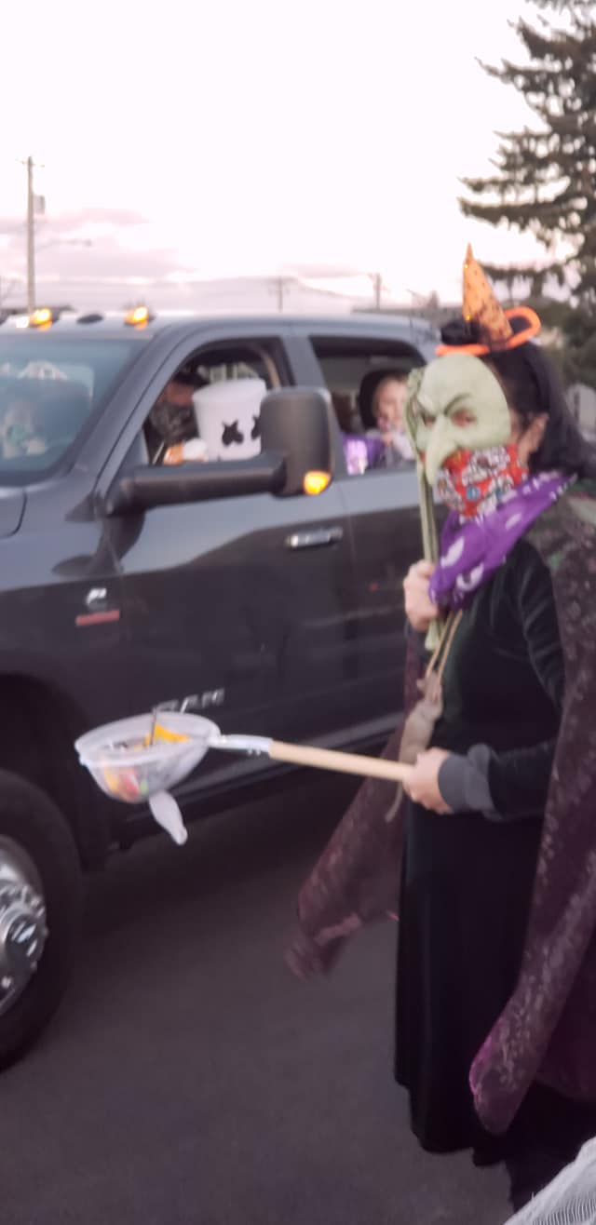
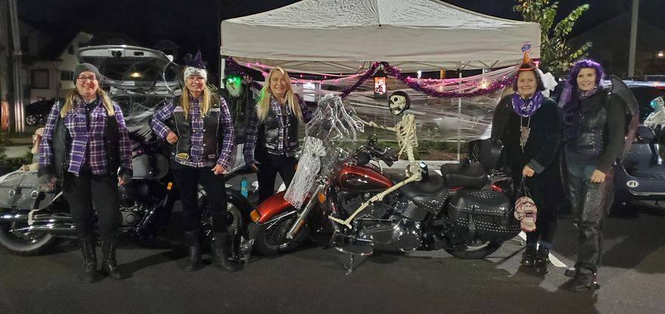



11
Trunk or Treat 10/31

Slide 12

12
Riding Tips from Shawnna
If there are road hazards, then why ride a motorcycle?
If you aren’t the proud owner of a motorcycle yet, you’ve probably asked this question many times over. The simple answer is because there is nothing like it.
Those of you first-time riders probably have visions of cloudless skies and smooth pavement dancing in your heads. Unfortunately, these perfect riding conditions may be hard to come by for bikers who live near dangerous roads or in places that experience severe weather. In any case, it’s important that all riders, new and seasoned, be equipped with the proper motorcycle safety tips so we can all navigate the roads safely and seamlessly.
How safe are motorcycles?
The short answer is: only as safe as the rider. For any new rider who might be reading this, know that a motorcycle is as safe as the person controlling it.
Let me offer some advice for new motorcycle riders: for the love of all that is good in this world, take a motorcycle safety course. I promise it’ll be well worth your time and money. You’ll learn how to ride a motorcycle the safe and law-abiding way, methods of staying safe on the road during the rainy season, how to avoid animals on the road, and more.
Sure, hazards on the road are inevitable, but the key is being able to anticipate danger before it strikes, which is why learning about dangerous road conditions before you take your bike out for the first time is so important.
Likewise, if you’re a first-timer, it’s always a good idea to consult some longtime riders in your area for new rider tips, even after you’ve taken a motorcycle safety course. And for those of you longtimers, be sure to set the example and brush up on your motorcycle safety every now and then!
https://brainbucket.rumbleon.com/motorcycle-safety-road-hazards

Slide 13




13
Motorcycle Humor!

Slide 14
W.A.R. Contacts
14
Director - Lilyann “Pixel” Lear warriorangelriders@gmail.com
Assistant Director - Charlie “Angel” Houmes charlie.houmes@gmail.com
Assistant Director - Gloria “Fireball” Padgett organizer.gloria.war@gmail.com
Treasurer – Sandy “Badass” Knab slemerson35@comcast.net
Secretary – Geneva “Blink” Laing ramjet31@yahoo.com
Head Road Captain - Tracy “Switchback” Cutler roadcaptain.tracy.war@gmail.com
Memberships - Michèle “Stitch” Courvoisier membership.michele.war@gmail.com
Ambassador – Hollie “Thumper” Imburgia hollieimb30@yahoo.com
Editor - Cammie “Boots” Wood editor.cammie.war@gmail.com
Safety Officer - Shawna “Thunder” Chisholm safetyofficer.Shawna.war@gmail.com
Road Captain JessieLynn “Pipes” Sturizone msjessielynnesturzione@gmail.com

