Slide 1
“the Secrets of staying young”
Dr. Alexis O. McNeil, NMD

Slide 2
Dr. Alexis…A brief Bio
Treating Women “Inside and Out”
Inspired by her mother’s battle with breast cancer, Dr. McNeil changed career paths from artist/designer to physician. It was Naturopathic Medicine that extended her mother’s life and enlightened Dr. McNeil to her passion for healing.
Upon earning her medical degree from Southwest College of Naturopathic Medicine, Dr. McNeil completed a 2 year residency in Acute Family Medicine and Women’s Health at Centro De Salud Familiar in downtown Phoenix, AZ. As a physician she has remained true to her artistic talents by incorporating cosmetic injections into her practice, truly treating women inside and out. Together with her husband Dr. Jason McNeil, they formed North Valley Medical Center; a full service primary care clinic dedicated to compassionate patient centered care. Out of the office you will find Dr. Alexis with her family and friends, doing yoga, enjoying good healthy organic food and wine, or hiking with her dogs.

Slide 3
A yoga junkie

Slide 4
North valley medical center
Full service Primary Care Clinic specializing in Integrative Care
We blend conventional and natural medicine, truly integrating the applications of each, resulting in patients with less side effects, increased compliance, less reliance upon medication, reduced costs and increased outcomes.
-The bottom line…use medication when necessary and appropriate but use alternatives when possible…SENSIBLE MEDICINE
- Annual Physicals, PAP’s, IV’s, Minor Surgery, Weight Loss, Cosmetic Injections, Joint Injections for chronic pain (Non-steroid), Bio-Identical Hormone Replacement

Slide 5
NVmc

Slide 6
Secrets of staying young
What is youth???
-Energy, vitality, sexuality, beauty…a feeling!!
What is OLD??
Tired, saggy, wrinkled, rigid, wisdom
Let’s blend the youthful vitality with the wise and content spirit of the later years

Slide 7
How do we age? A Female perspective
- # of ovarian eggs reaches very low levels (usually in 40’s)
- Menstrual Cycle begins to vary
-Progesterone declines in absence of ovulation (menstruation still occurs!)
- Then estrogen declines until there is no longer adequate levels to cause buildup of uterine lining…menstruation STOPS
- This transition happens over a LONG period of time
- Ovarian production of estradiol, progesterone and testosterone decreases with onset of true menopause (no menstruation for 1 year)
- Adrenal glands now are our only source of hormones (they make precursor hormones which can convert to estrogen, progesterone and testosterone)

Slide 8
How low hormone levels effect our bodies
-Estrogen increases HDL (good cholesterol)
-Women who have had either surgical or natural menopause have 2x the incidence of Coronary Artery Disease compared to women of the same age who still have ovarian function
-Osteoporosis (estrogen, progesterone and testosterone keep bones strong)
-Vaginal Dryness/Pain/Irritation (estrogen keeps vaginal tissue lubricated, and maintains healthy acidic environment to prevent infections of vagina and bladder)
-Urinary Problems → Incontinence and recurrent UTI’s
-Low Libido (testosterone is essential for normal sex drive)
-Insomnia
-Dry skin
-Hot Flashes (estrogen influences our internal temperature regulation center in the brain)
-Mood Swings/Depression/Anxiety (estrogen affects neurotransmitters in our brain including serotonin and dopamine)

Slide 9
Hormone Production simplified

Slide 10
Hormone testing…quick and easy blood test --insurance covers
-Cortisol AM and PM (should have nice curve, high AM and low PM)
-Estradiol and total estrogens
-Progesterone (day 21 in cycling woman to check for ovulation, >10 is goal)
-Testosterone free and total
-DHEA-s (check adrenal function, if low you don’t have a CHANCE!)
-TSH (over or underactive thyroid affects all other hormones)

Slide 11
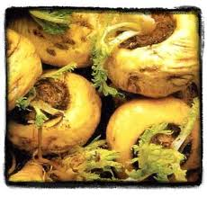
Time to restore balance
Maca (not just any Maca…”Feminessence Maca”) works amazing for perimenopause, irregular menstruation and anovulation…it DRIVES and BALANCES hormones
-stimulates ovulation, increases/balances hormones, boosts sex drive, reduces PMS symptoms and hot flashes
Transdermal progesterone cream or oral micronized progesterone last 2 weeks of cycle to correct estrogen:progesterone balance
Notes:
Conventional medicine offers 1 option…OCP’s in this phase of life

Slide 12
Restoring balance with Bio-identical hormone replacement therapy
Why Bio-Identical??? Bio-Identical EXACTLY duplicates your natural hormones. Synthetics (Prempro, Premarin, Provera) are created from pregnant horse urine and contain hundreds of types of estrogen and metabolites that our bodies cannot identify (it’s horse estrogen…DUHH). Synthetics cannot be metabolized as fast as bio-identicals, thus they linger in the body often landing in unintended receptor sites. Synthetics decrease your bodies own production of hormones, bio-identicals do not. Risk of blood clots, strokes and heart attack is DOUBLE with CEE vs. Bio-Identical Estradiol (JAMA 2013). Synthetics cause increased side-effects (weight gain, bloating, headaches, sore breasts, irritability, gallbladder, liver disease and cancer)
Compounded vs. Rx: Depends on if you want to use insurance…Compounding offers more customized choices
Rx Bio-Identical Progesterone: “Prometrium”
Rx Bio-Identical Estrogen: 17B-estradiol “Estrace”-oral, “Estrogel” or various generics
Dose of BHRT is about 1/6 the amount of hormones in Birth Control Pills—not nearly enough to cause a cycle, but enough to keep the body healthy and youthful. As with ANY medication the LOWEST EFFECTIVE DOSE should be administered!

Slide 13
Restoring balance with Bio-identical hormone replacement therapy
Estrogen: Hot Flashes, Mood Balancing, Osteoporosis, Prevent Coronary Heart Disease (decreased atherosclerotic plaque), prevent diabetes, overall improved quality of life
Almost always give 1:4 ratio → E2:E3
Estradiol (E2): most active form of estrogen
Estriol (E3): Protective estrogen, not as strong, doesn’t promote cell division and proliferation like E2, high in pregnancy (Increased # pregnancies and breastfeeding decreases breast cancer risk), women without breast cancer have naturally higher levels of E3
E3 (best) or E2 vaginal cream: Great for vaginal dryness, painful intercourse, atrophy, over-active bladder, recurrent UTI’s and vaginal infections (restores friendly bacteria)

Slide 14
Restoring balance with Bio-identical hormone replacement therapy
Progesterone (can be converted in body to other hormones→ estrogen, testosterone, adrenal hormones.) The body can often balance deficiencies or excesses in other steroids using this hormone.
-Oral Micronized Progesterone 100-200mg MUST be used in women who still have their uterus if taking estrogen therapy to prevent uterine lining thickening (hyperplasia).
-Improves Sleep and is naturally calming during day
-Helps balance fluid in cells (eliminates water retention and weight gain)
-Positive effect on high blood pressure and cholesterol
-Promotes new bone formation (estrogen reduces bone loss)

Slide 15
Restoring balance with Bio-identical hormone replacement therapy
Testosterone- ovarian production decreases 50% after menopause, bioavailable estrogen increases in the presence of testosterone…so testosterone improves symptoms of menopause, improves sexual desire and sexual function, decreases cholesterol and triglycerides, increases bone density, improves energy
-Administered topically or orally, or applied to genitalia before sexual activity

Slide 16
Restoring balance with Bio-identical hormone replacement therapy
DHEA: most abundant circulating steroid in humans; estrogen (small amount) and testosterone (much larger amount) are made from it; 90% comes from adrenals, 10% from ovaries; More of a reflection of adrenal function (stress increases cortisol and decreases DHEA)…no wonder we don’t feel like having sex when we’re stressed!!
-Enhances general well-being
-Improves stress response
-Increases lean muscle mass
-Increases energy

Slide 17
Now…how do you get that “healthy glow”?
Healthy Lifestyle→ Alignment in MIND, BODY and SPIRIT
We can tell when someone is living in their truth…when you feel good about yourself, you GLOW…and that creates TIMELESS BEAUTY
I’m NO COUNSELOR or MINISTER, but here are the 5 ways to live a spiritual life… “For Dummies”
- Find what makes fulfilled and do it (it’s NOT about the $$$)
- Nurture yourself
- Serve others
- Live with gratitude and trust (the glass is ALWAYS half full)
- Spread unconditional love and kindness

Slide 18
Now…how do you get that “healthy glow”?
- Get off unnecessary medications (obviously done under physician supervision)...MOST medications are needed because of our unhealthy lifestyles
- Get back to the basics…our bodies CANNOT survive or thrive without clean air, clean healthy food, clean water, sunshine and exercise…without these essential elements there is no basis for health because our basic human needs aren’t being met.
- Our bodies were designed to move…exercise AT LEAST 45 mins/day
- Sweating and healthy bowel movements is how our bodies eliminate waste and detoxify…make sure you are doing this daily (pesticides, herbicides, industrial waste, nuclear waste, etc. …pollution is everywhere)

Slide 19
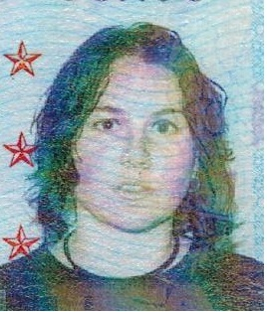
Can you be fat and happy? ...I can’t
This is me 15 years ago!!
-”Freshman 45lbs”
-A MISERABLE MESS (on
anti-depressants, toenail fungus,
yeast infections, chronic colds/flus)
-Too much BOOZE
-Too many BUFFETS

Slide 20
Healthy weight is vital to wellbeing
We use the hCG diet frequently at our office
-Lose 10% of body weight in 4 weeks
-Easy to follow low-calorie diet, moderate exercise, daily injections of hCG encourage increased fat loss, weekly injections of B-Vitamins to increase energy and metabolism
-Maintenance plan follows 4 weeks of rigorous diet so patients keep the weight off

Slide 21
Phyllis lost over 50 lbs, now Wears Skinny Jeans!!!

Slide 22
Here is what 10% weight loss can do for cholesterol and inflammation!!
59 yo Female went from 180 lbs→162 lbs in 4 weeks…labs done before and after diet.
Total Cholesterol: 255→ 172
Triglycerides: 391→163
HDL “good cholesterol”: 40→ 39
LDL “bad cholesterol”: 137→100
hsCRP (risk factor for heart disease): 5.78→ 2.52 (>3 high risk)

Slide 23
Make sure your doctor orders the right cholesterol panel
We’ve all heard about the athletic/health/young person who drops dead from a heart attack who had “normal cholesterol”
-”NMR Lipoprofile” or “Atherotech” are two in-depth cholesterol panels that insurance covers…most Cardiologists and Lipidologists order these as standard practice, but your PCP should too for preventative health!
-Lipid PARTICLE SIZE is very important. Small dense LDL’s are what clog vessels and cause plaque, larger LDL particles don’t. Large buoyant HDL’s are cardio-protective, small HDL’s are not…SO it is necessary to know what type of LDL and HDL your body has circulating.
-Normal cholesterol panels only use calculated HDL/LDL and don’t use particle size or exact count of each.

Slide 24
Best general diet for anti-aging…7 easy rules to live by
1. 50% raw food (veggies, fruit, nuts): Raw food brings life and vitality
2. At least 7 cups fresh veggies every day (no fatty, potatoes/carrots/corn don’t count)
3. -2 pieces fresh fruit every day
4. Lean protein with each meal (beans, nuts, fish, fowl, game, tofu, cheese-sparingly)
5. Healthy fat does not make you fat, have some with each meal (Olive, Avocado, Coconut, etc.)
6. Eat grains with caution, 1-2 servings/day…whole grain only (brown rice, sprouted bread, quinoa, etc.)
7. <7 alcoholic drinks/week (no you lush, you cannot save them all for the weekend)

Slide 25
Now that your hormones are balanced, you’re healthy, skinny and happy…time for a little extra umph!
COSMETIC INJECTIONS…Oh PLEASE, everyone’s doing it!!
- Botox
- Dysport
- Dermal Filler (Restylane)
- Chemical Peels (not those sissy spa peels, I’m talking DEEP peels that remove hyperpigmentation and fine lines)
-My Goal with all Cosmetic Procedures: Go for a natural, rested look…no one should ask what you’ve had done, they should say “wow, what have you done different, you look Great!”

Slide 26
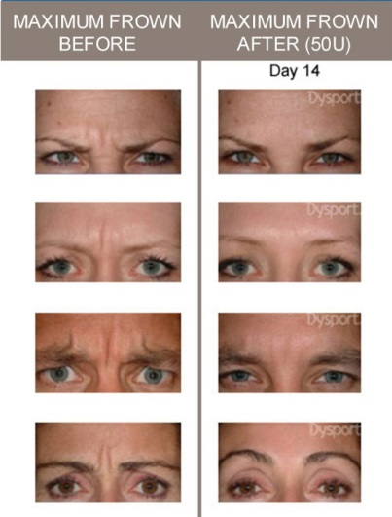
Cosmetic injections 101
Dysport (my favorite) and Botox→
RELAX muscles in the face
drastically reducing lines on the
forehead, between the eyebrows,
and around the eyes.

Slide 27
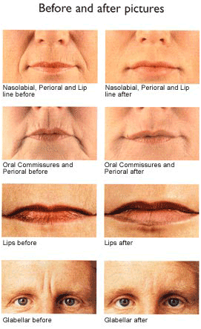
Cosmetic injections 101
Restylane Dermal Filler:
Clear hyaluronic acid gel immediately
adds volume to smooth away wrinkles.
Add volume to lips, smile lines,
marionette lines, cheeks and
sunken tear troughs.
-Lasts 6-9 months

