Slide 1
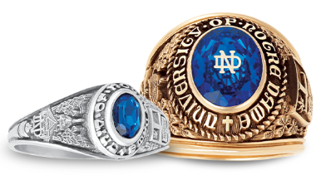
The Notre Dame Ring
Options and Frequently asked questions.

Slide 2
All of the official Notre Dame Ring styles have been pre-designed in cooperation with the University depicting iconic Notre Dame images.
The only customizable feature on the exterior of the ring is the ability to choose to include MBA, JD, PHD or MSA on selected ring styles.
Having all of the rings look consistent is the goal, making them recognizable to fellow alumni, ever strengthening the bond they share.
Students reach eligibility to order their ring when they have completed 60 credit hours.
Each ring includes free engraving on the interior. Most students choose to engrave their name and grad year or initials and grad year.

Slide 3
Ring Styles Men’s Large Men’s Medium Pre ‘72 Women’s Official Petite Dinner

Slide 4
Metals and Finishes
Yellow Gold Rings are available in 3 finishes:
Natural-The entire ring is the same shiny gold
Medium-The design has a bit of darkening behind it.
Dark Antique-Offers more darkness behind the design for maximum contrast
White metals are available in Natural Finish and Dark Antique Finish.
Each ring is available in the following metals:
10K, 14K or 18K Yellow or White Gold
Argentium- A fine silver that is purer than Sterling
Celestrium- A jeweler quality Stainless Steel.

Slide 5
Stone Choices
The most popular stone colors for Notre Dame Rings:
ND Blue
Emerald
Sapphire
Aquamarine and Mother of Pearl are gaining in popularity particularly in Women’s Styles.
Balfour offers a total of 17 synthetic stone choices.
Genuine stones are also available at customer request.

Slide 6
Encrusting The Interlocking ND Logo can be encrusted on any ring with the exception of the Petite Style. A smooth cut stone will accommodate a large or small ND. A faceted stone will allow a small ND.

Slide 7
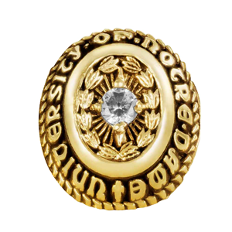
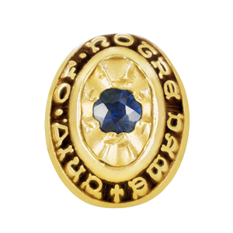
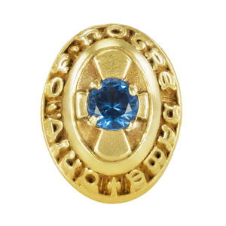
Panels
Sportsman’s
Standard Reflector
Cross Reflector
Metal panels can be added to any ring style for additional $60.
The panels can be left plain, or a smaller stone can be set in the center.
Sportsman’s panels are available for each ring style with 3pt or 5pt CZ
or diamond.
Petite Rings are also available with the standard reflector panel or
cross panel. In addition to diamonds and CZ’s, these panels can be
set with any of the stone choices.

Slide 8
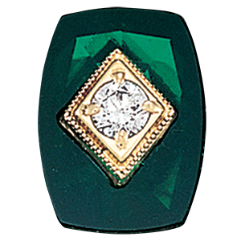
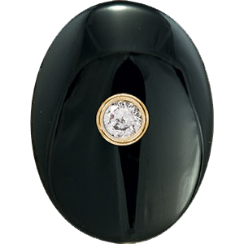
Stone in Stone Options
Each ring, with the exception of petite, is available with a stone in stone top. The base stone is available in any of the stone options. The choices for the center set stone include diamonds and CZ’s in several sizes. The center setting is available in square or round

Slide 9
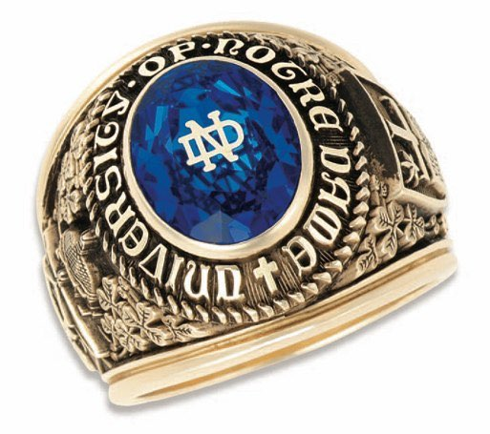
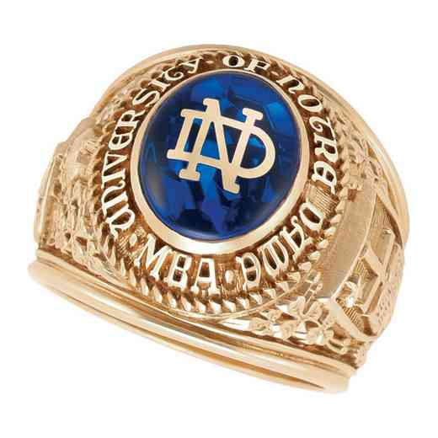
Men’s Rings
Current students have the choice of the Medium style or Large Style.
These rings are identical other than scale. Most men determine which style suits them by trying each on their hand.
Alumni who graduated prior to 1972 have option of ordering the Large Style that was available at that time.

Slide 10
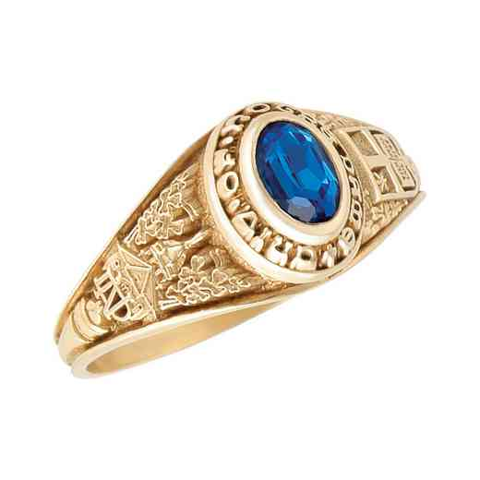
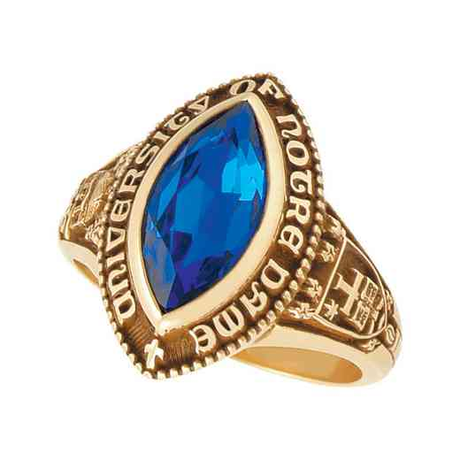
Women’s Rings
Women can choose from 3 styles
Women’s Official, a replica of the Men’s ring
on a smaller scale.
Petite, as the name implies the smallest
of the Notre Dame rings. All of the elements
as it’s larger counterpart with the exception of
the ability to include the ND interlock encrusting
on the stone top or the specialty degree spellout.
Dinner Ring, a more fashion forward choice with
a unique shape. This ring allows for the ND encrusting
but not specialty degrees.

Slide 11
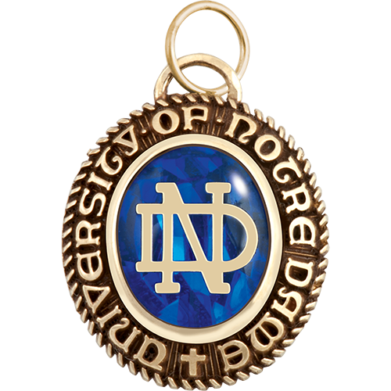
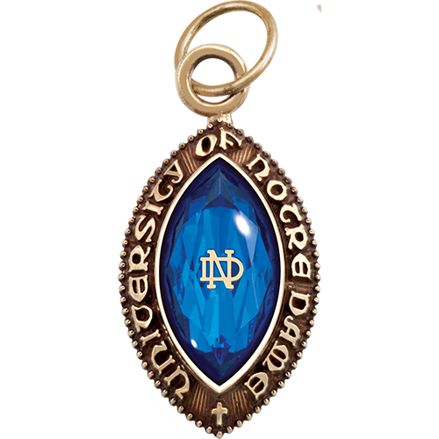
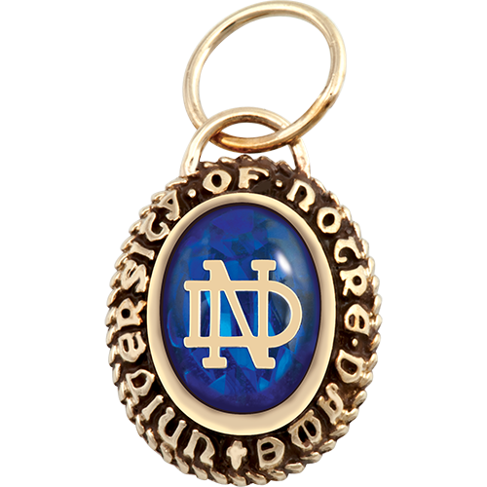
Pendants
If you are not a ring person, no problem. Balfour has designed pendants that mimic the Notre Dame ring tops.
Choose the Large Pendant, Small/Miniature Pendant or the Dinner Pendant.
All have same stone and encrusting options as the rings and can be customized with engraving on the reverse.

Slide 12
Engraving
You have option of adding engraving the interior of your Notre Dame Ring free of charge. Most students either engrave their name and graduation year or initials and graduation year. Men’s, Women’s Official and Dinner Style Rings all will accommodate 30 characters. The Petite Style only has room for 18. This count includes spaces.
We encourage students to engrave their name and grad year, if it will fit, in case they lose their ring and it is turned into the Alumni Office.

Slide 13
Ring Sizing
Be sure to order the correct size for your ring. Balfour representatives are on campus periodically during the school year to assist students with their ring orders.
If you do not order with a representative, be sure to have the staff at Hammes Bookstore or any jewelry store help you determine the correct size to order.
Your ring will be resized for your lifetime free of charge, so order it to fit now. To have it resized, your ring will simply need to be shipped to Balfour to have it modified to your new size.

Slide 14
Ring Loss Protection Plans
Your ring includes a 4 year Ring Loss Protection Plan. If your ring is lost or stolen within the first 4 years, you can submit a claim, pay a deductible and your ring will be replaced.
You can choose to extend that plan to 10 years for a one time charge of $34.95. This plan must be purchased at the time of ring order.
Plan details can be found at:
https://www.balfour.com/HelpCenter/Warranties-Repair-Returns/Ring-Loss-Protection-Plan/

Slide 15
Frequently Asked Questions
When do most Notre Dame students order their ring?
Most order as soon as they are eligible, typically junior year.
How long does it take to receive my ring?
Rings take 8-10 weeks to manufacture and ship.
Where will my ring ship?
If you order at Hammes Bookstore, it will ship to the store. Bookstore staff will contact you when it comes in. If you order online, it will ship to the address you provide.
Who do I contact if I have questions?
Contact the Balfour Representative, Monte Reed montereed-Balfour@outlook.com 317-606-8366.

